Slide 1
Data science on subscription service
Datalab Analytics Work Experience and Certification Project By:
Comfort Fatimoh Sheidu
Data Science Ladies Programme (Team Achiever, 2023)

Slide 2
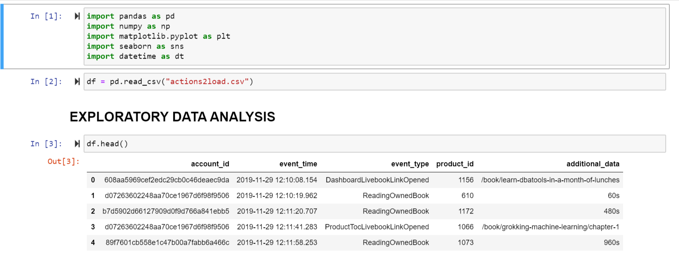
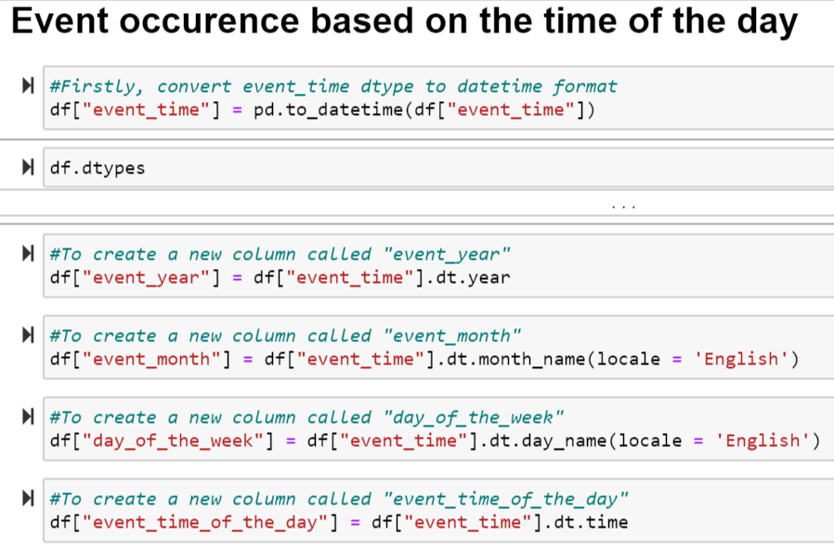
EXPLORATORY DATA ANALYSIS USING JUPYTER NOTEBOOK(PYTHON)
The data “Actions2load.csv” was read into the Jupyter notebook and various libraries were imported to analyse the data.
The dataframe has 3242076 rows and 5 columns. It was discovered that the “event_time” was not in the datetime format. Therefore it becomes relevant to change the format so as to be able to make new colums, such as; “Event_year”, “Event_month”, “Day_of_the_week”, and “Event_time_of_the_day”
This newly created columns assisted in knowing the trends of events that occur at different time of the day.

Slide 3
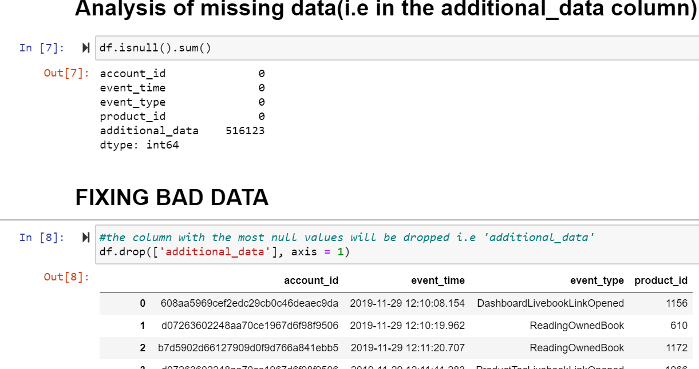
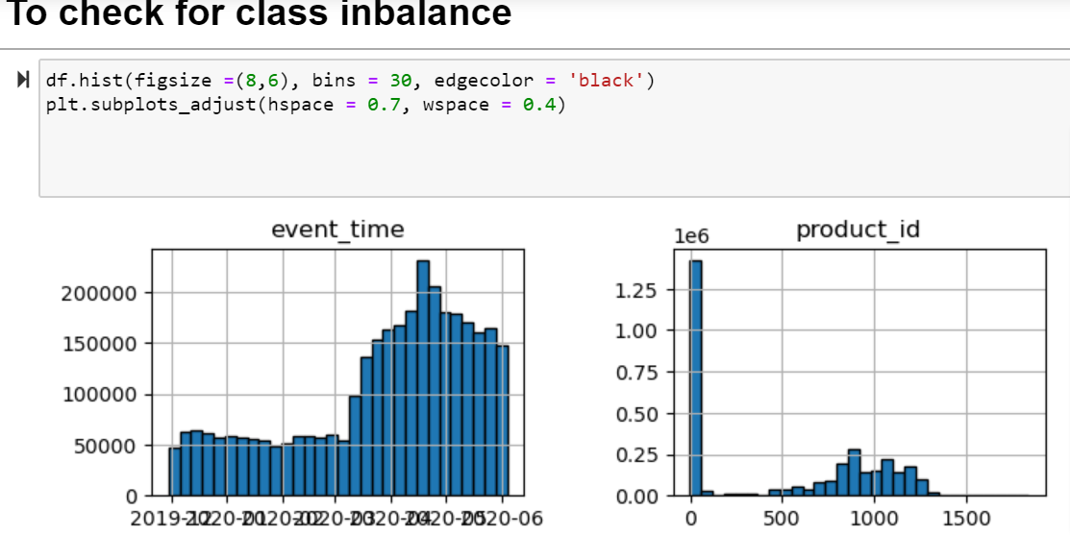
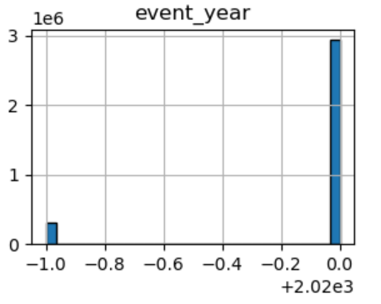
ANALYSING MISSING DATA AND CLASS IMBALANCES
The dataset has 516123 missing data in the “additional_data” column and it was fixed by completely dropping the column, since it has no significance in the data analysis.
Using the boxplot to check for outliers is very important in order to ascertain the range so that anything above or below is an outlier or class imbalance.

Slide 4
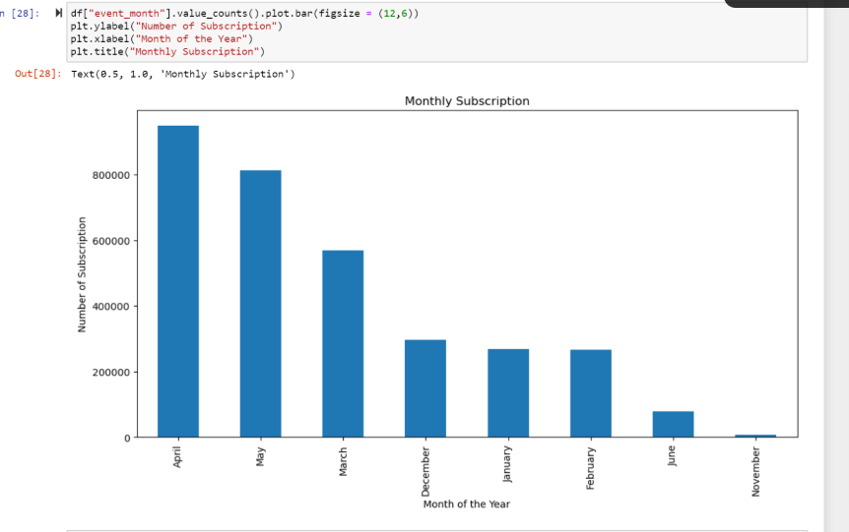
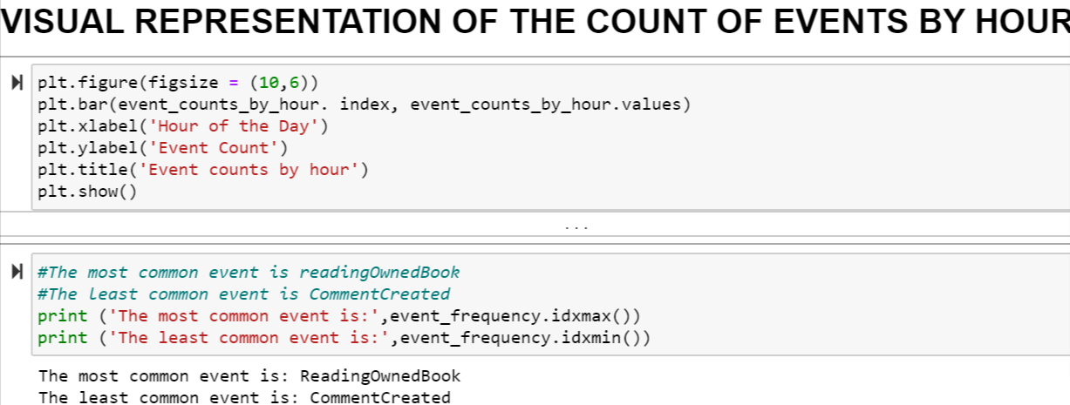
VISUAL REPRESENTATION OF EVENTS
This visualizations assist us to see how events happen at different time, and the total number of the event. We could also see the most common event and the least common event

Slide 5
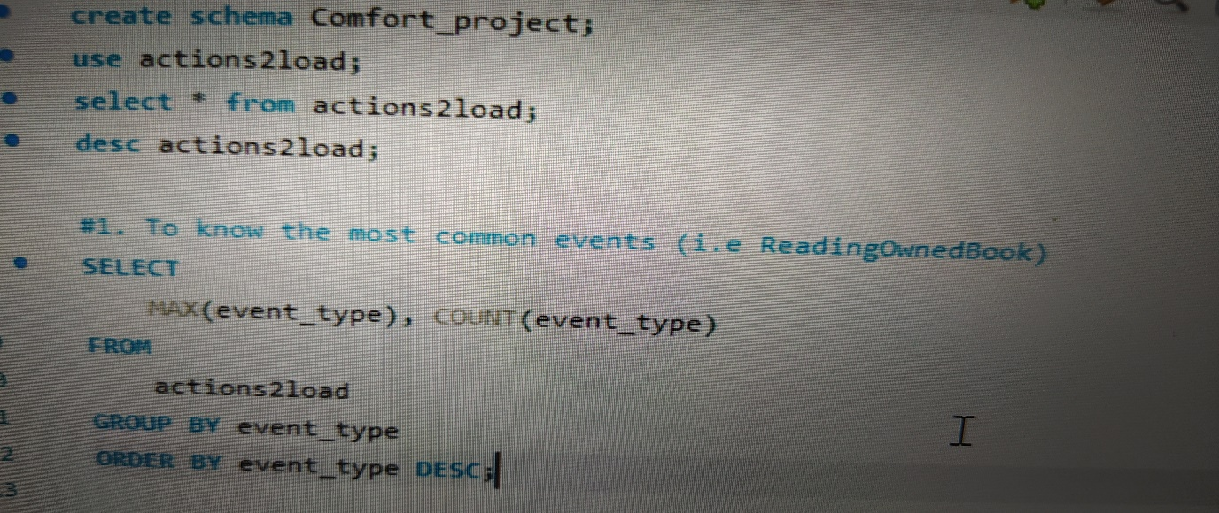
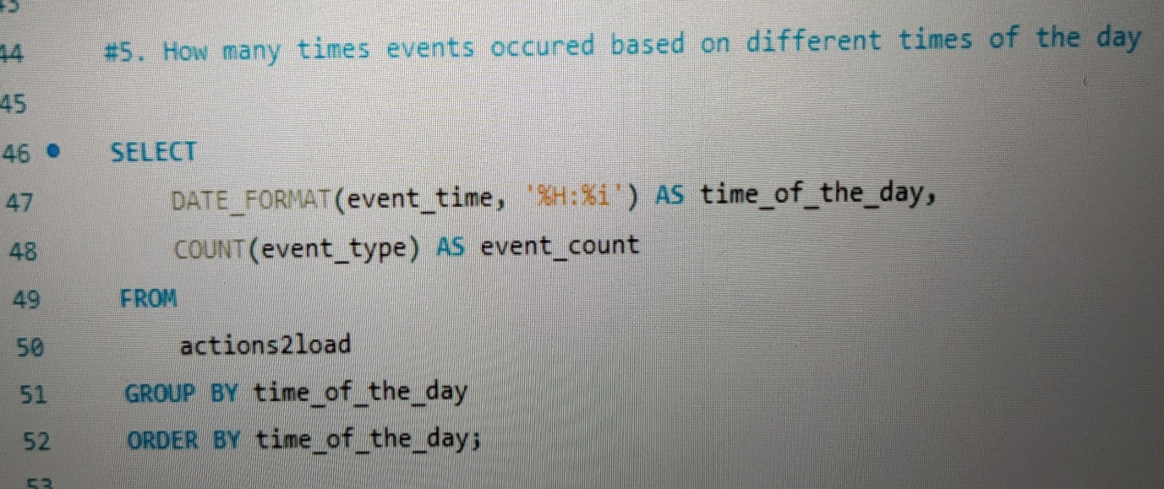
ANALYSIS USING SQL QUERIES
Mysql workbench was used in this section to give a further analysis to the data. Just like in the python analysis, the data was imported into a new database for analysis. Therefore, Sql queries were run to determine the events that are most and least common, get account ids that have the highest and lowest number of events.
Query was also written to determine how many times events occurred based on different times of the day.

Slide 6
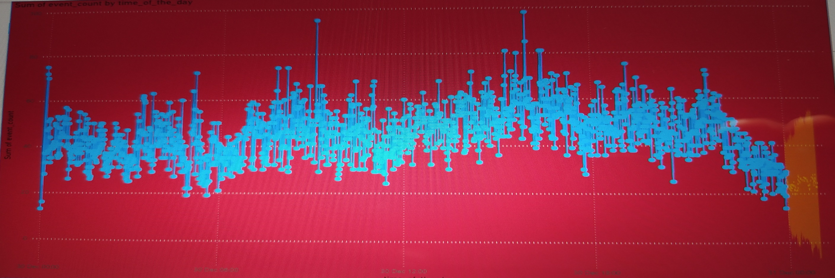
POWER BI VISUALIZATION AND PREDICTION
The dataset from the sql query written to determine how many times events occurred based on different times of the day was exported and used for the visualization and prediction for the next 24 hours in power bi.
A timeseries or overtime chart are always plotted with the use of line chart.

Slide 7
ACCESSING THE CODES AND QUERIES
A copy of the project codes, queries and slides is available in my personal Github repo with the link:
https://github.com/comsheidu/Datalab_Final_project
THANK YOU

