Slide 1

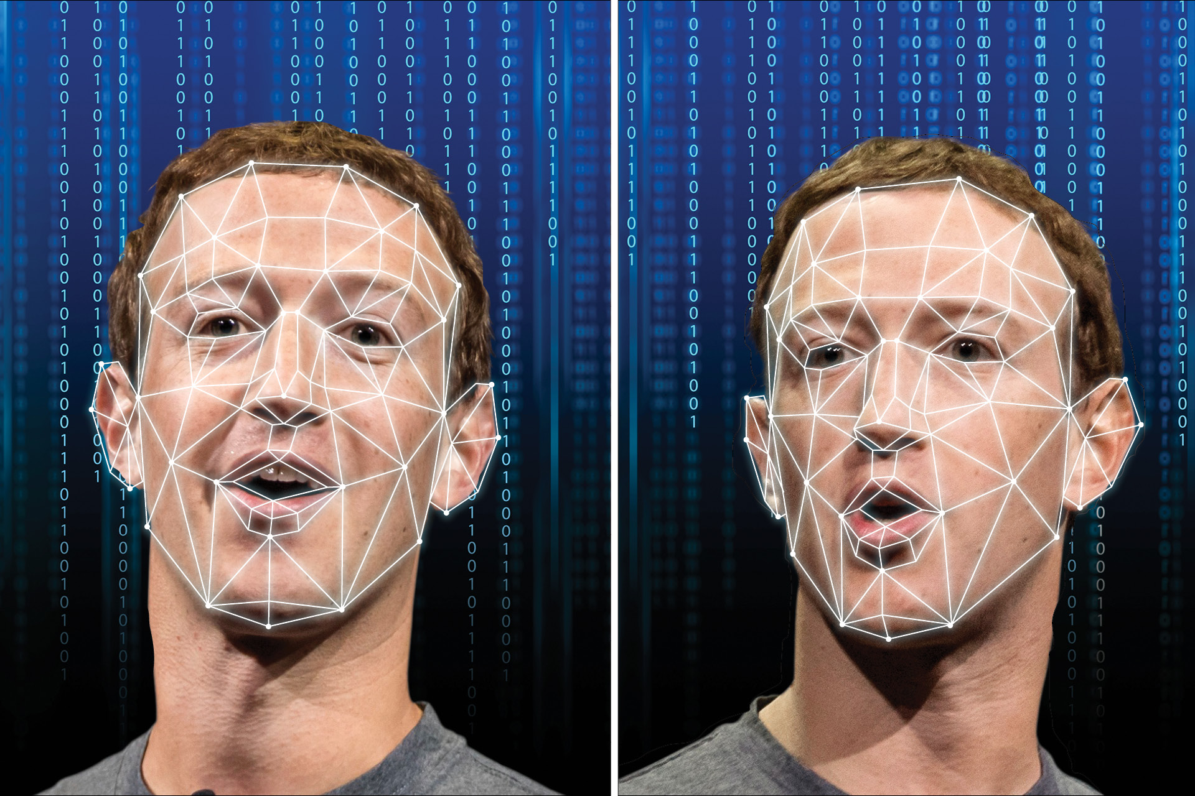
DeepFake
Kalybek Aruzhan

Slide 2
Introduction
Deepfake images and videos appear authentic but are created using artificial intelligence algorithms. By leveraging deep learning techniques, deepfakes can manipulate facial expressions, voices, and actions to fabricate hyper-realistic yet false content. These AI-generated media are often used for entertainment and creative applications but also pose serious risks, including misinformation, fraud, and privacy violations.
Deepfake technology relies on neural networks that analyze large datasets to mimic human features with high accuracy. Even non-experts can create deepfakes using tools like Face2Face and FaceSwap, making their spread more accessible. Given the rising ethical and security concerns, it is crucial to explore deepfake detection methods and mitigation strategies to combat potential threats.

Slide 3
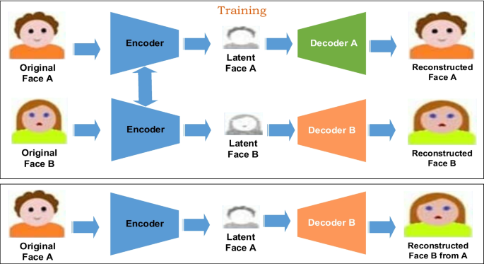
Generating deepfake
Deepfakes are produced using deep neural networks, specifically through the utilization of autoencoders. This procedure involves the training of a neural network to encode and decode images or videos. The encoder’s role is to take the initial input of an image or video and condense it into a latent code, retaining the critical features while filtering out unnecessary details. Subsequently, this latent code is transmitted to the decoder, which reconstitutes the original content.

Slide 4
Tools and software for creating deepfake content
The rapid development of deepfake technology has led to the creation of various tools, ranging from research focused software to user-friendly applications. Below are some of the most notable deepfake tools:
DeepSwap – A widely used, user-friendly tool for generating deepfake content quickly. It prohibits explicit content but has received criticism for complex subscription cancellation processes.
DeepFace Lab – An advanced, open-source platform favored by researchers for realistic face-swapping and AI-based video editing. While powerful, it requires technical skills to operate.
DeepNostalgia – Known for animating old photographs with realistic expressions, popular in genealogy but controversial due to ethical concerns.
Deep Art Effects – Available on mobile and desktop, but suffers from compatibility and quality issues, limiting its adoption.
These tools highlight the accessibility of deepfake technology, raising both creative opportunities and ethical challenges.

Slide 5
History of Deepfakes
1990s: Researchers began using CGI (computer-generated imagery) to create realistic images of humans, laying the groundwork for future deepfake technology.
2014: Ian Goodfellow introduced Generative Adversarial Networks (GANs), a breakthrough in deep learning that would eventually enable sophisticated deepfakes.
2017: The term “deepfake” was coined by a Reddit user who created a subreddit for sharing celebrity face-swapped pornography.
2018: Deepfakes gained mainstream attention, with platforms like BuzzFeed creating viral videos demonstrating the technology’s potential.
2019: The number of deepfake videos online nearly doubled in just nine months, reaching over 15,000.
2021: Text-to-image AI models like DALL-E emerged, expanding the scope of synthetic media beyond face-swapping.
2023-2024: Deepfake incidents increased by 245% year-over-year, with significant growth in various sectors, including iGaming, marketplaces, and fintech.

Slide 6
How Deepfake Technology Works
Data collection: The first step is gathering a substantial dataset of content related to the target subject, be it videos, images, or audio. The more diverse and comprehensive this dataset, the more realistic the final deepfake.
Training: Deep learning algorithms are then used to train the AI model on the collected data. This involves analyzing facial features, expressions, and movements to understand how the subject looks and behaves in various contexts.
Generation: Once trained, the model can create new content based on the learned patterns. This might involve superimposing the target’s face onto another person’s body in a video or generating entirely new audio using the target’s voice.
Refinement: The initial output is often imperfect, so an iterative improvement process follows. Tweaking the output might involve further training, manual adjustments, or using additional AI tools to enhance realism.

Slide 7
Types of Deepfake Scams
Financial fraud: Criminals use deepfake audio or video to impersonate executives, authorizing fraudulent wire transfers or financial transactions. This type of scam led to a $25 million loss in a recent high-profile case.
Account takeover: Deepfakes are used to bypass biometric security measures, allowing fraudsters to gain unauthorized access to accounts. Gartner predicted that in 2023, deepfakes would play a role in 20% of successful account takeover attacks.
Application fraud: Scammers create synthetic identities using deepfake technology to apply for loans and credit cards or open bank accounts fraudulently.
Stock price manipulation: Fabricated videos or audio of company executives making announcements are used to artificially influence stock prices.
Reputation damage: Deepfakes can create false social media posts or videos of executives or employees engaging in inappropriate behavior, damaging a company’s brand and reputation.
Social engineering: Deepfakes enhance the effectiveness of phishing attacks by creating more convincing impersonations of trusted individuals.
Employee exploitation: Malicious actors create non-consensual deepfake content of employees, leading to potential harassment, blackmail, or reputational damage.
Disinformation campaigns: Deepfakes are used to spread false information rapidly, potentially influencing public opinion or election outcomes.

Slide 8






Example
&
&

Slide 9
Сonclusion
Deepfake technology is a powerful tool with both positive and negative implications. While it enhances entertainment, education, and creative industries, it also poses risks like misinformation, fraud, and privacy violations. As deepfake creation becomes more accessible, the need for advanced detection methods, legal regulations, and digital literacy grows. A balanced approach is essential to mitigate risks and ensure the responsible use of this technology.

