Slide 1

Face Filters with Python
Kalybek Aruzhan

Slide 2
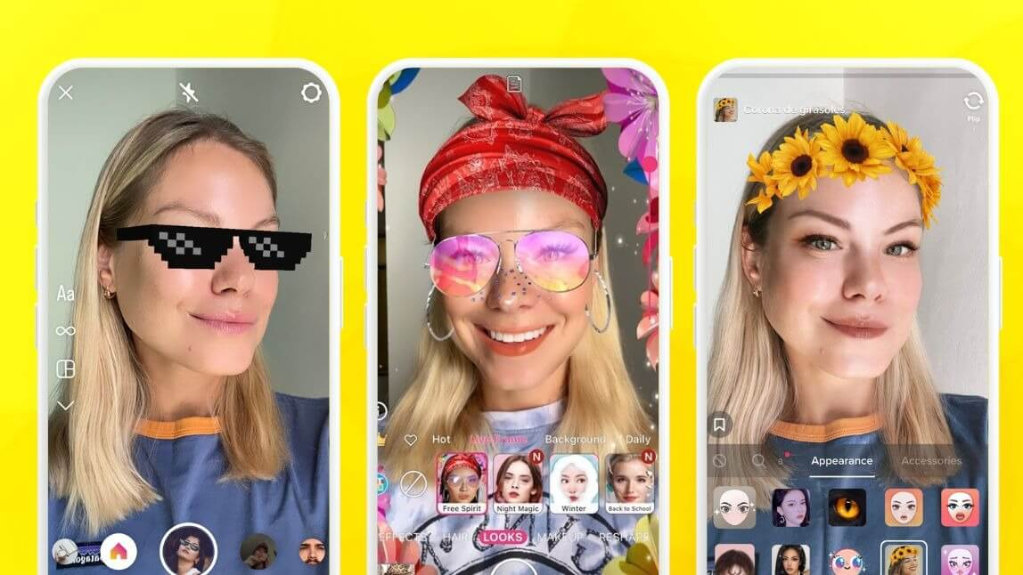
What is a face filter?
Face filters, also known as AR (augmented reality) filters, are digital enhancements applied to images or videos in real-time. These filters use advanced technology to detect facial features and overlay virtual effects to alter or enhance the appearance of a person's face. Popularized by social media platforms like Instagram and Snapchat, face filters have become a fun and engaging way for users to express themselves creatively and interact with digital content.

Slide 3
The benefits of using face filters
Face filters offer a variety of benefits for individuals, developers, and businesses alike. For individual users, face filters provide a fun and creative way to enhance their selfies or videos, making them more engaging and shareable. For developers and businesses, integrating face filters into apps or platforms can drive user engagement, increase retention rates, and boost brand visibility.

Slide 4
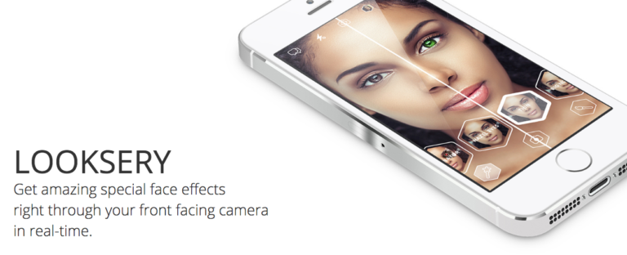
The Technology
The technology came from a Ukrainian startup Looksery, which is an application that allowed users to modify their facial features during video chats and for photos. Snapchat acquired this Odesa-based face changing startup in September 2015 for $150 million dollars. That’s reportedly the largest tech acquisition in Ukrainian history.

Slide 5
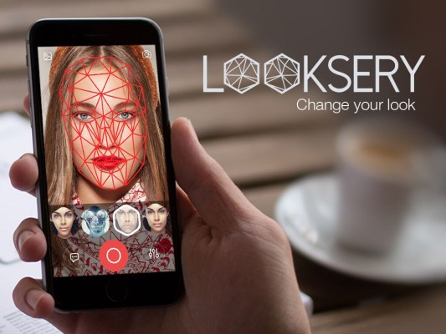
The Technology
Their augmented reality filters tap into the large and rapidly growing field of computer vision. Computer vision can be thought of as a direct opposite of computer graphics. While computer graphics try to produce image models from 3D models, computer vision tries to create a 3D space from image data.
Computer Vision is starting to be utilized more and more in our society. It is how you scan your checks and the data is extracted from the lines. It is how you can deposit checks with your phone. It is how Facebook knows who’s in your photos, how self-driving cars can avoid running over people and how you can give yourself a dodgy nose.

Slide 6
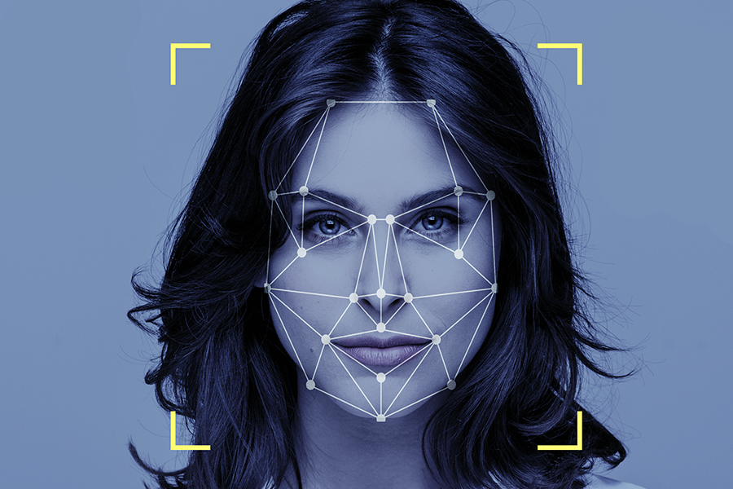
How Snapchat Filters Work
Looksery maintains their engineering more confidential, but every one can access their patents online. The specific area of Computer Vision that Snapchat filters use is called Image processing. Image processing is the transformation of an image by performing mathematical operations on each individual pixel on the provided picture.

Slide 7
Step 1 – Face Detection
The first step works like this: Given an input image or video frame, find out all present human faces and output their bounding box (i.e. The rectangle coordinates in the form: X, Y, Width & Height).
Face detection has been a solved problem since the early 2000s but faces some challenges including detecting tiny, partial & non-frontal faces. The most widely used technique is a combination of Histogram of Oriented Gradients (HOG for short) and Support Vector Machine (SVM) that achieve mediocre to relatively good detection ratios given a good quality image but this method is not capable of real-time detection at least on the CPU.

Slide 8
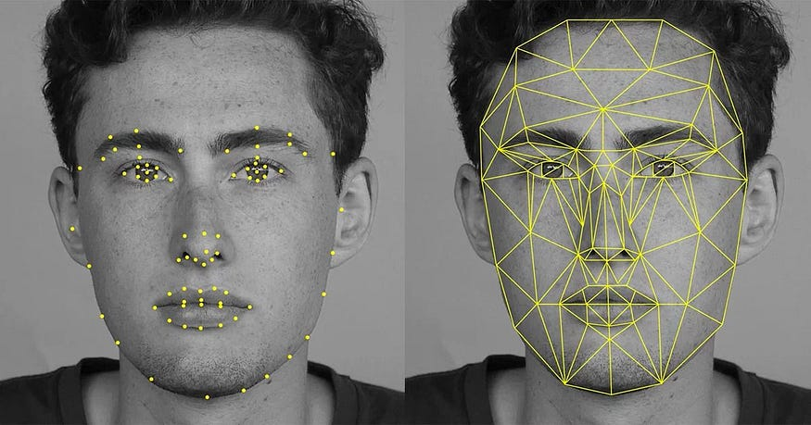
Step 2 – Facial Landmarks
This is the next step in our analysis phase and works as follows: For each detected face, output the local region coordinates for each member or facial feature of that face. This includes the eyes, bone, lips, nose, mouth,… coordinates usually in the form of points (X,Y).
Extracting facial landmarks is a relatively cheap operation for the CPU given a bounding box (i.e. Cropped image with the target face), but quite difficult to implement for the programmer unless some not-so-fast machine learning techniques such as training & running a classifier is used.

Slide 9
Step 3 - Image Processing
Now that the face has been detected, Snapchat can use Image Processing to apply features onto a full face. However, they chose to go one step further and they want to find your facial features. This is done with the aid of the Active Shape Model.
The Active Shape Model is a facial recognition technique trained on many images with manually marked facial features. It creates an “average face” and aligns it with a given image. Since faces vary, the model adjusts by analyzing shading differences and patterns. Using machine learning, it refines its detection, correcting errors based on surrounding points. Finally, it generates a 3D mesh that moves and scales with the face.

Slide 10
USES OF THE FACE FILTERS USING COMPUTER VISION
Computer Entertainment
Virtual try-on
Prevent crime
Clothes tryouts
The Face Filters using Computer Vision application has been used to attract people of all age groups due to its unique and fun features to try it at least once in their lifetime and come off surprised every time.
Face filters using computer vision allow virtual try-ons to help market products. The application detects the face using 68 landmark points, covering the forehead, chin, and ears. This helps accurately position items like jewelry, makeup, or sunglasses for a seamless try-on experience.
The Face Filters using Computer Vision application which uses the technology of Face Recognition has been used to identify criminals in public places, drug dealers on school grounds, and cheaters in casinos to prevent crime and maintaining peace and discipline
The Face Filters using Computer Vision application which uses the technology of Face Recognition has been used to make virtual clothing try on a possibility. Here, the user has to just stand in front of the webcam to access a virtual closet full of attractive clothing.

Slide 11

Python methods: OpenCV
OpenCV (Open Source Computer Vision Library) is an open-source computer vision library used for face detection, image processing, and augmented reality effects. It primarily works with Haar cascades and deep learning models for detecting faces in images or videos. OpenCV allows applying face filters using:
Haar cascades to detect faces quickly.
Bitwise operations for masking and merging filters with the face.
Affine and perspective transformations to adjust filters to fit facial features.
Weighted overlays to apply semi-transparent effects like beauty filters or color adjustments.
Despite being fast and efficient, OpenCV’s facial detection methods are less accurate than deep learning-based models like dlib or Mediapipe.

Slide 12

Python methods: dlib
dlib is a powerful machine learning library specializing in face recognition and landmark detection. Unlike OpenCV, dlib uses a Histogram of Oriented Gradients (HOG) + Support Vector Machine (SVM) for face detection, offering better accuracy. It also provides deep learning-based models for improved performance.
Face detection with HOG + SVM or CNN-based models.
Facial landmark detection (68 key points) to precisely identify eyes, nose, mouth, and jawline. Face recognition and comparison using deep learning-based face embeddings. dlib is useful for precisely placing and warping filters onto faces, making it a popular choice for Snapchat-style masks. However, it requires more computational power than OpenCV.

Slide 13

Python methods: Mediapipe
Mediapipe, developed by Google, is an advanced framework optimized for real-time facial analysis. It outperforms both OpenCV and dlib in terms of accuracy and speed. Mediapipe’s Face Mesh model detects 468 facial landmarks, providing high-detail tracking for realistic filters. Key features include:
Face Mesh for ultra-precise facial landmark detection, enabling 3D effects and real-time AR filters.
Face Detection for fast and efficient real-time tracking.
Selfie Segmentation for background removal or modification. Mediapipe is ideal for real-time applications like AR filters in video calls, beauty effects, and interactive 3D masks. It’s widely used in mobile applications due to its lightweight and optimized deep learning models.

Slide 14


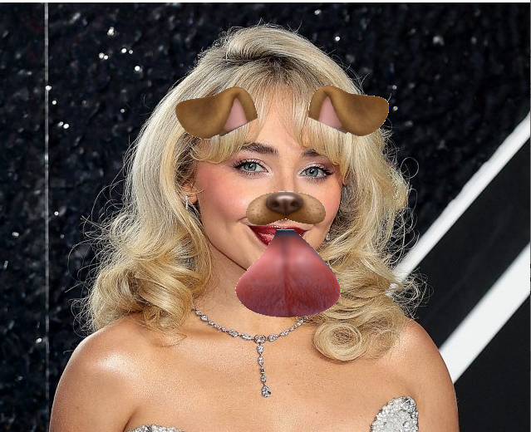
Python example

Slide 15
Conclusion
Face filters use computer vision to apply effects in real time. The main steps include face detection, landmark identification, and filter application.
OpenCV – Fast and simple, but less accurate.
dlib – High accuracy but resource-intensive.
Mediapipe – Best for real-time AR effects with precise tracking.
Face filters are widely used in social media, video calls, AR apps, and medical fields. Advances in neural networks make them faster, more accurate, and more realistic.

Slide 16
Thanks for attention!
Kalybek Aruzhan

