Slide 1
Movie Recommendation System using Graph Database
Student: NGUYEN KE VAN

Slide 2
Introduction
Problem Statement: The goal of this project is to develop the model which will allow us to find movie recommendation based on user’s previous experience. We’ll use neo4J graph database as a tool and use 2 datasets: MovieLens, which contains ratings and tag applications applied toward movies by users, and TMDB 5000 Movie Dataset, which contains, among other, credits data for movies.

Slide 3
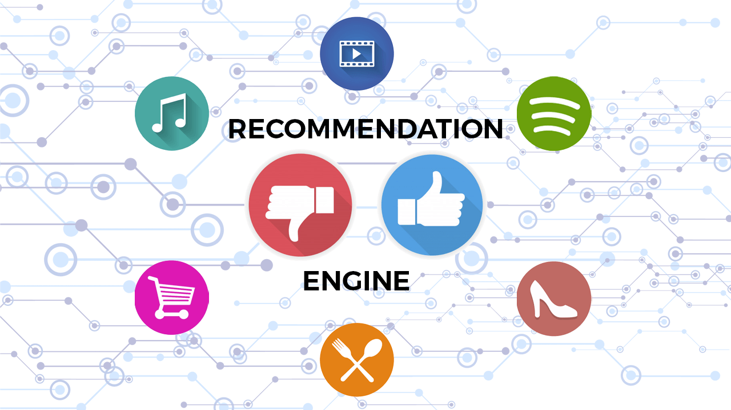
Real-time Recommendation
Real-time recommendation is a very popular topic in the retail industry.
The goal of real-time recommendation is to provide personalized recommendations for users immediately after they search for products on e-commerce websites.
It is a challenging task since the user has not yet decided which product they want to buy, so it requires a deep understanding of their preferences and behaviors.
Notes:
In order to achieve this goal, real-time recommender systems need to be able to process big data at near real-time speed. Real-time systems are often used as part of e-commerce websites or mobile apps, where they can recommend products based on what the user is currently doing. For example, if an e-commerce site is selling shoes, it might want to show the user different styles of shoes when they are looking at the "men's sneakers" page.

Slide 4
Recommendation
There are two basic approaches to recommendation algorithms:
Content-Based Filtering
Collaborative Filtering

Slide 5
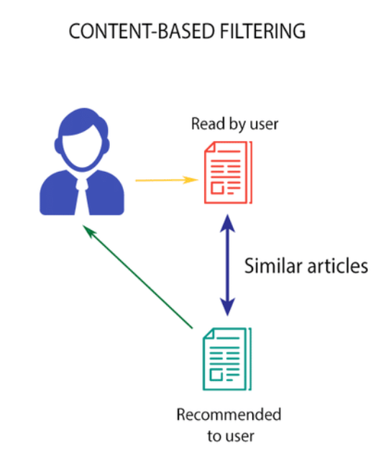
Content-Based Filtering
Content-based filtering: uses item features to recommend other items similar to what the user likes, based on their previous actions or explicit feedback.

Slide 6
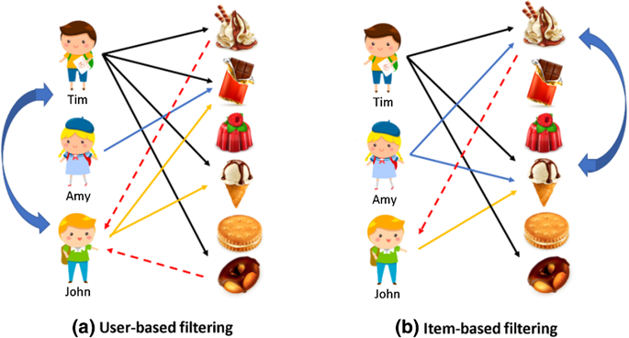
Collaborative filtering
Collaborative filtering: is a technique that can filter out items that a user might like on the basis of reactions by similar users. It works by searching a large group of people and finding a smaller set of users with tastes similar to a particular user.

Slide 7
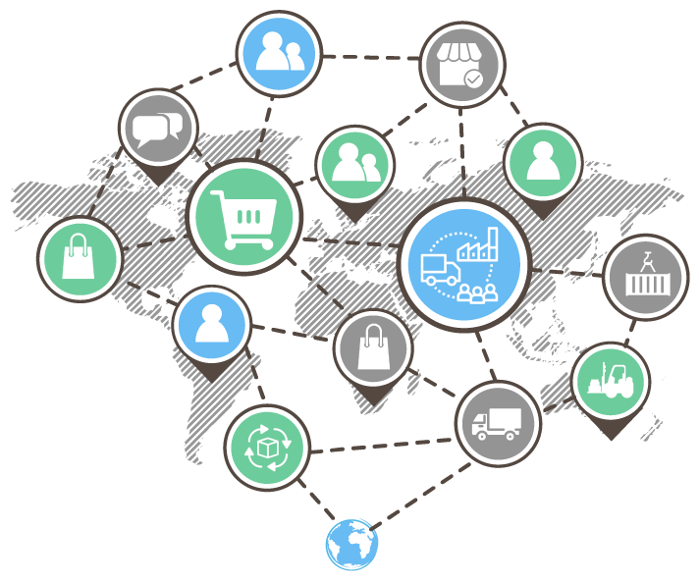
Graph Technology
Graph technology is a good choice for real-time recommendation.
Graph factorization is a graph-based model that can be used to represent user preferences as well as the relationship between users, items, and attributes.
The goal of graph factorization is to extract the latent features from user ratings and recommendations so that these features can be used to predict users' preferences in an unsupervised manner.
Notes:
graph databases are a core technology platform of internet giants like Google, Facebook and LinkedIn. But while those pioneers had to build their own in-house data stores from scratch, off-the-shelf graph databases – notably Neo4j – are now available to any business wanting to make the most of real-time recommendation engines.
Graph technology is a good choice for real-time recommendation. It has the ability to predict user behavior and make recommendations based on it. Graph databases like Neo4j provide a flexible data model that allows you to represent any kind of relationship between entities. This includes not only the typical "product" and "user" relationships, but also any other relationships that are important to your application. For example, you can use a graph database to represent complex groupings of users (such as "friends") or categories of products (such as "books"). As long as there's an edge between two entities, you can use graph technology.

Slide 8
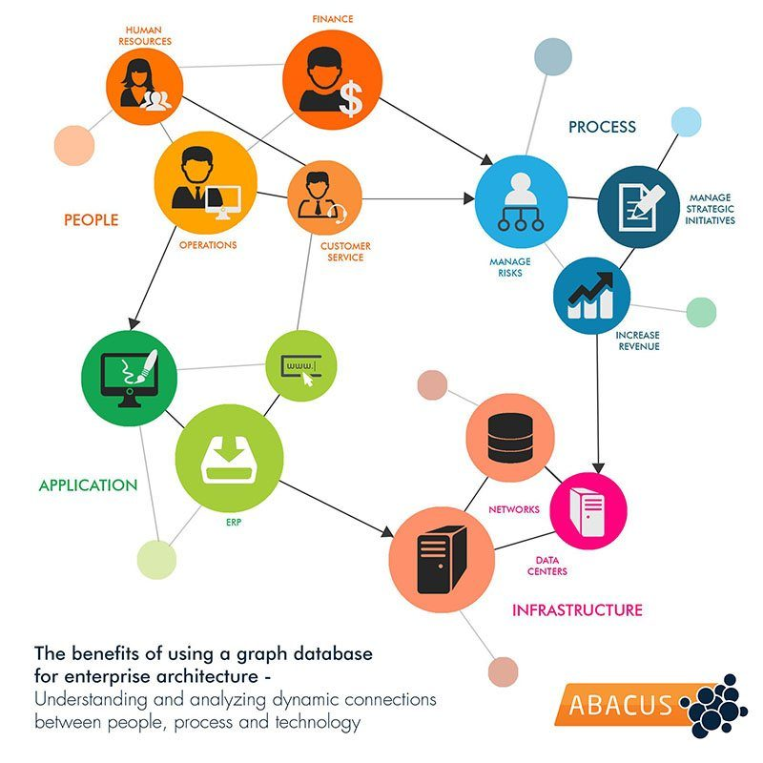
What is a Graph database?
A graph is known as a diagram that illustrates a relationship between two things.Thus, A graph database can be assumed to be a database to understand relationships between data.
Graph databases are fundamentally designed with a focus on the relationship between data sets.
Notes:
Graph databases are unlike traditional Relational Database Management Systems (RDBMSs) most people are familiar with. RDBMSs house data in a table of columns and rows with little or no relation to each other.
Graph databases are designed to uncover important relationships between many big data sets. In other words, it can connect the dots between multiple datasets that might otherwise just be sitting useless in silos. And graph databases are already widely used for such purposes.

Slide 9
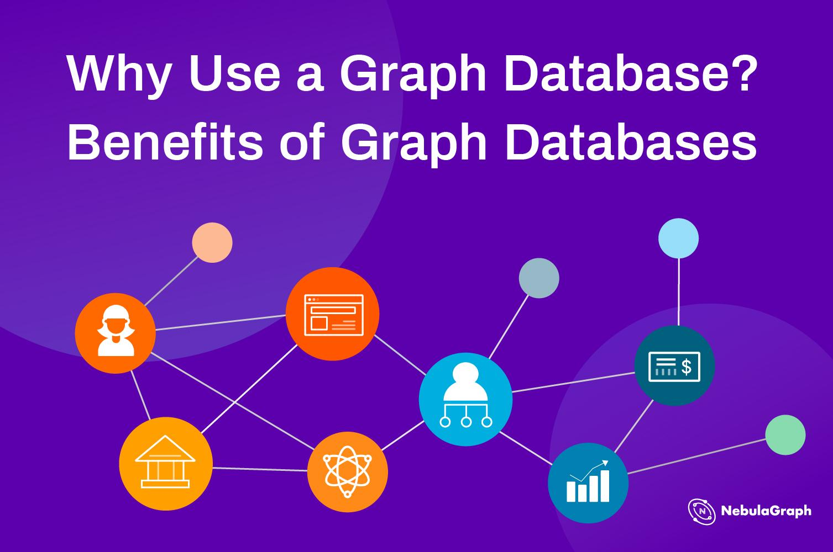
Why we need to use Graph database for real-time Recommendation ?
Some of the main benefits of using graphs to generate recommendations include:
- Performance. Index-free adjacency allows for calculating recommendations in real time, ensuring the recommendation is always relevant and reflecting up-to-date information.
- Data model. The labeled property graph model allows for easily combining datasets from multiple sources, allowing enterprises to unlock value from previously separated data silos.

Slide 10
How graph technology is used in recommendation systems?
There are two main types of recommender systems:
1) Collaborative filtering methods
2) Model-based methods
A collaborative filtering method, such as KNN, can predict the movie rating without knowing the attributes of the movies and users. To address this challenge, the graph factorization approach combines the model-based method with the collaborative filtering method to improve prediction accuracy when the rating record is sparse
Graph factorization is done by breaking down the original dataset into smaller datasets or clusters. This process can be done using graph databases because they are designed to support highly connected data structures and relationships between data points.

Slide 11
Implementation
Find suitable dataset and obtain data
Preprocess data
Load data to a graph database
Find and evaluate multiple recommendation schemas.
Build app and demo

Slide 12
Implementation
1. Find suitable dataset and obtain data

Slide 13
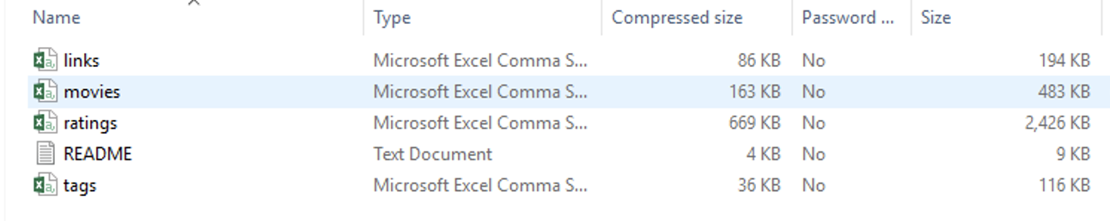
Dataset
MovieLens dataset
Describes 5-star rating and free-text tagging activity from MovieLens,
It contains 100836 ratings and 3683 tag applications across 9742 movies.
These data were created by 610 users between March 29, 1996 and September 24, 2018. This dataset was generated on September 26, 2018.
Download ml-latest-small.zip at this link

Slide 14
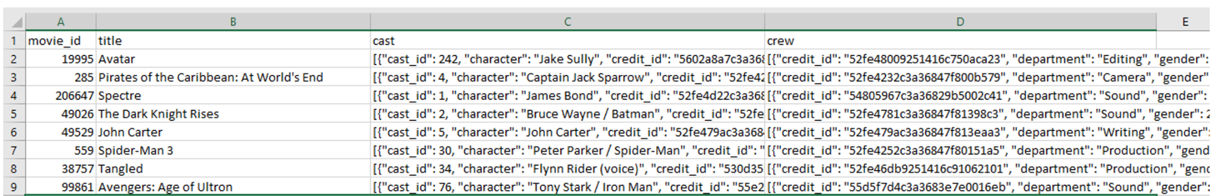
Dataset
TMDB 5000 Movie Dataset
This dataset was generated from The Movie Database API.
It contains 2 csv files:
detailed information about the movie (budget, genres, original language and so forth),
contains movies credits – actors, directors, producers. Only one of two csv files with credentials will be used.
Compressed size of tmdb_5000_credits.csv file: 7.64 MB; uncompressed: 39 MB.
Download at this link

Slide 15
Implementation
2. Preprocess data & Load data to graph database

Slide 16

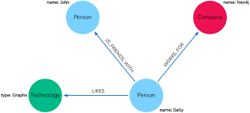
Data reading and preprocessing
Neo4j started as a graph database and has evolved into a rich ecosystem with many tools, applications, and libraries, which allows you to integrate graph technologies with your working environment such as:
Neo4j Graph Database
Neo4j Aura
Neo4j Graph Data Science
Cypher Query Language

Slide 17
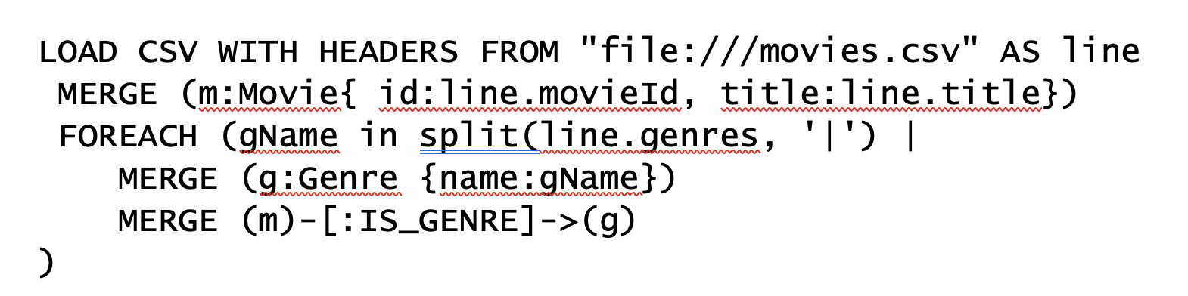
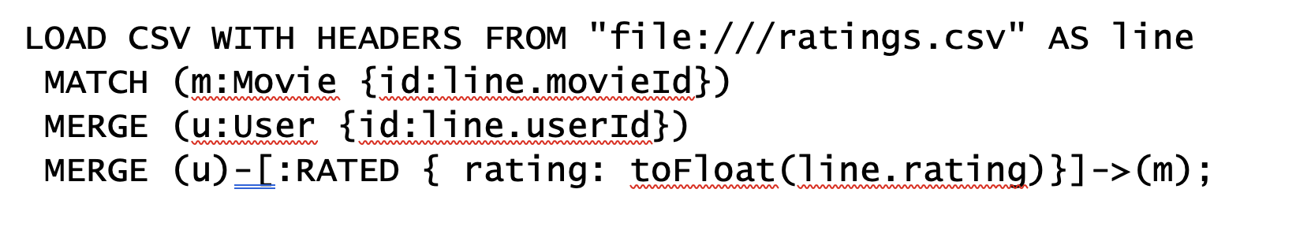
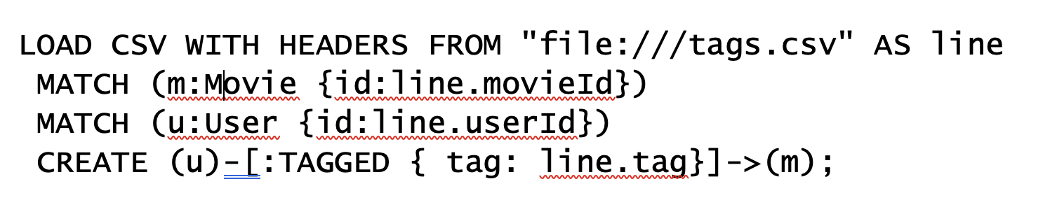
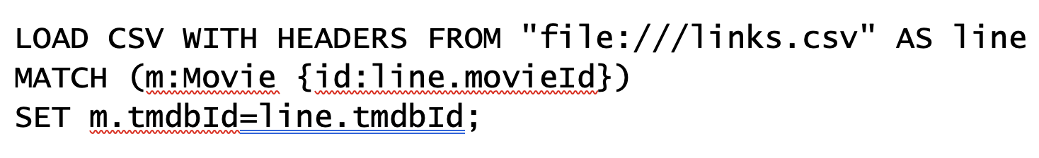
Data reading and preprocessing
Load file into Neo4j using Cypher language

Slide 18
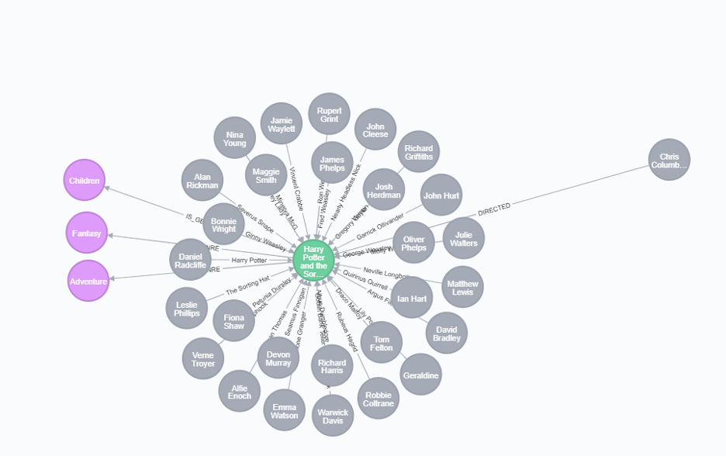
Data reading and preprocessing
The graph illustrates the relationship between genres, actors and director of a movie which named “Harry Potter and the Sorcerer's Stone ”

Slide 19
Implementation
3. Find and evaluate multiple recommendation schemas.

Slide 20
Implementation
3.1. Content-Based Filtering

Slide 21
Content-Based Filtering
The goal of content-based filtering is to find similar items, using attributes (or traits) of the item. Using our movie data, one way we could define similarity is movies that have common genres.

Slide 22
Content-Based Filtering
Similarity Based on Common Genres:
Ex: Find movies most similar to movie having title “Inception” based on shared genres
MATCH (m:Movie)-[:IN_GENRE]->(g:Genre)
<-[:IN_GENRE]-(rec:Movie)
WHERE m.title = 'Inception'
WITH rec, collect(g.name) AS genres, count(*) AS commonGenres
RETURN rec.title, genres, commonGenres
ORDER BY commonGenres DESC LIMIT 10;

Slide 23
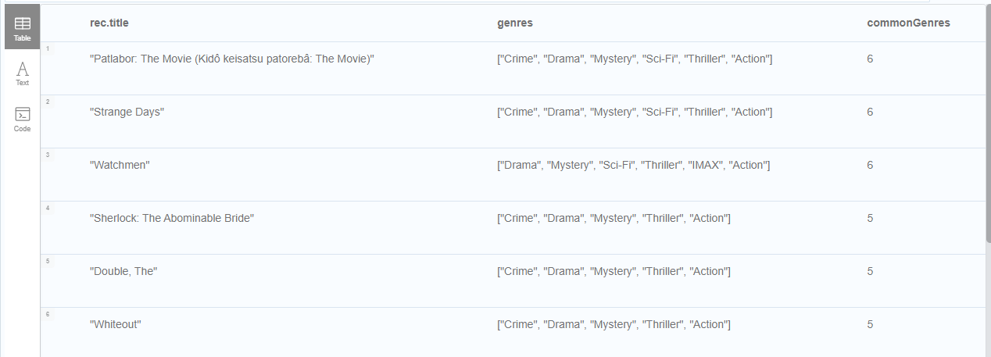
Content-Based Filtering
Similarity Based on Common Genres:
Ex: Find movies most similar to movie having title “Inception” based on shared genres

Slide 24
Content-Based Filtering
Personalized Recommendations Based on Genres:
If we know what movies a user has watched, we can use this information to recommend similar movies:
Ex: Recommend movies similar to the user named “Angelica Rodriguez” has already watched
MATCH (u:User {name: 'Angelica Rodriguez'})-[r:RATED]->(m:Movie),
(m)-[:IN_GENRE]->(g:Genre)<-[:IN_GENRE]-(rec:Movie)
WHERE NOT EXISTS{ (u)-[:RATED]->(rec) }
WITH rec, g.name as genre, count(*) AS count
WITH rec, collect([genre, count]) AS scoreComponents
RETURN rec.title AS recommendation, rec.year AS year, scoreComponents,
reduce(s=0,x in scoreComponents | s+x[1]) AS score
ORDER BY score DESC LIMIT 10

Slide 25
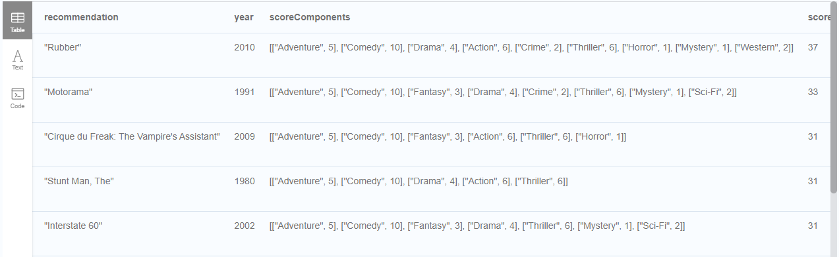
Content-Based Filtering
Personalized Recommendations Based on Genres:
Ex: Recommend movies similar to the user named “Angelica Rodriguez” has already watched

Slide 26
Content-Based Filtering
Weighted Content Algorithm:
There are many more traits in addition to just genre that we can consider to compute similarity, such as actors and directors. Let’s use a weighted sum to score the recommendations based on the number of actors (3x), genres (5x) and directors (4x) they have in common to boost the score: Compute a weighted sum based on the number and types of overlapping traits

Slide 27
Content-Based Filtering
Weighted Content Algorithm:
Ex: Find similar movies with the movie having title
“Wizard of Oz, The” by common genres
MATCH (m:Movie) WHERE m.title = 'Wizard of Oz, The'
MATCH (m)-[:IN_GENRE]->(g:Genre)<-[:IN_GENRE]-(rec:Movie)
WITH m, rec, count(*) AS gs
OPTIONAL MATCH (m)<-[:ACTED_IN]-(a)-[:ACTED_IN]->(rec)
WITH m, rec, gs, count(a) AS as
OPTIONAL MATCH (m)<-[:DIRECTED]-(d)-[:DIRECTED]->(rec)
WITH m, rec, gs, as, count(d) AS ds
RETURN rec.title AS recommendation,
(5*gs)+(3*as)+(4*ds) AS score
ORDER BY score DESC LIMIT 25

Slide 28
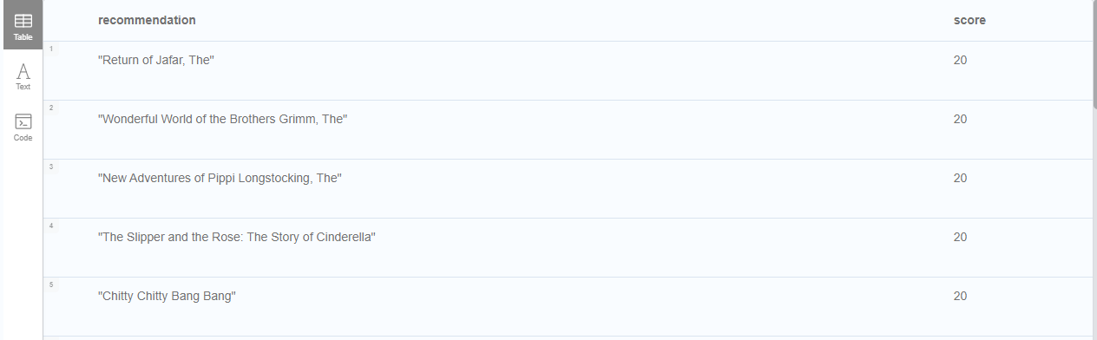
Content-Based Filtering
Weighted Content Algorithm:
Ex: Find similar movies with the movie having title
“Wizard of Oz, The” by common genres

Slide 29
Content-Based Filtering
Content-Based Similarity Metrics:
Jaccard Index : The Jaccard index is a number between 0 and 1 that indicates how similar two sets are.
We can calculate the Jaccard index for sets of movie genres to determine how similar two movies are

Slide 30
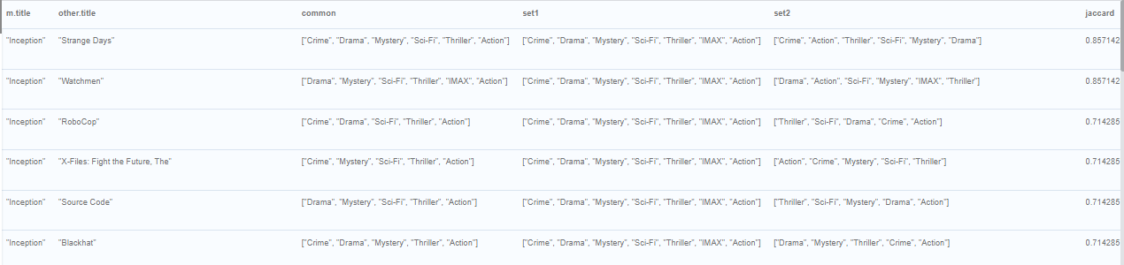
Content-Based Filtering
Content-Based Similarity Metrics:
Jaccard Index :
Ex: What movies are most similar to Inception based on Jaccard similarity of genres?

Slide 31
Implementation
3.2. Collaborative Filtering

Slide 32
Collaborative Filtering
~~ Leveraging Movie Ratings ~~
Steps:
Find similar users in the network (our peer group).
Assuming that similar users have similar preferences, what are the movies those similar users like?

Slide 33
Collaborative Filtering
~~ Leveraging Movie Ratings ~~
Ex: What are the movies that Misty liked more than average?
MATCH (u:User {name: 'Misty Williams'})
MATCH (u)-[r:RATED]->(m:Movie)
WITH u, avg(r.rating) AS average
MATCH (u)-[r:RATED]->(m:Movie)
WHERE r.rating > average
RETURN *
LIMIT 100;

Slide 34
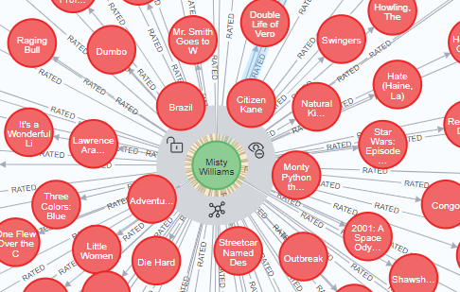
Collaborative Filtering
~~ Leveraging Movie Ratings ~~
Ex: What are the movies that Misty liked more than average?

Slide 35
Collaborative Filtering
~~ The Wisdom of Crowds ~~
Consider Genres Liked by the User:
Ex: For a particular user, what genres have a higher-than-average rating? Use this to score similar movies.
Step: - Compute mean rating
-Find genres with higher than average rating and their number of rated movies
-Find movies in those genres, that have not been watched yet
- Order by sum of scores

Slide 36
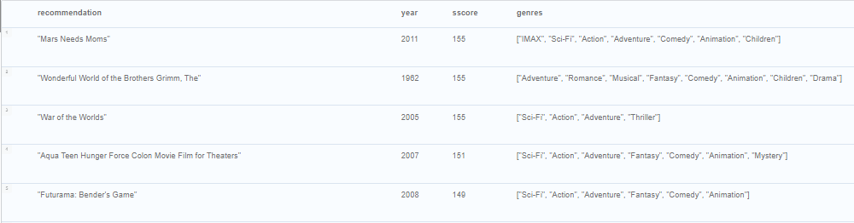
Collaborative Filtering
~~ The Wisdom of Crowds ~~
Consider Genres Liked by the User:
Ex: For a particular user, what genres have a higher-than-average rating? Use this to score similar movies.

Slide 37
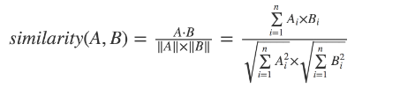
Collaborative Filtering
~~ Similarity Metrics ~~
Cosine Similarity
The cosine similarity of two users will tell us how similar two users' preferences for movies are. Users with a high cosine similarity will have similar preferences.

Slide 38
Collaborative Filtering
~~ Similarity Metrics ~~
Cosine Similarity
Ex: Find the users with the most similar preferences to Cynthia Freeman, according to cosine similarity
MATCH (p1:User {name: 'Cynthia Freeman'})-[x:RATED]->(movie)<-[x2:RATED]-(p2:User)
WHERE p2 <> p1
WITH p1, p2, collect(x.rating) AS p1Ratings, collect(x2.rating) AS p2Ratings
WHERE size(p1Ratings) > 10
RETURN p1.name AS from,
p2.name AS to,
gds.similarity.cosine(p1Ratings, p2Ratings) AS similarity
ORDER BY similarity DESC

Slide 39
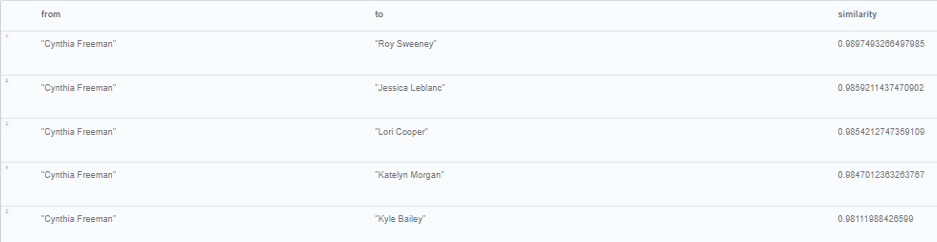
Collaborative Filtering
~~ Similarity Metrics ~~
Cosine Similarity
Ex: Find the users with the most similar preferences to Cynthia Freeman, according to cosine similarity

Slide 40
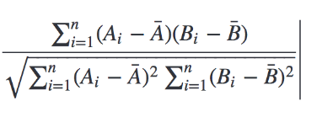
Collaborative Filtering
~~ Similarity Metrics ~~
Pearson Similarity
Pearson similarity considers differences about the mean, this metric will account for these discrepancies.

Slide 41
Collaborative Filtering
~~ Similarity Metrics ~~
Pearson Similarity
Ex: Find users most similar to Cynthia Freeman, according to the Pearson similarity function
MATCH (p1:User {name: 'Cynthia Freeman'})-[x:RATED]->(movie)<-[x2:RATED]-(p2:User)
WHERE p2 <> p1
WITH p1, p2, collect(x.rating) AS p1Ratings, collect(x2.rating) AS p2Ratings
WHERE size(p1Ratings) > 10
RETURN p1.name AS from,
p2.name AS to,
gds.similarity.pearson(p1Ratings, p2Ratings) AS similarity
ORDER BY similarity DESC

Slide 42
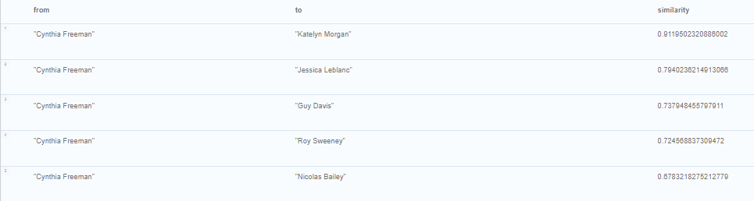
Collaborative Filtering
~~ Similarity Metrics ~~
Pearson Similarity
Ex: Find users most similar to Cynthia Freeman, according to the Pearson similarity function

Slide 43
Collaborative Filtering
~~ Neighborhood-Based Recommendations~~
Ex: "Who are the 10 users with tastes in movies most similar to mine? What movies have they rated highly that I haven’t seen yet?"
We used kNN movie recommendation using Pearson similarity

Slide 44
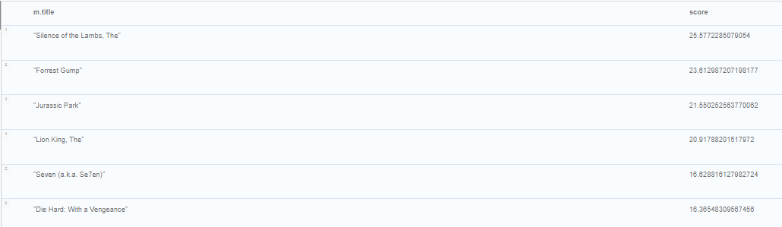
Collaborative Filtering
~~ Neighborhood-Based Recommendations~~
Ex: "Who are the 10 users with tastes in movies most similar to mine? What movies have they rated highly that I haven’t seen yet?"

Slide 45
Implementation
4. Build app and demo

Slide 46
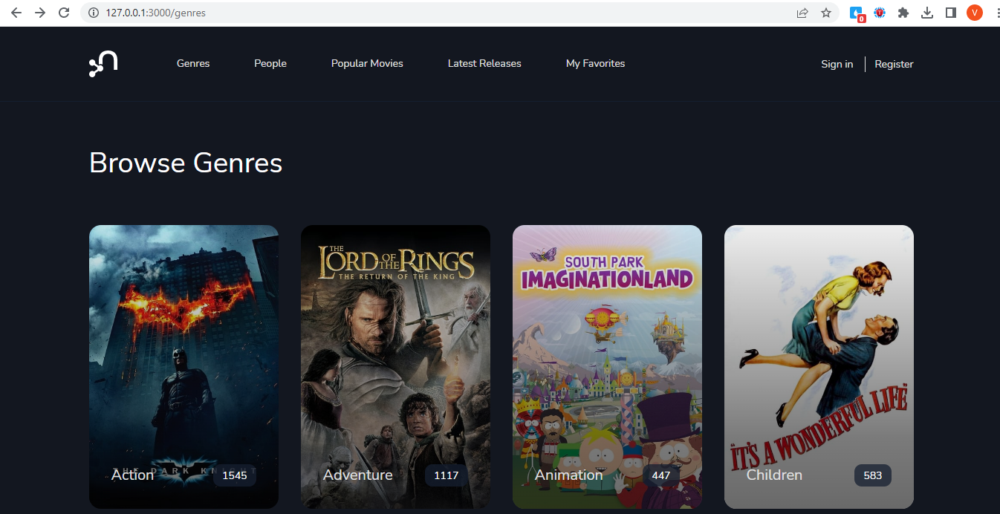
Build app and demo

Slide 47
Advantages
Pros of using Graph database for recommendation system:
Process queries very fast, enabling using the model for real-time recommendation engines
Easy to visualize and understand the connections and paths with lead us to recommendations.
Notes:
Pros: With graph database we have fast access to both data (user, movie, genre) and relationships between them, which allow us to process queries very fast, enabling using the model for real-time recommendation engines. Another advantage of using a graph database for this model is that it’s easy to visualize and understand the connections and paths with lead us to recommendations.
Cons: It’s hard to evaluate the performance of proposed models without access to real users in real time. It would be nice to expand the model by adding more features and connections.

Slide 48
Disadvantages
Cons of using Graph database for recommendation system:
Hard to evaluate the performance of proposed models without access to real users in real time. It would be nice to expand the model by adding more features and connections.
Scalability: Graph databases may not be the best option for massive datasets that require high-speed querying. Need to sharding or other strategies to improve scalability.
Data model limitation: which can make them less suitable for storing other types of data that not graph-based
Notes:
Pros: With graph database we have fast access to both data (user, movie, genre) and relationships between them, which allow us to process queries very fast, enabling using the model for real-time recommendation engines. Another advantage of using a graph database for this model is that it’s easy to visualize and understand the connections and paths with lead us to recommendations.
Cons: It’s hard to evaluate the performance of proposed models without access to real users in real time. It would be nice to expand the model by adding more features and connections.

Slide 49
Conclusion
Used neo4j graph database and graph query language Cypher in order to create a model for movie recommendation system
Data source: MovieLens (for rating and tag) & TMDB 5000 Movie Dataset (for actors, directors))
Used 2 different models: both Content-Based, Collaborative Filtering and combination of them.
Can expand model such as user demographic information, social relationships, more information about movies itself,... etc

Slide 50
References
Neo4j Database: https://neo4j.com/
Jaccard index: https://en.wikipedia.org/wiki/Jaccard_index
Recommendation using Graph database: https://neo4j.com/blog/real-time-recommendation-engine-data-science/
Similarity functions: https://neo4j.com/docs/graph-data-science/current/algorithms/similarity-functions/
Collaborative Filtering: https://neo4j.com/blog/collaborative-filtering-creating-teams/?ref=browser-guide

