Slide 1

Word Tree
Corpus Interface
Lightning Talk, JISC Learnability and Usability Programmme
June 1st, 2011

Slide 2
Problems
Small, targeted corpora have been created to support investigation of speech and writing.
Difficult to extract data for use elsewhere.
Available tools designed for domain specialists: lexicographers and information scientists.
Existing corpora underused due to lack of online interface.

Slide 3
KWIC: KeyWords In Context
if love be rough with you , be rough with love
if love be blind , love cannot hit the mark
if love be blind , it best agrees with night
All instances of “if love” in Romeo and Juliet.

Slide 4
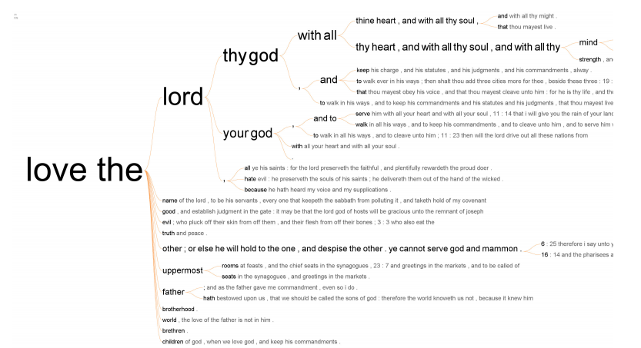
ManyEyes Word Tree
http://www-958.ibm.com/software/data/cognos/manyeyes/

Slide 5
Approach
Extend Word Tree for larger datasets, add asynchronous preprocessing (parsing) stage.
Allow users to filter number of terms and metrics interactively, with better fluidity.
Introduce comparisons using overlays and/or split screen, test using online and offline User Studies.
Allow users to tag, save and distribute interesting visualisation states.

Slide 6
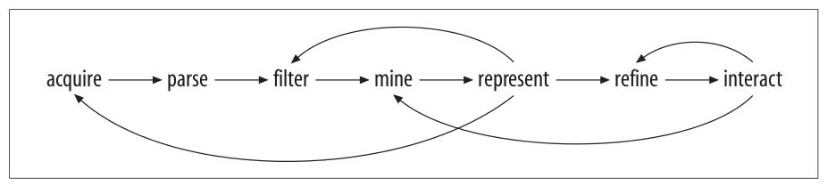
Visualisation Workflow
Visualising Data (Fry), 2007
Data Engineering
User Interface
Test features and performance against BAWE Corpus.
User Studies
Log Analysis
Online Qualitative Feedback

Slide 7
More details at: thewordtree.net
http://cuba.coventry.ac.uk/wordtree/

