Slide 1

BRAND DECK / 2026
OBSKURA
Visual identity for live moments that travel.
Branded content, full performance coverage, and after-movies for artists, venues, festivals, and culture-forward brands.
CHICAGO AND BEYOND
SOURCE: CURRENT OBSKURA SITE ASSETS
01

Slide 2
BRAND SYSTEM
Contrast is the system: paper, ink, signal.
The site already has a sharp identity. The deck translates it into a practical presentation system: heavy display type, thin metadata, hot orange for signal moments, and image-led proof.
INK
PAPER
SIGNAL
COLD LIGHT
STEEL
MonumentExtended
OS
01/08
DISPLAY / LOGO-LIKE HEADLINES
MONO METADATA
Space Grotesk carries the practical read: captions, bodies, and production notes. Courier New handles metadata and website-adjacent interface labels.
COLORS + FONTS: CSS/INDEX.CSS
02

Slide 3
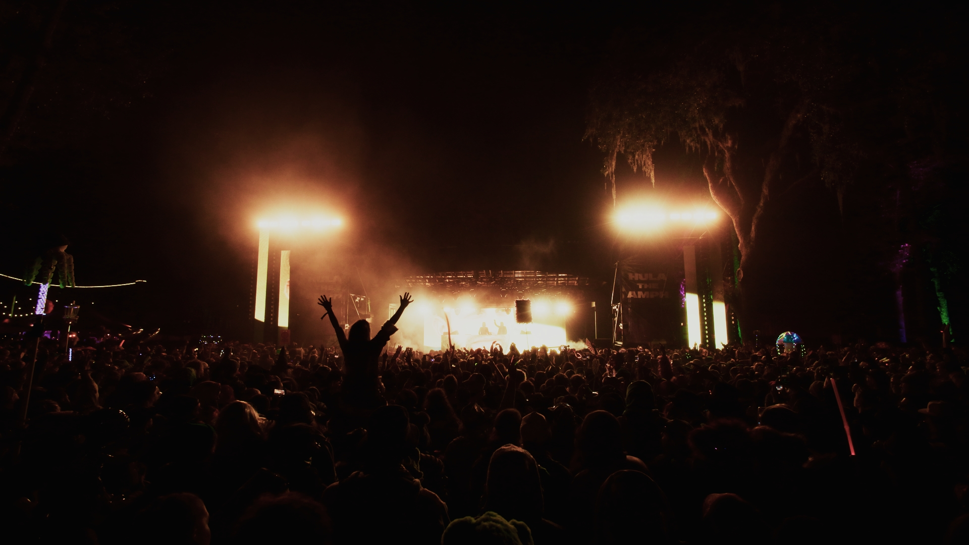
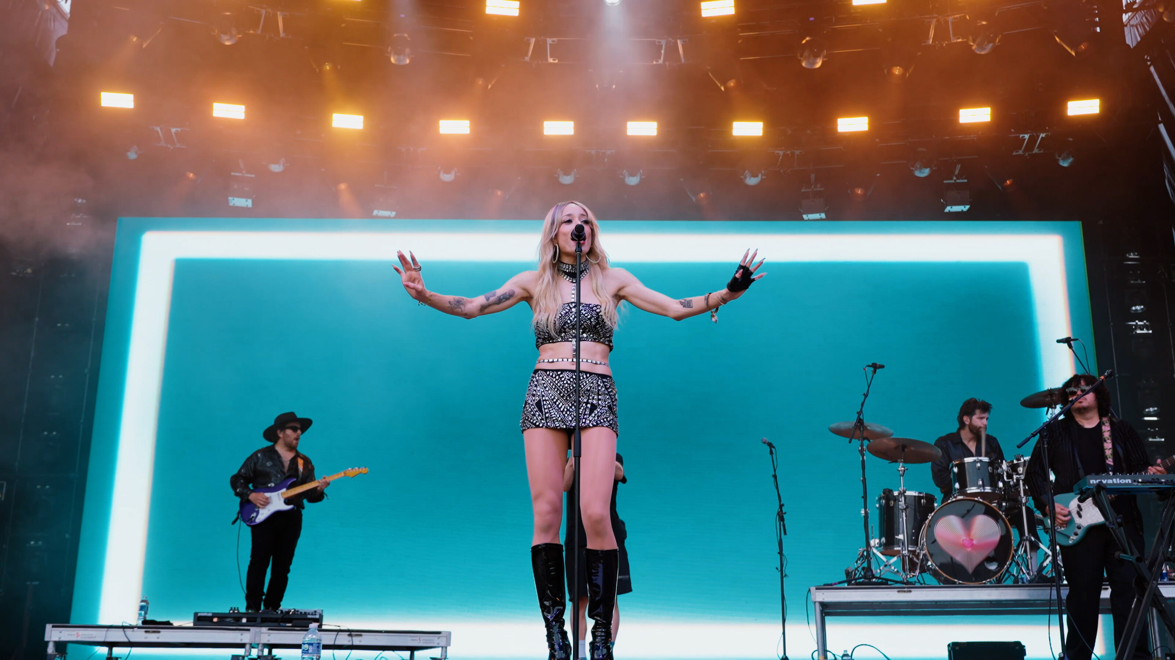
VISUAL LANGUAGE
Immediate.
Loud.
Controlled.
Obskura imagery works best when the crop feels close to the event: light hitting skin, crowds in motion, a performer held in the frame with confidence.
CROP RULES
Use full-bleed moments for emotion. Use grids only when range is the point. Keep captions small and factual.
live / brand / aftermovie
SOURCE: SITE PHOTO + WORK ASSETS
03

Slide 4
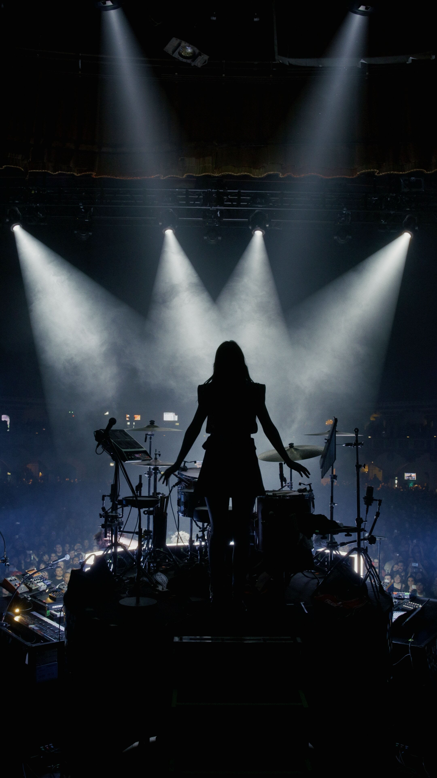
OFFER ARCHITECTURE
Three production modes keep the brand easy to buy.
01
Branded Content
On-brand visuals that capture identity and connect across every platform.
02
Full Performance Coverage
Stage-to-crowd capture with cinematic precision and no missed beats.
03
After-Movie Duties
Fast, loud edits that turn events into shareable highlight reels.
BUILT FOR MOMENTS THAT MOVE FAST
SOURCE: INDEX.HTML SERVICES
04

Slide 5
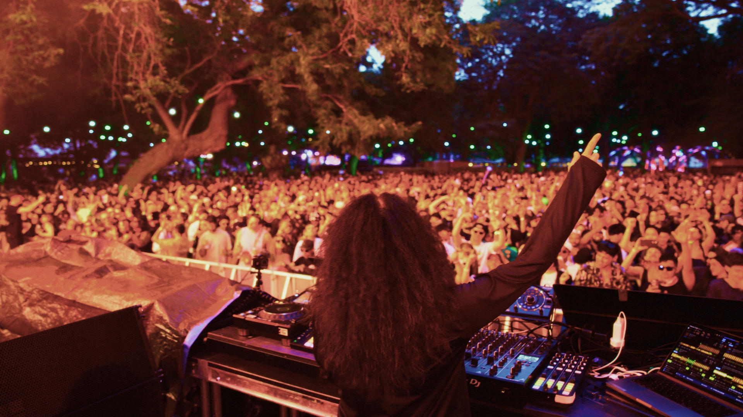
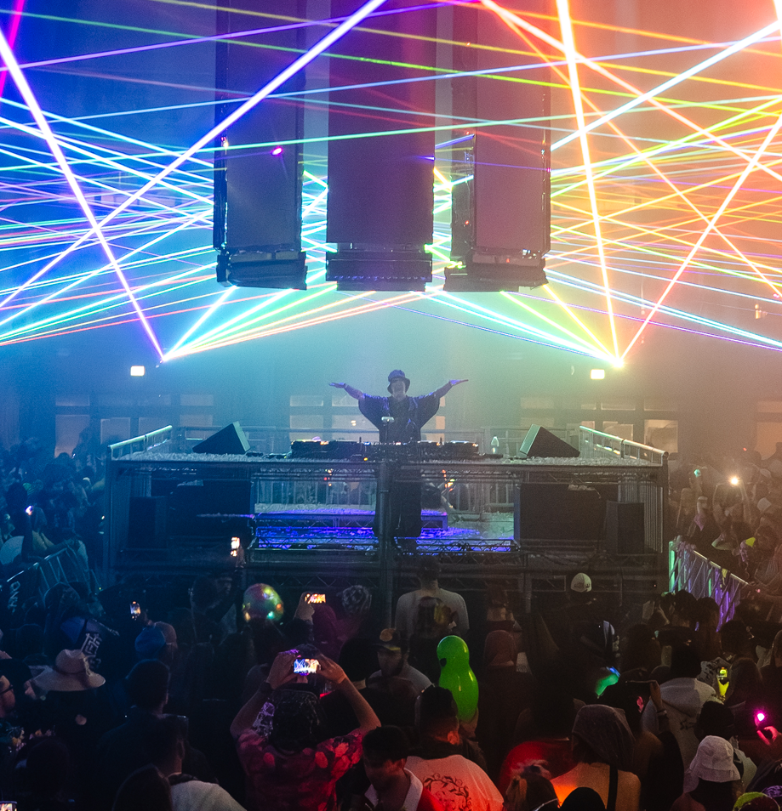
FEATURED WORK
Range is the proof: venue, festival, full set, social clip.
The site portfolio should feel like a live catalog, not a case-study archive. Large crops and spare labels make the work the main argument.
ZEDS DEAD
NICOLE MOUDABER
HULAWEEN / FULL SET
ARC CHICAGO / FULL SET
L'IMPERATRICE
LSDREAM
ARAGON BALLROOM
NEW YEAR'S EVE
SOURCE: INDEX.HTML FEATURED WORK
05

Slide 6
CONTENT SYSTEM
Every shoot should leave with a content ecosystem.
The brand promise gets stronger when each production is planned as a package: anchor film, platform cuts, stills, and fast social proof.
ANCHOR
Hero recap, music video, or full-set capture
CUTDOWNS
9:16 and 1:1 social edits built for speed
STILLS
Press-ready event and campaign images
MOMENTS
Short clips that preserve FOMO and crowd energy
A shoot becomes a system when the edit plan is designed before the lights go down.
SOURCE: SITE SERVICE LANGUAGE
06

Slide 7
WORKFLOW
Fast delivery works when the decisions are made early.
Obskura's operating story is simple: understand the brand, capture the whole environment, and move quickly while the moment is still culturally warm.
01
02
03
04
05
Brief
Shot logic
Capture
Edit
Deploy
Brand, audience, event, deliverables
Stage, crowd, artist, sponsor moments
Performance-first coverage
Hero film plus social-ready cuts
Files packaged for fast publishing
SOURCE: INDEX.HTML WHY CHOOSE US
07

Slide 8
BRAND RULE
Keep the frame dark. Keep the signal hot. Keep the moment real.
That is the practical north star for Obskura's decks, proposals, socials, show recaps, and client-facing brand materials.
OBSKURA STUDIOS
BRANDED CONTENT / PERFORMANCE COVERAGE / AFTER-MOVIES
END
08

