Slide 1
Introduction to Neural Networks
What is special about NNs?
Sub-symbolic representation
Potential NN applications
Perception
Classification
Feedforward Neural Networks

Slide 2
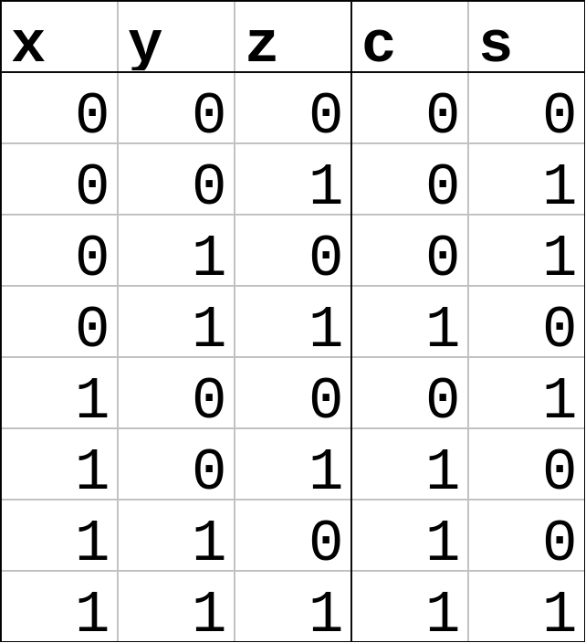
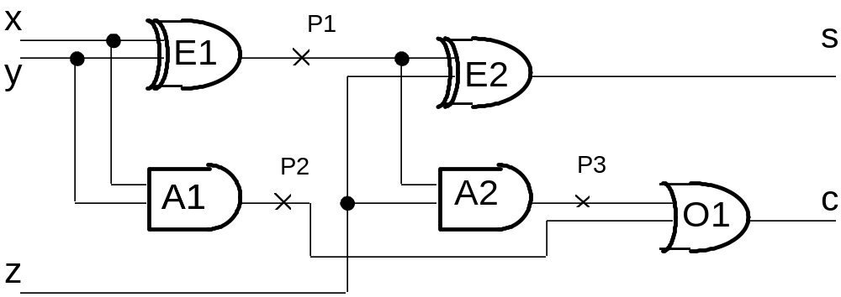
Symbolic & Sub-symbolic Representation
Consider the simulation of a full adder

Slide 3
Naïve Symbolic Representation
Rules representing behaviour of components
If (x = true and y = false) or
(x = false and y = true)
Then
p1 = true
If (p1 = true and z = false) or
(p1 = false and z = true)
Then
S = true
• • •
Explicit representation of the causal interactions within the system.

Slide 4
same as in Mycin
IF: (1) the stain of the organism is gram-positive, and
(2) the morphology of the organism is coccus, and
(3) the growth conformation of the organism is
clumps.
THEN
there is suggestive evidence(0.7) that the identity of
the organism is staphylococcus.
PREMISE: ($AND (SAME CNTXT GRAM GRAMPOS)
(SAME CNTXT MORPH COCCUS)
(SAME CNTXT CONFORM CLUMPS)
ACTION: (CONCLUDE CNTXT IDENT STAPHYLOCOCCUS TALLY .7)
Main disadvantage of symbolic representation is figuring out these causal interactions.

Slide 5
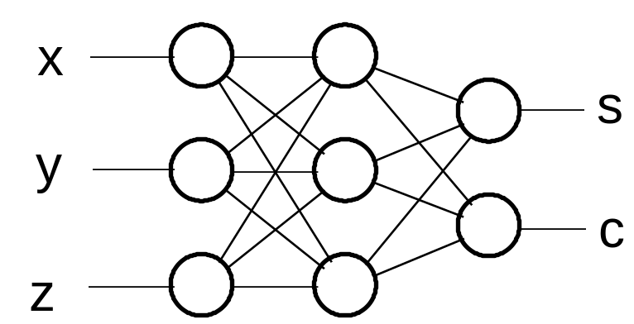
Neural Network (Connectionist) Alternative
sub-symbolic (what does this mean?)
learns behaviour from examples.
no explicit representation of causal interactions.
representation is distributed or sub-symbolic

Slide 6
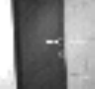
NN for recognising Doors
Trained with 80 images of doors and 80 images of non-doors.

Slide 7
NN for recognising Doors
Image is 32x30 ➔ 960 unit in input layer
4 units in hidden
Hidden
Output
Input

Slide 8
Other ANN applications
Predicting financial time series
  www.predictiondynamics.com
Decision support in medicine
  Predicting outcome in IVF
  Child with bronchiolitis: keep in overinght?
  Diagnosing heart disease

Slide 9
www.hnc.com
Detect and Manage Credit Card Fraud HNC Falcon Fraud Manager For CNP Transactions is the most intelligent credit card fraud detection and risk management solution available to telecommunications carriers today. It can reduce your fraud risk and enable you to accept more valid orders by detecting card-not-present (CNP) credit card fraud quickly and accurately.
For example, a new wireless subscriber may visit your Web site, sign up for service activation and a new phone, and pay for the service and equipment with a credit card. HNC Falcon Fraud Manager would be used to predict the likelihood that the transaction is fraudulent.
Created by HNC's scientists and software engineers, HNC Falcon Fraud Manager uses our proven neural network models and other predictive technologies to uncover CNP fraud in real time so you can minimize chargebacks. Today, HNC Falcon Fraud Manager is recognized as the leading global payment card fraud detection system and has saved telecommunication carriers, issuers and merchants over $300 million.

Slide 10
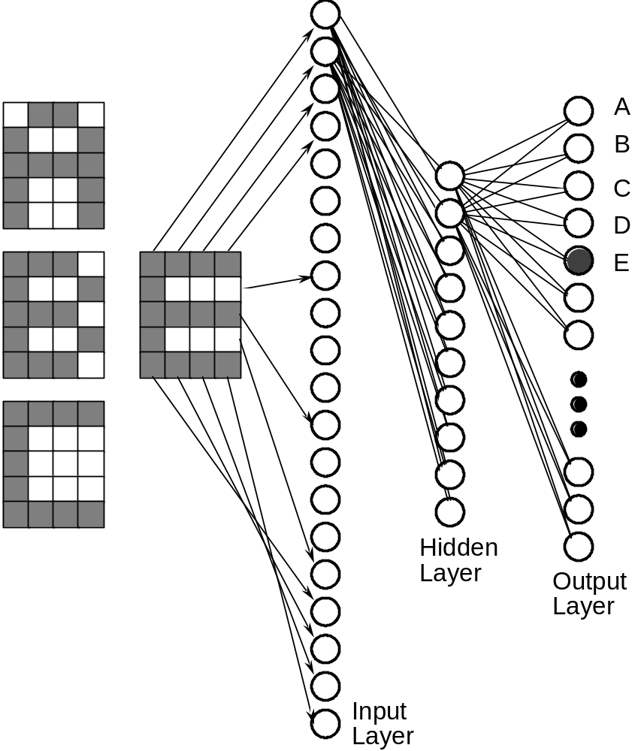
Neural Net for OCR
feedforward network
trained using Backprop

Slide 11
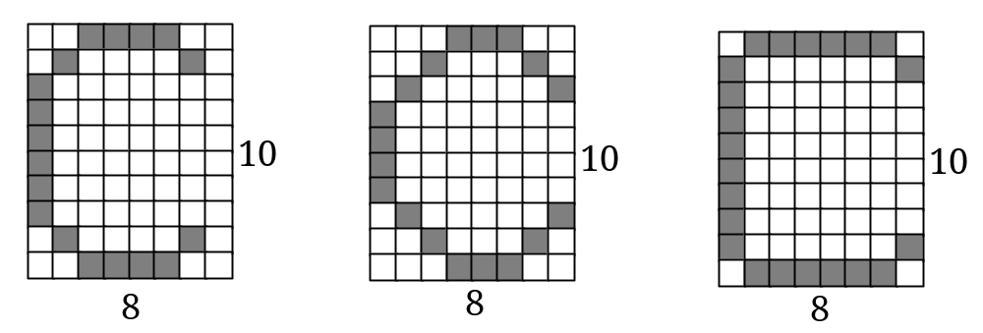
OCR of 8x10 characters
• NN are able to generalise
• learning involves generating a partitioning of the input space
• for single layer network input space must be linearly separable
? what is the dimension of this input space
? how many points in the input space
• this network is binary
• networks may also be continuous

Slide 12
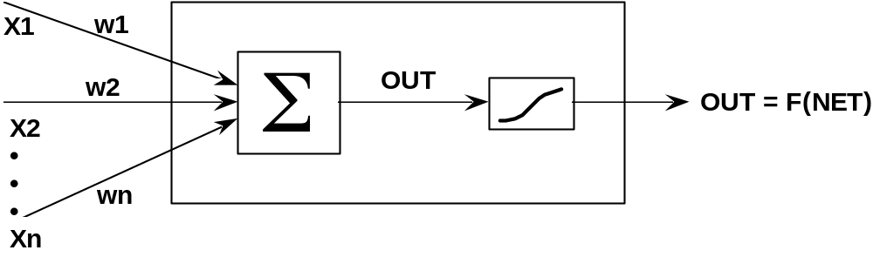
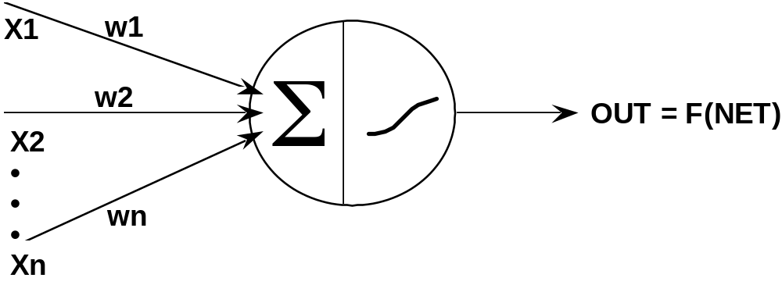
Single Layer Perceptron
Squashing function need not be sigmoidal
http://home.cc.umanitoba.ca/~umcorbe9/perceptron.html

Slide 13
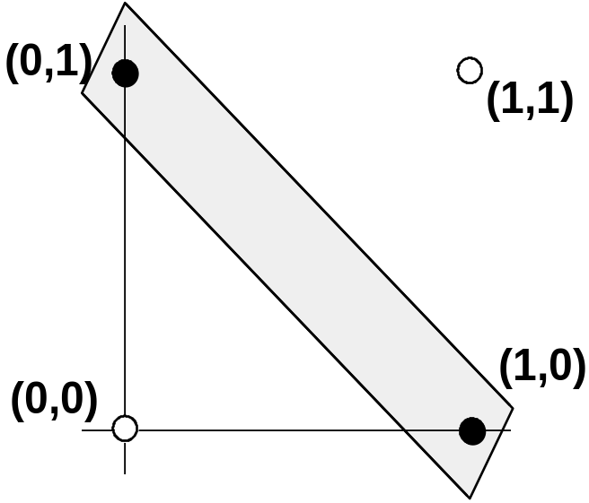
Historical Note
There was great interest in Perceptrons in the '50s and '60s
- centred on the work of Rosenblatt.
This was crushed by the publication of
"Perceptrons" by Minsky and Papert.
• EOR problem
regions must be linearly separable.
• Training Problems
esp. with higher order nets.

Slide 14
Simple Feed-forward net for Adder Problem
recognition task: classify these
0 1 0
1 0 1
Sample 0 output 0 = 0.555765
Sample 1 output 0 = 0.518783
Single layer network won't work
Add a hidden layer with 3 neurons
Sample 0 output 0 = 0.873134
Sample 1 output 0 = 0.122916
• single layer network
(no hidden layer)
• training data:-
X Y Z Sum
0 0 0 0
0 0 1 1
0 1 0 1
0 1 1 0
1 0 0 1
1 0 1 0
1 1 0 0
1 1 1 1

