Slide 1
Supervised & Unsupervised NNs
Unsupervised Learning & Clustering
Applications of Unsupervised Learning
Associative Memory
Hopfield Nets

Slide 2
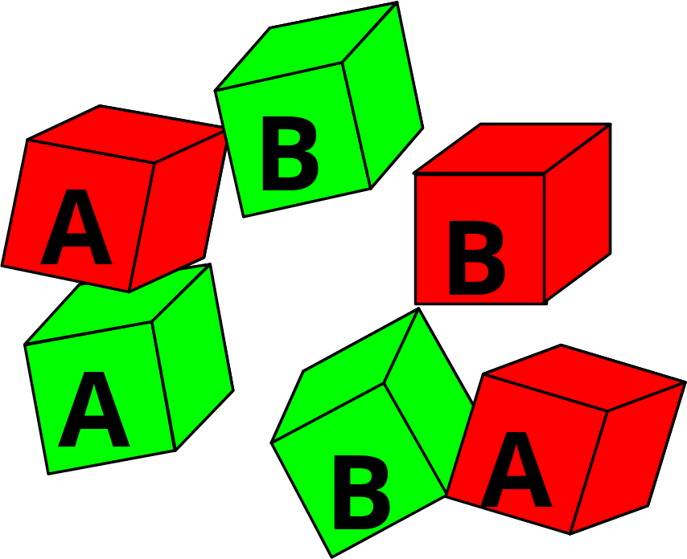
Supervised & Unsupervised Learning
Organise these blocks into classes
An un-supervised learning task

Slide 3
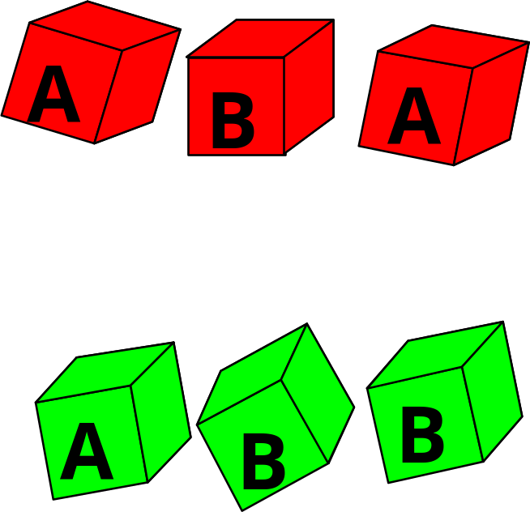
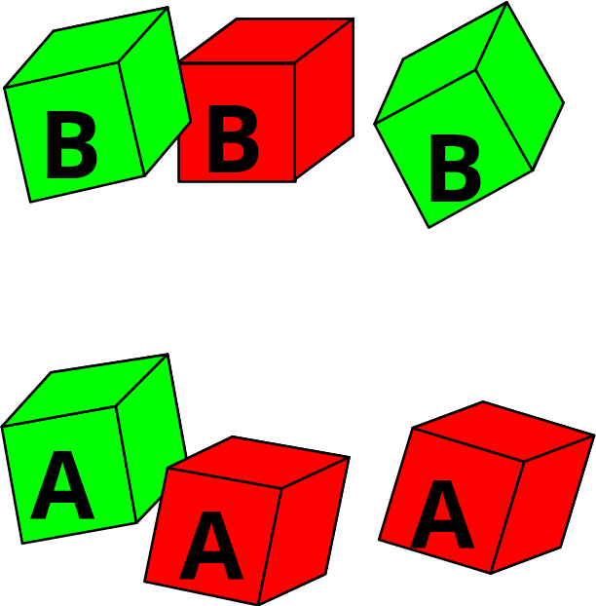
Two Possible Groupings…
No guidance on which to choose

Slide 4
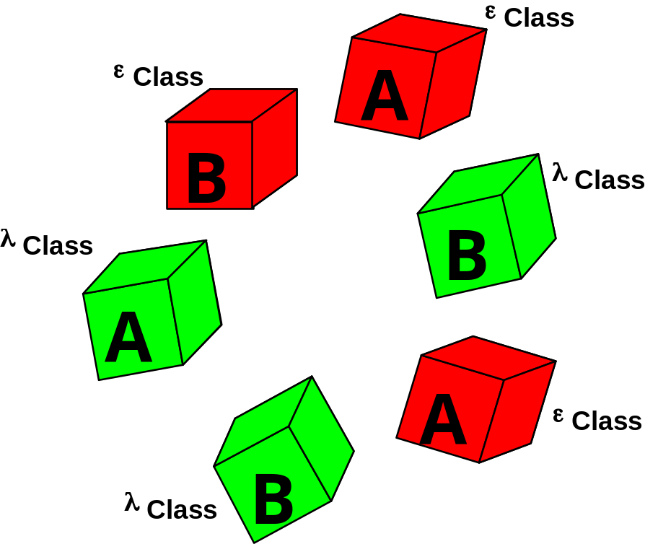

Supervised Learning
Class categories are given as side information.
From the biological perspective un-supervised learning is more important.

Slide 5
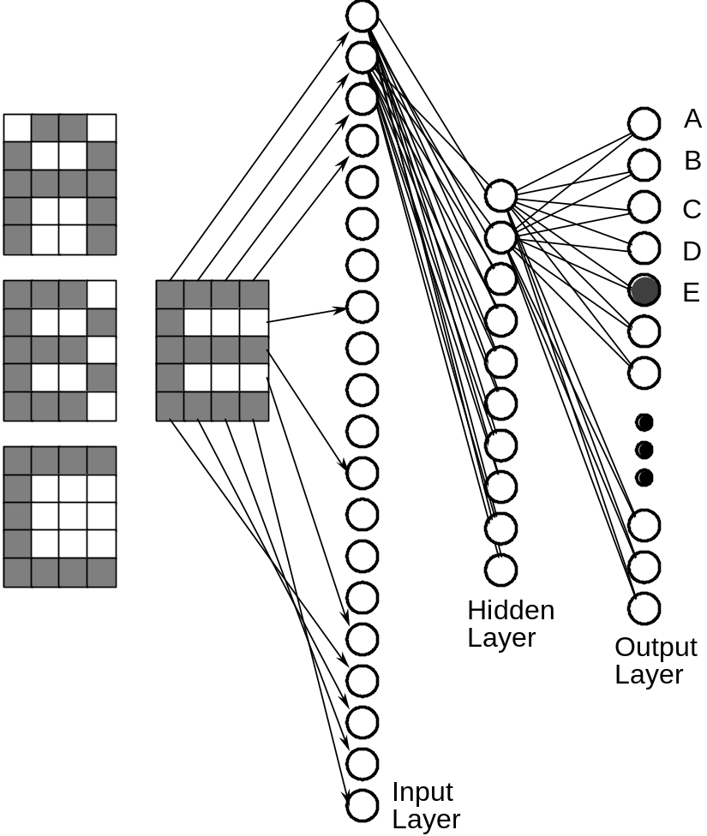
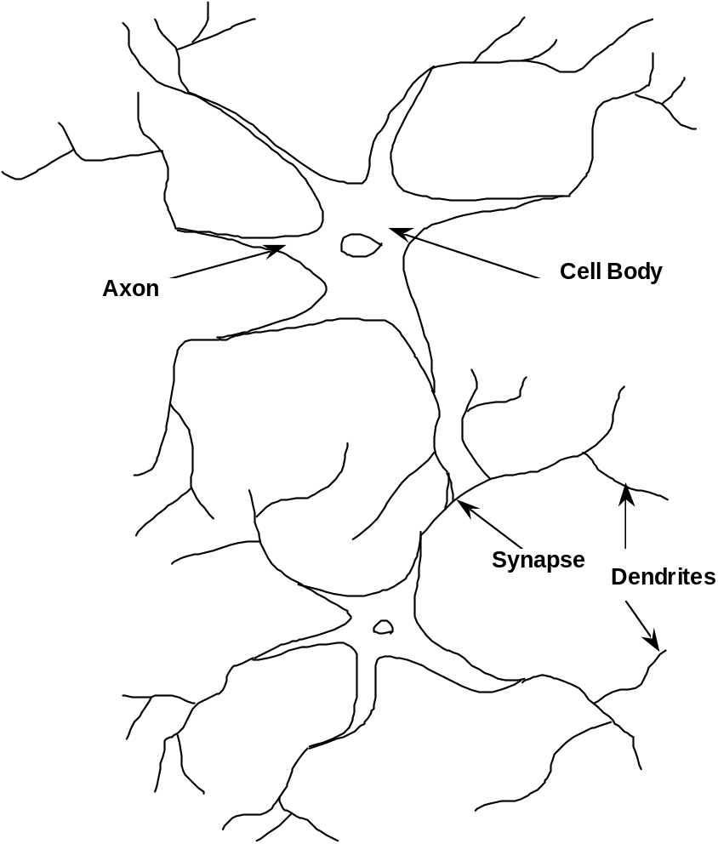
Aside on biological plausibility
V’s

Slide 6
Biological prespective
Biologically inspired Computational Model.
Human has approx. 100 billion neurons, 10¹¹
with 1000 approxdendrites each ⇒ 10¹⁴ synapses
Storage depends on number of interconnections.
Speed depends on no. of interconnects/sec.
Brain operates at about 100Hz
⇒ 10¹⁶ interconnects/ second
64K Connection Machine 1.3 x 107 con/sec
A fly operates at about 109 con/sec
Note: These figures are very approximate.

Slide 7
Task Categories
Categorisation using labelled training data to partition input patterns into a pre-specified number of groups or classes.
(eg. different vowels for a speech recogniser)
Self-organisation and category formation self-organising networks partition input examples into groups or clusters using unlabelled training data.
Associative Memory provides a complete memory item from a key consisting of a partial or corrupted version of the memory (content-addressable memory.)

Slide 8
Task Categories…
Sensory data processing in which auditory or visual
information is pre-processed at low levels as is done in the
human brain. (eg. edge detection)
Computational problems including combinatorial
optimisation.
Note: Expert Systems type problems can be formulated into
one or other of these categories (5).

Slide 9
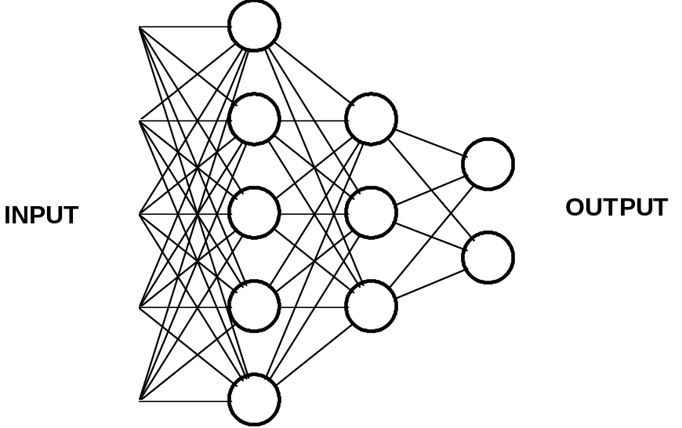
Consider particularly…
Categorisation (i.e. classification)
Self-organisation
Associative Memory
Categorisation has this
general structure
If ES problem can be cast in this format
(typically a problem of parameterisation)
and if training data is available
Then a Connectionist solution may be practicable.
(parameterisation may be difficult)

Slide 10
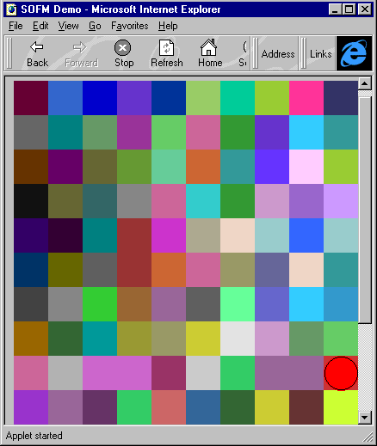
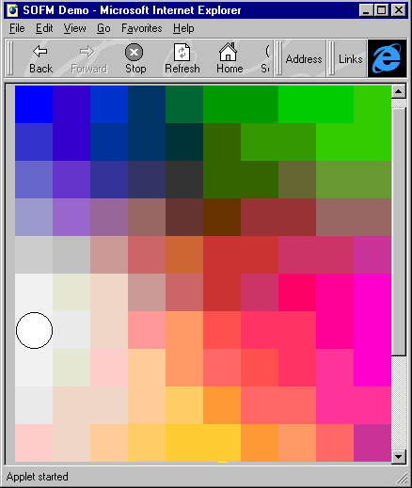
http://www.eas.asu.edu/~eee511/demos/som-color/sofm.html
This is a simple demonstration of using self-organising feature maps to project a high-dimensional space onto a lower-dimensional space - though in this case the mapping is from a 3-d rgb colour to a 2-d grid.

Slide 11
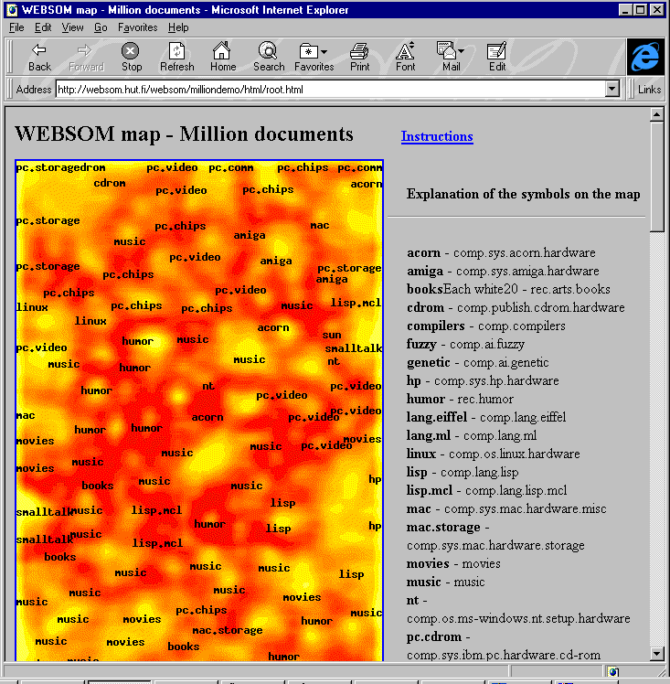
WEBSOM
Self-Organizing Map for Internet Exploration
http://websom.hut.fi/websom/

Slide 12
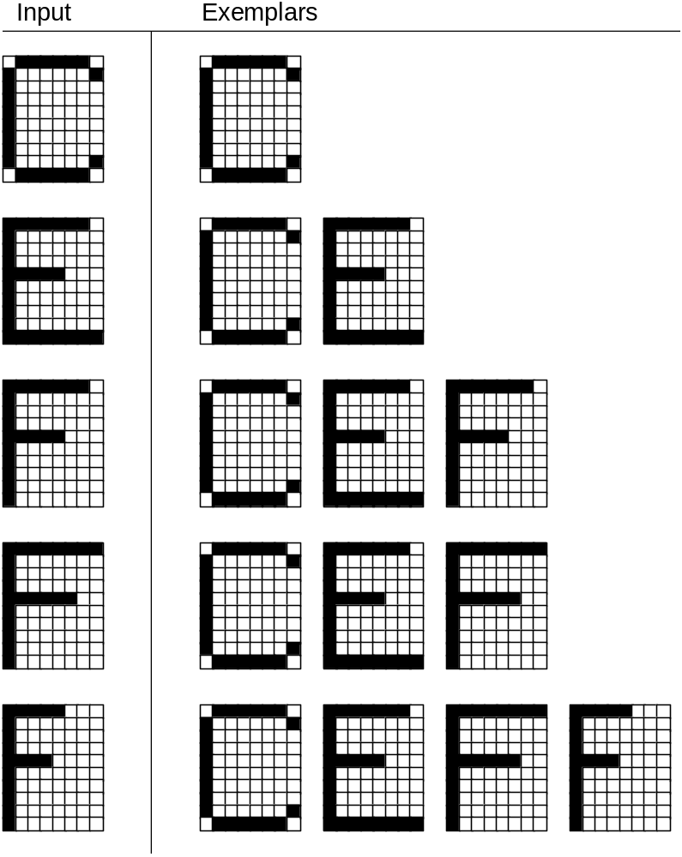
Self-organisation as clustering
Vigilance threshold controls creation of new clusters.
Vigilance set to 0.9 in this case.

Slide 13
FuzzyART
Test Data
0.1 0.1 0.9 p1
0.9 0.9 0.1 p2
0.1 0.1 0.8 p3
0.9 0.9 0.1 p4
$ artf -l -n 4 -B 1.0 -R .97
Opened gen.train in learning mode
Pattern - p1 Classified in group 0
Pattern - p2 Classified in group 1
Pattern - p3 Classified in group 0
Pattern - p3 Classified in group 2
Pattern - p4 Classified in group 1
If we drop R (rho) to .96 p3 stays in group 0
**Note: classification is also very sensitive to B (beta)

Slide 14
Plagiarism Detection using NNs
to d wi ud sy r do fo if wh re el ca sw
---------------------------------------
19 6 19 17 9 2 0 6 37 6 39 8 0 0 s01
9 4 20 11 10 6 1 2 35 10 11 7 13 1 s02
15 4 17 7 9 0 0 1 28 11 2 18 0 0 s03
9 5 35 11 13 2 0 1 40 8 5 27 0 0 s04
39 6 39 13 13 0 0 19 52 9 21 38 0 0 s05
9 4 19 10 10 1 0 2 32 10 17 18 0 0 s06
3 6 22 13 15 1 3 28 46 11 37 12 9 1 s07
3 7 24 18 19 2 0 7 32 11 7 15 2 1 s08
9 6 31 14 12 1 1 14 56 8 22 41 0 0 s09
24 4 24 9 10 0 0 1 8 10 3 1 0 0 s10
8 4 10 4 10 0 0 0 25 18 16 14 0 0 s11
25 7 25 13 10 0 4 5 38 6 13 20 15 5 s12
4 8 17 15 12 2 0 7 25 2 4 18 0 0 s13
11 4 11 6 7 0 0 7 18 3 12 6 8 1 s14
34 4 38 8 13 2 0 2 42 21 4 25 8 1 s15
6 7 19 14 12 2 2 0 34 11 26 9 0 0 s16

Slide 15
Plagiarism Detection using Clustering
$ cluster -n 1 profiles
(These are based on square root
of sum of abs. diference?)
|-----|----> s05
-| |----> s09
| |------> s15
|------| |------> s07
|------| |-----> s10
|------| |----> s14
|-----| |----> s12
|----| |----> s04
| | |---> s02
|----| |----| ___|--> s03
| |----| |---| |--> s06
| | | |---> s11
|----| |____|---> s08
| |---> s13
|____|---> s01
|---> s16

Slide 16
Plagiarism Detection using FuzzyART
$ artf -l -n 16 -B 1.0 -R .85
Opened gen.train in learning mode
Pattern - sta01 Classified in group 0
Pattern - sta02 Classified in group 1
Pattern - sta03 Classified in group 2
Pattern - sta04 Classified in group 3
Pattern - sta05 Classified in group 4
Pattern - sta06 Classified in group 2
Pattern - sta07 Classified in group 5
Pattern - sta08 Classified in group 6
Pattern - sta09 Classified in group 4
Pattern - sta10 Classified in group 7
Pattern - sta11 Classified in group 2
Pattern - sta12 Classified in group 8
Pattern - sta13 Classified in group 6
Pattern - sta14 Classified in group 9
Pattern - sta15 Classified in group 10
Pattern - sta16 Classified in group 11
16 patterns; 12 groups
Group2: sta03, sta06, sta11
Group4: sta05, sta09
Group6: sta08, sta13

Slide 17
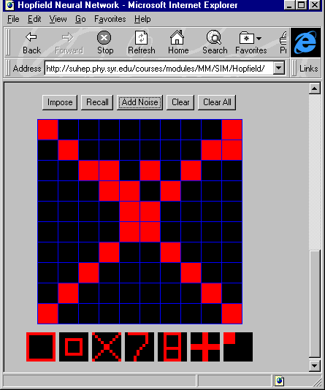
Hopfield Net in Java
http://suhep.phy.syr.edu/courses/modules/MM/SIM/Hopfield/

Slide 18
Hopfield Net in Java
Squares represent artificial neurons -- black indicates a non-firing neuron, red a firing neuron. Select a pattern by left-clicking on a set of squares. Right-clicking sets the neuron firing rate back to zero. Once selected the memory can be stored in the net by clicking on the impose button. You can store up to 8 such patterns.
You can pick up one of the stored patterns by clicking on its miniature image. Try adding noise to the image by clicking on the noise button. Alternatively change the pattern by clicking on some more squares. You can think of this changed pattern as analogous to a partial memory or a corrupted memory. See if the network can find the true memory by clicking on the recall button. You may need to do this more than once to achieve full memory recall. You should see that the neural network can automatically relax its activity on to a stored pattern even for a rather noisy first image.

Slide 19
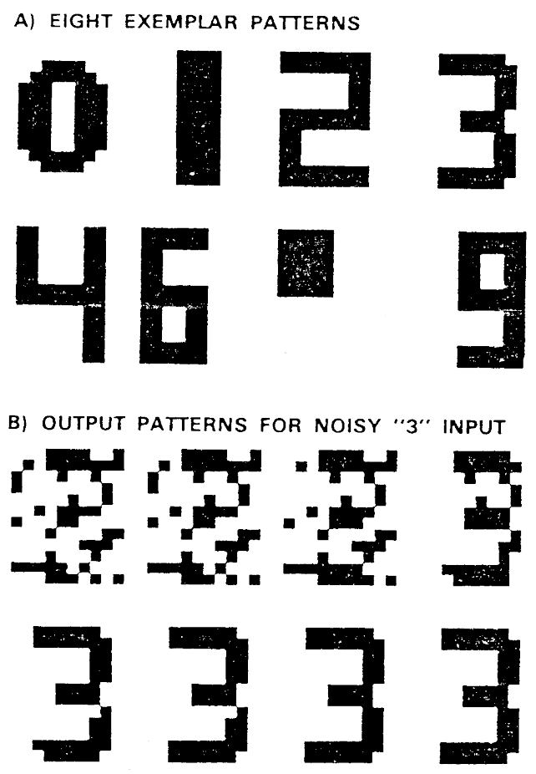
Autoassociative Memory
Content-Addressable Memory
Fault Tolerance
Distributed Representation ?
120 node net
  14,400 weights
  .25 probability of corruption
  first seven iterations

Slide 20
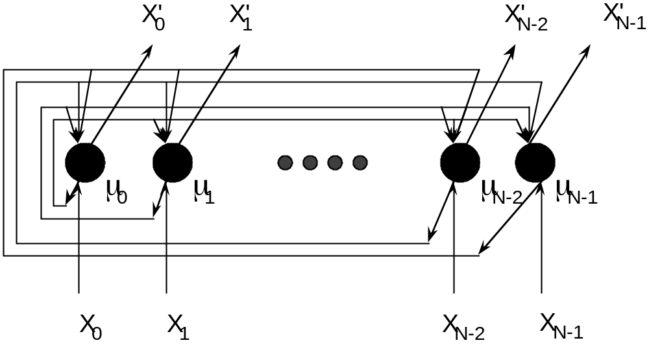
Hopfiled Net
Typically, number of classes must be
  < 0.15 N

Slide 21
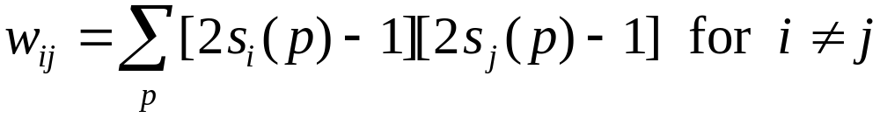
Algorithms for Discrete Hopfield Net
To store a set of binary patterns
s(p) = (s₁(p),...,s_{i}(p),...sn(p)),
the weight matrix W = {w_{ij}} is given by
and w_{ii} = 0.
This is essentially Hebbian learning

Slide 22
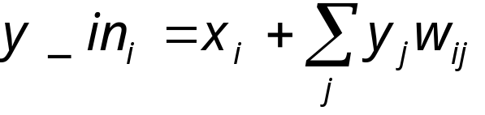
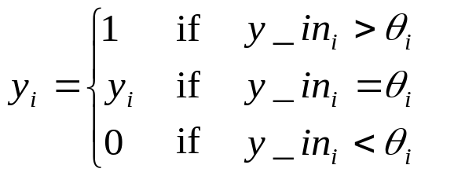
Hopfield
Application Algorithm
The net should associate x with one of the trained patterns s.
Step 0. Initialize weights to store patterns.
While activations of the net are not converged, do Steps 1-7.
Step 1. For each input vector x, do Steps 2-6.
Step 2. Set initial activations of net equal to the external
input vector x:
y_{i} = x_{i},(i = 1, . . . ,n)
Step 3. Do Steps 4-6 for each unit Y_{i}.
(Units should be updated in random order.)
Step 4. Compute next input:
Step 5. Determine activation (output signal):
Step 6. Broadcast the value of y_{i} to all other
units(this updates activation vector).
Step 7. Test for convergence

Slide 23
Summary
3 main types of ANN
  Supervised (classification & regression)
    Simple perceptron
    Multi-layer feedforward NN (backprop)
  Self-organising nets
    SOM
    FuzzyART
  Autoassociative nets
    Hopfield

