Slide 1
Feed-forward Neural Nets
Practical applications
Getting Feed-froward NNs to work
Overfitting
Ensemble techniques

Slide 2
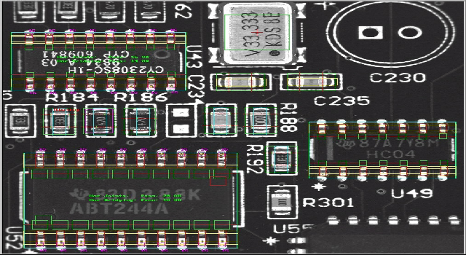
e.g. MVT
Machine Vision for inspection of PCBs
  components present or absent
  solder joints good or bad

Slide 3







Components present?
Absent
Present

Slide 4
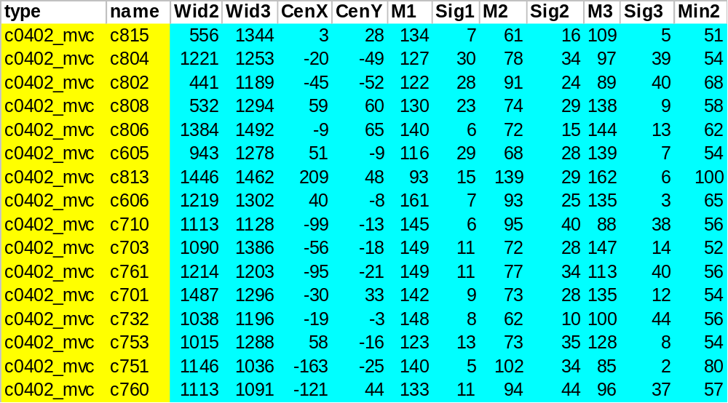
Characterise image as a set of features

Slide 5
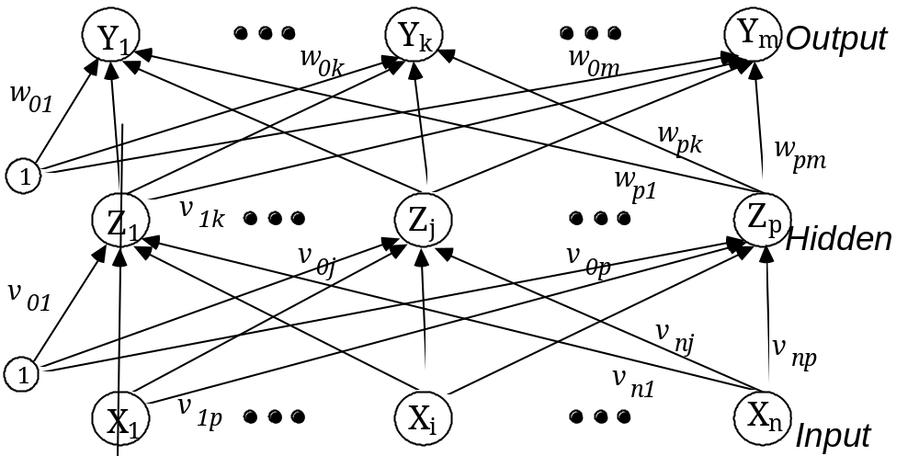
Back-propagation training
  1. Initialize Weights and Offsets
  2. Present Inputs and desired Output
  3. Calculate Actual Output
  4. Adapt Weights
  5. Repeat from 2

Slide 6
Tuning
How many units in the hidden layer?
  Assume just one hidden layer
What learning rate (α)?
What momentum?
When should training stop?
  Based on error?
    What about overfitting?
You need to search this space of models to find the best model.

Slide 7
Beware of Overfitting
Error
Generalisation
error
In-sample
error
Training time

Slide 8
Avoiding Overfitting
‘Hold-out’ validation
  hold back some data from training
  stop training when performance of this data starts to deteriorate
  loose data from training process
Training data
Validation data
Available data

Slide 9
k-Fold Cross Validation
Divide data into k sets
Train k nets using different sets of data for training and validation
Determine
  generalisation error
  assoc. training error
  assoc. number of epochs
Train using all data
  use epochs or tr. error to stop
Error
Generalisation
error
In-sample
error
Training time

Slide 10
Ensemble techniques
Neural Networks are high variance predictors.
Build several networks
  different training subsets
Aggregate results
  voting
    vote based on generalisation error
Outcome
Combiner
NNs

