Slide 1
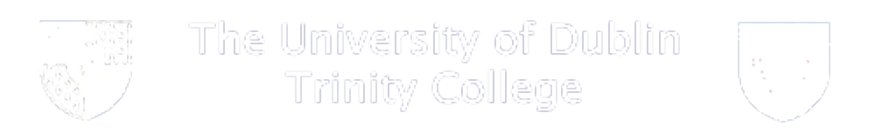
Neural Nets Summary
Feedforward Nets
(classification)
(regression)
Self Organising Nets
Associative Nets

Slide 2
Simple Perceptron
http://home.cc.umanitoba.ca/~umcorbe9/neuron.html
  Weights v’s Activations

Slide 3
Perceptron Learning
http://home.cc.umanitoba.ca/~umcorbe9/perceptron.html
  Thresholds
  Weights
  XOR

Slide 4
Backprop Learning
http://neuron.eng.wayne.edu/bpFunctionApprox/FuncApproxApplet.html
  Regression, function aproximation
  Overfitting

Slide 5
Self Organising Nets

Slide 6
Associative Nets

Slide 7
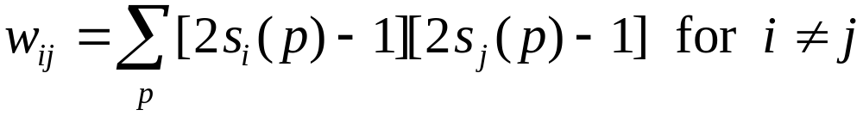
Question
Calculate the resulting weights on a 4 node Hopfield net after the following patterns have been stored.
Weight update rule
Why is this a hopeless exercise?

