Slide 1
Genetic Algorithms
Introduction
GAs and Simulated Annealing
The Biology of Genetics
The Logic of Genetic Programmes
Demo
Summary
Incorporating Slides
by Joe Sant

Slide 2
Genotypes/Phenotypes & Mutation
Genotypes are representations of the genetic sequence
Phenotypes are the physical results of the decoding of the genotype
Mutations
  A permanent change in the genetic material.
  Rare (excepting nuclear/chemical exposure).
  Most are deleterious.
  Some are beneficial.
  Can ‘refresh’ the gene pool.

Slide 3
GAs and Simulated Annealing
Simulated Annealing is Hill-Climbing with occasional reversals
Genetic Algorithms are parallel Hill-Climbing
  population of individuals
  Selection based on fitness function
  Crossover
  Mutation

Slide 4
GAs
What are they?
  Programmes which emulate the biological processes of genetic recombination, mutation, and natural selection to generate solutions to problems.
When are they used?
  Problems with massive search spaces and many parameters resulting in a combinatorial explosion of possible solutions

Slide 5
Where are They Used?
Production Management (John Deere, BP).
Credit Scoring ( UK Banks ).
Robot Vision/Machine Learning.
Network Design.
Financial applications (eg. equity trading and asset allocation.)
Picking Pub Locations (BASS)

Slide 6
How do they work?
    function GENETIC-ALGORITHM(population, FITNESS-FN)
    returns an individual
    inputs: population, a set of individuals
    FITNESS-FN: a fn. that measures the fitness of an individual
    repeat
    parents ← SELECTION(population, FITNESS-FN)
    population ← REPRODUCTION(parents)
    until some individual is fit enough
    return the best individual in population, according to FITNESS-FN

Slide 7
GA details
Individuals are usually represented by a bit string
  This is often the tricky bit
The best individuals contribute most to the next generation
Most change is achieved by crossover, little by mutation

Slide 8
The Biology of Genetics.
Members of same species share similar sets of genes.
Two members of the same species mate to recombine specific areas of their chromosomes into a new genotype.
Progeny (phenotypes) will survive based on their fitness for the environment. Fit individuals are more likely to produce offspring than less fit individuals (natural selection).
Over time less beneficial genes are eliminated from gene pool because progeny with these genes compete less successfully and therefore produce less progeny.

Slide 9
Biology of Genetics
A gene pool is the sum total of ‘functional units’ of all chromosomes of the system.
A genotype is the genetic pattern which encodes for a specific trait or set of traits.
Gene Diversity - Maintaining a diversity of solutions to a wide variety of problems.
Natural Selection - Culling phenotypes which are less fit to survive the environment.
Recombination - Combining discrete features (genes) of different solutions (chromosomes) in order to come up with superior solutions.

Slide 10
Mutations.
A permanent change in the genetic material.
Rare (excepting nuclear/chemical exposure).
Most are deleterious.
Some are beneficial.
Can ‘refresh’ the gene pool.

Slide 11
Recombination--Crossover
Genotype 1
Genotype 2
New Genotypes

Slide 12
GAs: What We Need?
Decide how to determine fitness of a solution
A method for selecting individuals from population for crossover or mutation
Decide how to represent a solution
  Choose a technique for mutating chromosomes
  Choose a technique to enable crossover
Choose a technique to reinsert children into population.

Slide 13
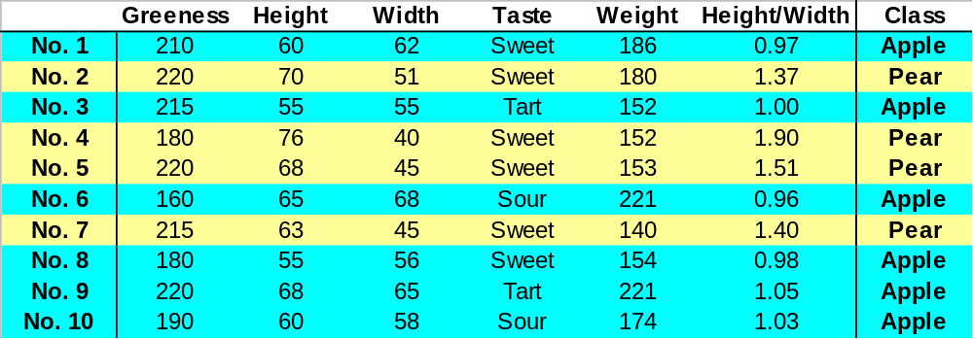
Consider the Feature Selection problem
What is the best feature subset to use?

Slide 14
Fitness Evaluation.
Maximum of function.
  Magnitude of Y value.
Schema to Predict the Dow Jones.
  Quality of Match with Historical Values.
Generating Schedules.
  Complex evaluation function to determine the quality of the generated schedule.

Slide 15
Selection – Roulette Wheel
Want to maintain an element of randomness but ‘fix’ the selection so that fitter individuals have better odds of being chosen.
Assign slots on a roulette wheel proportionate to each individuals fitness.
Generate a random number to select a slot on the wheel (spin the wheel).
Determine which individual occupies that slot of the wheel.
Choose that individual.

Slide 16
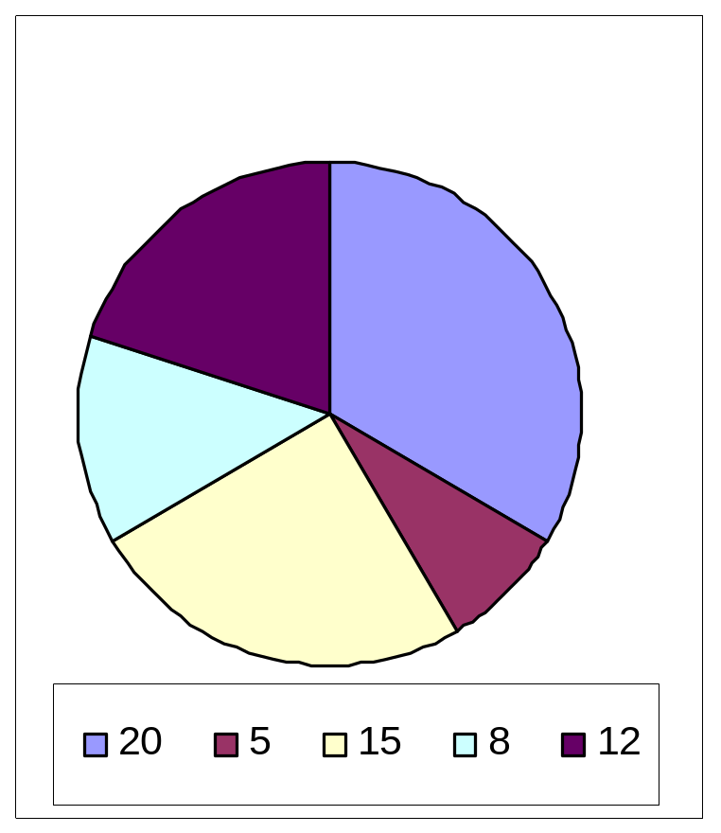
Roulette Wheel -Example
Chromosome Fitness
------------------------
10110110 20
10000000 5
11101110 15
10010011 8
10100010 12

Slide 17
Roulette Wheel -Example
Random
Numbers Father Mother
44, 31 10010011 11101110
5, 32 10110110 11101110
49, 3 10100010 10110110
18, 27 10110110 11101110
22, 54 10000000 10100010

Slide 18
Cross-Over Example
ORIGINAL
individual 1 0 1 1 1 0 0 1 1 0 1 0
individual 2 1 0 1 0 1 1 0 0 1 0 1
CROSSOVER POINTS 2 6 10
AFTER CROSSOVER
offspring 1 0 1| 1 0 1 1| 1 1 0 1 | 1
offspring 2 1 0| 1 1 0 0| 0 0 1 0| 0

Slide 19
What do we do with Progeny?
Must re-insert them back into population.
Candidate strategies
  replace the worst individual in the population.
  replace a randomly chosen individual.
  Select a random subset of chromosomes and replace the worst of that subset.

Slide 20
Schemata and Recombination.
1
1
0
Schema are subsets of genes in a chromosome that have some determinable affect on fitness.
Crossover can disrupt schema.
The more spread out schema are and the more genes they entail, the higher the probability that will be disrupted.

Slide 21
Building Blocks.
BUILDING BLOCK: (EC) A small, tightly clustered group of GENEs which have co-evolved in such a way that their introduction into any CHROMOSOME will be likely to give increased FITNESS to that chromosome.
The "building block hypothesis" [GOLD89] states that GAs find solutions by first finding as many BUILDING BLOCKs as possible, and then combining them together to give the highest fitness.

Slide 22
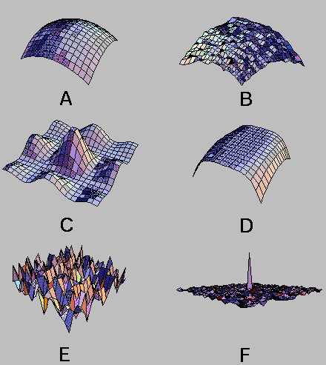
Special
Problems:
Solution
Spaces
http://www.cwp.mines.edu/html_reports/coool/node3.html

Slide 23
Demos
Complex cost functions
http://www.oursland.net/projects/PopulationExperiment/
TSP
http://cs.felk.cvut.cz/~xobitko/ga/

Slide 24
Summary
Genetic Algorithms mimic evolution and genetics.
Used for problems with large search spaces.
Computational Intensive.
Parallelisable

