Slide 1
Naïve Bayes Classifier
Bayes Theorem
Naïve Bayes: Assume Independence
Examples
Text Classification
Numeric Attributes

Slide 2
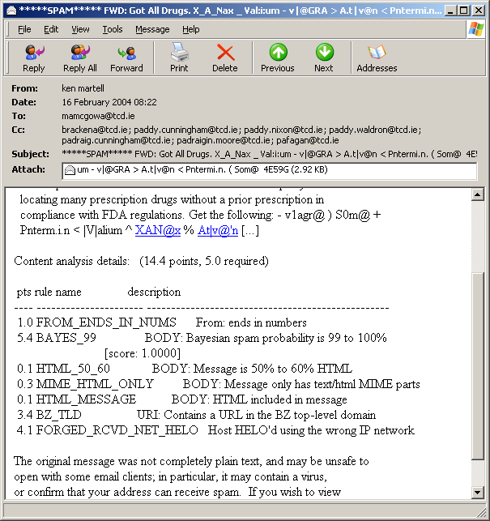
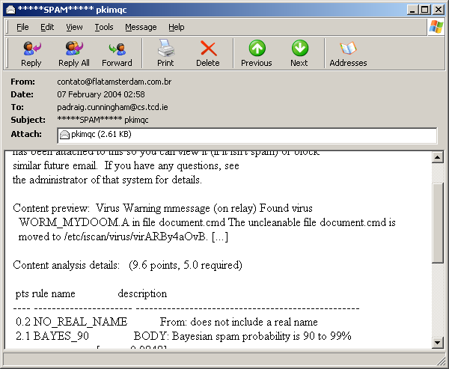
Spamassassin uses Naïve Bayes
How does it work?

Slide 3
Some Notation
Probability of a hypothesis h being true, given the observed data D
P(h) Probability of the hypothesis
  (prior probability)
P(D) Probability of the Data
P(h|D) Probability of the hypothesis given the Data
  (posterior probability)

Slide 4
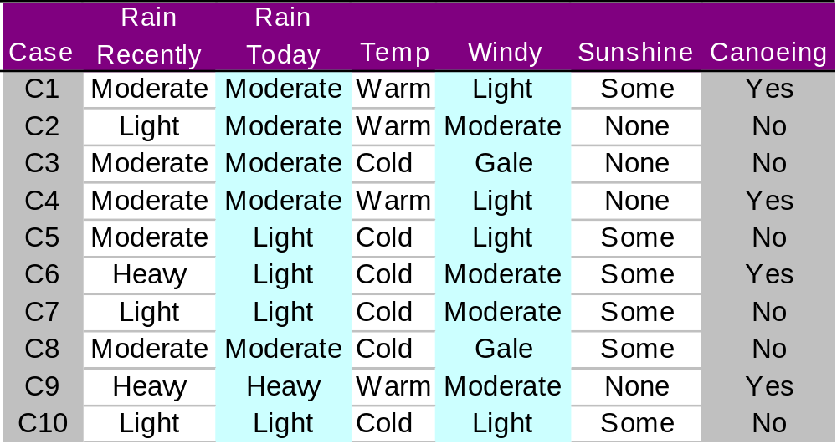
Naïve Bayes Classifier for Canoeing
P[C] =?
P[M-RR|C]=?

Slide 5
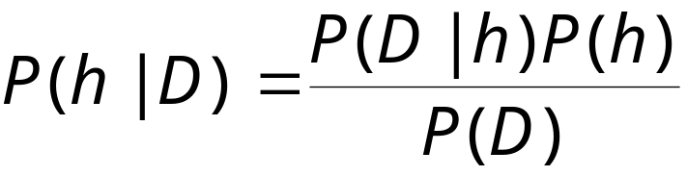
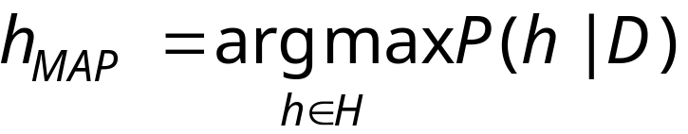
Maxium Aposteriori Hypothesis
For each h in the hypothesis space
The Maximum Aposteriori Hypothesis (MAP) is

Slide 6
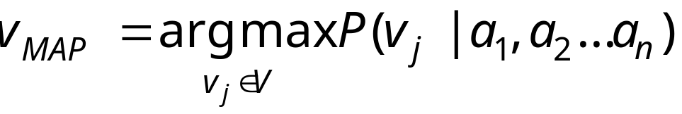
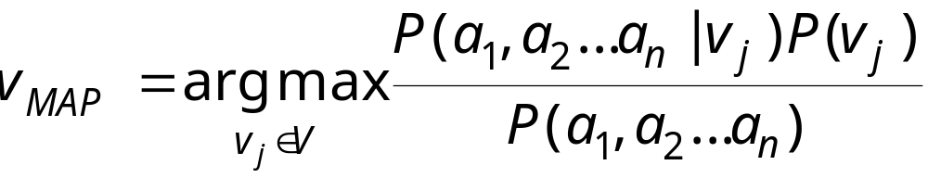
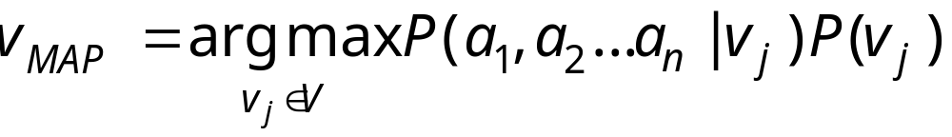
Naïve Bayes Classifier
Classification task: which v∈V
For an example with attribute values < a₁, a₂,… a_{n}>

Slide 7
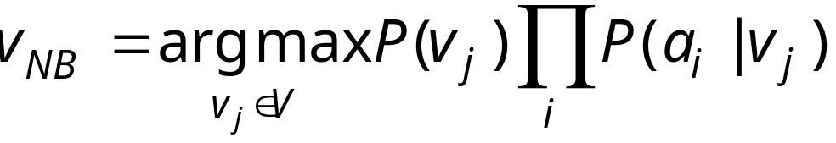
Naïve Bayes Classifier
If we assume the attributes are independent (a big assumption!)

Slide 8
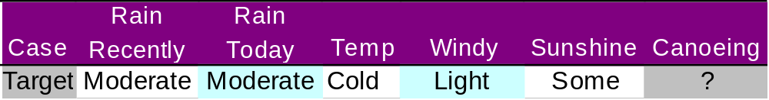
Naïve Bayes Classifier for Canoeing
P[C] =4/10
P[L-RR|C]=0/4
P[M-RR|C]=2/4
P[H-RR|C]=2/4
P[L-RT|C]=1/4
P[M-RT|C]=2/4
P[H-RT|C]=1/4
P[C-T|C]=1/4
P[W-T|C]=3/4
P[L-W|C]=2/4
P[M-W|C]=2/4
P[G-W|C]=0/4
P[S-S||C]=2/4
P[N-S|C]=2/4
P[C]= 2/4 × 2/4 × 1/4 × 2/4 × 2/4 × 4/10
=0.00625

Slide 9
Naïve Bayes Classifier for Canoeing
P[NC] =6/10
P[L-RR|NC]=3/6
P[M-RR|NC]=3/6
P[H-RR|NC]=0/6
P[L-RT|NC]=3/6
P[M-RT|NC]=3/6
P[H-RT|NC]=0/6
P[C-T|NC]=5/6
P[W-T|NC]=1/6
P[L-W|NC]=2/6
P[M-W|NC]=2/6
P[G-W|NC]=2/6
P[S-S|NC]=4/6
P[N-S|NC]=2/6
P[NC]= 3/6 × 3/6 × 5/6 × 2/6 × 4/6 × 6/10
=0.028

Slide 10
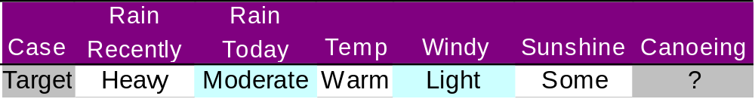
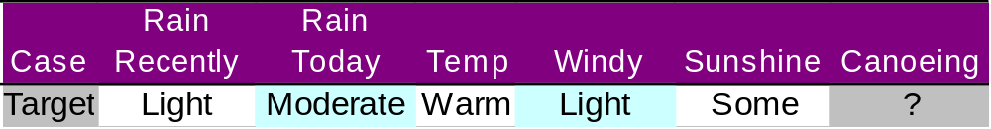
Naïve Bayes Classifier for Canoeing
P[C]= 2/4 × 2/4 × 1/4 × 2/4 × 2/4 × 4/10
=0.00625
P[NC]= 3/6 × 3/6 × 5/6 × 2/6 × 4/6 × 6/10
=0.028
Normalising
How about:
P[C]'= P[C]/(P[C]+P[NC]) = 0.18
P[NC]'= P[NC]/(P[C]+P[NC]) = 0.82

Slide 11
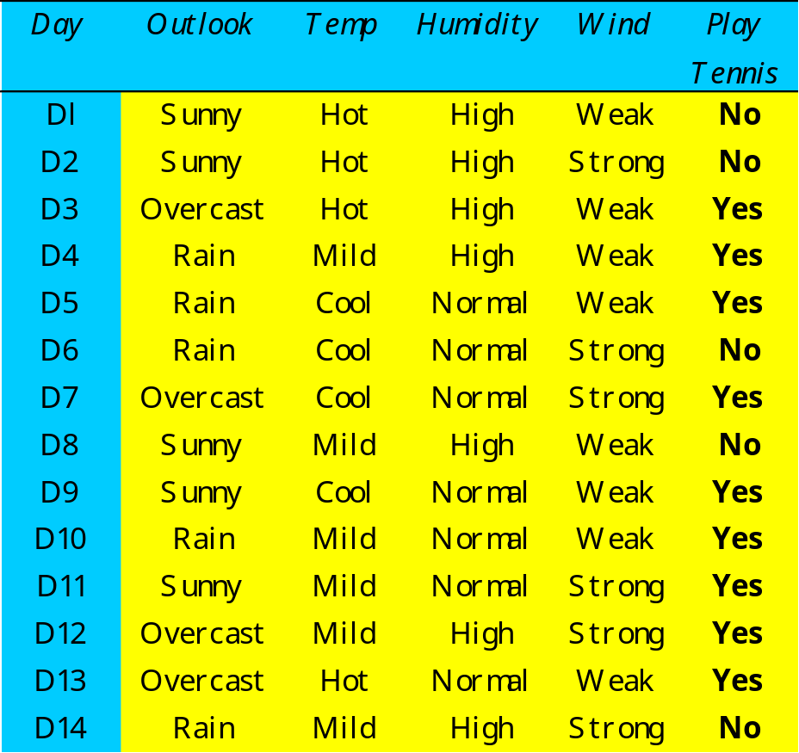
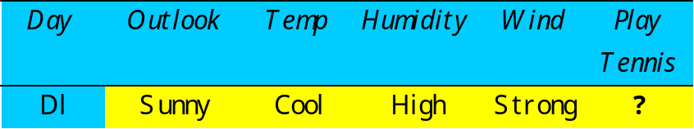
Play Tennis Example
Classify this using Naïve Bayes

Slide 12
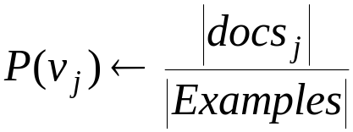
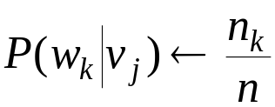
Naïve Bayes: Text Classification
Given Examples (a set of docs), V (classes, e.g. Spam, NonSpam)
Learn_Naïve_Bayes_Text (Examples, V)
Vocabulary ←set of all words in Examples
For each v_{j} in V do
docs_{j} ← subset of Examples with class v_{j}
Text_{j} ← concatenation of all docs_{j}
n ← total number of word positions in Text_{j}
For each w_{k} in Vocabulary do
n_{k} ← number of occurrences of w_{k} in Text_{j}

Slide 13
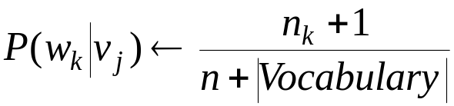
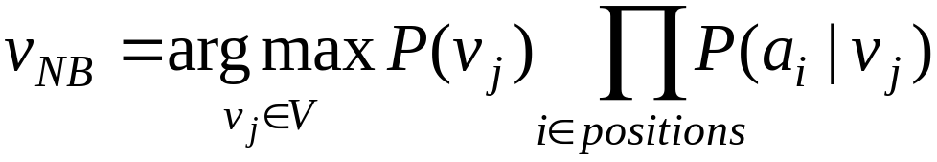
Naïve Bayes: Text Classification
Note: Mitchell proposes the following formula to address problems
with small probabilities:
Classify_Naïve_Bayes_Text (Doc)
positions ← all word positions in Doc with words from Vocabulary
Return v_{NB} where

Slide 14
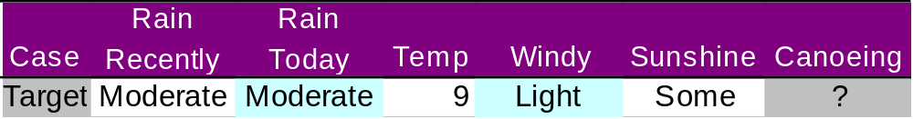
Naïve Bayes: Numeric Atts.
What if Temp were Numeric?
It could be discretised
Or it could be assumed to fit some distribution
  e.g. Normal Distribution
    For numeric att a_{i}: store μ_{i} and σ_{i} for each v_{j}
    In classification: find prob. that value fits this distribution.

Slide 15
Summary
Bayes Theorem
Naïve Bayes: Assume Independence.
Examples
Text Classification
Numeric Attributes

