Slide 1
TeleBand
Semtex Solutions Ltd.
Vivian Hunt
Stephen Kealy
Conall O’Brien

Slide 2

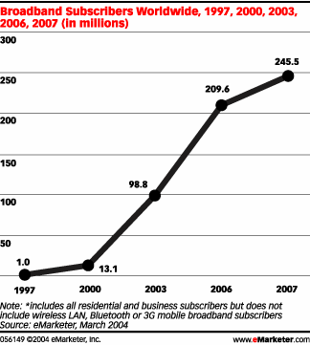
Broadband Internet
Established Technologies (DSL, Cable, Fibre Optics)
Emerging Technologies (Wireless)
Widely available (100 Million subscribers worldwide according to EMarketer by end of 2004)
Increasing popularity, competitively priced, increasing in speed

Slide 3
Broadband’s Qualities
Extensive multimedia usage - video calls, high quality music, high quality video, content on demand.
Real time updates (news, weather, stocks, websites)
Very high speed data transfer with increasing speed and improved services.
Large number of broadband providers.
- Esat BT
- Eircom
- Smart Telecom
- Irish Broadband
74% of Web users have viewed online video at least once; 51% do so a minimum of once a month; 27% watch streaming video at least once a week; and 5% view Web video streams daily, according to Online Publishers Association.
As of yet, there are no television on demand services, let alone TV/Movie media content providers.

Slide 4
Our Product - TeleBand
TeleBand is a hardware and software solution to high quality media entertainment. It comes with a digital convertor and decryptor for use with television. It also has a complete media environment software package for use of the service on a personal computer.
Features of TeleBand are:
Digital TeleBand Box
Connects directly to a TV and internet connection
Universal Remote Control
Full media playing software
On demand television programmes
On demand video download

Slide 5
Our Product - TeleBand
And More features:
Store and archive video and television content
Fully compatible with existing media formats ( Mp3, DivX, XviD, mpeg)
DRM prevents purchased content being copied or pirated
Utilise broadband without a computer.
View regular television stations ( RTE, TV3, BBC, Channel 4)
Digital Television service available ( Subscription to Digital TV provider necessary )
Payment for this service is per user consumption.

Slide 6
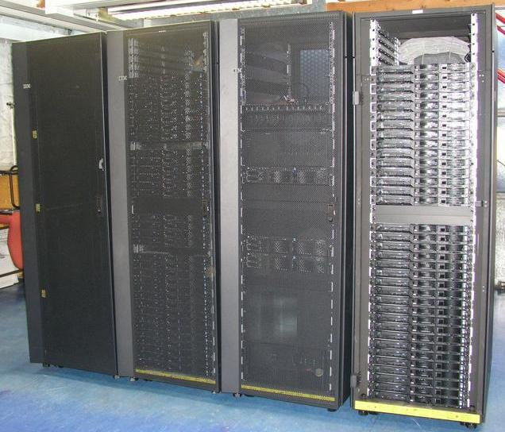
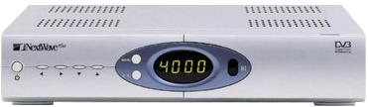
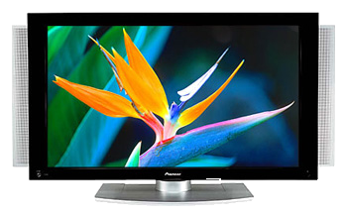
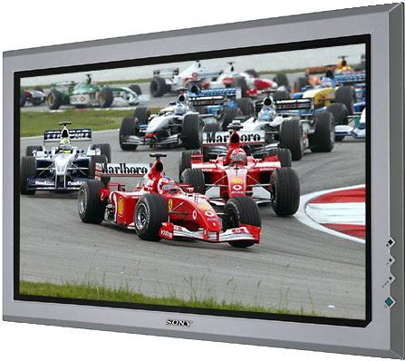
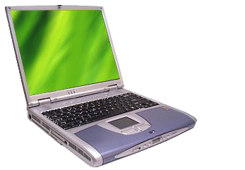
How It all works
TeleBand Servers
Box & TV
TeleBand
Software
Box & TV

Slide 7
New Technology?
Digital Rights Management = DRM
Existing multimedia formats (mp3, ogg, mpeg, DivX, XviD, etc) are not supported by content providers
  No DRM, content easily copied and pirated
Marketable formats (AAC, WMA, WMA, etc) all support DRM and restrict digital copying and prevent piracy
  Large ammounts of content available and being marketed
We will use a new DRM based format
  Content providers agree to provide content once protection is guaranteed
  Users gain access to huge archives of video footage, all available on demand. Users pay for what they view in a bill.
  Content is encrypted and compressed, then sent to the user and is decompressed and decrypted using the users private key.

