Slide 1
Introduction to AI
“Computers like the ones in the movies”
Objective: Introduce issue of representation in AI then look at some of the philosophical debates about AI.

Slide 2
Overview
Strong AI
Eliza
The Turing Test
Physical Symbol System Hypothesis
Symbolic AI
  Aside on connectionist AI (ANNs)
Searle’s Chinese Room

Slide 3
Strong AI
"I find it useful to distinguish what I will call "strong" AI from "weak" or "cautious" AI. According to weak AI, the principle value of the computer in the study of the mind is that it gives us a very powerful tool. For example, it enables us to formulate and test hypothesis in a more rigourous and precise fashion. But according to strong AI, the computer is not merely a tool in the study of the mind; rather, the appropriately programmed computer really is a mind, in the sense that computers given the right programs can be literally said to understand and have other cognitive states."
[Searle, 1980, Minds, Brains and Programs]

Slide 4
Eliza
Called after Eliza Doolittle of Pygmalion fame.
Developed in 1964-1966 by Joseph Weizenbaum in MIT
Models (parodies) the rôle of a Rogerian psychotherapist engaged in an initial interview with a patient. Much or the technique of the Rogerian psychotherapist involves drawing the patient out by reflecting the patient’s statements back at him.

Slide 5
Eliza
Men are all alike
IN WHAT WAY
They’re always bugging us about something or other.
CAN YOU THINK OF A SPECIFIC EXAMPLE
Well, my boyfriend made me come here.
YOUR BOYFRIEND MADE YOU COME HERE
He says I am depressed much of the time.
I AM SORRY TO HEAR YOU ARE DEPRESSED
It’s true. I am unhappy.
DO YOU THINK COMING HERE WILL HELP YOU NOT TO BE UNHAPPY
I need some help, that much seems certain.
WHAT WOULD IT MEAN TO YOU IF YOU GOT SOME HELP
Perhaps I could learn to get along with my mother.

Slide 6
Eliza
TELL ME MORE ABOUT YOUR FAMILY
My mother takes care of me.
WHO ELSE IN YOUR FAMILY TAKES CARE OF YOU
My father.
YOUR FATHER
You are like my father in some ways
WHAT RESEMBLANCE DO YOU SEE
You are not very aggressive but I think you don’t want me to notice that.
WHAT MAKES YOU THINK I AM NOT VERY AGGRESSIVE
You don’t argue with me
WHY DO YOU THINK I DON’T ARGUE WITH YOU
See the decendants of Eliza at alice.sunlitsurf.com

Slide 7
Philosophical criticisms of AI
Two categories of criticism:
  It cannot be done because ...
  It cannot be done the way ye are trying.
The danger of can’t be done arguments…
"Philosophers are forever telling scientists what they can't do, what they can't say, what they can't know, and so on and so forth. In 1844 the philosopher August Compte said that if there was one thing man would never know it would be the composition of the distant stars and planets. But three years after Compte died physicists discovered that an object's composition can be determined by its spectrum no matter how far off the object happens to be."

Slide 8
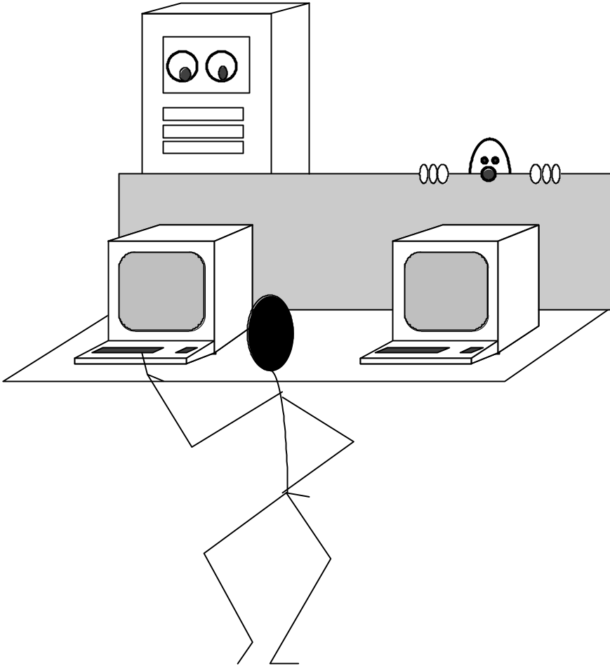
What is Intelligence?
The Turing Test
A machine can be described as a
thinking machine if it passes the
Turing Test. i.e. If a human agent is engaged in two isolated dialogues (connected by teletype say); one with
a computer, and the other with
another human and the human agent cannot reliably identify which dialogue is with the computer.

Slide 9
Objections to the TT
The Theological Objection
  "Thinking is a function of man’s immortal soul. God has given an immortal soul to every man and woman, but not to any other animal or to machine. Hence no animal or machine can think."
The “Head in the Sand” Objection
  "The consequences of machines thinking are to dreadful to think about."

Slide 10
Objections to the TT
Mathematical Objections
  "There are a number of results of mathematical logic that can be used to show that there are limitations to the power of discrete state machines.“
    (eg. Gödel’s incompleteness theorem)
The Argument for Consciousness
  “A machine cannot write a sonnet or compose a concerto because of thoughts or emotions felt.”

Slide 11
Physical Symbol System Hypothesis
A physical symbol system has the necessary and sufficient means for intelligent action
  a system, embodied physically, that is engaged in the manipulation of symbols
  an entity is potentially intelligent if and only if it instantiates a physical symbol system
  symbols must designate
  symbols must be atomic
  symbols may combine to form expressions
Newell & Simon 1976

Slide 12

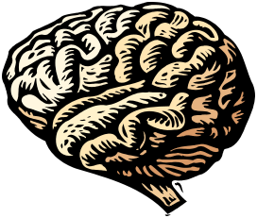
What does the PSSH mean?
Intelligent action can be modelled by a system manipulating symbols.
Nothing special about our wetware.
Intelligence can be implemented on other platforms, e.g. silicon.

Slide 13
Symbolic AI: Rule-Based Systems
Whale Watcher Demo
  http://www.aiinc.ca/demos/whale.html

Slide 14
Rule-Based System: Car Maintenance
BadElecSys:
IF car:SparkPlusCondition #= Bad Or
car:Timing #= OutOfSynch Or
car:Battery #= Low;
THEN car:ElectricalSystem = Bad;
GoodElecSys:
IF car:SparkPlugCondition #= Ok And
car:Timing #= InSynch And
car:Battery #= Charged;
THEN car:ElectricalSystem = Ok;

Slide 15
Consider the following rules
If A and B then F
If C and D
and E then K
If F and K then G
If J and G then Goal
J
A
Goal
B
F
C
G
D
K
E
  We can Forward Chain from Premises to Goals
  or Backward Chain from Goals and try to prove them.

Slide 16
A model of knowledge-based systems development
Real
World
Problem
Problem Analysis
Reasoning
System
?
Solution
Representation

Slide 17
Connectionist (Subsymbolic) Hypothesis
“The intuitive processor is a subconceptual connectionst dynamical system that does not admit a complete, formal and precise conceptual-level description.” [Smolensky 1988]
Okay, the inner workings of an ANN are difficult to interpret – but are they substantially different to a symbolic system?

Slide 18
Searle's Chinese Room
A scenario constructed by Searle as a reply to various claims at Artificial Intelligence. Chinese Room is specifically directed at Schank’s idea of
scripts but applies to claims at machine understanding in general.
Consider that :
you know no Chinese
you are confined in a room
you are given three batches of Chinese writing:-
  - the first batch is called a ‘script’
  - the second batch is called a ’story’
  - the third batch is ‘questions’ about the story
you are also given a set of rules that will allow you to generate
answers to the questions using the symbols in the script and the
story. You are also given an English story and some questions
about it

Slide 19
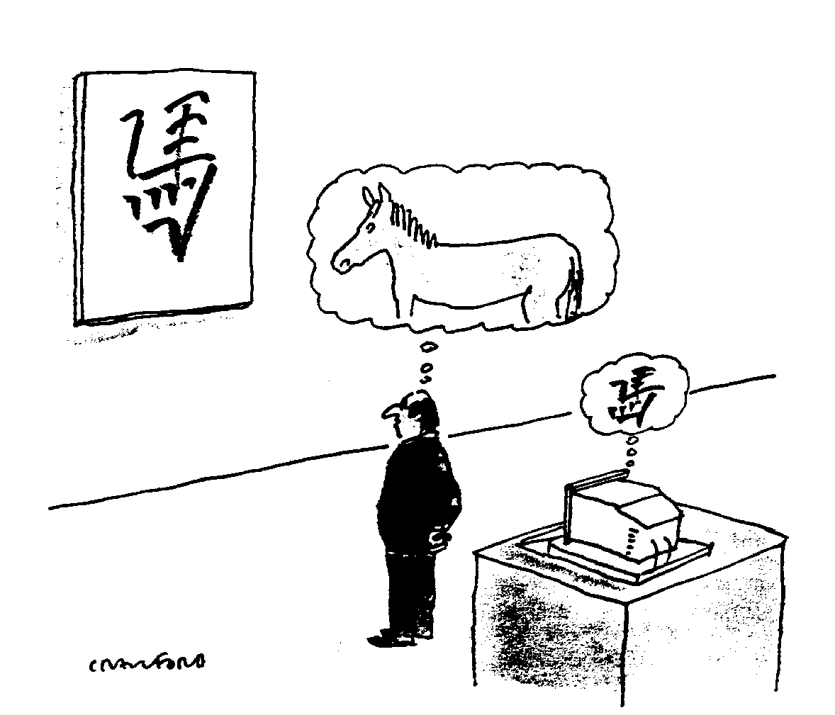
Searle's Chinese Room
  Is there any substantive difference between your
  answering on the English story and the Chinese story?
  Computer Programs are formal (syntactic)
  Human minds have mental contents (semantics)

Slide 20
Syntax and Semantics
You are presented with a deck of cards (face up and face down). Cards have a D or an A on the face side and a 4 or a 7 on the back. All cards with Ds should have a 4 on the back. How do you check this as you go through the deck?
  Turn over
    All face-up cards with Ds
  Turn over
    All face-up cards with Ds
    And all back-up cards with 4s and 7s
  Turn over
    All face-up cards with Ds
    And all back-up cards with 4s
  Turn over
    All face-up cards with Ds
    And all back-up cards with 7s

Slide 21
Syntax and Semantics
You are presented with a pile of cheques (face up and face down). You need to check to see that all cheques worth more than €50 are signed by the manager.
  Turn over
    Cheques face-up > €50
  Turn over
    Cheques face-up > €50
    & cheques back-up, signed and not signed
  Turn over
    Cheques face-up > €50
    & cheques back-up, signed
  Turn over
    Cheques face-up > €50
    & cheques back-up, not signed

Slide 22
Summary
Strong AI
Eliza
The Turing Test
Physical Symbol System Hypothesis
Symbolic AI
  Aside on connectionist AI (ANNs)
Searle’s Chinese Room

