Slide 1
Rule-Based Systems
The Physical Symbol Systems Hypothesis
What are Rule-Based Systems?
Backward Chaining

Slide 2
Physical Symbol System Hypothesis
A physical symbol system has the necessary and sufficient means for intelligent action
  a system, embodied physically, that is engaged in the manipulation of symbols
  an entity is potentially intelligent if and only if it instantiates a physical symbol system
  symbols must designate
  symbols must be atomic
  symbols may combine to form expressions
Newell & Simon 1976

Slide 3


What does the PSSH mean?
Intelligent action can be modelled by a system manipulating symbols.
Nothing special about our wetware.
Intelligence can be implemented on other platforms, e.g. silicon.

Slide 4
Rule-Based Systems: Mycin
IF: (1) the stain of the organism is gram-positive, and
(2) the morphology of the organism is coccus, and
(3) the growth conformation of the organism is clumps.
THEN
there is suggestive evidence(0.7) that the identity of
the organism is staphylococcus.
PREMISE: ($AND (SAME CNTXT GRAM GRAMPOS)
(SAME CNTXT MORPH COCCUS)
(SAME CNTXT CONFORM CLUMPS)
ACTION: (CONCLUDE CNTXT IDENT STAPHYLOCOCCUS TALLY .7)

Slide 5
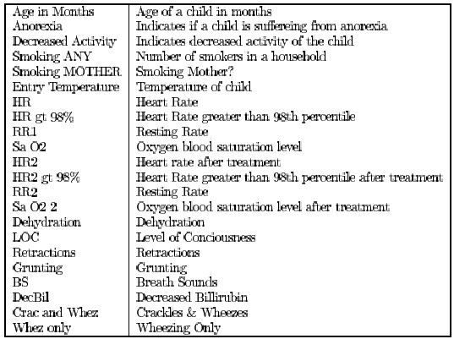
Bronchiolitis

Slide 6
Bronchiolitis
Kids presenting at an A&E with Bronchiolitis: Admit or Discharge?
If
  Age in Months > 1.87
  And SaO2 > 95.3
  And Dehydration = None
  And HR <166
Then DISCHARGE
IF
  Age in Months < 2
  And HR > 160
Then ADMIT

Slide 7
Rule-Based Systems: Dendral
IF there is a high peak at 71amu
there is a high peak at 43amu
there is a high peak at 86amu
there is any peak at 58amu
THEN
there must be an N-PROPYL-KEYTONE3
substructure

Slide 8
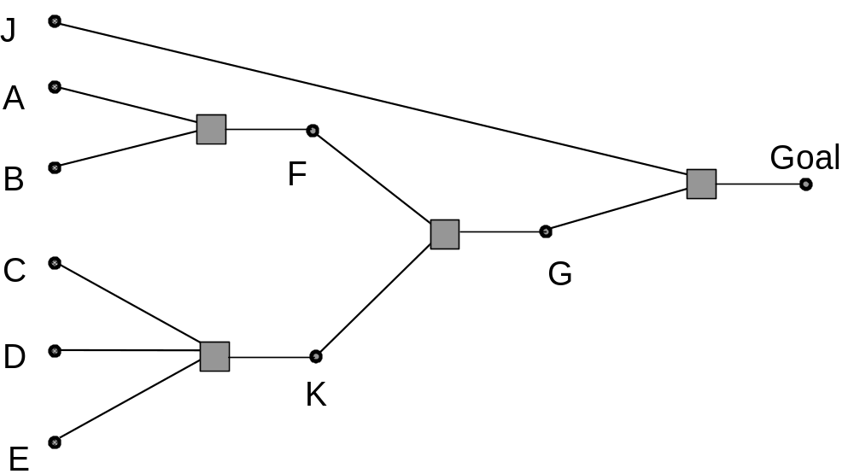
Rule-Chaining
If A and B then F
If C and D
and E then K
If F and K then G
If J and G then Goal
We can Forward Chain from Premises to Goals
or Backward Chain from Goals and try to prove them.

Slide 9
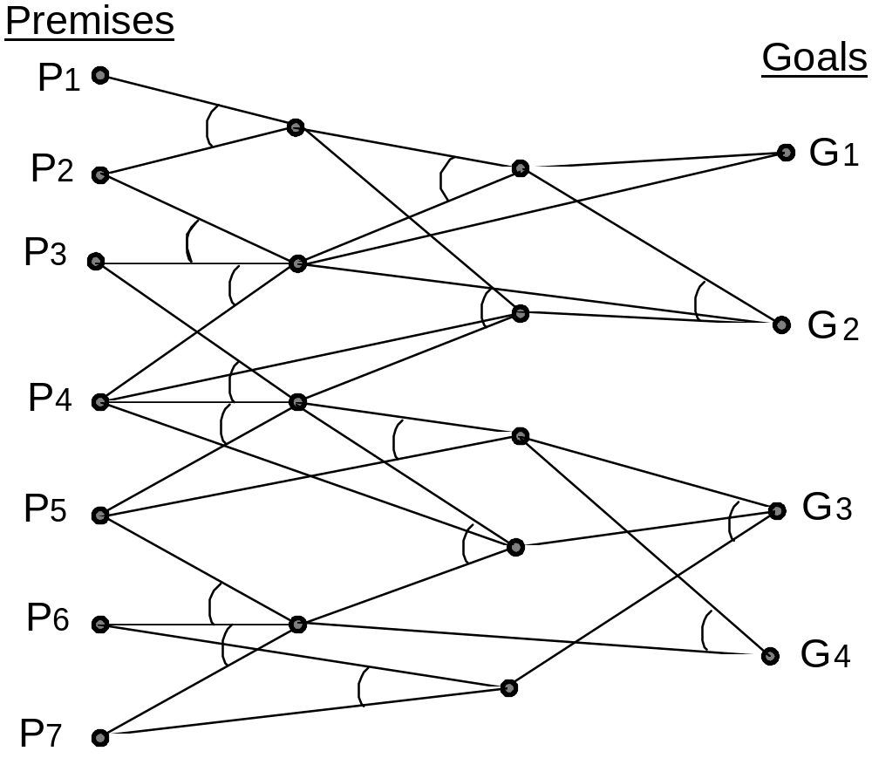
Rule-Chaining as State Space Search
When to search forward or backward?
Performance criteria:
› Branching factor
› # Premises v's # Goals
Pragmatic Criteria
› User interface
› Data availability

Slide 10
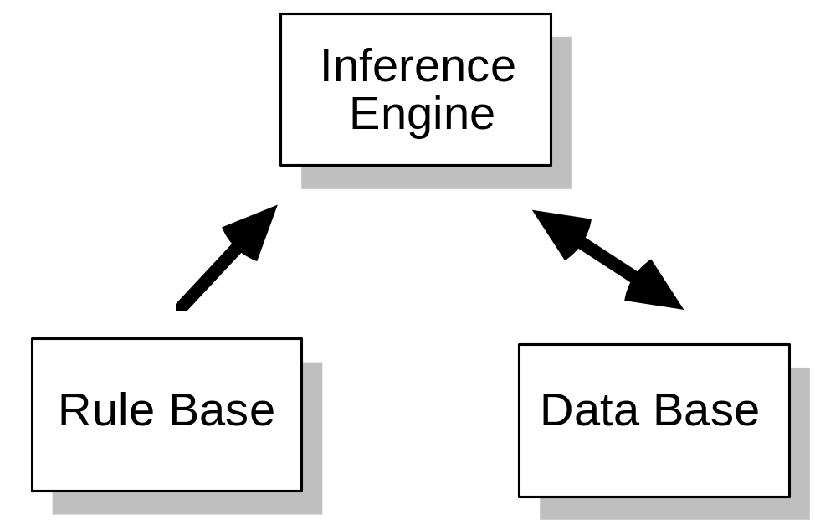
Production System Architecture
1 Rules Base: Table of rules representing the knowledge encoded in the system.
2. Data Base: Contains facts, details of the system's domain.
3. Inference Engine: Mechanism for deriving inferences from rules and data.

Slide 11
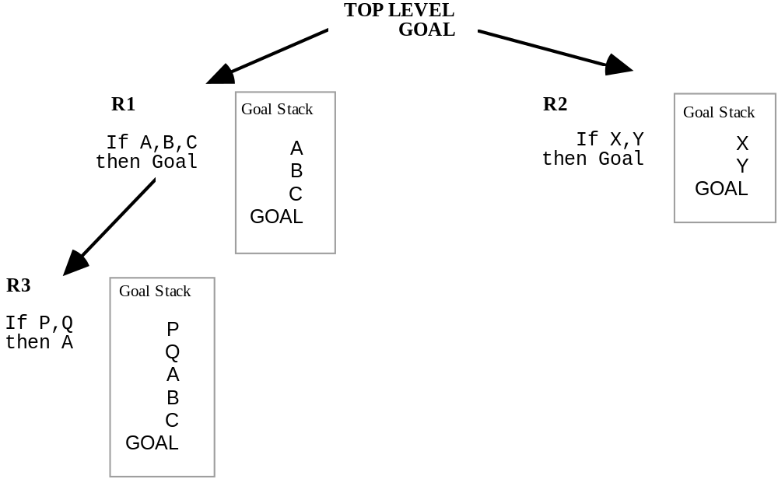
Backward-Chaining
1. Select rules with conclusions matching the goal and create a search tree, each rule selected will become a node in the search tree and will have a goal stack associated with it.
2. Select one of these nodes as a sub-goal and repeat step 1.
3. If a goal is proved end by firing the correct string of rules.

Slide 12
Two pairwise-recursive functions…
function verify-fact (fact){
if True-fact(fact) return TRUE
Else {
Rule-set ← rules-that-prove-fact(fact)
For-each rule ∈ Rule-set
If (Verify-antecedents(Get-antecedents(rule)))
return TRUE
}
return FALSE}
function verify-antecedents (Antecedents-set){
For-each antecedent ∈ Antecedents-set{
If Not(verify-fact(antecedent))
return False;
}
Retrun TRUE}
Return TRUE if a fact known
Return TRUE if a rule proves fact
Return TRUE if all facts in Antecedents TRUE

Slide 13
Trace: verify-fact, verify-antecedents
verify-fact (goal)
0: VERIFY-FACT (GOAL)
1: VERIFY-ANTECEDENTS ((J G))
2: VERIFY-FACT (J)
2: returned T
2: VERIFY-FACT (G)
3: VERIFY-ANTECEDENTS ((F K))
4: VERIFY-FACT (F)
5: VERIFY-ANTECEDENTS ((A B))
6: VERIFY-FACT (A)
6: returned T
6: VERIFY-FACT (B)
6: returned T
5: returned T
4: returned T
4: VERIFY-FACT (K)
5: VERIFY-ANTECEDENTS ((C D E))
6: VERIFY-FACT (C)
6: returned T
6: VERIFY-FACT (D)
6: returned T
6: VERIFY-FACT (E)
6: returned T
5: returned T
4: returned T <<and so on>>

Slide 14
Summary
Rule-Based Systems
  Backward-Chaining
  Forward-Chaining
How Backward-Chaining works

