Slide 1
RBS: Forward Chaining
How Forward Chaining works
Forward v’s Backward Chaining
Clips (C based FC engine)
JESS (Java based)

Slide 2
Forward Chaining Strategy
Match: Construct a set of candidate rules whose LHS are true.
Conflict Resolution: Select a rule from this set.
Act: Fire this rule.
Go back to 1.
RB systems involve a lot of search;
Conflict Res. strategy is important in reducing this search.

Slide 3
Conflict resolution strategy
Efficiency depends very much on the conflict resolution strategy, some possible criteria are:-
  Least Premise Complexity
  Greatest Premise Complexity
  Greatest Weight
  Weighted Least Premise Complexity
  Weighted Greatest Premise Complexity
  Most Recently Instantiated
    (requires time stamping of facts)
  *Something Dynamic*

Slide 4
Forward v’s Backward Chaining
FC is appropriate when there exist many equally acceptable goal states, a narrow body of facts and rules and a single initial state.
  Required facts are available
  It is difficult to form a goal to verify
Goal directed inference is relevant when:-
  Relevant data must be acquired during the inference process
  Large number of applicable rules exist

Slide 5
Clips
Clips is a freely available rule-based shell.
  http://www.ghg.net/clips/CLIPS.html
  http://www-ai.cs.uni-magdeburg.de/~akav/clips/
Jess is a Java-based equivalent
  http://herzberg.ca.sandia.gov/jess/

Slide 6
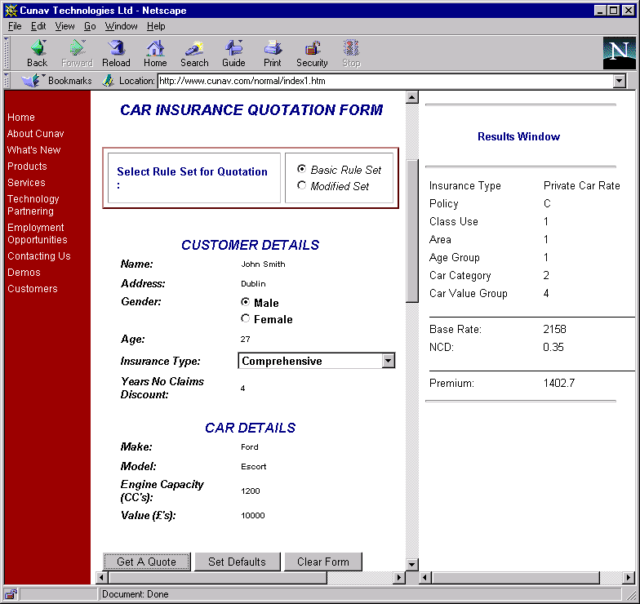
Forward chaining system for insurance quotation

Slide 7
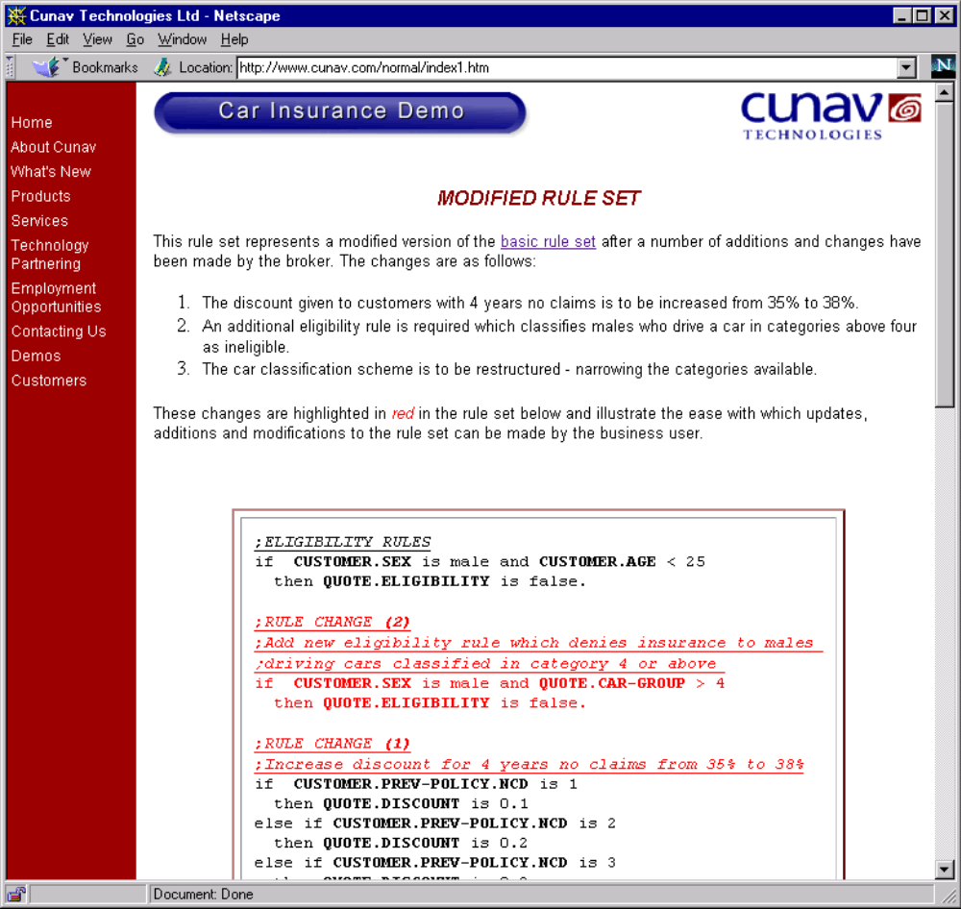
Sample Rule in Clips (Jess) format
(defrule eligible-male-carCat4-over
(customer ?nme ?add ?sex&:(eq ?sex M) ?age ?ncd)
(car ?typ ?mod ?cc&:(> ?cc 1350) ?val)
=>
(call ?*quote* setEligibility FALSE)
(call ?*quote* setReason "Males, aged between 2
and 30 are ineligible for insurance in a car category
greater than 4.")
)

Slide 8
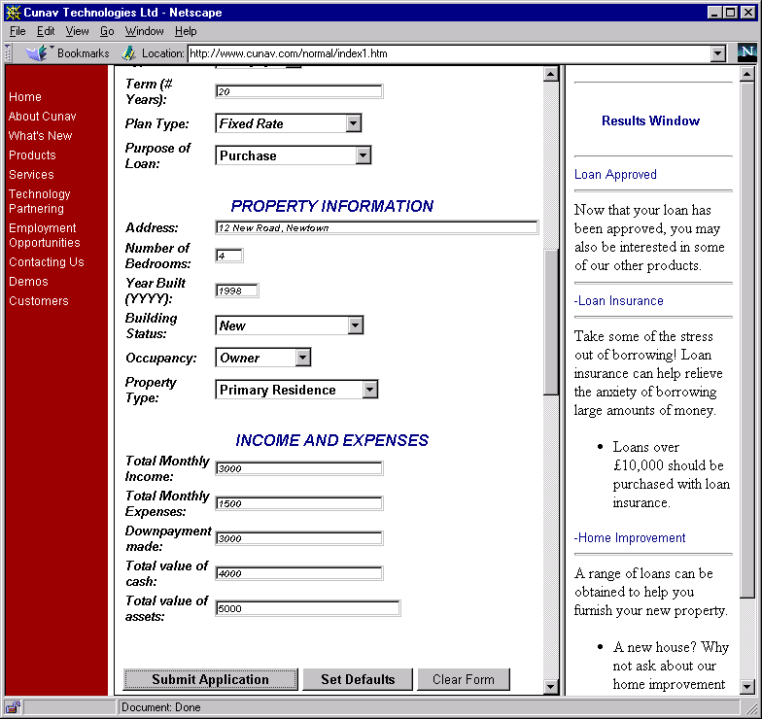
Forward chaining system for loan approval

Slide 9
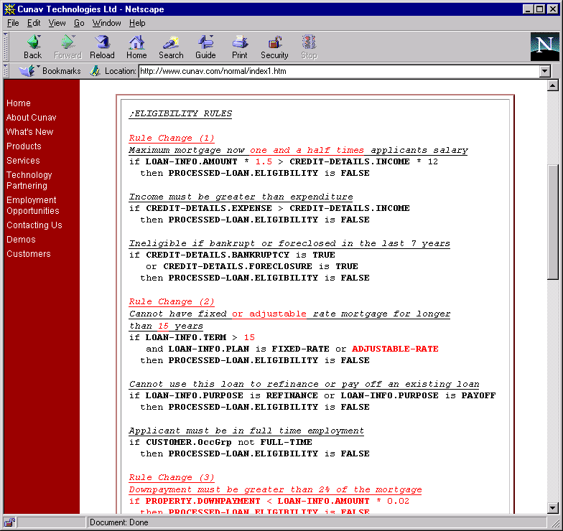
Loan approval
rules

Slide 10
Loan approval in CLIPS
;;; Facts are setup as follows
;(Customer Name Address Age OccupationGroup YearsAtAddress)
;(LoanInfo Term Plan PurposeType lAmount)
;(Property Address NumBedrooms YearBuilt PropertyType
Status Occupancy DownPayment)
;(CreditDetails Income Expense TotalCash
TotalAssets Bankruptcy ForeClosure)
(assert (startEng))
;(assert (Customer Conor Dublin 24 2 4))
;(assert (LoanInfo 24 6 1 2 100000))
;(assert (Property Dublin 3 1988 2 3 2 20000))
;(assert (CreditDetails 100 200 1000 2000 FALSE FALSE))
; Commented out, this info comes from GUI.

Slide 11
Sample rules
(defrule mortgage-2half-salary
(CreditDetails ?inc ?exp ?csh ?ast ?bnk ?fcls)
(LoanInfo ?trm ?pln ?pur ?typ ?lam)
(test (< (* 1.5 (* 12 ?inc)) ?lam))
=>
(call ?*PLoan* setReason "You are not eligible for a
mortgage greater than 1.5 times your salary")
(call ?*PLoan* setEligibility FALSE)
)
(defrule loan-refinan-existing
(LoanInfo ?trm ?pln ?pur&:(or (eq ?pur 2) (eq ?pur 4)) ?typ ?lam)
=>
(call ?*PLoan* setReason "You cannot obtain a mortgage for
refinancing or to payoff an existing mortgage.")
(call ?*PLoan* setEligibility FALSE)
)

Slide 12
Wine Advisor
(rule (if has-sauce is yes and
sauce is spicy)
(then best-body is full))
(rule (if tastiness is delicate)
(then best-body is light))
(rule (if tastiness is average)
(then best-body is light with certainty 30 and
best-body is medium with certainty 60 and
best-body is full with certainty 30))
(rule (if tastiness is strong)
(then best-body is medium with certainty 40 and
best-body is full with certainty 80))

Slide 13
Summary
How Forward Chaining works
Forward v’s Backward Chaining
Clips (C based FC engine)
JESS (Java based)

