Slide 1
Building Decision Trees
D-Tree Algorithm
Entropy
Numerical Attributes
Examples

Slide 2
Decision Trees
Each internal node tests an attribute
Each branch corresponds to an attribute value
Each leaf node assigns a classifications
Cannot readily represent
  ∧,∨, XOR
  (A ∧ B) ∨, (C ∧ ¬D ∧ E)
  M of N

Slide 3
When to consider D-Trees
Instances described by attribute-value pairs
Target function is discrete valued
Disjunctive hypothesis may be required
Possibly noisy training data
  Examples
  Equipment or medical diagnosis
  Credit risk analysis
  Filtering email messages

Slide 4
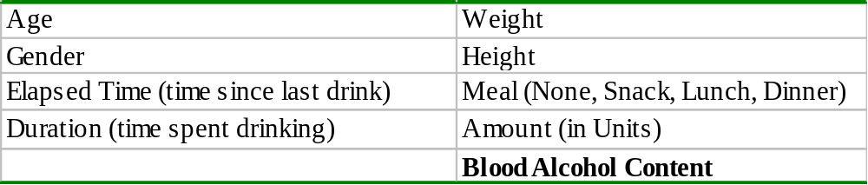
D-Tree Example
Predicting blood alcohol content
  Possible predictive features

Slide 5
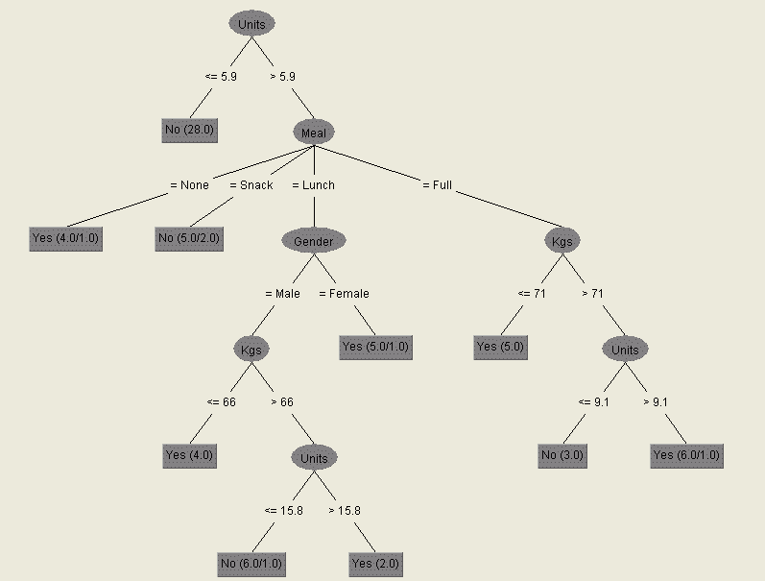
D-Tree Breathalyser

Slide 6
D-Tree Example
Alternative Whether there is a suitable alternative restaurant nearby.
Bar Is there a comfortable bar area?
Fri/Sat True on Friday or Saturday nights.
Hungary How hungry is the subject?
Patrons How many people in the restaurant?
Price Price range.
Raining Is it raining outside?
Reservation Does the subject have a reservation?
Type Type of Restaurant.
Stay? Stay or Go

Slide 7
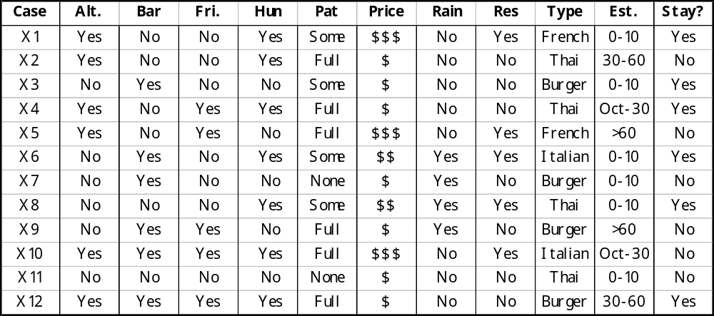
D-Tree Example

Slide 8
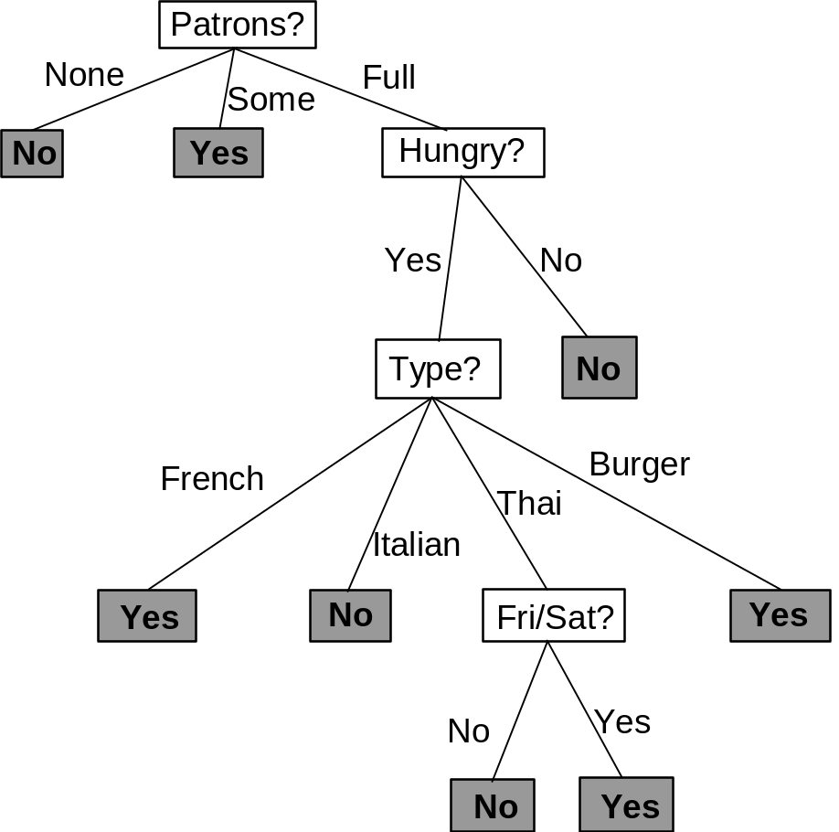
D-Tree Example
Very good D-Tree
Classifies all examples correctly
Very few nodes
Objective in building a decision tree is to choose attributes so as to minimise the depth of the tree

Slide 9
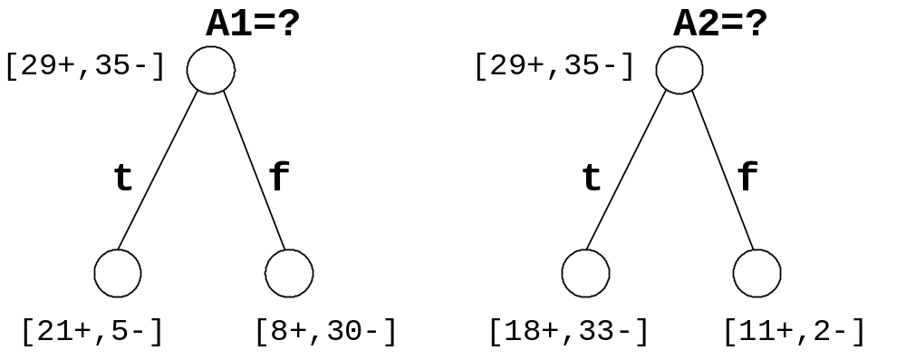
Top-down induction of D-Trees
1. A ← the “best” decision attribute for next node
2. Assign A as decision attribute for node
3. For each value of A create new descendant of node
4. Sort training examples to leaf nodes
5. If training examples perfectly classified,
Then Stop,
Else repeat recursively over leaf nodes
Which attribute is best

Slide 10
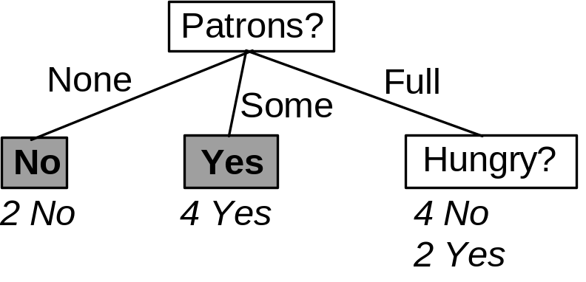
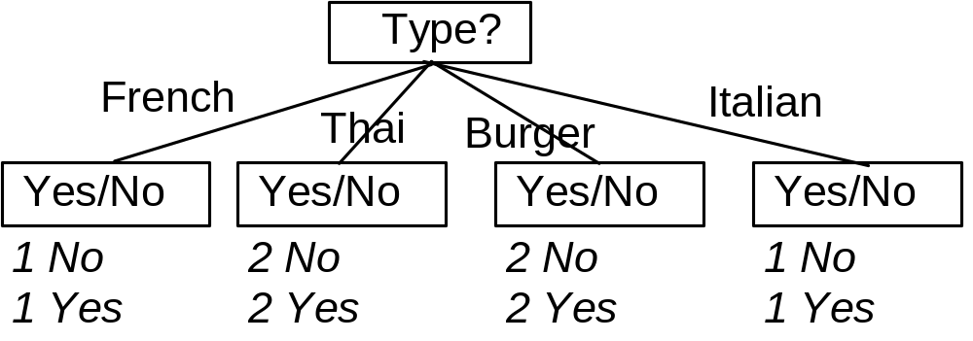
Good and Bad Attributes
A perfect attribute divides examples into categories of one type. (e.g. Patrons)
A poor attribute produces categories of mixed type. (e.g. Type)
How can we measure this?

Slide 11
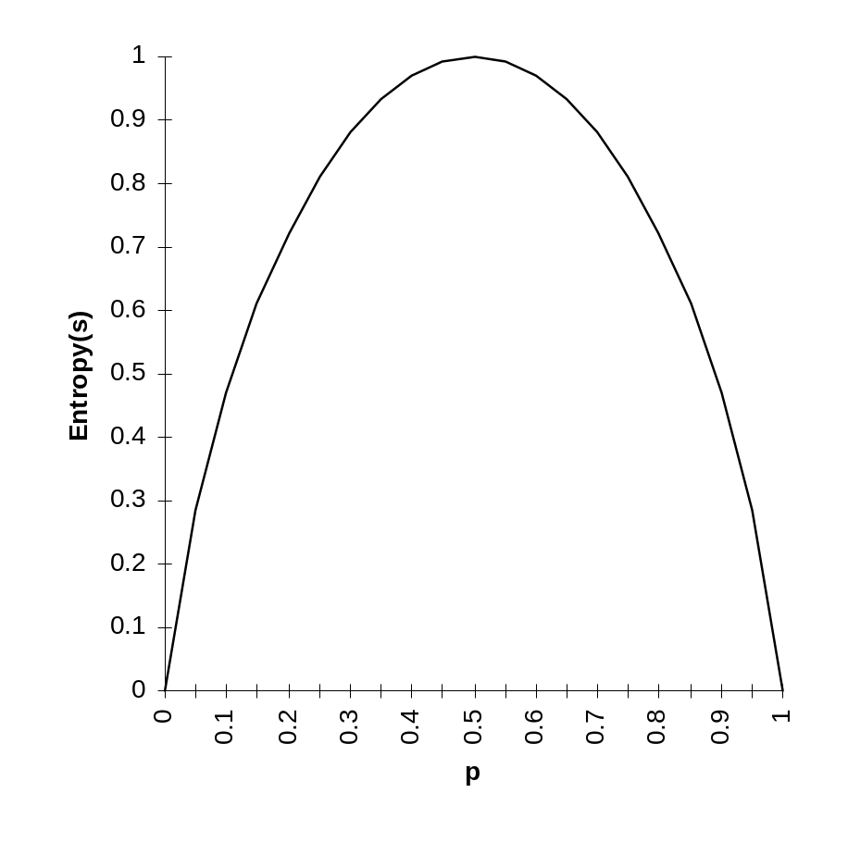
Entropy
S is a sample of training examples
p is the proportion of positive examples in S
q is the proportion of negative examples in S
Entropy measures the impurity of S
  Entropy(S) = -plog₂(p) -qlog₂(q)

Slide 12
Entropy
Entropy(S) = expected number of bits needed to encode class (p or q) of randomly drawn members of S (under optimal shortest length code)
Why?
Information theory: optimal length code assigns
- log₂(q) bits to messages having probability q.
So, expected number of bits to encode messages in ratio p:q of random members of S.
-p(log₂(p)) -q(log₂(q))
i.e. Entropy(S) = -plog₂(p) -qlog₂(q)

Slide 13
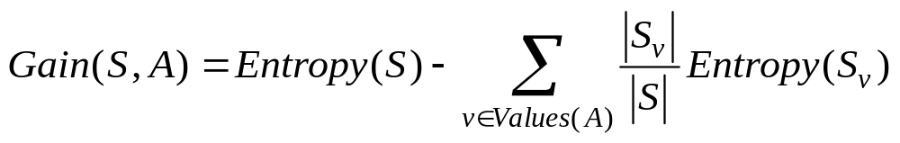
Information Gain
Gain(S,A) = expected reduction in entropy due to sorting on A

Slide 14
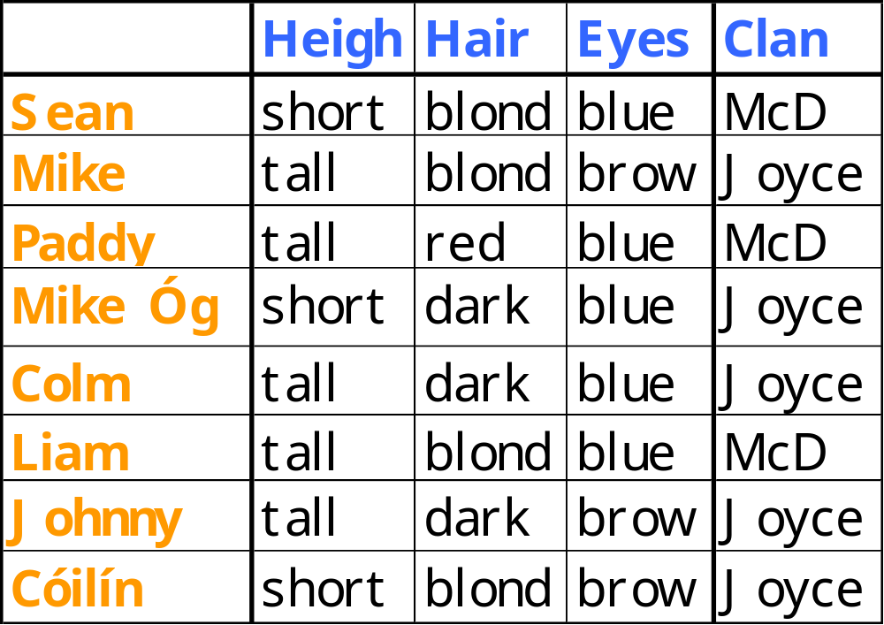
D-Tree Example

Slide 15
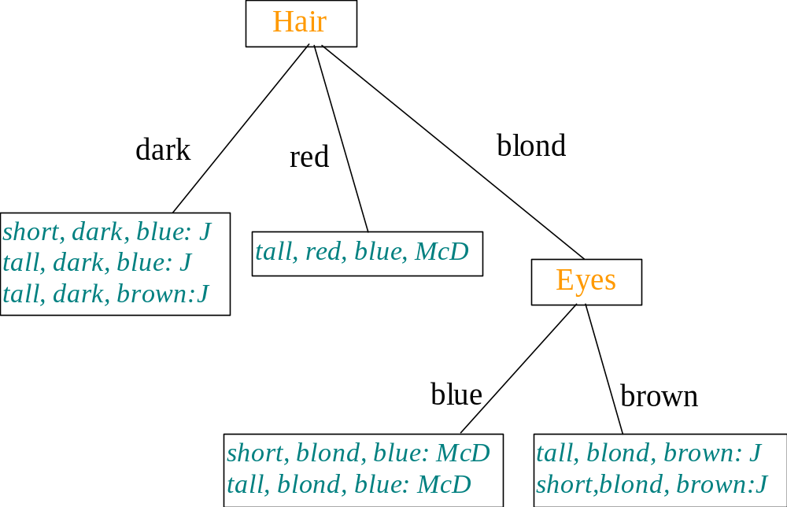
Minimal D-Tree

Slide 16
The Story so far…
Recursive algorithm for bulding D-Trees
Using informatio gain (Entropy) to select discriminating attribute
Example

Slide 17
Exam Question
4. The table below shows some training examples that are to be used in building a decision tree that determines whether or not to play tennis given some weather information.
Describe in detail how an information theoretic analysis can be used to illustrate that the Outlook feature is more predictive of the outcome than the Humidity feature. (You need not analyse the Temp and Wind features.)
(b) If Outlook proves to be the most predictive feature show in outline how the building of the decision tree progresses from there.

Slide 18
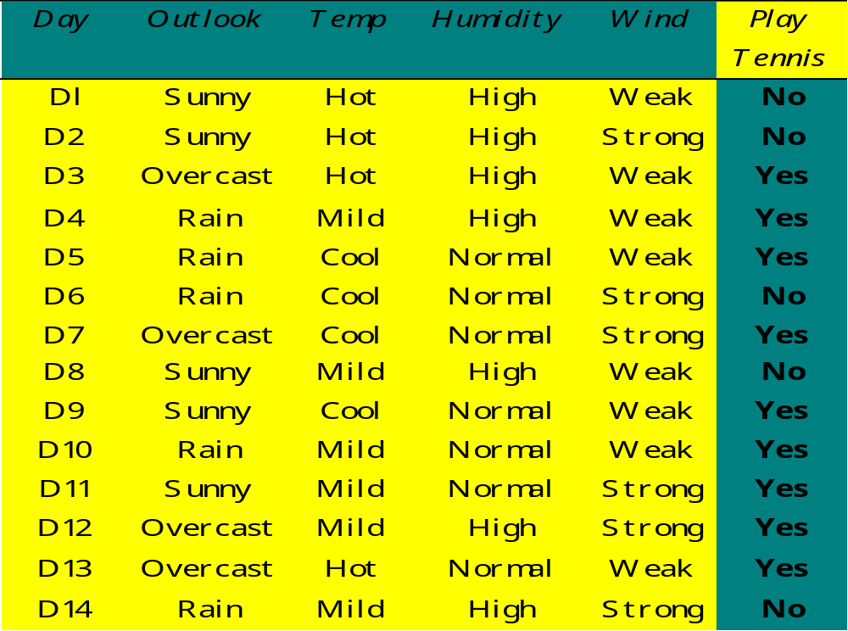
Q4 4D2 1998

Slide 19

Imagine Temp as Numeric

Slide 20
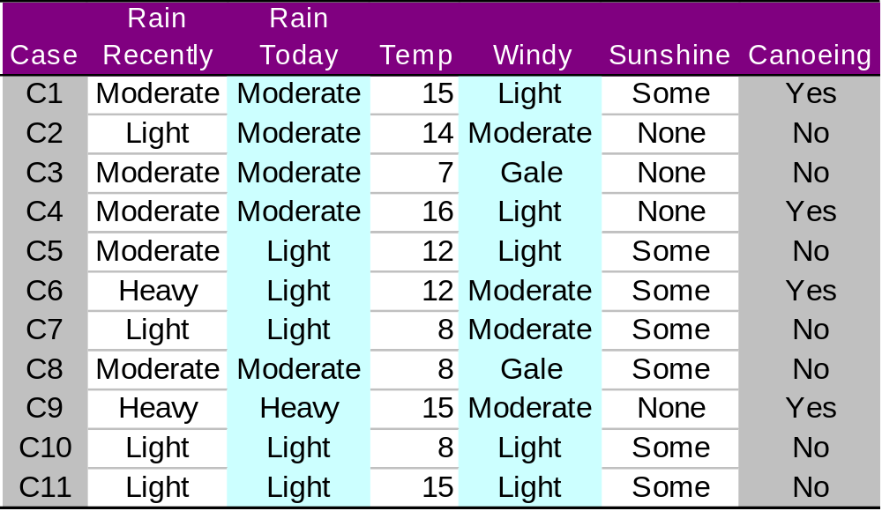
D Tree for Canoeing
Rain Recently
Light
Heavy
Mod
No
Temp
Yes
≤12
>12
No
Yes
heavy recent rain
or moderate recent rain
and temperature > 12.
FSS:
RainRecently & Temp.

Slide 21
Overfitting: Canoeing data
Temp
≤14
>14
Rain Recently
Yes
Light
Heavy
Mod
Deleting last case produces different DTree
  Overfits pecularities in training data
No
No
Yes

Slide 22
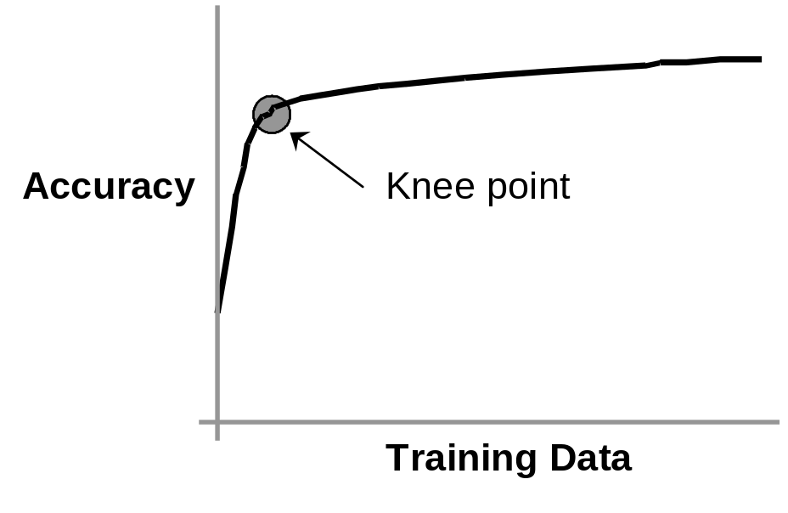
Overfitting
Learning Curve
If small changes in training data can have significant influence on the outcome of a machine learning exercise then models will have high variance
  individual models will overfit their training data and not generalise well to other data.

Slide 23
Summary
Exercise
How to handle numerical atts
Overfitting

