Slide 1
1. INTRODUCTION
Background
computer-based information systems are essential in virtually all large organisations today
data is input manually (e.g. Banklink machine) or automatically (e.g. POS systems)
Introduction to Database Mgt Systems- Section 1
© Vincent P. Wade

Slide 2
1.1. Definitions
A database is a persistent collection of related data
supporting several different applications within an
organisation.
Key features of definition:
data stored in a database (DB) is related in some way
DB supports (manages) data for several different
applications
DB is persistent i.e. data is permanently stored
Introduction to Database Mgt Systems- Section 1
© Vincent P. Wade

Slide 3
1.1. Definitions (cont)
What is data?
data is known facts that can be recorded
and have an implicit meaning
Metadata Data
Student number: 89041258
Name: John Patrick Smith
Account balance: 42.26
A Database Management System (DBMS) is the set of software which manages a DB or set of DBs
Introduction to Database Mgt Systems- Section 1
© Vincent P. Wade

Slide 4
1.2 DBMSs provide.....
1. Efficient, reliable and secure management of large amounts of persistent data.
2. Languages for storing, retrieving and
updating data in the DB - data manipulation languages
3. Language(s) for defining the DB - data definition language.
This data about about data (e.g. student number is a seven digit number plus one check digit) is called metadata
Introduction to Database Mgt Systems- Section 1
© Vincent P. Wade

Slide 5
Database System (DBS)
USER
DBS
Application Programs
Figure 1.1
DBMS
DB
definition
(metadata)
application
DB
(data)
The DBMS, together with a DB containing application data and its associated metadata, and application programs which manipulate the data, constitute a Database System (DBS).
Metadata and data are stored separately
Introduction to Database Mgt Systems- Section 1
© Vincent P. Wade

Slide 6
1.3 Example of a DB (GP DBS)
records details about patient, their visits to the doctor,
referrals to consultants and their accounts
patients, accounts, referrals and consultants are all
examples of real-world entities
an entity is an “object” about which we wish to store
information in the DB
Introduction to Database Mgt Systems- Section 1
© Vincent P. Wade

Slide 7
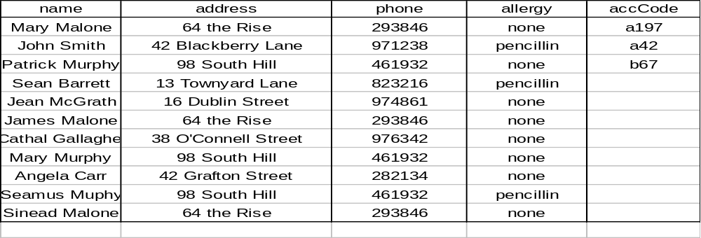
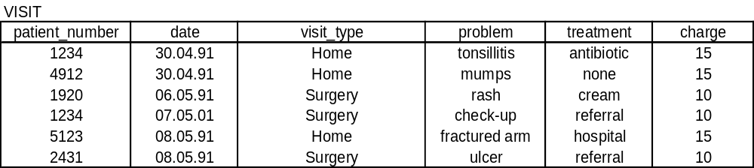
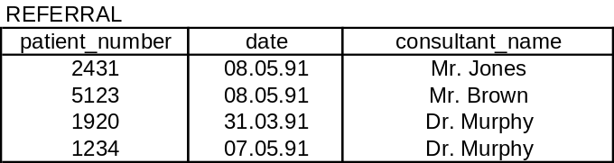
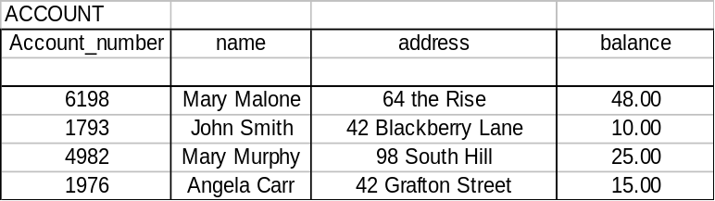
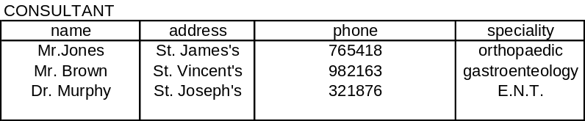
        Figure 1.2
Introduction to Database Mgt Systems- Section 1
© Vincent P. Wade

Slide 8
Example GP DBMS (contd.)
entities are linked together by relationships
entities and relationships together constitute the
mini-world (a subset of the real world) which we will
model in the DB
examples of relationships are:
PATIENTs make VISITs to doctor
VISITs are charged to ACCOUNTs
PATIENTs are referred to CONSULTANTS
Introduction to Database Mgt Systems- Section 1
© Vincent P. Wade

Slide 9
Example GP DBMS (contd.)
Data definition
PATIENT ‘file’ is divided into a set of PATIENT records, each of
which stores the same information about a single patient:
patient_number name
address phone
allergy
patient_number, name, address, etc. are called data items or fields or attributes
a data item is the basic unit of information stored in a DB
other ‘files’ are VISIT, ACCOUNT, REFERRAL and
CONSULTANT
Figure 1.2 shows the GP DB populated with data
Introduction to Database Mgt Systems- Section 1
© Vincent P. Wade

Slide 10
1.4 Data as a resource
many organisations are critically dependent on
their computer-based information systems
data is a strategic organisational resource
DBMSs provide the technology for managing
the information resource efficiently, reliably
and securely
Introduction to Database Mgt Systems- Section 1
© Vincent P. Wade

Slide 11
1.5 Why database technology?
pre-DB era (up to end of 1960’s) characterised by file processing systems
file systems offered efficient direct access to individual records and fast sequential processing
choice of file organisation technique is based on the needs of a particular application
where multiple applications want to share data, this can give rise to wasteful duplication (e.g. of patient names, addresses, visit charges etc.) between patient record application and accounting application
Introduction to Database Mgt Systems- Section 1
© Vincent P. Wade

Slide 12
1.5 Why database technology (cont.)
Duplication of data is wasteful of storage and inefficient but, more importantly, it leads to inconsistencies
DB approach aims to eliminate such redundancy (data duplication)
Data from all applications is integrated and stored once in the DB
All applications access the same physical copy of the data
Introduction to Database Mgt Systems- Section 1
© Vincent P. Wade

Slide 13
Student
& course
data file
Grade
Reporting
System
Grade
Reports
Student
Details
Student
Records
System
Student
Records
Student
& fee
Data
Fees
System
Fee
Invoices
Figure 1.3aFile-based approach
Grade
Reporting
System
Grade
Reports
Fees
Data
Course
Data
Student
Records
System
Student
Records
DBMS
Grades
Data
Fees
System
Fee
Invoices
Student
Date
Figure 1.3b Database Approach
Introduction to Database Mgt Systems- Section 1
© Vincent P. Wade

Slide 14
End
Users
Database Management System
Application
Programs
Database
ο
ν
μ
Figure 1.4 Shared/Integrated Data
Introduction to Database Mgt Systems- Section 1
© Vincent P. Wade

Slide 15
Disadvantages of file based approach to data
mangement:
lack of data independence
lack of support for data integrity
inadequate backup and recovery mechanisms
no query language support
no support for management of metadata
Introduction to Database Mgt Systems- Section 1
© Vincent P. Wade

Slide 16
How do DBMSs overcome these problems?
data independence
File based systems are data dependent because the way in which data is viewed by an application and way in which it is physically stored are built in to the logic of the application program
DBMSs support physical data independence by insulating the way in which data is viewed by the application programs/users from the way in which it is physically stored
DBMSs support logical data independence by allowing applications to change their view of the data without affecting the physical organisation of the data
Introduction to Database Mgt Systems- Section 1
© Vincent P. Wade

Slide 17
Data Integrity
data integrity is concerned with the consistency and accuracy of the data in the DB
data redundancy is a major threat to data integrity
support for data integrity is a key feature of a DBMS
DBs model a mini-world to which many rules apply
e.g. “A student has only one address” or “A student must
take 5 courses in the final year or 4 courses plus a project”
DBMSs express such rules by means of integrity constraints
validation of data values being entered into the DB is another aspect of data integrity
many users/application programs simultaneously updating the DB can threaten data integrity (requiring concurrency control)
Introduction to Database Mgt Systems- Section 1
© Vincent P. Wade

Slide 18
Backup and Recovery
only facility available to file processing systems to restore data
following failure was the back-up copy
insufficient in many on-line environments and also organisations
where data is a strategic resource
DBMSs provide very sophisticated recovery mechanisms
Introduction to Database Mgt Systems- Section 1
© Vincent P. Wade

Slide 19
Query Language Suppport
file sytems are basically tools for physical storage of data
file systems make data much less accessible to users than
DB systems - the GP would have to write an application
program every time they wanted to look up a patient record!
DBMSs provide a variety of interfaces to suit the needs of a
wide range of users
Introduction to Database Mgt Systems- Section 1
© Vincent P. Wade

Slide 20
Metadata Management
in fps, metadata is part of the application program
leads to duplication of metadata across application
programs leading to integrity problems
a stored patient record
1234
Mary Malone
64 The Rise
290846
penicillin
Introduction to Database Mgt Systems- Section 1
© Vincent P. Wade

Slide 21
Metadata Management (contd.)
to interpret the data, we need to look at an
application program:
Struct.patient_record {
short int patient_number;
char name [30];
char address [40];
char phone [6];
char allergy [10];
};
Introduction to Database Mgt Systems- Section 1
© Vincent P. Wade

Slide 22
Metadata Management (contd.)
With DB approach:
  metadata is stored centrally in the catalogue
  DB catolog entry for patient record
  Patient_record contains basic details on patient
patient_number alpha (4) unique;
name alpha (30) firstname followed by
surname;
address alpha (40) truncate if necessary:
phone alpha (6) home phone;
allergy alpha (10) drug name or none;
Introduction to Database Mgt Systems- Section 1
© Vincent P. Wade

Slide 23
Disadvantages of the DB approach
cost of software, hardware and training
loss of autonomy brought about by centralised
control of the data
inflexibility due to complexity
Introduction to Database Mgt Systems- Section 1
© Vincent P. Wade

Slide 24
Database Users
Database Administrator (DBA)
  has overall responsibility for the DB including deciding on information content, specifying access constraints, selection of appropriate backup and recovery measures, monitoring performance etc.
Other users of the DB:
  systems analysts
  DB designers
Introduction to Database Mgt Systems- Section 1
© Vincent P. Wade

