Slide 1
3. The Relational Model
3.1 Relation Theory
Given a collection of sets D₁,D_{2,} …,D_{n} (not necessarily distinct), R is a relation on these n sets if it is a set of ordered n-tuples {A₁, A₂, ......, A_{n}} such that
A₁ D₁, A₂ D₂,…, A_{n} D_{n}
where A₁, A₂, ......, A_{n} are the attributes of R
and the sets D₁, D_{2,…}, D_{n} are domains of R;

Slide 2
Relational Model (cont)
a domain is the pool of values from which the attribute values actually appearing in any one column are drawn
e.g. the domain of patient# could be an integer between 1000 and 9999
the value of n is the degree of R
(n = # of columns in the table/relation)

Slide 3
Relational schema
relations are normally represented in quasi-mathematical form by a relational schema or relation intension:
R (A₁, A₂, ......, A_{n} )
Example:
PATIENT (patient_number, name, address, phone, allergy)
Figure 1.2 shows the relation extension; i.e. it contains actual values

Slide 4
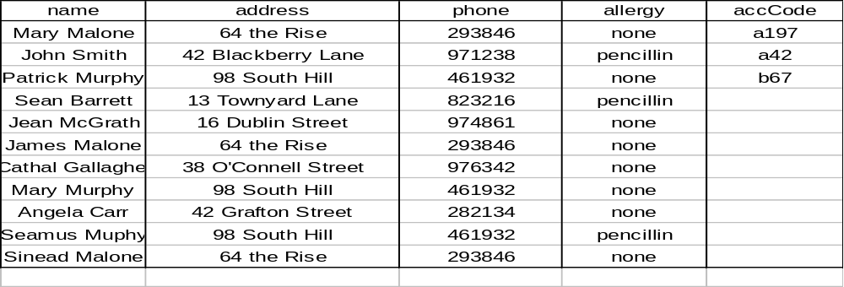
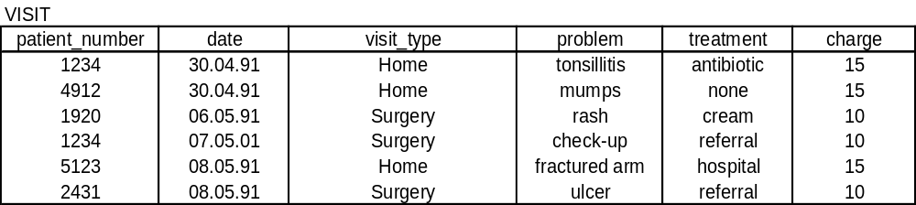
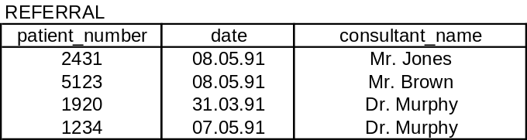
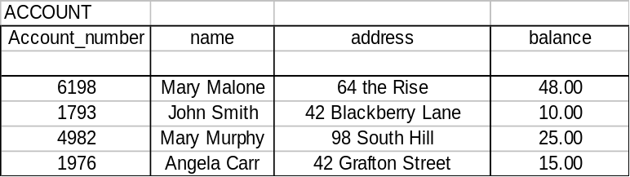
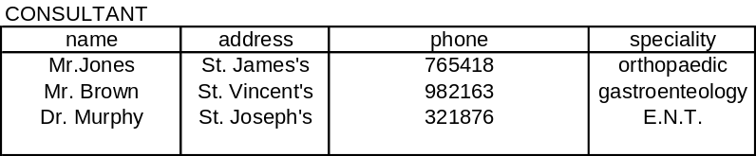

Slide 5
Null values
it is possible to have null values (there are restrictions) in certain (row, column) positions in a relation if the value is not known or inapplicable
the null value is a special value defined for each domain

Slide 6
3.2 Keys and integrity constraints
a relational DB consists of many relations;
every relation and every attribute has a name and hence can be uniquely identified
attribute names are often qualified by the relation name to which they belong
e.g. PATIENT.name
CONSULTANT.name

Slide 7
Primary Keys
most relations have one attribute where values uniquely identify the tuples of a relation
e.g. patient_number in relation PATIENT - no two patients can have the same patient number;
such a key is called a primary key

Slide 8
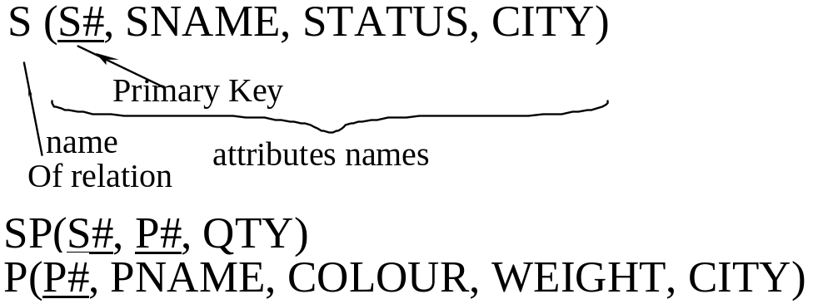
Primary Keys (cont)
not every relation has a single attribute
key e.g. S# and P# in SP

Slide 9
Integrity constraints
semantic integrity constraints
relate to the meaning of attributes in the mini-world modelled by the DB e.g. a patient can only have one allergy
entity constraints will be enforced automatically by the system

Slide 10
Integrity constraints (cont)
Structural integrity constraints
are part of relational model itself:
  key constraints, which are concerned with the uniqueness of primary keys
  entity constraints, which require that no part of a primary key is null
  once an attribute (possibly composite) is defined to be the primary key of a relation, key and entity constraints will be enforced automatically by the system

Slide 11
Integrity constraints (cont 2)
Foreign keys and referential integrity referential integrity constraints are inter-relational constraints that govern relationships between relations

Slide 12
Example - A University DB
STUDENT(student_number, student_name, student_address)
RESULT (course_number, student_number, grade)
COURSE (course_number, course_title, lecturer)

Slide 13
University DB (cont)
it would be logical to constrain values for student_number and course_number in the RESULT relation to be the same as existing tuples in the STUDENT and COURSE relations
student_number and course_number in RESULT are referred to as foreign keys of the STUDENT and COURSE relations
constraint on the values of student_number and course_number is called a referential integrity constraint

Slide 14
Foreign Keys (Formally)
A set of attributes FK in a relation schema R₁ is a foreign key of R₁ if it satisfies the following two rules:
1. The attributes FK have the same domain as the primary key attributes of another relation schema R₂; the attributes FK are said to reference or refer to the relation R₂.
2. A value of FK in a tuple t₁ of R₁ either occurs as a value of PK for some tuple t₂ in R₂ or is null. In the former case, we have t₁[FK]= t₂[PK] and tuple t₁ references or refers to tuple t₂

Slide 15
3.3 Relational Algebra
Traditional Data Schema Languages (DLS) operate on a tuple (or record) at a time e.g. hierarchial DB DSL
Relational algebra provides us with a set-at-a-time language.
Relational algebra is a collection of high-level operations on relations which fall into 2 groups:
  traditional set operations (union, intersection, etc.)
  relational operations (selection, projection, join, etc)
All operations result in new relations

Slide 16
Set Operators
Traditional set operations
Union, Intersection, Difference
For union, intersection and difference, 2 relations must be union compatible,
i.e. they must be of the same degree (same number of columns!), n say, and the jth attribute of one must be drawn from the same domain as the jth attribute of the other

Slide 17
UNION
The union of two (union-compatible) relations A and B,
A UNION B
is the set of all tuples t belonging to either A or B (or both).

Slide 18

Example Of Union
Let A be the set of supplier tuples for suppliers in London & B the set of supplier tuples for suppliers who supply part P1.
Then A UNION B
is the set of supplier tuples for suppliers who either are located in London or supply part P1 (or both).

Slide 19
INTERSECTION
The intersection of two (union-compatible) relations A and B,
A INTERSECT B
is the set of all tuples t belonging to both A and B

Slide 20

Example of Intersection
Example: Let A be the set of supplier tuples for suppliers in London, and B the set of supplier tuples for suppliers who supply part P1
Then A INTERSECT B
is the set of supplier tuples who are located in London and who supply part P1.

Slide 21
Difference
The difference between two (union-compatible) relations A and B,
A MINUS B
is the set of all tuples belonging to A and not to B.

Slide 22
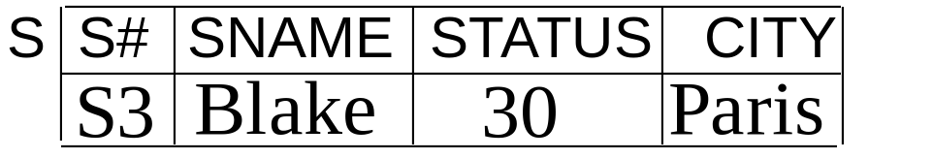
Example Of Difference
Let A be the set of supplier tuples for suppliers in Paris and B the set of supplier tuples for suppliers who supply part P1
Then A MINUS B
is the set of supplier tuples for suppliers who are located in Paris and who do not supply part P1.

Slide 23
Relational Operators
SPECIAL RELATIONAL OPERATORS
We will look at 3 operators:
(a) selection
(b) projection
(c) join

Slide 24
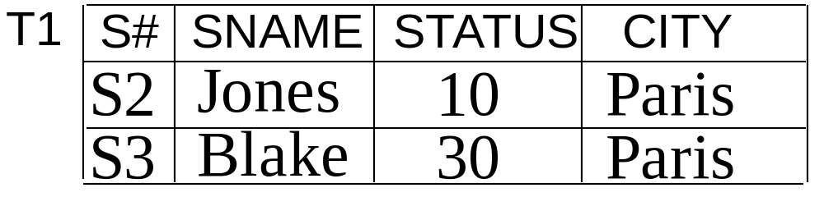
SELECTION
The SELECT operation is an operation for constructing a horizontal subset of an existing relation,
i.e. all rows (tuples) of an existing relation which can satisfy some conditions.
Examples:
SELECT S WHERE CITY='PARIS' GIVING T1;

Slide 25
Examples of Selection
SELECT P WHERE WEIGHT < 17 GIVING T2;
T2
P# Pname Colour Weight City
P1 Nut Red 12 London
P4 Screw Red 14 London

Slide 26
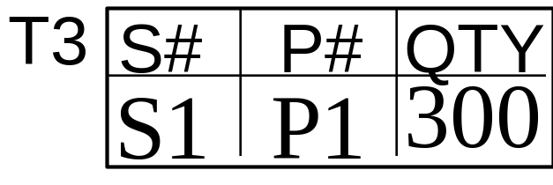
Example of SELECTION (2)
SELECT SP WHERE S#='S1' AND P#='P1' GIVING T3;

Slide 27
PROJECTION
PROJECT is an operator for constructing a vertical subset of a relation
i.e. a subset obtained by selecting specified attributes and eliminating others, (also eliminating duplicate tuples within the attributes selected).

Slide 28

Example Of Projection
PROJECT S OVER CITY GIVING T4;
PROJECT S OVER SNAME, CITY, S#, STATUS
GIVING T5;
SName City Status S#
Smith London 20 S1
Jones Paris 10 S2
Blake Paris 30 S3
T5

Slide 29
JOIN
If two relations have a domain in common they may be joined over that domain;
the result of the join is a new relation of higher degree in which each row is formed by joining together two rows;
one from each of the original tables such that the two rows concerned have the same value in the common domain.

Slide 30
Example Joins
JOIN S AND P OVER CITY GIVING T6;
T6
S# SName Status City P# Pname Colour Weight
S1 Smith 20 London P1 Nut Red 12
S1 Smith 20 London P4 Screw Red 14
S2 Jones 10 Paris P2 Bolt Green 17
S3 Blake 30 Paris P2 Bolt Green 17
A join in which one of the two identical columns is eliminated is called a natural join.

