Slide 1
Relational Modelling
Objectives
• Illustrate techniques to describe information
in terms of table definitions and occurrences
• Guard against loss of information consistency
• How do we know our tables are correct ?

Slide 2
Key Points In Rel. Modelling
1. Ordering of rows is not significant
2. Ordering of columns is not significant
3. Each row/column intersection contains a single
attribute value. Multiple values are not allowed
4. Each row in a table must be distinct.
=> row can always be uniquely identified by quoting
an appropiate combination of attribute values
A table conforming to these restrictions is called
a normalised table

Slide 3
Exercise
Suggest a relation structure for a company wishing
to manage its sales/customer records.
Each customer has a name and is serviced by
one salesman. The structure must contain customer
numbers, salesman numbers, customer names and
salesman names.

Slide 4
Duplicated vs Redundant Data
• Must be careful to distinguish between redundant
and duplicated data
• Duplicated data:- occurs where an attribute
(column) has two or more identical values
• Redundant data:- occurs if you can delete a value
without information being lost
=> redundancy is unnecessary duplication

Slide 5
Duplication vs. Redundancy (2)
Example
Part#
Part Desc.
delete
nut
loss of
information
Part#
Part Desc.
P2 nut
P1 bolt
P3 washer
P4 nut
P2 ..........
P1 bolt
P3 washer
P4 nut
=> nut was duplicate but NOT redundant!

Slide 6
Duplicated vs. Redundant (3)
Delete
bolt
no
loss
of
information
S#
Part#
Part Desc.
S#
Part#
Part Desc.
S2
S7
S2
S5
P1 bolt
P6 bolt
P4 nut
P1 bolt
S2
S7
S2
S5
P1 bolt
P6 bolt
P4 nut
P1 ......
=> duplicated data was redundant

Slide 7
Eliminating Redundancy
• We cannot just delete values from the table in the
pervious example!
•Preferable to split table into 2 tables
Part#
Part Desc.
S#
Part#
P1 bolt
P6 bolt
P4 nut
S2
S7
S2
S5
P1
P6
P4
P1

Slide 8
Eliminating Redundancy (2)
• Eliminated redundancy by table splitting
- P1 description only appears once
- relationship is made by including part#
in two tables
• So far we've assumed that table structures which
permit redundancy can be recognised by
inspection of table occurrence
• This is not entirely accurate since attribute values
are subject to insertion / change / deletion

Slide 9
Eliminating Redundancy (3)
SP
S# P# Desc
S2 P1 bolt
S7 P6 bolt
S2 P4 nut
Inspection of table SP does not reveal any redundancy
Could even suggest that
"no two suppliers may supply same part#"

Slide 10
Repeating Groups
• We stated earlier that:
" An attribute must only have one value in each
row"
S# SName P#
S5 Wells P1
S2 Heath P1, P4
S7 Barron P6
S9 Edwards P8, P2, P6

Slide 11
Repeating Groups (2)
Problems:
1. Table is asymmetric representation of symmetrical
data
2. Rows can be sorted into s# but not into p#
3. Rows are different length 'cos of variation in number
of p#'s
4. If rows were fixed length, they would need to be
padded with null values

Slide 12
Elimination of Repeating Groups
• Easiest way to eliminate repeating groups is to write out the table occurrence using a vertical layout and fill in the blanks by duplicating the non- repeating data necessary
S# SName P#
S5 Wells P1
S2 Heath P1
P4
S7 Edwards P8
P2
P6
S# SName P#
S5 Wells P1
S2 Heath P1
S2 Heath P4
S7 Edwards P8
S7 Edwards P2
S7 Edwards P6
But this can lead to ‘redundancy’ of information!
(Does the right hand table contain redundant information?)

Slide 13
Elimination of Repeating Groups(2)
Alternate method:
• Split table into two tables so that repeating group
appears in one table and rest of attributes in another
• Need to provide correspondance between tables by
including a key attribute with the repeating group table
S# SName
S5 Wells
S2 Heath
S7 Barron
S9 Edwards
S# P#
S5 P1
S2 P1
S2 P4
S7 P6
S9 P8
S9 P2
S9 P6

Slide 14
Eliminating Repeating Groups & Redundancy
• Snapshot of table is inadequate guide
to presence / absence of redundant data
• Need to know underlying rules
• DBA must discover rules which apply to conceptual
model

Slide 15
Determinants
• If there are rules such that duplicate values of
attribute A are always associated with the same value
of attribute B (within any given occurrence of the table)
then attribute A is a determinant of attribute B
Note: A is determinant of B can be written as
A B
Note: In the special case where duplicate values of A
are not allowed in a table ( i.e. A is a key) then A is
obviously a determinant on B

Slide 16
Determinants (2)
Example:
• If each possible p# value has precisely one
associated part description value (i.e. P4 has just
one description nut) then we can say that p# is a
determinant of part description.
p# p_desc
• Similarly if each possible p# value has precisely
one quantity in stock then we can say p# is a
determinant of quantity in stock
p# Qty_in_Stock

Slide 17
Determinants (3)
Stock
P# P_Desc Qty
P2 nut 5000
P1 bolt 8300
P3 washer 9750
P4 nut 2326
Question:
is P_Desc a determinant of P# ?
is P_Desc a determinant of Qty ?

Slide 18
Superfluous Attribute
• If P# determines Qty then composite attribute
{P#, P_Desc} also determines Qty, but P_Desc is
superfluous
• We assume determinants do not contain any
superfluous attributes

Slide 19
Determinancy Diagrams
• We need a notation to express where one attribute
determines another => we use determinancy
diagrams
A is determinant of B
A is determinant of B
and vice versa
A
B
A
B
P_Desc
P#
Determinancy diagram
of stock table
Qty

Slide 20
Determinancy Diagrams (2)
EXAMPLE
• Supplier identified by single S# & a part is
identified by single P#
• Each supplier has only one SName but different
suppliers may have same names
• A supplier may supply many different parts in many
different pack sizes
• A part may be supplied by many different suppliers
in many different pack sizes
• A given supplier supplies a given part in just one
pack size

Slide 21
Determinancy Diagrams (3)
Supp-Part (S#, Sname, P#, PackSize)
• Can recognise determinants by drawing determinancy
diagrams
S#
SName
P#
PackSize
{ S#, P# } is determinant for packsize

Slide 22
Transitive Determinants
• If A is determinant of B & B is determinant of C
Then A is determinant of C
A
B
C

Slide 23
Identifiers
• Because of the rule that 'no two rows in a table can
have identical values throughout'
therefore
individual row can always be identified by quoting
the values of all its attributes. However some values
may not be needed.

Slide 24
Identifiers (2)
Example:
Employee ( Employee#, Employee_name, Salary)
Rules:
• No two rows should have the same value for Employee#
=> Employee# is a row identifier of the table
• Where a composed attribute forms the identifier
=> no component part (of identifier) can be null
(entity constraint)

Slide 25
Identifiers (3)
Examples:
E
G
H
I
D
Identifier D
F
Identifier G
M
K
P
Q
R
L
N
Identifier P & Q
2 candidate identifiers
Identifier {K, L}

Slide 26
Determinancy & Redundancy
• Given a determinancy diagram (developed from
enterprise rules) we can detect and eliminate table
structures which could contain redundant data
determinant
only
Customer#
determinant
& identifier
Salesman#
Salesman Name

Slide 27
Determinancy & Redundancy(2)
• Each customer# is associated with one salesman#
but a salesman# may be associated with several
different customer#
• Therefore salesman# could have duplicate values
• But salesman# is a determinant of salesman name
•Therefore each occurrence of a duplicate salesman#
values will be associated with the same salesman name
=> table can contain redundant values of salesman

Slide 28
Determinancy & Redundancy (3)
• But customer# values cannot be duplicated ( because
customer# is the identifier for our table) so we cannot
allow redundant values of salesman#
• Potential redundancy arises because salesman# is a
determinant but not a candidate identifier

Slide 29
Determinancy & Redundancy (4)
Example 2
Qty
S# P_Desc
P# Unit Price
Potential redundancy in values of P_desc and Unit_Price
P# is a determinant but not a candidate identifier! Gives rise to Boyce-Codd Rule for detecting redundancy

Slide 30
Transforming tables in well-normalised table
• Boyce/Codd rule for determining redundancy is rule
"Every determinant must be a candidate identifier"
• A table which obeys this rule is said to be in
Boyce / Codd normal form (BCNF)
to put it another way:
“all attributes in a relation should be dependent on the
key, the whole key and nothing but the key”

Slide 31
Transformation into Well N.F.
• A determinant which is not a candidate identifier is
called a non identifying determinant
• To transform a badly normalised (non BCNF)
table into well normalised tables:
Create new tables such that each non identifying
determinant in the old table becomes a candidate
identifier in a new table

Slide 32
Example of BCNF Normalisation
Example 1
in normalised form is:
determinant
only (non identifiying
determinant)
Customer#
determinant
& identifier
Salesman Name
Salesman#
Customer# Salesman#
determinants
& identifiers
link
Salesman# Salesman name

Slide 33
Example of BCNF Normalisation (2)
Example2
in normalised form is:
Qty
S# P_Desc
P# Unit Price
Qty
S# P_Desc
P#
P# Unit Price

Slide 34
Fully Normalised Tables
• Fully normalised tables are structured in such a way
that they cannot contain redundant data
• Generally a well normalised table (i.e. one in which
each determinant is a candidate identifier) is also
fully normalised, but not always! - so further
normalisation may be desireable.

Slide 35
Fully Normalised Tables (2)
Badly Normalised (hidden transitive dependency)
order# customer# customer name
Normalised
A
B
order# customer#
order# customer#
order# customer name
customer# customer name

Slide 36
Fully Normalised Tables (3)
A
contains redundant data e.g.
order# customer# order# customer name
1 C1 1 Smith
2 C2 2 Jones
3 C1 3 Smith
• If delete smith from row 1 of customer name table
- can still use order#(1) to find corresponding customer#
in order cust table
- search order cust table for another order# placed by
that customer (order# 3 or 4)
- uses order# to search customer name table for
corresponding customer name

Slide 37
Fully Normalised Tables (3)
• Basic error: associate in customer name table a
determinant (order#) with the transitively
dependant attribute customer name

Slide 38
Multi-valued Determinacy
author# author_name
book book_title
subject_name
Well normalised tables:
Author (author#, author_name)
Book (book#, book_title)
Author_Book_Subject(author#,book#,subject_name)

Slide 39
Multi-valued Determinacy(2)
author# author_name
subject_name
book book_title
If author is responsible for particular subject content of book
Author_book_subject2(author#, book#, subject_name)

Slide 40
Enterprise Rules for Book example
each book has a unique book#
each author has a unique author #
each subject classification has a unique subject_name
book# does not distinguish an individual copy of a book, only an individual work
A book may be written by several authors and be classified under several subject_names
an author may write several books
a subject_name may be applied to several books

Slide 41
Book example (2)
Book#B15 is jointly authored by A2 and A5 and is classified under subject names biology & physics.
If every author of a given book is always associated with all the subject-names under which the book is classified, then the attribute subject-name can contain certain redundant values.

Slide 42
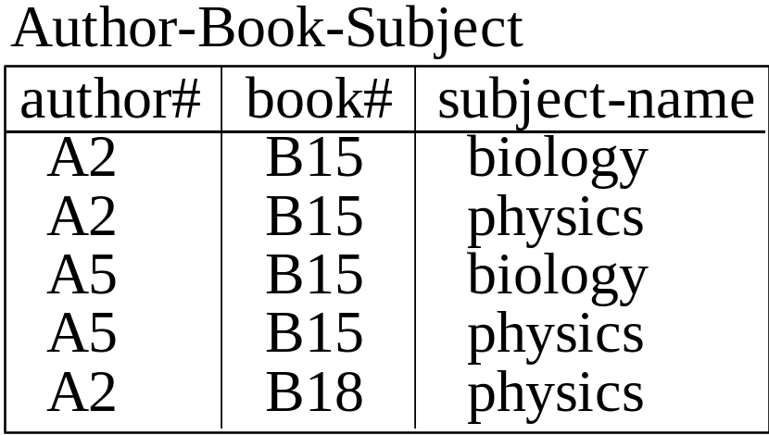
Book example (3)
If subject names biology & physics were deleted from rows 1 and 2, it would be possible to deduce those values from row 3 and 4
Therefore
author-book-subject
is well but
not fully
normalised

Slide 43
Book example (4)
The table is not fully normalised because the same set of subject-names is associated with each author of the same book.
Book# is said to multi-determine author# &
subject_name.
Note
This would not be true if a different rule were assumed. i.e. that subject-name refers to a subject area within a book for which an individual author was responsible.
eg. delete biology from row 3 => you cannot deduce the info. from elsewhere in the table.

Slide 44
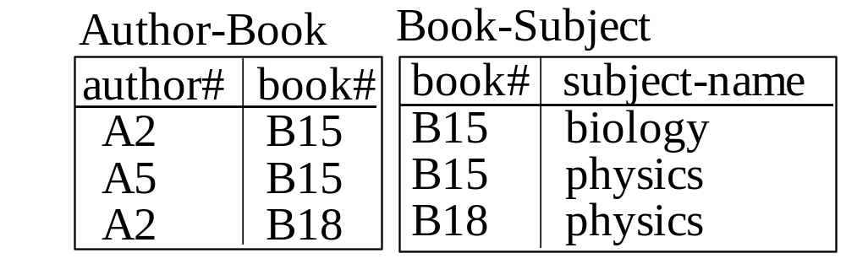
Book example (5)
Full normalisation can be achieved by splitting the table into two parts:

Slide 45
Advantages of Full Normalisation
• So far emphasis has been placed on eliminating
redundancy. Further benefits relate to deletion , insertion
operations.
Deletion Side Effect
Customer Name
Customer#
Salesman# Salesman Name
(badly normalised)

Slide 46
Advantages of Normalisation(2)
C# CName S# SName
C1 Brown S4 Jones
C2 Carter S7 Samson
C3 Cross S4 Jones
C4 Barns S8 Baker
• Delete C2 => delete whole tuple
=> lose salesman information
• Deleting C# on its own is not allowed as it is an
identifier and cannot be null

Slide 47
Advantages of Normalisation(3)
Insertion Side Effect
• Add S3 whose name is Hall
• You cannot do this until that salesman is associated
with a customer, otherwise identifier C# will be null
Should be modelled as:
C#
CName
S# SName
S#

Slide 48
Review

