Slide 1
DBMS IMPLEMENTATION
CONCURRENCY CONTROL
Transaction
• transaction is the basic unit of work in a DBMS
4 basic or acid properties of a transaction:
atomicity
consistency
independency
durability

Slide 2
Concurrency Control Properties
• atomicity
the all or nothing property; a transactions is an indivisible unit of work
• consistency
transactions transform the DB from one consistent state to another consistent state
• independence
transactions execute independently of one another i.e. partial effects of one transaction are not visible to other transactions
• durability ( also called persistence)
the effects of a successfully completed (committed) transaction are permanently recorded in the DB and cannot be undone

Slide 3
DB Processing
Execution of application processing consists of a series of atomic transactions with non-DB processing taking place in between
Figure 6.1 - Program executing several transactions

Slide 4
DB Processing (contd.)
• transaction manager oversees execution of a transactions and co-ordinates DB requests on behalf of the transaction
• scheduler implements a particular strategy for transaction execution
• objective of the scheduler is to maximise concurrency without allowing transactions to interfere with one another and compromise the integrity of the DB

Slide 5
DB Processing (contd.)
.
Transactions can be interleaved in 2 ways:
• end-to-end txn execution Figure 6.2
• concurrent txn execution Figure 6.3

Slide 6
DB Processing (contd.)
• start of a transactions signalled by
begin transaction
• end of a transaction signalled by either
commit (= successful termination)
or
abort (= unsuccessful termination)
(rollback)

Slide 7
Example DB Transaction
Figure 6.4 Funds transfer transaction

Slide 8
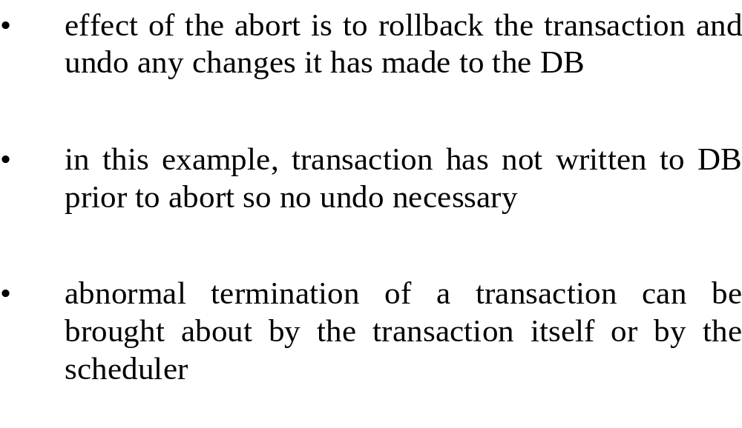
Example DB Transaction (contd.)

Slide 9
Transaction Interference
There are three different ways in which concurrently executing transactions can interfere with one another:
• lost update problem
• violation of integrity constraints
• inconsistent retrieval

Slide 10
Lost update Problem
• Apparently successful updates can be overwritten by other transactions
Figure 6.5 Lost Update Problem

Slide 11
Violation of Integrity Constraints
Example DB:
SCHEDULE (surgeon_name, operation, date)
SURGEON (surgeon_name, operation)
• SCHEDULE specifies which surgeon is to perform a particular operation on a particular day.
• SURGEON records the qualifications by operation for eachoperation
• integrity constraint:
surgeons must be qualified to perform the operations for which they are scheduled
Figure 6.6 shows the initial state of the DB,
Figure 6.7 shows the interleaving of 2 transactions, T₃ and T₄

Slide 12
        Figure 6.6 Initial DB State
Figure 6.7 Interleaving of Txns T₃ and T₄

Slide 13
Violation of Integrity Constraints (Contd.)
• Figure 6.8 shows the invalid state of the DB after execution of T₃ and T₄ .
Figure 6.8
Note: Neither transaction is aware of the action of the other transaction as they are both updating different data

Slide 14
Inconsistent retrieval (dirty read)
• Most Concurrency Control work concentrates on transactions which update DB since only they can corrupt the DB
• If transactions are allowed to read the partial results of incomplete transactions, they can obtain an inconsistent view of the DB (dirty or unrepeatable read)
• Example given in Figure 6.9

Slide 15
Example: Inconsistent Retrieval Problem
Figure 6.9

Slide 16
Schedules and serialisation
• A transaction consists of a sequence of reads and writes to the database
• The entire sequence of reads and writes by all concurrent transactions in a database taken together is known as a schedule.

Slide 17
Schedules and serialisation contd.
• a schedule S is generally written:
S = [ O¹, O², O³, ............, O^{m}]
where O^{i} indicates either a read (R) or write (W) operation executed by a transaction on a data item
• O¹ precedes O², which in turn precedes O³, and so on. This is generally denoted
O¹ < O² < O³ < ............ < O^{m}

Slide 18
Schedules and serialisation contd
• The schedule S for transactions T₁ and T₂ in Figure 6.5 would be
S = [R₂(balance_{x}), R₁(balance_{x}), W₂(balance_{x}), W₁(balance_{x}), R₁(balance_{y}), W₁(balance_{y})]
where R_{i} and W_{i} denote read and write operations, respectively, by transaction T_{i}.

Slide 19
Schedules and serialisation contd
• Most concurrency control algorithms assume that transactions read a data item before they update it (constrained write rule) i.e.
R_{i} (x_{j}) < W_{i} (x_{j}).
• The order of interleaving of operations from different transactions is crucial to maintaining the consistency of the database

Slide 20
Serial schedule
A serial schedule is one in which all the reads and writes of each transaction are grouped together so that the transactions are run sequentially one after the other, as in Figure 6.2(a)
• Schedule, S, is said to be serialisable if all the reads and writes of each transaction can be reordered in such a way that when they are grouped together as in a serial schedule, the net effect of executing this serial schedule is the same as that of the original schedule S

Slide 21
Serial schedule contd.
• This reorganised schedule is called the equivalent serial schedule of the original serialisable schedule
• A serialisable schedule will therefore be equivalent to and have the same effect on the DB as some serial schedule
Example
S₁ = [R₇(x), R₈(x), W₈(x), R₆(y), W₆(y), R₇(y), W₇(y)]

Slide 22
Serial schedule contd.
• chronologically, by start-time, the order of execution of transactions is T₇, then T₈ and followed by T₆
• logically however T₆ precedes T₇ which in turn precedes T₈, since T₆ reads the pre-T₇ value of y, while T₇ sees the pre-T₈ value of x,
i.e. T₆ < T₇ < T_{8,}
in spite of the fact that chronologically T₈ finishes before T₆ begins!

Slide 23
Serial schedule contd.
• schedule S₁ for Figure 6.10 is
S₁ = [R₇(x), R₈(x), W₈(x), R₆(y), W₆(y), R₇(y), W₇(y)]
and the equivalent serial schedule, SR₁ is
SR₁ = [R₆(y), W₆(y), R₇(x), R₇(y), W₇(y), R₈(x), W₈(x)]

Slide 24
Serial schedule contd.
• note that a serialisable schedule is not the same as a serial schedule
• Serialisability is taken as proof of correctness since a serial schedule cannot contain transactions which interfere with each other and a serialisable schedule is a schedule which has the same net effect as executing a serial schedule
=> one possible approach is to examine the schedule produced and see if it is serialisable

Slide 25
Serial schedule contd.
• However, deciding whether a schedule is equivalent to some serial schedule is a very difficult computational problem (with constrained write rule: polynomial complexity; without: NP-complete problem)
• better to design schedulers in such a way that they are guaranteed to generate only serialisable and hence correct schedules

Slide 26
Serial schedule contd.
Formally, we can state the rules for equivalence of schedules as:
Rule 1: Each read operation reads the same values in both schedules; this effectively means that those values must have been produced by the same write operations in both schedules
Rule 2: The final database state is the same for both schedules; thus the final write operation on each data item is the same in both schedules.

Slide 27
Conflicting operations
• Read operations cannot conflict with one another and the order of execution of R₁(x) and R₂(x) does not matter, i.e.
[R₁(x), R₂(x)] ≡ [R₂(x), R₁(x)]
but
[R₁(x), W₁(x), R₂(x)] ≠ [R₁(x), R₂(x), W₁(x)]

Slide 28
Conflicting operations contd.
• In terms then of schedule equivalence, it is the ordering of conflicting operations which must be the same in both schedules
• The conflict between a read and a write operation is called a read-write conflict, and a conflict between two write operations a write-write conflict.

Slide 29
CONCURRENCY CONTROL TECHNIQUES
Three basic concurrency control techniques:
• locking methods (conservative)
• timestamp methods (conservative)
• optimistic methods

Slide 30
Locking methods
• Most widely used approach
• A transaction must claim a read (shared ) or write (exclusive ) lock on a data item prior to the execution of the corresponding read or write operation on that data item
• More than one transaction can hold read locks simultaneously on the same data item

Slide 31
Locking methods contd.
• Only one transaction at a time can hold a write lock on a data item
• Transaction holds a lock until it explicitly releases it
• Effects of the write operation are not visible to other transactions until the write lock has been released

Slide 32
Locking methods contd.
• in Figure 6.10, the request by transaction T1 for a write lock on balance_{x} would be denied since T₅ already holds a read lock on balance_{x} .
• some systems allow upgrading and downgrading of locks
i.e. a read lock on a data item can be upgraded to a write lock, if it is the only transaction holding a read lock on that data item; similarly a write-lock can be downgraded to a read lock
(potentially allows greater concurrency)

Slide 33
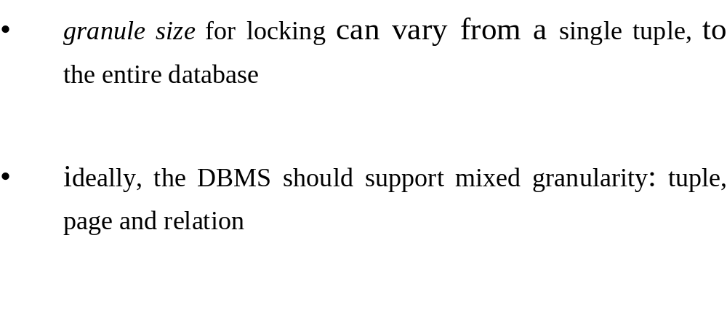
Granularity of locks

Slide 34
2 Phase Locking
most common locking protocol is known as two-phase locking (2PL)
transactions operate in 2 distinct phases:
  a growing phase during which the transaction acquires locks and a
  shrinking phase during which it releases those locks

Slide 35
Rules for transactions obeying 2PL
1. transactions are well-formed, thus a transaction must acquire a lock on a data object before operating on it and all locks held by a transaction must be released when the transaction is finished
2. compatibility rules for locking are observed, thus no conflicting locks are held (write-write and read-write conflicts are forbidden)
3. once the transaction has released a lock, no new locks are acquired
4. all write locks are released together when the transaction commits (to ensure atomicity).

Slide 36
Rules for transactions obeying 2PL (cont)
Note:
upgrading and downgrading of locks are possible under 2PL, with the restriction that downgrading is only permitted during the shrinking phase.
it can be proved that the schedules produced by transactions which obey 2PL are guaranteed to be serialisable.

Slide 37
Deadlock
Under 2PL, if a transaction T₁ requests a write-lock on data item x_{i}, which is currently locked by another transaction, T₂, there are two possibilities:
  Approach 1:
  Place T₁ on a queue for x_{i} awaiting release of lock by T₂
  Approach 2:
  Abort and rollback T₁

Slide 38
Deadlock (cont)
with Approach 1, T₁ retains all the locks it currently holds and just enters a wait state
Approach 1 can lead to deadlock
deadlock occurs when one transaction is waiting for a lock to be released by a second transaction, which is in turn waiting for a lock currently held by the first transaction
Therefore, in approach 1, a deadlock detection protocol is needed

Slide 39
Deadlock (cont 3)
With Approach 2, T₁ must release all its locks and restart (this could involve high overhead)
Approach 2 is referred to as a deadlock prevention protocol because transaction releases all its locks on becoming blocked, so deadlock cannot occur

Slide 40
LiveLock
transactions can be repeatedly rolled back or left in a wait state indefinitely, unable to acquire their locks, even though the system is not deadlocked => livelock, e.g. summary transactions
priority system is needed to avoid livelock, whereby the longer a transaction has to wait, the higher its priority.

Slide 41
Deadlock Detection
deadlock is generally detected by means of wait-for graphs.
transactions are represented by nodes and blocked requests for locks are represented by labelled, directed edges (see Figure 6.11)
deadlock is represented in the graph by the existence cycle between T₁ and T₂
informally, a cycle in a graph forms a closed loop by which it is possible to start at one node, traverse the edges of the graph according to the directions of the arrows and get back to where you started

Slide 42
Figure 6.11

Slide 43
DeadLock Detection (cont)
wait-for graph, G, can also be represented symbolically as:
G = T₁ → T₂ → T₁
where T₁ → T₂ indicates that transaction T₁ is waiting for transaction T₂ ; the → represents the wait-for relationship)
deadlock can occur between two transactions indirectly via a chain of intermediate transactions as shown in Figure 6.12

Slide 44
Figure 6.12

Slide 45
Deadlock Detection Graph
G' = T₁ → T₂ → T₃ → T₄ → T₅ → T₁
once detected, deadlock must be resolved by pre-emptying, i.e. aborting and rolling back, one of the transactions (any one will do since this will always break the cycle)

Slide 46
Deadlock Prevention
how does the transaction manager decide whether or not to allow a transaction T₁, which has requested a lock on data item x_{i} currently held by transaction T₂, to wait and to guarantee that this waiting cannot give rise to deadlock?
can force locks to be acquired in a certain data-dependent order (difficult to implement)
alternatively, transactions can be ordered and ensure that all conflicting operations are executed in sequence according to this order;

Slide 47
Deadlock Prevention (Cont)
deadlock is prevented by only allowing blocked transactions to wait under certain circumstances which will maintain this ordering
ordering mechanism is generally based on timestamps (unique identifier assigned to transaction when it is launched)
can ensure that either older transactions wait for younger ones (Wait-die) or vice versa (Wound-wait)
figure 6.13 gives the algorithm for wait-die, while figure 6.14 gives the algorithm for wound-wait.

Slide 48
Wait Die - Fig 6.13
BEGIN
T1 requests lock on data item currently held by T2
if T1 is older than T2 (I.e. ts(T1)<ts(T2) )
then T1 waits for T2 to commit or rollback
else T1 is rolled back
endif
END

Slide 49
Wound Wait Fig 6.14
BEGIN
T1 requests lock on data item currently held by T2
if T1 is older than T2 (I.e. ts(T1)<ts(T2))
then T2 is rolled back
else T1 waits for T2 to commit or rollback
endif
END

Slide 50
Deadlock Prevention (Cont)
if a transaction is rolled back, it retains its original timestamp (otherwise it could be repeatedly rolled back)
wait-die and wound-wait use locks as the primary concurrency control mechanism and are therefore classified as lock-based rather than timestamp

Slide 51
The deadlock spectrum
at one end of this spectrum, techniques are deadlock-free, i.e. deadlocks can never occur (require no run-time support)
at the other end, techniques detect and recover from deadlock
deadlock prevention methods lie in the middle,

Slide 52
TIMESTAMP METHODS
no locks are involved and there can therefore be no deadlock.
no waiting; transactions involved in conflict are simply rolled back and restarted.
transactions are ordered globally in such a way that older transactions, transactions with smaller timestamps, get priority in the event of conflict
read or write only be allowed if the last update on that data item was carried out by an older transaction; otherwise the requesting transaction is restarted and given a new timestamp.

Slide 53
Timestamps (cont)
Thus:
Timestamp methods produce serialisable schedules,
which are equivalent to the serial schedule defined by the timestamps of successfully committed transactions.
each transaction is assigned a unique timestamp, when it is launched
timestamps can use the system clock, a global counter or sequence number generator

Slide 54
Atomicity of transactions with timestamps
with timestamp protocols we must prevent other transactions from seeing partial updates since there are no locks
done by using pre-writes (deferred update)
updates of uncommitted transactions are not written out to the database, but instead are written to a set of buffers, which are only flushed out to the DB when the transaction commits.
has the advantage that when a transaction is aborted and restarted, no physical changes need to be made to the DB

Slide 55
Basic timestamping
To implement basic timestamping, the following variables are required:
for each data item x
  ts(read x) = the timestamp of the transaction which last read data item x
  and
  ts(write x) = the timestamp of the transaction which last updated data item x
  and for each transaction T_{i}
  ts(T_{i}) = the timestamp assigned to transaction T_{i} when it is launched
  transactions actually issue pre-writes to buffers rather than writes to the DB
  physical writes to the DB are only performed at commit

Slide 56
Pre-Write Algorithm Fig 6.18
BEGIN
Ti attempts to pre-write data item x
if x has been read or written to by a younger transaction (I.e. ts(Ti)<ts(read x) or ts(Ti)<ts(write x)
then reject Ti and restart as Tj
else accept pre-write: buffer (pre) write together with ts(Ti)
end if
END

Slide 57
Write Algorithm Fig 6.19
BEGIN
Ti attempts to update (I.e. write) data item x
if there is an update pending on x by an older transaction Tj (I.e. ts(Tj) < ts(Ti)
then Ti waits until Tj is committed or restarted
else Ti committs update and sets ts(write x) = ts(Ti)
end if
END

Slide 58
Read Operation using Basic Timestamping Fig 6.20
BEGIN
Ti attempts a read operation on data item x
if x has been updated by a younger transaction (I.e. ts(Ti)<ts(write x)
then reject read operation and restart Ti
else if there is an update pending on x by an older transaction Tj (I.e. ts(Tj)<ts(Ti) )
then Ti waits for Tj to commit or restart
else accept read operation and set ts(read x ) = max(ts(read x), ts(Ti) )
endif
enf if
end

Slide 59
Timestamping (cont)
Figures 6.18, 6.19 and 6.20 illustrate the algorithms for the pre-write, write and read operations, respectively, under basic timestamping
Timestamping method is equivalent to applying exclusive locks on the data items between the pre-write and write operations
Since all waits consist of younger transactions waiting for older transactions "deadlock" is not possible.

