Slide 1
Overview of Search
Basic Search
Heuristic Search
  Best First
  Hill-Climbing
Optimal Search
  Branch & Bound
  A*

Slide 2
Search
Obvious:
  Finding World Cup schedule on the Web.
  Finding the cheapest comms link between here and Tokyo.
  A robot navigating an environment strewn with obstacles.
  A web-crawler indexing web pages
Less Obvious:
  Playing Chess
  Job Shop Scheduling
  Planning a party

Slide 3
Search
Locations are called nodes
Collections between nodes are called arcs
Arcs can be directed so that they can only be traversed in one direction
A collection of arcs and nodes is a net or a graph
If every node in the net has a unique parent with one exception the net is a tree
The unique node is the root and has no parents

Slide 4
A Directed Graph (DG)
S
L
O
P
M
Q
N
F
  In fact a Directed Acyclic Graph (DAG)

Slide 5
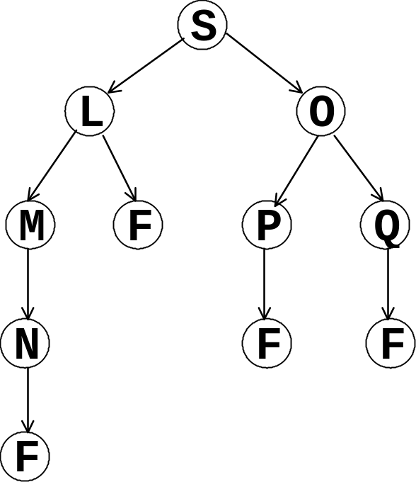
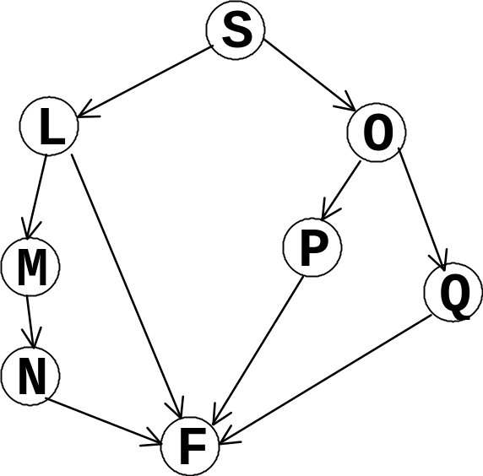
Search
  If we want to search through this graph from S to F this graph can be viewed as a tree.

Slide 6
Converting from graphs to trees
  A new copy is made of a node when it is about to be reached in more than one way
  A path is terminated when it is about to close on itself

Slide 7
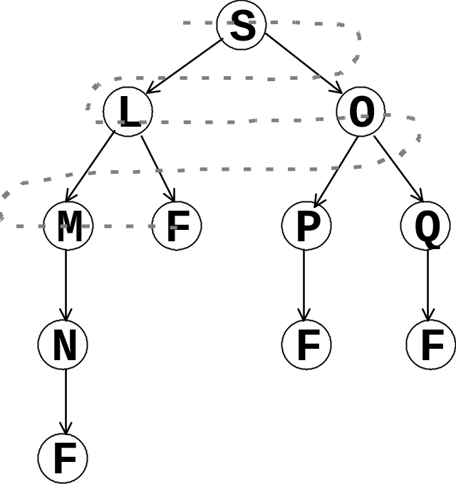
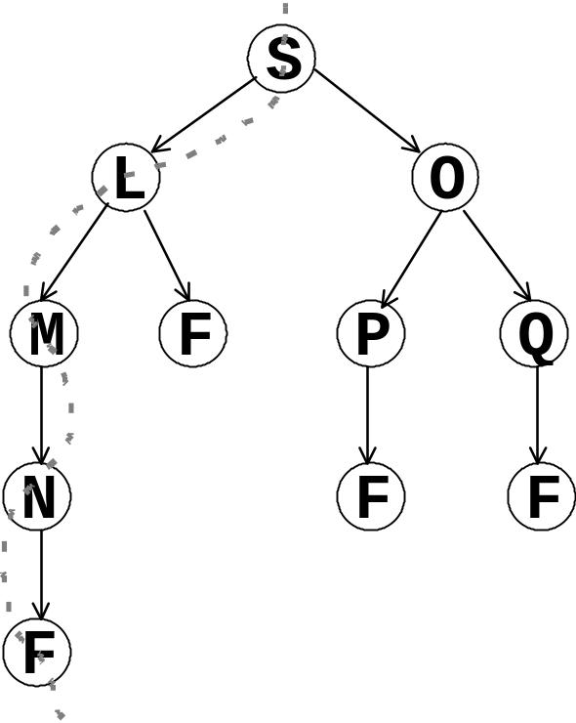
Breadth-first v’s Depth First
Breadth-first
Depth-first

Slide 8
Pseudo-code for search
function Search(agenda, finish)
{
case Empty(agenda)
return "Failed"
Reaches-Finish?(First(agenda))
return First(agenda))
otherwise
Search(Expand(agenda), finish)
}
Start by:-
Search(start, finish)
e.g:-
Search(S, F)

Slide 9
Managing the Agenda
The details of Expand determine the search strategy. This would implement depth first search.
function Expand(agenda){
if Not-Empty(agenda) then
agenda ← Append(Extend(First(agenda)),
Rest(agenda))
return agenda
}
i.e. extend the start of the agenda.
Dive into the tree

Slide 10
A trace of this code
search (s, f)
Level 0: Agenda: (((s)) f)
Level 1: Agenda: (((l s) (o s)) f)
Level 2: Agenda: (((m l s) (f l s) (o s)) f)
Level 3: Agenda: (((n m l s) (f l s) (o s)) f)
Level 4: Agenda: (((f n m l s) (f l s) (o s)) f)
Reaches-Finish?(First(agenda))
is now true so return (f n m l s)

Slide 11
Breadth-first
A simple modification to Expand would produce a breadth-first search strategy.
What is it?
Notes:
function Expand(agenda){
if Not-Empty(agenda) then
agenda ← Append(Rest(agenda),
Extend(First(agenda)))
return agenda
}
i.e. push new paths to the end - finish current level first.

Slide 12
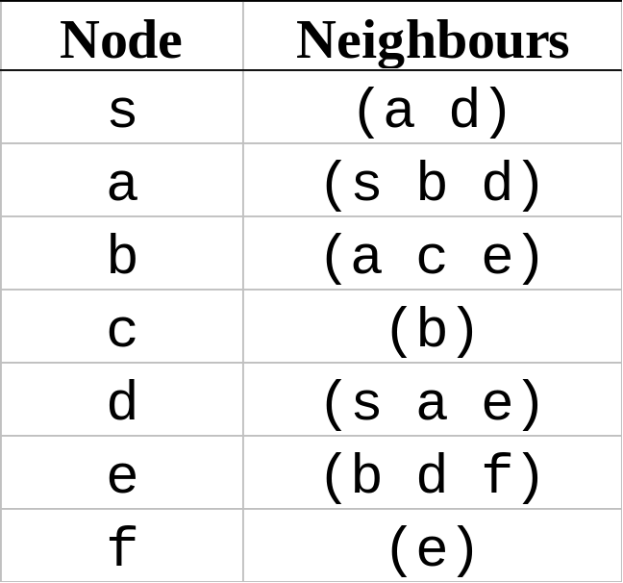
Basic Search
Show how the agenda would develop for this network when searching depth-first from s to f.
Notes:
This network is cyclic so there is a need to remove cyclic routes as they arise.
((s))
((sa)(sd))
((sas)(sab)(sad)(sd))
((saba)(sabc)(sabe)(sad)(sd))
((sabcb)(sabe)(sad)(sd))
((sabeb)(sabed)(sabef)(sad)(sd))
((sabeds)(sabeda)(sabede)
(sabef)(sad)(sd))

Slide 13
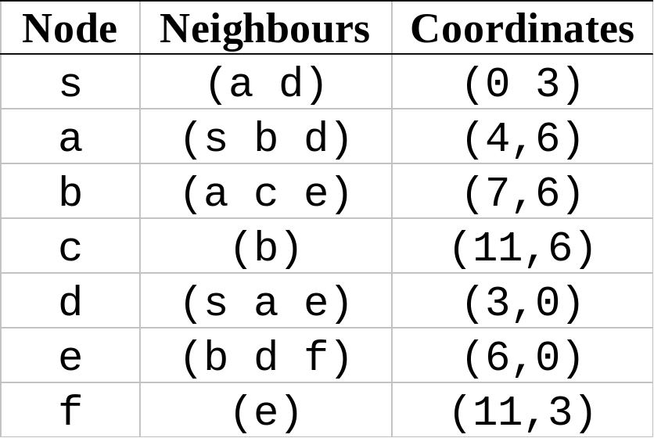
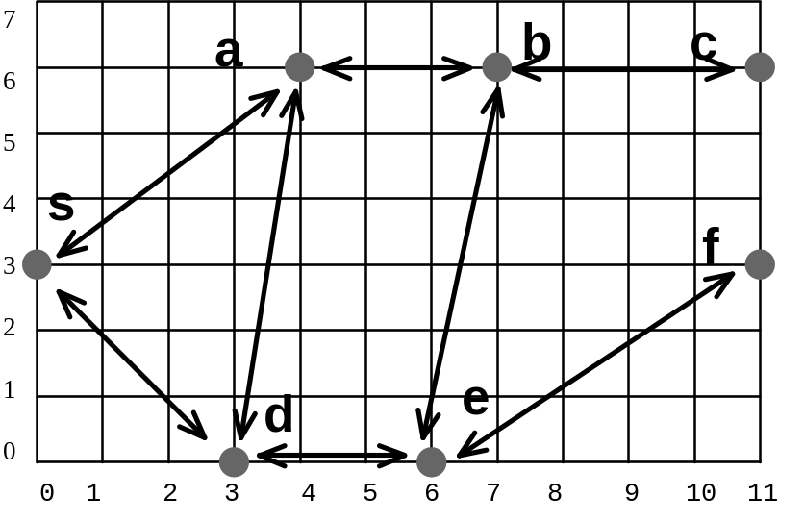
Heuristic Search
If we knew we were getting closer to the destination we could make search a bit smarter.
Hill Climbing: Select branch that brings us closest to goal.
Best First: Sort the agenda based on distance to go - branch on closest.

Slide 14
Hill Climbing v’s Best First
Best First and Hill-Climbing are often equivalent;
H-C is local while B-F is more global.
Agenda for B-F and HC
((sa)(sd))
((sab)(sad)(sd))
((sabc)(sabe)(sad)(sd))
((sabef)(sabed)(sad)(sd))
Draw a network where H-C and B-F will produce different results.

Slide 15
Optimal Search
These heuristic search techniques are quick but they do not produce very good solutions.
If we always branched on the shortest path so far it would always produce an optimal solution. This is Branch & Bound search.
Bound refers to the fact that you can bound out partial solutions longer than any full solutions that are found.

Slide 16
Branch & Bound
function B&B(agenda, finish)
{
case Empty(agenda)
return "Failed"
Reaches-Finish?(First(agenda))
return First(agenda))
otherwise
B&B(Sort(Expand(agenda)), finish)
}
If the agenda is sorted in order of increasing length, once a complete solution comes to the front it is guaranteed to be optimal.
Think about it!

Slide 17
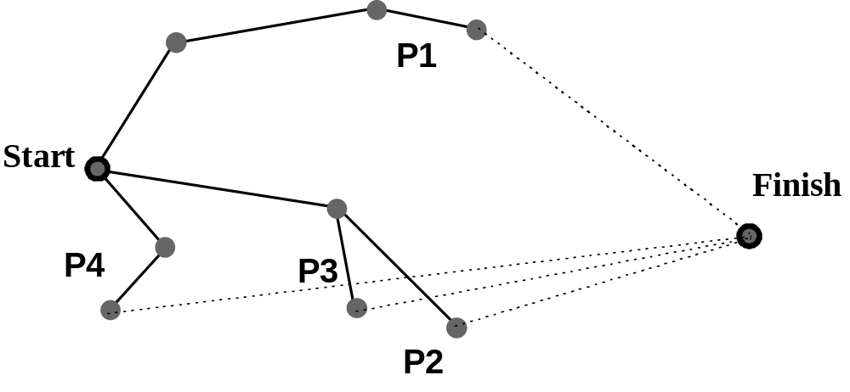
A*
1st Improvement
Sort agenda based on path-length + estimate of distance remaining.
  + If the estimate is an underestimate the solution will still be optimal.
Two improvements over B&B
B&B is not smart.
  · P4 would be selected above
  · P2 would be better

Slide 18
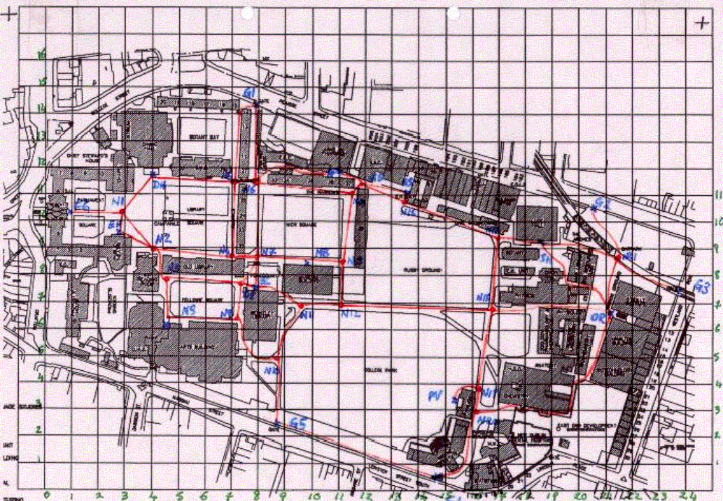
TCD Map

Slide 19
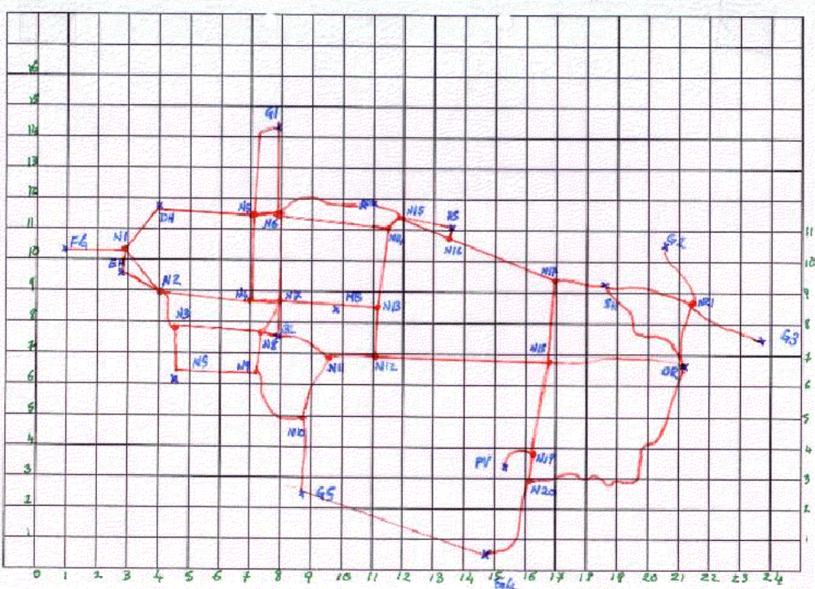
TCD Nodes

Slide 20
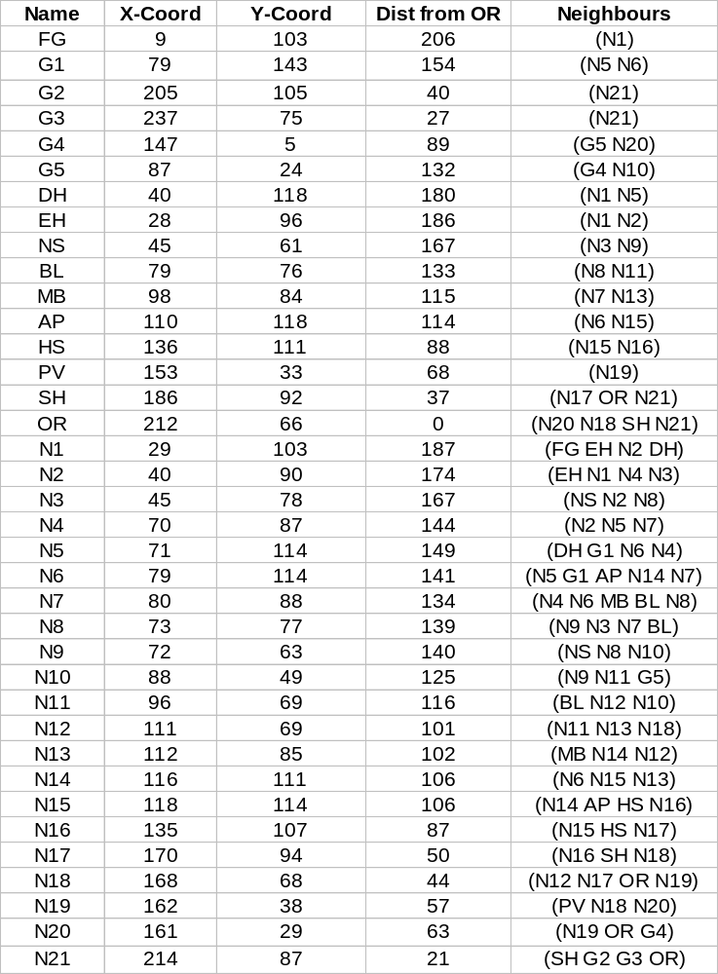
TCD
Co-ords

Slide 21
  If we search from OR to DH in the network above
  the final agenda looks like this:-
  (dh n5 n6 ap n15 n16 n17 sh or)
  (n14 n15 n16 n17 sh or)
  (n11 n12 n18 or)
  (hs n16 n17 sh or)
  (n13 n12 n18 or)
  (n21 or)
  (n17 n18 or)
  (n20 or)
  (n18 n17 sh or)
  (n19 n18 or)
  (hs n15 n16 n17 sh or)
  (g1 n6 ap n15 n16 n17 sh or)
  (n7 n6 ap n15 n16 n17 sh or)
  (n4 n5 n6 ap n15 n16 n17 sh or)
  (g1 n5 n6 ap n15 n16 n17 sh or)
  (n21 sh or)
  (n14 n6 ap n15 n16 n17 sh or)
2nd Improvement
Remove equivalent paths from agenda

Slide 22
Summary
Basic Search
Heuristic Search
  Best First
  Hill-Climbing
Optimal Search
  Branch & Bound
  A*

Slide 23
Tutorial
Using the network on slide 13 show the first 4 stages of the agenda for
  Depth First
  Breadth First
  Best First (distance to goal)
  Branch and Bound
Use Manhattan distance for BF and B&B
(instead of Euclidean)

