Slide 1
Nearest Neighbour Classifiers
Lazy v’s Eager
K-NN
Condensed NN

Slide 2
Classification problems
Exemplar characterised by a set of features; decide class to which exemplar belongs
Compare regression problems
Exemplar characterised by a set of features;
decide value of continuous output (dependant) variable

Slide 3
Lazy v’s Eager
D-Trees are an example of an Eager ML Algorithm
  D-Tree is built in advance off-line
  Less work to do at run-time
k-NN is a Lazy approach
  Little work done off-line
  keep training examples,
    find k nearest at run time

Slide 4
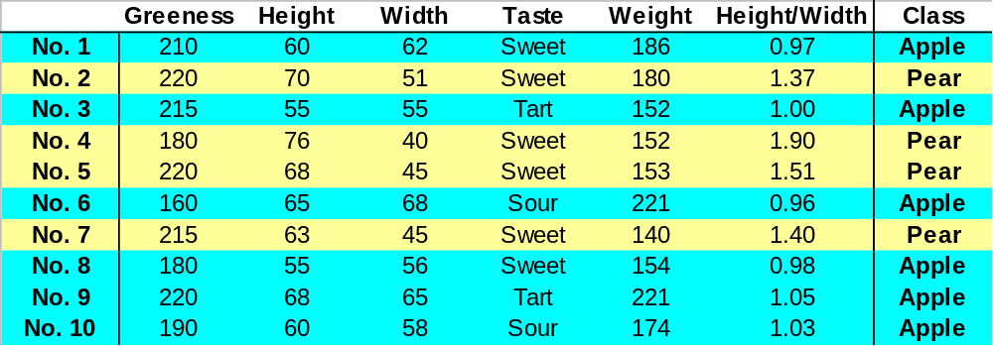
Classifying apples and pears
To what class does this belong?

Slide 5
Consider a Loan Approval System
What does similar mean?
σA
Amount
Monthly_Sal
Job Category
Credit Score
Age
Amount
Monthly_Sal
Job Category
Credit Score
Age
σM
σJ
σC
σG

Slide 6
Imagine just 2 features
2 features
  Amount
  Monthly_Sal
o
o
o
o
o
Monthly_Sal
o
o
o
o
x
x
x
x
x
x
x
x
Amount

Slide 7
k-NN and Noise
1-NN easy to implement
  susceptible to noise
    a misclassification every time a noisy pattern retrieved
k-NN with k ≥ 3 will overcome this

Slide 8
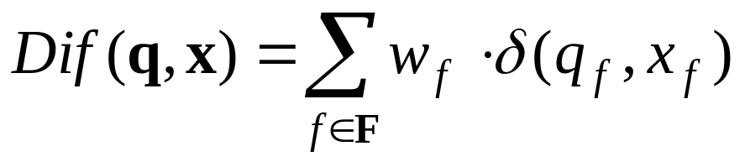
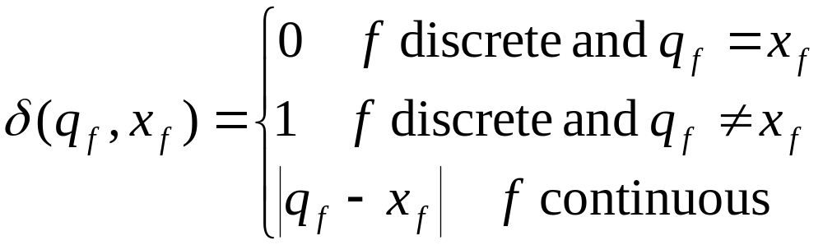
k-Nearest Neighbour
D set of training samples
Find k nearest neighbours to q according to this difference criterion
For each x ∈ D
where
Category of q decided by its k Nearest Neighbours

Slide 9
Appropriate δ functions
To what class does this belong?

Slide 10
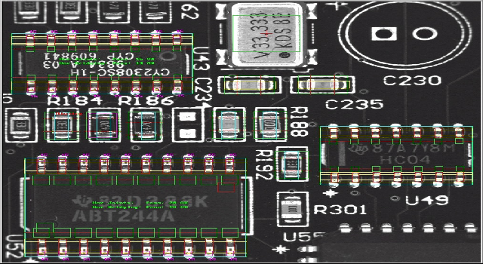
e.g. MVT (now part of Agilent)
Machine Vision for inspection of PCBs
  components present or absent
  solder joints good or bad

Slide 11







Components present?
Absent
Present

Slide 12
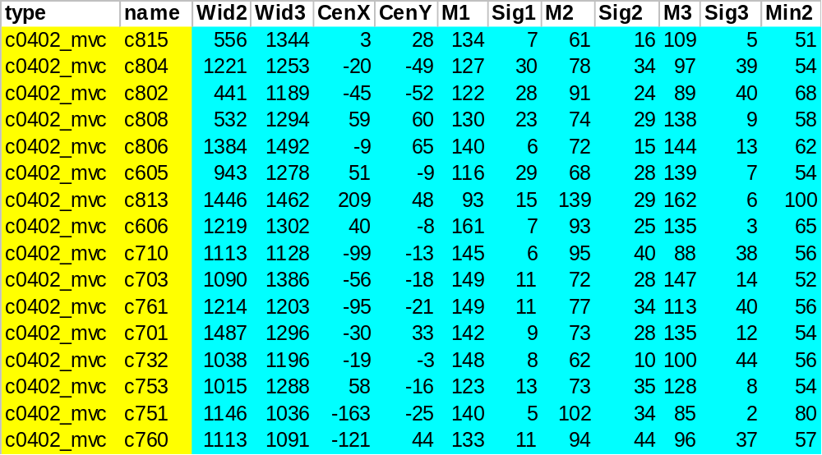
Characterise image as a set of features

Slide 13
Dimension reduction in k-NN
q best features
Feature Selection
Not all features required
  noisy features a hindrance
Some examples redundant
  retrieval time depends on no. of examples
n covering examples
m examples
Case Selection
p features

Slide 14
Condensed NN
D set of training samples
Find E where E ⊂ D; NN rule used with E
should be as good as D
choose x ∈ D randomly,
D ← D \ {x}, E ← {x},
DO
learning? ← FALSE,
FOR EACH x ∈ D
classify x by NN using E,
if classification incorrect
then E ← E ∪ {x},
D ← D \ {x},
learning ← TRUE,
WHILE (learning? ≠ FALSE)

Slide 15
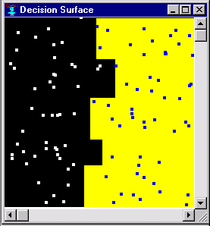
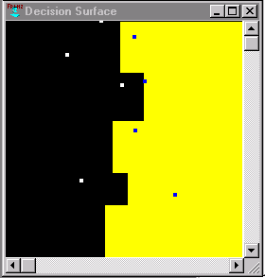
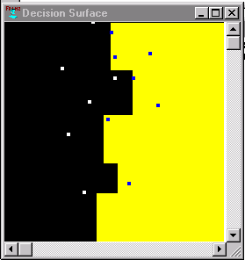
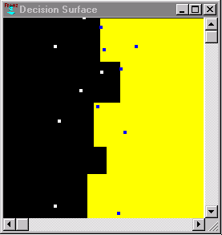
Condensed NN
100 examples
2 categories
Different CNN solutions

Slide 16
Improving Condensed NN
Different outcomes depending on data order
  that’s a bad thing in an algorithm
Sort data based on distance to nearest unlike neighbour
  identify exemplars near decision surface
  in diagram
  B more useful than A
A
B

Slide 17
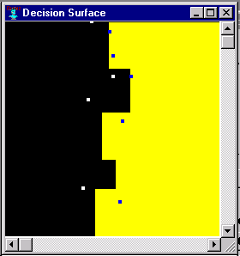
Condensed NN
100 examples
2 categories
CNN
using
NUN
Different CNN solutions

Slide 18
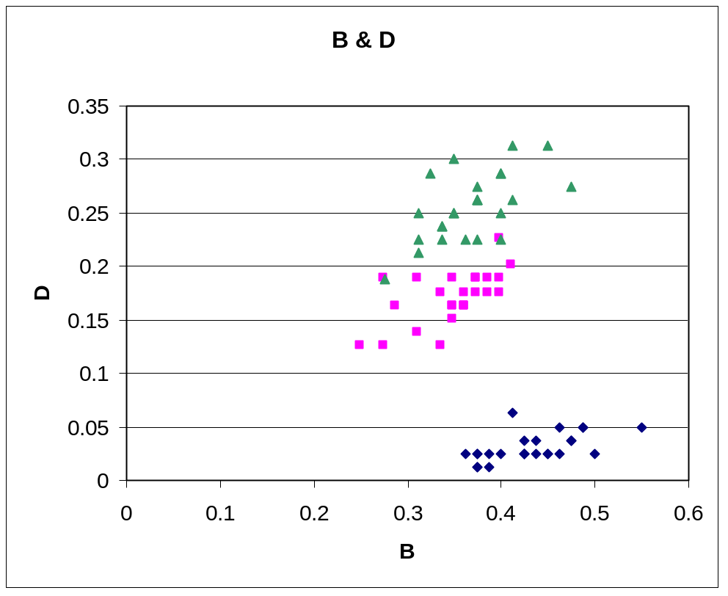
Aside: Real Data is not Uniform
Iris Data in two dimensions

Slide 19
K-NN: Summary
Lazy v’s Eager
How k-NN works
Dimmension reduction
  Condensed NN
  Feature Selection

