Slide 1
Nearest Neighbour Classifiers
Lazy v’s Eager
K-NN
Condensed NN
Feature Selection
Feature Weighting

Slide 2
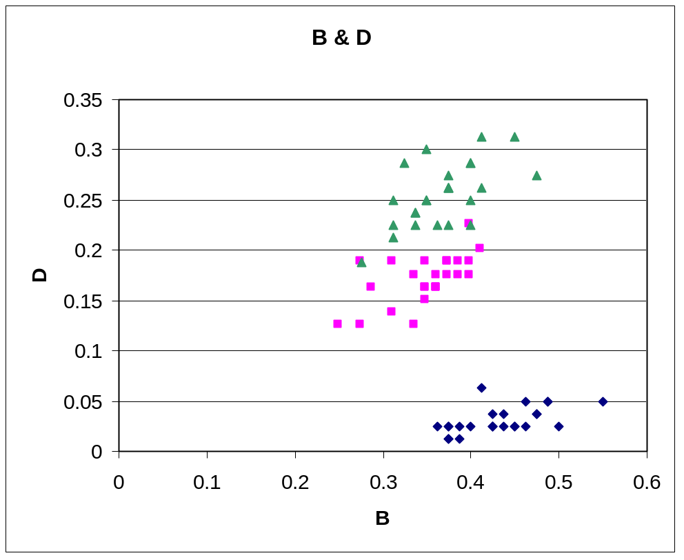
Aside: Real Data is not Uniform
Iris Data in two dimensions

Slide 3
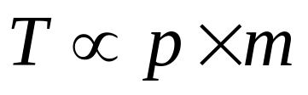
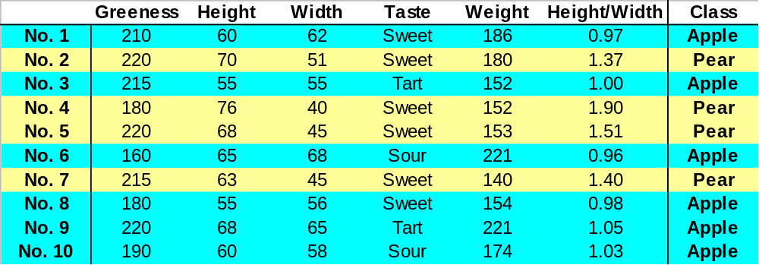
Feature selection
Irrelevant features are noise:
  make classification harder
Extra features add to computation cost
p
m

Slide 4
Feature selection is NP
2^{n} possible feature combinations
  powerset of all features
  two evaluation strategies
Filter
Selected
Features
Wrapper
Search
Algorithm
Search
Algorithm
Features
Features
Evaluation
Function
Classifier
Classifier

Slide 5
Filtering: Evaluation Function
Score predictivness of features, e.g.
  eigenvalues of covariance matrix of features
  information theoretic analysis
    high information gain
    all features appearing in a decision tree
  Relief algorithm
    Assign high scores to features that match on near hits and don’t match on near misses.
  some other statistical tests
    e.g. chi-square statistic

Slide 6
The Filter Approach: Problems
Model Bias
  Different features may suit different Induction Models (ANNs, Dtrees, K-NN, etc.).
Dependencies
  Features considered in isolation
    Two predictive but correlated features
      One will do!
    One features needs another
      Pears v’s apples; need width and height

Slide 7
Wrapper Approach
Training set
Feature selection search
Training set
Induction Algorithm
Performance
estimation
Feature set
Feature set
Induction Algorithm
Test set
Final Evaluation
Estimated
Accuracy
Induction Algorithm is ‘wrapped’ in the selection mechanism
Strengths
Takes bias of alg. into account
Considers features in context

Slide 8
Searching space of 2^{n} feature sets
Exponential search
  not on: evaluating classifier O(p × m²)
Stochastic Search
  Genetic Algorithm
  Simulated Annealing
Sequential Search
  Forward Sequential Selection
  Backward Sequential Selection

Slide 9
Performance Estimation
Performance Estimation guides search
  i.e. if we can determine that a classifier that uses features AC performs better than one that uses ACD we can drop feature D
  Test on Training Data
  Hold back data for testing
  K-fold Cross Validation

Slide 10
Performance Estimation guides search
Problems
  instability
    use k-fold cross vaidation
  overfitting
    if available data does not cover problem space
  minority classes
    e.g. 90% of tests negative
    relative costs of misclassificaiton
71%
59%
ABC
76%
B
AB
73%
58%
71%
ABD
71%
AD
A
ABCD
72%
68%
ACD
BD
66%
BCD

Slide 11
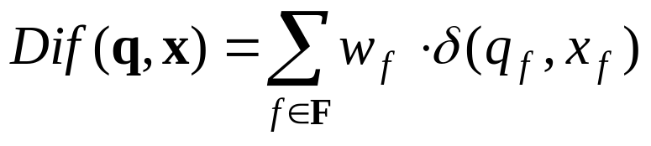
Feature Weighting
Remember
Unit Feature Weights
Weight Important Features
Target

Slide 12
Feature Weighting
Push
Use stochastic search ?
Use introspective learning
  Test training data on itself
    For a correct retrieval
      increase weight of matching features (pull)
      decrease weight of un-matching features (pull)
    For an incorrect retrieval
      decrease weight of matching features (push)
      increase weight of un-matching features (push)
Pull

Slide 13
Aside: beware of Overfitting
Error
Generalisation
error
In-sample
error
Training time

Slide 14
k-NN Summary
Lazy v’s Eager
HowK-NN works
Condensed NN
Feature Selection
  Filter
  Wrapper
Feature Weighting

