Slide 1
An AI-Based Boxing Force Estimation System Using Wearable Inertial Sensors
Speaker: Shou-Yi Huang
Date: 2026/10/15

Slide 2
Outline
4. Validation Method
  Dataset
  Data Split
  Metrics & Baselines
5. Results
  Overall Performance
  Prediction Analysis
  Feature Importance
  Future Work
1. Motivation
  Why Measure Punch Force?
  Limitations of Force Plates
2. Problem Definition
  High-Level Problem
  Input
  Output
3. Algorithm
  Pipeline Overview
  Acquisition & Synchronization
  Magnitude & Impact Window
  Feature Extraction
  XGBoost & Early Stopping

Slide 3
Outline
4. Validation Method
  Dataset
  Data Split
  Metrics & Baselines
5. Results
  Overall Performance
  Prediction Analysis
  Feature Importance
  Future Work
1. Motivation
  Why Measure Punch Force?
  Limitations of Force Plates
2. Problem Definition
  High-Level Problem
  Input
  Output
3. Algorithm
  Pipeline Overview
  Acquisition & Synchronization
  Magnitude & Impact Window
  Feature Extraction
  XGBoost & Early Stopping

Slide 4
Motivation: Why Measure Punch Force?
Punch force is a key indicator of striking performance, training progress and fatigue in boxing and other combat sports.
In daily training, coaches usually judge power by eye, which is subjective and cannot be compared across sessions or athletes.
Objective, per-punch quantitative feedback would let athletes and coaches track improvement and adjust training load.
Wearable inertial sensors (IMUs) are small, cheap and portable, and can be worn during any kind of training.

Slide 5
Limitations of Current Force Measurement
Force plates / instrumented bags measure impact force accurately, but they are expensive and fixed in one place.
They only measure punches that hit that specific target — not pads, heavy bags, shadowboxing or sparring.
Our force plate only displays a single peak value and must be read manually after each punch.
Goal: use the force plate only to collect labels, then let a wearable IMU + learned model estimate force anywhere.

Slide 6
Outline
4. Validation Method
  Dataset
  Data Split
  Metrics & Baselines
5. Results
  Overall Performance
  Prediction Analysis
  Feature Importance
  Future Work
1. Motivation
  Why Measure Punch Force?
  Limitations of Force Plates
2. Problem Definition
  High-Level Problem
  Input
  Output
3. Algorithm
  Pipeline Overview
  Acquisition & Synchronization
  Magnitude & Impact Window
  Feature Extraction
  XGBoost & Early Stopping

Slide 7
High-Level Problem
Given the motion of a punch measured by wearable IMUs, estimate how hard it hit (peak impact force) — without any force sensor at inference time.
Formulated as supervised regression: IMU signals → peak force.

Slide 8
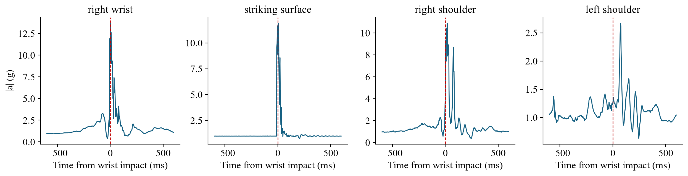
Input
One trial = a 5-s synchronized recording from 4 wireless IMUs (ANROT HI221, ≈400 Hz): right wrist, striking surface, right shoulder, left shoulder.
Each sample: 3-axis acceleration (g) and 3-axis angular velocity (deg/s); magnetometer and quaternion are also stored.
Current model input: right-wrist 6-axis signal, a ≈2000 × 6 matrix per trial.
Notes:
橫軸以右手腕 |a| 最大的時間點為 0，前後各取 600 ms。

Slide 9
Output
A single scalar ŷ = estimated peak punch force in kgf (1 kgf = 9.80665 N), one value per punch (trial).
Ground truth y: the peak force shown on the boxing force plate, entered manually after each trial (integer kgf).
Observed range in the current dataset: 16 – 53 kgf.
Notes:
1公斤力是指「1公斤質量」的物體在地球標準重力加速度（9.80665 m/s²）下所受到的重力。

Slide 10
Outline
4. Validation Method
  Dataset
  Data Split
  Metrics & Baselines
5. Results
  Overall Performance
  Prediction Analysis
  Feature Importance
  Future Work
1. Motivation
  Why Measure Punch Force?
  Limitations of Force Plates
2. Problem Definition
  High-Level Problem
  Input
  Output
3. Algorithm
  Pipeline Overview
  Acquisition & Synchronization
  Magnitude & Impact Window
  Feature Extraction
  XGBoost & Early Stopping

Slide 11
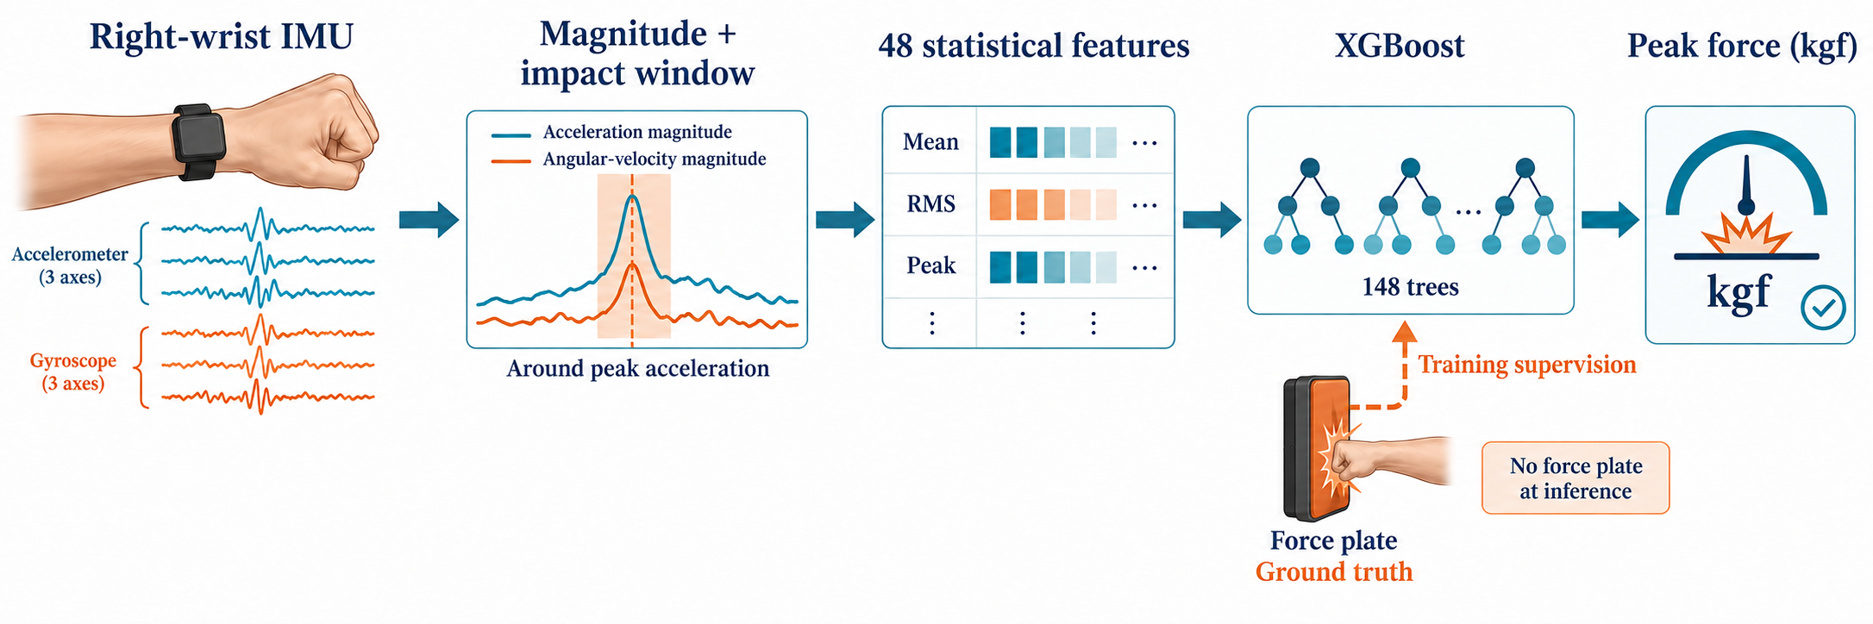
Pipeline Overview
Right-wrist IMU → magnitude + impact window → 48 statistical features → XGBoost (148 trees) → peak force (kgf); ground truth is used only during training.

Slide 12
Step 1: Data Acquisition & Synchronization
Load the trial configuration (COM port, group / node ID and wear location of each IMU) and open all receivers.
Count down 3 s, flush the serial buffers, then start one shared recording clock (t = 0).
Record all 4 IMUs simultaneously for 5 s; every sample is timestamped on the shared clock.
Save one raw CSV per IMU, then enter the force-plate peak force (kgf) as the trial label.
Purpose: all sensors share one time base, so the short impact can be aligned across sensors.

Slide 13
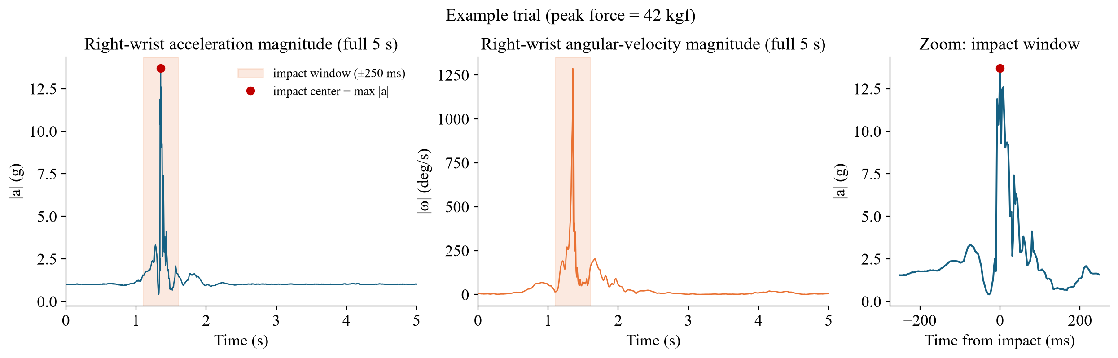
Step 2: Signal Magnitude & Impact Window
Compute the magnitudes |a| = √(a_{x}² + a_{y}² + a_{z}²) and |ω| = √(ω_{x}² + ω_{y}² + ω_{z}²) at every sample (independent of sensor orientation).
Find the impact center t* = argmax |a|, then cut the impact window [t* − 250 ms, t* + 250 ms] to isolate the punch.
Notes:
步驟1. 算出每個樣本的 |a|：三軸加速度做 L2 norm，得到長度 N（約 2000）的陣列。
2. 找 t*：argmax 取得 |a| 最大的樣本索引，再用它查出該樣本的 elapsed_us。
3. 建遮罩：每個樣本都檢查一次自己的時間和 t* 是否相差在 250 ms 以內，即 |elapsed_us − t*| ≤ 250,000 µs。符合的是 True，否則是 False。
4. 取出視窗內的資料：用遮罩挑出樣本，例如 acc_mag[impact_mask]、acc_x_g[impact_mask]，再對這些值算 mean、std、RMS、peak、P95、P99。
不會另外算角速度的 argmax。程式只用加速度算一次 t*，產生一個 impact_mask，再把同一個遮罩套用到所有訊號，包括角速度。

Slide 14
Step 3: Feature Extraction (48 Features)
Take two windows of the right-wrist signal: the full 5 s and the ±250 ms impact window.
For each window, compute:
  |a| and |ω|: mean, std, RMS, peak, P95, P99 → 2 × 6 = 12 features
  Each axis (a_{x}, a_{y}, a_{z}, ω_{x}, ω_{y}, ω_{z}): RMS and absolute peak → 6 × 2 = 12 features
Concatenate both windows → a 48-dimensional feature vector x per trial (2 × 24).
Purpose: compact, physically meaningful descriptors (peak ≈ intensity, RMS ≈ energy) suit the small dataset (102 trials).

Slide 15
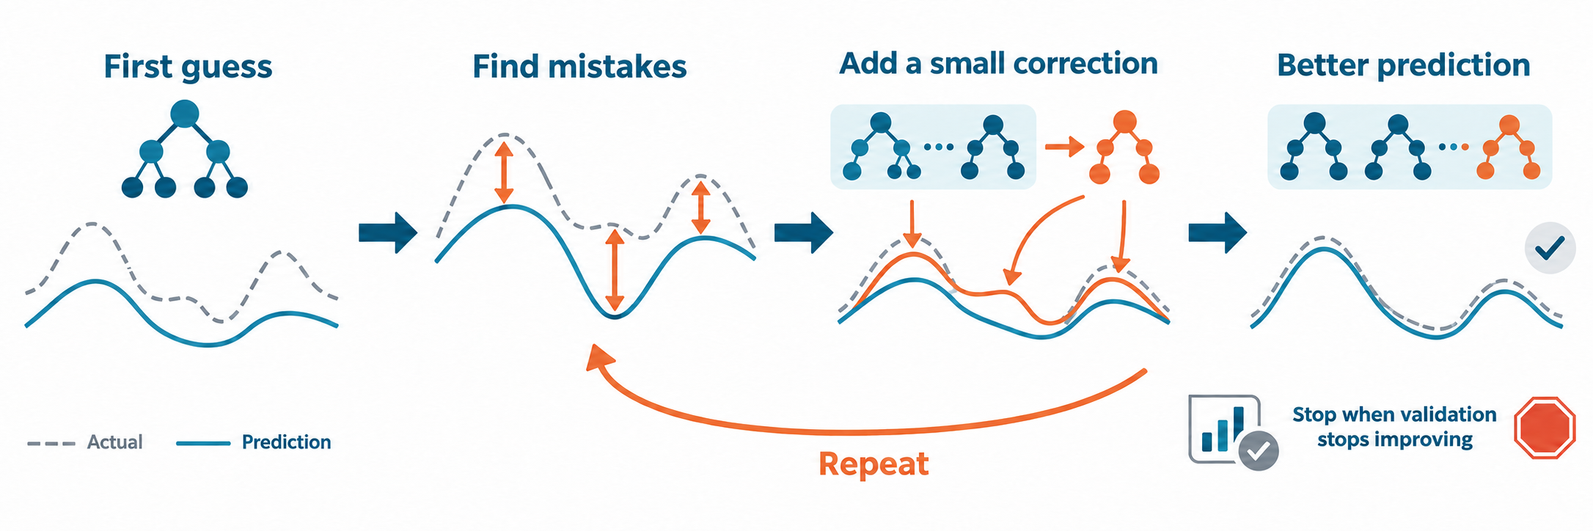
Step 4: XGBoost & Early Stopping
Build the training matrix (82 trials × 48 features) with peak force as the target.
Train gradient-boosted regression trees: each new tree fᵢ fits the residual of the current ensemble (squared-error loss); max depth 3, learning rate η = 0.03, subsampling 0.8.
After every round, compute the validation RMSE; stop when it has not improved for 50 rounds (max 1000).
Keep the best round (148 trees); prediction ŷ = base + η · Σ fᵢ(x).
Notes:
每新增一棵樹 \(f_i\)，都會學習目前整體模型（Ensemble）的殘差（Residual），以逐步降低預測誤差（使用平方誤差損失函數）。

Slide 16
Outline
4. Validation Method
  Dataset
  Data Split
  Metrics & Baselines
5. Results
  Overall Performance
  Prediction Analysis
  Feature Importance
  Future Work
1. Motivation
  Why Measure Punch Force?
  Limitations of Force Plates
2. Problem Definition
  High-Level Problem
  Input
  Output
3. Algorithm
  Pipeline Overview
  Acquisition & Synchronization
  Magnitude & Impact Window
  Feature Extraction
  XGBoost & Early Stopping

Slide 17
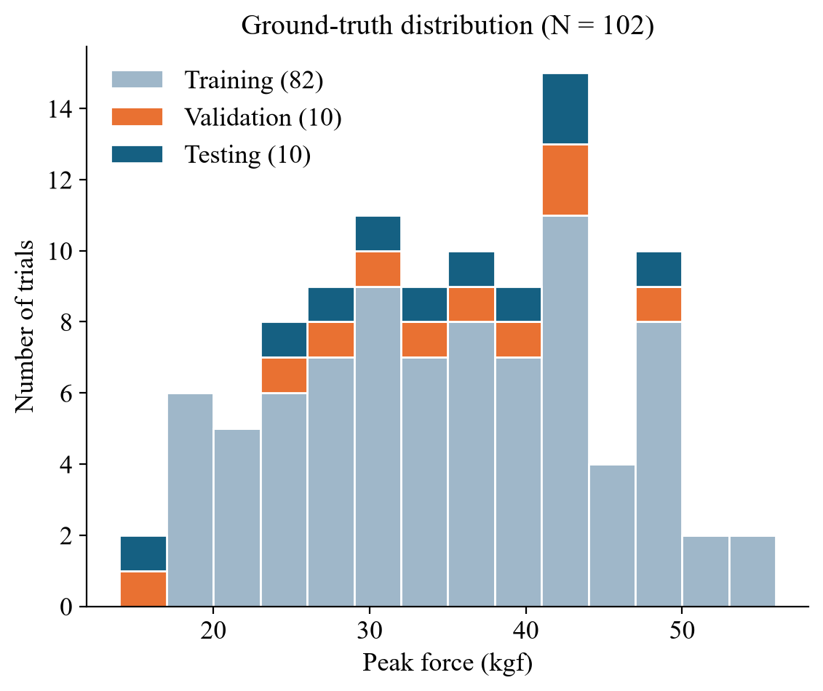
Dataset
1 subject (171 cm, 70 kg), right-hand punches, without gloves.
102 complete trials, each with 4 IMU recordings and one force-plate reading.
Peak force: 16 – 53 kgf, mean 34.5 ± 9.6 kgf.
Raw data, configuration and metadata of every trial are versioned and traceable.

Slide 18
Data Split: Force-Stratified 80 / 10 / 10
Sort trials by peak force, cut into blocks of 10, and randomly assign 8 / 1 / 1 in each block (seed 42) → 82 training / 10 validation / 10 testing.
Validation set: used only to decide when to stop training.
Testing set: never seen during training or model selection; used once for the final report.
Notes:
排序：102 個 Trial 依 Peak Force 由小到大排。力量相同時依 trial_id 排，確保每次排序結果一樣。
切組：第 1–10 名一組、第 11–20 名一組，依此類推，用的是 list slicing ordered[start:start+10]。
組內打亂：用固定 seed 42 的亂數打亂組內順序，所以每次執行結果相同。
分配：打亂後的前 8 筆給 Training，第 9 筆給 Validation，第 10 筆給 Testing。5. 餘數：102 不是 10 的倍數，最後剩 2 筆，全部給 Training。

Slide 19
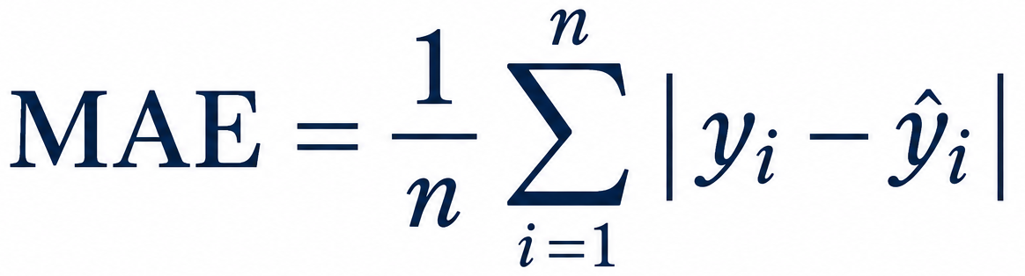
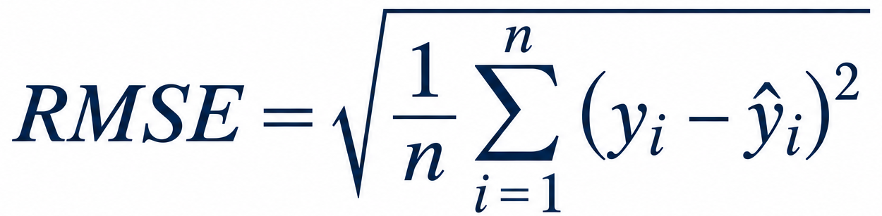
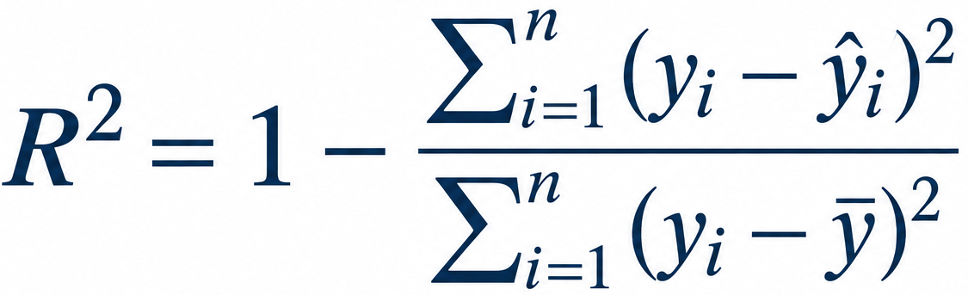
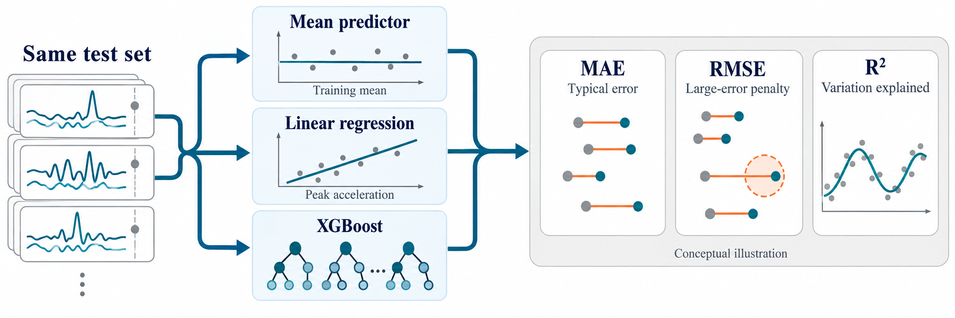
Metrics & Baselines
MAE (kgf): average absolute error — directly interpretable.
RMSE (kgf): penalizes large errors more heavily.
R²: fraction of force variance explained (1 = perfect, 0 = no better than the mean).
Baselines on the same testing set:
  Mean predictor — always outputs the training-set mean (lower bound).
  Linear regression on impact peak |a| — tests whether “larger acceleration = larger force” alone is enough.
Notes:
\(R^2=0\)：模型的平方誤差與直接使用真實值平均數預測相同。
R^2: 相對直接預測平均數的平方誤差

Slide 20
Outline
4. Validation Method
  Dataset
  Data Split
  Metrics & Baselines
5. Results
  Overall Performance
  Prediction Analysis
  Feature Importance
  Future Work
1. Motivation
  Why Measure Punch Force?
  Limitations of Force Plates
2. Problem Definition
  High-Level Problem
  Input
  Output
3. Algorithm
  Pipeline Overview
  Acquisition & Synchronization
  Magnitude & Impact Window
  Feature Extraction
  XGBoost & Early Stopping

Slide 21
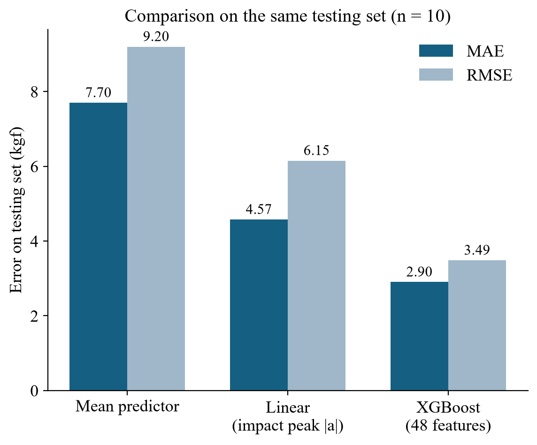
Overall Performance
Testing: MAE 2.90 kgf, RMSE 3.49 kgf, R² 0.856.
Validation: MAE 3.22 kgf, RMSE 3.88 kgf, R² 0.820.
MAE is 62 % lower than the mean predictor (7.70) and 37 % lower than linear regression on peak |a| (4.57, R² 0.55).
Peak |a| alone correlates only moderately with force (r = 0.53) → combining multiple features is necessary.
Notes:
\[
r=0.53\Rightarrow R^2=0.2809
\]
代表這個簡單線性迴歸模型可以解釋約 28.1% 的目標變數變異。

Slide 22
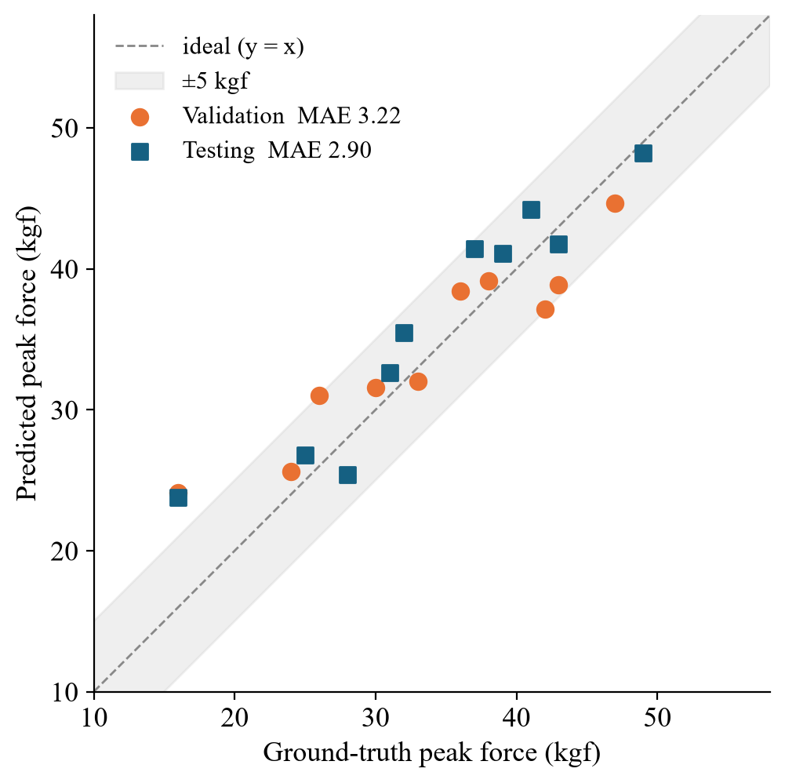
Prediction Analysis
9 / 10 testing punches are within ±5 kgf; maximum absolute error is 7.8 kgf.
Mid-range punches (25 – 50 kgf) follow the ideal line closely.
The weakest punches (16 kgf) are over-estimated (≈24 kgf): few training samples at the range extremes pull predictions toward the mean.

Slide 23
What Is Feature Importance?
Feature importance: how much each input feature contributes to the predictions.
Gain of a split: how much that split reduces the training loss.
Average gain: the mean gain over all splits that use the feature, across all trees.
Average Gain(f) = Total gain of all splits on f ÷ Number of splits on f
Example: f = full_acc_magnitude_g_std — used in 23 splits across the 148 trees
Tree 1
Gain 3,073.3
Tree 2
Gain 3,301.2
Tree 4
Gain 3,438.5
⋯
19 more splits
Tree 140
Gain 5.9
Average Gain
18,021.2 ÷ 23 = 783.5
Each gain = how much one split reduces the squared error (kgf²), summed over its samples — not one prediction error ŷ − y.
Notes:
Average Gain:某個特徵在所有樹的所有分裂（split）中，平均每次分裂讓 loss 下降多少。
Gain（單次分裂）= 分裂前的 loss − 分裂後左右子節點 loss 的總和（XGBoost 另含正則化項）。數值越大，代表這次分裂越能降低誤差。
單次 Gain 例子（Tree 1 根節點，64 拳，λ = 1）：Gain = G_L²/(H_L+λ) + G_R²/(H_R+λ) − G_P²/(H_P+λ) = 211.83²/23 + 219.78²/43 − 7.95²/65 = 1,950.95 + 1,123.33 − 0.97 ≈ 3,073.3。G 是節點內 Σ(ŷ − y)，H 是樣本數；gain 是分裂讓平方誤差減少的量，不是單一拳的誤差。
實際例子（本次模型共 148 棵樹）：full_acc_magnitude_g_std 在其中 22 棵樹被用來分裂，共 23 次，Gain 總和 18,021.2，Average Gain = 18,021.2 ÷ 23 ≈ 783.5，也就是下一頁排名第一的長條。
注意：impact_acc_magnitude_g_mean 的 Gain 總和 19,423.4 其實更高，但它被用了 33 次，平均每次只有 588.6，所以排第三。Average Gain 衡量的是「每次分裂的品質」，不是「被使用的總量」。

Slide 24
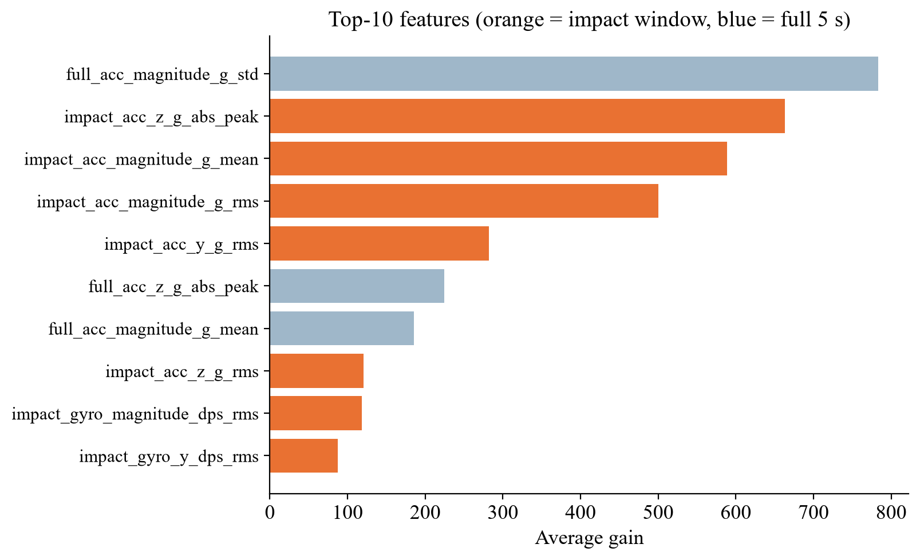
Feature Importance
The top 8 features are all acceleration-based; angular velocity contributes less.
7 of the top 10 come from the impact window → localizing the impact is useful.
The most important single feature is the std of |a| over the full 5 s, i.e. overall punch intensity.

Slide 25
Future Work
Train the model using data from multiple IMUs placed at different locations, aiming to reduce MAE and RMSE and improve R².

Slide 26
Thank You!!!

