Slide 1
An AI-Based Boxing Force Estimation System Using Wearable Inertial Sensors
Speaker: Shou-Yi Huang
Date: 2026/11/19

Slide 2
Outline
4. Pipelines
  Training Pipeline
  Force Estimation Pipeline
5. Future Work
1. Motivation
  Replacing the Force Plate
2. Force Model
  Force = m_{eff} × a_{peak}
  Measuring a_{peak}
  Range Limit of the Current IMU
  Higher-Range IMU Candidates
3. Effective Mass m_{eff}
  Factors Affecting m_{eff}
  Ground-Truth m_{eff}
  m_{eff} Regression Model
Notes:
本週主軸：用 IMU 訊號估計揮拳力量，取代昂貴的拳擊力板。

Slide 3
Motivation: Replacing the Force Plate
Boxing force plates measure punch force accurately, but they are expensive, fixed in place, and only measure punches on that specific target.
Wearable IMUs are small, low-cost and portable, and can be worn during any training — pads, heavy bags or sparring.
Goal: estimate punch force from IMU signals alone; the force plate is only needed to collect training labels.
Boxing force plate
+ accurate ground-truth force
– expensive
– fixed to one target
Wearable IMU + model
+ low cost, portable
+ any target, any training
– force must be estimated
Notes:
力板很準，但貴、固定在一處，只能量打在它上面的拳。IMU 便宜、可穿戴，任何訓練都能用。目標：只用 IMU 估計力量，力板只用來收集訓練標籤。

Slide 4
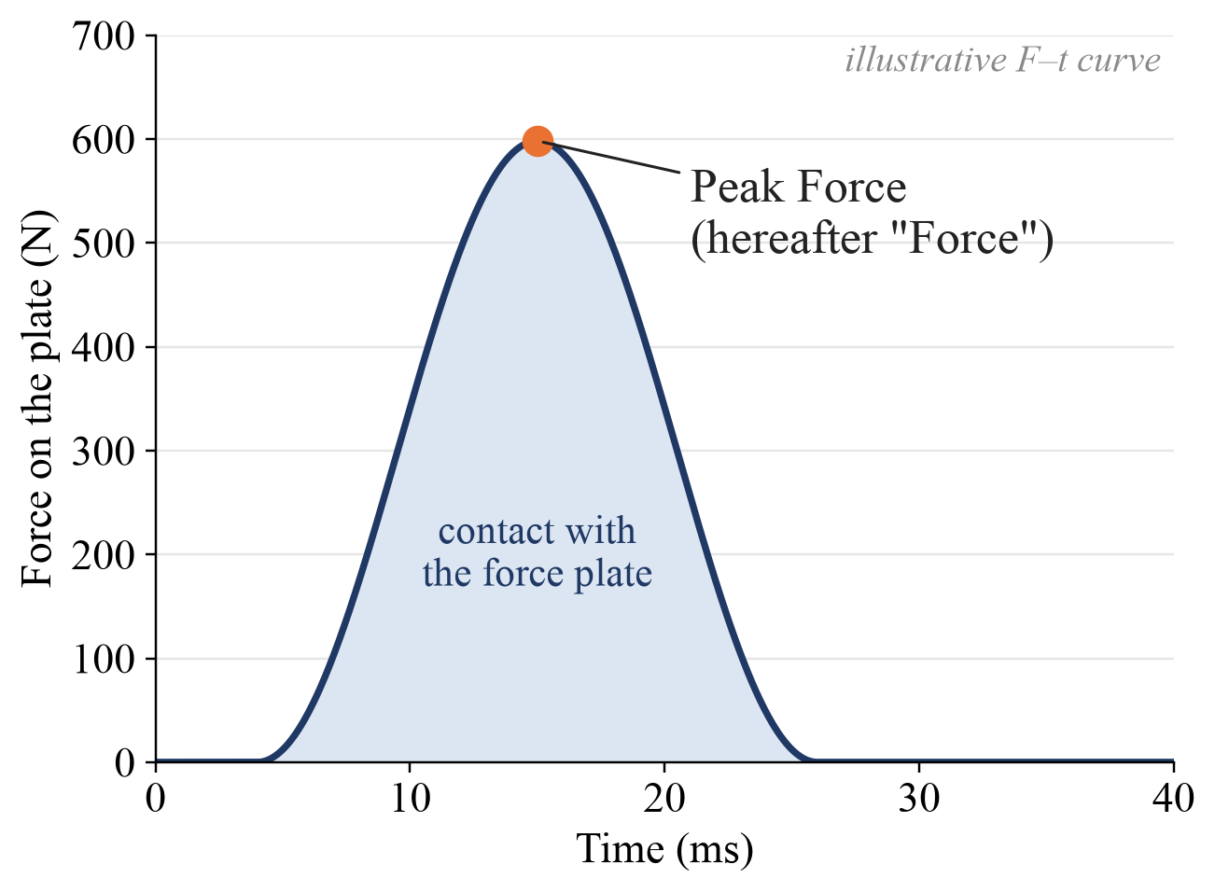
Force Model: Force = m_{eff} × a_{peak}
Peak Force: the maximum of the force–time (F–t) curve recorded by the force plate during one punch. Hereafter, Peak Force is called Force.
Force = m_{eff} × a_{peak}
a_{peak}: peak reverse acceleration (deceleration, opposite to the punch direction) while the fist is in contact with the plate.
m_{eff}: effective mass — the part of the body that is stopped together with the fist.
Units: Force [kgf] ÷ a_{peak} [g] = m_{eff} [kg].
Notes:
Peak Force 是力板 F–t 曲線的最大峰值，之後簡報都稱為 Force。依牛頓第二定律，Force = m_eff × a_peak。單位：kgf ÷ g = kg，所以 m_eff 直接以公斤表示。

Slide 5
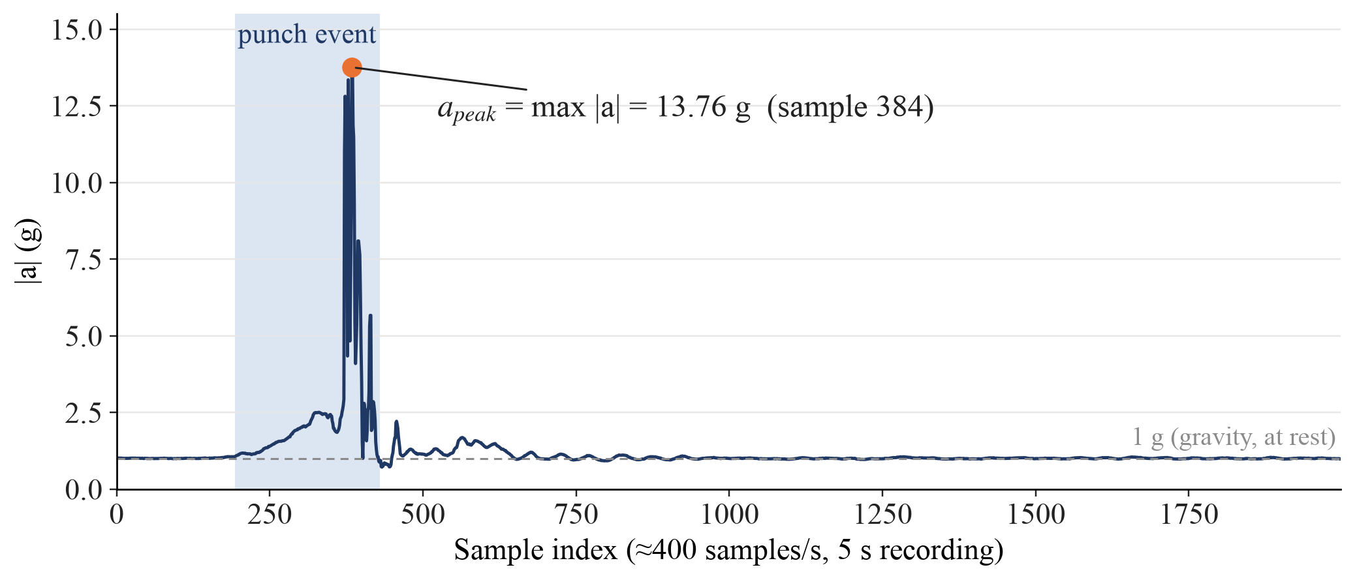
Measuring a_{peak}
IMU on the back of the right wrist (ANROT HI221, ≈ 400 samples/s).
Acceleration magnitude at every sample: |a| = √(a_{x}² + a_{y}² + a_{z}²), gravity included.
a_{peak} = maximum |a| over the whole punch event. Example (Force = 61 kgf): a_{peak} = 13.76 g.
Notes:
IMU 黏在右手腕背面。每個 sample 計算三軸合成加速度 |a|（含重力），a_peak 取整段揮拳事件的最大值。例：61 kgf 那拳，a_peak = 13.76 g。

Slide 6
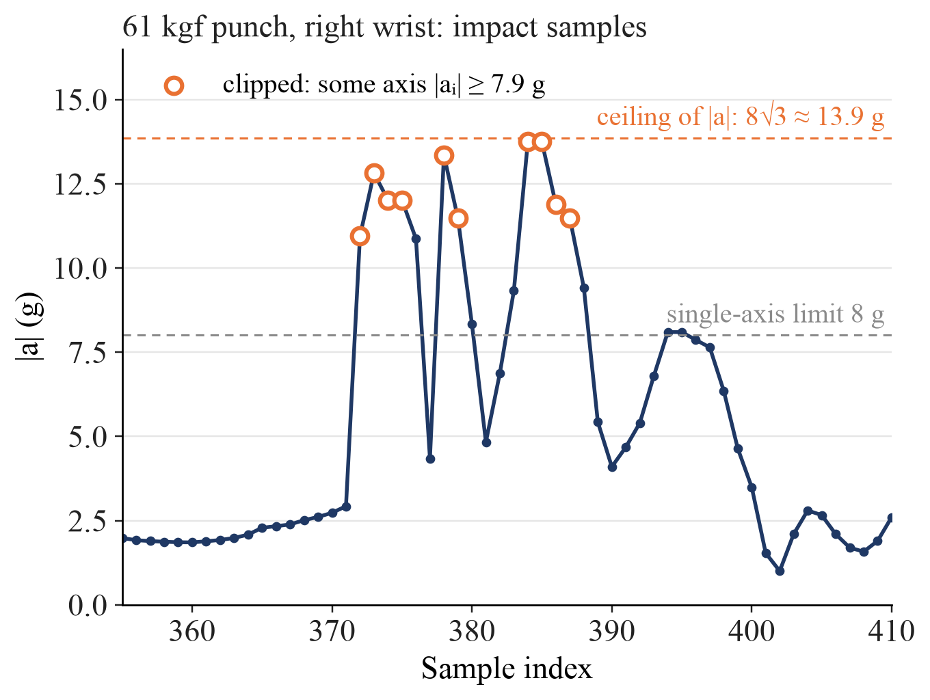
Why a_{peak} Is Not Accurate Yet
Current IMU (HI221): accelerometer range ±8 g per axis, including 1 g of gravity; not adjustable by AT commands.
Every right-wrist punch hits the limit: 89 / 89 trials (gloves) and 102 / 102 trials (no gloves).
With 2–3 axes clipped, |a| piles up near the ceiling 8√3 ≈ 13.9 g, so a_{peak} cannot separate weak from strong punches.
Conclusion: a higher-range IMU is required.
Notes:
HI221 加速度計每軸量程 ±8 g（含 1 g 重力），規格書的 AT 指令無法調整。右手腕 100% 的 Trial 都觸頂，每拳約 10–11 個 sample（約 25 ms）被截斷，正好是撞擊瞬間。兩三軸同時觸頂時 |a| 會堆在 8√3 ≈ 13.9 g 附近，無法分辨強弱拳。結論：需要更高量程的 IMU。

Slide 7
Higher-Range IMU Candidates
Product | Accelerometer | Gyroscope | Output rate | Unit price (TWD)
ANROT HI221 (current) | ±8 g | ±2000 dps | ≈ 400 samples/s | —
x-io x-IMU3 | ±24 g + ±200 g | ±2000 dps | 400 Hz; high-g 3200 Hz | ≈ 13,100 (£300)
Vicon Blue Trident | ±16 g + ±200 g | ±2000 dps | 1125 Hz; high-g 1600 Hz | ≈ 52,700 (US$1,600, 2020)
APDM Opal | ±16 g + ±200 g | ±2000 dps | — | quote only
Noraxon Ultium Motion | ±200 g | ±7000 dps | 1600 Hz | quote only
ST LSM6DSV320X (DIY chip) | ±16 g + ±320 g | ±4000 dps | — | board ≈ 530 + own build
Dual accelerometers: a low-g channel for the swing and orientation, a high-g channel for the impact.
The sensor must also be mounted rigidly: with the current foam tape it rings after impact (axes flip between ±8 g within 2.5 ms).
List prices converted at 2026-11-12 rates; tax and shipping excluded.
Notes:
高 g 產品通常同時有低 g（揮拳、姿態）與高 g（撞擊）兩顆加速度計。x-IMU3 約 NT$13,100，就有 ±200 g、3200 Hz 與 Wi-Fi 多顆同步，CP 值最高。另外安裝要剛性：目前泡棉膠讓感測器撞擊後振盪。價格為 2026-11-12 匯率換算的原價，未含稅與運費。
quote only
意思是「需要詢價」。APDM Opal 和 Noraxon Ultium Motion 這類研究級產品，官網沒有公開價格，只能聯絡原廠或代理商索取報價（quote）。所以表格無法填數字，只能寫 quote only。
board ≈ 530 + own build
這是 ST LSM6DSV320X 那一列，意思是：
board ≈ 530： 能買到的只有一塊評估用的轉接板 STEVAL-MKI251A，約 US$16.2 ≈ NT$530。上面只有這顆 IMU 晶片。
+ own build： 它不是現成可以戴在手上的無線感測器。要實際使用，還得自己做微控制器、無線傳輸、電池、外殼、多顆同步，以及韌體。官方的評估平台 STEVAL-MKI109D 要另外買，價格我沒查到。所以 NT$530 只是晶片板的價錢，實際總成本會高很多。

Slide 8
Factors Affecting m_{eff}
m_{eff} = how much body mass is rigidly coupled to the fist at impact; it changes from punch to punch.
Body size
Height, weight, segment and glove mass.
Signal: subject height & weight
Shoulder rotation
Trunk rotation speed at the moment of impact.
Signal: shoulder IMU angular velocity
Wrist angle
Wrist alignment and locking at impact.
Signal: wrist IMU orientation
Arm extension & joint stiffness
Elbow angle; muscles braced at impact.
Signal: wrist vs. shoulder orientation
Weight transfer
Body still moving forward at impact.
Signal: shoulder IMU forward velocity
Punch type & target
Jab / cross / hook; glove padding, plate stiffness.
Signal: trial metadata
Notes:
m_eff 代表撞擊瞬間有多少身體質量「跟著拳頭一起被擋下來」，每一拳都不同。這些因素大多可以用身高體重或手腕、肩膀 IMU 的訊號間接量到。

Slide 9
Ground-Truth m_{eff} from the Force Plate
Training: with a force plate
Force from the force plate (kgf)
a_{peak} from the wrist IMU (g)
m_{eff} = Force ÷ a_{peak}
→ one true m_{eff} label (kg) per punch
Deployment: no force plate
Ordinary pad or heavy bag
m_{eff} predicted by the pre-trained model
Force = m_{eff} × a_{peak}
→ Force without a force plate
pre-trained
m_{eff} model
Unit check: kgf ÷ g = kg, so m_{eff} is directly in kilograms.
Requires an unclipped a_{peak} → depends on the higher-range IMU.
Notes:
有力板時，每一拳 m_eff = Force ÷ a_peak，得到真實的 m_eff 標籤。未來在沒有力板、只有一般沙包或手靶的場景，m_eff 由預先訓練好的模型預測，再乘上 a_peak 得到 Force。前提是 a_peak 不能被截斷，所以依賴更高量程的 IMU。

Slide 10
m_{eff} Regression Model
Target: the m_{eff} label (kg) of each punch = Force ÷ a_{peak}.
Model: supervised regression — XGBoost as in the current baseline, with linear regression as a reference.
Evaluation: MAE of m_{eff} (kg) and of the resulting Force (kgf) on held-out punches; leave-one-subject-out once several subjects are recorded.
Data needed: several subjects to learn the effect of height and weight (current data: 1 subject).
Input group | Example features
Subject | height (cm), weight (kg)
Wrist IMU | wrist orientation at impact, pre-impact speed, angular velocity
Shoulder IMU | trunk rotation speed, forward velocity, timing relative to the impact
Output: predicted m_{eff} (kg)
Notes:
訓練目標是每一拳的 m_eff 標籤；輸入是受試者身高體重，以及手腕、肩膀 IMU 的特徵。模型沿用 XGBoost，並以線性迴歸作為對照。要學到身高體重的影響需要多位受試者，目前只有 1 位。

Slide 11
Training Pipeline of the m_{eff} Model
Force plate
Force (kgf)
m_{eff} label
= Force ÷ a_{peak}
Wrist IMU
a_{peak} (g)
target
Regression training
XGBoost
Trained m_{eff} model
Subject info
height, weight
Feature extraction
Feature vector
input
Wrist & shoulder IMU
Notes:
上半部產生 m_eff 標籤：力板給 Force，手腕 IMU 給 a_peak，相除得到 m_eff。下半部產生輸入特徵：身高體重與手腕、肩膀 IMU 特徵。兩者一起訓練迴歸模型，輸出預先訓練好的 m_eff 模型。

Slide 12
Force Estimation Pipeline
Wrist IMU
a_{peak} (g)
×
Force (kgf)
= m_{eff} × a_{peak}
Subject info
height, weight
m_{eff} (kg)
Feature extraction
Pre-trained m_{eff} model
Wrist & shoulder IMU
No force plate is needed at inference — only the IMUs and the subject’s height and weight.
Notes:
推論時不需要力板。手腕 IMU 直接得到 a_peak；身高體重與手腕、肩膀 IMU 特徵輸入預先訓練好的 m_eff 模型得到 m_eff；兩者相乘得到 Force（kgf）。

Slide 13
Future Work
Acquire a higher-range IMU (e.g., x-IMU3) and verify that a_{peak} is no longer clipped.
Mount the sensors rigidly and run a tap test to compare with the current foam tape.
Collect new trials with the force plate plus wrist and shoulder IMUs; recruit more subjects with different heights and weights.
Train and evaluate the m_{eff} model; compare the Force error with the current XGBoost baseline.
Notes:
下一步：採購高量程 IMU 並確認 a_peak 不再被截斷；改用剛性固定並做敲擊測試；搭配力板收集手腕＋肩膀 IMU 資料、增加受試者；訓練 m_eff 模型並和目前的 XGBoost baseline 比較。

Slide 14
Thank You!!!

