Slide 1
Exploiting Social Networks to Improve Recommendations

Slide 2
Research Plan
Hypothesis: People with more friends are more influential
Weight kNN votes by network degree so that predicted ratings/recommendations reflect this
Compare to other recommenders using RMSE to measure accuracy

Slide 3
kNN Recommender
Each unobserved rating is predicted as the (weighted) average of the k nearest neighbors (using Euclidean distance)

Slide 4
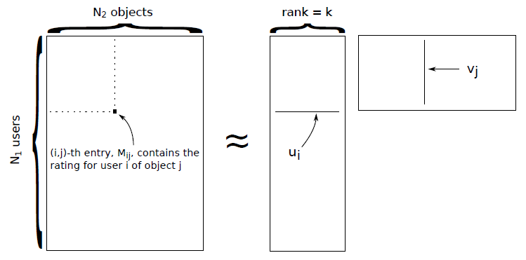
Collaborative Filtering / Matrix Factorization

Slide 5
Issues and Challenges
Size of dataset / scalability
1.6 million reviews; 61 thousand businesses; 3 million user friendships
AZ data was still large: 6.8 thousand users and 7.7 thousand businesses (full ratings matrix would be a little over 53 million cells)
Took several hours to run collaborative filtering for a single value of k (k=20)
Took 1.5 hours to run kNN for all 18 thousand ratings in the test set
Dealing with such data in the real world, it would be necessary to use MapReduce framework
Incompleteness of dataset – working with a small subset of total data led to inconsistencies (businesses with only 1 or 2 ratings had to be dropped)

Slide 6
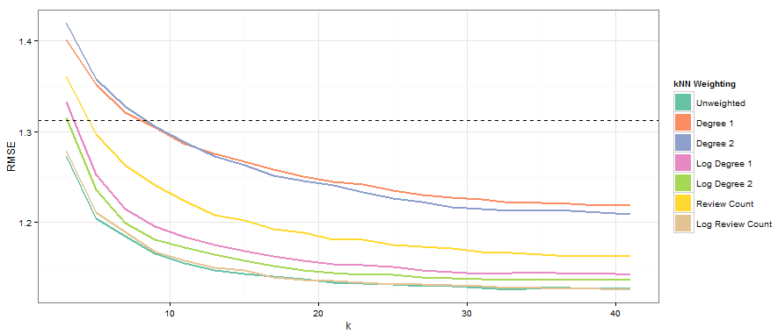
Results

Slide 7
Results Summary
Across the board the log counts performed better than raw counts
None of the weights performed better than the unweighted kNN algorithm
Even the bad weighting schemes beat the matrix factorization recommender by about k=8

Slide 8
The takeaway:
Keep it simple!!

