Slide 1
Yelp: Friendships and Recommendations
Presented By:
Jeff, Conan, and Jonathan

Slide 2
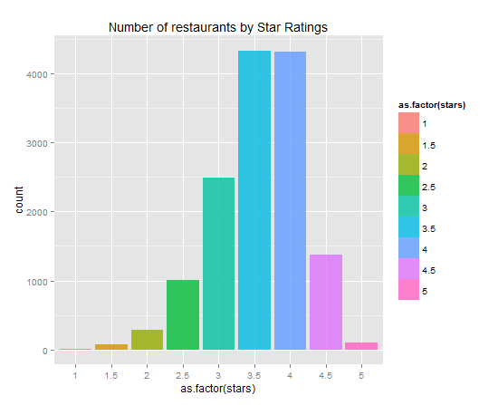
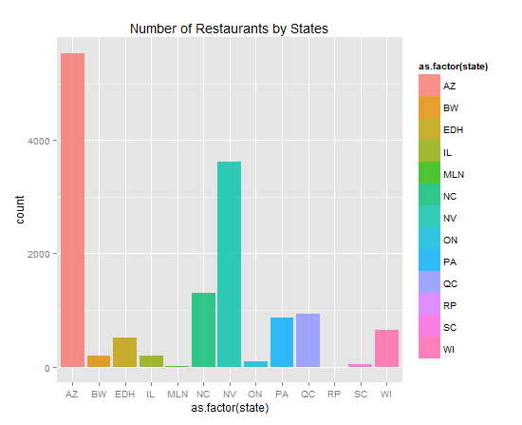
Overview
Notes:
Left: Skewed Normal Distribution centered between 3.5 and 4. Not surprising after all.
Better than average restaurants tend to get more customers, thus more reviews.
Restaurants with perfect ratings are hard to achieve, and relatively rarer to come by
Right: Top three states by number of restaurants reviewed are Arizona, Nevada, and North Carolina where Phoenix, Las Vegas, and Charlotte reside.

Slide 3
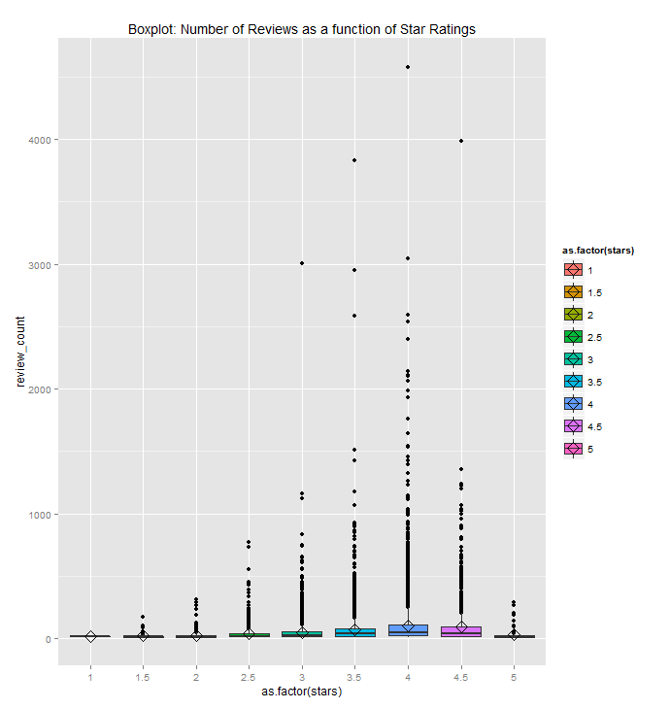
Review vs Stars
Notes:
Number of reviews as a function of stars:
A skewed distribution centered around 4 stars, where ratings around 4 stars have lots of outliers. This means lots of restaurants with more than 500 reviews per restaurant.
The most extreme outlier is a 4 star restaurant with 4,578 reviews
Thus if a restaurant is very popular and the number of reviews are just over the roof, the average rating of the restaurant is expected to be 4 stars, plus minus 0.5

Slide 4
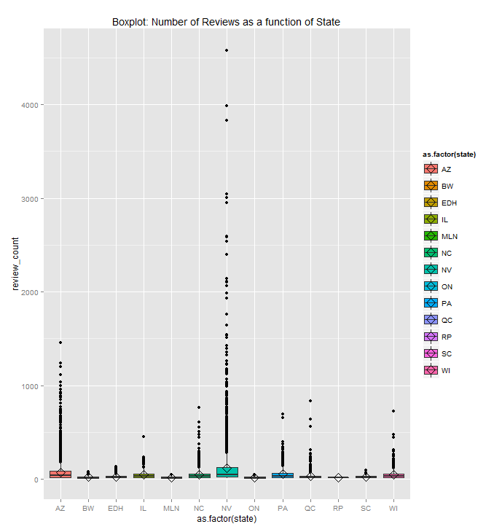
Review Count vs State
Notes:
The graph clearly shows where restaurants with ridiculously number of reviews reside: Greater Las Vegas, NV
In fact, all restaurants with more than 1500 reviews reside in Nevada, although Nevada does not have the most number of restaurants reviewed.

Slide 5
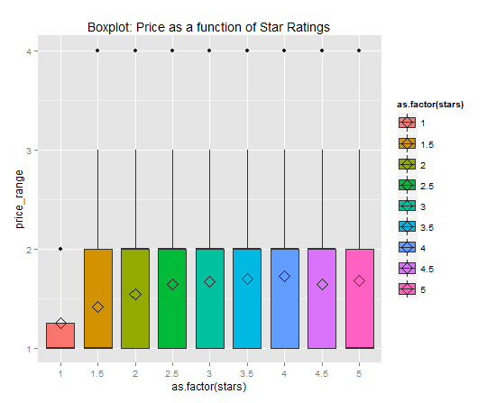
Price Level vs Star Ratings
Notes:
We see a nice parabola-shaped imaginary line connecting average price range across all star ratings from low to high. Between star rating 1 and 4, we see as star ratings goes up, the price generally goes up at a decreasing rate. But when star rating hit 4.5, we observe a dip in average price level that’s on par with star rating 2.5. And when star rating reaches 5, it is almost on par with 3.
It’s interesting to note that the median price level of star rating 5 is at 1, indicating that there are other factors that might affect price level

Slide 6
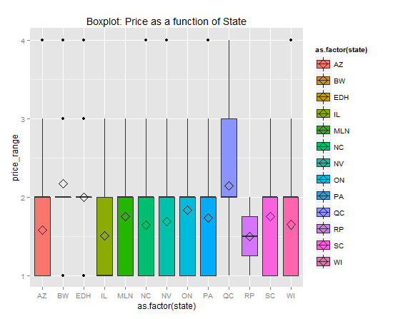
Price Level vs State
Notes:
First, restaurants from outside of the U.S, such as BW, QC, EDH, and ON, tend to have higher average price level, with the exception of RP in Germany, which has both the lowest price both in mean and median.
Secondly, East Coast states, such as PA and SC tend to have higher price level than their west coast peers, but still less than their international peers.
Thirdly, price level in the South West and Mid-West, such as AZ and WI are on par, while IL is on par with RP from Germany

Slide 7
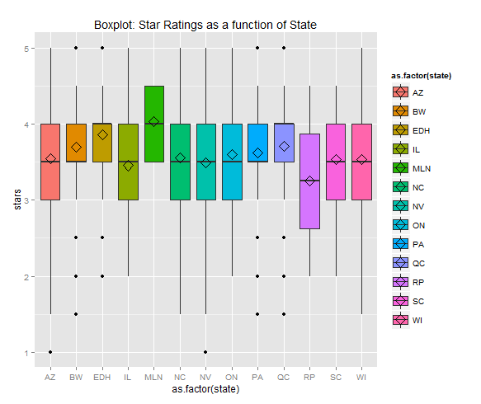
Star Ratings vs States
Notes:
Some general trends:
Cities at the UK and Canada tend to have higher median restaurant ratings than the U.S, while cities in Germany have the same or lower median ratings than these in the U.S. All US states have the same median ratings
Given its relatively small size, WI still have extremely similar distribution to the top three states, AZ, NC, NV
BW, Germany and PA have very similar distribution while EDH and QC have very similar distribution

Slide 8
Yelp and Social Networking

Slide 9
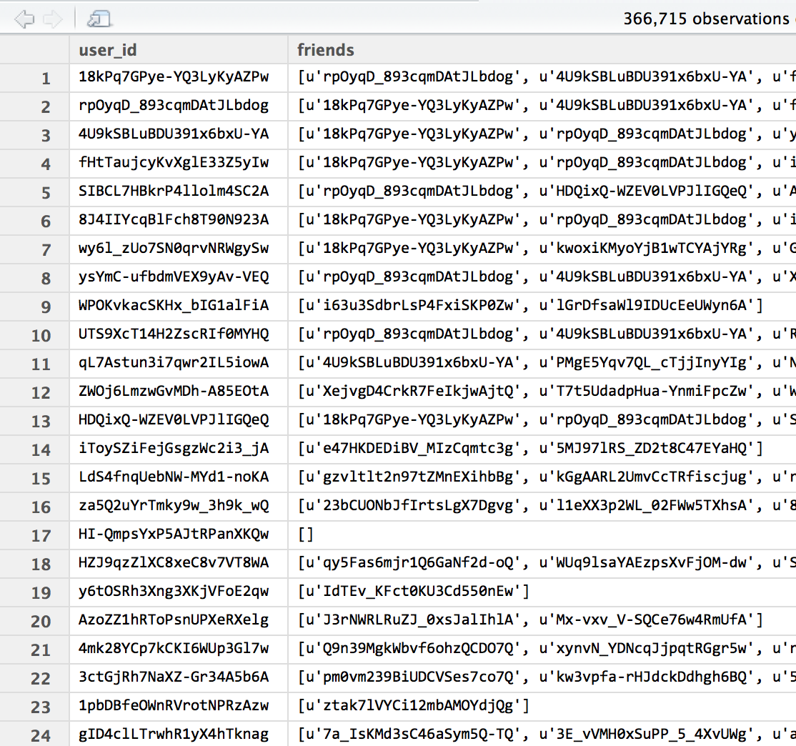
Data Structure

Slide 10
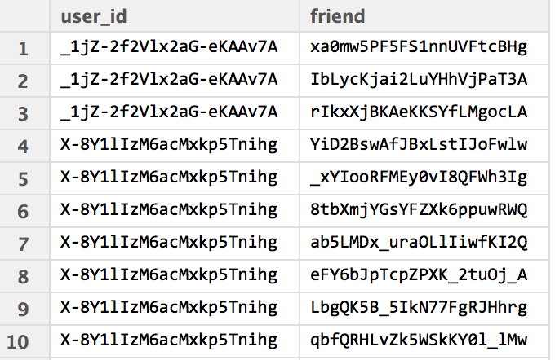
Transformation
longedge <- function(edgelist){
user <- edgelist$user_id
cnx <- edgelist$friends
split <- as.data.frame(ifelse(cnx=="",NA,str_split(cnx,", ")))
combine <- as.data.frame(cbind(user,split))
colnames(combine) <- c("user_id", "friend")
combine$user_id <- as.character(combine$user_id)
combine$friend <- as.character(combine$friend)
return(combine)
}
# Creating long edgelist
az.edgelist <- social_1 %>%
rowwise() %>%
do(longedge(.)) %>%
rbind()

Slide 11
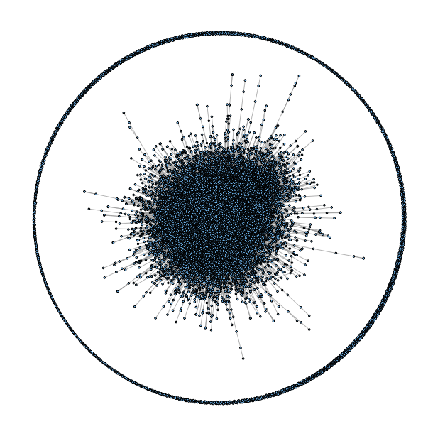
Network Graph
>library(igraph)
>layout_fr <- layout.fruchterman.reingold(graph.yelp)
>plot(graph.yelp,layout=layout_fr,
vertex.size=0.1, vertex.label=NA)

Slide 12
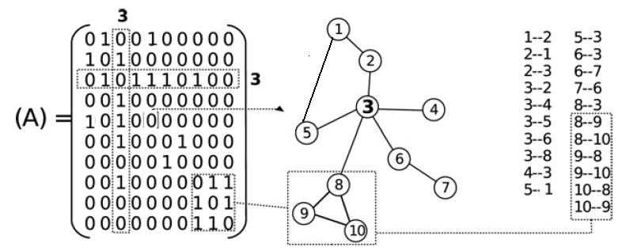
Finding Your 2-hop Neighbors
Create Ad
library(igraph)
library(Matrix)
az_net <- as.matrix(az.edgelist[,3:4]) #convert data frame into a matrix
graph.az <- graph.edgelist(az_net,directed=FALSE) #create igraph object
adj.az <- Matrix(get.adjacency(graph.az),sparse=TRUE) #write out adjacency matrix
d2 <- adj.az %*% adj.az # d2 contains 2-walks
diag(d2) <- 0 # take out loops
D2 <- d2
D2[adj.az==1] <- 0 # remove 1st degree connections
D2[D2!=0] <- 1 # transform to remove multiplicity of walks
D2[D2<0] <- 0 # remove negative values created by above

Slide 13
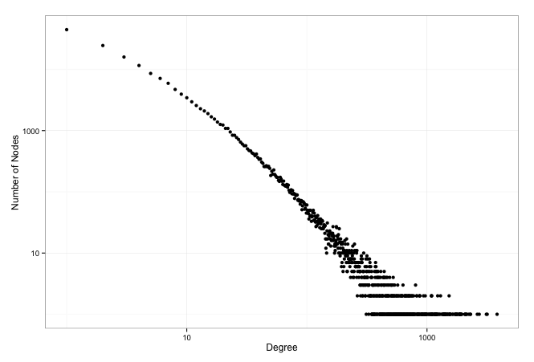
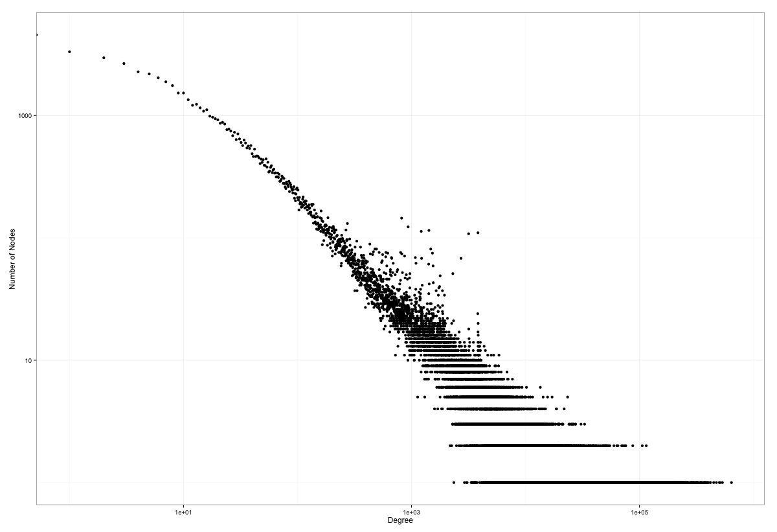
Connection Distribution
1st Degree
2nd Degree

Slide 14
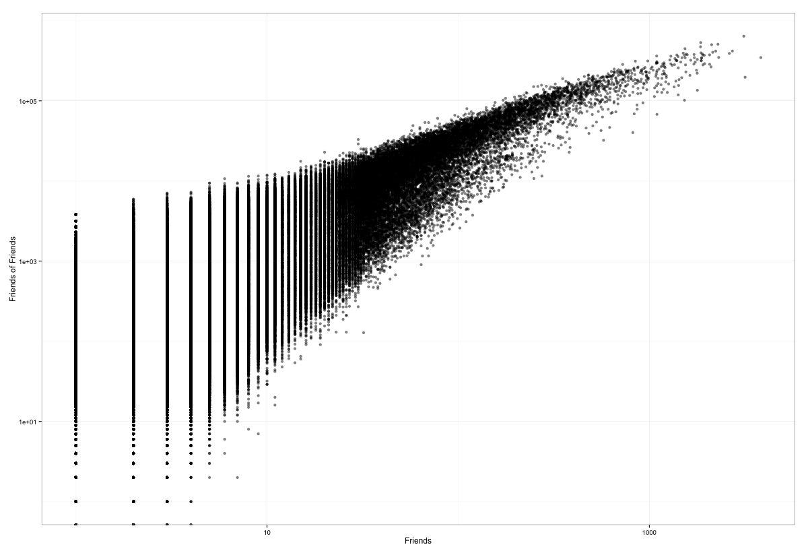
Friends and Friends-of-Friends

Slide 15
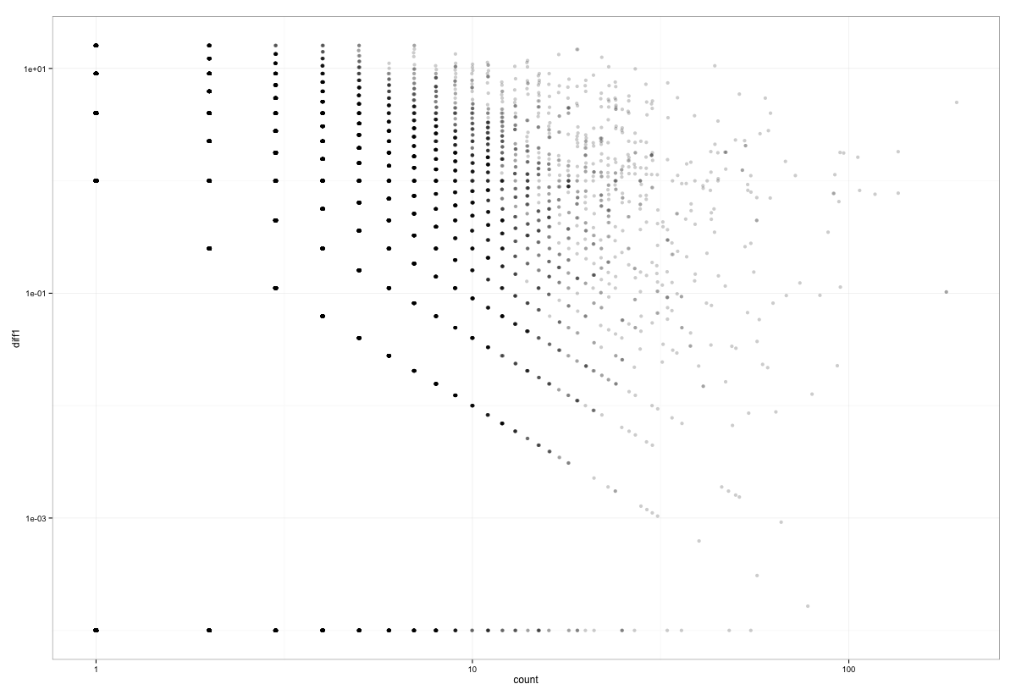
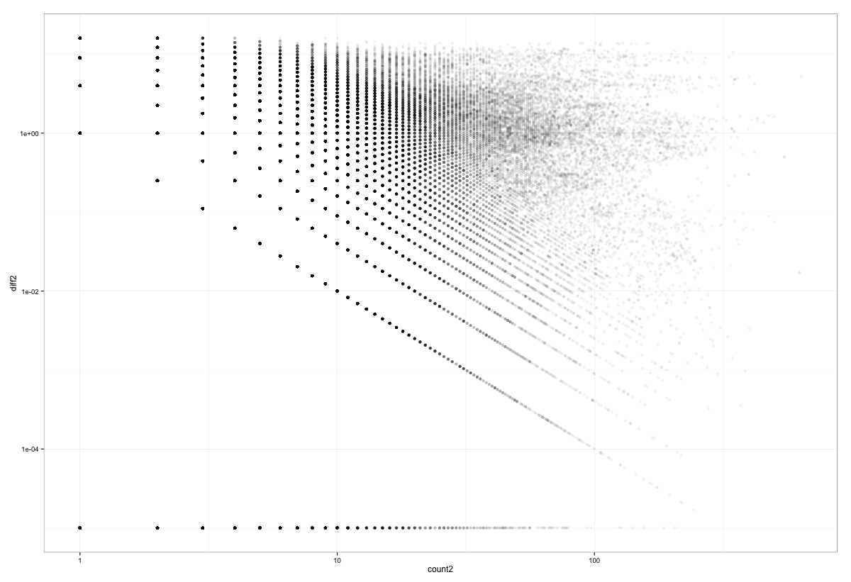
Network Recommendations
ratings1 <- Matrix(0,nrow=dim(az.key)[1],ncol=dim(bizcount)[1],sparse=TRUE)
…
for (i in 1:dim(bizcount)[1]){ #7941
reviewbybiz <- az.review[az.review$bizkey==bizcount$bizkey[i],]
# 1st Degree node
cnxlist.N <- reviewbybiz %>%
rowwise() %>%
left_join(az.edgelist[,3:4],.,by=c("edge"="u.node")) %>%
na.omit() %>%
rbind() %>%
rename(u.node=edge,cnx=node)
# 1st Degree edge
cnxlist.E <- reviewbybiz %>%
rowwise() %>%
left_join(az.edgelist[,3:4],.,by=c("node"="u.node")) %>%
na.omit() %>%
rbind() %>%
rename(u.node=node,cnx=edge)
# Join
cnxlist1 <- rbind(cnxlist.N,cnxlist.E)
# Summarize
cnxlist <- cnxlist1 %>%
group_by(cnx) %>%
summarize(net_rating=sum(r.stars)/n(),count=n())
row <- as.vector(cnxlist$cnx)
values <- as.vector(cnxlist$net_rating)
count <- as.vector(cnxlist$count)
ratings1[row,i] <- values
counts1[row,i] <- count
…
}

Slide 16
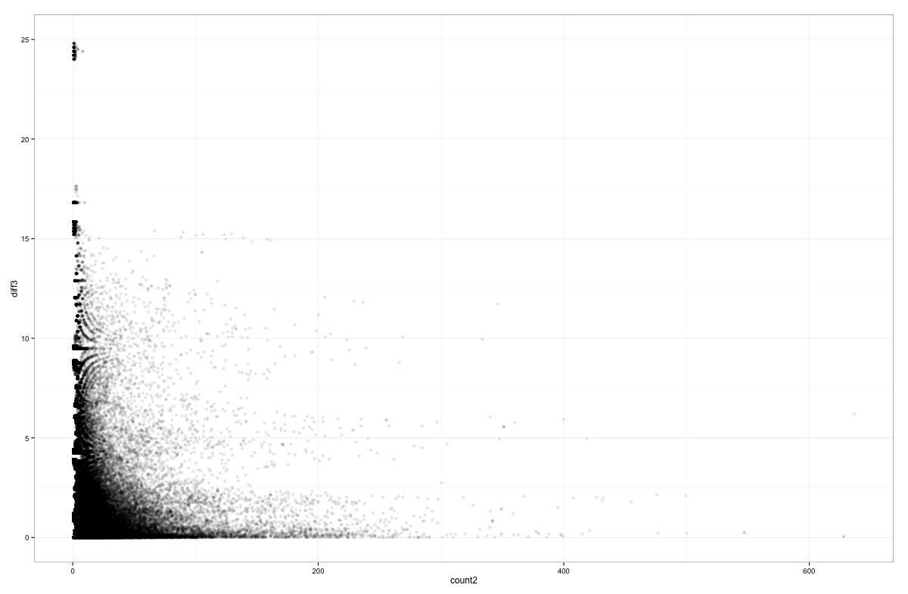
Predictions
Inference for Stan model: yelp.
4 chains, each with iter=100; warmup=50; thin=1;
post-warmup draws per chain=50, total post-warmup draws=200.
mean se_mean sd 2.5% 25% 50% 75% 97.5% n_eff Rhat
beta[1] 0.02 0.00 0.00 0.02 0.02 0.02 0.03 0.03 35 1.11
beta[2] 1.01 0.00 0.00 1.00 1.01 1.01 1.01 1.01 96 1.04
sigma 2.89 0.00 0.00 2.88 2.89 2.89 2.89 2.90 200 1.00
lp__ -434087.99 0.12 1.23 -434091.33 -434088.50 -434087.61 -434087.20 -434086.70 109 1.01
Samples were drawn using NUTS(diag_e) at Thu May 14 23:13:23 2015.
For each parameter, n_eff is a crude measure of effective sample size,
and Rhat is the potential scale reduction factor on split chains (at
convergence, Rhat=1).

Slide 17
Exploiting Social Networks to Improve Recommendations

Slide 18
Research Plan
Hypothesis: People with more friends are more influential
Weight kNN votes by network degree so that predicted ratings/recommendations reflect this
Compare to other recommenders using RMSE to measure accuracy

Slide 19
kNN Recommender
Each unobserved rating is predicted as the (weighted) average of the k nearest neighbors (using Euclidean distance)

Slide 20
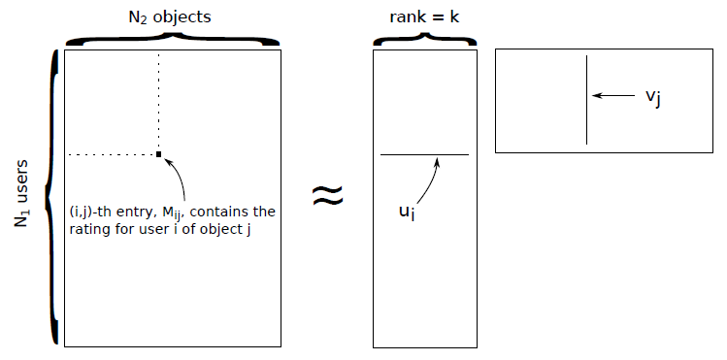
Collaborative Filtering / Matrix Factorization

Slide 21
Issues and Challenges
Size of dataset / scalability
1.6 million reviews; 61 thousand businesses; 3 million user friendships
AZ data was still large: 6.8 thousand users and 7.7 thousand businesses (full ratings matrix would be a little over 53 million cells)
Took several hours to run collaborative filtering for a single value of k (k=20)
Took 1.5 hours to run kNN for all 18 thousand ratings in the test set
Dealing with such data in the real world, it would be necessary to use MapReduce framework
Incompleteness of dataset – working with a small subset of total data led to inconsistencies (businesses with only 1 or 2 ratings had to be dropped)

Slide 22
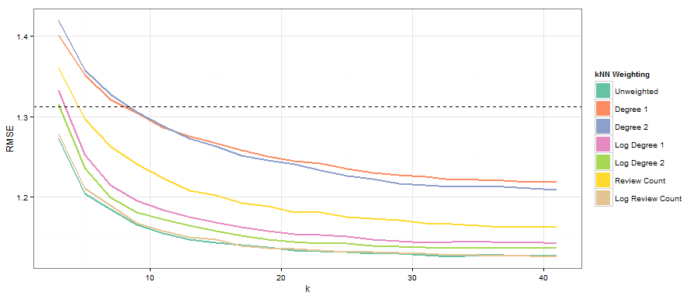
Results

Slide 23
Results Summary
Across the board the log counts performed better than raw counts
None of the weights performed better than the unweighted kNN algorithm
Even the bad weighting schemes beat the matrix factorization recommender by about k=8

Slide 24
The takeaway:
Keep it simple!!

