Slide 1
HW10 The Cliff Walking Problem
이한진

Slide 2
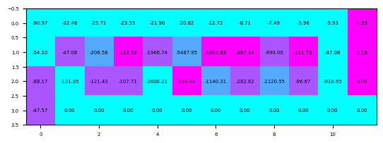

MC, U = {→, ←, ↑, ↓}

Slide 3
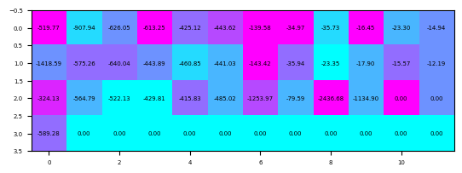

MC, U = {→, ←, ↑, ↓, ↗, ↙, ↖, ↘}

Slide 4
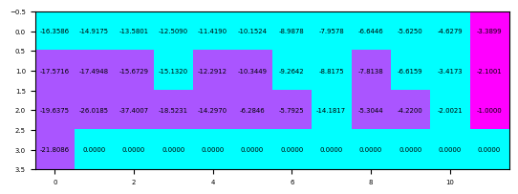
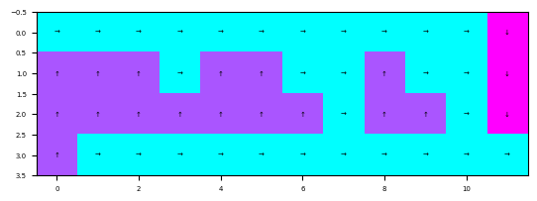
SARSA, U = {→, ←, ↑, ↓}

Slide 5
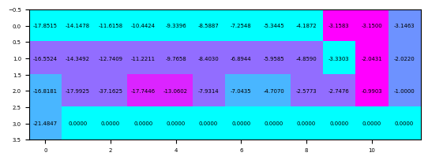

SARSA, U = {→, ←, ↑, ↓, ↗, ↙, ↖, ↘}

Slide 6
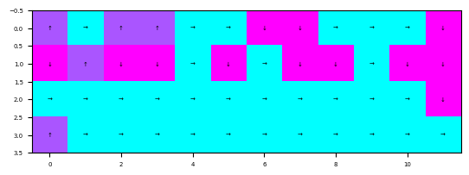
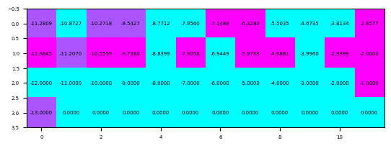
Q-Learning, U = {→, ←, ↑, ↓}

Slide 7
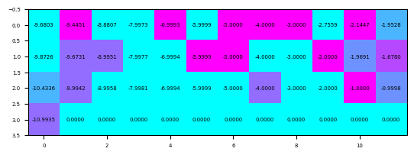

Q-Learning, U = {→, ←, ↑, ↓, ↗, ↙, ↖, ↘}

Slide 8
QnA

