Slide 1
This is your presentation title

Slide 2
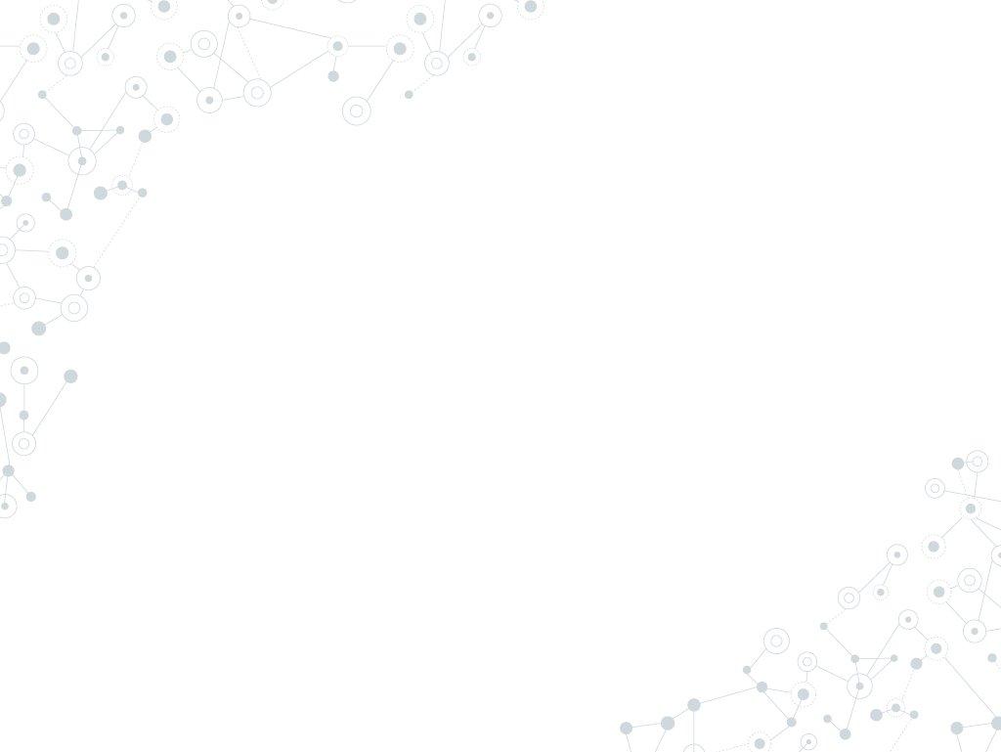

Roteiro
Introdução
Objetivos
Fundamentação Teórica
Estado da Arte
Solução Elaborada
Conclusões
Referências

Slide 3
1.
Introdução

Slide 4
Quotations are commonly printed as a means of inspiration and to invoke philosophical thoughts from the reader.

Slide 5
This is a slide title
Here you have a list of items
And some text
But remember not to overload your slides with content
Your audience will listen to you or read the content, but won’t do both.

Slide 6
Big concept
Bring the attention of your audience over a key concept using icons or illustrations

Slide 7
You can also split your content
White
Is the color of milk and fresh snow, the color produced by the combination of all the colors of the visible spectrum.
Black
Is the color of coal, ebony, and of outer space. It is the darkest color, the result of the absence of or complete absorption of light.

Slide 8
In two or three columns
Yellow
Is the color of gold, butter and ripe lemons. In the spectrum of visible light, yellow is found between green and orange.
Blue
Is the colour of the clear sky and the deep sea. It is located between violet and green on the optical spectrum.
Red
Is the color of blood, and because of this it has historically been associated with sacrifice, danger and courage.

Slide 9
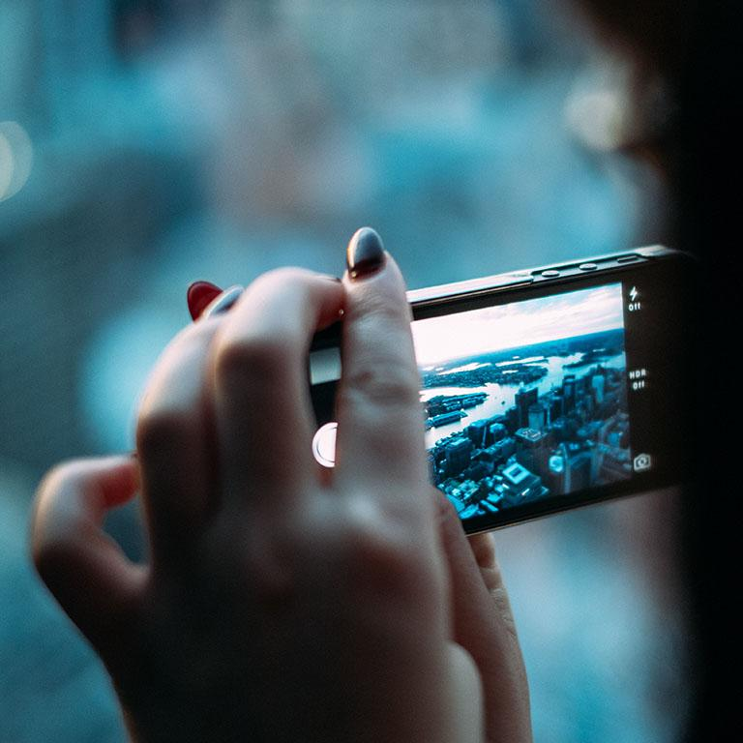
A picture is worth a thousand words
A complex idea can be conveyed with just a single still image, namely making it possible to absorb large amounts of data quickly.

Slide 10
Use charts to explain your ideas
White
Gray
Black

Slide 11
And tables to compare data
 | A | B | C
Yellow | 10 | 20 | 7
Blue | 30 | 15 | 10
Orange | 5 | 24 | 16

Slide 12
89,526,124
Whoa! That’s a big number, aren’t you proud?

Slide 13
89,526,124$
185,244 users
100%
That’s a lot of money
And a lot of users
Total success!

Slide 14
Our process is easy
last
first
second

Slide 15

Let’s review some concepts
Yellow
Is the color of gold, butter and ripe lemons. In the spectrum of visible light, yellow is found between green and orange.
Blue
Is the colour of the clear sky and the deep sea. It is located between violet and green on the optical spectrum.
Red
Is the color of blood, and because of this it has historically been associated with sacrifice, danger and courage.
Yellow
Is the color of gold, butter and ripe lemons. In the spectrum of visible light, yellow is found between green and orange.
Blue
Is the colour of the clear sky and the deep sea. It is located between violet and green on the optical spectrum.
Red
Is the color of blood, and because of this it has historically been associated with sacrifice, danger and courage.

Slide 16
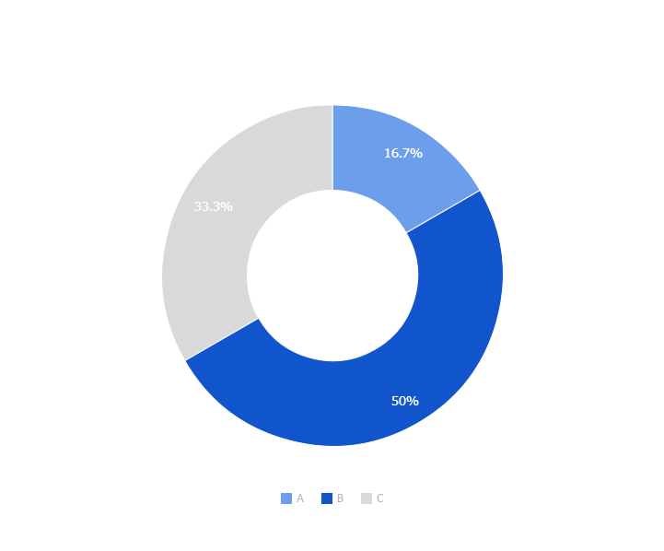
You can copy&paste graphs from Google Sheets

Slide 17
Thanks!
Any questions?
You can find me at:
@username
user@mail.me

Slide 18
SlidesCarnival icons are editable shapes.
This means that you can:
Resize them without losing quality.
Change line color, width and style.
Isn’t that nice? :)
Examples:

