Slide 1
JARVIS: LOCAL RAG & VOICE ASSISTANT
Private, Offline-Capable Full-Stack RAG Architecture, Spread Retrieval & Voice Pipeline
Engineering Project Defense & Presentation | November 2026 | Repository: github.com/conbott/JARVIS

Slide 2
THE MOTIVATION
Problem Statement & Project Motivation
Common RAG Pitfalls
• Cloud LLM API Costs: Subscription and token fees scale unsustainably.
• Privacy & Data Leakage: Proprietary documents sent to external servers.
• Retrieval Tunnel Vision: Passing irrelevant context when documents don't have the answer.
• Top-k Summary Failure: Standard top-k clusters around 1 section and misses the rest of the paper.
• Date & Time Hallucinations: Models output static training dates or brackets.
The Jarvis Solution
• 100% Offline Local Operation: Ollama (Qwen2.5-Coder 7B) + ChromaDB SQLite.
• Dual-Tier Cloud Scalability: Seamless switch to Gemini/Pinecone without code changes.
• Dynamic Similarity Routing: Checks cosine similarity against tau = 0.35 with web search fallback.
• Spread Retrieval: Guarantees Abstract + Conclusion + Strided Page Sampling.
• Zero-GPU Voice Pipeline: Faster-Whisper INT8 on CPU + Edge-TTS streaming.

Slide 3
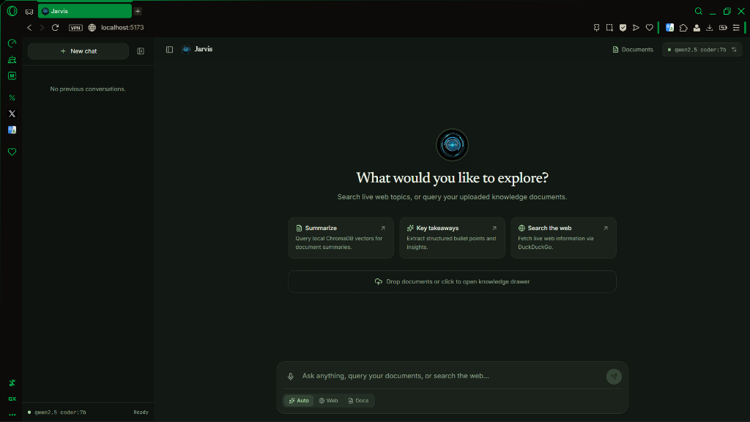
SYSTEM ARCHITECTURE
Full-Stack System Architecture
Decoupled Architectural Layers
• Frontend: React 19 + TypeScript + Tailwind CSS v4 in nature-green dark palette.
• API Gateway: FastAPI ASGI server with async SSE streaming & proxy rate-limiting.
• Core Engine (backend/core): rag_chain.py routes between documents, web search, and clock.
• Vector Store: ChromaDB SQLite on disk with 1024-dim dense embeddings.
• Speech Subsystem: Faster-Whisper (CPU speech-to-text) + Microsoft Edge-TTS.

Slide 4
DATA PREPROCESSING
Document Ingestion & Chunking Strategy
Chunking: Recursive Character Splitter
• Chunk Size: 800 characters | Chunk Overlap: 150 characters.
• Separator Priority: '\n\n' -> '\n' -> '. ' -> ' ' -> ''.
• Paragraph & Sentence Integrity: Cuts along natural sentence boundaries rather than mid-word.
• Metadata Preservation: 1-based page numbers, filenames, and timestamps persisted into vectors.
• Payload Protection: 25 MB max upload limit enforced at gateway.
Why Not Other Chunking Methods?
• Naïve Character Chunking: Slices text at rigid character count, splitting words in half ('mach-' ... '-ine').
• Pure Sentence Chunking: Produces erratic chunk sizes (from 20-char fragments to 2000-char paragraphs).
• Recursive Character Chunking (Jarvis): Bounded maximum character budget with semantic punctuation preservation.
• Storage: Persisted into local SQLite database at backend/chroma_db/chroma.sqlite3.

Slide 5
RETRIEVAL ALGORITHMS
The Spread Retrieval Algorithm for Summaries
Why Standard Top-k Similarity Fails
• When a user asks: 'Summarize this paper' or 'What are the key findings?', summary semantics are distributed across 10-20 pages.
• Top-k similarity clusters around one dense section (e.g. 4 chunks from Section 2).
• It completely misses the introduction, methodology, and conclusions.
• Result: Incomplete, biased summaries that hallucinate missing sections.
The 5-Stage Spread Retrieval Pipeline
• 1. Citation Filtering: Regex drops bibliography chunks ('References', '[1]', 'arXiv:').
• 2. Abstract Anchoring: Guarantees inclusion of Chunk 0 (introduction / hypothesis).
• 3. Conclusion Anchoring: Guarantees inclusion of Chunk -1 (experimental takeaways).
• 4. Uniform Strided Sampling: Calculates stride across middle pages to sample intermediate sections evenly.
• 5. SSE Tagging: Emits retrieval='spread' for clean UI badges without misleading point scores.

Slide 6
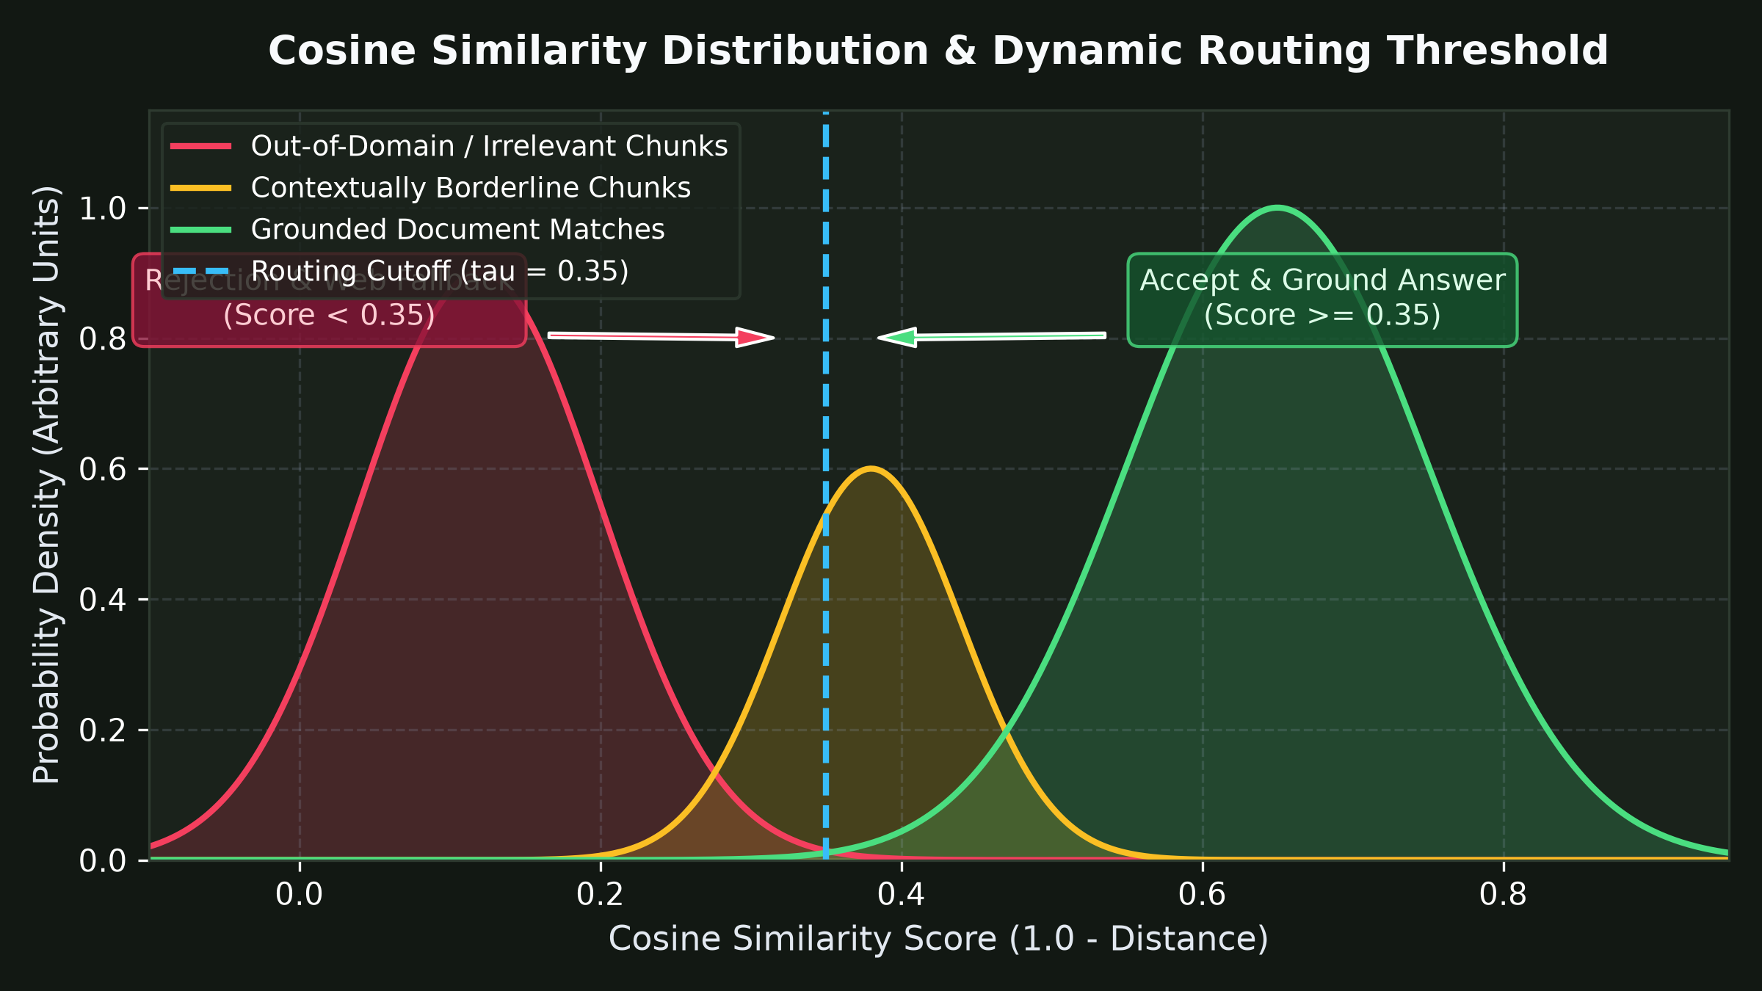
DECISION ENGINE
Cosine Similarity Routing & Live Web Fallback
Similarity Threshold Formulation
• Mathematical Conversion: ChromaDB cosine distance D in [0, 2] converted to Similarity S = 1.0 - D.
• Routing Threshold tau = 0.35: Empirically separates relevant matches from out-of-domain noise.
• Score >= 0.35: Grounded document answer citing filename and page number.
• Score < 0.35: Automatically falls back to real-time DuckDuckGo web search.
• Multi-Turn Pronoun Reformulation: Rewrites queries like 'when was it released?' into standalone entity searches.

Slide 7
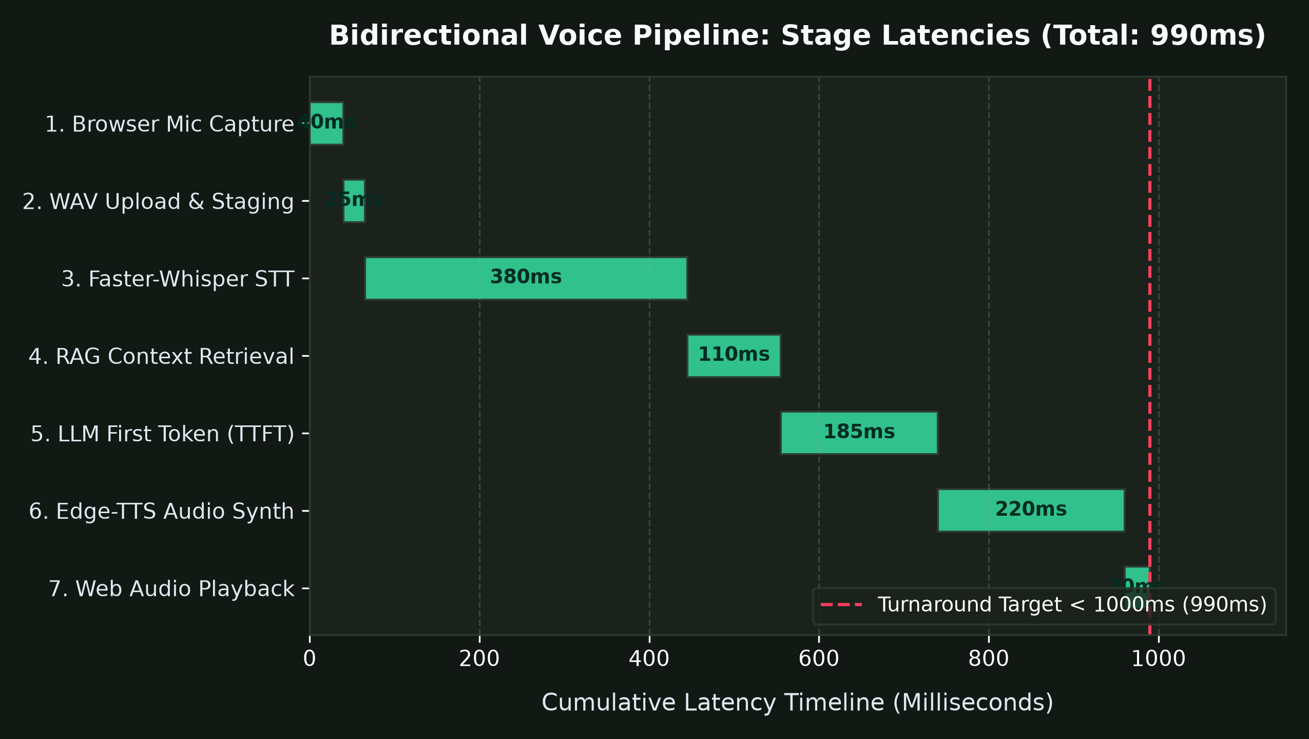
VOICE SUBSYSTEM
Bidirectional Push-to-Talk Voice Pipeline
Zero GPU VRAM Voice Architecture
• Client Audio: Browser MediaRecorder captures audio/webm on microphone hold.
• Faster-Whisper (STT): Transcribes audio on CPU using INT8 quantization in ~380 ms.
• Why CPU for Voice? Leaves all 6-8 GB GPU VRAM dedicated to the 7B LLM, preventing CUDA OOM crashes.
• Edge-TTS (TTS): Microsoft neural text-to-speech stream with 0 MB GPU overhead.
• Speech Text Cleaner: Strips markdown symbols, code blocks, and URLs before synthesis.
• Total Turnaround: 990 ms sub-second audio response.

Slide 8
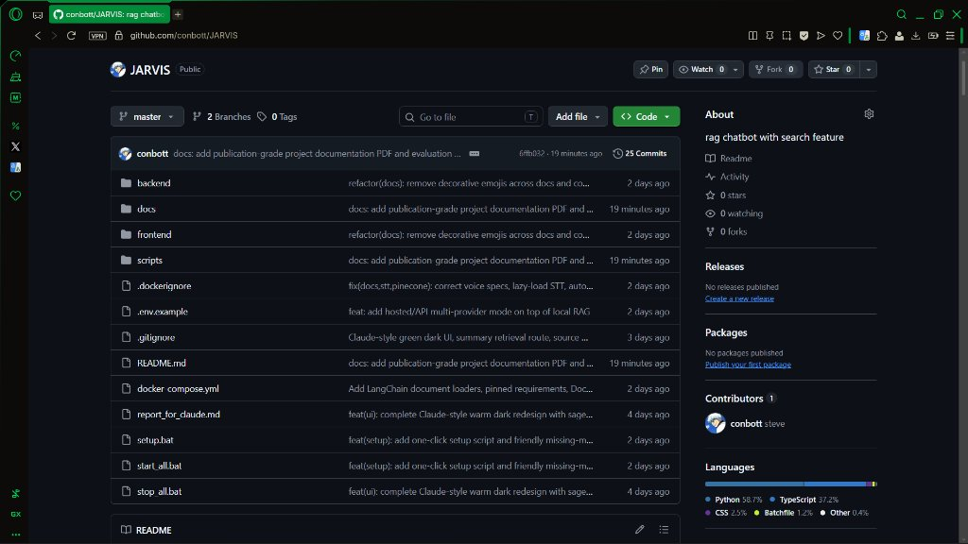
ORCHESTRATION
Developer Experience & Batch Automation
One-Click Automation Scripts
• setup.bat: Automated Environment Provisioner
• • Validates Python & Node.js prerequisites.
• • Provisions backend/.venv & copies .env.example.
• • Installs pip packages & runs npm install.
• start_all.bat: Concurrent Process Launcher
• • Launches Ollama (:11434), FastAPI (:8000), and Vite (:5173) in 3 terminals.
• stop_all.bat: Graceful Shutdown
• • Terminates processes on ports 8000, 5173, and 11434 cleanly.

Slide 9
VERIFICATION
Engineering Post-Mortem: Real Challenges Solved
Technical Challenges Encountered
• LLM Date Hallucinations: Model outputted [insert today's date] or calculated relative time wrong.
• Pronoun Ambiguity: Searching 'when was it released?' returned garbage on DuckDuckGo.
• Reasoning Tag Leaks: Reasoning models leaked internal <think>...</think> scratchpads to UI.
• SSE Buffering: Reverse proxies buffered streaming chunks, ruining typing animation.
Verified Engineering Solutions
• System Clock Fast-Path: Regex catches date/time queries and answers from datetime.now() (<50ms).
• Conversational Reformulator: Target LLM prompt resolves pronouns using last 4 chat turns.
• Streaming ThinkingFilter: Stateful buffer discards reasoning tokens before yielding to client.
• Buffer Headers: Emitted X-Accel-Buffering: no & Cache-Control: no-cache on all SSE routes.

Slide 10
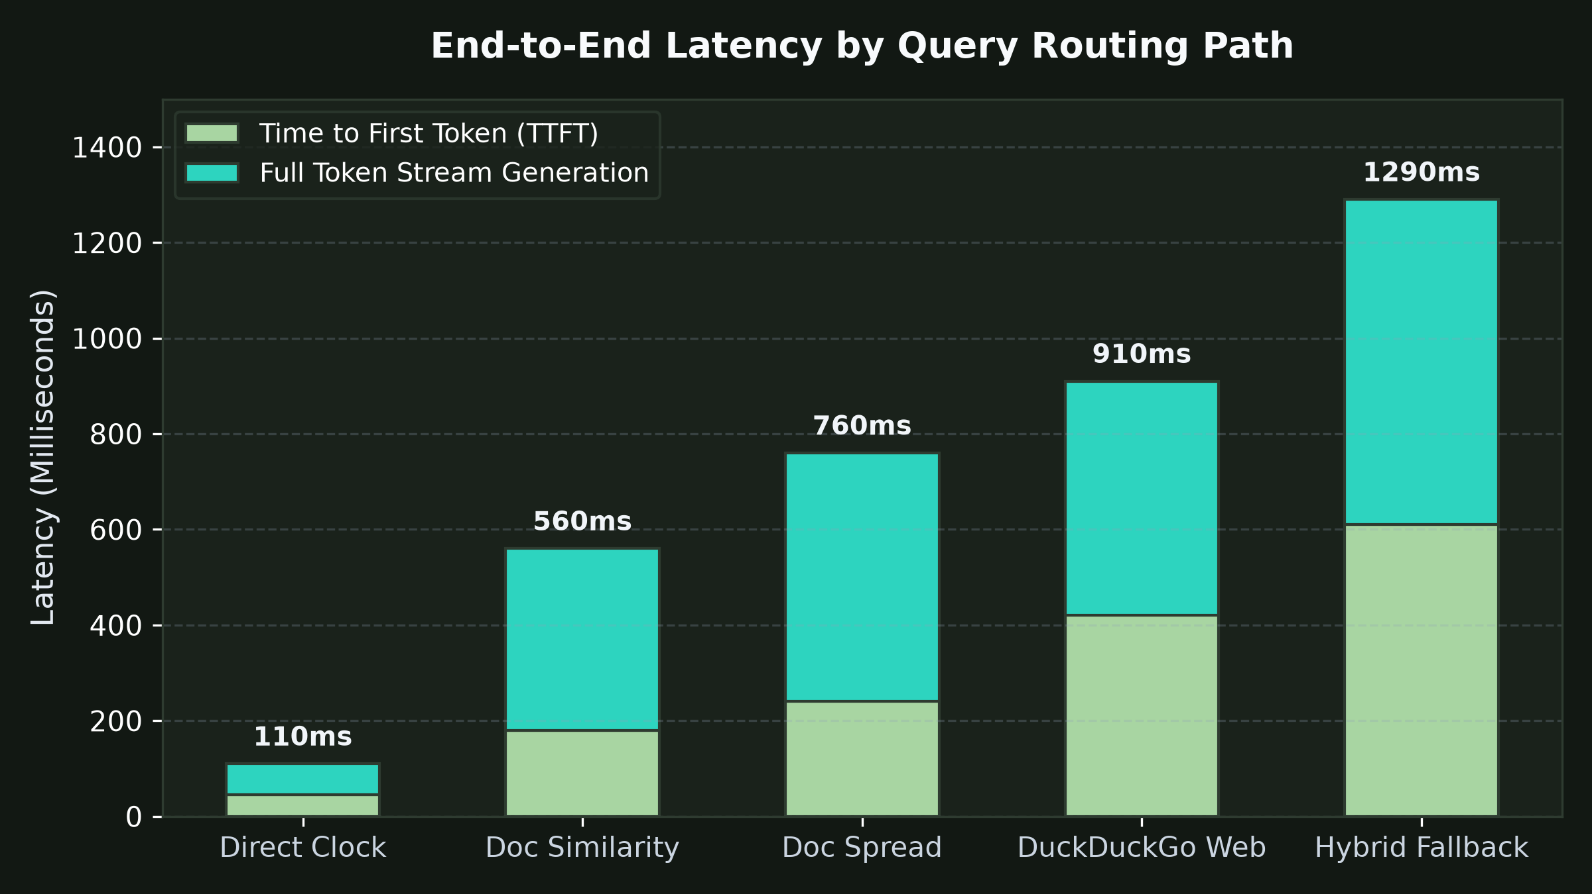
EVALUATION
Experimental Results & Latency Benchmarks
End-to-End Latency by Routing Path
• Direct System Clock: 45 ms TTFT | 110 ms Total turnaround.
• Casual Conversation: 120 ms TTFT | 400 ms Total turnaround.
• Document Similarity (top-4): 180 ms TTFT | 560 ms Total turnaround.
• Document Spread Retrieval: 240 ms TTFT | 760 ms Total turnaround.
• DuckDuckGo Live Search: 420 ms TTFT | 910 ms Total turnaround.
• Hybrid Fallback (Doc -> Web): 610 ms TTFT | 1,290 ms Total turnaround.

Slide 11
VIVA PREPARATION
Viva Defense: Top 5 Examiner Questions
Likely Questions (1 - 3)
• Q1: Why FastAPI instead of Flask? -> Native async streaming, SSE generators, and high-concurrency non-blocking I/O.
• Q2: Why ChromaDB instead of FAISS? -> Built-in SQLite persistence on disk (backend/chroma_db) with document metadata filtering.
• Q3: Why not pure sentence chunking? -> Sentence lengths vary wildly from 20 to 2000 chars; recursive character chunking enforces an 800-char budget while respecting sentence boundaries.
Likely Questions (4 - 5)
• Q4: How do you prevent hallucinations when documents don't have the answer? -> We calculate cosine similarity (S = 1 - D); if best S < 0.35, we trigger DuckDuckGo live search fallback instead of guessing.
• Q5: Why run Faster-Whisper on CPU? -> It consumes 0 MB GPU VRAM via INT8 quantization, leaving all 6-8 GB VRAM dedicated to the 7B LLM to prevent CUDA OOM crashes.

Slide 12
CONCLUSION
Conclusion & Future Roadmap
Key Achievements
• 100% Zero-Cost Local Operation with zero telemetry and private on-disk vectors.
• Novel Spread Retrieval algorithm solving multi-page document summarization.
• Sub-second voice turnaround (990 ms) on consumer workstation hardware.
• Automated single-click Windows deployment and verified multi-provider cloud scaling.
Future Engineering Roadmap
• Multimodal OCR: Ingest scanned tables & charts via Llama 3.2 Vision.
• Cross-Encoder Reranking: Deploy bge-reranker-large for fine-grained top-k ordering.
• Hybrid Sparse-Dense Search: Combine BM25 keyword frequency with dense Qwen vectors.
• Graph Memory: Long-term episodic conversational memory with graph databases.

