Slide 1
Lab _
Dr. Farshid Alizadeh-Shabdiz
Spring 2024

Slide 2
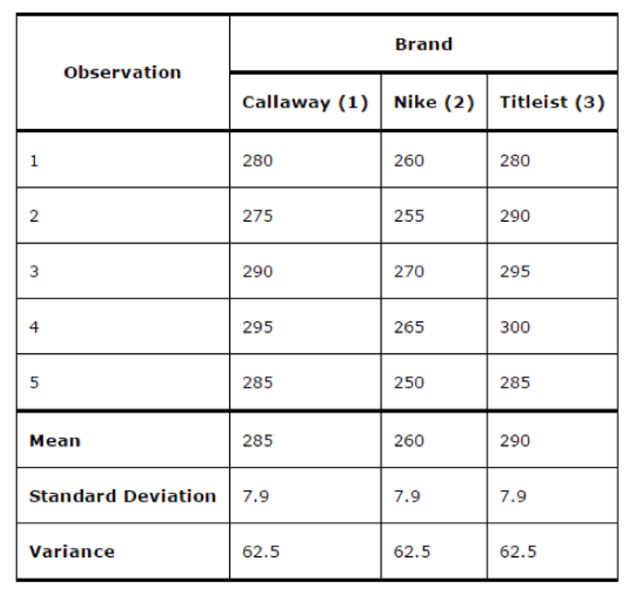
One Way Analysis of Variance
Investigate if there is a difference between following golf ball brands

Slide 3
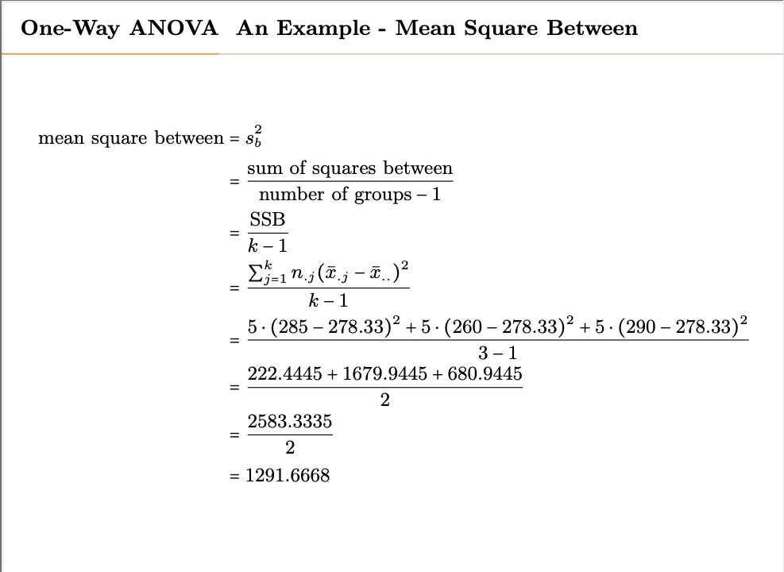

Slide 4
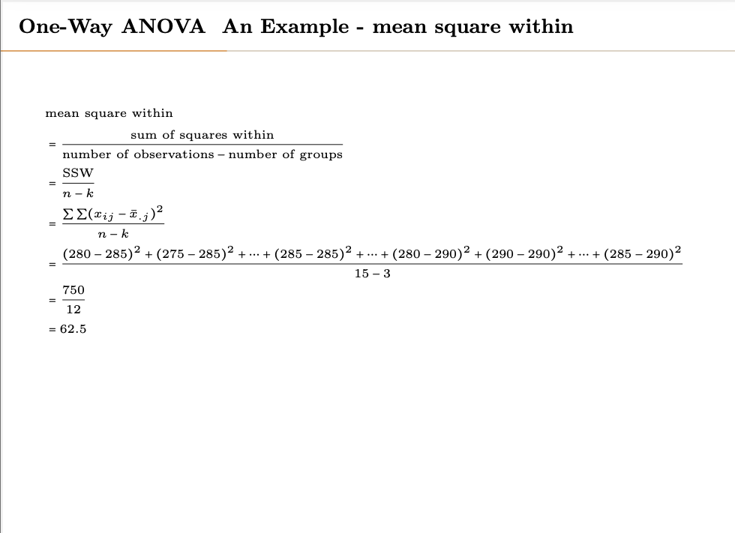

Slide 5
Example 2
Load smoking data set. Investigate if smoking has impact on SBP (systolic blood pressure)

