Slide 1
Examples Data Analysis and Visualization
Dr. Farshid Alizadeh-Shabdiz
Spring 2021

Slide 2
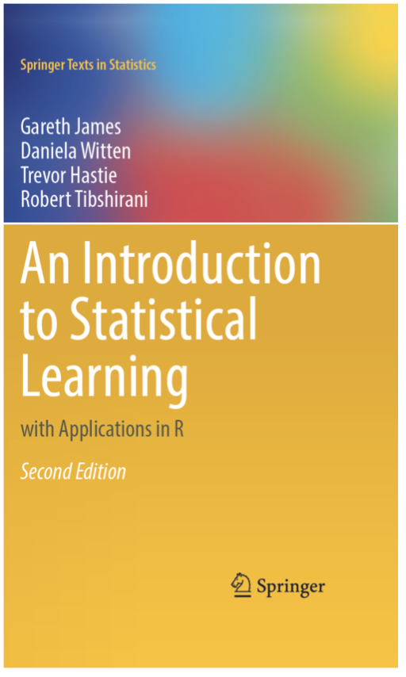
Text Book
An Introduction to Statistical Learning with Applications in R.
By: Gareth James, Daniela Witten, Trevor Hastie and Robert Tibshirani. (2013) Springer.
The book has been made available online at https://statlearning.com

Slide 3
Important RV – Standardization of Normal Distribution
If N(μ,σ) – z-score is calculated as follows
Pdf of normal distribution will become:

Slide 4
Example 1 – Normal Distribution
What point (z-score) corresponds to 85% of the area under the pdf of normal distribution?
What area under the pdf of normal distribution corresponds to z-score=2.0?

Slide 5
Example 1 - answer
qnorm(0.85 , mean=0, sd=1)
pnorm(2, mean=0, sd=1)

Slide 6
Central Limit Theorem and Normal Distribution
Mean of arbitrary random variables with arbitrary distribution approaches normal distribution as the number of random variables goes to infinity

Slide 7
Example 2 – T-test
What point (critical values/z-score) corresponds to 85% of the area of confidence interval for 25-sample of a larger population?
What area under the pdf corresponds to critical value of 2.0 for a 25-sample set of a larger population ?

Slide 8
Example 2 - answer
qt (0.85 , df=24)
pt (2, df=24)

Slide 9
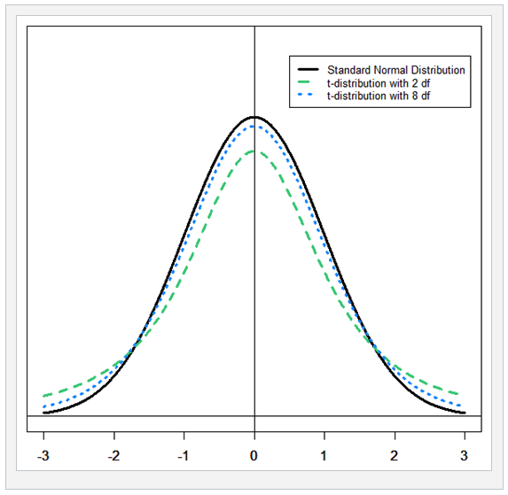
T-Test with df 2 & 8
Notes:
As number of df increases, T-distribution gets closer to normal distribution.

Slide 10
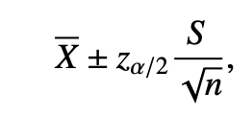
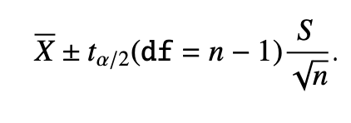
Confidence Interval based on Sample
Remark. What if σ is unknown? We instead use the interval
where S is the sample standard deviation.
If n is large, then X will have an approximately normal distribution regardless of the underlying population (by the CLT) and S will be very close to the parameter σ (by the SLLN – strong low of large numbers); thus ~ 100(1 − α)% confidence of covering μ.
If n is small, then ◦ If the underlying population is normal then we may replace z_{α/2} with t-distribution with degree of freedom of n-1 OR t_{α/2}(df = n − 1).
The resulting 100(1 − α)% confidence interval is

Slide 11

Confidence Interval
For (n<30)
$$\overline{x}±t\frac{σ}{\sqrt{n}}, \overline{x}±t\frac{S}{\sqrt{n}}$$
For (n>=30)
$$\overline{x}±z\frac{σ}{\sqrt{n}}, \overline{ x}±z\frac{S}{\sqrt{n}}$$

Slide 12
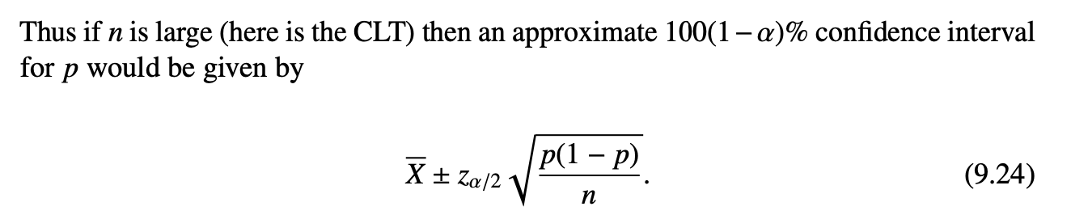

Confidence intervals for proportion
If what we are interested to know is a proportion, the resulting sample is a binomial distribution.
For a binomial distribution we know
$$E\left(X\right)=p and E\left(X−P\right)2=P(1−p)$$

Slide 13
Two Sample Test/Procedure
Comparing the distribution of the sample means from two populations
Example:
Clinical trials - where subjects are divided randomly into one of two groups, each of which is exposed to two different treatments.
Taking random samples from two different populations (for example, males and females or younger versus older patients). Each experimental unit belongs only to one population or is treated with only one treatment.

Slide 14
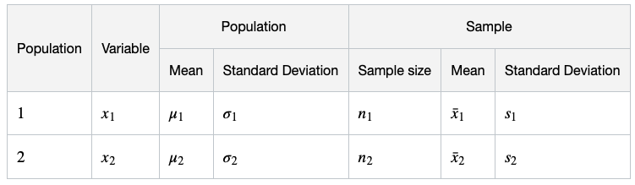

Two Sample Test/Procedure
Comparing the distribution of the sample means from two populations and generally interested to
H0: $μ1=μ2 or μ1−μ2=0$
H1: means are not equal or difference is not zero

Slide 15
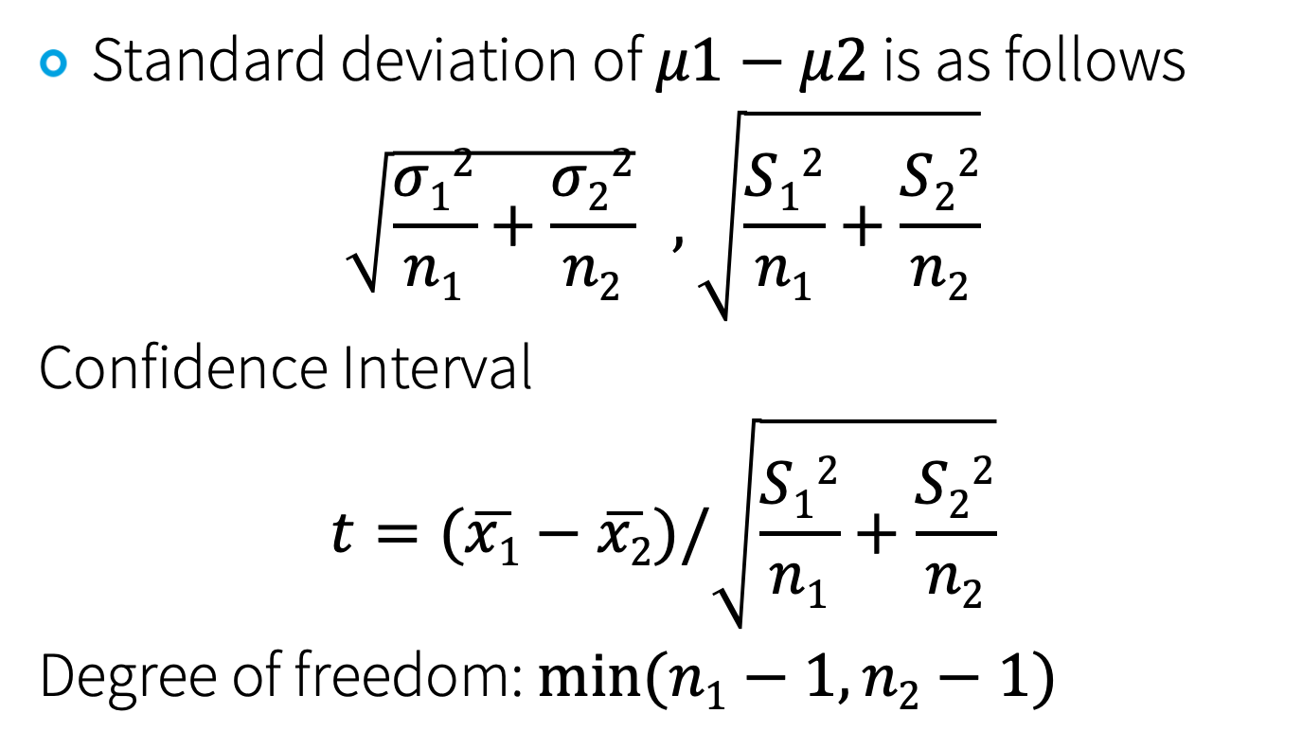
Confidence Interval
Standard deviation of $μ1−μ2$ is as follows
$$\sqrt{\frac{σ12}{n1}+\frac{σ22}{n2}} , \sqrt{\frac{S12}{n1}+\frac{S22}{n2}}$$
Confidence Interval
$$t=(\overline{x1}−\overline{x2})/\sqrt{\frac{S12}{n1}+\frac{S22}{n2}}$$
Degree of freedom: $min⁡(n1−1,n2−1)$

Slide 16
Terminology
Null hypothesis – H₀
Alternative hypothesis – H₁
Processes/procedure
Collect random samples
Construct confidence interval for P
If the confidence interval covers H0, we “fail to reject H0”. Otherwise, “reject H0”.
The rejection region is called “critical region” or “critical area”.
One sided : H1>= or H1<=
Two sided
Critical Value

Slide 17
Significant Test Recipe
Set up the hypotheses and select the alpha level
Select the appropriate test statistic
State the decision rule
Compute the test statistic and the associated p-value
State your conclusion

Slide 18
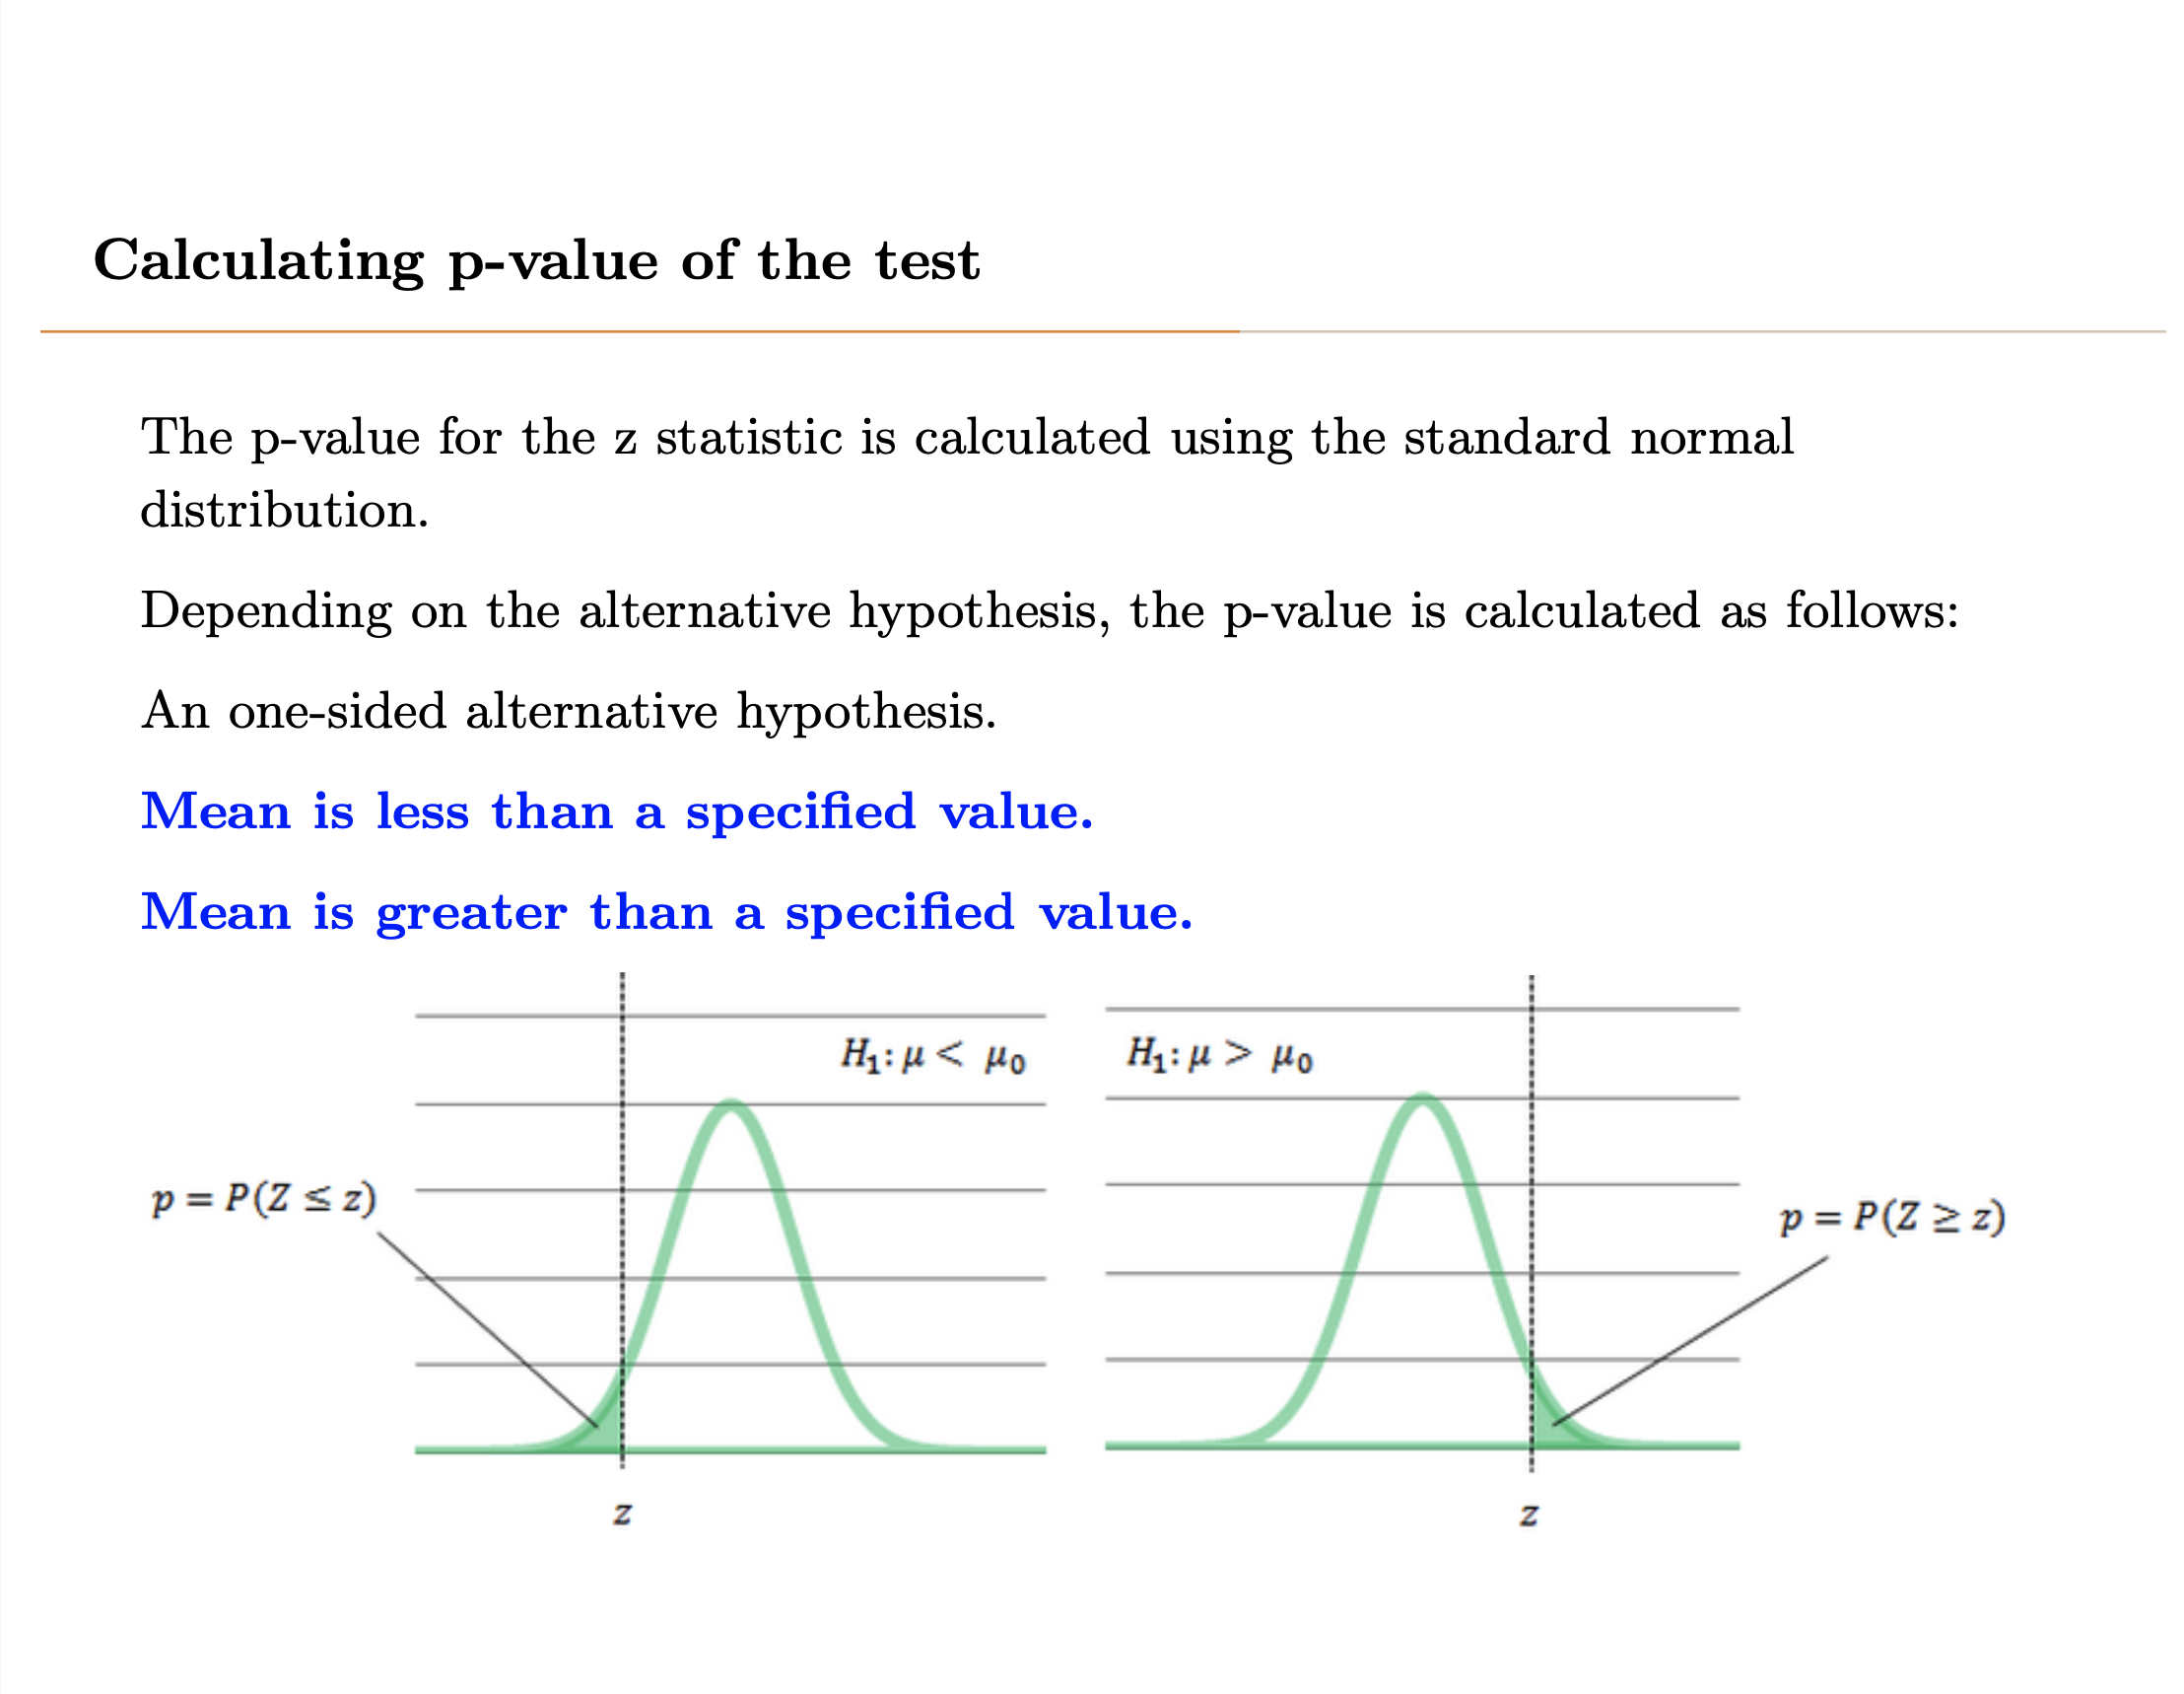

Slide 19
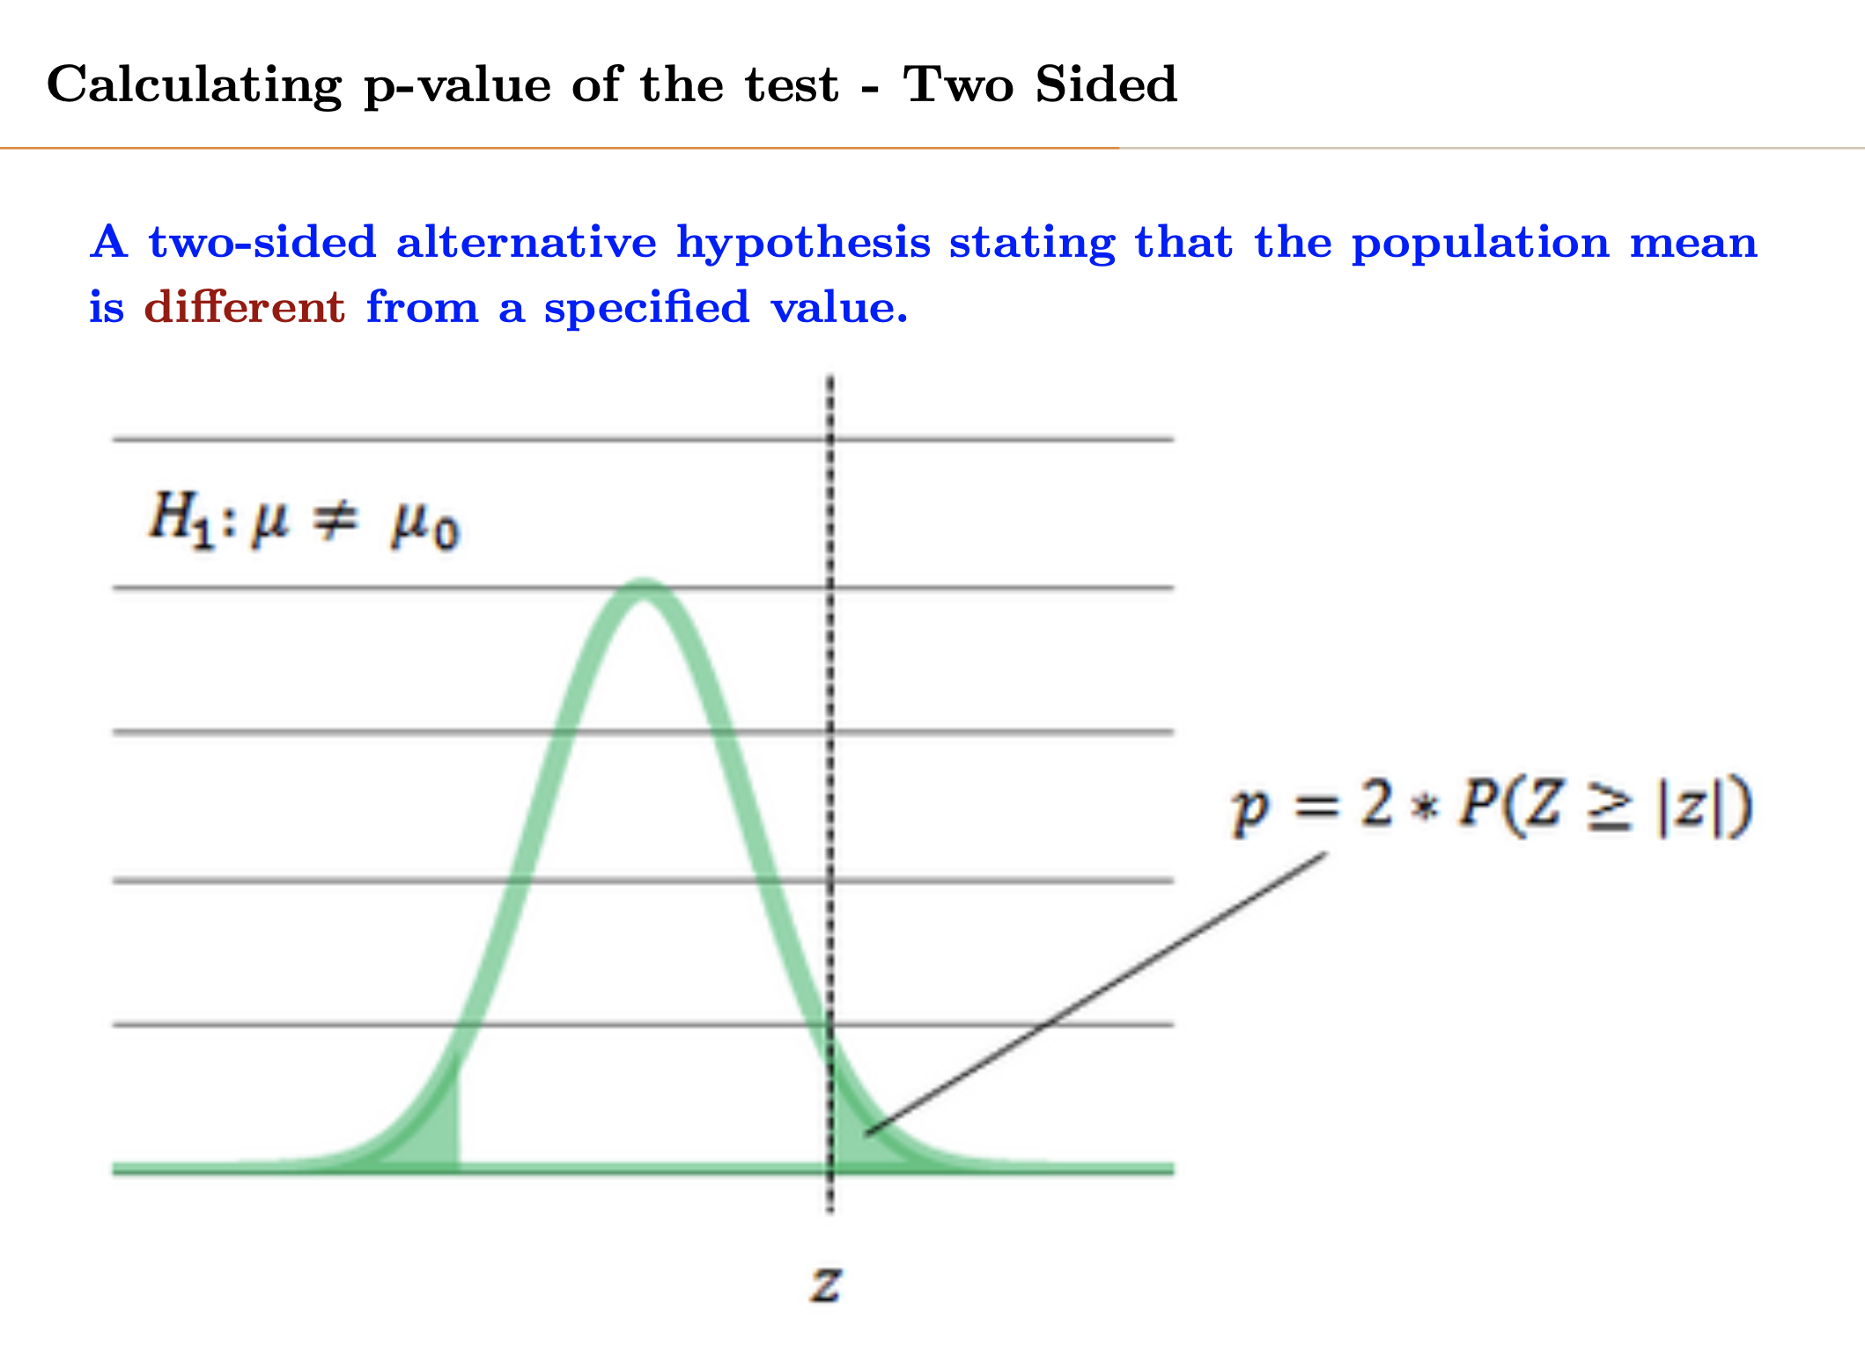

Slide 20
Test statistics
Proportion P:
$$Z=\frac{\hat{p}−p}{\sqrt{\frac{p(1−p)}{n}}}$$
Mean $μ:$
$Z=\frac{\hat{x}−μ}{σ/\sqrt{n}}$ (if population sd in known) or
$Z=\frac{\hat{x}−μ}{S/\sqrt{n}}$ (if population sd is unknown)

Slide 21
Corrolation
Cor()

Slide 22
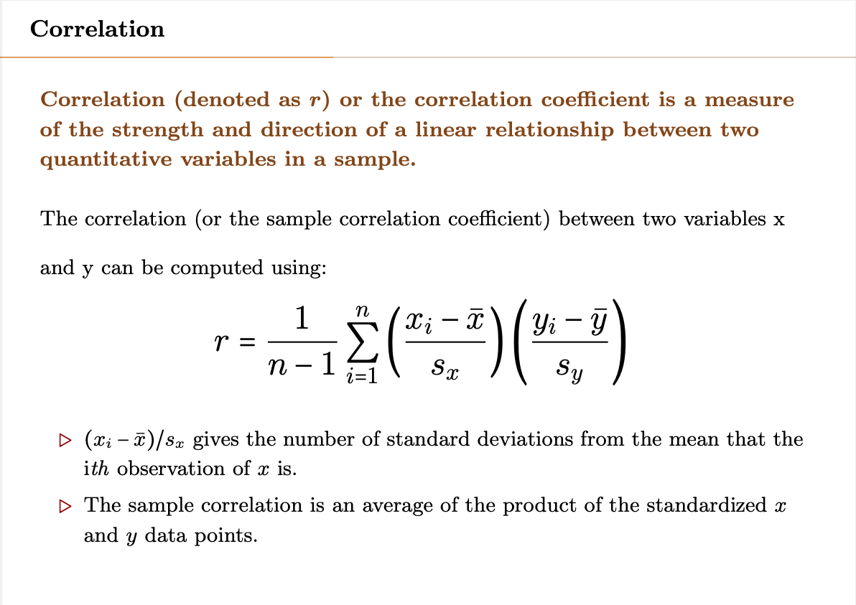

Slide 23
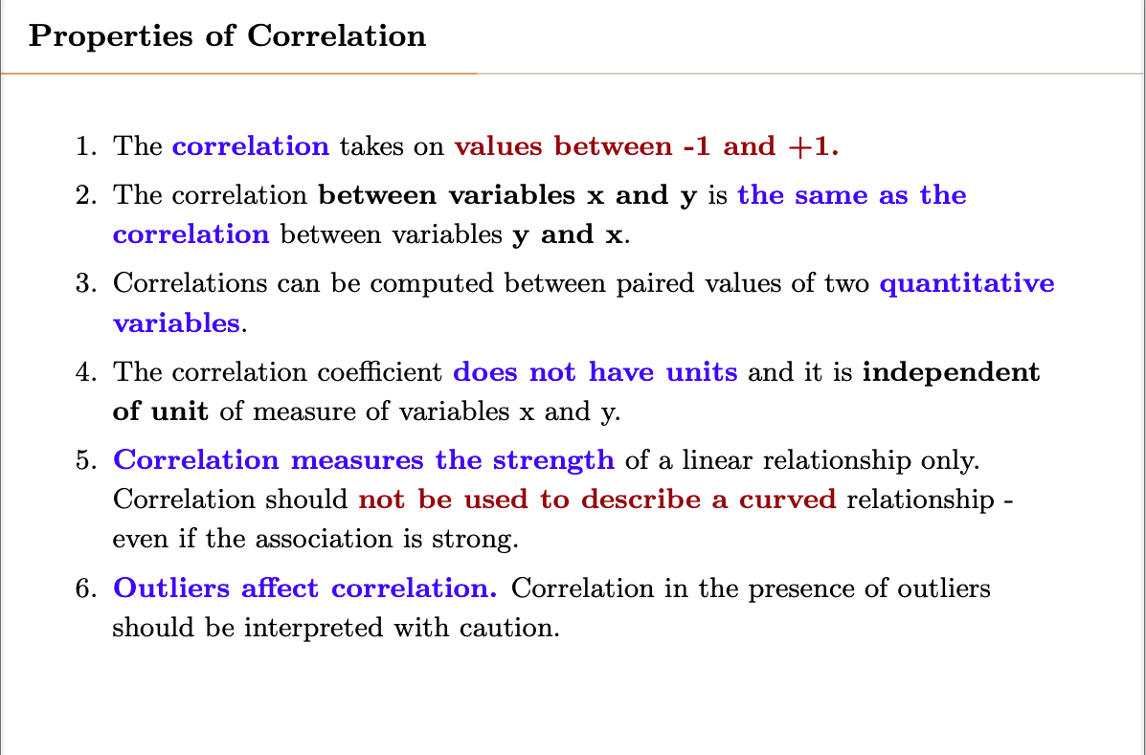

Slide 24
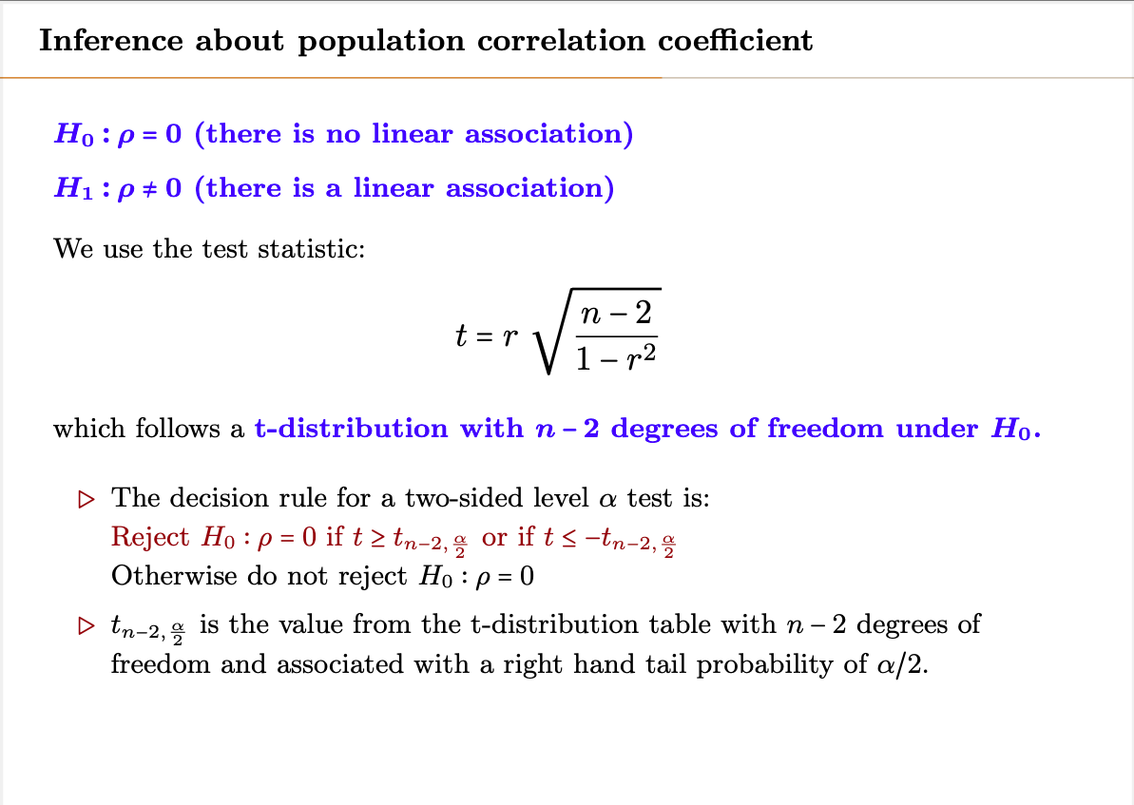

Slide 25
Linear Regression

Slide 26
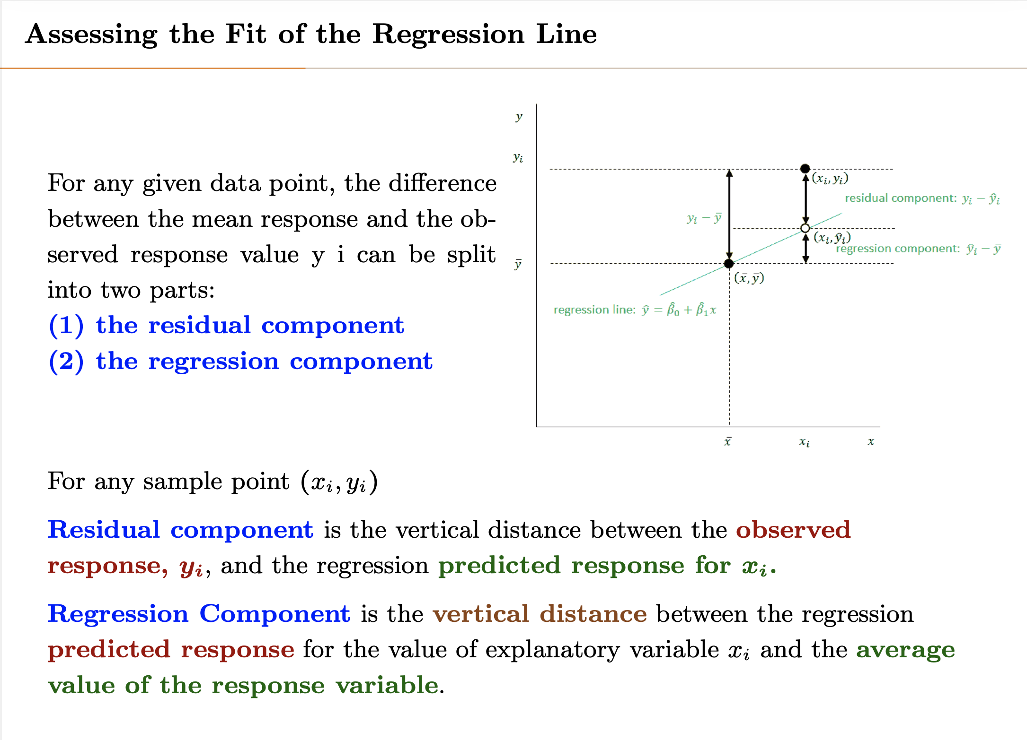

Slide 27
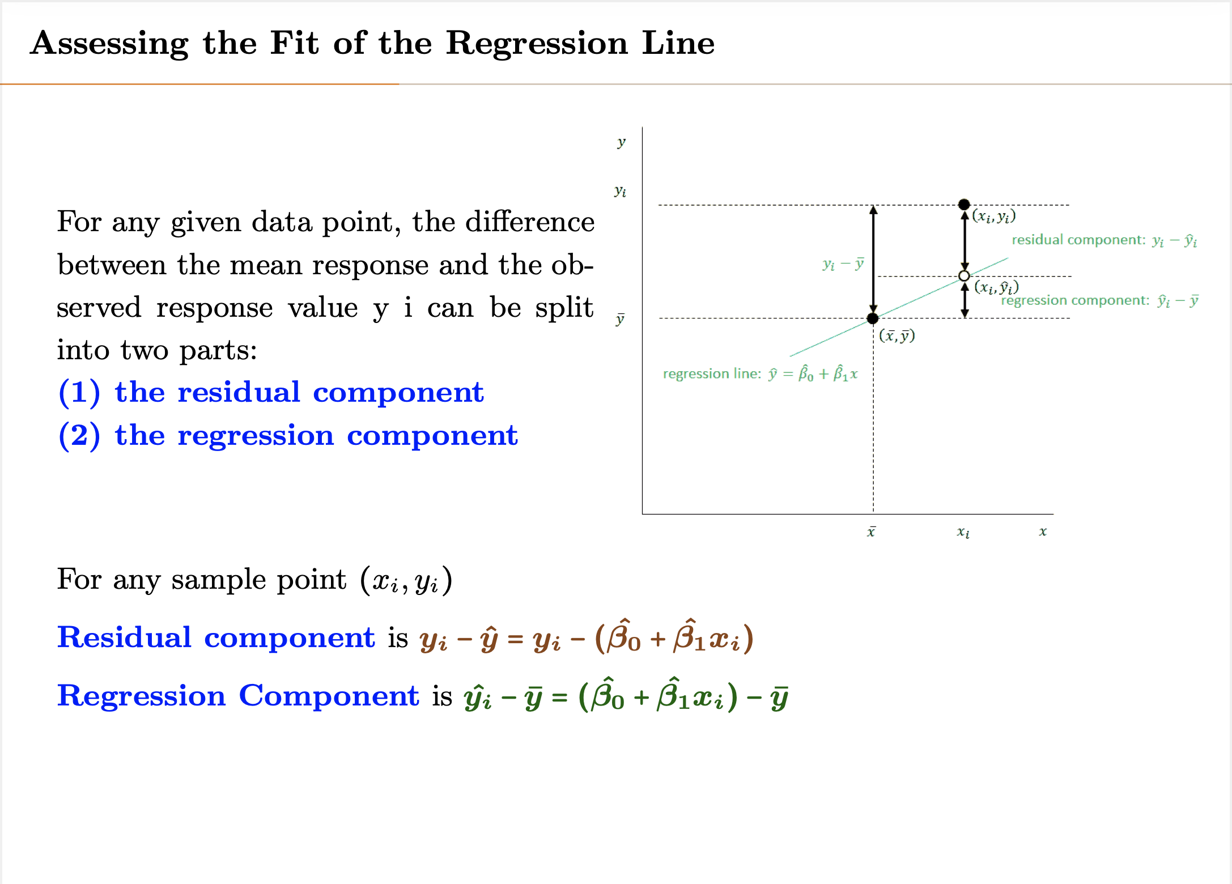

Slide 28
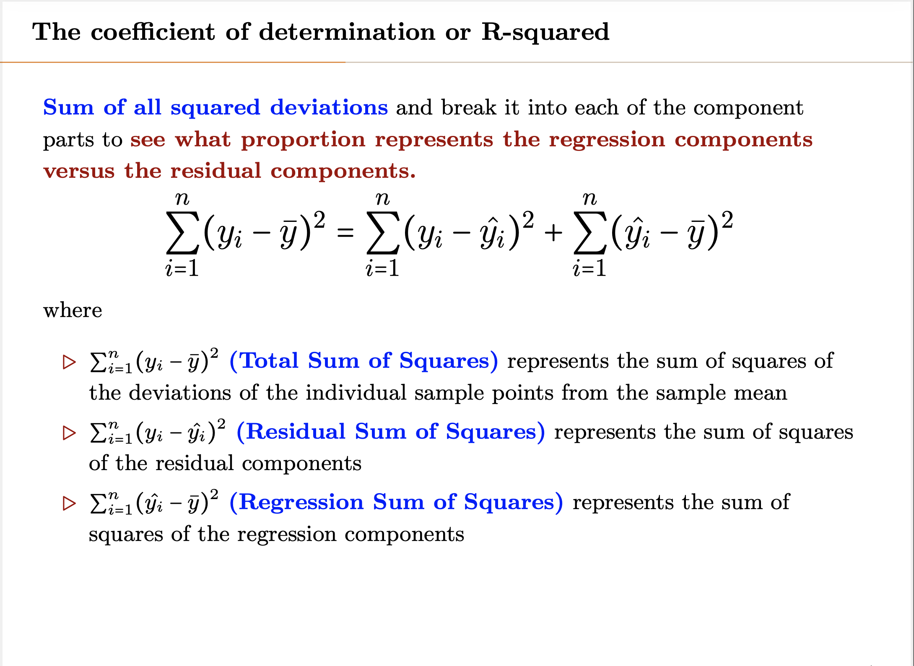
Notes:
Note that the above equation is correct, since error and estimate are orthogonal and their covariance is 0 (or they correlation is 0)

Slide 29
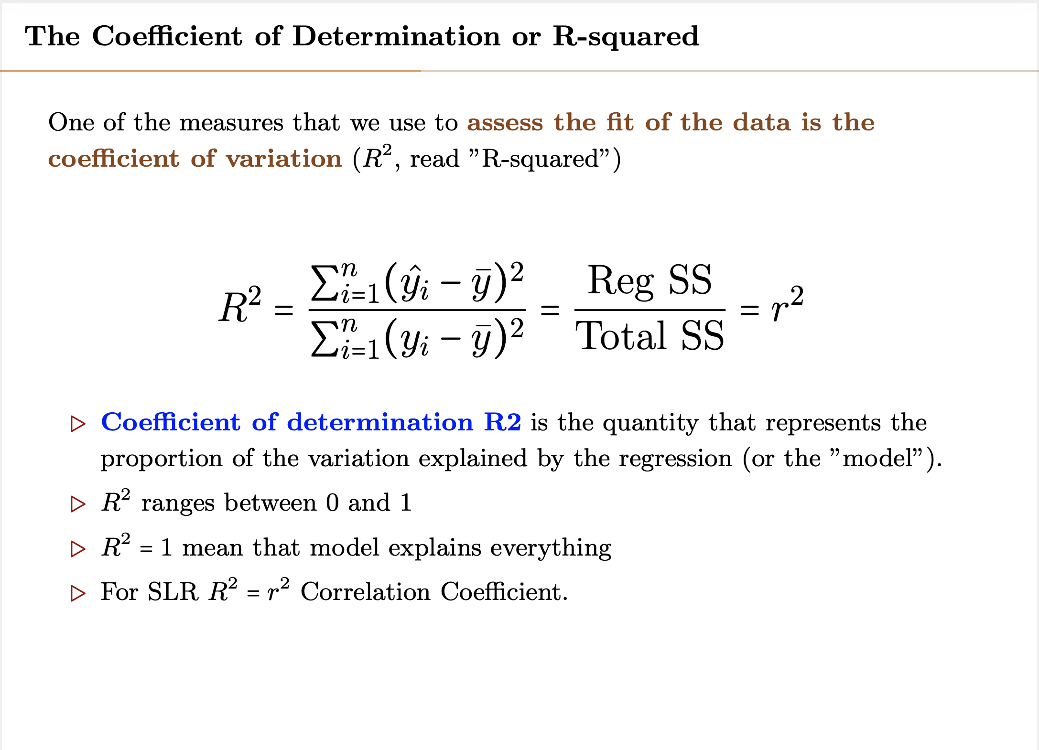
Notes:
Proof of R^2 = r^2:
Note: y=y^ + e
Cov(y^ , e) =0
Cov(x , y+z) = cov(x , y) + cov(x , z)
r (is correlation between Y and Y^) = cov(y , y^) / [var(y)var(y^)]^(0.5)
cov(y,y^) = cov(y^+e , y) = cov(y^,y^) + cov(e,y^) = cov (y^,y^) = var(y^)
r^2 = var(y^)^2 / var(y) var(y^) = var(y^) / var(y) = R^2

Slide 30
R² Issues
Adding any new parameter always results to increase in R², even if the new parameter is not significant
As number of parameters increase, R² approaches 1
Overfitting would also make R² approach one ( -> 1)
Can not be used to assess multiple parameters

Slide 31
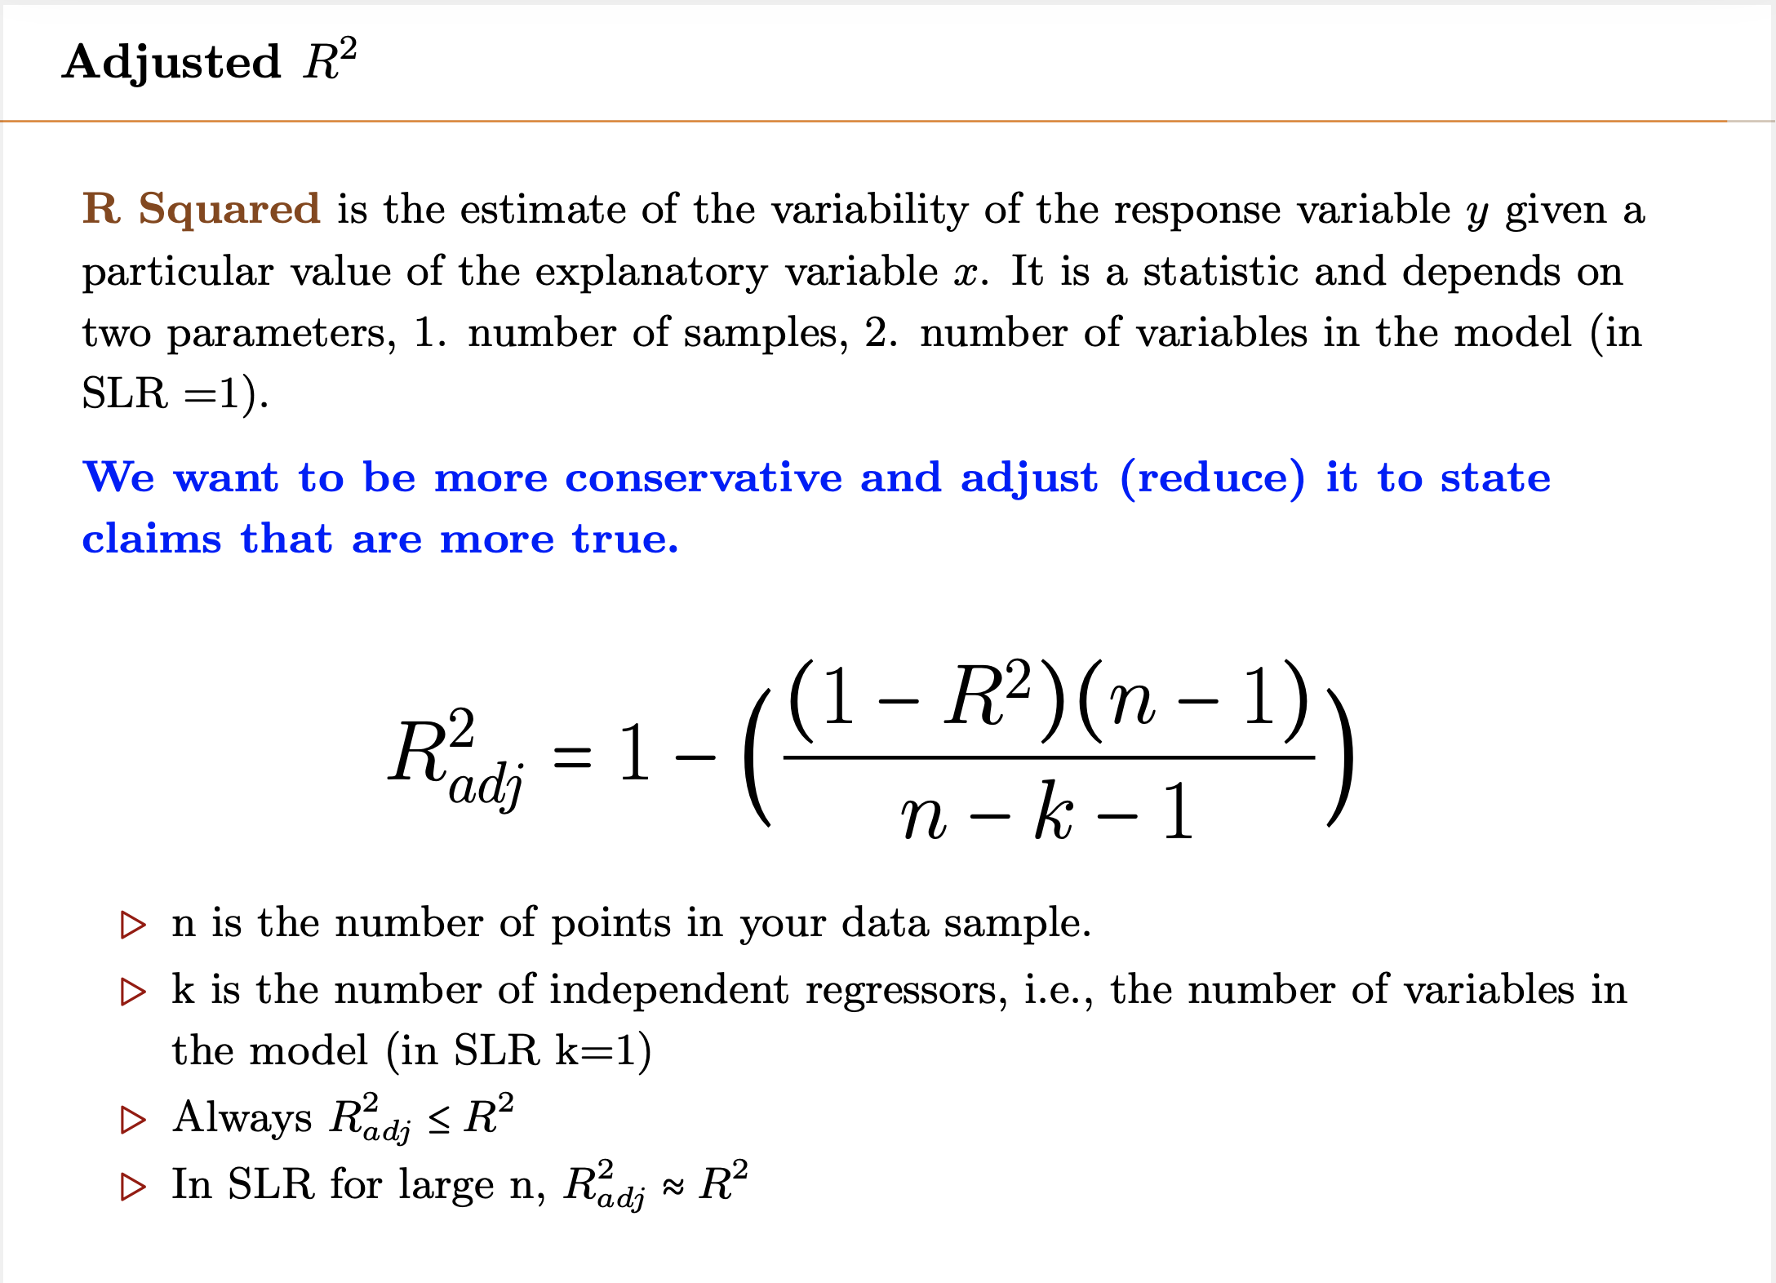
Notes:
Adjusted R – to mitigate R2 issue with not being dependent on k.

Slide 32
Another way of writing R²
Adjusted R2 can be written as follows which make it easier to understand
$$R2adj=1−(\frac{{Res SS}/{(n−k−1)}}{{Total SS}/{(n−1)}})$$
Note: simple equation and no need to calculate standard deviation of noise and also works for n<p.
Notes:
Note: R2 = 1- RSS/TSS

Slide 33
One parameter – Linear Regression

Slide 34
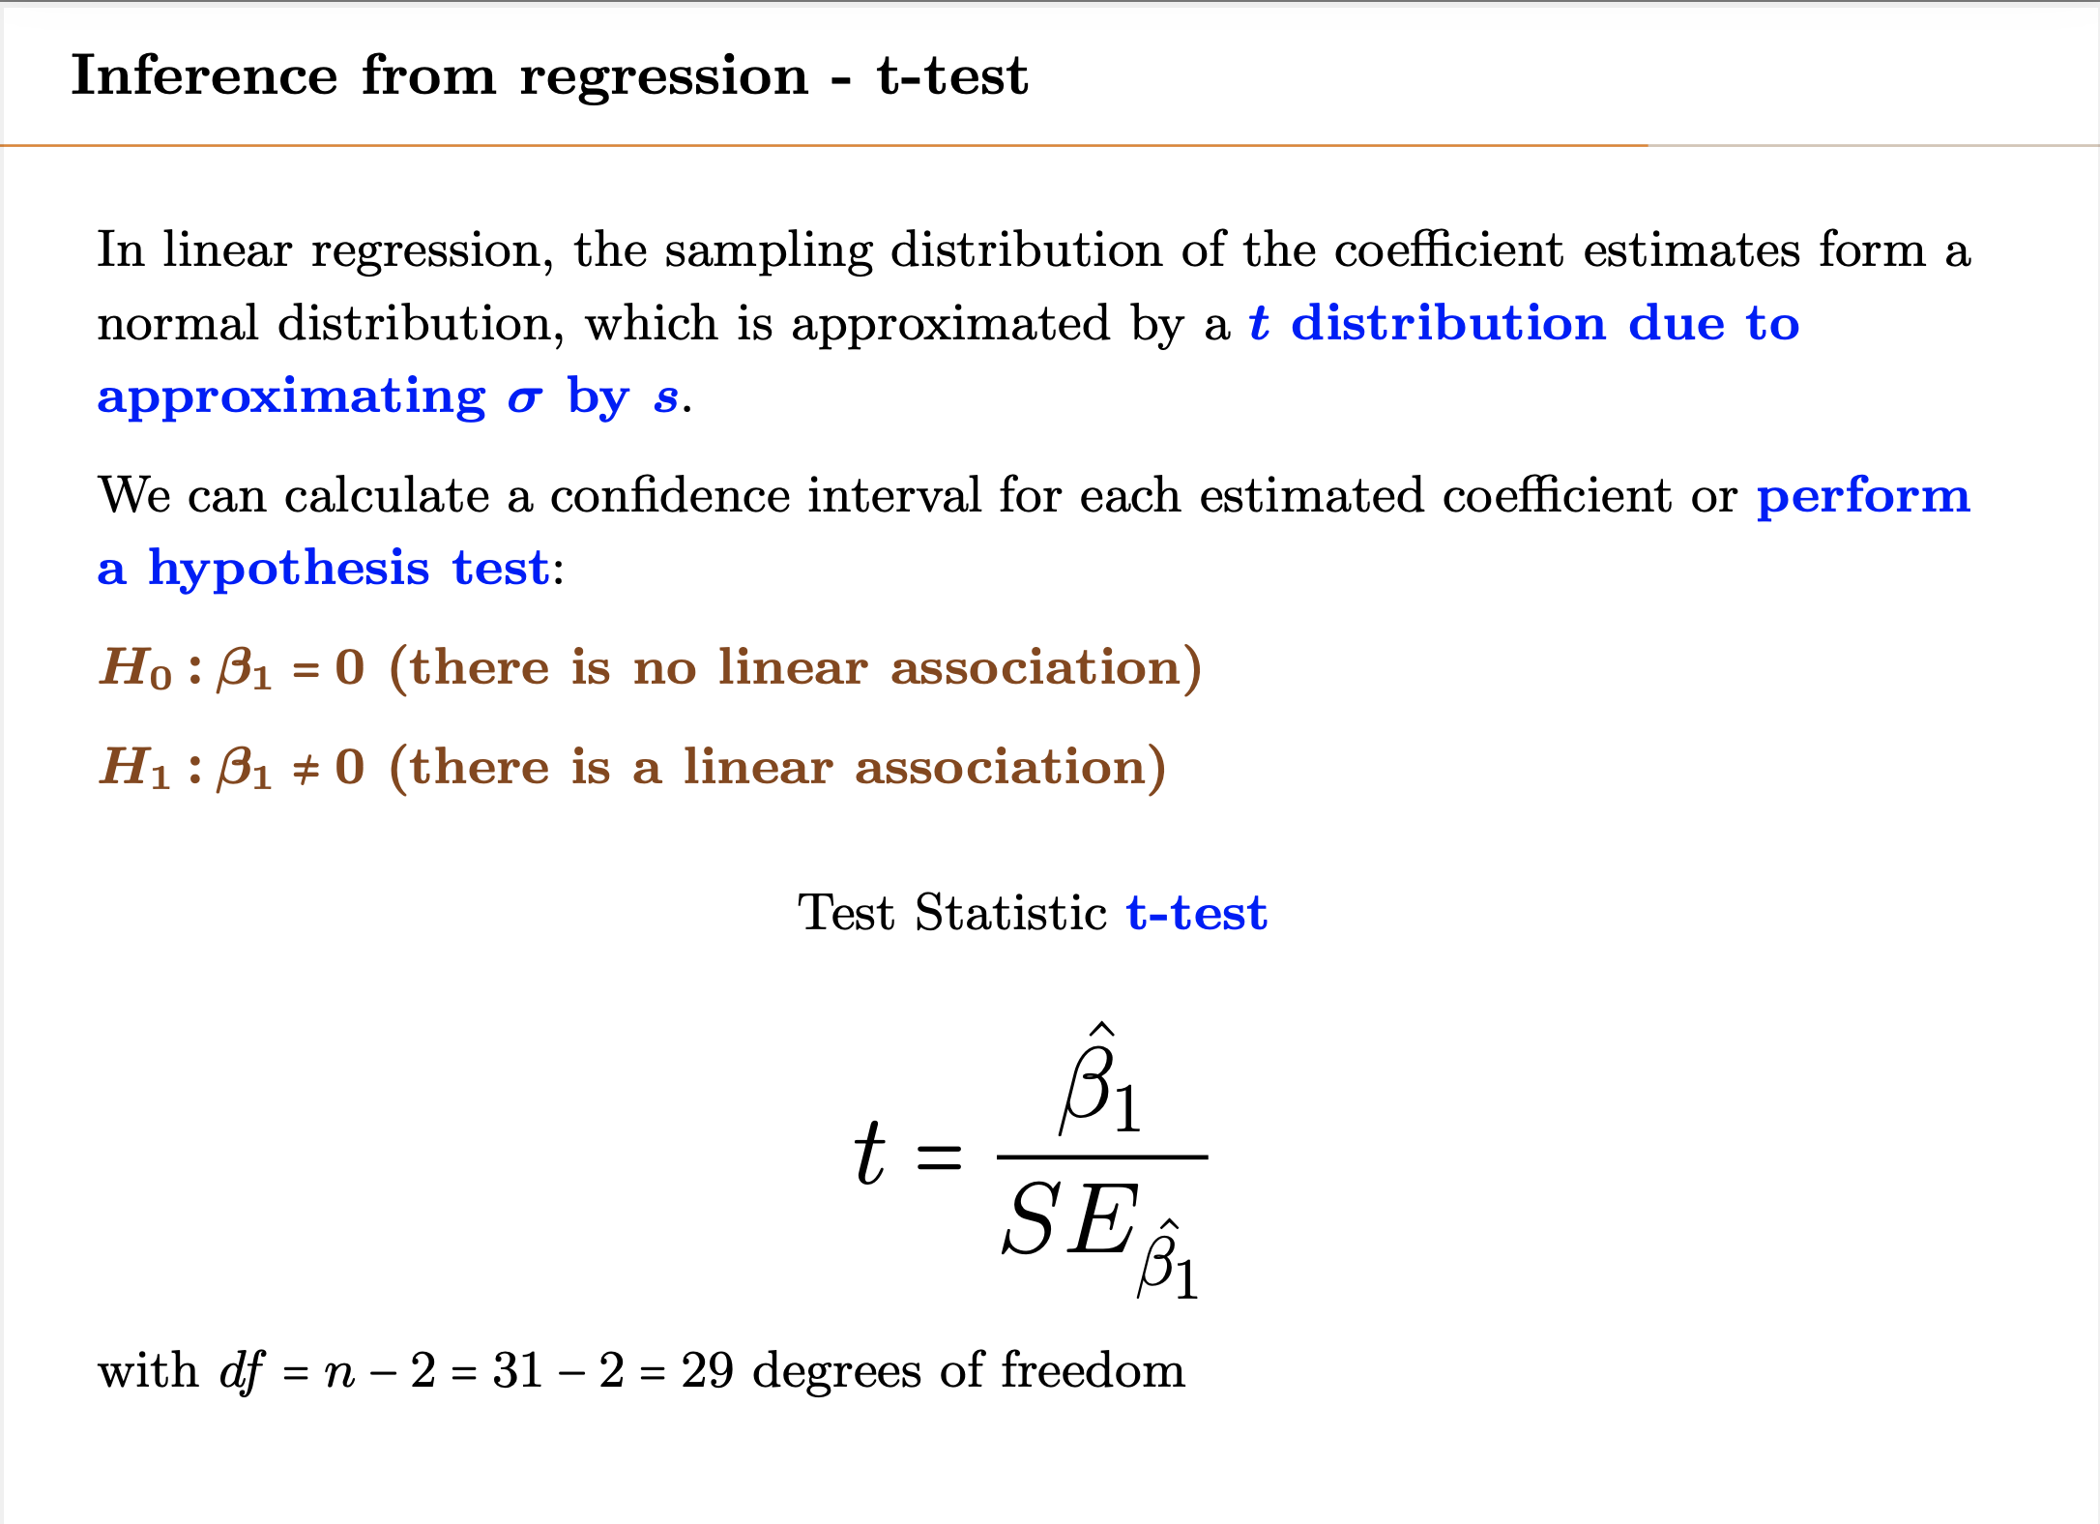

Slide 35
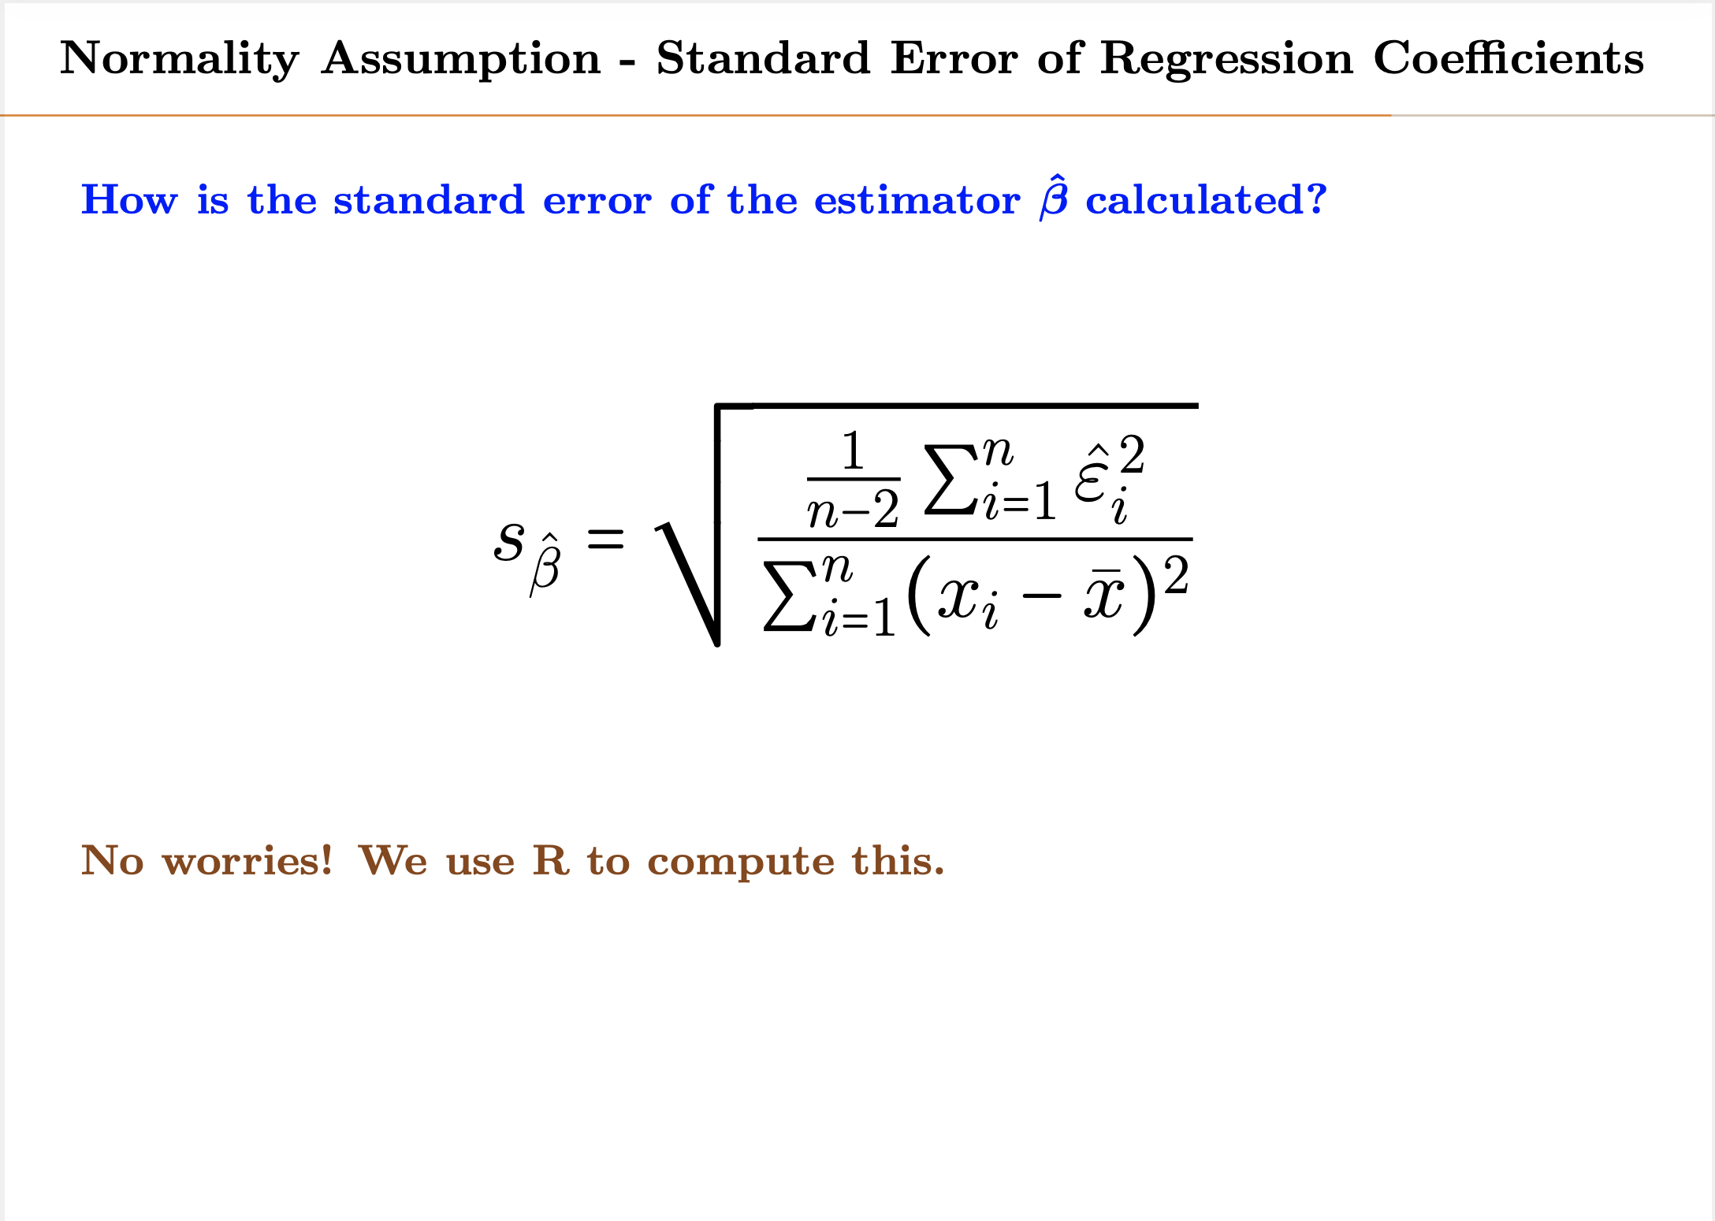
SE
Notes:
Typo here – this is SE- corrected.
Important note: for normalizing x – then applying hypothesis testing for Beta1 which is normalizing beta1 with mean=0.
Why df = n-2 : since we are talking about a linear regression with one parameter.
If there were 2 parameters, df will be : df = n-3.
Note: SE is the standard deviation of standardized error.
If we consider (samples-mean)/sd as standardization, then sqrt(n) gets cancels from denominator of the above equation, since the CI already has a sqrt(n) also.

Slide 36
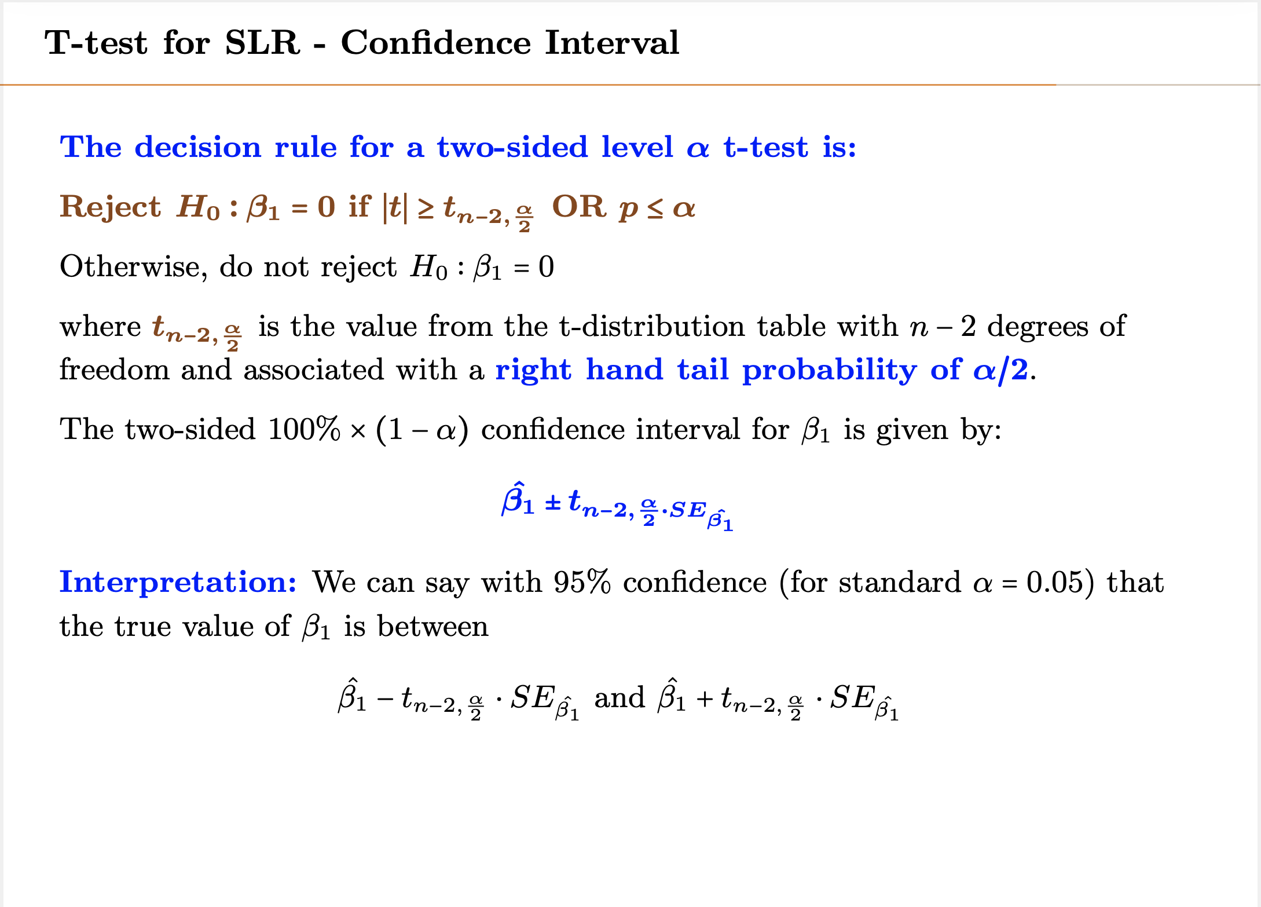

Slide 37
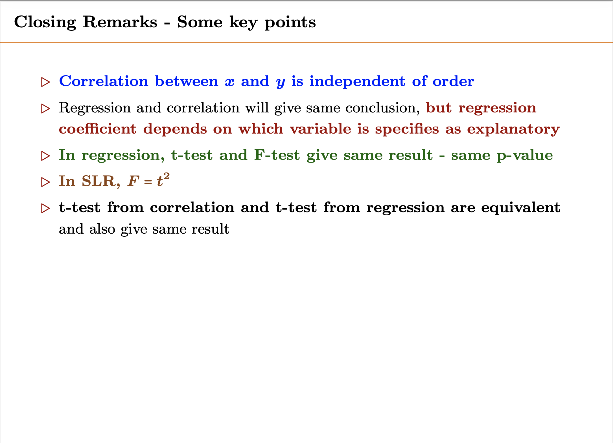

Slide 38
Example – Predicting Stock value of company X based on PE
For the company X we calculated its stock value as a linear function of its PE ratio, which is
StockValue = 6.25 + 20.3 x PE
Sum of residual square = 1848
PE ratio has been gathered every quarter for 2 years – variance of PE samples = 3.6
Question: is there a linear relationship with 95% confidence?

Slide 39
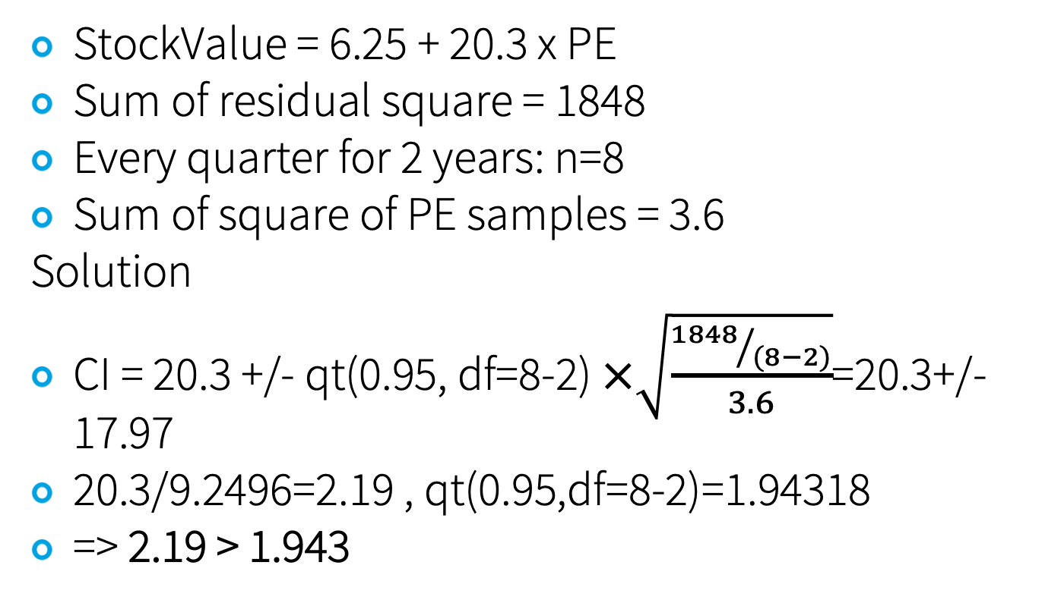
Example – Predicting Stock value of company X based on PE
StockValue = 6.25 + 20.3 x PE
Sum of residual square = 1848
Every quarter for 2 years: n=8
Sum of square of PE samples = 3.6
Solution
CI = 20.3 +/- qt(0.95, df=8-2) $×\sqrt{\frac{{1848}/{(8−2)}}{3.6}}$=20.3+/-17.97
20.3/9.2496=2.19 , qt(0.95,df=8-2)=1.94318
=> 2.19 > 1.943

Slide 40
Example – Age vs Cholesterol
Age | Cholesterol | Age | Cholesterol
25 | 180 | 42 | 183
25 | 195 | 48 | 204
28 | 186 | 51 | 221
32 | 180 | 51 | 243
32 | 210 | 58 | 208
32 | 197 | 62 | 228
38 | 239 | 65 | 269
Find linear model capturing relationship between age and cholesterol?
What is the critical value corresponding to 95%?
And also R²

Slide 41
Example cont.
Line: Y=151.3537 + 1.3991x
R² = 0.515
Critical value: qt(df=14-2, 0.025)

Slide 42
Example cont.
Test for linear relationship?
Find confidence interval of slope

Slide 43
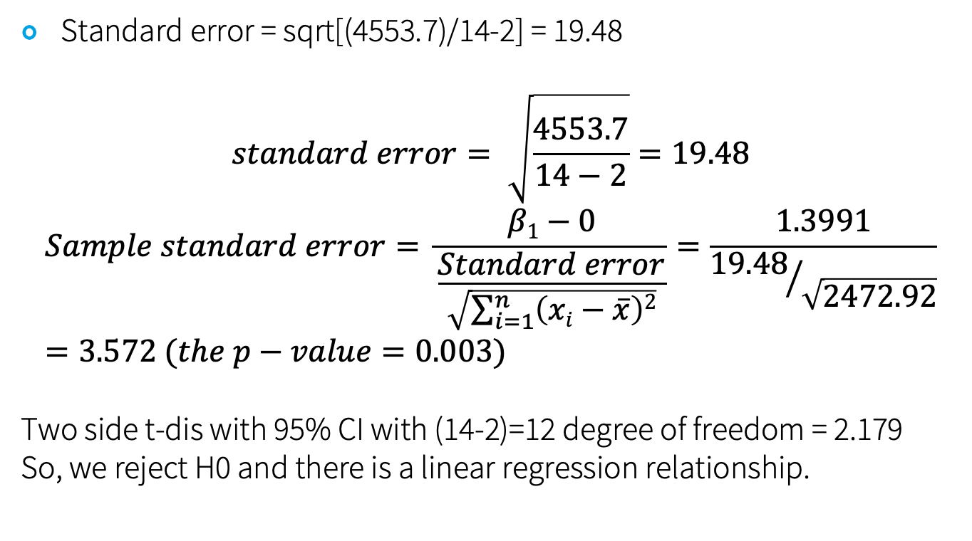
Standard error = sqrt[(4553.7)/14-2] = 19.48
$$standard error= \sqrt{\frac{4553.7}{14−2}}=19.48$$
$$Sample standard error= \frac{β1−0}{\frac{Standard error}{\sqrt{\sum_{i=1}^{n}{\left(xi−\overline{x}\right)2}}}}=\frac{1.3991}{{19.48}/{\sqrt{2472.92}}}=3.572 (the p−value=0.003)$$
Two side t-dis with 95% CI with (14-2)=12 degree of freedom = 2.179
So, we reject H0 and there is a linear regression relationship.

Slide 44
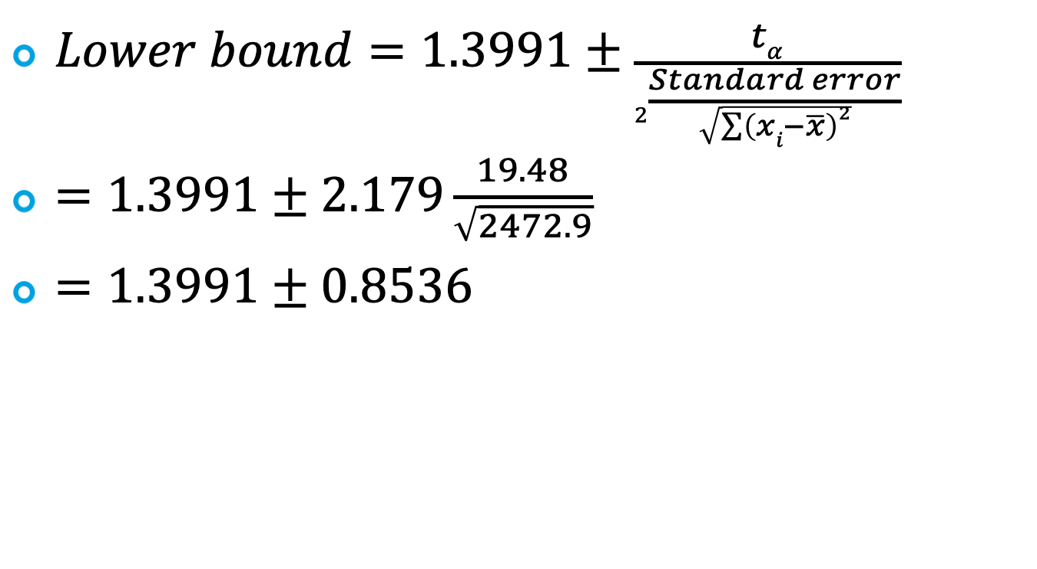
Slope confidence interval
$Lower bound=1.3991±\frac{tα}{2\frac{Standard error}{\sqrt{\sum{\left(xi−\overline{x}\right)2}}}}$
$=1.3991±2.179\frac{19.48}{\sqrt{2472.9}}$
$=1.3991±0.8536$

Slide 45
Multiple Linear Regression

Slide 46
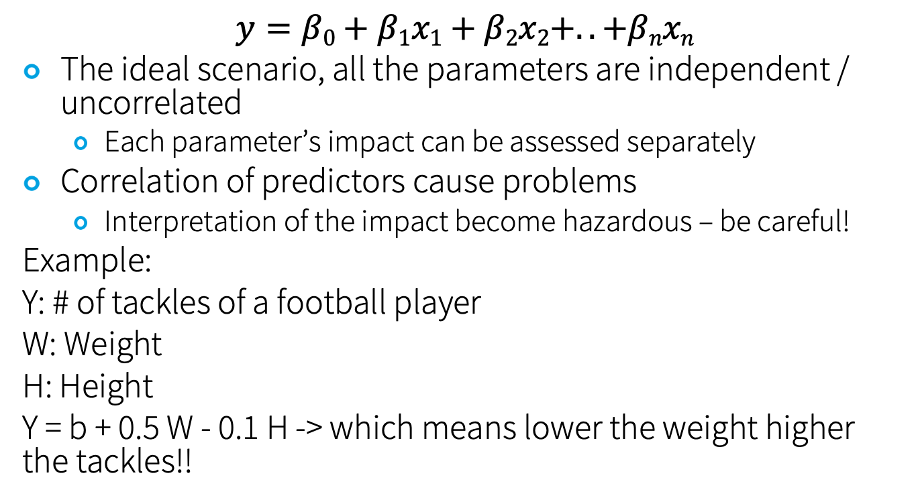
Multiple Linear Regression
$$y=β0+β1x1+β2x2+..+βnxn$$
The ideal scenario, all the parameters are independent / uncorrelated
Each parameter’s impact can be assessed separately
Correlation of predictors cause problems
Interpretation of the impact become hazardous – be careful!
Example:
Y: # of tackles of a football player
W: Weight
H: Height
Y = b + 0.5 W - 0.1 H -> which means lower the weight higher the tackles!!

Slide 47
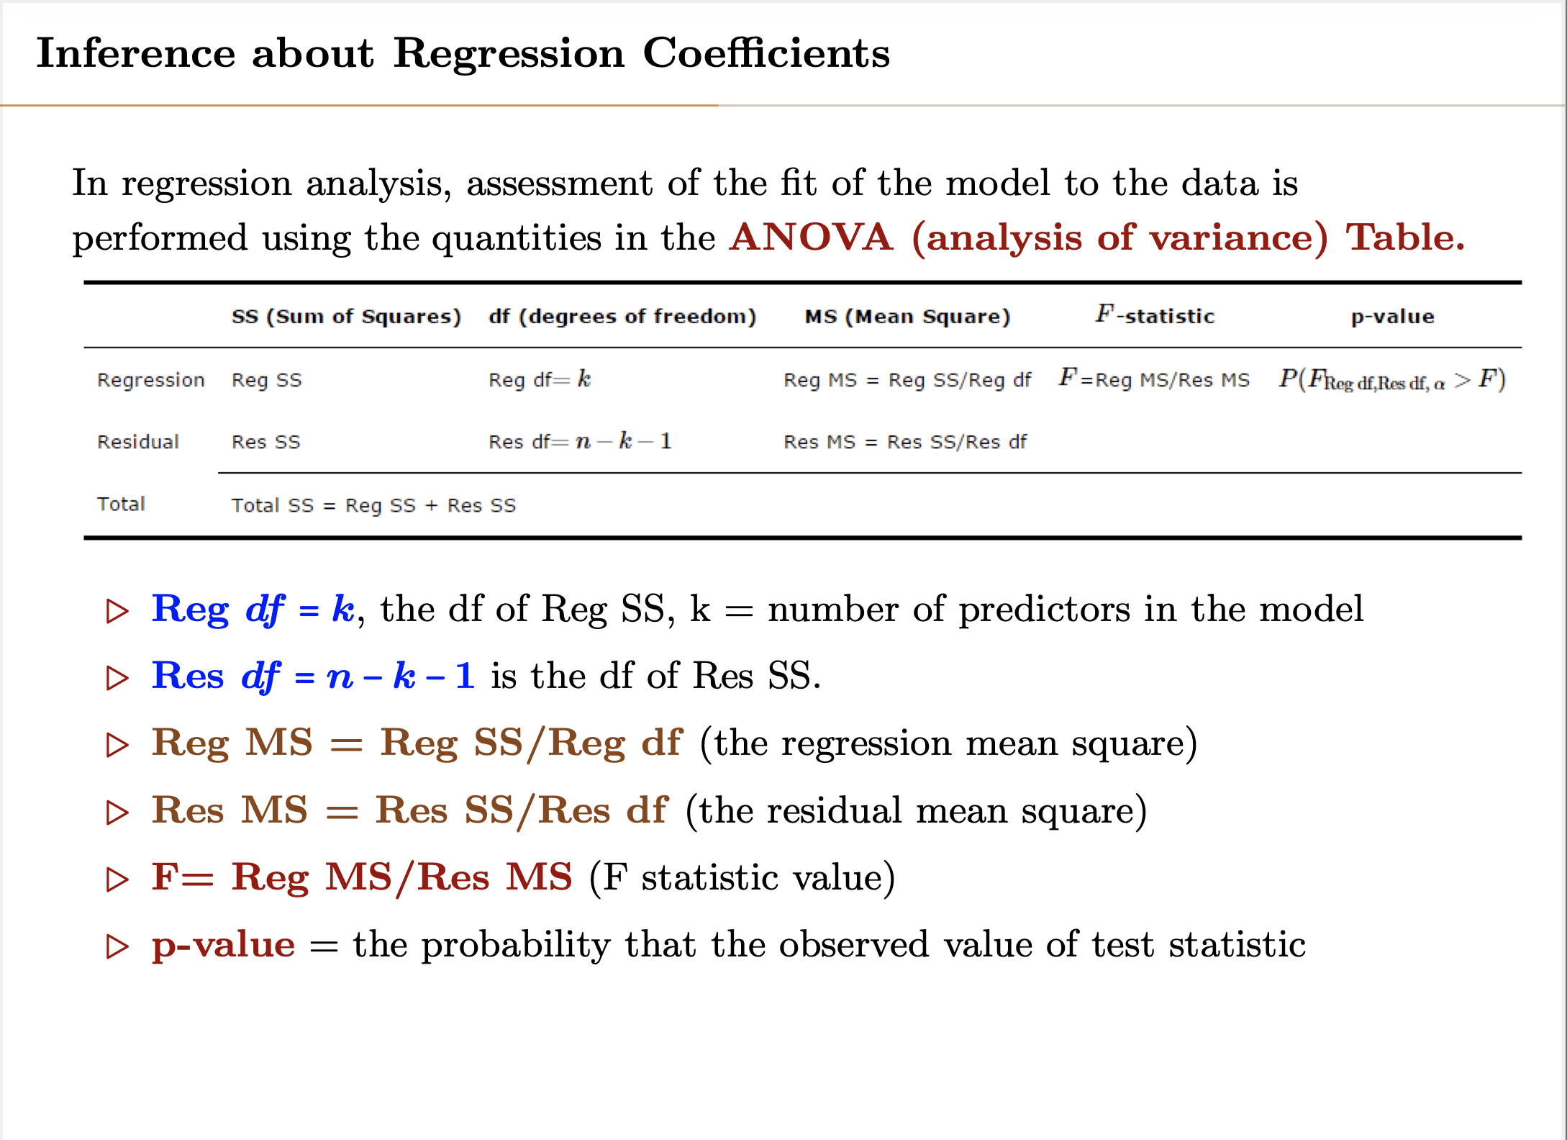
Notes:
Explain degree of freedom.
In case of regression, we have k+1 parameters, but only k of them are changed.
In case of residual error, with n number of points we have n degree of freedom minus the model which is K+1 (one is for the interception of mean)

Slide 48
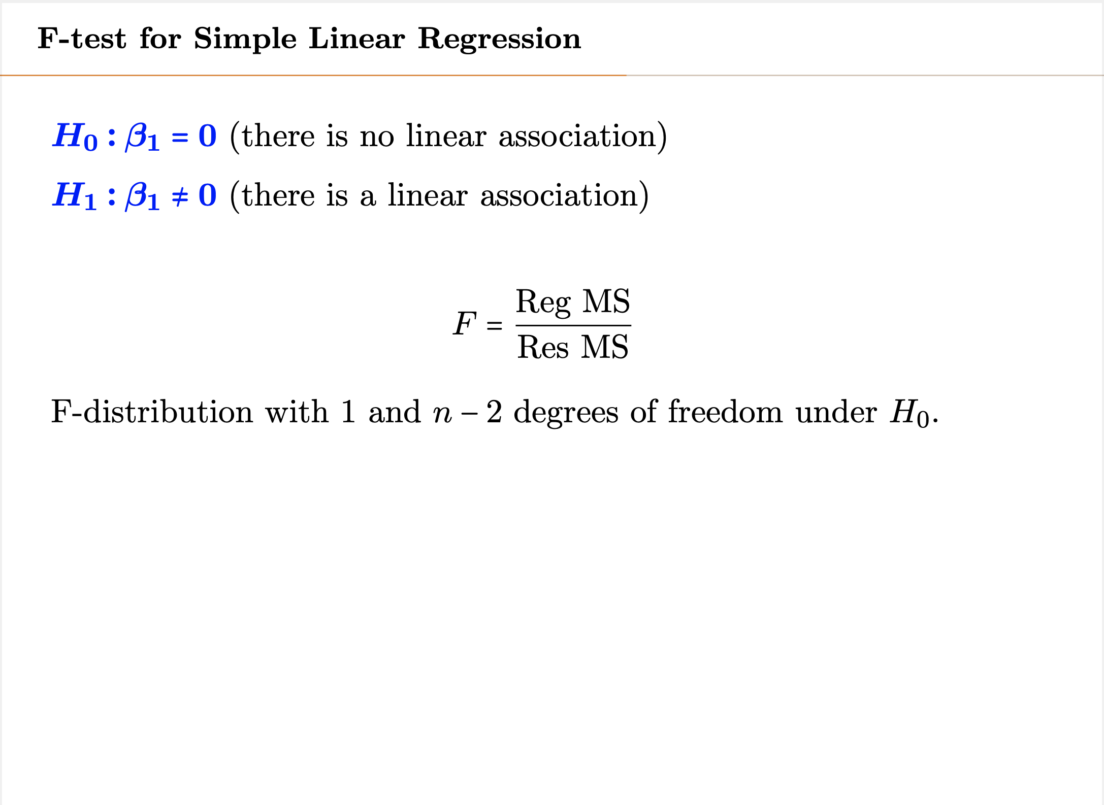

Slide 49
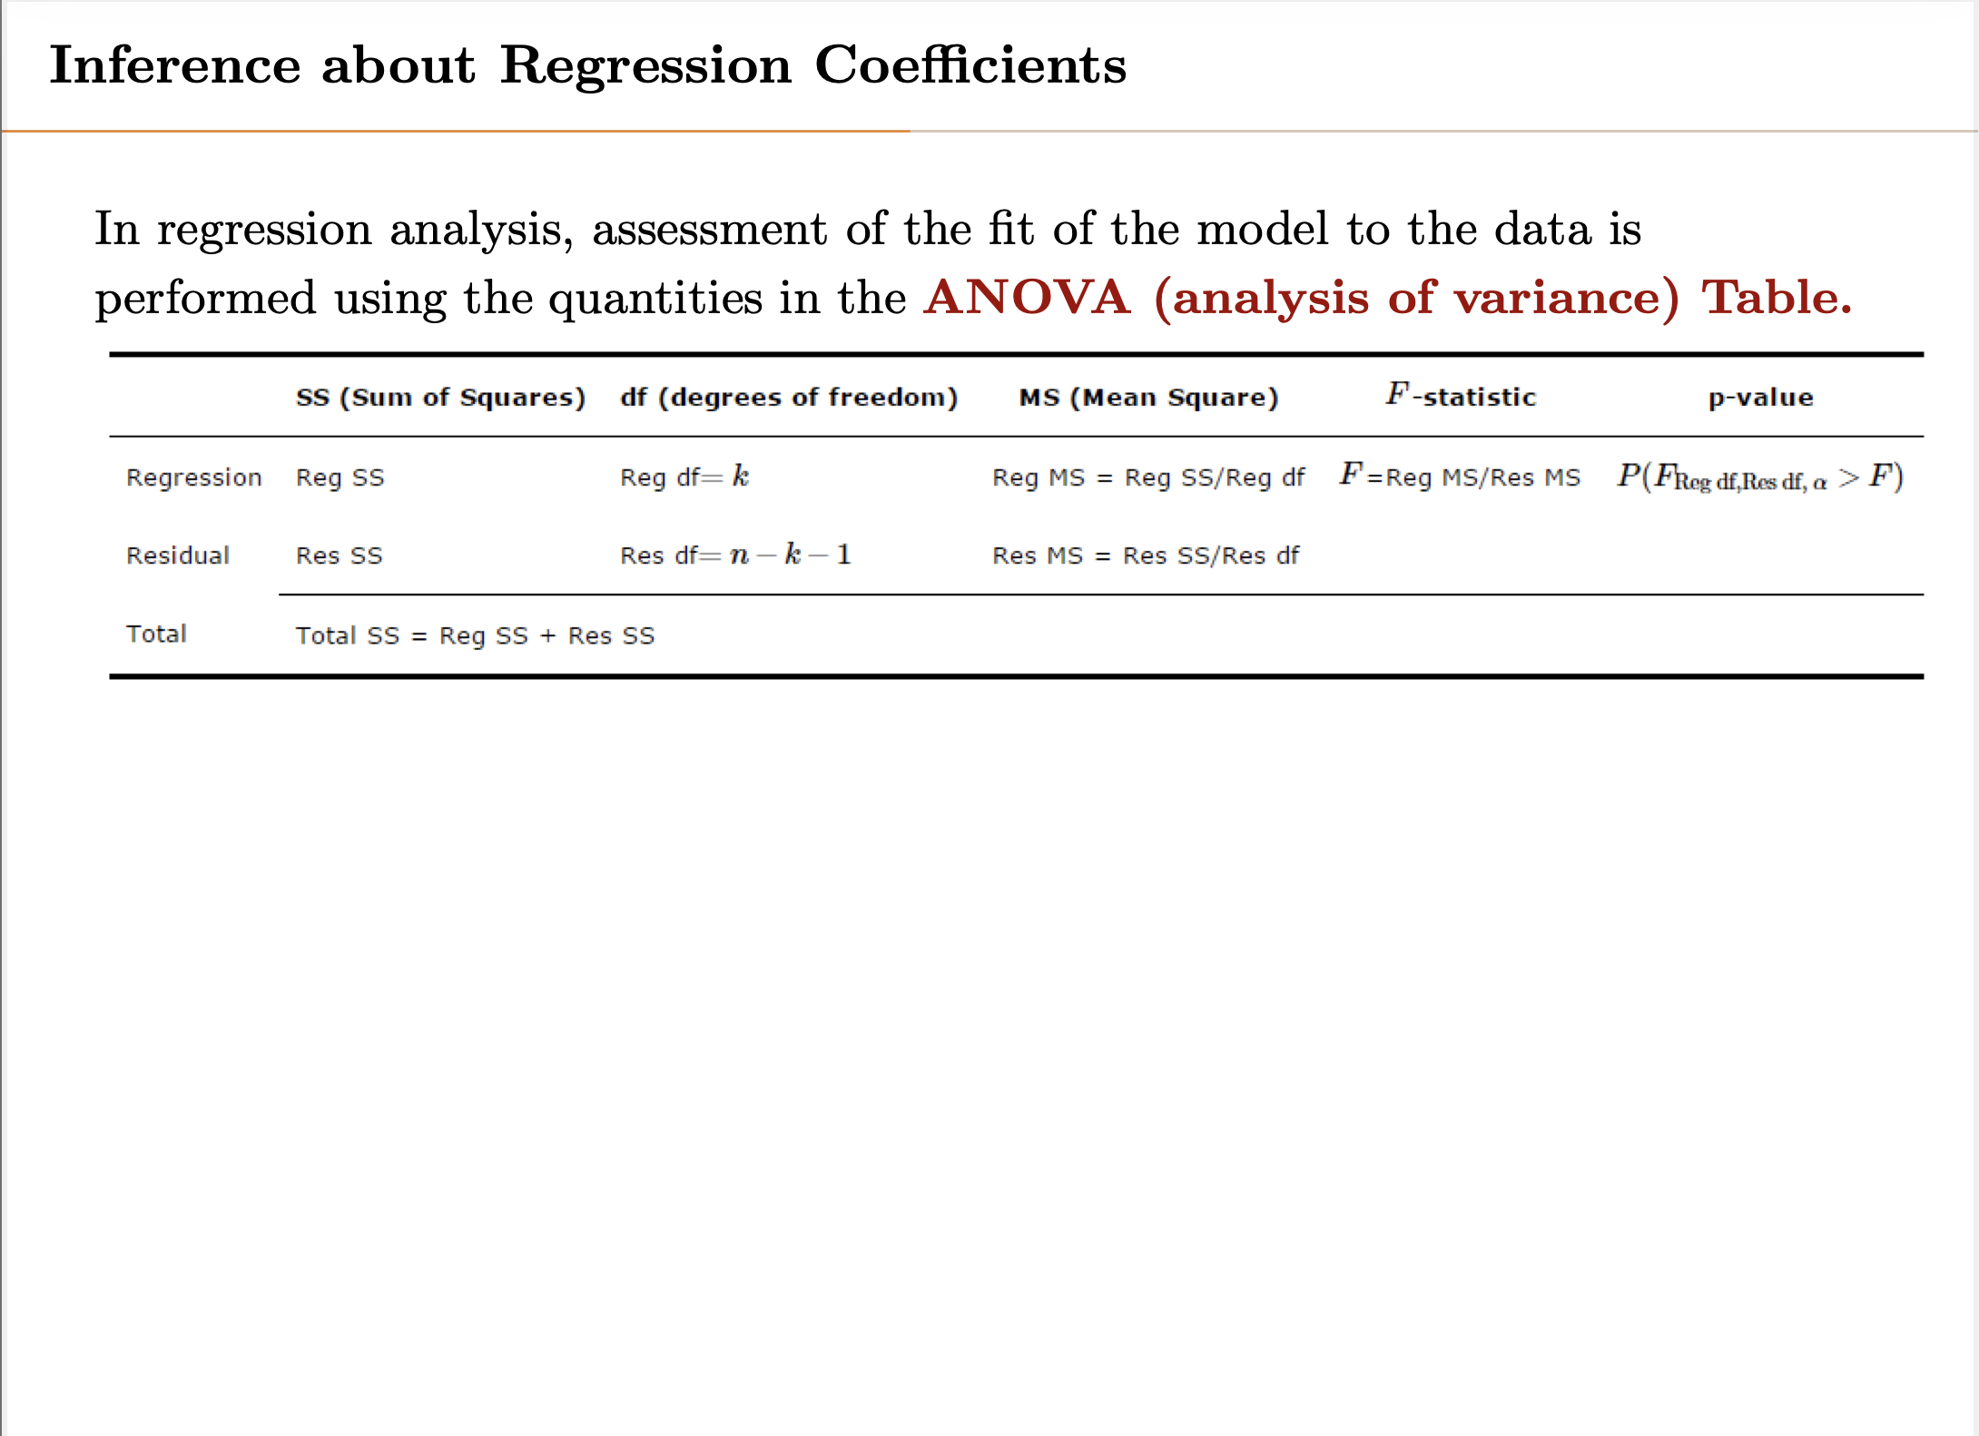
Notes:
Explain degree of freedom.
In case of regression, we have k+1 parameters, but only k of them are changed.
In case of residual error, with n number of points we have n degree of freedom minus the model which is K+1 (one is for the interception of mean)

Slide 50
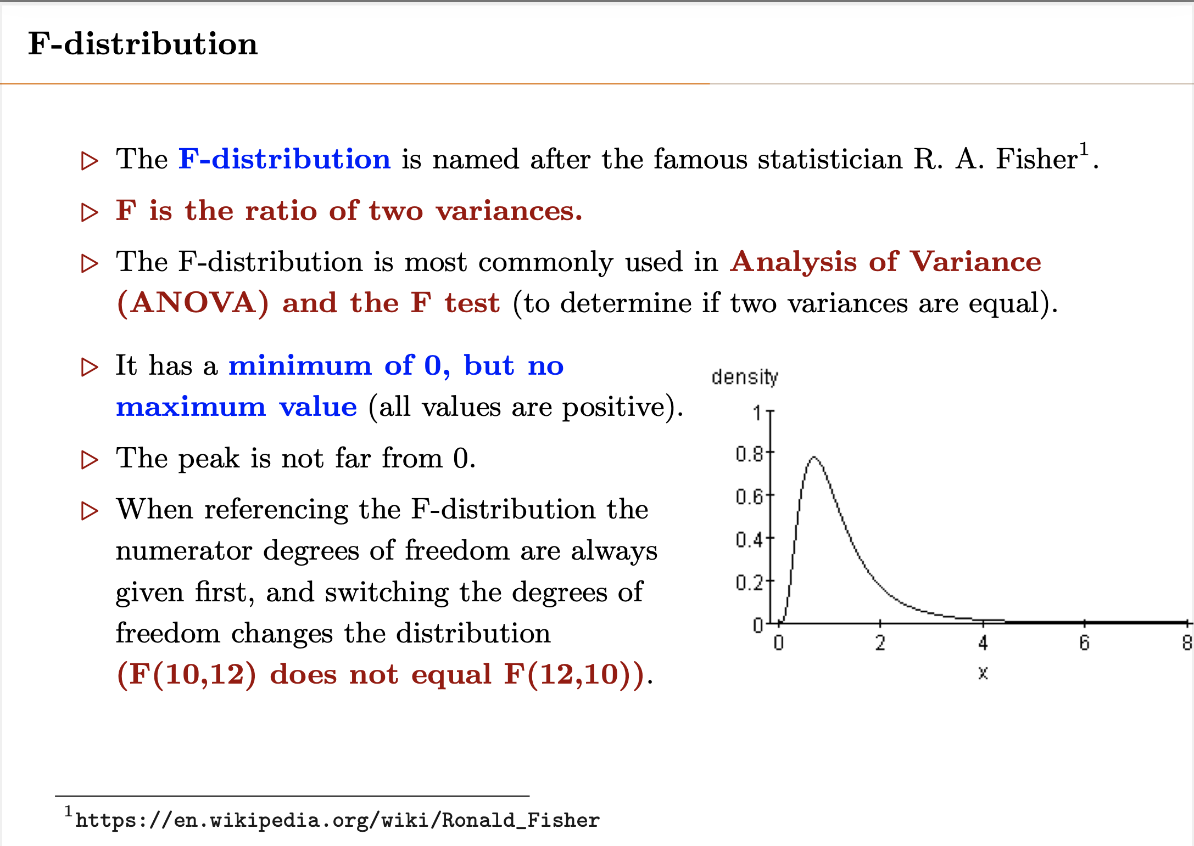
Notes:
One side vs two sided – in regression, it is always one sided (lift sided).

Slide 51
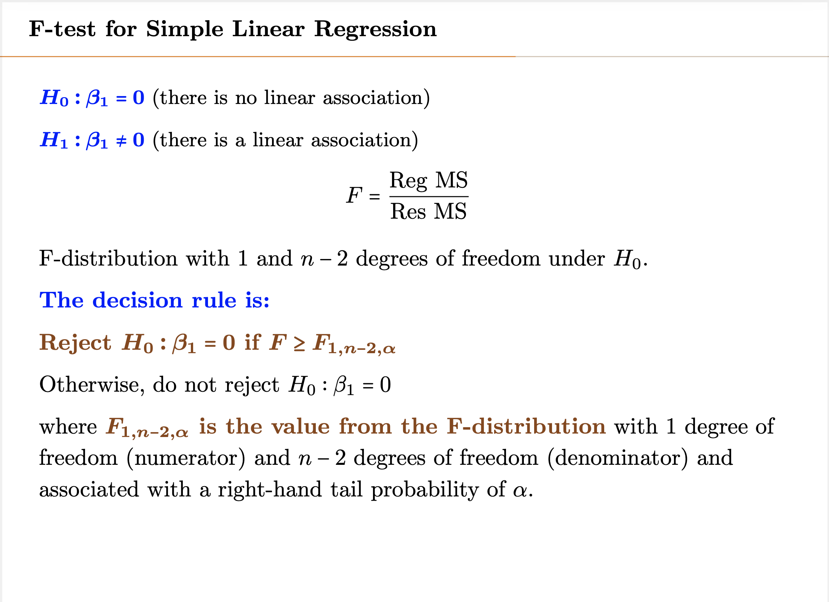

Slide 52
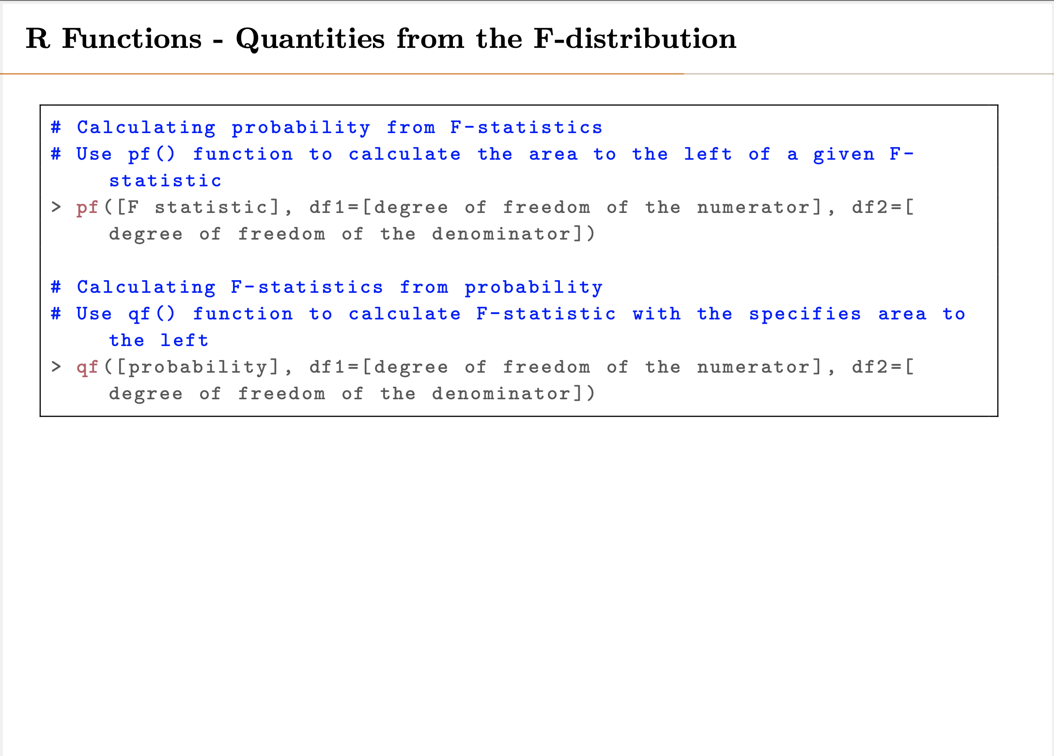

Slide 53
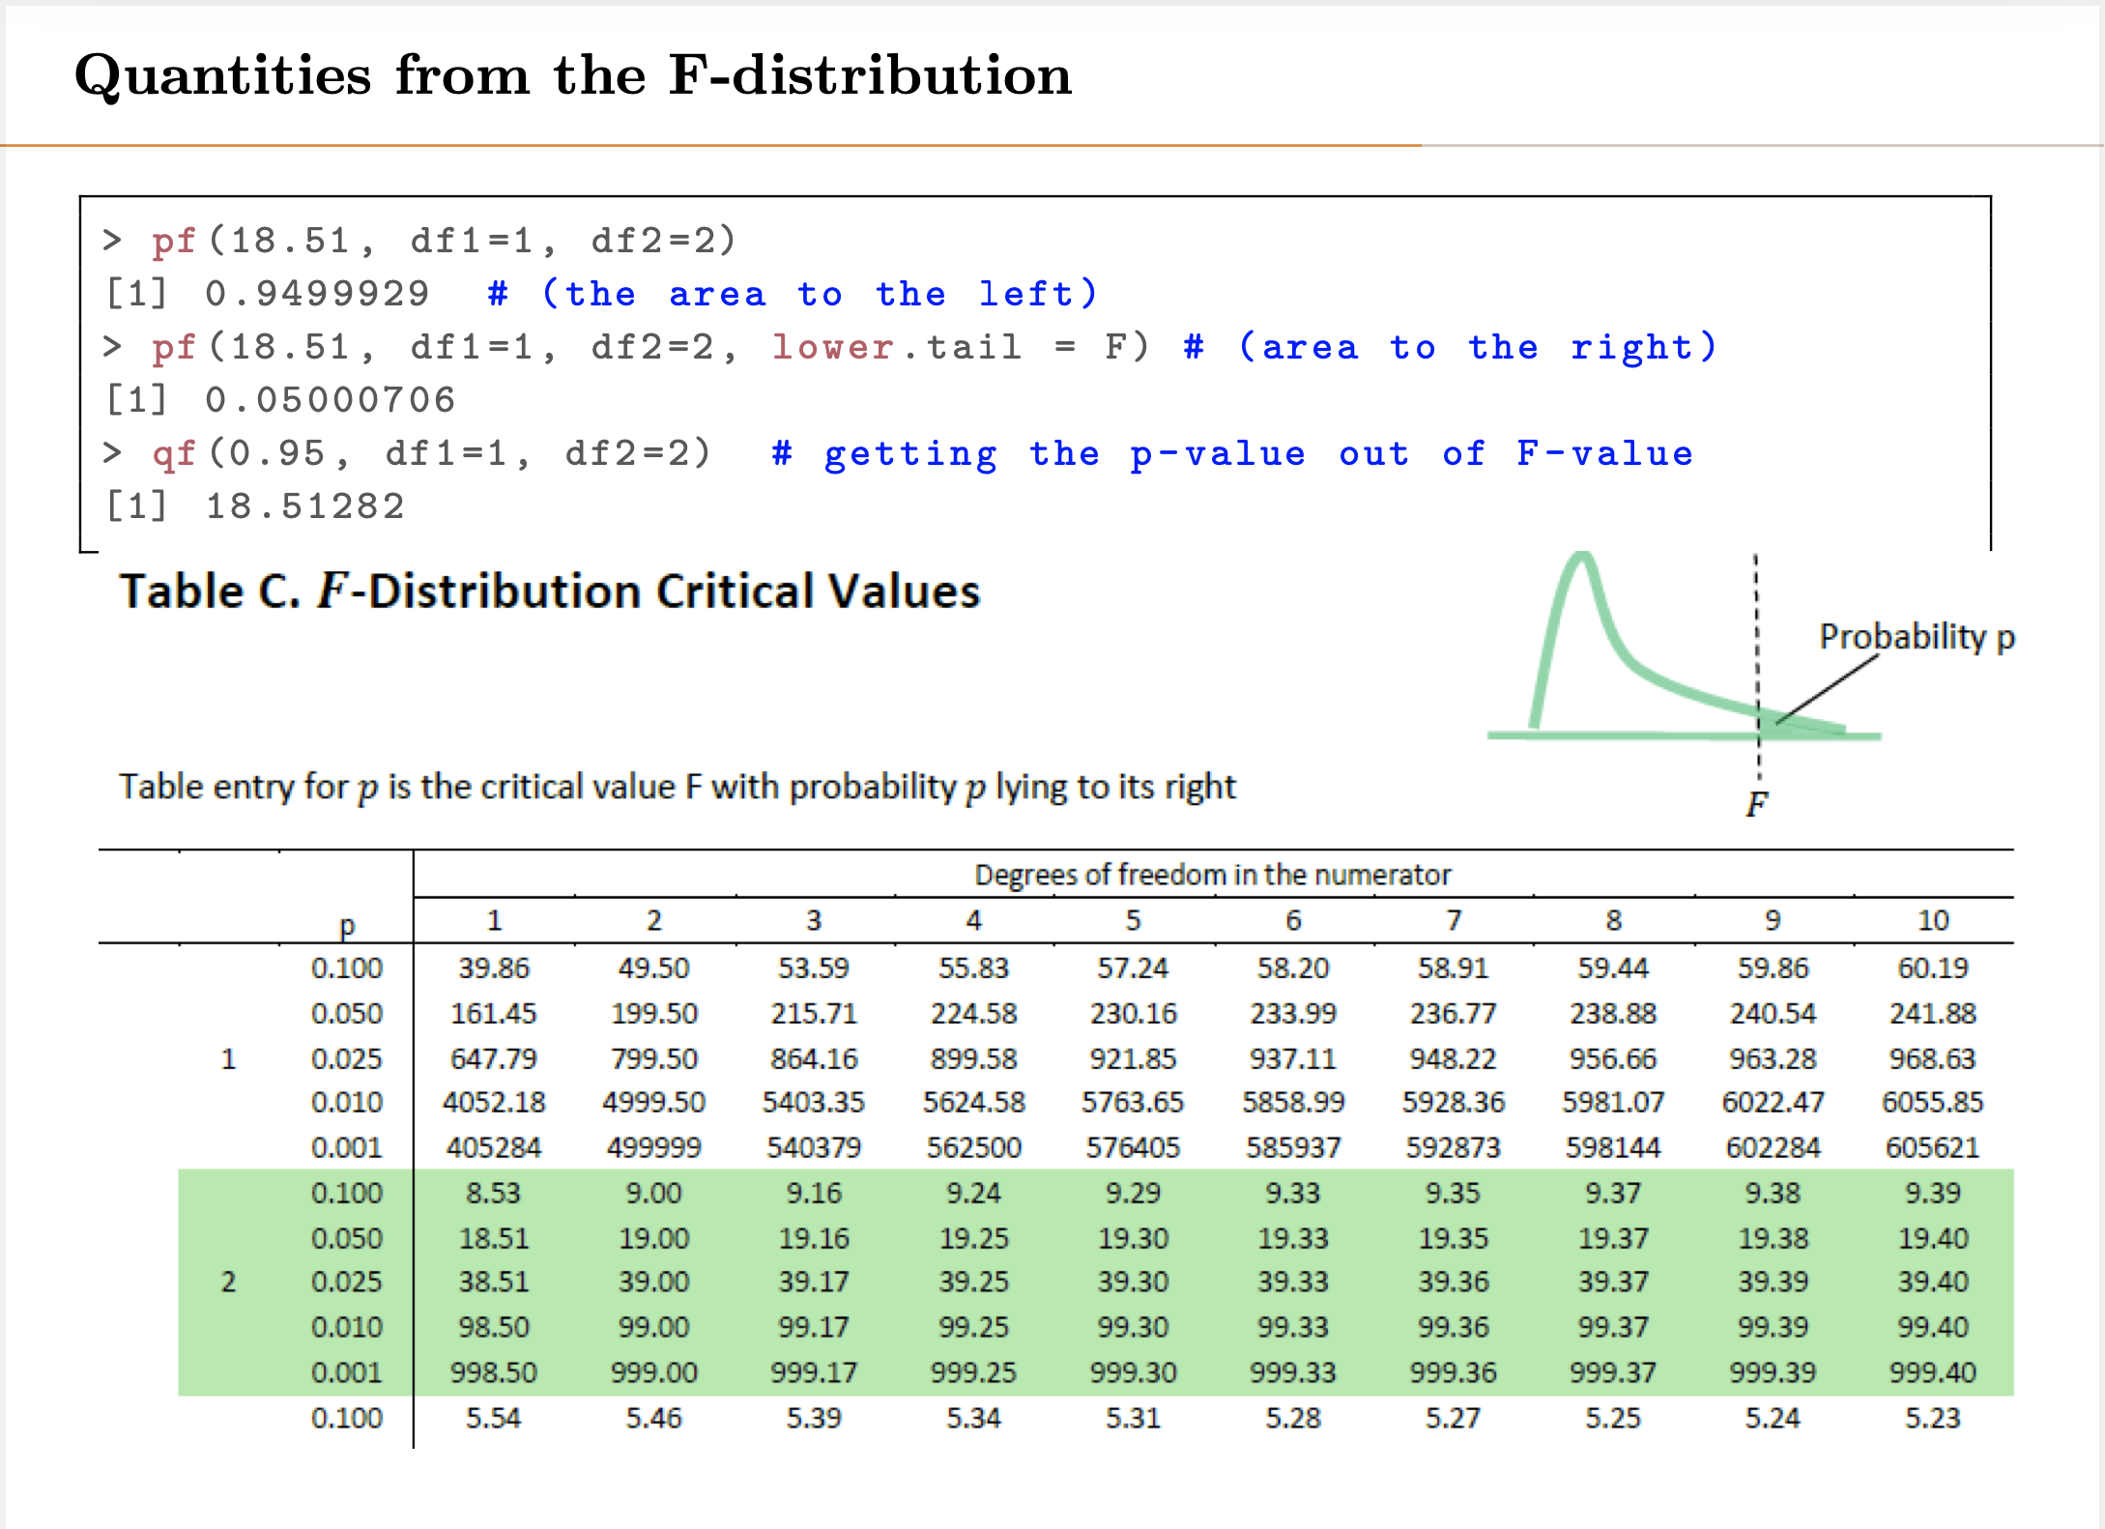

Slide 54
F – Test Testing for Significance of Multiple Parameter
In order to assess a multi variable linear regression, an equation is needed reflecting impact of multi-parameters
F test is the ratio of regression error to residual error
Numerator has been standardized by dividing by number of parameter
Denominator has been standardized by dividing by (number of samples-number of parameters-1)
(-1) in denominator because of one parameter in the alternative equation
This is called F-distribution

Slide 55
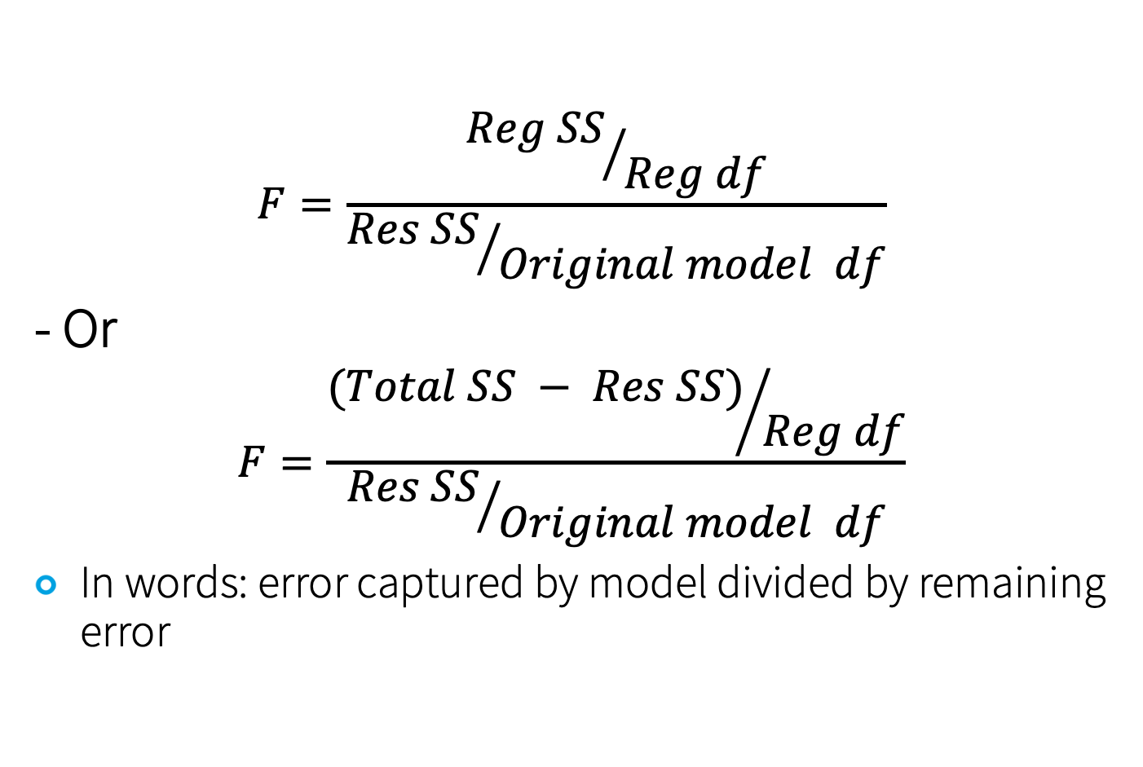
General F function
$$F=\frac{{Reg SS}/{Reg df}}{{Res SS}/{Original model df}}$$
- Or
$$F=\frac{{(Total SS − Res SS)}/{Reg df}}{{Res SS}/{Original model df}}$$
In words: error captured by model divided by remaining error

Slide 56
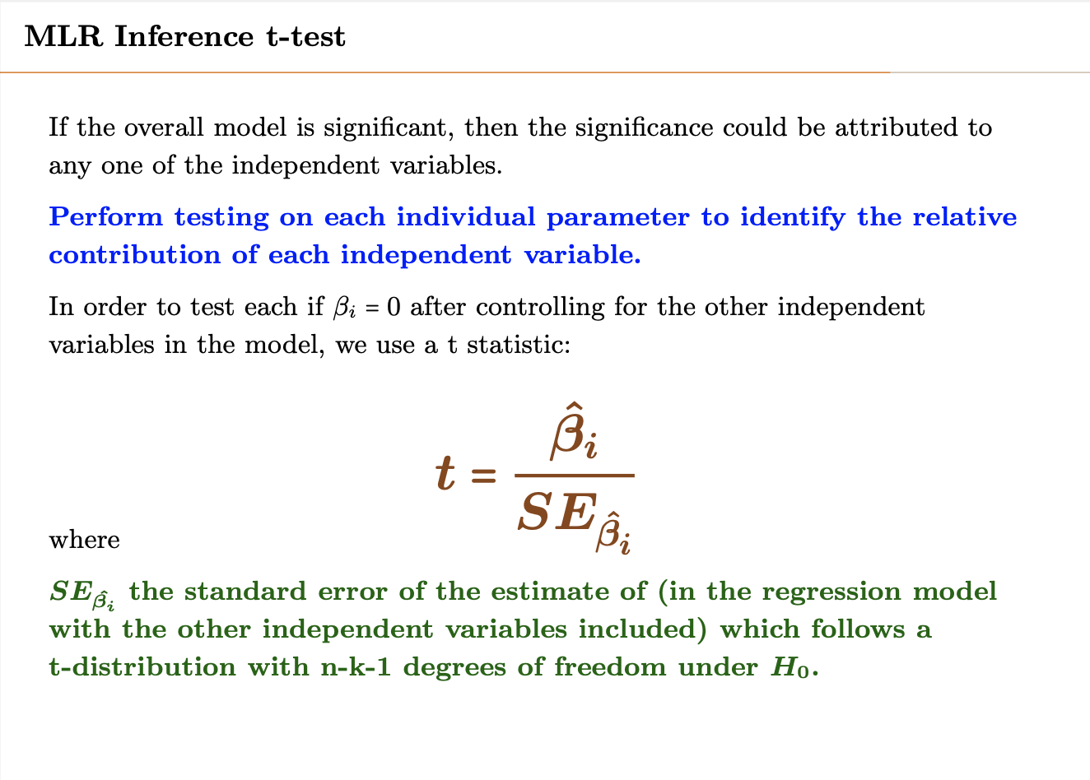

Slide 57
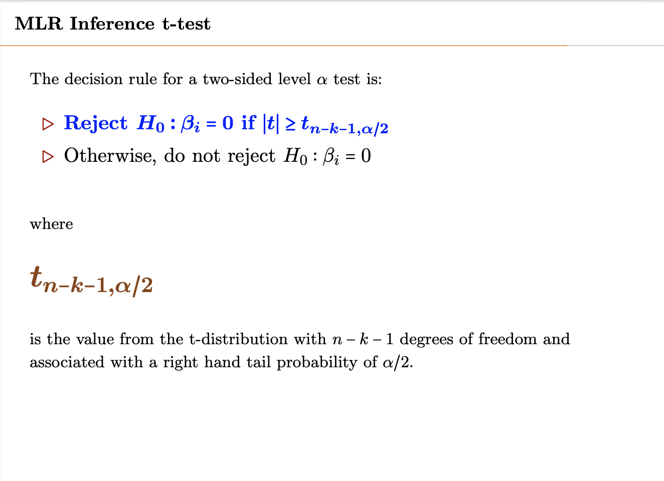

Slide 58
F- test example2
Predicting stock value as a function of PE ratio, earning per stock, and dividend.
We have taken 350 companies.
Total sum of squares: 130
Residual sum of squares after model: 30
Test the significance of this solution with 95% CI

Slide 59
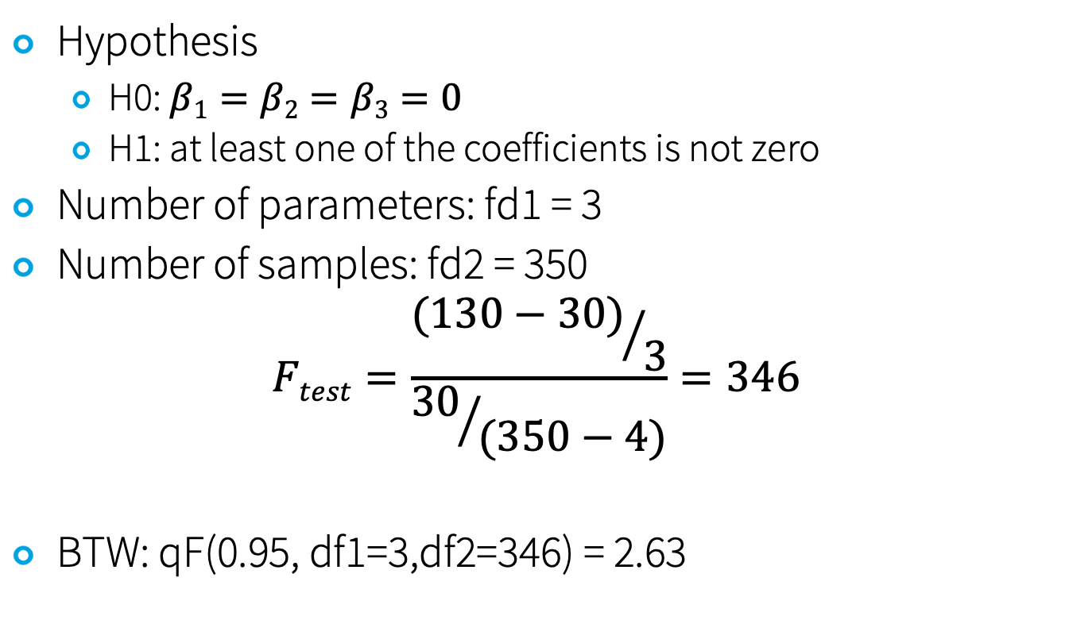
Answer to Example 2
Hypothesis
H0: $β1=β2=β3=0$
H1: at least one of the coefficients is not zero
Number of parameters: fd1 = 3
Number of samples: fd2 = 350
$$Ftest=\frac{{(130−30)}/3}{{30}/{(350−4)}}=346$$
BTW: qF(0.95, df1=3,df2=346) = 2.63

Slide 60
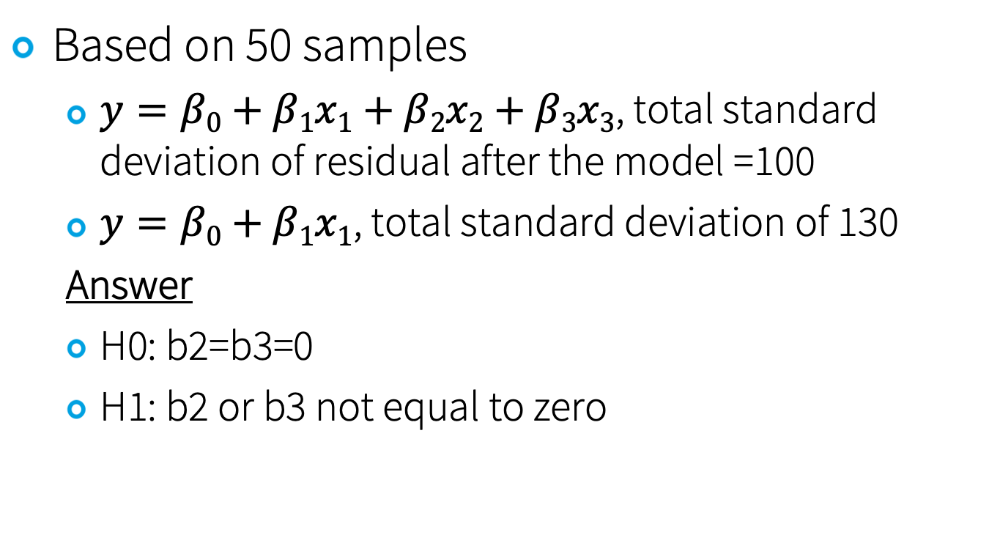
F-Test Example 3
Based on 50 samples
$y=β0+β1x1+β2x2+β3x3$, total standard deviation of residual after the model =100
$y=β0+β1x1$, total standard deviation of 130
Answer
H0: b2=b3=0
H1: b2 or b3 not equal to zero

Slide 61
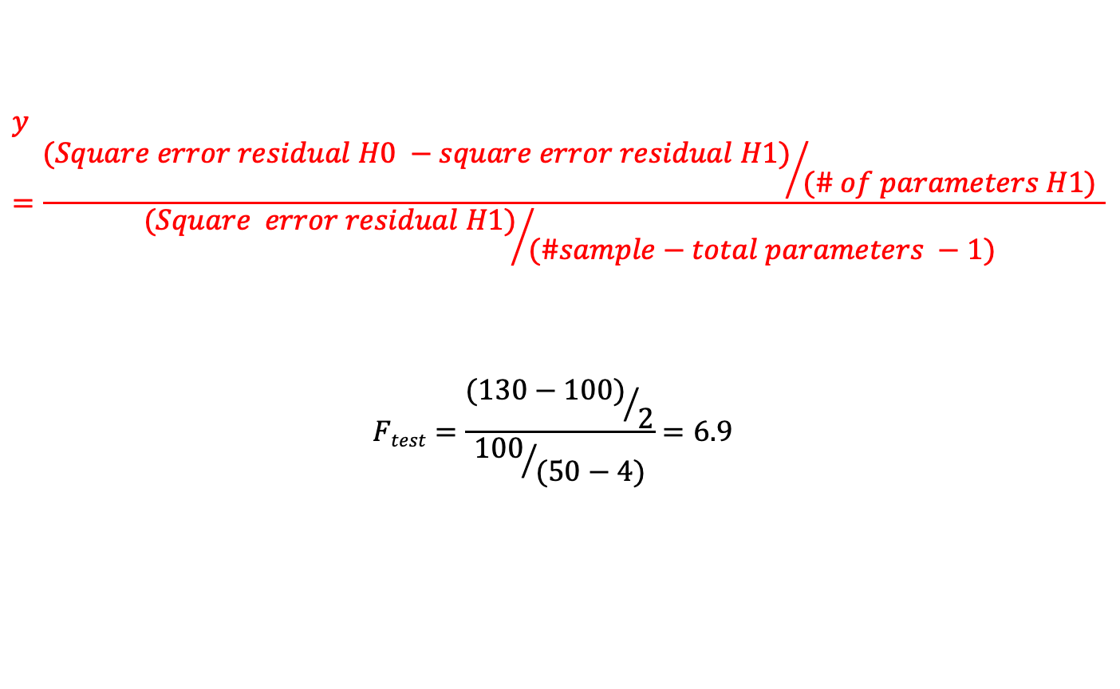
F-Test Example 3 - Solution
$$y=\frac{{(Square error residual H0 −square error residual H1)}/{(\# of parameters H1)} }{{(Square error residual H1)}/{(\#sample−total parameters −1) }}$$
$$Ftest=\frac{{(130−100)}/2}{{100}/{(50−4)}}=6.9$$

Slide 62
Critical value of
95% confidence interval of 86 samples
Two sided vs one sided
95% CI of 23 samples
Two sided vs one sided
95% Confidence interval of a following measurements
86 samples gave us value of 41.8 with sd = 3.65
Two sided vs one sided
86 samples gave us proportion of 0.82
23 samples gave us value of 41.8 with sd = 3.65

Slide 63
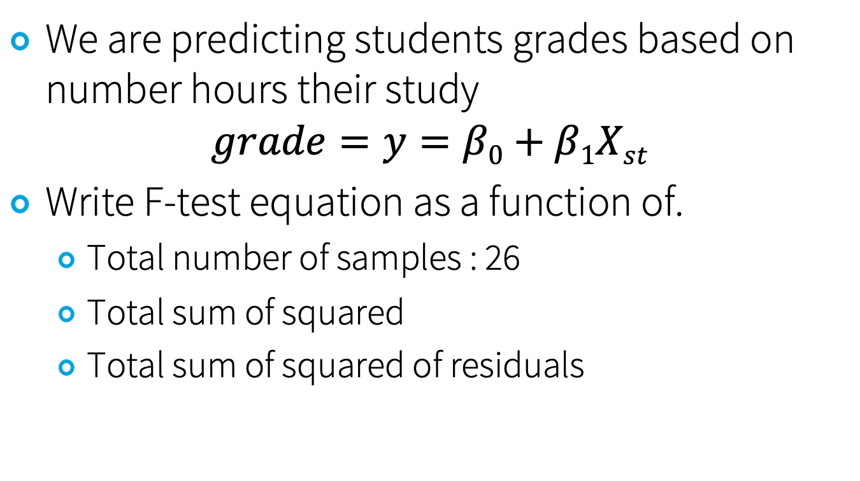
Example: Predicting grades
We are predicting students grades based on number hours their study
$$grade=y=β0+β1Xst$$
Write F-test equation as a function of.
Total number of samples : 26
Total sum of squared
Total sum of squared of residuals

Slide 64
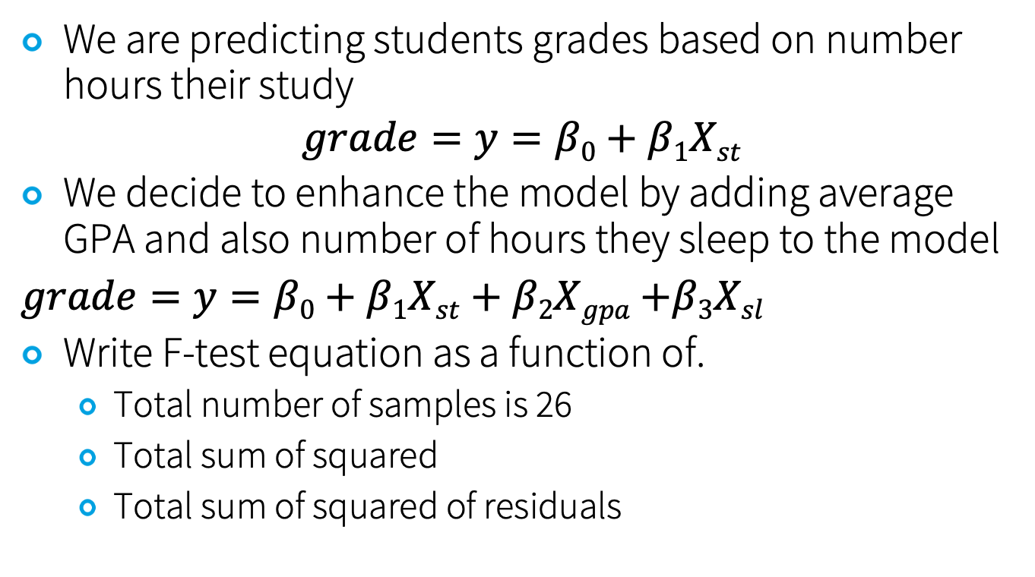
Example: Improving prediction
We are predicting students grades based on number hours their study
$$grade=y=β0+β1Xst$$
We decide to enhance the model by adding average GPA and also number of hours they sleep to the model
$grade=y=β0+β1Xst+β2Xgpa$ $+β3Xsl$
Write F-test equation as a function of.
Total number of samples is 26
Total sum of squared
Total sum of squared of residuals

Slide 65
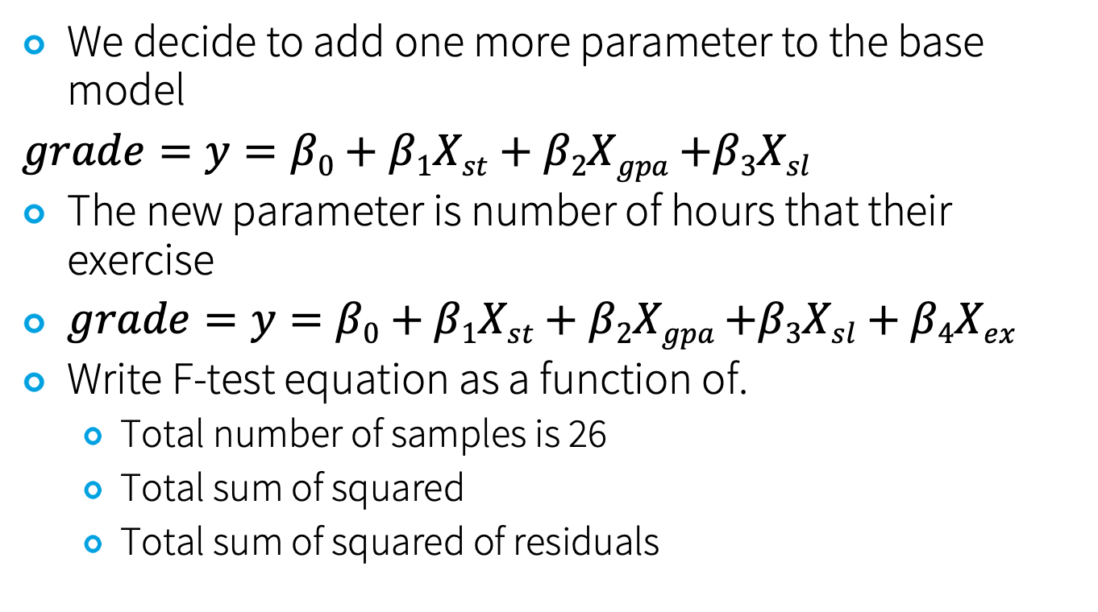
Example: Improving prediction further
We decide to add one more parameter to the base model
$grade=y=β0+β1Xst+β2Xgpa$ $+β3Xsl$
The new parameter is number of hours that their exercise
$grade=y=β0+β1Xst+β2Xgpa$ $+β3Xsl+β4Xex$
Write F-test equation as a function of.
Total number of samples is 26
Total sum of squared
Total sum of squared of residuals

Slide 66
We have taken 23 samples and created a linear model to predict students grade with a linear model as a function of number of hours their study: y=1.62+2.3 X
We decide to add a new

Slide 67
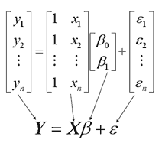
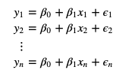
Multi Linear Regression –Numerical Solution
Error Surface
Gradient Descent
Multi-Linear Regression in matrix form
$$\text{y}\text{i}\text{=}\text{β}\text{0}\text{+}\text{β}\text{1}\text{x}\text{i}\text{+}\text{ϵ}i \text{for} \text{i}\text{=1,...,}\text{n}$$
=>
Notes:
Matrix multiplication – inner product (also talk about matrix dimensions)
Matrix addition
Matrix transpose
Identity matrix
Inverse matrix (A-1 A = I)

Slide 69
Two sample test

Slide 70
Two Sample Test/Procedure
Comparing the distribution of the sample means from two populations and generally interested to
H0: $μ1=μ2 or μ1−μ2=0$
H1: means are not equal or difference is not zero

Slide 71
Confidence Interval
Standard deviation of $μ1−μ2$ is as follows
$$\sqrt{\frac{σ12}{n1}+\frac{σ22}{n2}} , \sqrt{\frac{S12}{n1}+\frac{S22}{n2}}$$
Confidence Interval
$$t=(\overline{x1}−\overline{x2})/\sqrt{\frac{S12}{n1}+\frac{S22}{n2}}$$
Degree of freedom: $min⁡(n1−1,n2−1)$

Slide 72
ANOVA

Slide 73
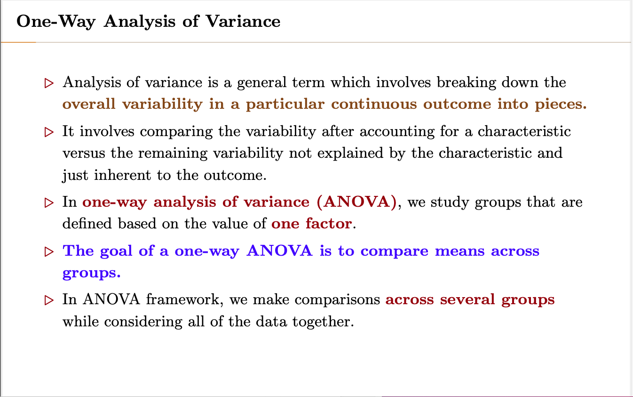

Slide 74
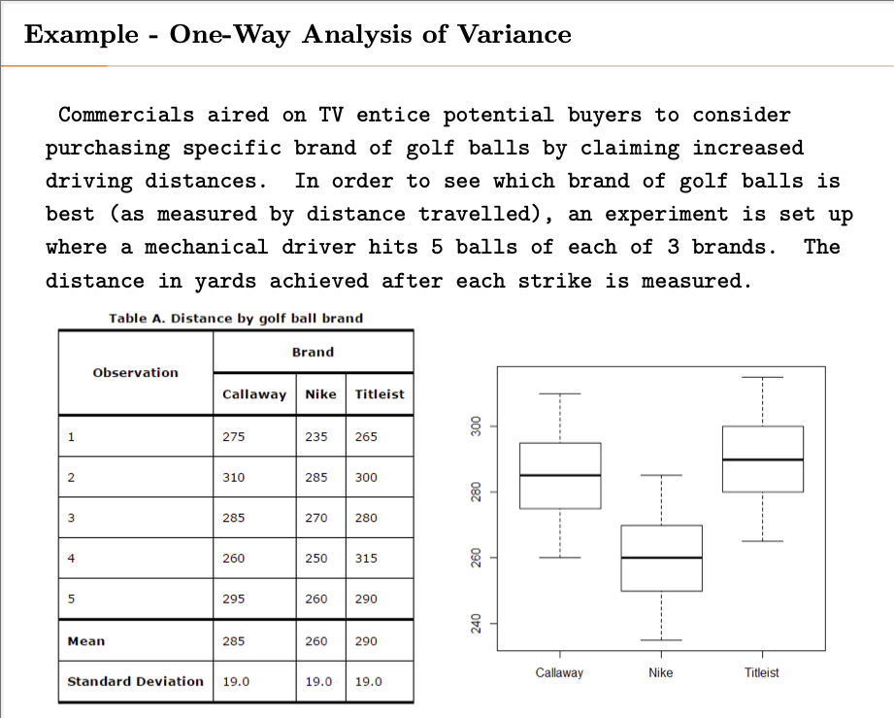

Slide 75
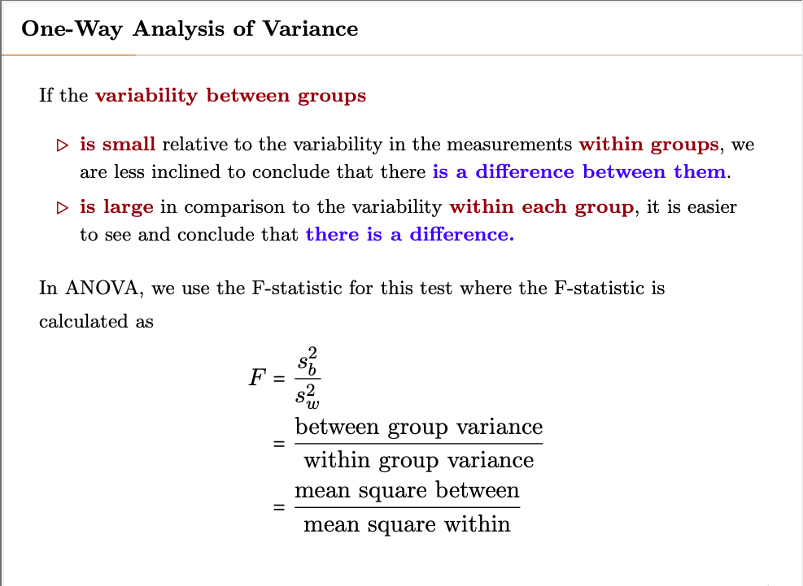

Slide 76
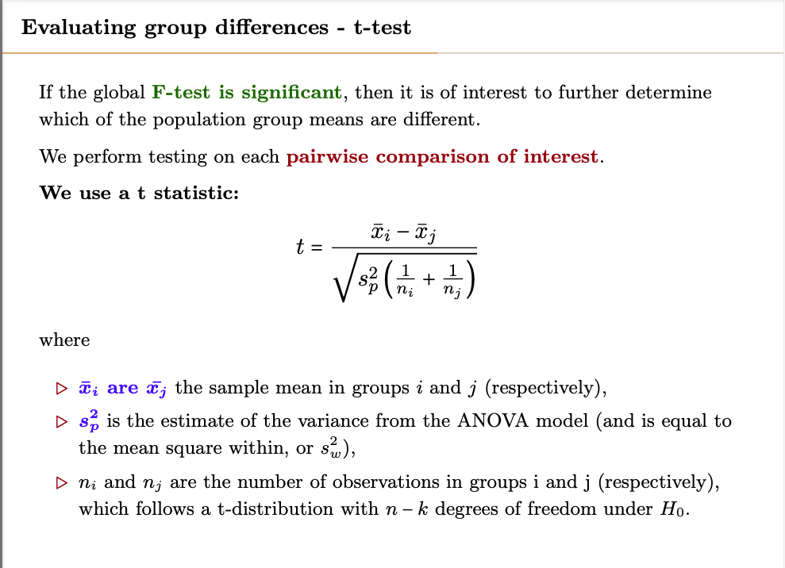

Slide 77
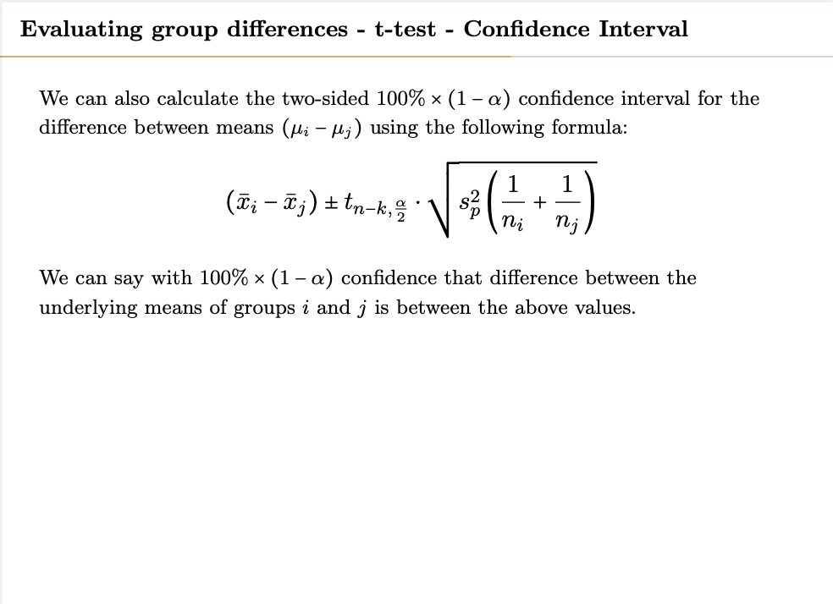

Slide 78
Error Type

Slide 79


Slide 80


Slide 81

$$Tukey HST=q\sqrt{\frac{SSW}{ni}}$$
q: constant number
SSW: mean squared within
ni: number of samples in each group (assumes to be the same)

Slide 82
ANOVA vs Regression

Slide 83


Slide 84
ANCOVA

Slide 85


Slide 86


Slide 87


Slide 88
Two Way ANOVA

Slide 89


Slide 90


Slide 91
Classification

Slide 92

Logistic Function Is a Good Fit
Logistic Function:
$y=\frac{eZ}{1+ez }$

Slide 93
Logistic Regression & Case Control Sampling
When Logistic regression is used for rare events, the model will be trained for a none proportional ratio of samples
Like training with a set with 40% of rare event sample
As a result the model will calculate probabilities wrong!
Solution:
Case control sampling
Regression parameters $βi$ are accurate, and only the intercept $β0$ is not, which gets corrected by
$$β0∗=β0+\log\left(\frac{prare}{1−prare}\right)−log⁡(\frac{pset}{1−pset})$$
P_{rare}: actual probability of the rare event
P_{set}: probability of the rare event in the training set
Notes:
We cheat! For a rare event, we use a sample size in which rare event is not rare?!

Slide 94


Reference: Wikipedia

Slide 95


Slide 96


Slide 97


Slide 98
Pros and Cons of Logistic Regression
Logistic regression is easy to implement and interpret.
If number of observations is less than the number of features, it will overfit
No assumption on distribution of classes in feature space
The boundaries constructed are linear
Multinomial regression/multiple classes implementation and interpretation is easy
Assuming linear dependency of dependent and independent variables
Measures importance of each independent variable and also positive or negative correlation
Not appropriate for non-linear problems and complex relationships
Mostly doesn’t overfit
Extracts linear dependency of independent variables and log odd of dependent variable.

Slide 99
Polynomial and Piecewise Poly

Slide 100
Polynomial Regression
Same as multi-linear regression, except higher degree of parameters also get included.
$$f\left(x\right)=β0+β1X+…+βnXn$$
Since $f\left(x\right)$ is a linear combination of $β$ values, we can compute pointwise variance of the function – $Var[f\left(x0\right)]$ and also find confidence interval for prediction at point $x0$

Slide 101
Bias-Variance Trade-off
The examples of test versus training MSE’s shows an important tradeoff of choosing a model.
Bias vs Variance
Variance is variability of the model over different training set
Bias is the expected difference between the model and actual value or $E[\hat{f}(x0)]−f(x0)$
These are two competing choices

Slide 102
Suppose a model $\hat{f}(x)$ is fit to a training data, and let (x₀,y₀) be a test observation point.
If the true model is $y=f\left(x\right)+ε$with
$$f\left(x\right)=E[Y|X=x]$$
Then the expected MSE is
$$E\left[\left(y0−f\left(x0\right)\right)2\right]=bias2+var\left[\hat{f}\left(x0\right)\right]+var(noise)$$
Where $bias =E\left[\hat{f}\left(x0\right)−f\left(x0\right)\right]=E\left[\hat{f}\left(x0\right)\right]−f\left(x0\right)$
$var\left[\hat{f}\left(x0\right)\right]=E\left[\hat{f}\left(x0\right)−y0\right]$²
Typically as the flexibility of the model increases, its variance increases, and its bias decreases.

Slide 103

Spline
The value are the same at the junctions
Also derivatives are the same at the junctions
Ref: In-depth introduction to machine learning, by T. Hastie and R. Tibshirani

Slide 104
Overfitting and Model Selection

Slide 105
Choosing the Optimum Model
The best model gives us the lowest error over the population and not only training set,
So R² or Residual error is not the best parameter
Might results to overfitting!

Slide 106

Assessing a Model
Mallow’s Cp
$$Cp=\frac{1}{n}[ResSS+2(k+1)σ2]$$
In which
k: number of predictors used in the model
$σ2$: is standard deviation of total error for the full model
ResSS: residual error sum square of the model – training SS
n: number of samples
Note: Cp gets written different ways, but all fundamentally the same.
BIC (or Bayesian Information Criterion)
$$BIC=\frac{1}{n}[ResSS+ln⁡(n)(k+1)σ2]$$
In which n is # of observations, and k is # of parameters.
Note: for n > 7 we have ln(n) > 2.
Therefore, BIC penalizes more variables more.
Notes:
Note: Mallow’s Cp and AIC are equivalent if
Noise is gaussian
Model is linear
Note from the text book: Mallow’s Cp is sometimes defined as Cp′ = RSS/σˆ2 + 2k − n. This is equivalent to
the definition given above in the sense that Cp = 1/n σˆ2(Cp′ + n), and so the model with smallest Cp also has smallest Cp′ .
Note: sigma squared is sigma of the full model, means using all the predictors (maximum k)

Slide 107
Stepwise Selection
With large set of parameters, best subset selection is not feasible – Too large!

