Slide 1

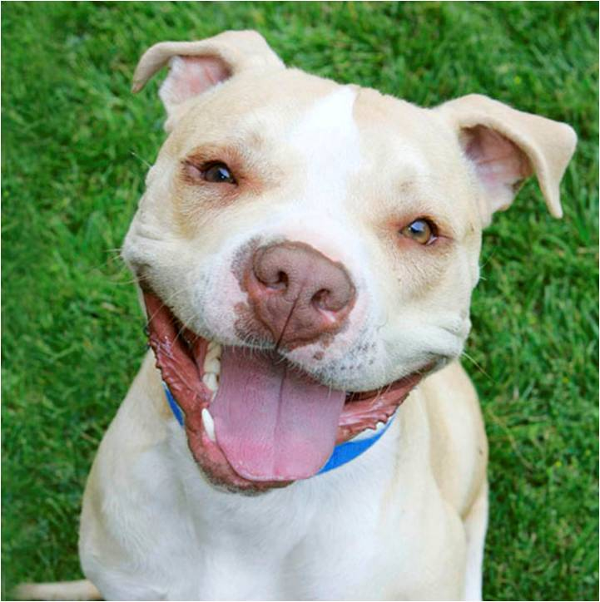
Pit Bulls: “We Love to Please”
A PR and media campaign to restore the image of pit bulls and demonstrate their true nature as “America’s Family Pet.”
For more information:
Landon Pollack
landon@ignite-vp.com
Michael Mountain
michaelm@msn.com
Laura Allen
lauraallen@animallawcoalition.com
Office
480-575-9717

Slide 2


. . . just a few decades ago ...
They were celebrated as “America’s Family Pet” – the most beloved of dogs.
Today, pit bulls and related breeds are demonized as America’s most dangerous animal.
How did such a thing happen?
And how can we bring these loving pets back into our homes and hearts?
“There are no ‘wild’ animals until man makes them so ... Our partialities and prejudices change places with an easy facility.”
Mark Twain.

Slide 3

Typical, stereotyped press coverage:
“Crime has made him the most maligned of all dogs”
Helena Daily Independent
“The size, muscular appearance and strong features are evidence to the prejudiced that the dog is a savage customer.” Stevens Point Journal
“Most people have the impression that [it] is a savage, treacherous brute.”
Letter to the London Times
“The very nature of these dogs conjures horrible pictures of relentless beasts… It is a very wrong impression with little fact upon which to base it, but it will take several decades to remove it.”
Massillon Independent
Thanks to Karen Delise, founder of the National Canine Research Council, for the use of this and the next three slides.

Slide 4
Those words were written in the . . .
Helena Daily Independent: February 11, 1938
Stevens Point Journal: July 17, 1915
Letters, London Times: October 8, 1888
Massillon Independent: Sept 30, 1897
. . . and the kind of dog they were actually written about was . . .

Slide 5
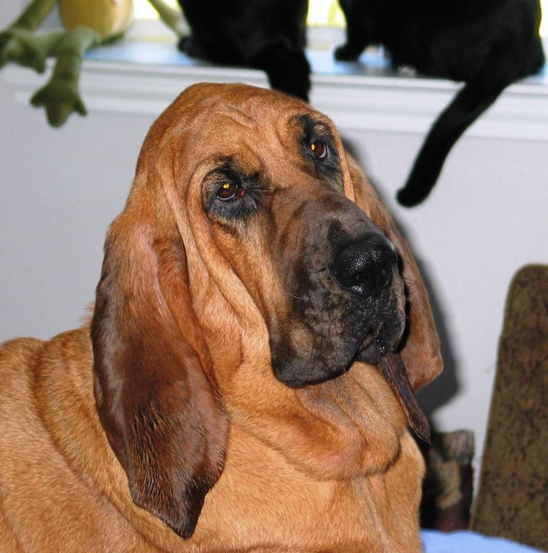
. . . the bloodhound!

Slide 6
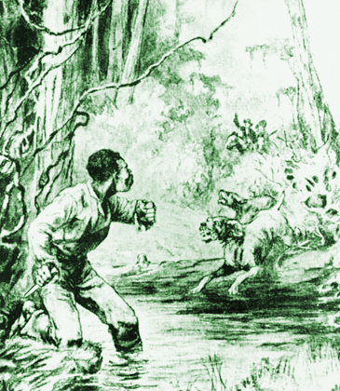
In the 19th Century, bloodhounds were the dog of choice to track down escaped slaves.
They were known as vicious attack dogs. And their reputation outlived the end of slavery. People were terrified of them.

Slide 7
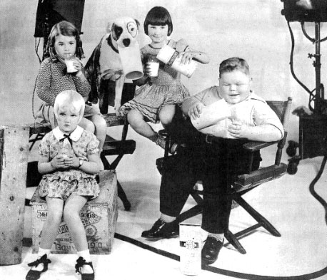
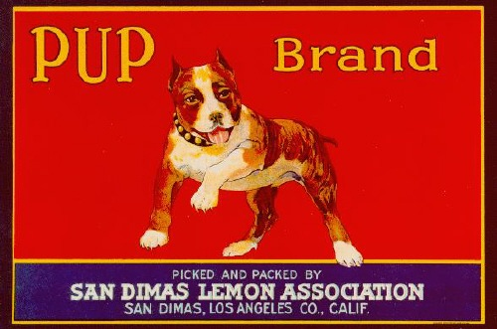
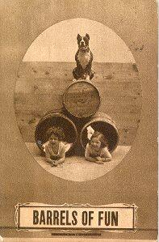
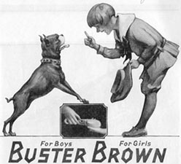
Meanwhile . . .
. . . pit bulls had become America’s Family Pet, the “best pets for your children.”

Slide 8
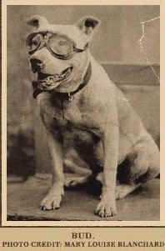
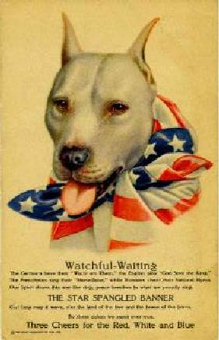
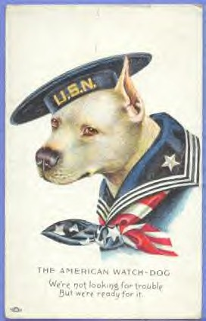
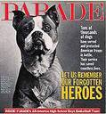
They were beloved war heroes.
Stubby (left) was the most decorated dog of World War One.

Slide 9


. . . their blessing – absolute loyalty and devotion – has become their curse.
That’s because it’s so easily exploited by gangs and the dog-fighting industry.
So now they are being banned wholesale from a growing number of cities, to the point where police show up at ordinary people’s homes and literally drag away the family pet to be killed.
And more than a million of them are being destroyed in “shelters” each year.
All of this addresses the wrong problem, solves nothing, and serves no end. It’s simply the crudest form of knee-jerk stereotyping.
“No single neutered household pet
pit bull has ever
killed anyone.”
Karen Delise,
National Canine Research Council.

Slide 10
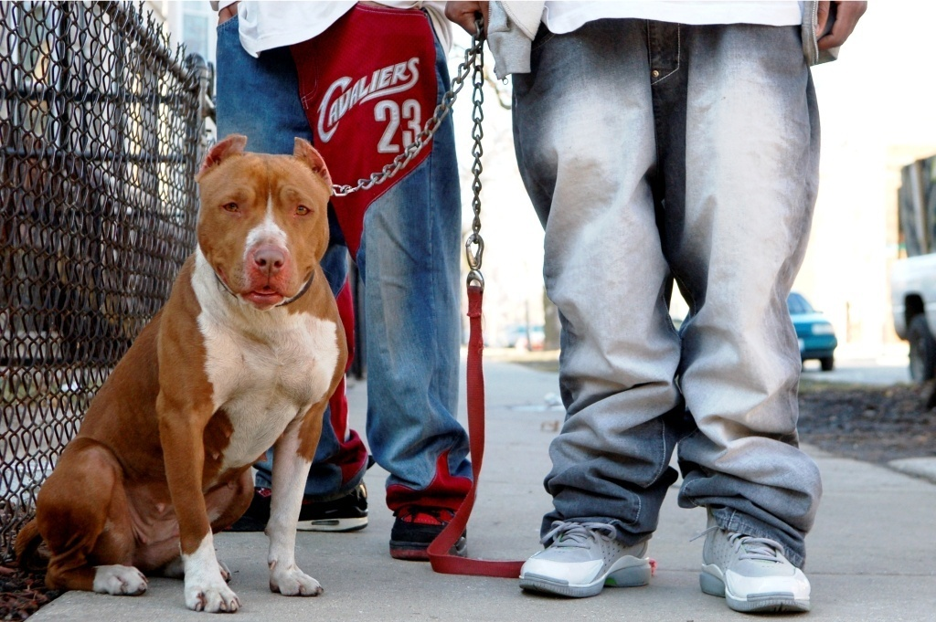
How Pit Bulls Became
Victims of Crime & Abuse
Dog-fighting used to be associated mainly with poor, white, rural regions.
But it has migrated into city neighborhoods, initiating pre-teens into its murky culture, and displacing and even rivaling the drug trade.

Slide 11
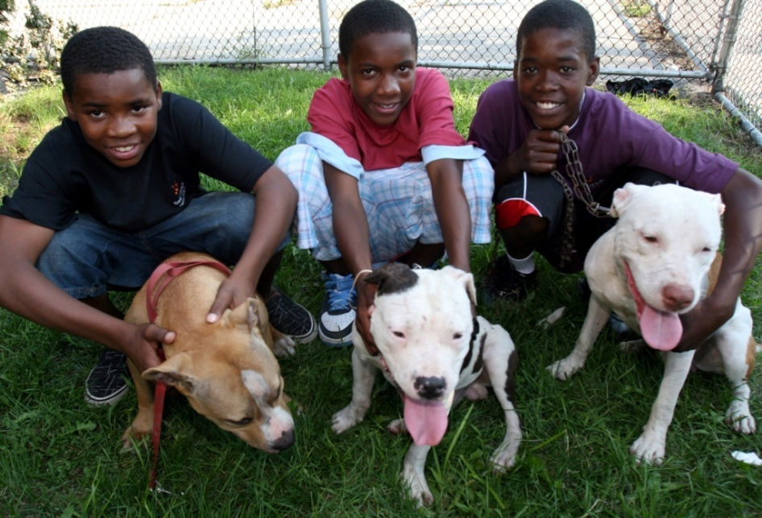
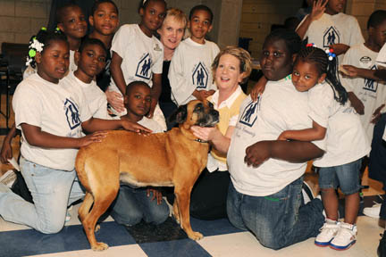
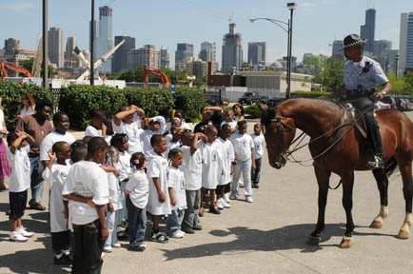
At a recent presentation in Chicago, a group of students aged six through 13 was asked who among them had ever attended a dog fight.
Virtually every hand went up.

Slide 12


To develop and execute a PR and media campaign, working primarily through the entertainment media that will “re-brand” pit bulls in the public eye by:
Replacing myths and fallacies with clear and defensible facts.
Recasting these dogs as victims of criminal abuse.
And restoring them to their rightful place as loyal family pets.

Slide 13

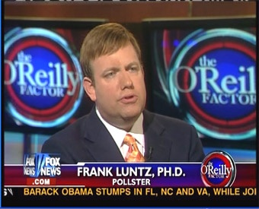
Developing the Message
Pit bull – the very name evokes fear.
So first, we are working with political pollster Frank Luntz (Words That Work) to develop a new language, vocabulary and iconography that will reframe the message we deliver to the general public about pit bulls.

Slide 14
Brand Strategy
Phase One: Empathy
Show pit bulls as victims, not aggressors. Reorient people’s negative attention onto people who abuse them. (Note, for example, how legislation to ban or kill pit bull types is as pointless as dealing with drunk driving by banning cars.)
Key Communication: “Poor dogs. People who treat them like this (dog fighters etc.) should be prosecuted!”
Phase Two: Loyalty
Shift the key perception associated with pit bulls: from aggressiveness to loyalty. Show how their greatest attribute, their loyalty, has been exploited by people who abuse them for greed and profit, and in ways (like only rewarding negative behavior) that would make any animal – any human – aggressive
Key Communication: “Pit bulls aren’t naturally more aggressive; they are more naturally loyal.”
Phase Three: Family Pet
Demonstrate that pit bulls make loyal, loving and lovable family pets. Encourage positive and responsible pet guardianship, just as with any other kind of dog.
Key Communication: “Pit bulls live among families like any other dog.”

Slide 15

Provide a go-to place online for the general public and members of the media needing accurate information and resources, along with community organizing.
Create a series of TV spots and other media that execute the brand strategy.
Use the entertainment media as a key vehicle to help change public perceptions by:
  Producing a documentary that focuses on the many, diverse, interesting people – from celebrities to tattoo artists, bikers to bankers, and suburban families to wealthy socialites – who are passionate about their pit bulls. This movie sets up the three main elements of the brand strategy in an entertaining way.
  Placing pit bulls in sitcoms and other TV shows, commercials, and movies in a way that associates them with good people, popular celebrities and positive experiences.

Slide 16
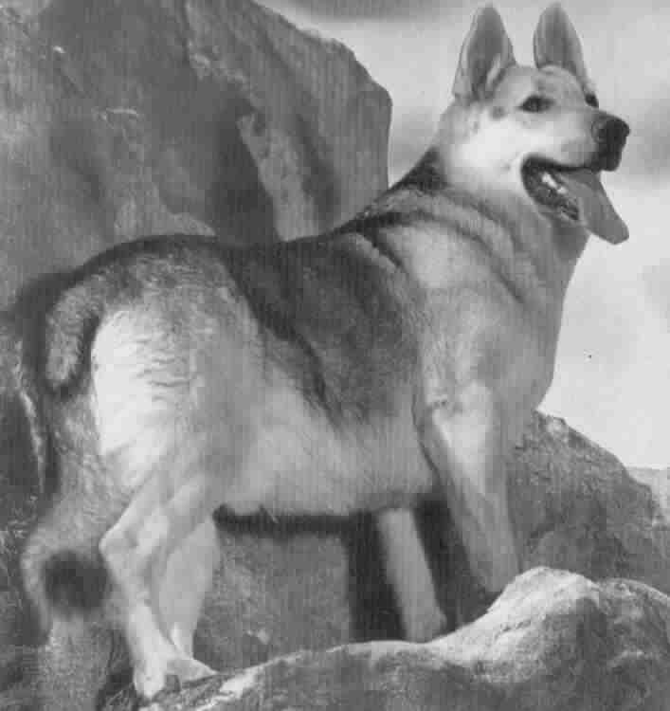
A Model Success
In the years following World War II, when German shepherds had become associated with Nazism, they became a shunned breed in the United States.
All this changed when
Rin Tin Tin came to the rescue
in the remarkable TV series
of the 1950’s.
It was a classic in terms of what can be accomplished through a successful marketing and media strategy, and we will leverage a comparable model for pit bulls.

Slide 17
Web Overview
The Media Center will be the go-to place for members of the media looking for the facts, trustworthy news, information and resources. It will:
Provide accurate information and materials (photos, video, etc.) for TV, print or web stories.
Make available experts from partner organizations for interviews, background, etc.
Combat reports that are simply incorrect or misleading, and do this within the current news cycle. (A correction several days later is useless since the damage has already been done.)
-- cont’d--

Slide 18
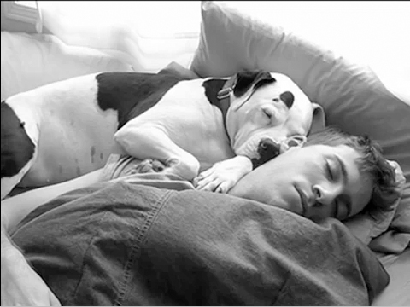

Web Overview (2)
General News and Resources: Straightforward, digestible, factual information for the general public. Plus resources for anyone wanting to:
Combat misperceptions in their own city or neighborhood.
Write a letter to a local newspaper or go on TV.
Campaign against legislation that attempts to target pit bulls as a breed, rather than targeting irresponsible or criminal behavior on the part of dog owners.
News, updates, fun photos, and general encouragement. -- cont’d--
“I love a dog. He does nothing for purely political reasons.”
Will Rogers

Slide 19
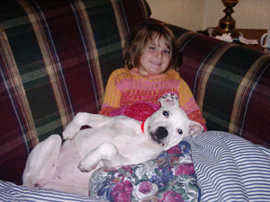

Web Overview (3)
Community: A full range of advanced social networking technologies, integrated with existing social networks and pro-pit bull sites will enable people to:
Tell their own stories.
Share their love of pit bulls.
Build their own personal profile pages.
Contribute to the overall effort.
Work together on campaigns and other activities.
“There is no faith which has never yet been broken, except that of a truly faithful dog.”
Konrad Lorenz

Slide 20
Fallacy
Fact
Dog bites are reduced when cities pass ordinances banning pit bull types.
Denver enacted a breed ban in 1989, but has seen no appreciable difference in number or severity of attacks compared to cities without breed bans. (The Netherlands and Italy have repealed their breed bans.)
It’s easy to tell a pit bull from other dogs. The breed is easy to identify.
More than 20 breeds are routinely mistaken for “pit bulls”. DNA tests on a random selection revealed numerous other breeds, from Labrador to poodle, often in high percentages.
Dog bites are on the increase.
Dog bites overall have dropped 85-90% over the last 35 years (in New York City, from 37,488 in 1971 to 3,776 in 2007), due to better pet care, spay/neuter and responsible guardianship.

Slide 21
Existing Humane Organization Strategies
Humane groups are doing critical work rescuing and rehabilitating pit bulls, shutting down dog-fighting operations, and fighting laws that target dogs rather than their abusers. Our efforts are designed to support this good work by focusing on public perceptions.
Lobbying at the local level against legislation that outlaws pit bulls and other dogs who look like them.
Lawsuits aimed at challenging the constitutionality of bans and restrictions.
Informational websites and literature.
Rehabilitation and re-homing of rescued pit bulls.
Undercover campaigns to expose dog-fighting rings and prosecute the offenders.
Local programs to protect young people from being drawn into fighting rings and to teach them good pet guardian practices, including spay/neuter.
Public relations efforts to place positive articles in the press, in movies, and on TV.

Slide 22

The Team
LANDON POLLACK: a veteran entrepreneur with a personal passion for pit bulls.
Managing partner of Ignite Venture Partners and a founder /investor for more than a dozen companies, bringing together consulting, capital, and concept incubation to build value in businesses of all sizes and stages.
Landon serves on various advisory boards of for-profit organizations in addition to several non-profits in the animal protection world.
His love of animals, enhanced by his personal studies of disciplines like Buddhism and martial arts, have led him to embrace a philosophy of kindness and respect for all living beings.
And his volunteer work for animal protection organizations and other charities has led him to combine his passion for animals and his business and marketing skills to lead this new effort to complement the efforts of humane organizations and pit bull lovers.
“As an entrepreneur who depends on capturing the public imagination with a new concept, I’ve seen, over and over, how even the best of concepts can crumble if they fail to win the hearts and minds of the public.
“And I’ve equally seen how, given the right marketing, a concept or image can be re-branded. You see it every day in the worlds of Hollywood, sports and politics.
“We need to apply the same tactics to these wonderful dogs. This is not rocket science.”

Slide 23
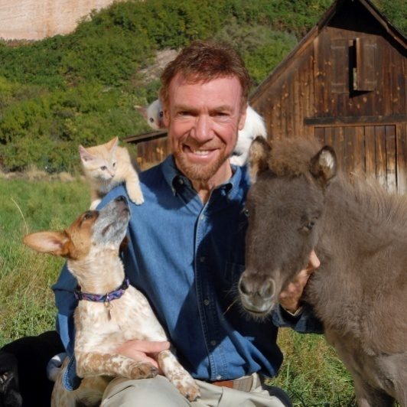
The Team
MICHAEL MOUNTAIN: one of the founders and past President of Best Friends Animal Society – the largest sanctuary for companion animals, and the leading animal rescue organization.
In the early 1990s, when 15 million homeless dogs and cats were being killed in shelters nationwide, Michael spearheaded the No More Homeless Pets campaign, building and energizing a grassroots effort that transformed the humane movement through messaging that was engaging, humorous and heartwarming.
In 2007, when 22 of the dogs rescued from Michael Vick’s dog-fighting kennels were placed in the care of Best Friends, Michael re-branded them as the “Vicktory Dogs”. They continue to appear regularly in the national press.
Today, Michael’s work extends to the protection of all animals, but he sees pit bulls as a classic case of how so many animals (e.g. sharks, snakes, wolves, big cats) come to be demonized in the public imagination.
“The key was changing the image of these special-needs pets. As we turned ‘unadoptable animals’ into lovable personalities,
it became fashionable to adopt them.
“And by the end of the decade, the number being killed in the shelters had dropped from 15 million to below five.”

Slide 24
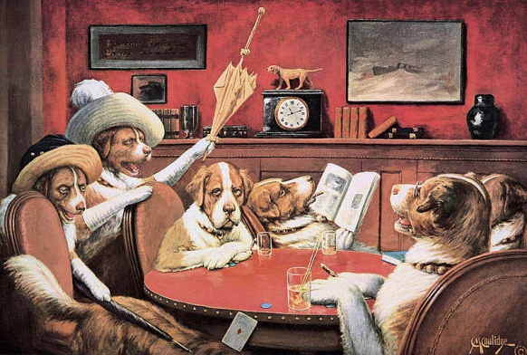
The Team
LAURA ALLEN: founder and director of the Animal Law Coalition, which works to stop animal cruelty and suffering through legislation, administrative agency action, and litigation.
An attorney with more than 25 years of experience in litigation, Laura has also worked as an attorney for Best Friends Animal Society, helping to develop a program to persuade communities not to adopt breed specific legislation. Through the Animal Law Coalition, she offers legal analysis of the often difficult and controversial issues relating to animals of all kinds and also works on animal welfare legislation and litigation.
Laura serves as principal advisor to this effort in matters relating to the progress of the multiple legislative and humane initiatives, so that we can best target our marketing efforts to support these programs.
ADVISORS : We have brought together the best and the brightest leaders in the fields of animal protection, media, marketing, advertising and public relations to provide expertise in this campaign. (Bios to come.)
We are also partnering with existing organizations setting out to protect pit bulls against stereotyping and breed bans.

Slide 25
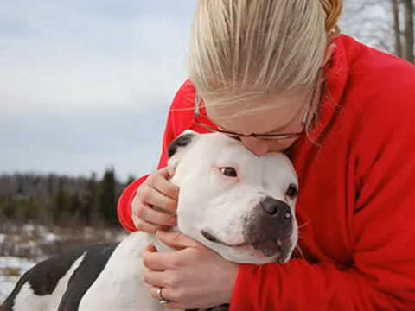
Organizational Structure
Our organization will be incorporated as not-for-profit.
Our mission is to change the public perception of pit bulls and use all forms of media to disseminate, educate and motivate mainstream America on what the “true” pit bull is.
We will not be directly involved in legislative or rescue related work.

Slide 26
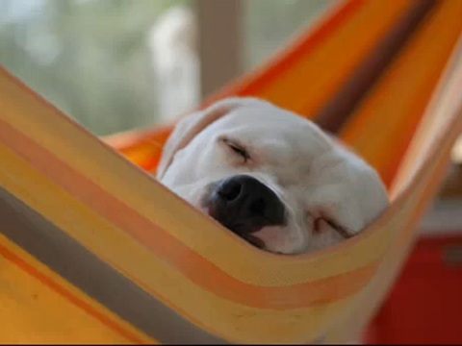
In Conclusion
Every week, on her world-renowned TV show, British dog trainer Barbara Woodhouse would remind her viewers:
“There are no bad dogs.”
Our vision is that those words will truly be taken to heart and that all dogs,
including “America’s family pet”, the pit bull, will once again be welcomed into our hearts and homes.

