Slide 1






Foundations of Interpretable Models
Pietro Barbiero & Mateo Espinosa Zarlenga
pietro.barbiero@ibm.com me466@cam.ac.uk
In collaboration with: Alberto Termine, Mateja Jamnik, Giuseppe Marra

Slide 2


Who are we?
Pietro Barbiero
Swiss Postdoctoral Fellow
IBM Research (Switzerland)
pietro.barbiero@ibm.com
Mateo Espinosa Zarlenga
Final-year PhD Student
University of Cambridge
me466@cam.ac.uk

Slide 3
Outline
What is interpretability?
Foundations
Assumptions, data structures, and design principles for interpretability
Blueprint for interpretable models
Instantiations
Instantiating the concept encoder P(C | X)
Instantiating the task predictor P(Y | C)
Open questions

Slide 4
Outline
What is interpretability?
Foundations
Assumptions, data structures, and design principles for interpretability
Blueprint for interpretable models
Instantiations
Instantiating the concept encoder P(C | X)
Instantiating the task predictor P(Y | C)
Open questions

Slide 5

Why do we need interpretability in the first place?
“opaque” model
Highly parametric
Complicated inference steps
Non-linearities
Sensitive to initial states and update rules
?
input
output

Slide 6
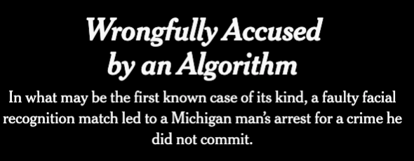
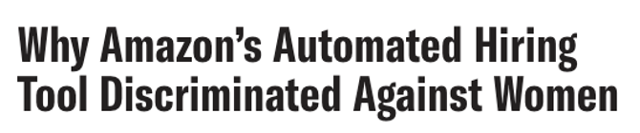

Why do we need interpretability in the first place?
“opaque” model
Highly parametric
Complicated inference steps
Non-linearities
Sensitive to initial states and update rules
?
input
output
Blindly using opaque models can lead to all sorts of problems
[1] Kashmir Hill, “Wrongfully Accused by an Algorithm.” The New York Times (2020).
[2] Rachel Goodman, “Why Amazon’s Automated Hiring Tool Discriminated Against Women.” ACLU (2018).
[3] Will Douglas Heaven, “Predictive policing algorithms are racist. They need to be dismantled.” MIT Technology Review (2020).

Slide 7
Why do we need interpretability in the first place?
“opaque” model
Highly parametric
Complicated inference steps
Non-linearities
Sensitive to initial states and update rules
?
input
output
Blindly using opaque models can lead to all sorts of problems
Regulatory/legal constraints:
General Data Protection Regulations (GDPR, 2016)
“The data subject shall have the right not to be subject to a decision based solely on automated processing, including profiling,…” (Art. 22)
The data subject has the right to “meaningful information about the logic involved” in the decision. (Art. 13 and 15)
EU AI Act (2024):
“Any affected person subject to a decision which is taken by… a high-risk AI system … shall have the right to obtain from the deployer clear and meaningful explanations (Art. 86)
[1] GDPR, EU. "Automated individual decision-making, including profiling." (2022).
[2] Act, EU Artificial Intelligence. "The EU Artificial Intelligence Act." (2024).

Slide 8
What is interpretability in AI?
“A method is interpretable if a user can correctly and efficiently predict the method’s results” [1]
“Systems are interpretable if their operations can be understood by a human” [2]
“Interpretability is the degree to which an observer can understand the cause of a decision” [3]
“There is no universal, mathematical definition of interpretability, and there never will be” [4]
Informal
Not “actionable”
[1] Kim et al, “Examples are not enough, learn to criticize! criticism for interpretability” NeurIPS (2016).
[2] Biran et al, “Explanation and Justification in Machine Learning: A Survey” IJCAI workshop (2017).
[3] Miller, “Explanation in artificial intelligence: Insights from the social sciences” Artificial Intelligence (2019).
[4] Murphy, “Probabilistic machine learning: Advanced topics” MIT press (2023).

Slide 9
What is interpretability… in other fields?
“A theory T is interpretable in a theory S if and only if there exists a translation from the language of T into the language of S such that every theorem of T is translated into a theorem of S”
✓
Formal
Comes with “strings attached”
Not contextualized in modern AI
Unclear consequences in modern AI
[1] Tarski "Undecidable Theories" (1953).

Slide 10
Problem #1
Lack of formal and “actionable” definition of interpretability.
Research in interpretability is ill-defined.
Research Question #1
Can we provide a general, simple & actionable definition of interpretability in AI?

Slide 11
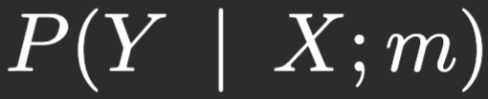
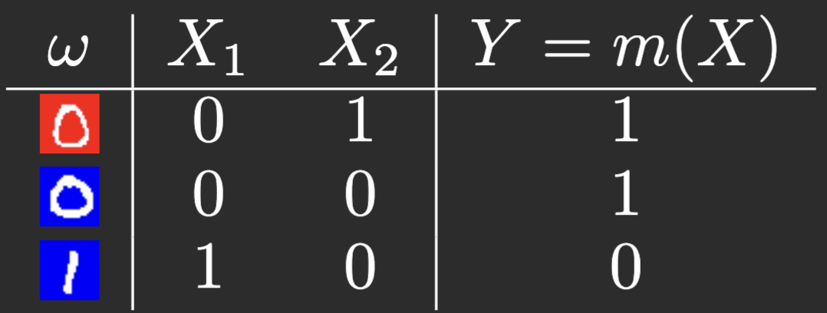
Is the model interpretable?
object
features
target

Slide 12
Is the model interpretable?
Let’s associate:
“one” to
“red” to
“even” to
Relation between the model and human knowledge (number theory)!

Slide 13
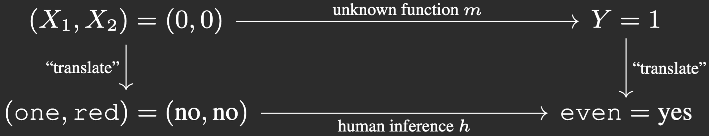
Is the model interpretable?

Slide 14
Is the model interpretable?

Slide 15

Is the model interpretable?

Slide 16
Is the model interpretable?

Slide 17
Is the model interpretable?

Slide 18

Is the model interpretable?
INFERENCE EQUIVARIANCE
[1] Marconato et al “Interpretability is in the mind of the beholder: A causal framework for human-interpretable representation learning” Entropy (2023).

Slide 19
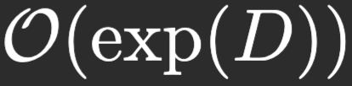
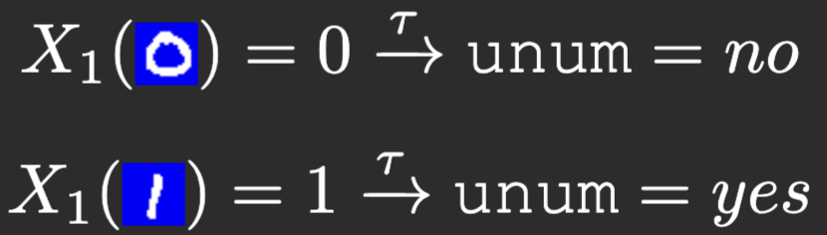
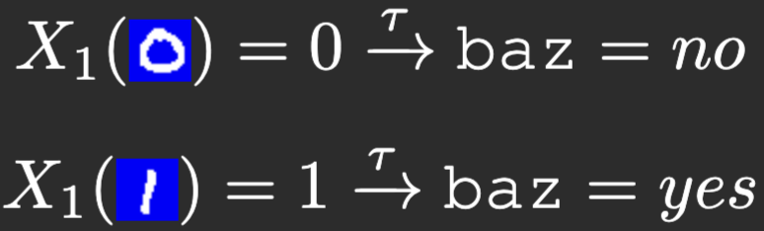
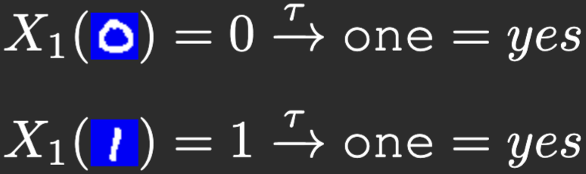
Consequences:
Any function is interpretable
But not all functions are easy to interpret by all users!
Interpretability is a spectrum
Diagram may commute only for a subset of samples
Naively verifying interpretability via inference equivariance is intractable
We need to scan a table with entries
With 10x10 pixel images we need more checks than #atoms in observable universe!
Many translations exist, but some are “not sound”
sound
not sound

Slide 20
Outline
What is interpretability?
Foundations
Assumptions, data structures, and design principles for interpretability
Blueprint for interpretable models
Instantiations
Instantiating the concept encoder P(C | X)
Instantiating the task predictor P(Y | C)
Open questions

Slide 21
Problem #2
Naively verifying inference equivariance is intractable.
Research Question #2
Can we identify assumptions & principles making inference equiv. tractable?

Slide 22
Can we make interpretability tractable by compression?
even
64x64 pixels

Slide 23

Can we make interpretability tractable by compression?
even
compression
preservation of information
64x64 pixels
[1] Cayton "Algorithms for manifold learning" Univ. of California at San Diego Tech (2005).

Slide 24
Can we make interpretability tractable by compression?
even
compression
preservation of information
64x64 pixels
conditional interpretability principle
[1] Cayton "Algorithms for manifold learning" Univ. of California at San Diego Tech (2005).
[2] Pearl “Probabilistic reasoning in intelligent systems: networks of plausible inference” Elsevier (1988).

Slide 25
Can we make interpretability tractable by compression?
even
compression
preservation of information
64x64 pixels
conditional interpretability principle
[1] Cayton "Algorithms for manifold learning" Univ. of California at San Diego Tech (2005).
[2] Pearl “Probabilistic reasoning in intelligent systems: networks of plausible inference” Elsevier (1988).
[3] Koh et al. "Concept bottleneck models" ICML (2020).

Slide 26

Can we make interpretability tractable by compression?
even
compression
preservation of information
64x64 pixels
conditional interpretability principle
Complexity (entries in the table) go from to
[1] Cayton "Algorithms for manifold learning" Univ. of California at San Diego Tech (2005).
[2] Pearl “Probabilistic reasoning in intelligent systems: networks of plausible inference” Elsevier (1988).
[3] Koh et al. "Concept bottleneck models" ICML (2020).

Slide 27
Problem #3
Translations may not be sound.
Research Question #3
Can we characterize sound translations?

Slide 28
Problem #3
Translations may not be sound.
Research Question #3
Can we characterize sound translations?
A: Yes! We can use “concepts”!
Research Question #3.1: What is a “concept”?

Slide 29
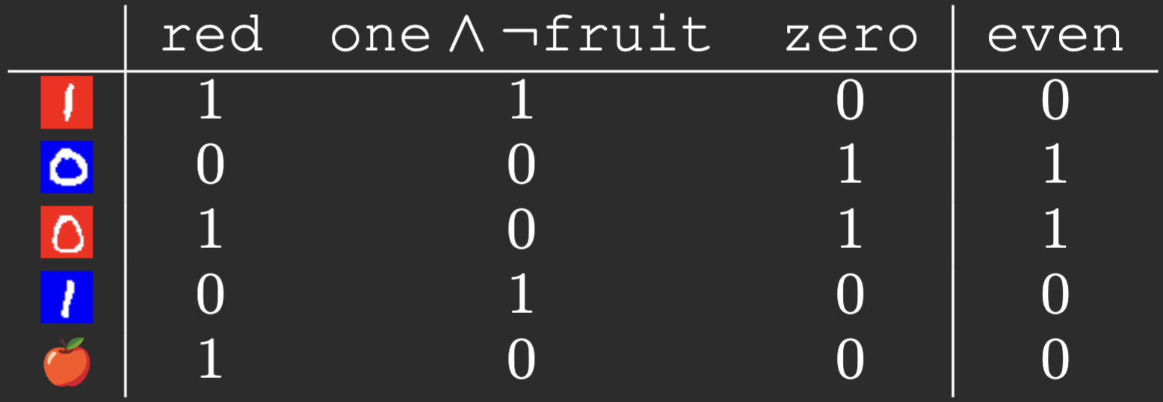


What is a concept?
Note that:
[1] Goguen "What is a concept?" International Conference on Conceptual Structures (2005).
[2] Ganter at al “Formal concept analysis” Springer (1999).

Slide 30
What is a concept?
Note that:
[1] Goguen "What is a concept?" International Conference on Conceptual Structures (2005).
[2] Ganter at al “Formal concept analysis” Springer (1999).

Slide 31
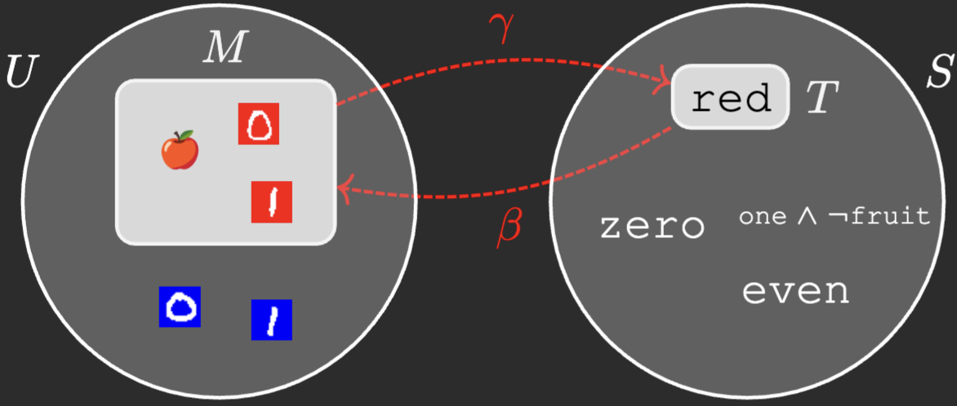
What is a concept?
Concept — Set of examples and sentences satisfying “closure” condition:
[1] Goguen "What is a concept?" International Conference on Conceptual Structures (2005).
[2] Ganter at al “Formal concept analysis” Springer (1999).

Slide 32
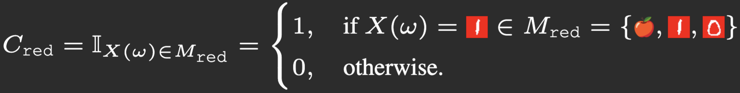

What is a concept?
Probabilistic interpretation:
Concept membership:
Concept CPD:

Slide 33
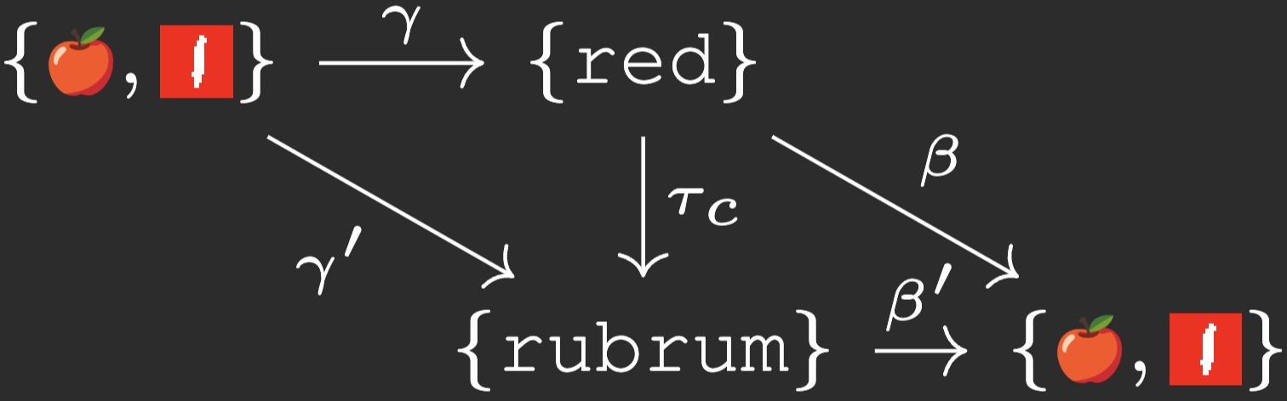
When is a translation “sound”?
Sound translations preserve closure:

Slide 34
When is a translation “sound”?
Sound translations preserve closure:

Slide 35
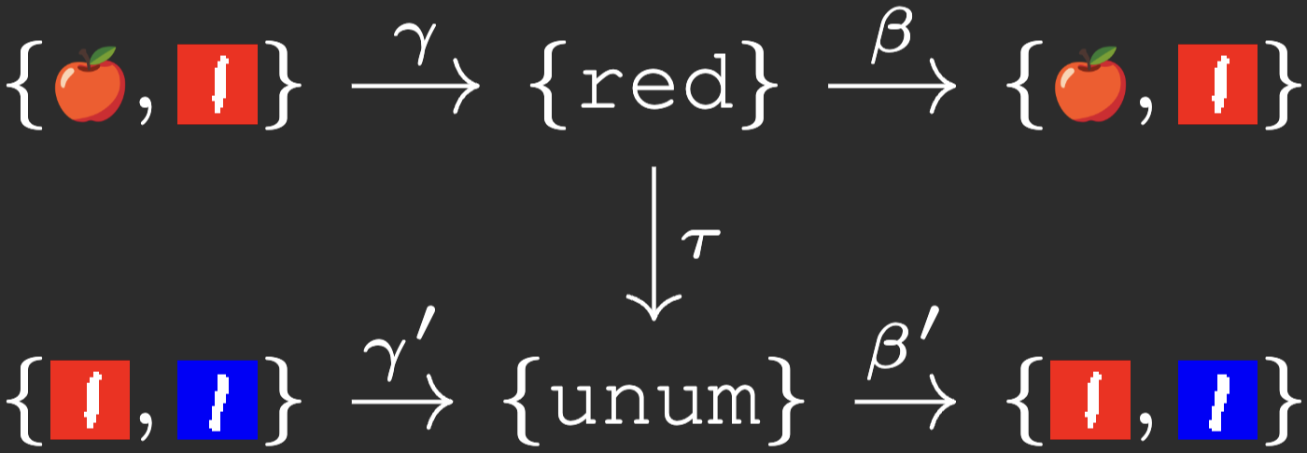
When is a translation “sound”?
Sound translations preserve closure:
“Unsound” translations do not preserve closure:

Slide 36
Problem #4
Multiple translations may exist.
Research Question #4
How do we choose among a set of sound translations?

Slide 37
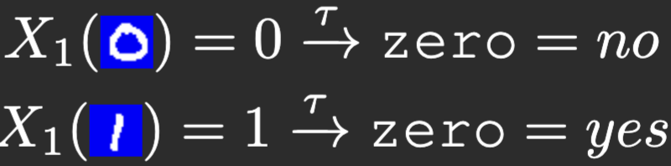
What to do when multiple sound translations exist?

Slide 38

What to do when multiple sound translations exist?
Reasoning shortcut — “Aligned” translation not identifiable
We need an “alignment” prior
[1] Melsa “System identification” Academic Press (1971).
[2] Geirhos et al. "Shortcut learning in deep neural networks" Nature Machine Intelligence (2020).
[3] Koh et al. "Concept bottleneck models" ICML (2020).
[4] Cunningham et al. "Sparse autoencoders find highly interpretable features in language models." arXiv preprint (2023).

Slide 39


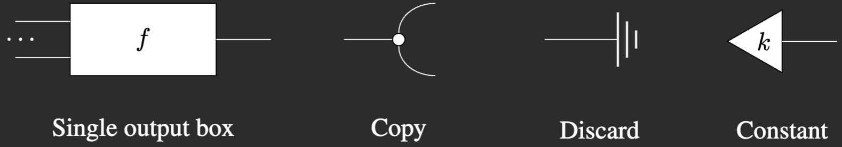
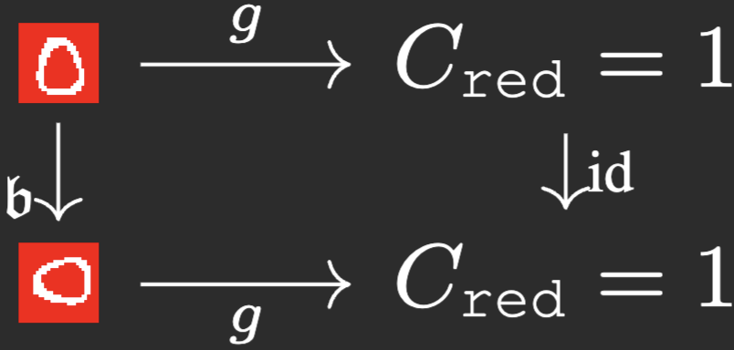
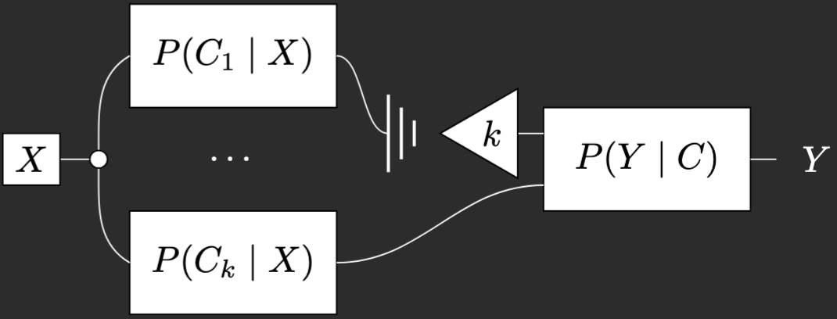
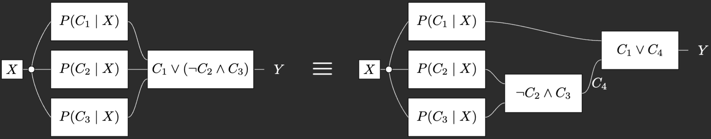
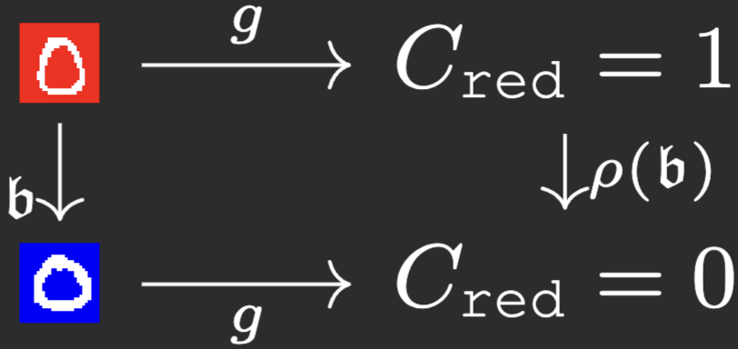
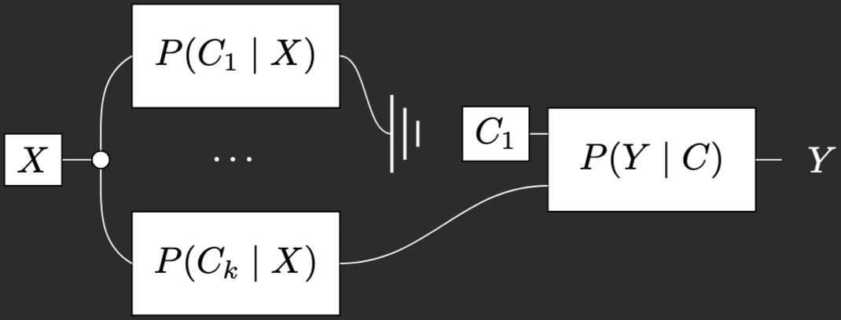
Design considerations
Human-model
interaction
Concept invariances
Do-interventions
Compositionality
Estimate causal effects
Concept equivariances
Ground-truth interventions
Sparsity
Improve model predictions

Slide 40
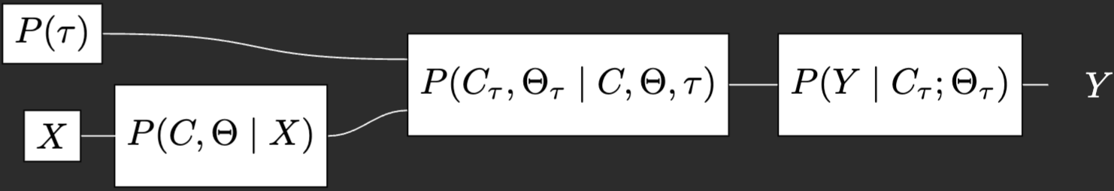
Blueprint for interpretable models
lossless compression
[1] Barbiero, Espinosa Zarlenga et al. (2025). Foundations of Interpretable Models. Under review.

Slide 41
Blueprint for interpretable models
alignment
lossless compression
[1] Barbiero, Espinosa Zarlenga et al. (2025). Foundations of Interpretable Models. Under review.

Slide 42
Blueprint for interpretable models
alignment
Compositional & sparse
lossless compression
[1] Barbiero, Espinosa Zarlenga et al. (2025). Foundations of Interpretable Models. Under review.

Slide 43
Outline
What is interpretability?
Foundations
Assumptions, data structures, and design principles for interpretability
Blueprint for interpretable models
Instantiations
Instantiating the Concept Encoder P(C | X)
Instantiating the Task Predictor P(Y | C)
Open questions

Slide 44
A high-level taxonomy of concept-based interpretability
We look at methods based on the main components in the blueprint they modify:
Concept-based Interpretable Architectures
Concept Encoder
Alignment
Task Predictor
How are concepts represented and aligned?
How are tasks predicted?

Slide 45
Outline
What is interpretability?
Foundations
Assumptions, data structures, and design principles for interpretability
Blueprint for interpretable models
Instantiations
Instantiating the concept encoder P(C | X)
Instantiating the task predictor P(Y | C)
Open questions

Slide 46

Instantiating the concept encoder $P(C | X)$
For now, we will assume:
The task predictor $P(Y | C;Θ$) will be parameterised as a (sparse) linear layer.
The parameters $Θ$ are deterministic and learnable variables
That is: we assume $P(C, Θ | X) = P(C | X) P(Θ | X)$ with $P(Θ | X)$ being a delta distribution.
We will parameterise $P\left(C | X\right)$ as a deep neural network $g\left(x ; θ_{g}\right)$
Concept Encoder
This allows us to focus on how $P(C | X)$ represents concepts

Slide 47


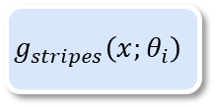
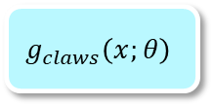

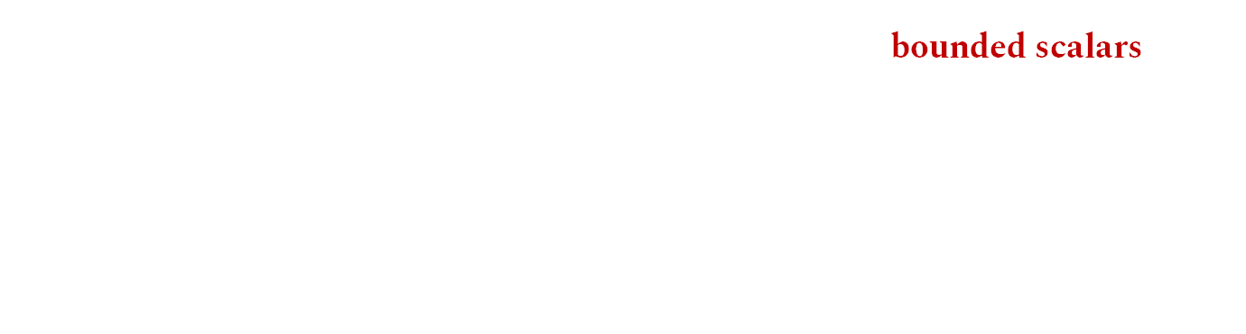
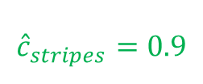
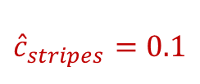
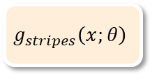


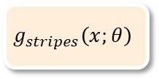


First steps: bounded scalar concept representations
The simplest concept encoder $g(x)$ represents concepts as bounded scalars:
For example, we may use sigmoidal “probes” for each concept of interest:
$$x$$
$$g_{stripes}\left(x;θ_{i}\right)$$
$${\hat{c}}_{i}∝P\left(C_{i}=1 | x\right)$$
$$g_{stripes}\left(x;θ\right)$$
$${\hat{c}}_{stripes}=0.9$$
$$g_{claws}\left(x;θ\right)$$
$${\hat{c}}_{claws}=0.2$$
$$g_{stripes}\left(x;θ\right)$$
$${\hat{c}}_{stripes}=0.1$$
$$g_{claws}\left(x;θ\right)$$
$${\hat{c}}_{claws}=0.75$$

Slide 48



First steps: bounded scalar concept representations
A Concept Bottleneck Model (CBM) [1] exploits this idea by assuming that:
We have a set of binary concepts labels C for each training sample.
Each concept in C can be independently predicted from X.
The downstream task Y can be perfectly predicted from C alone.
[1] Koh et al. "Concept bottleneck models." International Conference on Machine Learning. PMLR, 2020.

Slide 49
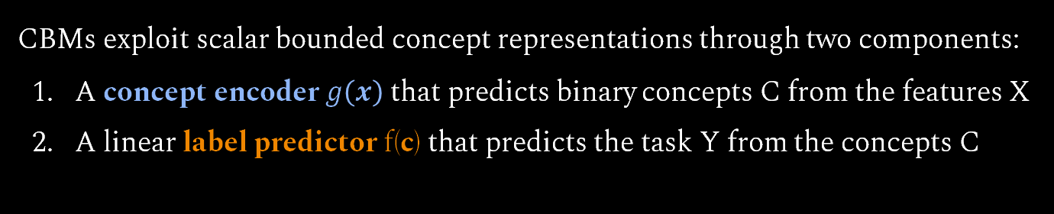
First steps: bounded scalar concept representations
CBMs exploit scalar bounded concept representations through two components:
A concept encoder $g\left(x\right)$that predicts binary concepts C from the features X
A linear label predictor f(c) that predicts the task Y from the concepts C
[1] Koh et al. "Concept bottleneck models." International Conference on Machine Learning. PMLR, 2020.

Slide 50

How to train your CBM: vanilla alignment
Given a dataset $𝒟={\left\{\left(x^{\left(j\right)}, c^{\left(j\right)}, y^{\left(j\right)}\right)\right\}}_{j=1}^{N}$ we can train a CBM in three different ways:
[1] Koh et al. "Concept bottleneck models." International Conference on Machine Learning. PMLR, 2020.

Slide 51



How to train your CBM: vanilla alignment
Given a dataset $𝒟={\left\{\left(x^{\left(j\right)}, c^{\left(j\right)}, y^{\left(j\right)}\right)\right\}}_{j=1}^{N}$ we can train a CBM in three different ways:
Independently: train $g\left(x\right)$and $f(c)$ separately.
$$𝔼_{\left(x, c, y\right)∼𝒟}\left[\text{BCE}\left(g\left(x\right), c\right)\right]$$
Align each component’s output to its corresponding ground-truth labels using a cross-entropy loss (CE)
$$𝔼_{\left(x, c, y\right)∼𝒟}\left[\text{CE}\left(f\left(c\right), y\right)\right]$$
[1] Koh et al. "Concept bottleneck models." International Conference on Machine Learning. PMLR, 2020.

Slide 52




How to train your CBM: vanilla alignment
Given a dataset $𝒟={\left\{\left(x^{\left(j\right)}, c^{\left(j\right)}, y^{\left(j\right)}\right)\right\}}_{j=1}^{N}$ we can train a CBM in three different ways:
Independently: train $g(x)$ and $f(c)$ separately.
Sequentially: train $g\left(x\right)$and then train $f(c)$ from the concept encoder’s outputs.
Train the concept encoder
Train the task predictor
$$𝔼_{\left(x, c, y\right)∼𝒟}\left[\text{BCE}\left(g\left(x\right), c\right)\right]$$
Freeze $g$
$$𝔼_{\left(x, c, y\right)∼𝒟}\left[\text{CE}\left(f\left(g\left(x\right)\right), y\right)\right]$$
[1] Koh et al. "Concept bottleneck models." International Conference on Machine Learning. PMLR, 2020.

Slide 53

How to train your CBM: vanilla alignment
Given a dataset $𝒟={\left\{\left(x^{\left(j\right)}, c^{\left(j\right)}, y^{\left(j\right)}\right)\right\}}_{j=1}^{N}$ we can train a CBM in three different ways:
Independently: train $g(x)$ and $f(c)$ separately.
Sequentially: train $g(x)$ and then train $f(c)$ from the concept encoder’s outputs.
Jointly: train $g\left(x\right)$and $f(c)$ at the same time through a weighted loss.
$$𝔼_{\left(x, c, y\right)∼𝒟}\left[\text{CE}\left(f\left(g\left(x\right)\right), y\right)+ λ⋅\text{BCE}\left(g\left(x\right), c\right)\right]$$
Controls how much we value concept alignment vs task alignment
[1] Koh et al. "Concept bottleneck models." International Conference on Machine Learning. PMLR, 2020.

Slide 54
Test-time concept interventions
Notice that this simple architecture already supports some of the powerful human-AI interactions we previously mentioned

Slide 55
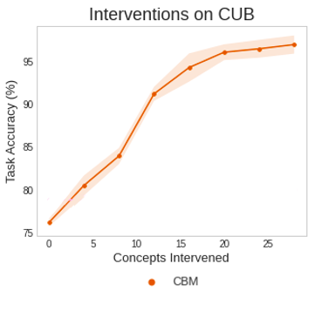
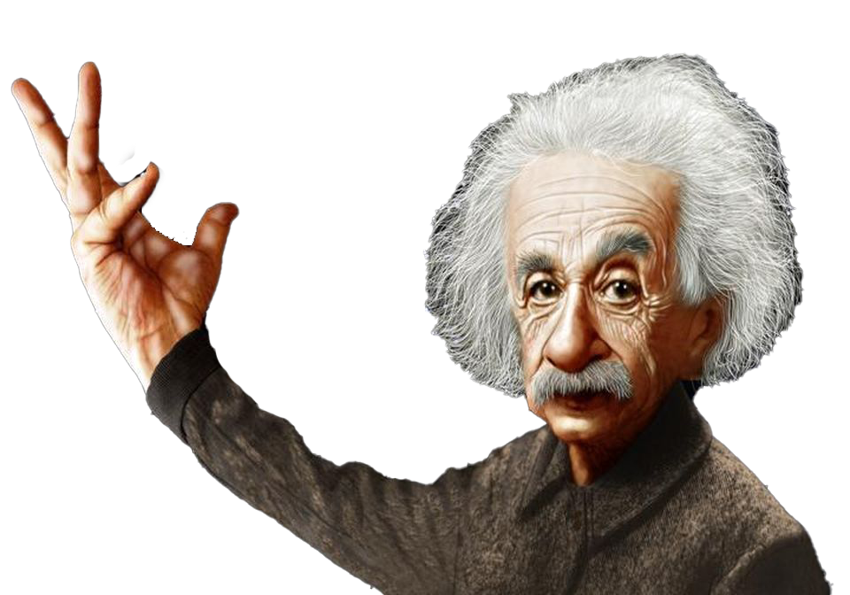


Test-time concept interventions
This leads to models that can improve their performance when deployed in conjunction with a domain expert
CBM
Domain Expert
+
=
[1] Shin et al. ”A Closer Look at the Intervention Procedure of Concept Bottleneck Models." ICML 2023.
[2] Chauhan et al. "Interactive concept bottleneck models." AAAI (2023).
ICML 23
AAAI 23

Slide 56



Diversity in concept representations
CBMs are a theoretically useful framework, but they are highly constrained in practice because of the information bottleneck their bounded scalar encodings impose
Data Distribution
Bounded Concept Representations
Task Prediction
$$\hat{c}$$
$$Y$$

Slide 57
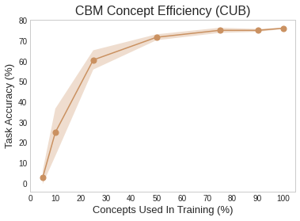
Diversity in concept representations
CBMs are a theoretically useful framework, but they are highly constrained in practice because of the information bottleneck their bounded scalar encodings impose
A CBM’s task accuracy significantly decreases when its concept set becomes incomplete

Slide 58
Diversity in concept representations
CBMs are a theoretically useful framework, but they are highly constrained in practice because of the information bottleneck their bounded scalar encodings impose
How can we design concept representations that can operate in incompleteness?
A CBM’s task accuracy significantly decreases when its concept set becomes incomplete

Slide 59

Dynamic concept embeddings
We can circumvent this by learning dynamic embedding representations that represent a concept’s activation using a high-dimensional vector
[1] Espinosa Zarlenga, Barbiero et al. "Concept embedding models: Beyond the accuracy-explainability trade-off." NeurIPS (2022)

Slide 60
Dynamic concept embeddings
We can circumvent this by learning dynamic embedding representations that represent a concept’s activation using a high-dimensional vector
[1] Espinosa Zarlenga, Barbiero et al. "Concept embedding models: Beyond the accuracy-explainability trade-off." NeurIPS (2022)

Slide 61







Dynamic concept embeddings
For example, Concept Embedding Models (CEMs) decompose the concept representation ${\hat{c}}_{i}$ as the mixture of two embedding representations $\left\{{\hat{c}}_{i}^{+}\left(x\right), {\hat{c}}_{i}^{−}\left(x\right)\right\}$:
$${\hat{c}}_{i}\left(x\right)={\hat{p}}_{i}\left(x\right) {\hat{c}}_{i}^{+}\left(x\right)+\left(1 −{\hat{p}}_{i}\left(x\right)\right) {\hat{c}}_{i}^{−}\left(x\right)$$
$${\hat{c}}_{i}^{+}\left(x\right)$$
$${\hat{c}}_{i}\left(x\right)$$
$${\hat{p}}_{i}\left(x\right)$$
$${(1 − \hat{p}}_{i}\left(x\right))$$
$${\hat{c}}_{i}^{−}\left(x\right)$$
“Positive” concept embeddings
“Negative” concept embeddings
Where the probability ${\hat{p}}_{i}\left(x\right)= P(c_{i} = 1 | x)$ of concept $c_{i}$ being present in $x$ is given by a simple (linear) function $s\left({\hat{c}}_{i}^{+}\left(x\right),{\hat{c}}_{i}^{−}\left(x\right)\right)$ of the positive and negative embeddings aligned via cross-entropy.
[1] Espinosa Zarlenga, Barbiero et al. "Concept embedding models: Beyond the accuracy-explainability trade-off." NeurIPS (2022)
Notes:
Determining a concept’s activation given ${\hat{c}}_{i}$ then comes down to determining whether ${\hat{c}}_{i}$comes from $P\left({\hat{c}}_{i}^{+}| x\right)$ or $P\left({\hat{c}}_{i}^{−}| x\right)$

Slide 62




Dynamic concept embeddings
More recent works have adapted concept embeddings to:
Enable better-calibrated uncertainty estimates (Probabilistic CBMs [1])
Compute arbitrary concept conditional distributions (Energy-based CBMs [2])
Learn ”ask” for effective concept interventions (Intervention-aware CEMs [3])
Better generalize within out-of-distribution shifts (MixCEMs [4])
ProbCBM
ECBM
IntCEM
MixCEM
[1] Kim et al. "Probabilistic Concept Bottleneck Models." ICML (2023).
[2] Xu et al. "Energy-based concept bottleneck models: Unifying prediction, concept intervention, and probabilistic interpretations." ICLR (2024).
[3] Espinosa Zarlenga et al. "Learning to receive help: Intervention-aware concept embedding models." NeurIPS (2023)
[4] Espinosa Zarlenga et al. "Avoiding Leakage Poisoning: Concept Interventions Under Distribution Shifts." ICML (2025).
Notes:
Determining a concept’s activation given ${\hat{c}}_{i}$ then comes down to determining whether ${\hat{c}}_{i}$comes from $P\left({\hat{c}}_{i}^{+}| x\right)$ or $P\left({\hat{c}}_{i}^{−}| x\right)$

Slide 63
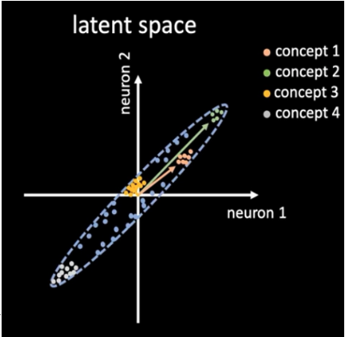
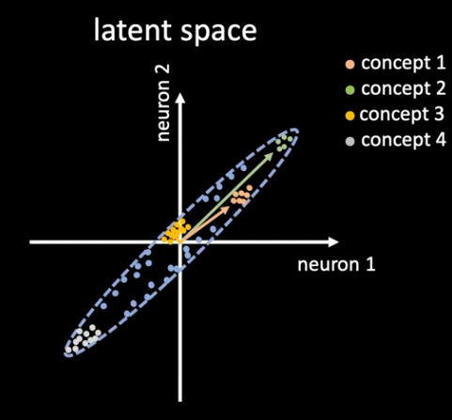
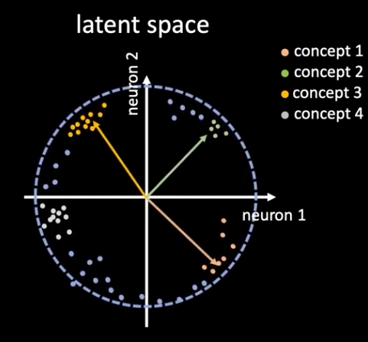

(Large) unbounded scalar concept representations
Recent approaches exploit unbounded scalar representations of large concept sets:
Concept Whitening rotates the output of a Batch Normalization layer so that the resulting activation scores are axis-aligned with known concepts
Normalize
Whiten
Rotate
[1] Chen et al. "Concept whitening for interpretable image recognition." Nature Machine Intelligence 2.12 (2020): 772-782.

Slide 64
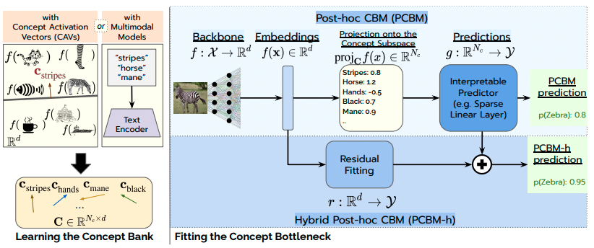

(Large) unbounded scalar concept representations
Recent approaches exploit unbounded scalar representations of large concept sets:
Post-hoc CBMs (PCBMs) project a pre-trained DNN’s latent space into a concept score space using linear concept probes
[1] Yuksekgonul et al. "Post-hoc concept bottleneck models." ICLR (2023).

Slide 65



(Large) unbounded scalar concept representations
This can be turned into a fully-unsupervised pipeline if we exploit large language models as knowledge bases and multimodal embeddings (e.g., CLIP) as annotators:
These are called Label-free CBMs [1] or Language-guided Bottlenecks (LaBos) [2]
“List the most important features for recognizing something as a {class}:”
[1] Oikarinen et al. "Label-Free Concept Bottleneck Models." ICLR (2023).
[2] Yang et al. "Language in a bottle: Language model guided concept bottlenecks for interpretable image classification." CVPR (2023).
ICLR 23
CVPR 23

Slide 66
What about other forms of alignment?
So far, we have assumed that we align concept representations and human-understandable concepts by:
Minimizing a cross-entropy term, or
Projecting samples into a direction correlated with each concept (e.g., via CLIP)
Alignment
[1] Margeloiu et al. "Do concept bottleneck models learn as intended?." ICLR Workshop on Responsible AI (2021).
[2] Mahinpei et al. "Promises and pitfalls of black-box concept learning models." ICML Workshop on Theoretic Foundation, Criticism, and Application of XAI (2021).
[3] Raman et al. "Do Concept Bottleneck Models Respect Localities?." TMLR (2025).

Slide 67
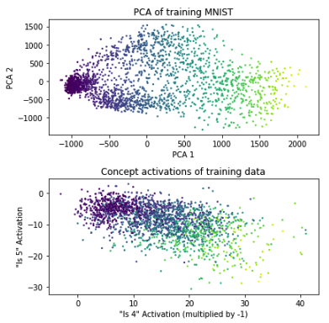
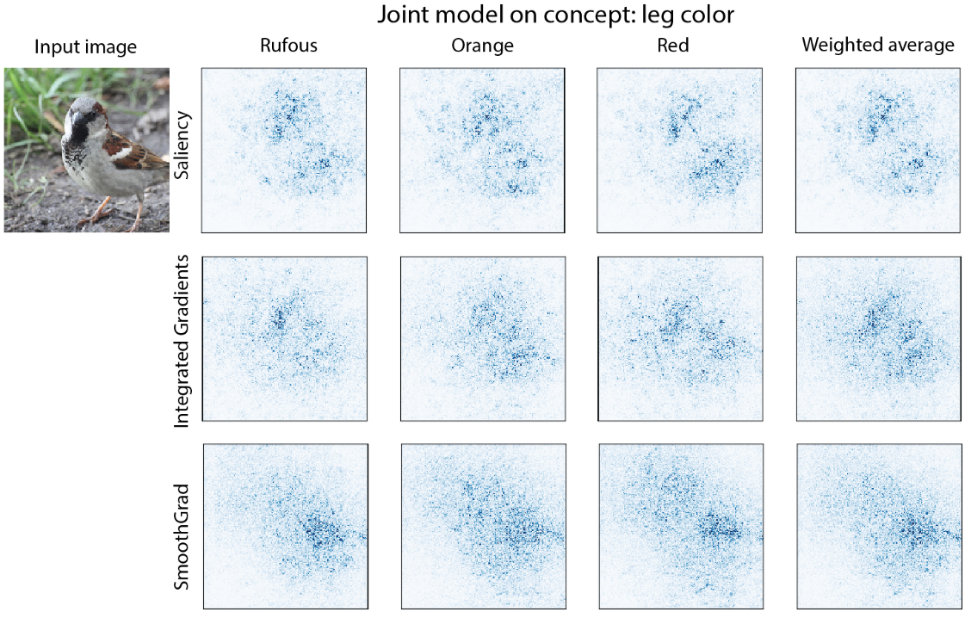
What about other forms of alignment?
These alignment mechanisms can lead to unwanted representational leakage
Saliency maps seem to suggest concepts do not properly attend the right features
(Margeloiu et al., 2021) [1]
CBMs may have incentives to encode the entire data representation in the concepts’ soft predictions
(Mahinpei et al., 2021) [2]
[1] Margeloiu et al. "Do concept bottleneck models learn as intended?." ICLR Workshop on Responsible AI (2021).
[2] Mahinpei et al. "Promises and pitfalls of black-box concept learning models." ICML Workshop on Theoretic Foundation, Criticism, and Application of XAI (2021).
[3] Raman et al. "Do Concept Bottleneck Models Respect Localities?." TMLR (2025).

Slide 68
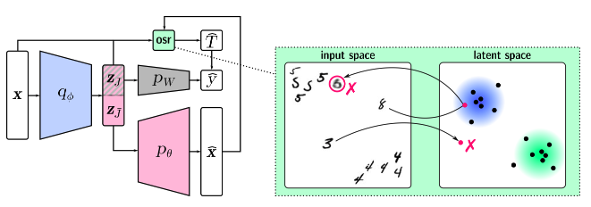
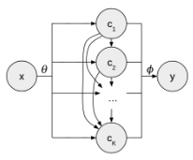
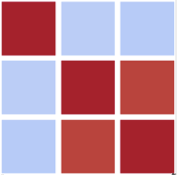

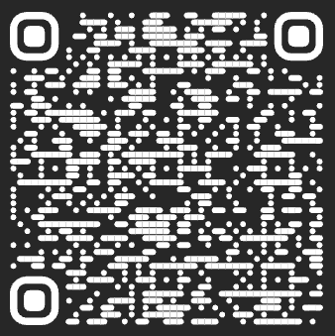






Re-thinking traditional concept alignment
Nevertheless, several works have been proposed to mitigate leakage by:
Framing alignment as a disentanglement learning task (e.g., GlanceNets [1])
Modeling concept relationships (e.g., Autoregressive CBMs [2] or Stochastic CBMs [3])
GlanceNets
Autoregressive CBMs
Stochastic CBMs
$$∼$$
$$𝒩\left( , \right)$$
$$σ^{−1}\left(\hat{c}\right)$$
$$μ\left(x\right)$$
$$Σ\left(x\right)$$
[1] Marconato et al. "Glancenets: Interpretable, leak-proof concept-based models." NeurIPS (2022).
[2] Havasi et al. "Addressing leakage in concept bottleneck models." NeurIPS (2022).
[3] Vandenhirtz, Laguna et al. "Stochastic Concept Bottleneck Models." NeurIPS (2024).
GlanceNets
Autoregressive
Stochastic

Slide 69
Outline
What is interpretability?
Foundations
Assumptions, data structures, and design principles for interpretability
Blueprint for interpretable models
Instantiations
Instantiating the concept encoder P(C | X)
Instantiating the task predictor P(Y | C)
Open questions

Slide 70

Instantiating the task predictor $P\left(Y \right|C;Θ)$
So far, we have assumed that the label predictor $P\left(Y | C ;Θ\right)$ is a linear layer.
Linear models, however, are not very expressive and may struggle to learn complex non-linear interactions between concepts and labels.
We will now consider different ways of parameterising $P\left(Θ| X\right)$ and $P(Y | C;Θ)$
Task Predictor

Slide 71


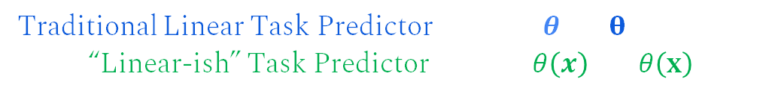
Powerful interpretable task predictors
A simple way to extend the power of linear task predictors is to make them act linearly at least in the concept neighbourhood of each sample x
Traditional Linear Task Predictor: $f\left(\hat{c} ;θ\right)=θ^{T}\hat{c}$
“Linear-ish” Task Predictor: $f\left(\hat{c} ;θ\left(x\right)\right)=θ{\left(x\right)}^{T}\hat{c}$
Where:
The distribution $P(Θ | X)= θ(x)$is parameterised as a learnable DNN, and
The function $θ(x)$is encouraged to be “stable” for samples with similar concepts
[1] Alvarez Melis et al. "Towards robust interpretability with self-explaining neural networks." NeurIPS (2018).

Slide 72

Neuro-Symbolic task predictors
Another way is to exploit different parameter spaces $P\left(Θ | X\right)$ such as symbolic rules

Slide 73
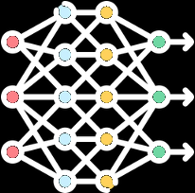








Neuro-Symbolic task predictors
Another way is to exploit different parameter spaces $P\left(Θ | X\right)$ such as symbolic rules
Step 1 (neural generation): Two DNNs generate both concept activations & rule parameters
Concepts
semantic transparency
Concept Encoder $P\left(C | X\right)$
Rule Generator $P\left(Θ\right|X)$
Logic rule
functional transparency
$$¬C_{1}∨C_{2}$$
[1] Barbiero et al. "Interpretable neural-symbolic concept reasoning." International Conference on Machine Learning. PMLR, 2023.
[2] Debot et al. "Interpretable concept-based memory reasoning." NeurIPS 2024.
ICML 23
NeurIPS 24

Slide 74



Neuro-Symbolic task predictors
Another way is to exploit different parameter spaces $P\left(Θ | X\right)$ such as symbolic rules
Step 1 (neural generation): Two DNNs generate both concept activations & rule parameters
Step 2 (interpretable execution): A symbolic engine executes rules using predicted concepts
Concepts
semantic transparency
Interpretable
execution
Concept Encoder $P\left(C | X\right)$
exec
Rule Generator $P\left(Θ\right|X)$
Logic rule
functional transparency
$$¬C_{1}∨C_{2}$$
[1] Barbiero et al. "Interpretable neural-symbolic concept reasoning." International Conference on Machine Learning. PMLR, 2023.
[2] Debot et al. "Interpretable concept-based memory reasoning." NeurIPS 2024.
ICML 23
NeurIPS 24

Slide 75




Neuro-Symbolic task predictors
An example is a Concept-based Memory Reasoning (CMR) where we:
Step 1: Predict a set of bounded scalar concept representations $P(C | X)$with a DNN
Concepts
Concept Encoder $P\left(C | X\right)$
= 0.2
= 0.9
= 0.1
[1] Debot et al. "Interpretable concept-based memory reasoning." NeurIPS 2024.

Slide 76




Neuro-Symbolic task predictors
An example is a Concept-based Memory Reasoning (CMR) where we:
Step 2: Select a rule “embedding” from a learnable ”rulebook” using a DNN
Concepts
Concept Encoder $P\left(C | X\right)$
= 0.2
= 0.9
= 0.1
Rule Selection $P\left(s \right| X)$
0.2
0.8
Rulebook
$$e_{1}$$
~
$$e_{2}$$
$$e_{2}$$
[1] Debot et al. "Interpretable concept-based memory reasoning." NeurIPS 2024.

Slide 77








Neuro-Symbolic task predictors
An example is a Concept-based Memory Reasoning (CMR) where we:
Step 3: Use a learnable model to decode the rule embedding into three states per concept
Concepts
Concept Encoder $P\left(C | X\right)$
= 0.2
= 0.9
= 0.1
$$C_{1}$$
$$C_{2}$$
$$C_{3}$$
Rule Selection $P\left(s \right| X)$
Rule Decoding $P\left(Θ \right| s)$
Positive | 0.1 | 1 | 0
Negative | 0.6 | 0 | 0
Irrelevant | 0.3 | 0 | 1
0.2
$$¬C_{1}∨C_{2}$$
0.8
Logic rule
Rulebook
$$e_{1}$$
~
$$e_{2}$$
$$e_{2}$$
[1] Debot et al. "Interpretable concept-based memory reasoning." NeurIPS 2024.

Slide 78

Neuro-Symbolic task predictors
An example is a Concept-based Memory Reasoning (CMR) where we:
Step 4: Execute the rule combining concept states and concept activations
Concepts
Concept Encoder $P\left(C | X\right)$
Interpretable
execution
= 0.2
= 0.9
$$\left(1−0.2\right)×0.9×1$$
= 0.1
$$C_{1}$$
$$C_{2}$$
$$C_{3}$$
Rule Selection $P\left(s \right| X)$
Rule Decoding $P\left(Θ \right| s)$
Positive | 0.1 | 1 | 0
Negative | 0.6 | 0 | 0
Irrelevant | 0.3 | 0 | 1
0.2
$$¬C_{1}∨C_{2}$$
0.8
Logic rule
Rulebook
$$e_{1}$$
~
$$e_{2}$$
$$e_{2}$$
$$e_{2}$$
[1] Debot et al. "Interpretable concept-based memory reasoning." NeurIPS 2024.

Slide 79
Neuro-Symbolic task predictors
These steps enable CMR to:
Become a universal approximator akin to opaque DNNs
Provide, by design, both local and global interpretability
Allow formal verification of desirable properties
[1] Debot et al. "Interpretable concept-based memory reasoning." NeurIPS 2024.
Notes:
Inference mechanisms can only be selected from a finite set of transparent rules!

Slide 80




Neuro-Symbolic task predictors
Other neuro-symbolic task predictors include:
Logic Explained Networks (LENs)
DeepProbLog
Deep Concept Reasoner (DCR)
Neural Algorithmic Reasoning (NAR)
[1] Ciravegna et al. "Logic explained networks." Artificial Intelligence (2023)
[2] Manhaeve et al. "Deepproblog: Neural probabilistic logic programming." NeurIPS (2018).
[3] Barbiero et al. "Interpretable neural-symbolic concept reasoning." ICML (2023).
[4] Veličković et al. "Neural algorithmic reasoning." Patterns (2021).
Notes:
Inference mechanisms can only be selected from a finite set of transparent rules!

Slide 81
Outline
What is interpretability?
Foundations
Assumptions, data structures, and design principles for interpretability
Blueprint for interpretable models
Instantiations
Instantiating the concept encoder P(C; X)
Instantiating the task predictor P(Y; C)
Open questions

Slide 82

Challenges and open questions
There are still a lot of significant challenges and open questions in concept-based interpretability, particularly on making these models more “real-world-friendly”.

Slide 83

Challenges and open questions: Label-free approaches
Label-free models open the door for practical interpretable models, yet they are currently not as reliable as supervised concept-based models
How can label-free models be used without domain-specific foundation models?

Slide 84

Challenges and open questions: Label-free approaches
Label-free models open the door for practical interpretable models, yet they are currently not as reliable as supervised concept-based models
How can we effectively intervene in label-free settings?
intervention

Slide 85
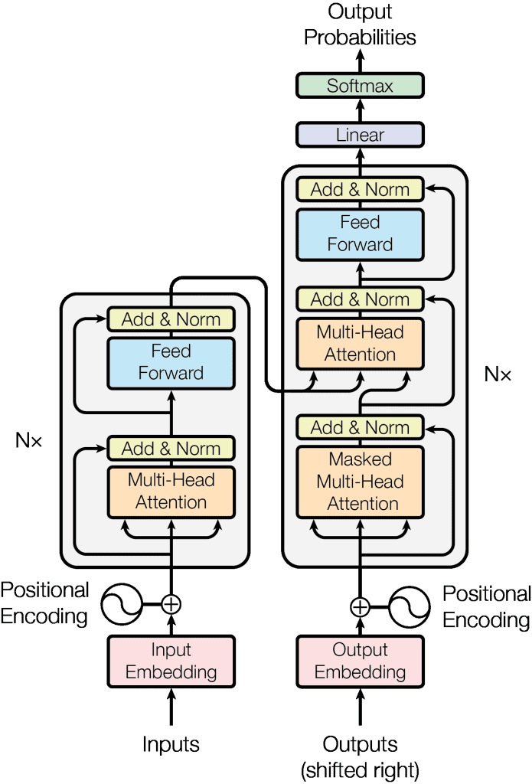
Challenges and open questions: Scalability
Concept-based interpretable models have yet to be properly integrated to large scale and multimodal models. This raises a lot of important questions:
Where should we look for/place concepts in LLMs? Should this be done at a token, sentence, paragraph, or text-level?
?
?
?

Slide 86








Challenges and open questions: Scalability
Concept-based interpretable models have yet to be properly integrated to large scale and multimodal models. This raises a lot of important questions:
What does a ”concept” really mean in textual inputs? What about in other modalities such as genomics, finance, and law?
Graph Data
(e.g., Xuanyuan et al.)
Tabular Data
(e.g., Espinosa Zarlenga et al.)
RL Tasks
(e.g., Ye et al.)
Time Series Data
(e.g., Kazhdan et al.)
[1] Xuanyuan al. "Global concept-based interpretability for graph neural networks via neuron analysis." AAAI (2023).
[2] Espinosa Zarlenga et al. "Tabcbm: Concept-based interpretable neural networks for tabular data." TMLR (2024).
[3] Ye et al. "Concept-based interpretable reinforcement learning with limited to no human labels." ICML (2024).
[4] Kazhdan et al. "MEME: generating RNN model explanations via model extraction." arXiv (2020).

Slide 87


Challenges and open questions: Scalability
Concept-based interpretable models have yet to be properly integrated to large scale and multimodal models. This raises a lot of important questions:
Can we even scale concept-based architectures to current large model standards?
Concept Bottleneck LLMs
(e.g., Sun et al.)
[1] Sun et al. "Concept bottleneck large language models." ICLR (2025).

Slide 88
Conclusion: Concepts and their role in interpretability
Today we:
Argued that interpretability can be thought as a form of “inference equivariance”
Showed that verifying this equivariance is intractable unless we rely on compressing our input space into a set of “concepts”
Proposed a blueprint for designing interpretable models formed by (1) a concept encoder, (2) an alignment mechanism, and (3) a label predictor
Discussed several instantiations of this blueprint across the literature

Slide 89


Further resources: Website and library
Website of a longer iteration of this tutorial (extended bibliography and slides):
conceptlearning.github.io
PyTorch Concepts (PyC), tutorials and library for concept-based interpretability:
pyc-team.github.io/pyc-book/intro.html
Thank you, grazie, gracias for your time!
Contact: pietro.barbiero@ibm.com and me466@cam.ac.uk

