Slide 1
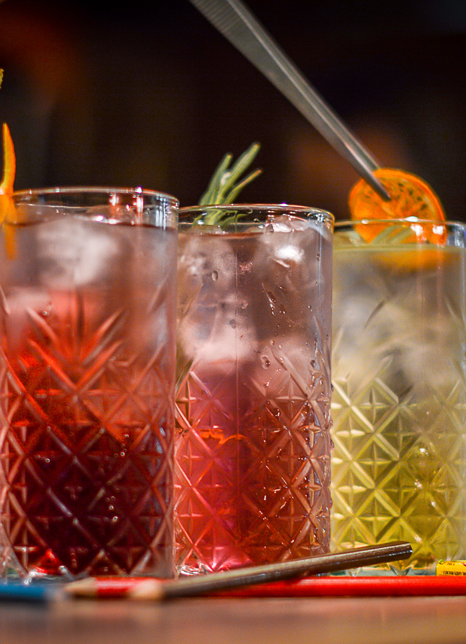
GASTROBAR · KIROVA 10 · YAROSLAVL
SWEET PEPPER
Brand & UX Case Study
Systemizing a beloved but chaotic gastrobar identity, then designing and building a full website that changes with the time of day.
ON THE BAR’S DOMAIN · RU + EN
Role: Brand & Web Designer · Timeline: Jun–Oct 2026 · Updated Oct 2

Slide 2
OVERVIEW
WHAT THIS PROJECT WAS
THE CLIENT
THE ASK
MY ROLE
DELIVERABLES
Sweet Pepper, a hybrid gastrobar in Yaroslavl, Russia — a serious all-day kitchen fused with a craft cocktail bar. Open 8:30am to late, every day.
The brand had 12 years of visual equity but no system — logos, colors, and posters existed in isolation. The new website needed a coherent identity and a real content plan to launch from.
Solo designer: brand system, logo consolidation, IA, homepage / menu / About / Visit UX in both day and night states, full site copy (EN/RU as register twins), the platform/CMS call, AI-assisted prototyping — and the custom WordPress build itself.
A written design system (color, type, grid, ratios, motion), a consolidated logo set, four page templates in both states validated by testing, a live bilingual style guide with PDFs, and a custom WordPress theme running on the bar’s domain in two languages.
Sweet Pepper — Brand & UX Case Study
02 / 39

Slide 3
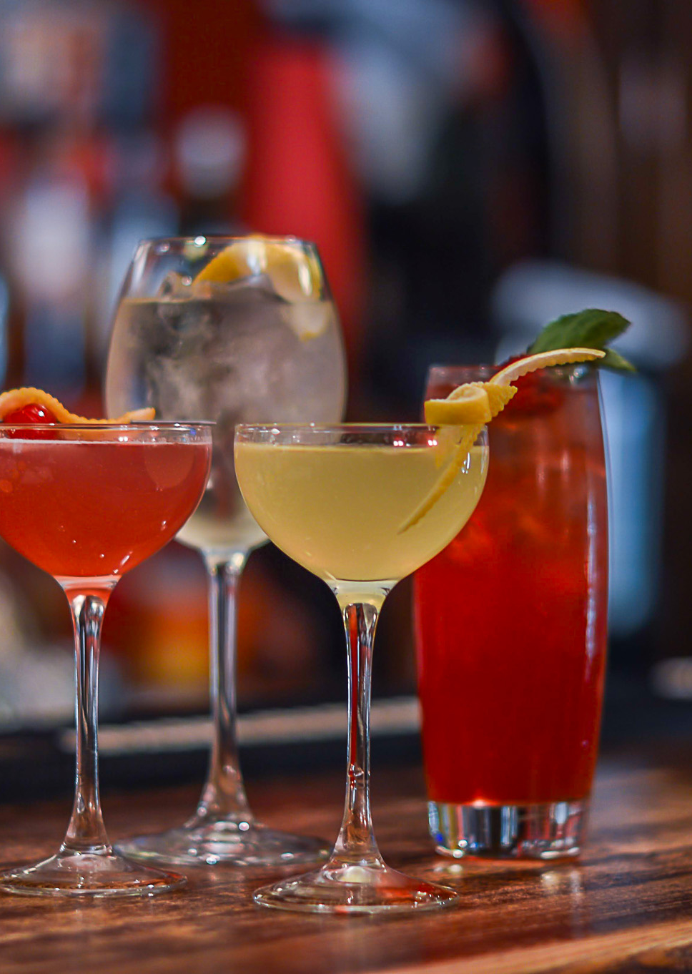
CONTEXT
A HYBRID THAT DIDN'T FIT A TEMPLATE
Sweet Pepper isn't a café that also serves drinks, or a bar that does brunch on weekends. It was built from day one to run breakfast, business lunch, after-work drinks, and late-night cocktails with equal intentionality — a 50/50 kitchen-to-bar revenue split, maintained deliberately for years.
That structural duality — one venue, four distinct daily identities — became the central design problem: how does a single homepage represent a breakfast spot, a lunch destination, an evening bar, and a late-night hang without picking one and alienating the rest?
4.6/5
50/50
8:30–late
Google rating
1,300+ reviews
Kitchen-to-bar
revenue split
Daily operating
window
Sweet Pepper — Brand & UX Case Study
03 / 39

Slide 4
RESEARCH
WHO ACTUALLY SHOWS UP
Combined public review-mining (Google, TripAdvisor, Yandex, 2GIS) with founder interviews to segment the audience before designing anything.
A · COMMUNITY REGULAR
B · LUNCH & BREAKFAST CROWD
C · EVENT & OCCASION VISITOR
D · COLLABORATOR / ECOSYSTEM
20–35, treats the bar as their neighbourhood spot. High loyalty, emotionally bonded, follows on social.
Office workers & students on Kirova St. Value-driven, transactional, price/speed sensitive.
Birthdays, after-work groups, company parties. Needs capacity and festive programming.
Fellow venue owners, musicians, book-club organisers — treat it as a platform, not just a customer stop.
"One of my favourite places on Kirova. Unique design, good food, decent coffee. Genuinely cosy." — guest review
Insight: the dominant word across every platform was "уютный" — cosy. The team's public perception wasn't manufactured by marketing; it grew from how the place actually runs. The website had to earn that word, not just claim it.
Sweet Pepper — Brand & UX Case Study
04 / 39

Slide 5
THE CHALLENGE
FOUR PROBLEMS, ONE HOMEPAGE
01
NO SYSTEM, JUST ARTIFACTS
02
A PALETTE THAT FIGHTS ITSELF
12 years of logos, posters, and menus existed — but no shared color logic, no type hierarchy, no rules for reuse.
Chili red, lime, and lemon are loud individually. Left unsystematized, saturated color-on-color fails contrast and fatigues the eye.
03
ONE VENUE, FOUR IDENTITIES
04
GENERIC TEMPLATE GRAVITY
Breakfast, lunch, evening bar, and late-night party each need different tone, imagery, and CTA — inside a single hero.
Early drafts kept defaulting to stock restaurant-site patterns: hero photo + headline + card grid — nothing that felt like this specific bar.
Sweet Pepper — Brand & UX Case Study
05 / 39

Slide 6
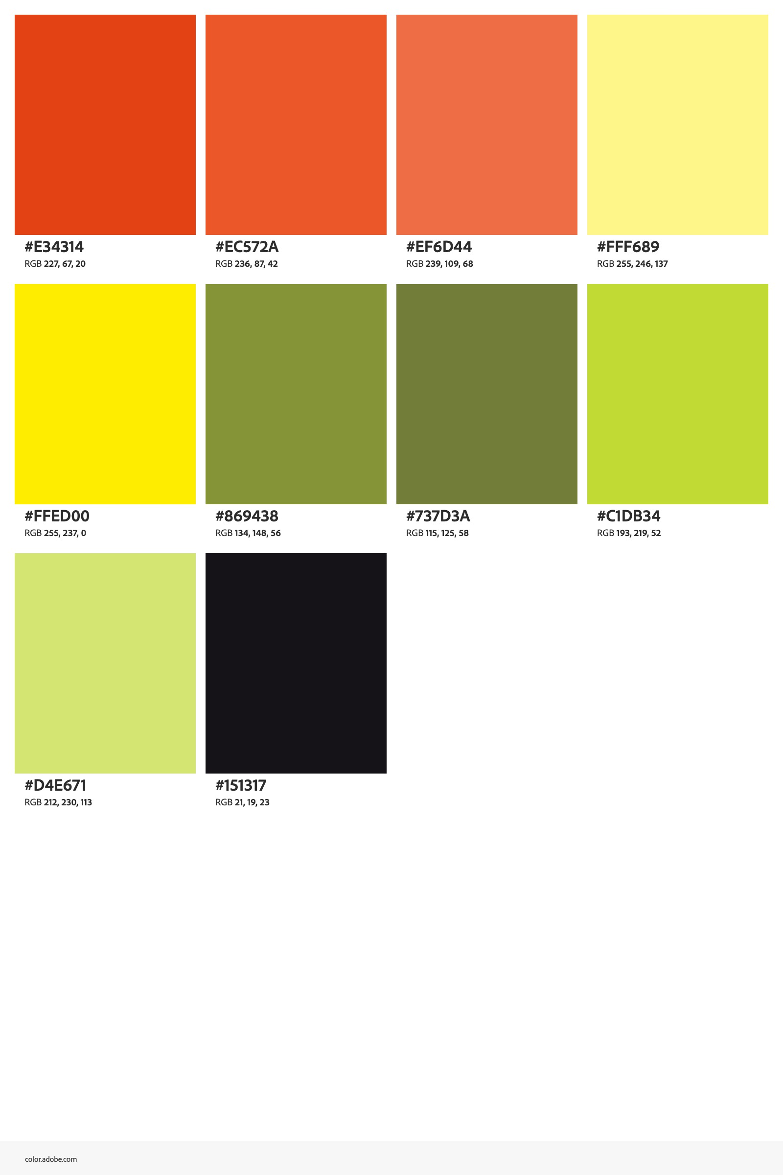
SOLUTION · BRAND SYSTEM
THREE RAMPS, NOT SIX FIGHTING COLORS
The generative rule: every brand color is a tint or shade of exactly three hues — red, green, yellow — plus neutrals. Need a new shade? Move along an existing hue line; never introduce a new one. That single rule turned a chaotic set of "loud" colors into something provably harmonious.
Colour-vision claim audited & narrowed later: no colour carries meaning alone
Day (Parchment) / Night (Peppercorn) modes mapped from the same palette
Molot (display, heavy, all-caps) leads; Golos Text carries everything meant for reading
Deep Chili token added specifically so red text passes AA at small sizes
Sweet Pepper — Brand & UX Case Study
06 / 39

Slide 7


SOLUTION · IDENTITY
KEEP THE MARK, BUILD THE SYSTEM AROUND IT
The chili-and-shaker mark and the bottle-cap seal already had years of recognition and guest affection — the research showed no reason to replace them. The job was consolidation: one clear hierarchy of lockups, one clear-space rule, minimum sizes, and defined backgrounds, so the mark could scale from a favicon to a storefront sign without improvisation.
SYSTEMIZED
INTO A FULL
LOCKUP SET →
BEFORE
AFTER — ONE OF SIX DEFINED LOCKUPS
Sweet Pepper — Brand & UX Case Study
07 / 39

Slide 8
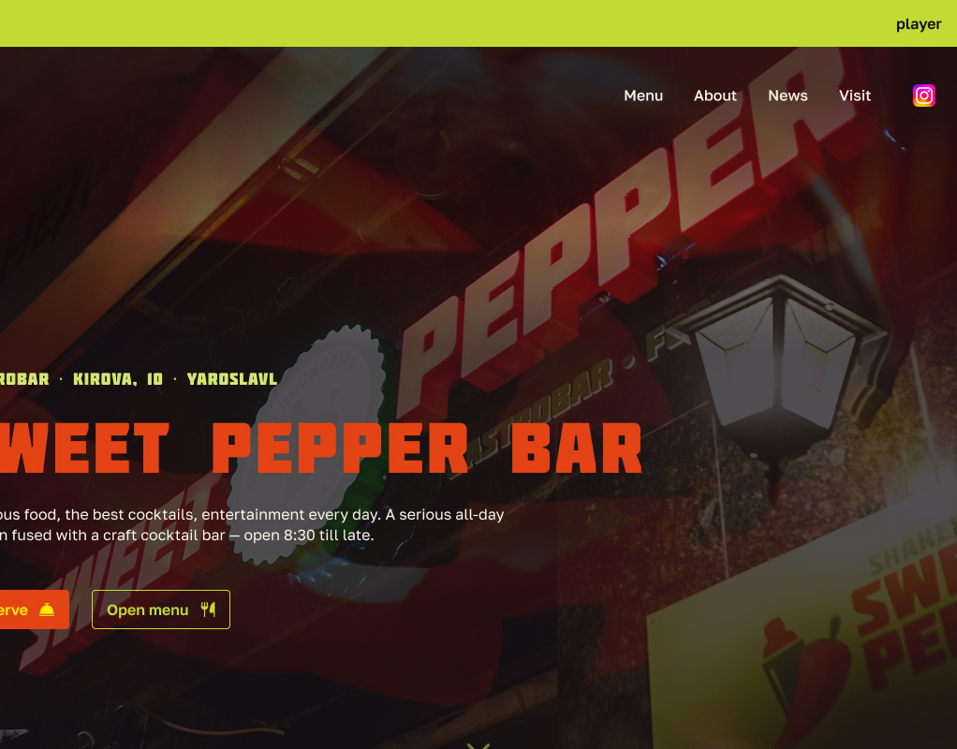
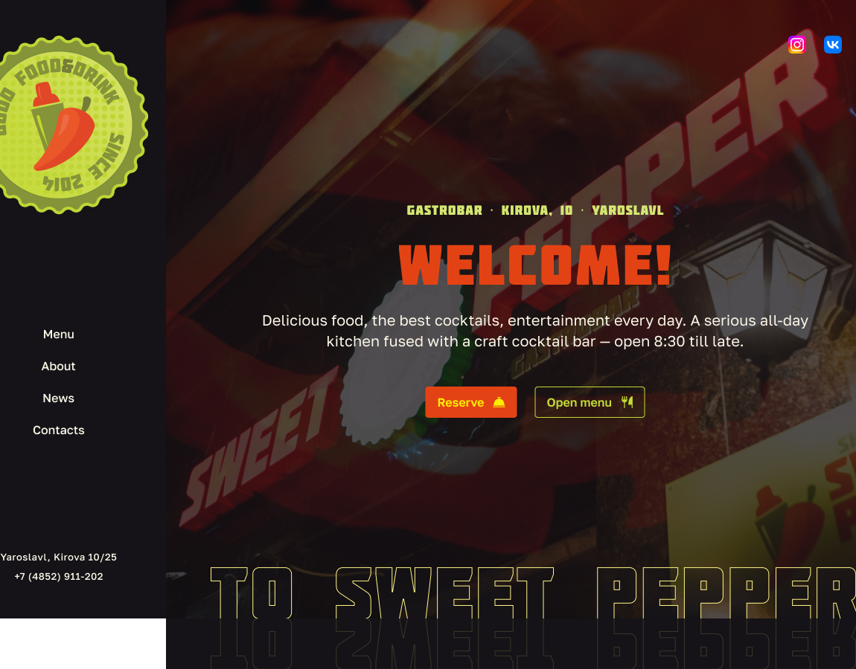
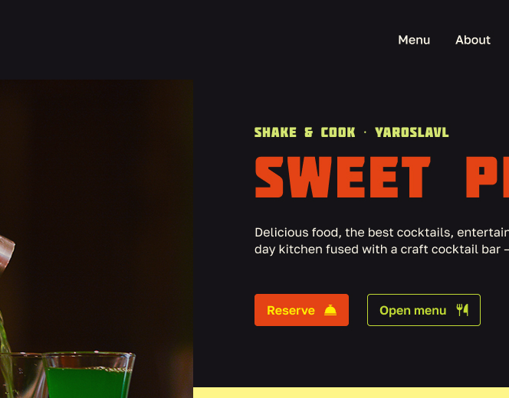
PROCESS
FINDING THE HERO, DRAFT BY DRAFT
Nine home-page explorations. The first drafts proved the brand assets worked together — but the layout logic was still generic restaurant-template thinking.
DRAFT 2 — STATIC TEMPLATE
DRAFT 5 — SIDEBAR + MOTIF
DRAFT 7 — CLEANER TWO-COLUMN
Centered hero, generic card grid below. Safe, but interchangeable with any bar site.
Introduced the seal logo and outlined wordmark. Sidebar nav added clutter without solving anything.
Cut the sidebar, tightened type hierarchy. Still one static headline for an all-day venue.
Sweet Pepper — Brand & UX Case Study
08 / 39

Slide 9
THE INSIGHT
STOP PICKING ONE MOMENT. USE THE CLOCK.
Every static draft forced a choice: show the cocktail bar and lose the breakfast crowd, or show breakfast and bury the thing everyone actually remembers the place for. The reframe: the venue already changes its whole identity four times a day — breakfast, lunch, dinner, party. So let the website do the same thing, automatically, tied to the guest's real local time.
BREAKFAST
LUNCH
DINNER
PARTY
One constraint shaped the mechanic more than any other: hospitality's "no-clock rule" — good service makes guests lose track of time, so the hero could never show a literal clock or countdown. The heat slider solves this by implying time through a metaphor (mild → on fire) instead of stating it.
mild
warm
spicy
on fire
Sweet Pepper — Brand & UX Case Study
09 / 39

Slide 10
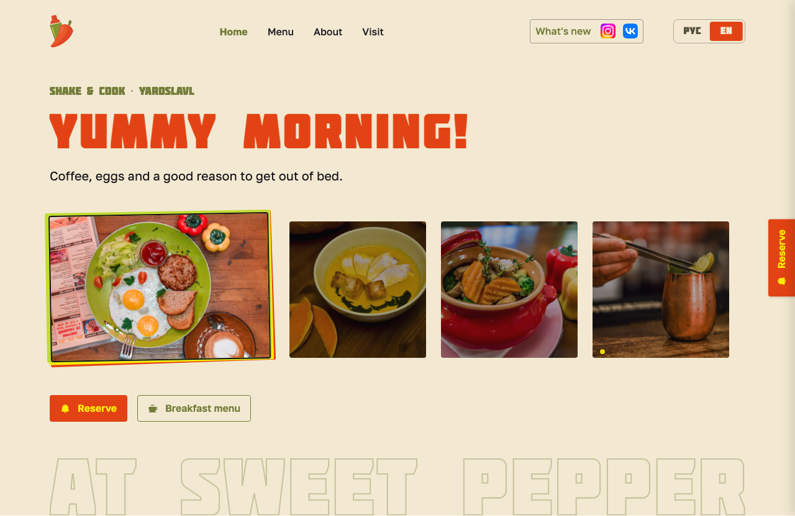
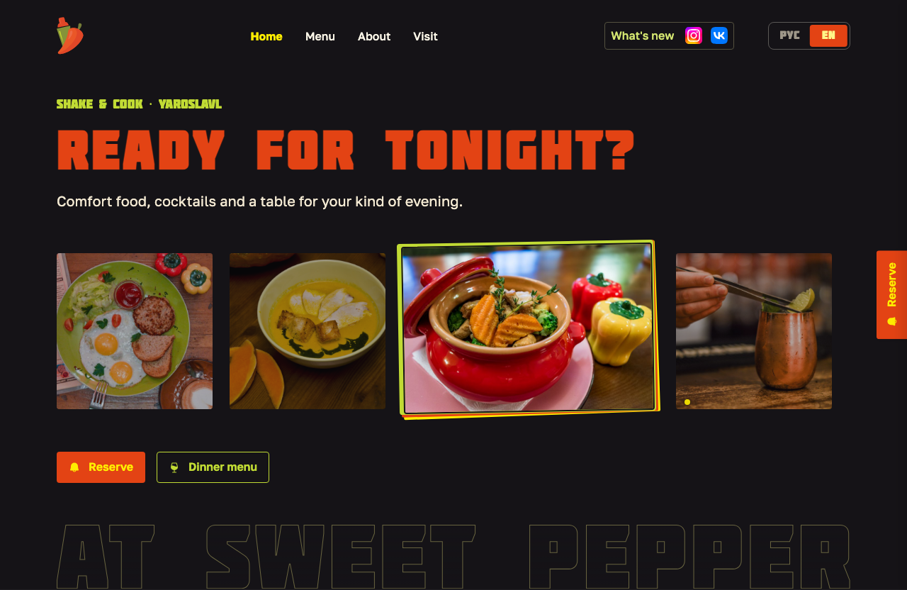
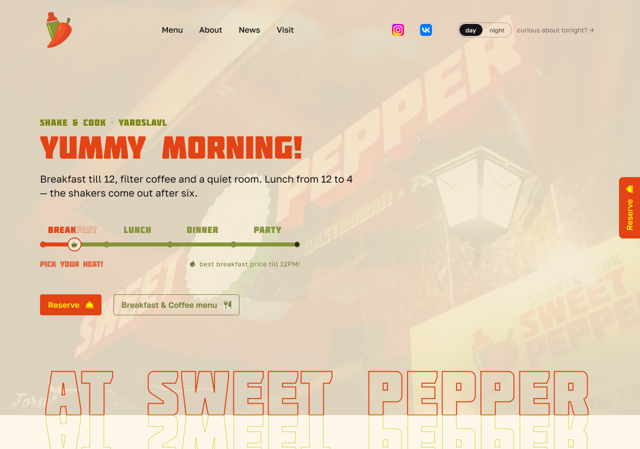
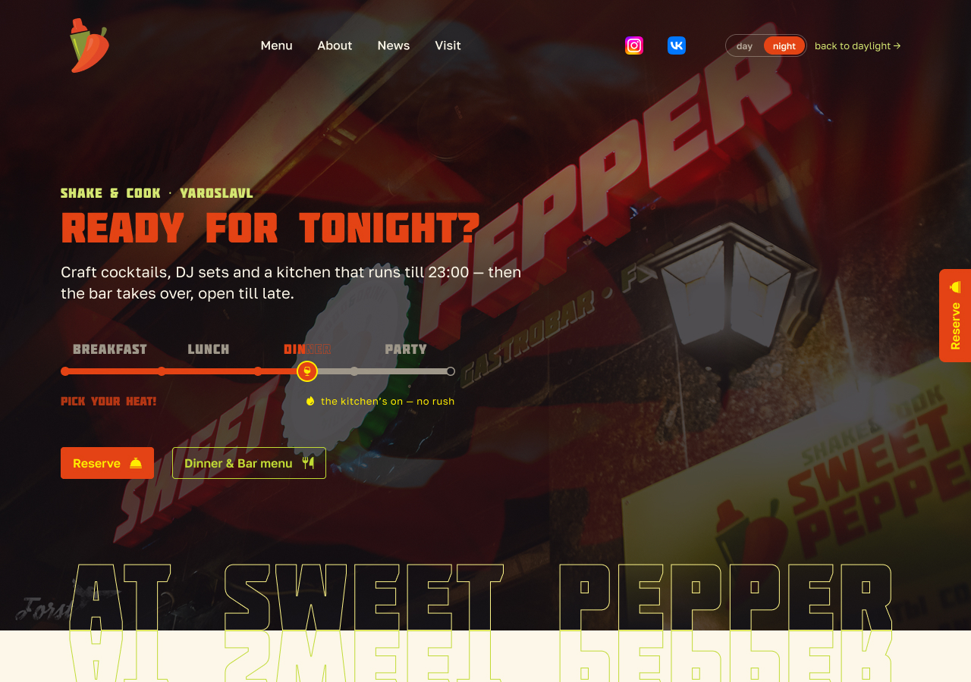
SOLUTION · THE HERO, FINAL FORM
ONE HERO, TWO STATES
The final edit: the heat slider became a visual slider — four photo tiles, one per daypart, at every width. The call was made on evidence: a mobile-first audience (the rail favoured desktop), usability, and A/B results — then refined in the browser, where the cards grew until the selected tile carried the composition.
DAY — "YUMMY MORNING!"
NIGHT — "READY FOR TONIGHT?"
10 / 39

Slide 11
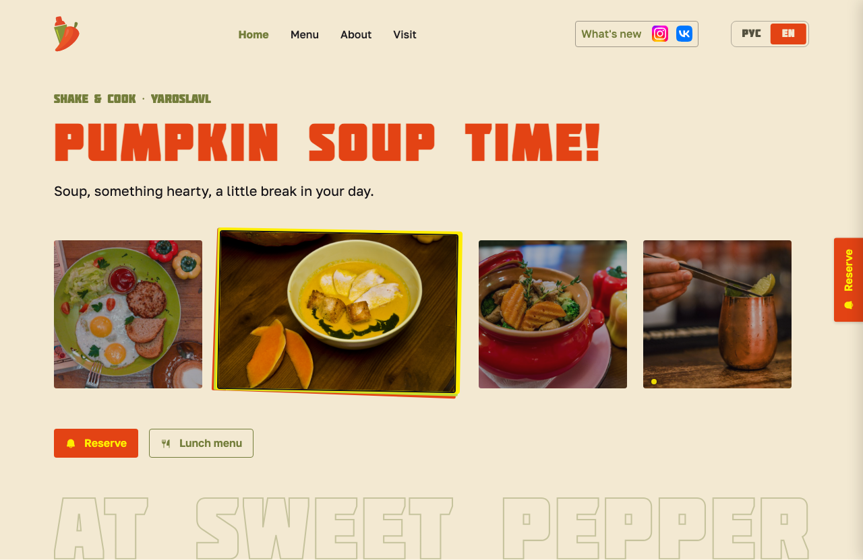
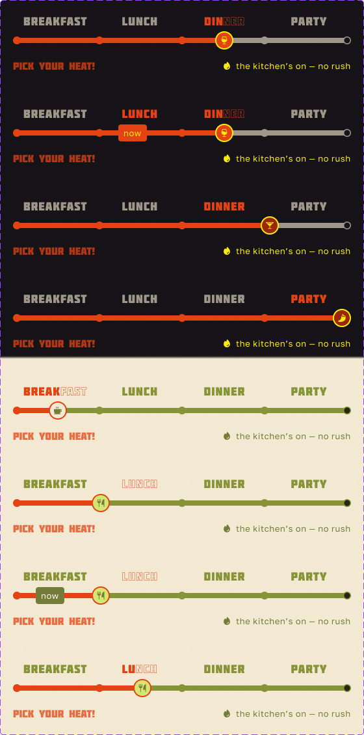
SOLUTION · HEAT CONTROL
A CONTROL THAT TELLS THE TRUTH WITHOUT A CLOCK
A PHOTO PER DAYPART
Each tile is an art-directed photograph — eggs say "morning here" faster than the word BREAKFAST, in both languages at once. The selected tile is the large one: size carries state, so the grid is the scale.
"NOW" IS NEVER LOST
A separate pill marks the real current daypart even while a guest previews another tile — selection and now are two axes, and the peek never overwrites the truth.
ONE STATUS LINE, FOUR MEANINGS
"The kitchen's on — no rush" persists across every state — informative without ever becoming a countdown.
Sweet Pepper — Brand & UX Case Study
11 / 39

Slide 12
PROCESS · AI-ASSISTED PROTOTYPING
SIX WAYS TO FEEL THE HEAT
Before locking the shipped interaction, I used Claude to rapid-prototype six divergent, fully-interactive variants of the heat slider in one afternoon — each pressure-testing a different way to express "heat = time" against the existing brand and hospitality rules.
1A · EMBER GRADIENT
1B · PROPORTIONAL SEGMENTS
1C · HOUR RULER
Fill heats up left→right (olive → paprika → chili) — heat read purely through color temperature.
Four bars sized to real opening-hour spans, not equal quarters — an honest hours-of-operation gauge.
Literal tick marks, 07→02, with a live "HH:MM · daypart" readout above the thumb.
1D · TYPE SCRUBBER
1E · MATCHSTICK BURN
1F · STATUS CARD
LUNCH
DINNER
PARTY
Dinner & Bar →
The daypart words ARE the UI: past = solid, active = chili, future = faint outline-only.
Five-stop ember gradient (near-black → rust → chili → yellow tip) with a glowing flame thumb.
Slider shrinks to a thin scrubber beneath a dashboard readout: "Right now · time", big daypart word, CTA pill.
Sweet Pepper — Brand & UX Case Study
12 / 39

Slide 13
PROCESS · JUDGMENT CALL
PROTOTYPING FAST DOESN'T MEAN ACCEPTING FAST
KEEP
PARK OR REJECT
1d's label transition
1c's hour ruler
Matches the shipped spec exactly (solid → chili → outline) — good validation that the documented rule already reads correctly to an outside model.
Reads great, but it reintroduces the literal clock the no-clock rule exists to prevent. Rejected on principle, not on execution.
The separate "now" marker
1e's matchstick gradient
Confirmed as the right call; toggling it on/off made it obvious how much the "peek, don't switch" idea depends on that marker never disappearing.
Beautiful, but its rust/near-black stops sit outside the three-hue-ramp rule — would need rebuilding from existing chili-ramp tokens to stay compliant.
1b's real-hours segments
1f's status-card layout
A more honest metaphor than four equal quarters — strong candidate to fold into the next iteration of the shipped slider.
A strong pattern, but de-emphasizing the slider undercuts the "one control, three jobs" mechanic. Parked for a possible inner page, not the hero.
Sweet Pepper — Brand & UX Case Study
13 / 39

Slide 14
PROCESS · HERO, ROUND TWO
THE MECHANIC OUTLIVED THE WIDGET
A PARTICIPANT SAID "TOO COMPLICATED"
COSTS RECORDED HONESTLY
Fairly: the slider rail carried four labels, a knob, a now-marker, a status line and an instruction — six pieces of chrome for one fact. Tested against alternatives, a four-tile photo grid won: a photograph of eggs says “morning here” faster than the word BREAKFAST, in both languages at once.
Sixteen art-directed photos instead of four, maintained by the team; the all-day story less visible at a glance (mitigations noted, not built). Layering stays desktop-only — at mobile sizes a 4px sheet offset reads as print misregistration, not depth.
HEAT = TIME SURVIVED
Now settled at every width: the visual slider is the hero, chosen on responsiveness, usability and A/B results — and finished in the browser rather than Figma, where the cards grew until the selected tile carried the composition.
The state model, the status-line matrix and the day/night flip all carry over — tapping a dinner tile darkens the site. Size carries selection (the grid is the scale); the NOW pip stays independent of selection — the slider’s two axes intact. No auto-revert: time proposes, memory disposes.
Sweet Pepper — Brand & UX Case Study
14 / 39

Slide 15
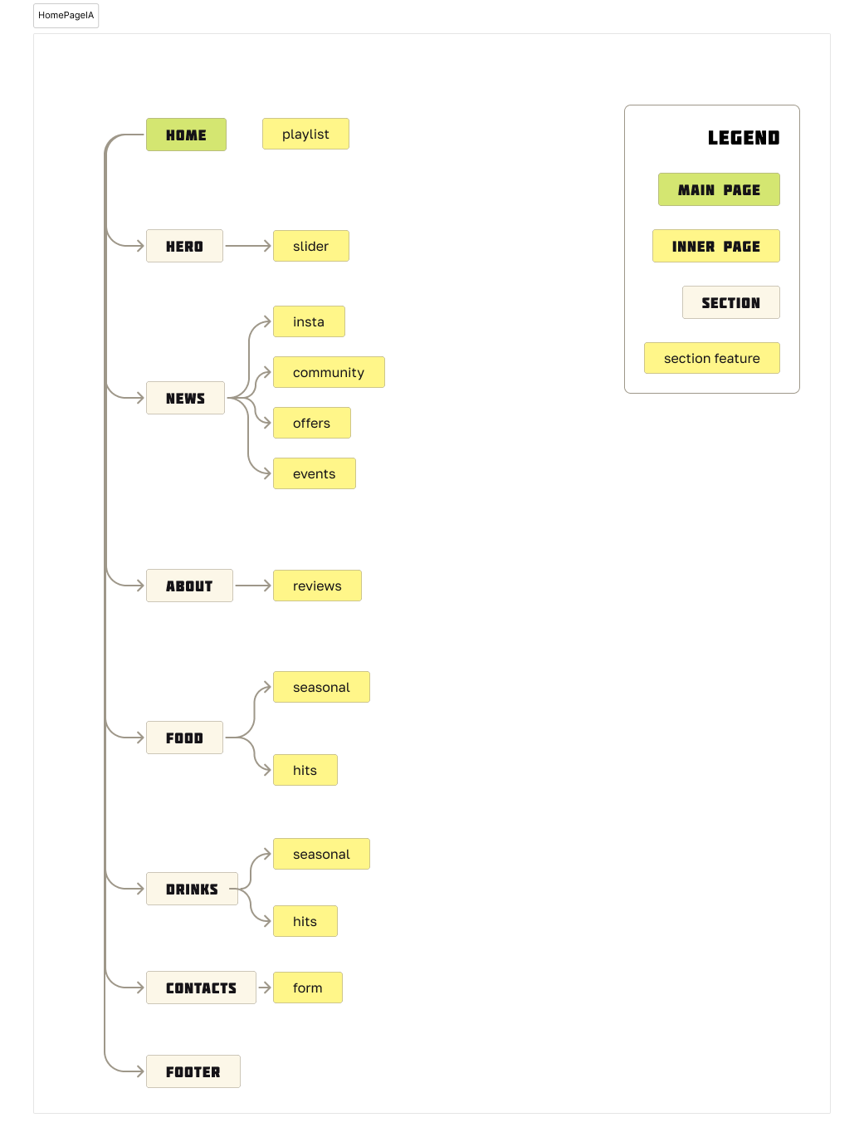
SOLUTION · INFORMATION ARCHITECTURE
THE HERO WAS NEVER THE WHOLE PAGE
With the hero mechanic proven, the homepage grew to its full shape: seven sections carrying the brand's actual content priorities, mapped before layout began.
1
Hero — the spice slider
2
Community Hits — permanent-by-guest-demand menu items
3
Home Made Infusions — the bar's signature craft proof
4
Seasonal Kitchen Menu — the food's quiet-retention story
5
The Pepper Story — About-page teaser
6
News, Parties, Promos — manual social feed mirror
7
Find Us — map, reservation form, hours, footer
Sweet Pepper — Brand & UX Case Study
15 / 39

Slide 16
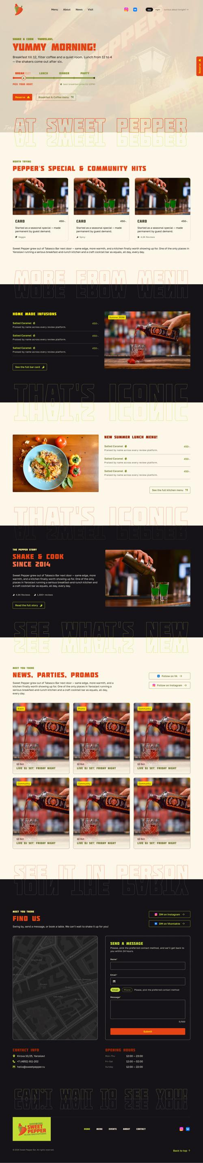
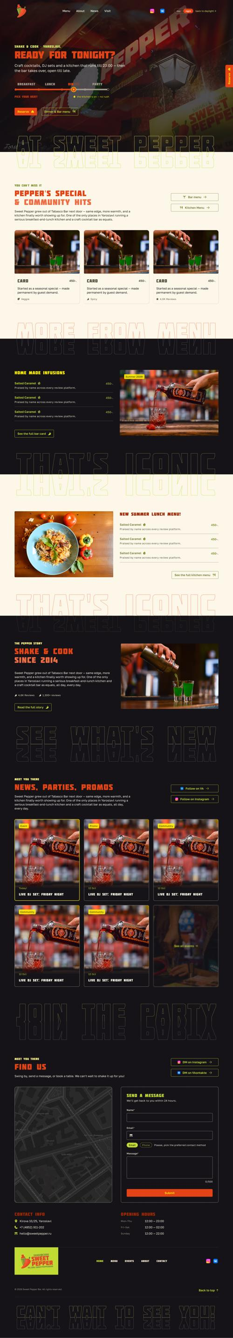
SOLUTION · LAYOUT RHYTHM
SAME SECTIONS, TWO RHYTHMS
Day alternates cleanly — light/dark down the page, one Lemon band as the single colour-block moment. Saturated hues stay banners, never full-page surfaces.
Night doesn’t checkerboard — it commits to darkness, accents glowing out of shared dark. Long dark runs break with a new Soft Peppercorn token (texture without contrast); one bright section stays as the mid-page point of light. Contact sits dark in both — the wind-down zone at any hour.
DAY
NIGHT

Slide 17
SOLUTION · MENU PAGE
TESTED, NOT GUESSED
WON — SIDE-NAV POSTER
RETIRED — BUT PAYING RENT
All sections visible at once
The carousel / ticker hero
Won stakeholder A/B + usability testing on the page’s stated KPI — time-to-dish. A Parchment nav panel merges into the content it navigates; photos stack on tilted Lemon + Chili sheets.
A loop re-reads the list one word at a time; the side-nav shows it all at once. Survives only as a display motif — scrolling text never means two things on one page.
Two independent axes
The split-screen hero
Content state (food/drinks) × theme (day/night) never lock — kitchen content at 9pm is kitchen content in night clothes. Time proposes, memory disposes.
Lost as a layout, but its seam sweep is the candidate transition when guests cross between menus through the door.
Soups: a separate section
Seasonal as a section
Testing showed guests could find soups under Hot dishes but agreed they don’t belong there — an accepted, documented web↔print divergence.
Years of separate seasonal print pieces underperformed integrated dishes — seasonal became a tag with a Lime badge feeding a query-driven rail.
Sweet Pepper — Brand & UX Case Study
17 / 39

Slide 18
SOLUTION · SIGNATURE COMPONENTS
THE INTERFACE ANSWERS LIKE THE BAR
THE BARTENDER'S TICKET
DOORS — THE THIRD TAPPABLE STYLE
An order slip the interface “prints” to answer the guest — the kitchen–bar handshake made tangible. Always Paper, day or night (a receipt is paper regardless of the hour), so on dark grounds it’s the brightest object in view: max one per viewport. The reply is always a person speaking, never a template.
A Molot word standing on a small tilted block with an always-visible arrow — used only to cross between the food and drinks menus. Nothing else may be door-shaped; the closed vocabulary grew by exactly one, under the same discipline.
ONE MOTION LANGUAGE
DRINKS exits with →, FOOD returns with ← — direction encodes the room metaphor site-wide. Once the hero scrolls away, an edge tab slides the same nav panel back in: the hero’s column returning, not a new mechanic to learn.
Outline → fill is the one state change everywhere — slider labels, nav words, the word cloud. One idle clock per section: untouched sections demo themselves; any interaction seizes the clock. Spring easing, transforms only; reduced-motion keeps state changes and drops the theatre.
Sweet Pepper — Brand & UX Case Study
18 / 39

Slide 19
SOLUTION · VISIT PAGE
THREE ANXIETIES, IN ORDER
OPEN NOW → FIND YOU → GET A SEAT
TWO-SPEED CONTACT & THE MAP
The page answers the three anxieties in that order; everything else is a chip. It’s the one page where the clock works for the guest — the documented service-page exemption to the no-clock rule. The hero is a bartender’s ticket printing today’s status.
Fast lane (phone, DM) for tables; slow lane (form + email) for feedback — the founder’s reasoning: a guest with a channel to complain is a guest whose issue can be resolved. The form is styled to never look like the booking path.
JOURNEY / STAY — ONE SOURCE, TWO PAGES
The map, decided twice. First Yandex: Google’s free embed is single-pin and its Yaroslavl data looked weak. The build overturned it on evidence — only Google My Maps carries the custom walking routes, and the team confirmed from Russia that it loads. One Google map now; Yandex and 2GIS a chip away.
House facts live in one ACF repeater: if a fact affects the journey to the door it renders on Visit; if it affects the stay, on About. Two registers, one source — never a copied section.
Sweet Pepper — Brand & UX Case Study
19 / 39

Slide 20
SOLUTION · CONTENT SYSTEM
STATUS LINES: COPY AS A SYSTEM
THE MATRIX
THE DISCIPLINE
Four stops × five states
Clockless numerals
Beginning, full swing, last call, off-hours — plus closed on the edge stops only. Every line follows one format: [fact] — [reassurance/wink]. "lunch till 4 — no rush."
"till 12", "till 4", "1:30" — never AM/PM. Exact times only where anxiety is real. The no-clock rule survives contact with an actual schedule.
"Closed" is never a fifth stop
16 variants, not 80
The scale enumerates offers, and closed isn’t one. Overnight the knob parks on the next open door — the site points forward, never at a dark room.
Only stop × mode × marker are Figma variants; every status line is a text prop. The copy matrix never explodes the component set.
Weekends rewrite the second stop
A testing log with predictions
LUNCH becomes BRUNCH from the same ACF hours source. No brunch menu exists — the copy frames it as generosity: "the brunch menu is the whole menu — that’s the deal."
testing.md records every open question with a prediction before the test runs — and labels what was user-tested versus decided on other evidence.
Sweet Pepper — Brand & UX Case Study
20 / 39

Slide 21
SOLUTION · MOBILE
SAME RULES, ONE HAND
THE DRAWER
FINDINGS ON RECORD
Four nav items collapse into a full-screen drawer that themes by time like every surface — Molot items with guest-voice descriptions, outline → fill marking “you are here” (readable in greyscale; colour never carries state alone), and a booking block where phone leads: Russian guests book by call.
Reserve’s right-edge tab doesn’t survive a 390px screen. Three placements tried and rejected — edge tab, floating button, persistent nav button — each failure written down so the ground is never re-covered. Built that way: no persistent Reserve on mobile at all.
TOUCH SPLITS PREVIEW FROM COMMIT
Rules get amended in daylight, not violated quietly: the “never a pill” caption ban was narrowed to what it actually meant, and scrolling text was restated as never-navigation, one job per page, when the Visit status rail gave it a second legitimate use.
The menu hero’s no-CTA rule turned out to be scoped to pointer input: hover and click are two channels, touch has one — a word can’t be both preview and commit. On touch, tapping a word previews and a boxed action commits; the active word drops its arrow, because on touch it isn’t the action.
Sweet Pepper — Brand & UX Case Study
21 / 39

Slide 22
SOLUTION · CONTENT STRATEGY
WRITING THE STORY, NOT INVENTING IT
Drafted, then restructured, the full About page. Final arc: Hero → Story → Concept → Mission → People → Recognition → Location → Careers → Visit — all sourced from research and founder interviews; nothing invented beyond phrasing.
OUR STORY
SHAKE & COOK SINCE 2014
FROM TABASCO TO SWEET PEPPER
Sweet Pepper grew out of Tabasco Bar next door — same edge, more warmth, and a kitchen finally worth showing up for. Regulars don't come for one or the other — they come because the team knows their name and their order.
Founding story — the name as a deliberate softening, kept edge plus added food
FIFTY-FIFTY, ON PURPOSE
The kitchen/bar split, with pumpkin soup and berry cheesecake as guest-elected proof
THE PEOPLE — THE CENTERPIECE
4.6★ · 1,300+ reviews — Est. 2014 — Kirova St. 10
Team and Our Guests as equal halves — a structural rhyme with the 50/50 concept; guests tease a photo-library page
"Every time I fall into a slump after studying, I come here and remember why life is worth living." — Google review
THE STORY GOT A FACE
Founder Iurii Primyshev credited with photo + quote; “How it feels” — a word cloud of guests’ own review words — replaced the stats banner
Sweet Pepper — Brand & UX Case Study
22 / 39

Slide 23
SOLUTION · INTERACTION RULES
A CLOSED VOCABULARY FOR "TAP ME"
A loud, playful brand risks every piece of text looking clickable. The fix: a strict, closed vocabulary — two styles at first; the menu door was admitted later as the third, under the same discipline.
Reserve
Open menu →
Name
BUTTONS
CHIPS
(optional)
Golos SemiBold 16, primary actions only.
Golos Medium 13, icon/arrow, secondary actions.
FORM LABEL / HINT — NEW
A dedicated group added this pass so Caption stays scoped to captions and fine print.
Non-interactive text never borrows these styles. Expressive copy ("Pick your heat!") stays in Molot. And in mixed rows, Chili is reserved for the action — heat means "act," content chips stay lime.
Accessibility note: Chili on Peppercorn measures ~3.4:1 — fine for large Molot headlines, but fails small text. Small accent text on dark surfaces uses Paprika or Lemon instead.
Sweet Pepper — Brand & UX Case Study
23 / 39

Slide 24
SOLUTION · SYSTEMIZED FURTHER
A GRID AND AN IMAGE SYSTEM, NOT PER-PAGE GUESSING
GRID
IMAGE RATIOS
1120px content width, 12 columns, 24px gutter. Body copy caps at 6 of 12 columns on desktop — even in full-bleed sections — set by column count, not word count, so it stays predictable regardless of what copy lands in it.
Leftover columns always get a job: short teasers pair with a stat or pull-quote; long-form splits into two reading columns instead of one narrow column plus dead space.
3:2
Default for art-directed photography — menu items, drinks, hero, events.
2:3
Portrait counterpart; fixed across breakpoints, not stretched on mobile.
1:1
Square, general use.
21:9
Cinematic full-bleed banners — wide environment shots only.
4:5
News/social cards — matches Instagram's own crop norm.
Excluded: 16:9 and 9:16. Added later by job: 4:1 divider bands for dense pages — the system grows when a content job appears, never per breakpoint.
Sweet Pepper — Brand & UX Case Study
24 / 39

Slide 25
SOLUTION · PLATFORM & CONTENT OPS
A CONSTRAINT NO MOODBOARD WOULD SHOW YOU
WHY NOT WEBFLOW
CONTENT OPS: LAUNCH SMALL, PHASE UP
Webflow is a US company bound by OFAC sanctions: it can't serve Russian accounts or payments, and Webflow-hosted sites don't reliably reach visitors physically in Russia. For a Yaroslavl gastrobar, that's not a technicality — it's the site not loading for its own guests.
The News page is deferred at launch entirely — no dead nav items, zero API dependencies, and the team learns WordPress on low-stakes content first. Phase 2 adds manual News cards: pasting posts the team already writes for VK/Instagram costs seconds.
THE CALL
Phase 3, as built: the VK importer runs hourly by itself on the Russian page. The planned Instagram proxy was withdrawn on the lawyer’s advice — Instagram shows only outside Russia, as hand-picked cards on the English page. Never a live embed.
Self-hosted WordPress + a fully custom hand-coded theme + Advanced Custom Fields — in the build its free fork, SCF: same field API, no licence tied to a foreign card. No foreign vendor in the loop, hostable anywhere including Russia, and the fields scope day-to-day editing to the team without exposing the layout to breakage.
Sweet Pepper — Brand & UX Case Study
25 / 39

Slide 26
SOLUTION · STACK
THE STACK IS CLOSED
CLASSIC PHP, THIN ON PURPOSE
REJECTIONS RECORDED, NOT REOPENED
A classic theme, not a block theme — the team edits content, never layout. PHP is a data layer: templates hold “a loop, an if, and holes”; everything carrying the design lives in CSS and JS. The daypart engine is client-side by necessity — a page cache would serve the wrong hour. Vite compiles tokens straight from design.md.
Headless: Next outright (React plus a US host for a site of text and photographs). Astro was the credible one — but two systems to maintain, rebuild-gated content edits, and handover narrowing to the author permanently. The Astro appetite goes to the case-study site instead.
FOUR PLUGINS, IN WRITING
Tilda: rejected on the design, not the politics — no token layer for day/night, no content model for tagged dishes, and the three tappable grammars stop being structurally enforceable, block by block, until they drift.
Custom fields (SCF), a page cache, backups — and a slot freed in writing: Polylang, displaced when one theme file took over the two-language routing. Anything proposed later must displace one. No page builder. The 2016 failure mode wasn’t one bad plugin — it was the absence of a rule about adding them.
Sweet Pepper — Brand & UX Case Study
26 / 39

Slide 27
PROCESS · SELF-AUDIT
RECOMPUTE YOUR OWN CLAIMS
FOUND — NOW ON THE FIX LIST
THE DISCIPLINE
The interaction rule was false
Findings only, nothing changed
“Exactly three tappable styles” forbade five things already designed — tiles, stamps, the word cloud. Fix: a closed, sanctioned exception list. The value was never the number; it’s the list being closed.
Eleven files cross-checked; where documents disagree, both sides are named and the current one identified. The calls stay the author’s — the audit changed no doc silently.
The price colour fails AA
Numbers re-derived, not trusted
Olive prices on Parchment measure 3.68:1 in exactly the small-text menu rows they were assigned to. A token decision — Deep Chili or a darker green step — queued before any CSS variable is written.
Contrast ratios and colour-vision claims recomputed from the hex values per the project’s own standing instruction — the tables had drifted from the math.
“Colour-blind safe” wasn’t
A work order, not a report card
Under protanopia, Chili and Olive — day’s two accents, adjacent on every menu row — collapse from ΔE 78 to 10. The claim narrows to what’s testable: no colour carries meaning alone.
A-items would ship bugs or wrong guest-facing facts; B-items block specific build phases; C is hygiene — and one section lists what came back clean, so the rest can still be trusted.
Sweet Pepper — Brand & UX Case Study
27 / 39

Slide 28
SOLUTION · BUILD
THE SPEC BECOMES CODE
A CLASSIC THEME, RUNNING
THE AUDIT PAID OFF FIRST
A classic WordPress theme runs locally with Vite compiling tokens straight from design.md. The day/night mechanic, the tile-grid hero, the side-nav menu hero and its doors, nine food sections plus the bar menu, and the rugged-edge ticket all exist as working template parts.
The A-list ran ahead of the first line of CSS: the interaction-rule exception list and the token decisions landed before variables.css was written, not after bugs shipped.
DOCS AS THE INTERFACE
The report captures each component’s states and dimensions as it’s built, so any future chat — or any freelancer in Yaroslavl — inherits a working spec, exactly the handover the stack decision was made for.
The theme is built one chat per section, steered by files rather than chat history: a living project report whose first line is “read this before writing any code,” agent briefs, and subagents. Git pushes go through Claude Code — every session starts from current truth, not archaeology.
Sweet Pepper — Brand & UX Case Study
28 / 39

Slide 29
SOLUTION · STYLE GUIDE
THE SYSTEM SHIPS AS A PRODUCT
ONE FILE, TWO LANGUAGES
THE GUIDE OBEYS ITS OWN SYSTEM
Live on the bar’s domain: a single-file bilingual guide — EN and RU as layers with a language switch — an app-style mobile shell under 768px, and A4 PDFs (EN 27pp, RU 30pp) from a scripted render pipeline. An in-page edit mode commits text fixes straight to the repo from the live page.
Every margin, padding and gap snapped to a 4px grid by a checker script — 340 values. Where the guide and design.md disagree, the guide is the one that’s wrong; open questions live in the working docs, never in the audience-facing artefact.
IF A RULE GETS MISSED, DRAW IT
One rule was amended in daylight along the way: social icons are the official full-colour marks — they’re contacts, not supporting icons. The earlier single-colour rule was a misreading of the source, corrected everywhere in one pass.
The logo clear-space rule existed in text and a teammate missed it — so it became a drawn four-card figure, constructed at load time from the artwork itself, exact even if a logo is swapped. Documentation failures are design problems, not reader problems.
Sweet Pepper — Brand & UX Case Study
29 / 39

Slide 30
SOLUTION · LIVING CONTENT
SYSTEMS THAT OUTLIVE LAUNCH DAY
“HOW IT FEELS” — THE PIPELINE
THE PEPPER STORY — FOUR STUDIES
No live API, again
One deliberately wrong
The review word-cloud runs on a periodic tally plus curated quotes — the same call as the News feed, for the same reasons. Zero platform dependencies at launch.
The studies included a rule-breaking candidate on purpose — a giant live-ticking Molot numeral in a Lemon band — per the standing agent brief: offer the option that breaks a rule, argue whether it earns the exception.
A written admission rule
The heat line won
The quote wheel caps at 12 cards; each update admits up to three — only quotes that add a word or beat a sitting card — and every admission retires the oldest.
The timeline joins the outline → fill grammar the site already speaks — heat travels the line as the story advances. A new section arrived without a new vocabulary.
An auditable ledger
Studies, then build
Every card carries platform, date and link; the ledger records added and retired dates, so the wheel’s history can be checked years from now.
Four desktop studies on one canvas, one pick, built the same day. Divergence stays cheap when the closed system does the converging.
Sweet Pepper — Brand & UX Case Study
30 / 39

Slide 31
SOLUTION · CONTENT MODEL
WHO EDITS WHAT
THREE TIERS, ONE ANSWER
TEMPTATIONS, SCORED IN ADVANCE
Rows (menu, hours, quotes) live in the WordPress admin; prose (the story, hero leads) in ACF fields with the block editor off; structure — section order, ratios, the daypart engine — is code, never editable. Sorting by content type dissolved the “do I need a Webflow-like editor?” worry.
A page-builder rebuild of About runs as a side experiment in a separate install — judged against criteria written down before it started. Testing a temptation properly beats resisting it forever.
THE EDITOR IS A LAYER, NOT A STORE
Languages: “one document, two languages” — one page per template, PHP rendering one language per request, / in Russian and /en/ in English. Pinned to a real extraction rather than decided in the abstract — and the extraction settled it: no plugin.
A bespoke keyed store was dropped: ACF is the store, and an in-place editor — a port of the style guide’s — is a later layer over the same fields, built only if the admin form annoys the team. The 239 hardcoded dish rows are already structured data; migration is a script, not a rewrite.
Sweet Pepper — Brand & UX Case Study
31 / 39

Slide 32
SOLUTION · RESPONSIVE
THE BAND BETWEEN PHONE AND DESKTOP
RULES THAT BEND, ON RECORD
WORDS GET THE SAME RIGOR
Tablets get the phone bento — by height
Copy reviews state their evidence
In the 768–991 band the desktop row read as thumbnails. The phone bento returns, guarded by min-height 1000px — a narrowed desktop window keeps the row. In practice, the band is portrait tablets.
The Menu and Visit copy passes open by declaring what was and wasn’t inspected — “no live Figma inspection is claimed.” The audit’s honesty rules, applied to copywriting.
The gutter ramps; the grid holds
And they catch real bugs
The page gutter became one fluid clamp; its off-grid values got a written carve-out from the 4px rule — nothing aligns against a page margin. A rounding variant was built and rejected: one 111px cliff traded for fourteen 8px sawteeth.
The review found a shipped row reading “Horseraddish” with the literal word “description” as its copy — corrected in the clean files and flagged for the implementation pass, not hot-fixed.
Five recurring faults, catalogued
The RU layer begins
The pass closed by writing down the five responsive faults that kept recurring — the testing-log move again: record the pattern, stop re-finding it.
Russian drafts run as register twins, never translations — «Для смелых — Ярославль с огоньком» carries the wink of “For the brave — a taste of Yaroslavl’s hot side,” not its words.
Sweet Pepper — Brand & UX Case Study
32 / 39

Slide 33
SOLUTION · RU LAYER & CONTENT OPS
SHIPPING IN TWO LANGUAGES
A VOICE, NOT A TRANSLATION
CONTENT OPS, TESTED FOR REAL
The Russian layer is a system
The admin got usability-tested too
A voice-and-vocabulary doc distils the bar’s own social-media voice into checkable rules, with a per-line test for new copy. RU and EN stay register twins — the wink carries over, never the words.
Menu storage — repeater vs dish posts — tested with two team members on the real WordPress admin. Dish posts won; the prediction on record lost, and the log admits it. The loser is archived, not deleted.
A contradiction, held openly
The VK importer, evidence first
The guest-perspective rule and the venue’s natural «мы» collide harder in Russian than in English. The voice doc records the tension where future drafts can see it, instead of resolving it by fiat.
Built with an evidence table before any live run: re-imports idempotent, hand edits surviving source edits, images self-hosted at 4:5. It now runs hourly by itself. EN stays manual — the languages never share a pipeline dependency.
Even the display layer is bilingual
Keys treated like keys
The giant outlined Molot connectors exist as separately drawn RU SVGs for every section — built for the language, not string-swapped.
An exposed credential was revoked and replaced the day it happened; failures are logged without secrets in a status line the team can actually read.
Sweet Pepper — Brand & UX Case Study
33 / 39

Slide 34
SOLUTION · LAUNCH READINESS
THE LAW IS A DESIGN CONSTRAINT
A LAWYER AND A STATUTE
ONE ADDRESS PER LANGUAGE
Instagram only outside Russia
The routing is one file, not a plugin
On the lawyer’s advice the Russian page never shows it and the English page hides it from Russian IPs — chips, drawers, contact rows, even the structured data. The planned proxy was withdrawn, not built.
Russian at /, English at /en/; one record with a RU/EN twin per text, one language per request, hreflang for the twin. Polylang’s slot was freed, in writing.
Maps wait for a choice
The browser proposes, a tap is remembered
The server renders the address instead of an iframe; a yes lasts 180 days and can be revoked from the footer. One exception — US and Canadian visitors to the English page — is on record with the advice against it.
The choice runs in the guest’s browser, so a cached page stays the same for everyone. The switch is one fill travelling between two codes — outline → fill by a single moving block.
Consent, in both languages
No nonce, on purpose
Forms carry a consent checkbox and a consent page, beside a published privacy policy with the operator’s registration confirmed.
One REST route, no plugin. A nonce baked into a cached page goes stale within a day and would turn away real guests — a honeypot, a fill-time floor and a rate limit do the job.
Sweet Pepper — Brand & UX Case Study
34 / 39

Slide 35
PROCESS · THE LAST PHASE
THE SLIDER COMES BACK — AS THE WAIT
THE RETIRED SLIDER RETURNS
THE BROWSER AS DRAWING BOARD
Heat rising is the whole task
Contact sheet → flag → default
The page loader: the knob moves through breakfast, lunch, dinner and party, the wordmark heats to Chili, the page arrives with «Подано!» — “Served!”. Shown only if a navigation is still pending after 700 ms.
Options are mocked on the live page as one contact sheet — always one that breaks a rule. Survivors become code behind a URL flag; the loser stays behind its flag until a real device has voted.
An honest creep
Motion converged on one curve
No real progress exists to report, so the knob runs on a curve built to never arrive. The lines under it are the team’s own — “Waking the hungover bartender” — editable in admin.
The build had kept the Figma spring’s 800 ms and lost its attack — hovers ran at half the prototype’s speed. The Gentle spring is now the one curve for movement and colour.
A replay knows its end
The audit ran again, on the rendered site
A tester tried to drag the knob, so the footer replay became a toy. Measured, it had borrowed the real wait’s curve: 7 s to “Served!”. Now its own curve — 3.3 s, the close button there from the start.
Ten pages, 63 media items: no alt text in the library, 60–90 icons per page exposed to screen readers, connector words read twice. Fixed at the source, in both languages.
Sweet Pepper — Brand & UX Case Study
35 / 39

Slide 36
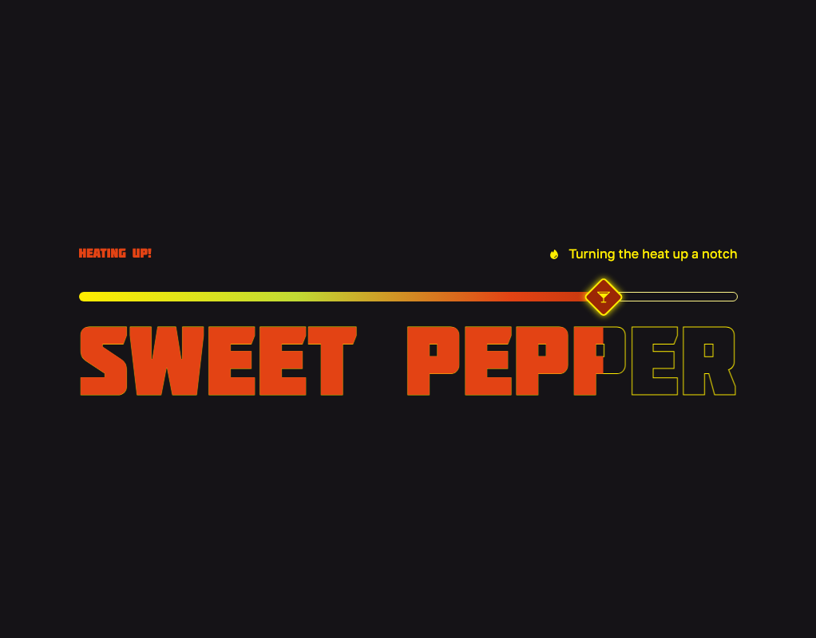
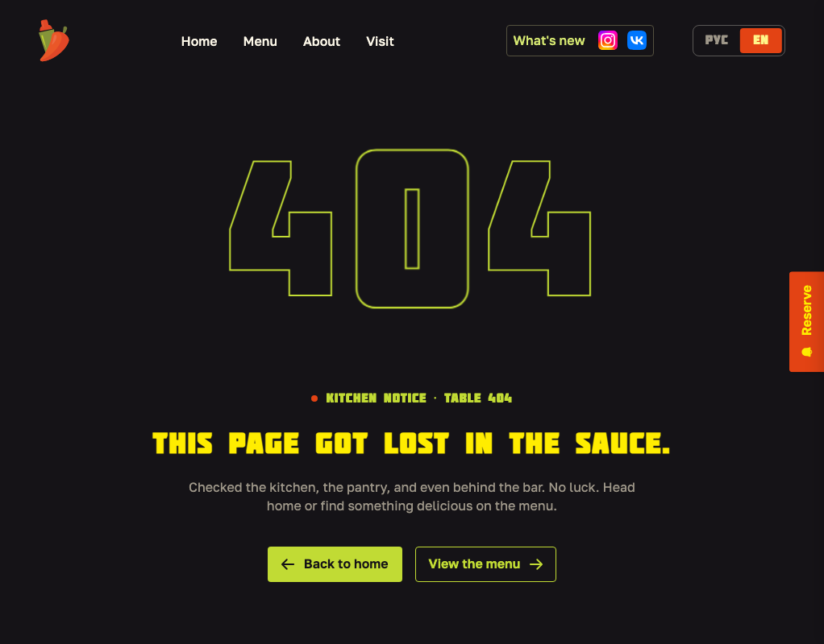
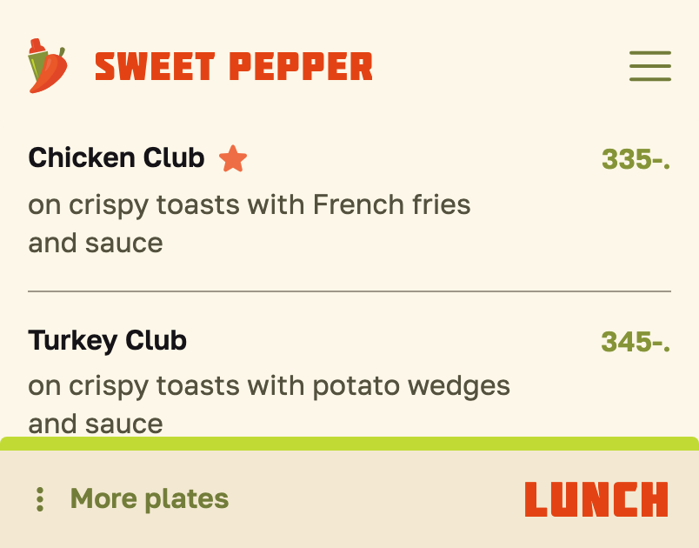
PROCESS · THE LAST PHASE, ON SCREEN
SHOWN AS BUILT, NOT AS DRAWN
Three screens from the running site, October 2026. Each was worked out in the browser — options on the live page, a URL flag, then a default; the real-device verdicts are still open.
PAGE LOADER — HEAT AS THE WAIT
404 — LOST IN THE SAUCE
PHONE MENU — A BAR AT THE FOOT
The retired heat slider as the screen between pages: the knob creeps, the wordmark heats, the team’s own lines run above it.
My Figma draft plus five other directions on one contact sheet; three were built behind a flag, and the choice between two is still open.
Ten options on one sheet. The bar opens the section list and names where you are; the sticky rail it replaced waits behind a flag.
Sweet Pepper — Brand & UX Case Study
36 / 39

Slide 37
WHERE IT STANDS
THE SITE IS UP. CHECKS REMAIN.
DONE
NEXT
Design system validated; palette pruned (Dark Olive out)
Device verdicts: phone menu bar, 404, loader, lightbox
Style guide live: bilingual HTML, mobile shell, PDFs, edit mode
Page cache, then open to search engines; analytics
All pages, both states, RU + EN: phone, tablet band, desktop
Photo-library template; team shoot; founder quote
Heroes, menu storage & the admin all usability-tested
Figma catch-up + guide pages; queued tests; holiday hours
Content model in use: fall menu applied, vacancies, forms
Site on the bar’s domain; VK feed updating itself hourly
Sweet Pepper — Brand & UX Case Study
37 / 39

Slide 38
REFLECTION
WHAT THIS PROJECT TAUGHT ME
SYSTEMIZING BEATS REDESIGNING
CONSTRAINTS FOUND THE IDEA
The strongest move was often restraint — keeping a logo guests already loved and building rules around it, instead of replacing it to prove originality.
The "no-clock" hospitality principle looked like a limitation. It's actually what forced the spice-slider metaphor instead of a literal schedule widget.
THE BEST CALL ISN'T ALWAYS A DESIGN CALL
LOUD COLOR NEEDS MORE RULES, NOT FEWER
Ruling out Webflow had nothing to do with aesthetics — OFAC sanctions would have made the site invisible to its own market. Good UX sometimes means researching infrastructure, not layouts.
A playful, saturated brand doesn't get to skip accessibility — it needs a stricter generative rule (three hue lines) to stay usable at all.
AI ACCELERATES, JUDGMENT CURATES
DEVELOPMENT IS A DESIGN REVIEW
Six working slider prototypes in one afternoon — but half quietly broke a rule the project had earned. The skill wasn't prompting; it was knowing which three to discard.
Building it myself surfaced limitations no mockup shows — caching, touch input, real pixel sizes — and decisions I was attached to had to be reconsidered. What survived the constraints is stronger for it.
Sweet Pepper — Brand & UX Case Study
38 / 39

Slide 39

THANK YOU
Sweet Pepper — Brand & UX Case Study · Etual
etualechka@gmail.com

