Slide 1

Best Ever Alarm System Toolkit
Kay Kasemir,
Xihui Chen,
Katia Danilova
SNS/ORNL
kasemirk@ornl.gov
April, 2013

Slide 2

What is BEAST?
An alarm system that monitors Process Variables (PVs) in a Control System
Effectively help operators take the correct action at the correct time.
Cool UI
Configuration
Alarm Server
Control System

Slide 3
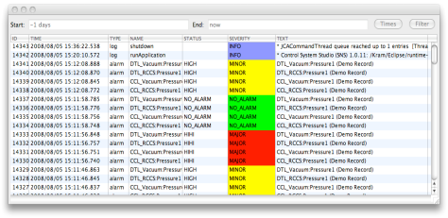
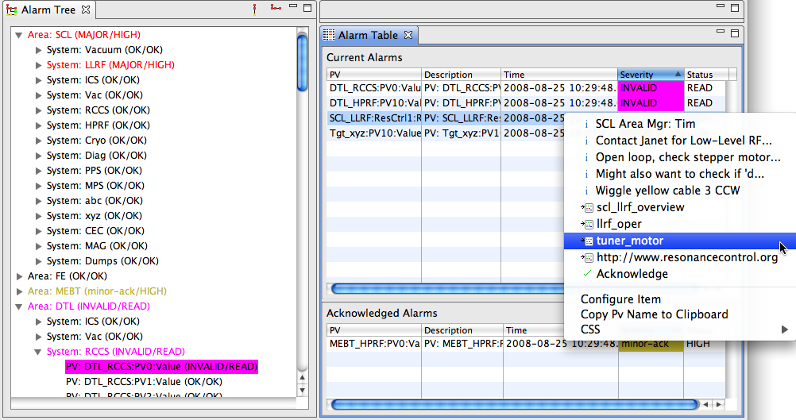
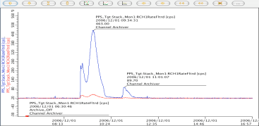
Architecture
IOCs
FECs/IOCs
PV Updates (Channel Access, …)
Alarm Server
Current Alarms: Latched? Annunciated? Acknowledged?
Tomcat
Reports
Log Messages
Annunciations
Alarm Updates
Ack’; Config Updates
JMS
Alarm Cfg & State
RDB
LOG
TALK
ALARM_SERVER
ALARM_CLIENT
JMS to RDB
JMS to Speech
Alarm Client GUI
Message RDB

Slide 4
Levels Of Complexity
Easy
Use the Alarm System
Control Room operator
Configure the Alarm System
Certain operators, IOC engineers
Alarm System Setup
CSS maintainer for site
Coming up with a good configuration
Everybody
Hard

Slide 5
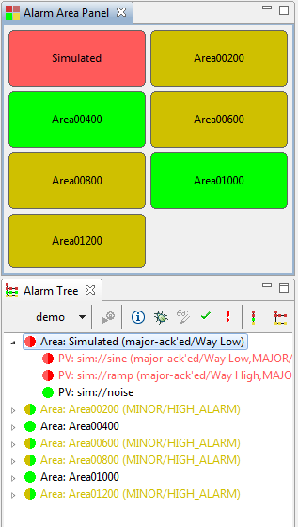
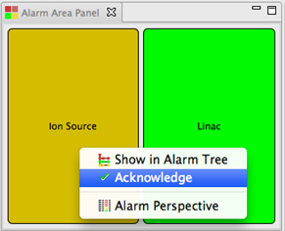
Client GUI: Alarm Area Panel
An overview of all alarm areas
Acknowledge the whole area

Slide 6
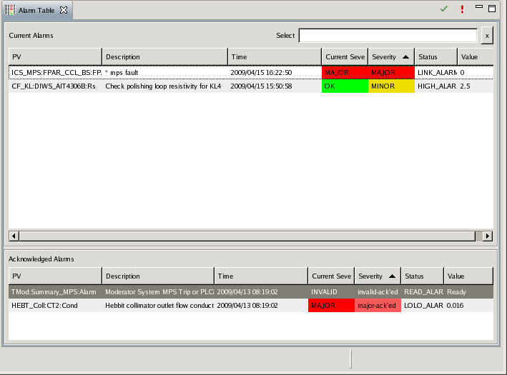

Client GUI: Alarm Table
Acknowledge one or multiple alarms
Select by PV or description
BNL/RHIC type un-ack’
Sort by column
All current alarms
active
ack’ed
Optional: Voice Annunciation

Slide 7
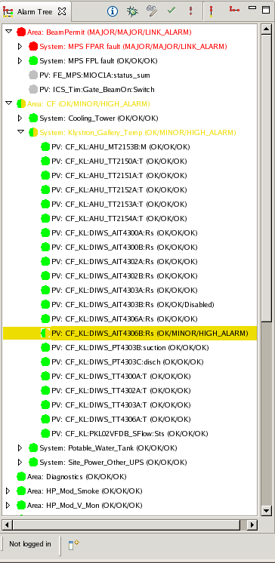
Client GUI: Alarm Tree
See complete configuration
Active, ack’ed, inactive, disabled
Hierarchical
Optionally only show active alarms
Ack’/Un-ack’ PVs or sub-tree

Slide 8
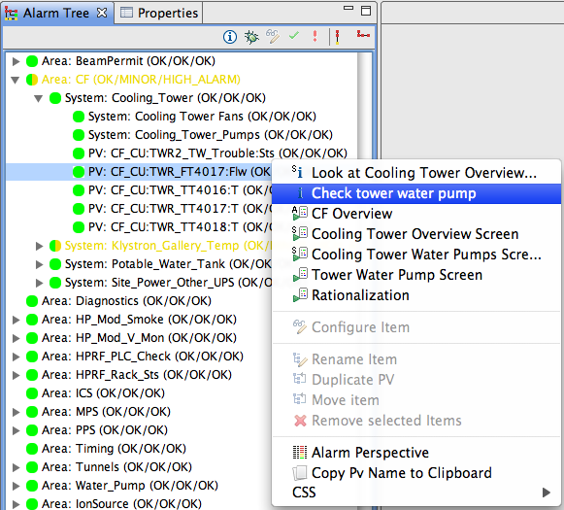
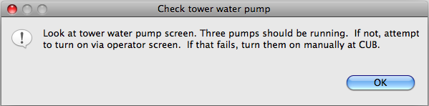
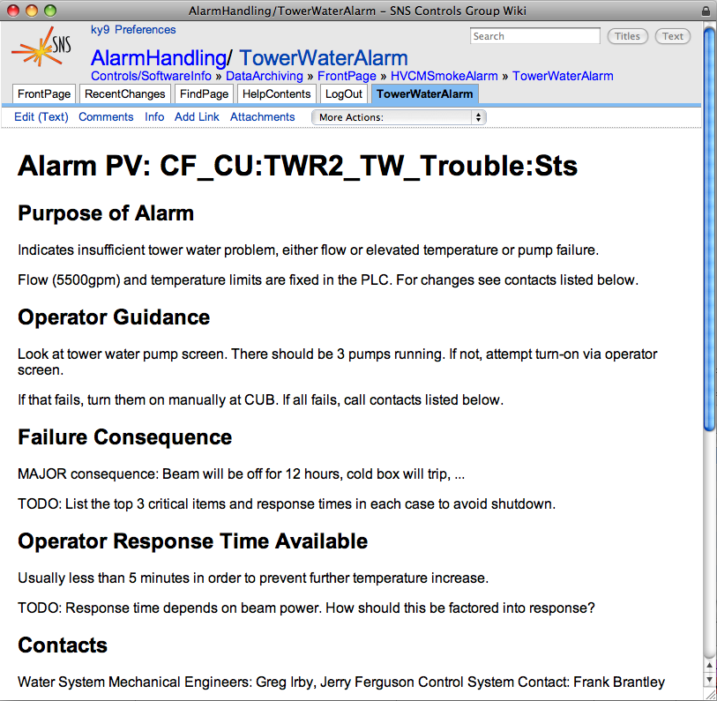
Guidance, Related Displays, Commands
View Guidance Texts
Start related displays (EDM)
Open Web pages
Run ext. commands
Hierarchical: Including info of parent entries
Merges Guidance etc. from all selected alarms

Slide 9
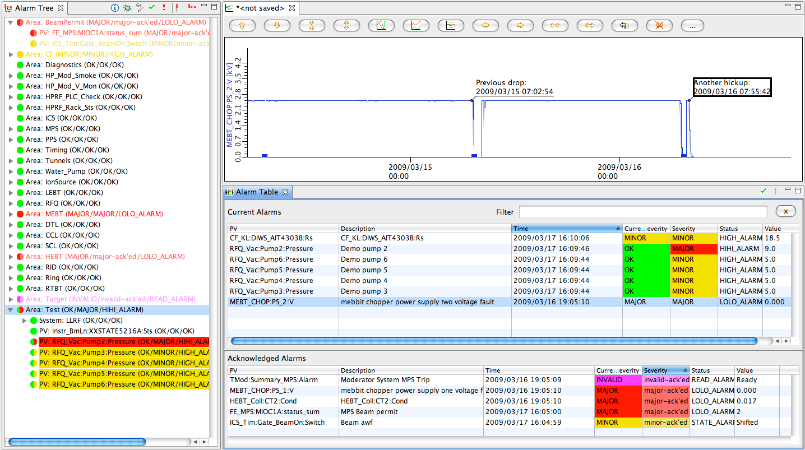
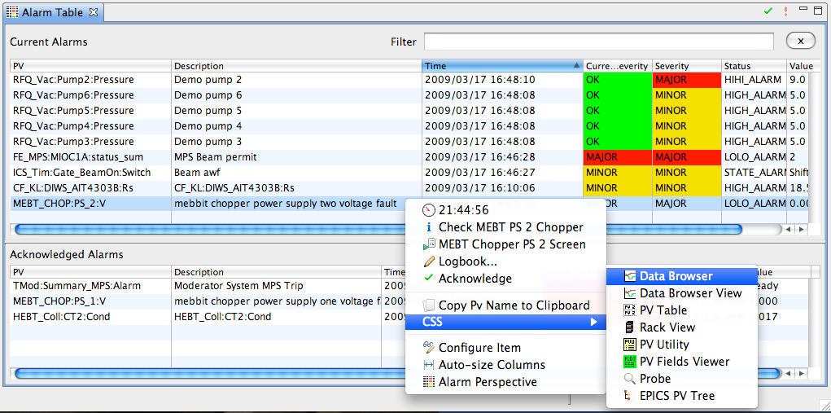
CSS Integration: Alarm ➔ Data Browser
Context menu: Alarm Duration, Guidance, Displays, …
Select Data Browser for PV in alarm
View history, annotate
3
2
1

Slide 10
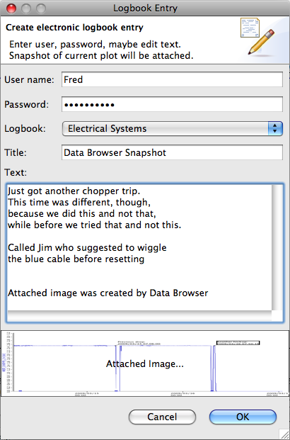
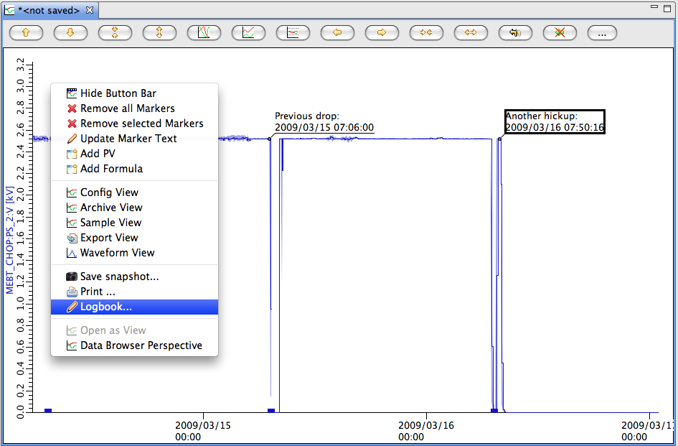
Data Browser ➔ Electronic Logbook
After inspecting alarm PV’s history, post commented plot to E-Log

Slide 11
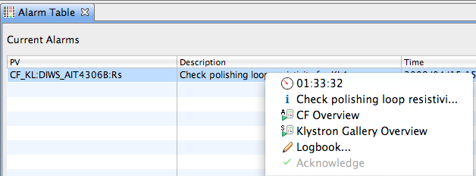
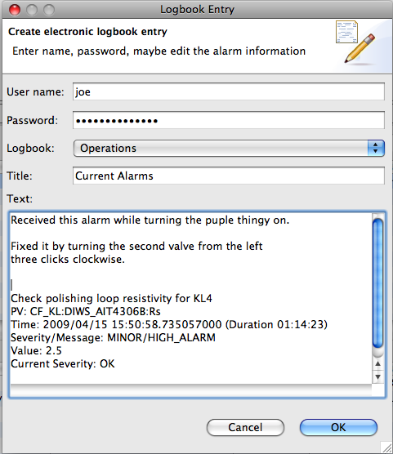
Directly from Alarm to E-Log
“Logbook” from context menu creates text w/ basic info about selected alarms. Edit, submit.

Slide 12
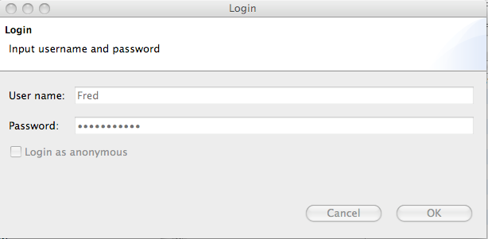
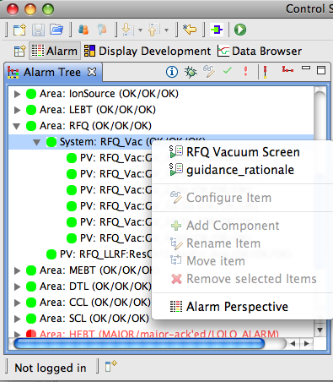
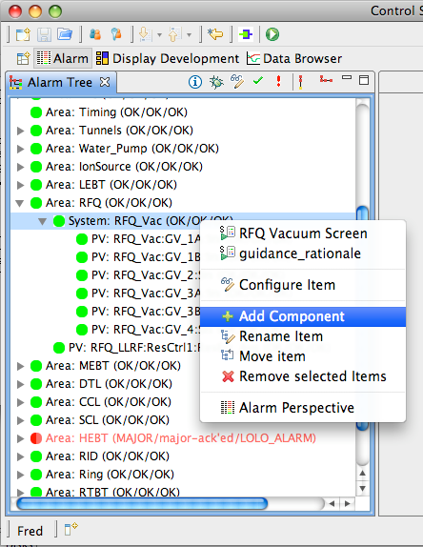
Online Configuration Changes
.. may require Authentication/Authorization (LDAP)
Log in/out

Slide 13
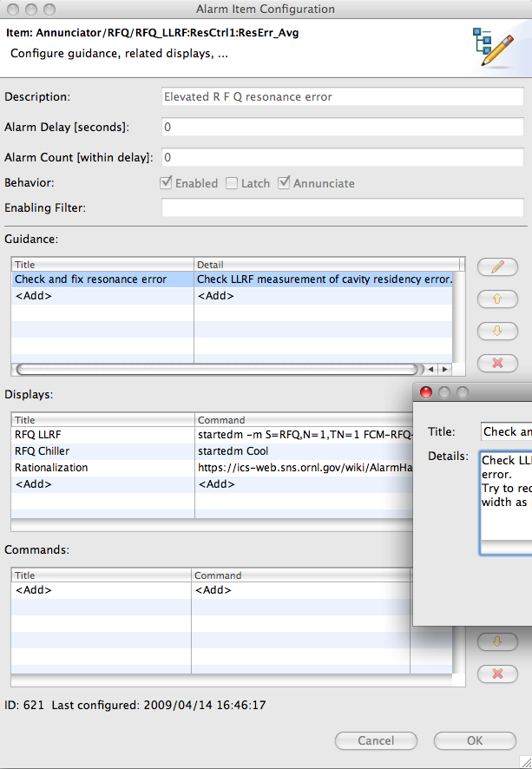
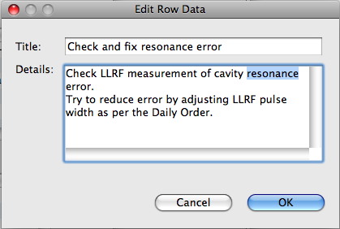
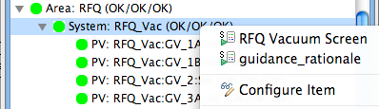
Configure PV
Chatter filter
Latch highest severity, require acknowledgement
formula-based alarm enablement

Slide 14
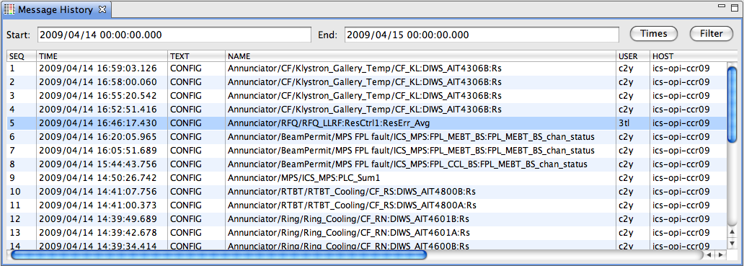
Logging
..into generic CSS log also used for error/warn/info/debug messages
Alarm Server: State transitions, Annunciations
Alarm GUI: Ack/Un-Ack requests, Config changes
Generic Message History Viewer
Example w/ Filter on TEXT=CONFIG

Slide 15
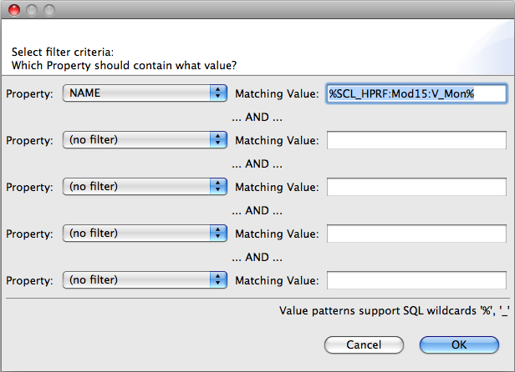
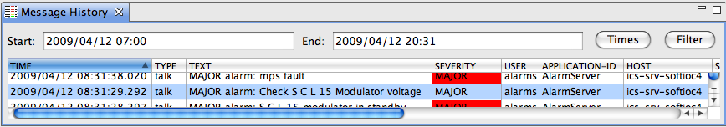
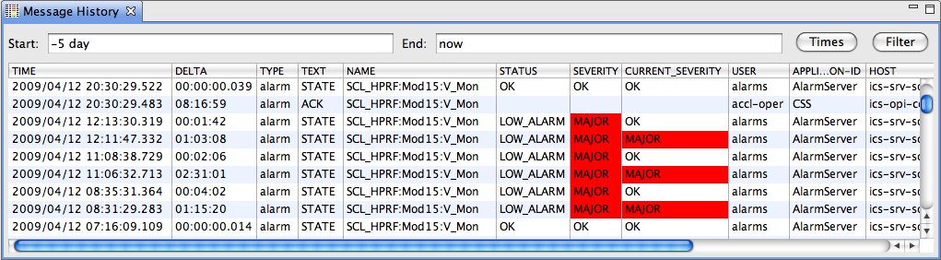
Logging: Get timeline
Filter on TYPE, PV
6. All OK
4. Problem fixed
5. Ack’ed by operator
3. Alarm Server annunciates
1. PV triggers, clears, triggers again
2. Alarm Server latches alarm

Slide 16
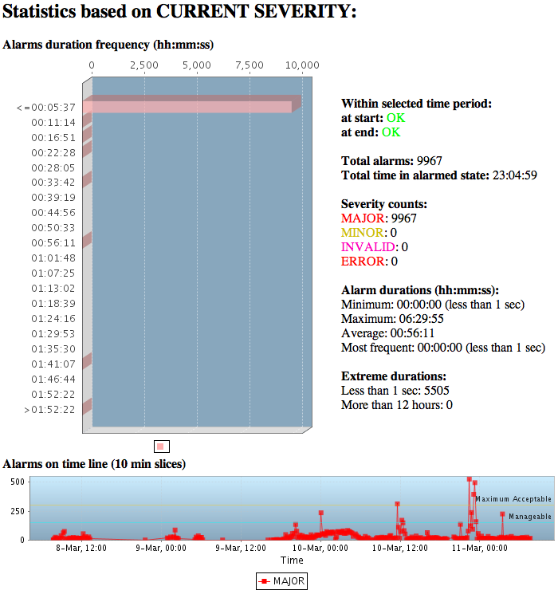
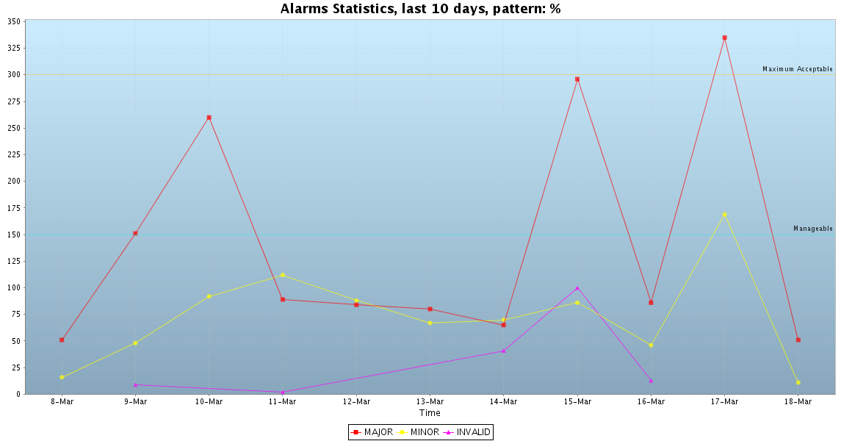
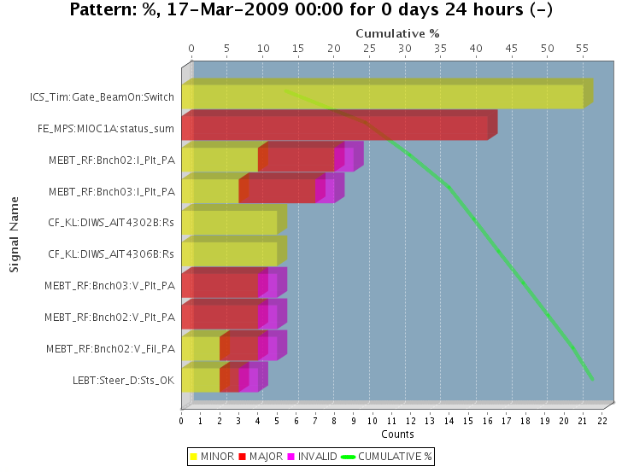
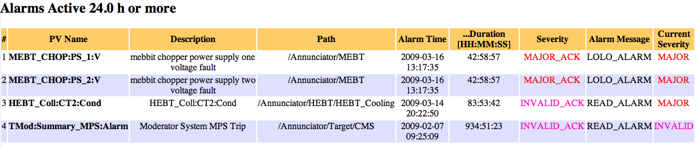
Web Report Examples
Examples from SNS
Code would need some rework to port to other sites

Slide 17

Creating a good Alarm Configuration
Hard
B. Hollifield, E. Habibi, "Alarm Management: Seven Effective Methods for Optimum Performance", ISA, 2007

Slide 18
Alarm Philosophy
Goal: Help operators take correct actions
Alarms with guidance, related displays
Manageable alarm rate (<150/day)
Operators will respond to every alarm (corollary to manageable rate)

Slide 19
What’s a valid alarm?
DOES IT REQUIRE IMMEDIATE OPERATOR ACTION?
What action? Alarm guidance!
Not “make elog entry”, “tell next shift”, …
Consequence of not reacting?
How much time to react?

Slide 20
How are alarms added?
Alarm triggers: PVs on IOCs
But more than just setting HIGH, HIHI, HSV, HHSV
HYST (alarm deadband) is good idea
Dynamic limits, enable based on machine state,...
Requires thought, communication, documentation
Added to alarm server with
Guidance: How to respond
Related screen: Reason for alarm (limits, …), link to screens mentioned in guidance
Link to rationalization info (wiki)

Slide 21
Example: Elevated Temp/Press/Res.Err./…
Immediate action required?
Do something to prevent interlock trip
Impact, Consequence?
Beam off if interlock tripped
Time to respond?
10 minutes to prevent interlock
⬇
MINOR? MAJOR?
Guidance: “Open Valve 47 a bit, …”
Related Displays: Screen that shows Temp, Valve, …

Slide 22
Avoid Multiple Alarm Levels
Analog PVs for Temp/Press/Res.Err./…:
Easy to set LOLO, LOW, HIGH, HIHI
Consider:
Do they require significantly different operator actions?
Will there be a lot of time after the HIGH to react before a follow-up HIHI alarm?
In most cases, HIGH & HIHI only double the alarm traffic
Set only HSV to generate single, early alarm
Adding HHSV alarm assuming that the first one is ignored only worsens the problem

Slide 23
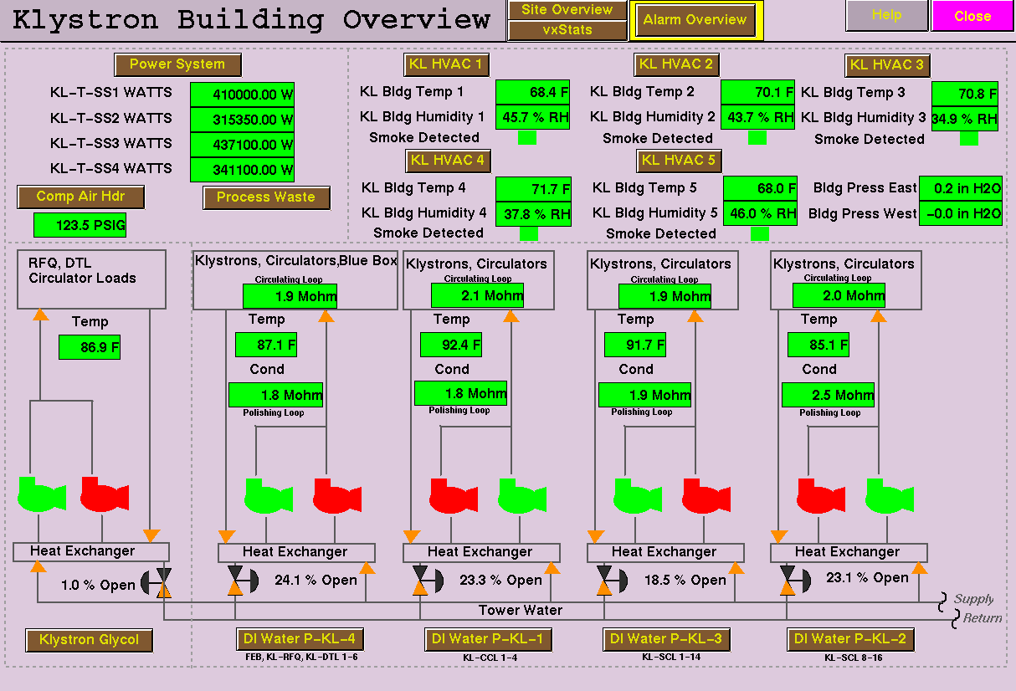
Alarms for Redundant Pumps

Slide 24
Alarm Generation: Redundant Pumps the wrong way
Control System
Pump1 on/off status
Pump2 on/off status
Simple Config setting: Pump Off => Alarm:
It’s normal for the ‘backup’ to be off
Both running is usually bad as well
Except during tests or switchover
During maintenance, both can be off

Slide 25
Redundant Pumps
Required Pumps:
1
Control System
Pump1 on/off status
Pump2 on/off status
Number of running pumps
Configurable number of desired pumps
Alarm System: Running == Desired?
… with delay to handle tests, switchover
Same applies to devices that are only needed on-demand

Slide 26
Weekly Review: How Many? Top 10?

Slide 27
Summary
Easy to use
Check alarms in Table, Tree, Panel
Fix it: Read Guidance, use Display Links
✔Acknowledge
Configuration
Can be changed on the fly
Operators can update guidance or add better display links
Alarm System Setup
Somewhat Involved, but only once
Coming up with a good configuration
Hard
Easy
Hard

Slide 28
Thank You!
BEAST Home Page:
http://sourceforge.net/apps/trac/cs-studio/wiki/BEAST
See also:
B. Hollifield, E. Habibi, "Alarm Management: Seven Effective Methods for Optimum Performance", ISA, 2007
Alarm Rationalization: Practical Experience Rationalizing Alarm Configuration for an Accelerator SubSystem, Xiaosong Geng, etc,. http://info.ornl.gov/sites/publications/files/Pub22522.PDF

