Slide 1
Control System Studio Training
-
Development Setup
Kay Kasemir, Xihui Chen
ORNL/SNS
chenx1@ornl.gov
April. 2013

Slide 2
Getting CSS to run from source code
Get Java, Eclipse, CSS Sources
Start Eclipse
“Import” Sources into Workspace
Open CSS *.product file, Launch

Slide 3
Java
Check: Is java available?
  java -version
  Need Java 1.7;

Slide 4
Eclipse Version
Eclipse just went from 3.x to 4.x
Most CSS Sources would ‘work’ with 4.x
  Except BOY
Need Eclipse (for RCP and RAP developers) 3.7.2
  http://www.eclipse.org/downloads/packages/eclipse-rcp-and-rap-developers/indigosr2
  Can use Eclipse 4.x as the IDE, but “Target Platform” must be 3.7.2

Slide 5
CSS source
For temporary learning:
  Download source snapshot from http://ics-web.sns.ornl.gov/css/products.html
For long term development:
  Clone or download whole CSS repository source from https://github.com/ControlSystemStudio/cs-studio

Slide 6
Start Eclipse
Run
  eclipse
Suggest to check Preferences:
  Java, Installed JREs: Is it the one you want?
    Eclipse may automatically find a JRE, but you want the JDK for source-level debugging
  Add (older) version of Eclipse as “Target Platform”?

Slide 7
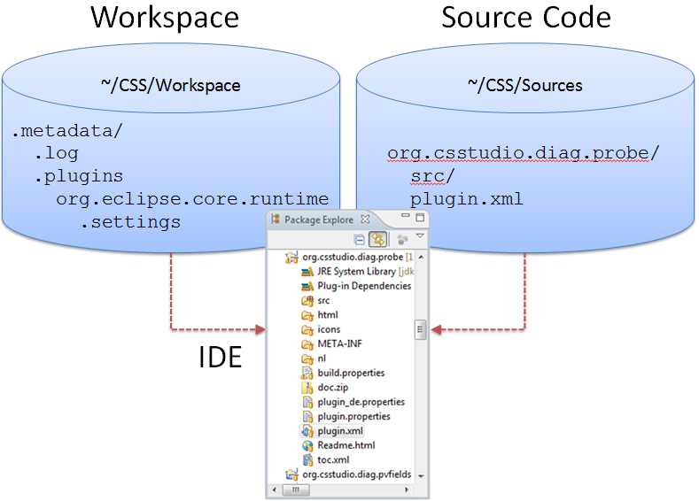
Source Code vs. Eclipse Workspace
Source Code:
  Where the sources are
Workspace:
Directory with
“.metadata”
subdir.
  Tracks currently
  open window, …
To avoid confusion: Keep Separate!
  Example: Use CSS/Sources, CSS/Workspace

Slide 8
Import projects into Workspace
“Import” Sources into Workspace:
  File/Import…, General, Existing Projects into Workspace
  Select “root” directory, import all projects found if you are using SNS source snapshot.
  If you are using source from github, select the projects you need. See http://cs-studio.sourceforge.net/plugins.html
  Do not
  “Copy projects into Workspace”
  Close all plugins end with .rap
Note: Need to “Import” even if sources are already located in workspace directory

Slide 9
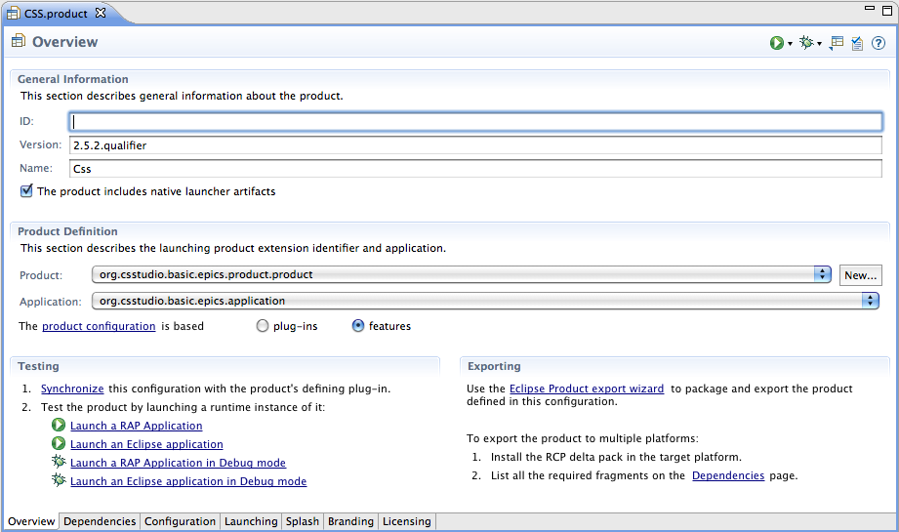
Run Product
Open org.csstudio.basic.epics.product/*.product
Press
  Synchronize
  Launch an Eclipse application
  Later, re-run via the Run button in toolbar

Slide 10
Fundamentally, that’s it
Product:
  List of plugins
  *.product file to run the product
  IDE can also ‘export’ product binary
Feature:
  Logical group of plugins
  Allows online ‘install’, automated ‘update’

Slide 11
“Headless Build”
Command-line process to turn *.product or *.feature into binary
Can be scripted, launched from Hudson, …
See products/SNS/product/org.csstudio.sns.updatesite/ for examples

Slide 12
“Update Site”
Fundamentally, just a build option to create “P2 Metadata Repository” for products and features
Published on web site
Products can then
  Install features from repository
  Automatically update to latest version
Requires careful setting of dependencies and version numbers

