Slide 1
Control System Studio Setup
-
Hierarchical Preferences, Workspaces, Shared Folders
Xihui Chen,
Kay Kasemir
ORNL/SNS
chenx1@ornl.gov
April 2013 at IHEP

Slide 2
Desired CSS Experience
Should be:
Not:
Download CSS
Run
Download CSS
Set EPICS address list
Configure email server
Add alarm GUI
Disable BOY editing
Add archive data sources
…
Run

Slide 3
How to get there?
Customized product:
  SNS CSS, NSLS-II CSS, …
  Local update site
  Best, but also more work
Generic product
  Basic EPICS CSS?
  Hierarchical Preferences for your site
  May be good enough to get started

Slide 4
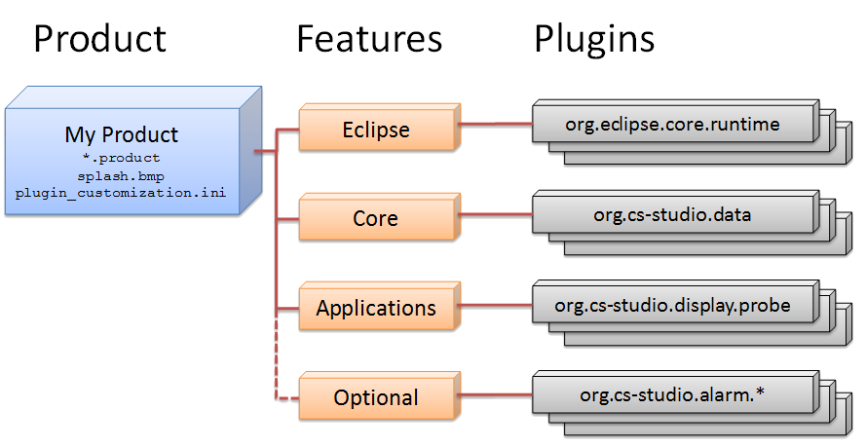
Eclipse “Product”

Slide 5
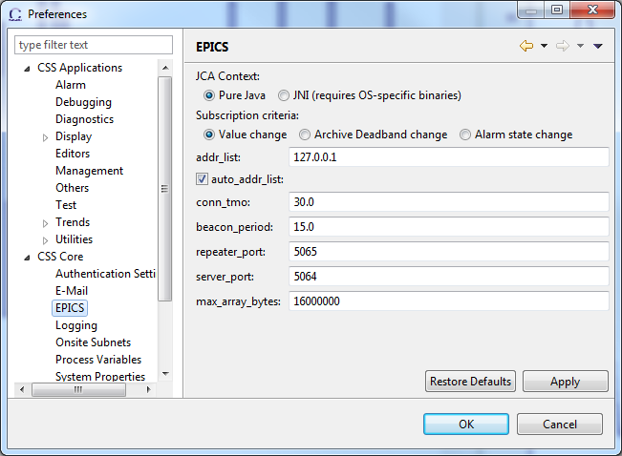
Hierarchical Preferences
Override Order
Preferences.ini inside individual plugin
  org.csstudio.platform.libs.epics/preferences.ini:
  addr_list=
Product’s plugin_customization.ini:
  org.csstudio.platform.libs.epics/addr_list=127.0.01
Command-line
  -pluginCustomization /path/to/settings.ini
Workspace Preference Page
  Only work per workspace

Slide 6
Exercise: Preferences from Command line
In your home directory, create a file “my_css_settings.ini”
Add a line
  org.csstudio.platform.libs.epics/addr_list=127.0.01 1.2.3.4
  Use the IP address of your computer instead of 1.2.3.4
Run CSS with option
  -pluginCustomization /path/to/your/my_css-settings.ini
  See menu Run/Run Configurations… to do this from within the IDE
When you now view the CSS/Preferences/CSS Core/EPICS settings, press “Default”, does it use the value from your settings.ini?
Check the spelling of “-pluginCustomization”
and the exact path of your …ini file.
There won’t be an error, it simply won’t “work”.

Slide 7
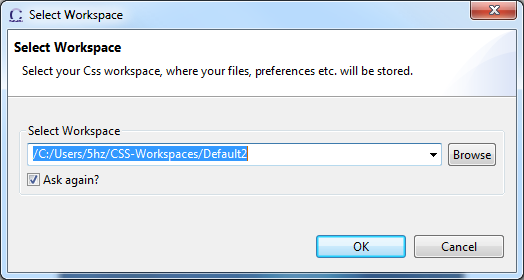
Workspace
User’s personal data
  Projects, folders, files
  Preferences
  .metadata/
    Remember the perspective, opened files and so on when it was closed
Each CSS instance needs a single workspace
  Workspace is locked if it is being used
    The lock file: .metadata/.lock
    If CSS exit abnormally and keep the workspace locked, delete the lock file to unlock it.

Slide 8
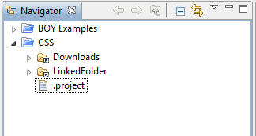
Shared Folders
If some folders need to be shared by all users
  Don’t copy it to workspace
  Instead, create link folder in workspace
How to create link folder?
  From command line
    -share_link /local/file/system/path=/workspace/path
  In CSS, New Folder dialog, select
    Link to alternate locations (Linked Folder)

Slide 9
Thank You!

