Slide 1
Eclipse Products, Features, Plugins, Extension Points
Kay Kasemir, Xihui Chen
ORNL/SNS
chenx1@ornl.gov
2012, April at SLAC

Slide 2

Eclipse Plugin Architecture
Extension Point: defines new function point that other plug-ins can plug into
Define XML description in plugin.xml
Define abstract class
Programmatic loading of the extensions
plug-in
Extension: concrete service
Implementations of abstract class defined in extension point
One extension point may have 0, 1 or unlimited extensions
plug-in
Code is nicely decoupled and “packaged”

Slide 3
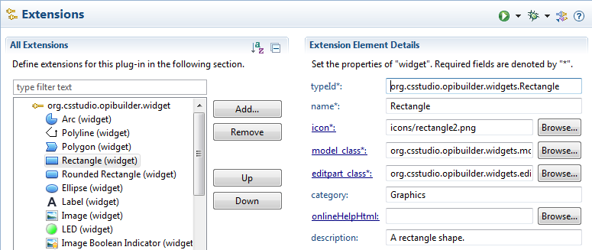
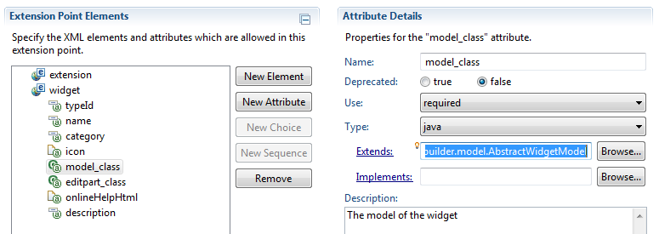
BOY widget extension point Example
Symbol widgets implemented by ITER
opibuilder.widgets.symbol
opibuilder.widget
…
Other widgets …
Slider widget
opibuilder
Rectangle widget
widget extension point
Extension usually is optional, if you don’t have that extension, you just don’t have that function.

Slide 4
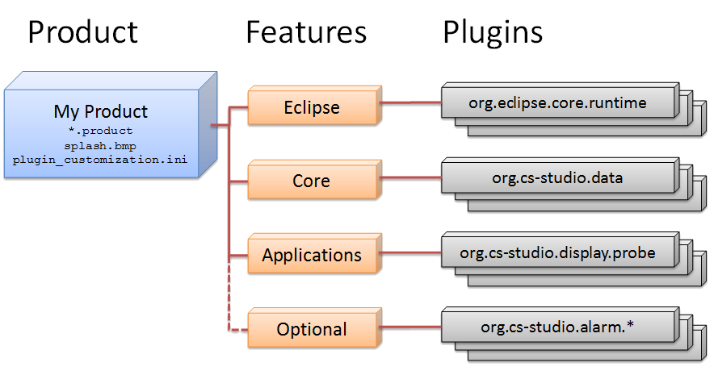
Product, Features, Plugins

Slide 5
From Product to Plugin
org.cstudio.basic.epics.product/CSS.product
  Based on “Features”
org.csstudio.sns.feature.applications
  org.csstudio.diag.probe
  org.csstudio.diag.epics.pvtree
  …
  and features …opibuilder, …databrowser
Features:
  “Group” plugins to better organize them
  Features can be installed & updated from update sites
    Individual plugins can’t

Slide 6
Smaller Products without Features
org.csstudio.archive.engine/ArchiveEngine.product
org.csstudio.archive.config.rdb/ArchiveConfigTool.product
org.csstudio.alarm.beast.server/AlarmServer.product
org.csstudio.alarm.beast.configtool/AlarmConfigTool.produc
It’s OK to not use features
Easier to start that way.
But: Less organized,
no install, update possible.

Slide 7
Dependencies
org.csstudio.diag.probe
  MANIFEST.MF, plugin.xml
  Dependency on ..utility.pv
org.csstudio.utility.pv
Products that include probe must also include utility.pv.
Otherwise obvious error about missing dependency at startup, or no product at all.
Similar: Databrowser depends on org.csstudio.archive.reader,
org.csstudio.logbook
* utility.pv will be replaced by PV Manager in next release

Slide 8
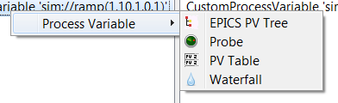
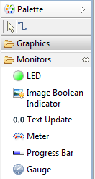
Extension Points
There are many!
  Read Eclipse RCP Books
  See Eclipse IDE online help
  http://cs-studio.sourceforge.net/docbook/
  Study CSS Sources
For example:
  Process Variable Menu
    Provide Process Variable or Provide Menu
  Logbook
  PV Manager Data Source
  Authentication & Authorization Provider
  BOY Widgets

Slide 9
To build a custom product:
You pick what you want
  Probe, Data Browser, BOY, …
Add dependencies, Eclipse helps
  Logbook, pv, archive, …
Determine what you may also need
  pv.epics, logbook.mysite, archive.reader.*
Test within Eclipse IDE (Run Configurations…)
  Then update your *product, *feature
  Read http://cs-studio.sourceforge.net/docbook/

