Slide 1
Contribute to CSS
Xihui Chen
chenx1@ornl.gov
April, 2013

Slide 2







CSS is a Collaboration
BEAST
BOY
BEAUTY
SCAN System
Data Browser
Probe
Utility.pv
CSS Framework
CSS Book
Basic EPICS product
…
Idea
CSS Framework
DAL
SDS
AMS
DCT
SNL Editor
…
PV Manager
ChannelFinder
Graphene
Olog
CSS Framework
Build Infrastructure
SourceForge website
…
Olog
…
MEDM to BOY converter
Symbol Widgets
BEAST enhancement
PV Name auto-completion
…
https://encrypted-tbn2.gstatic.com/images?q=tbn:ANd9GcSAGwOVeuVa0kprq2Hcqw_1LTAcEsBY8j-6vMMrqHaVVcmjAbr2

Slide 3

http://www.newlondonfirefightersunion.org/we%20need%20you(1).jpg

Slide 4
What you can contribute
Anything that could be useful to others
  Ideas
  Documentation
  Plugins
  Bug reports, fixes
  Enhancements
  …
Something still missing
  Fully functional EDM to BOY Converter

Slide 5
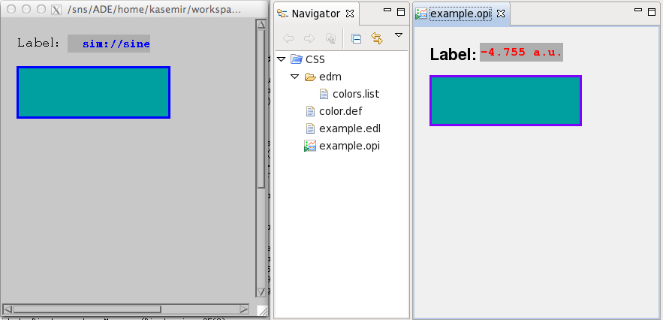
EDM to BOY Converter
So far…
  SNS contract w/ Cosylab:
  EDM-to-BOY (*.edl to *.opi) framework
    Only includes widget mapping for Label, TextUpdate, Rectangle.
  Decent skeleton, yet still just a skeleton.
  Eagerly awaiting people with time to add all the widget conversion code.

Slide 6
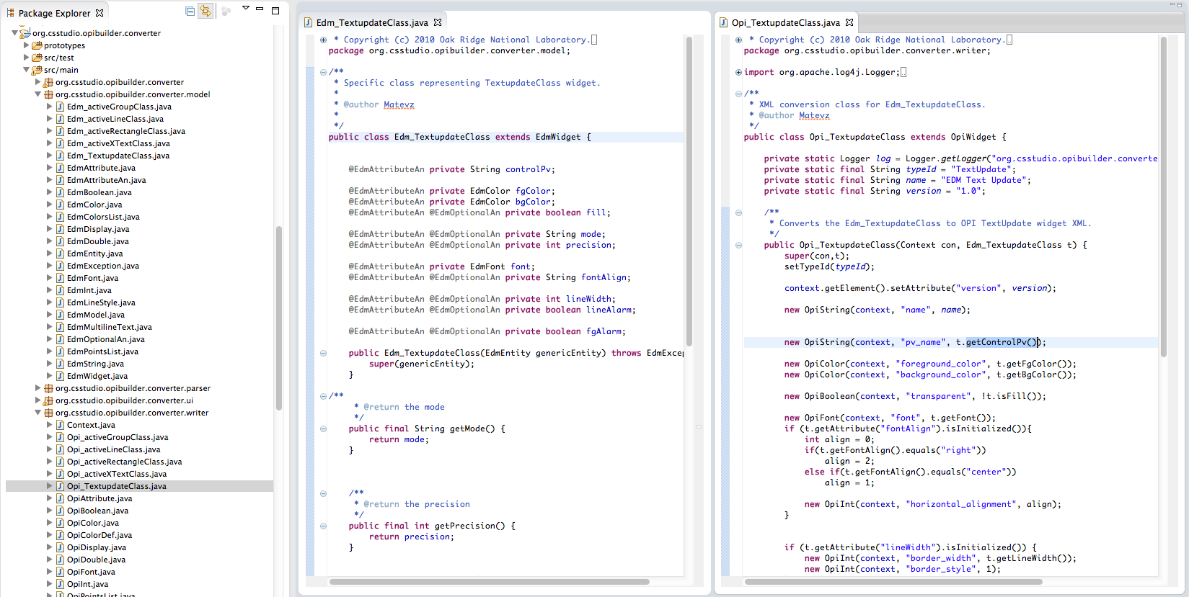
Fundamentally, Easy to Extend

Slide 7
What Should be Easy
Add most widget types
Add basic intelligence:
  Replace EDM ‘visibility’ with BOY ‘Rule’
Estimated Workload
  One man-month

Slide 8

How to contribute
Join cs-studio-core mailing list
  https://sourceforge.net/mail/?group_id=285388
Create an account at Github
Clone CSS source
  https://github.com/ControlSystemStudio/cs-studio
Make your changes
Create a patch and email to me (chenx1@ornl.gov ) for review
I will grant you write access to github
Commit and Push your changes
  Be sure you understand Git before pushing

Slide 9

http://jobryantnz.files.wordpress.com/2011/12/thankyou.gif?w=584&h=543

