Slide 1
WebOPI
-Build & Setup
Xihui Chen
chenx1@ornl.gov
April, 2013

Slide 2

Technologies behind WebOPI
Built on Eclipse RAP (Remote Application Platform)
  Bring Eclipse RCP to the Web
  Single Sourcing between RCP and RAP applications
  Using JavaScript and HTML5 in Web Browser
    Supported by all mainstream web browsers
  Standard servlet technology
    Server runs on any JEE servlet container, such as Tomcat, Jetty, Glassfish, JBoss and WebSphere
Most of BOY code (99%) is single sourced with WebOPI

Slide 3
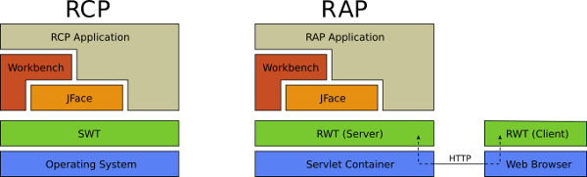
Why can it do single sourcing?

Slide 4
WebOPI build & setup manual
Development Setup
  http://htmlpreview.github.com/?https://github.com/ControlSystemStudio/cs-studio/blob/master/applications/plugins/org.csstudio.opibuilder.rap/html/WebOPI_developer.html
Deployment
  http://htmlpreview.github.com/?https://github.com/ControlSystemStudio/cs-studio/blob/master/applications/plugins/org.csstudio.opibuilder.rap/html/WebOPI.html

Slide 5
Prepare WebOPI Development Environment
Start Eclipse with a new workspace
Import projects as described in manual
Set Target Platform
Launch WebOPI from Eclipse

Slide 6
Build
Install WAR products tooling
Export WAR Product
Include org.csstudio.opibuilder.rap/html/META-INF
  jar uf webopi.war META-INF/

Slide 7

Deploy
Support all JEE servlet container
  Tomcat, Jetty, Glassfish, JBoss and WebSphere
Step 1. Copy webopi.war to the predefined location specified by servlet container
Step 2. Configure css_rap.ini
Step 3. Copy opi files to opi_repository
Open your favorite web browser with
  http://localhost:8080/webopi/
org.csstudio.opibuilder/opi_repository=C:/path/BOY Examples/ org.csstudio.opibuilder/startup_opi=main.opi org.csstudio.opibuilder/mobile_startup_opi=mobile.opi org.csstudio.opibuilder/color_file=color.def org.csstudio.opibuilder/font_file=font.def

Slide 8
Could Custom BOY Widgets work?
Yes, but it needs to follow few rules:
  Don’t use Display.getCurrent()
    There is no “current” because each client has its own Display
  Don’t use static color, font, cursor because they are Display related
  Make sure your code work with RAP

Slide 9
Thank you!
WebOPI homepage:
  http://sourceforge.net/apps/trac/cs-studio/wiki/webopi

