Slide 1
SNS Beamline Experiment Control (Future)
Xihui Chen, Kay Kasemir
4/15/2013

Slide 2
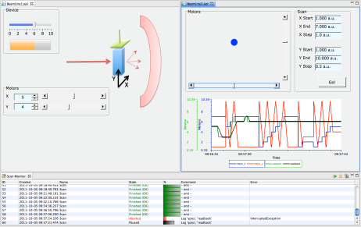
Overall Picture
Detector
Aggregator
Instrument Events
Data Stream
Translation Service
Nexus
Sample Environment
Sample Environment Equipments
Sample Environment Equipments
Scan Server
Neutron Count, Histogram, ..
Service
Mantid
GUI: CSS
GUI: CSS
EPICS IOCs
GUI: CSS
Channel Access
Experiment Control

Slide 3
Building blocks
User Interface
BOY
Data Browser
Scan UI
Alarm UI
Pydev, Git …
Services
Archive Engine
Autosave
Scan Server
Alarm Server
Statistic
Server
IOCs
Motor
Camera
ICP
Misc.
Only choose the blocks that you need to build your own experiment control system

Slide 4
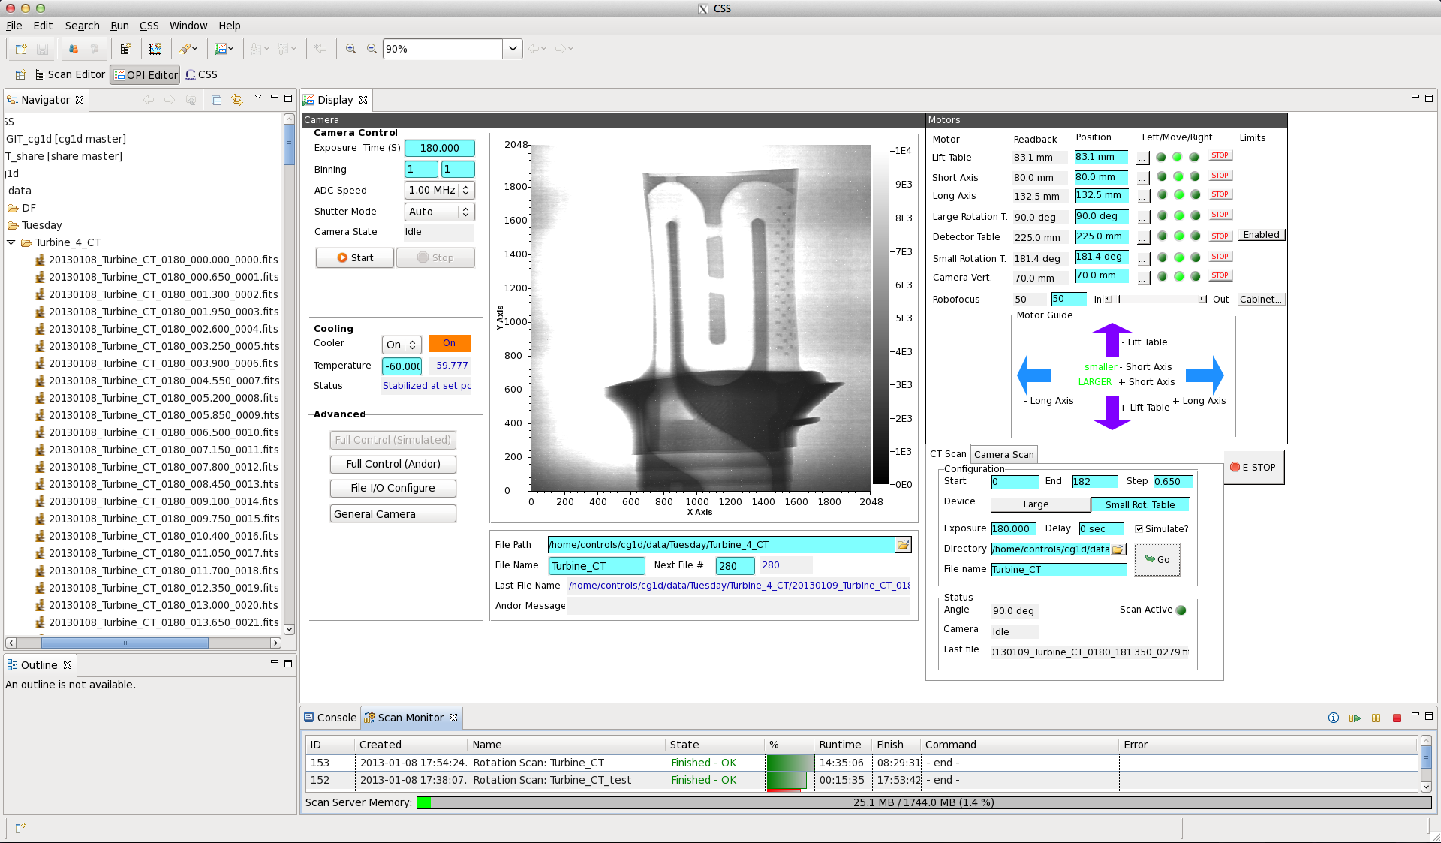
A real example at imaging beamline
Raw 2D image
Integrated Motor Controls
Direct access
to data
2D and 3D scans options
Constant monitoring of data acquisition progress with estimate of duration of a 2D (kinetic) and 3D (CT) scans

Slide 5


Automated Experiment Control – Scan System
A scan example
Open Shutter
“Scan” should be easy and robust
Graphical:
… or script:
Monitor, pause, resume, abort
Set motor X = 0
Wait for certain beam charge to accumulate
Step motor
X += 1
Yes
X < 10 ?
No
Close Shutter

Slide 6
Why not EPICS Sequencer?
Excellent for “permanent” automation, not for changing scan scenarios
Compile, link, …
No GUI
No progress, pause, resume
Can do anything

Slide 7
Why not Scripts (Python, Jython, Scala, …)?
“Works”, but…
No progress, pause, resume
Can do most anything
Lost of Control
Difficult
Error prone
Missing of common Scan functions
Error checking and handling
Simulation

Slide 8
APS “Scan Engine”
Claude Saunders, Mitch McCuiston, Brian Tieman, Tim Mooney
“Scan Engine” executes submitted scans
Scan = List of robust commands
“Loop” command
Pause, Resume
CSS PV instead of new PV layer
Tight CSS GUI integration AND basic script access

Slide 9
Scan Commands
Set
Set device (PV) to a value.
Optional wait for read-back, same or other PV, with timeout.
Wait
Wait until a device (PV) reaches a certain value. Support condition: >, <, ==, >=, <=, increment-by, decrease-by. Optional timeout.
Loop
Command that performs a loop, optional read-back and timeout.
Log
Log data for plot in addition to variables used by Set, Wait, Loop
Delay
Delay for a certain time. Discouraged. Use Wait.
Script
Execute jython code. Use with care.
Custom commands can be added via Eclipse extension points.

Slide 10
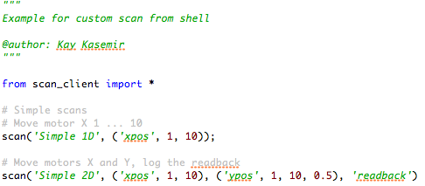
Experiment Control for EPICS
Client side:
Assemble scan
Submit scan
Monitor scan
Scan Server:
Keep the queue of Scans
Execute Scans
Sample Environment Equipment
Sample Environment Equipments
Sample Environment Equipments
A scan
GUI: CSS
Jython, Matlab, …
Scan
Server
EPICS IOCs
Channel Access

Slide 11
Scan Server
CSS/Eclipse ‘headless’ application
‘PV’: EPICS, simulated
Telnet interface: Status, pause, resume, …
Java RMI interface: Submit, status, pause, resume, get data, …
Scans transferred in XML format
RMI = Java, Jython, Matlab, Scala, JRuby, …
RESTful web interface

Slide 12
Scan Client
Can be anything as long as it can talk to Scan Server using the provided interfaces
CSS
Matlab
Python
LabVIEW
Web browser
…

Slide 13
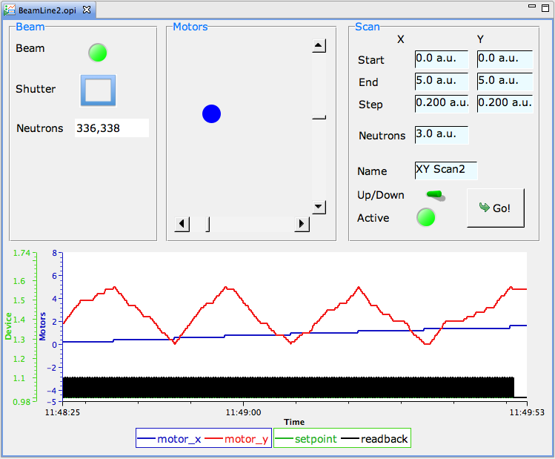
BOY Example
1. Configure
2. Start
3. Monitor

Slide 14
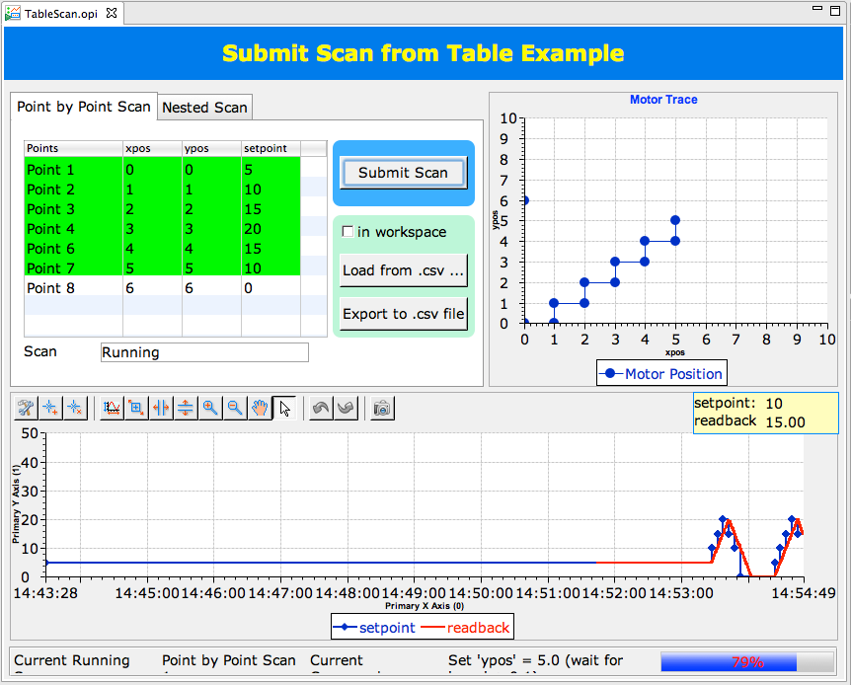
Tabular OPI

Slide 15
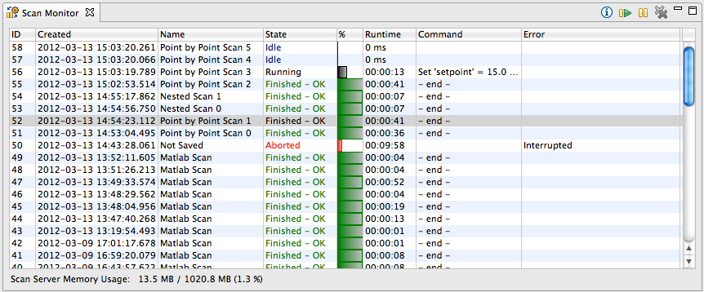
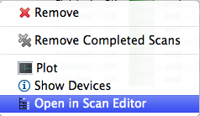
Scan Monitor
List Scans on Server
Idle: To be executed next
Running: With progress report
Finished, Failed: Past runs

Slide 16
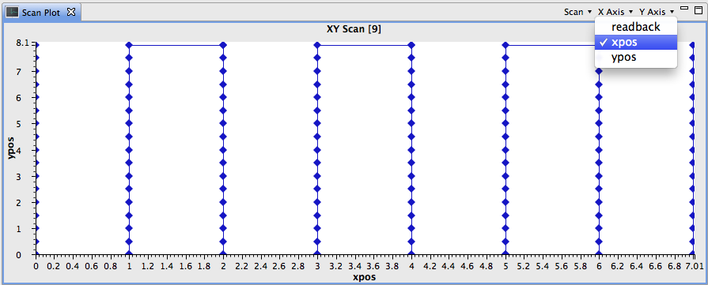
Scan Plot
Plot variables used by scan
Get data from Running or Finished scans

Slide 17
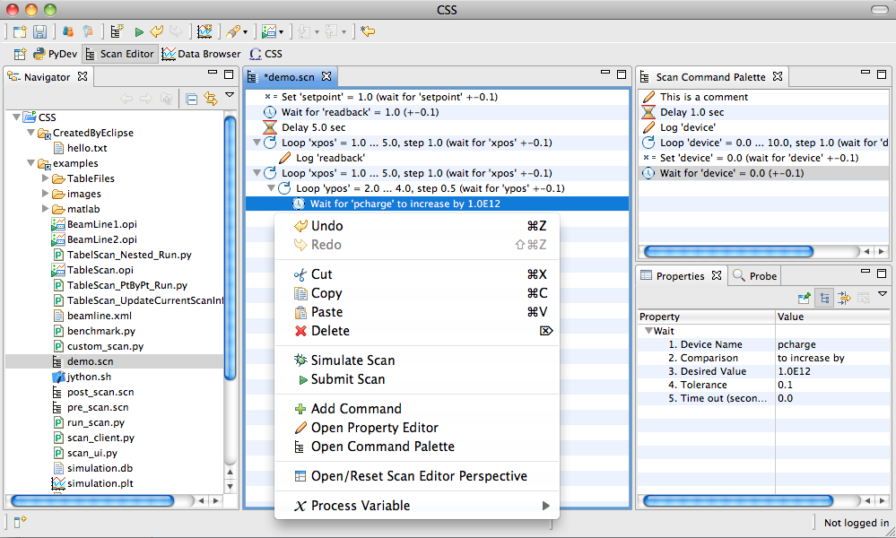
Scan Editor
Add commands
Open, save
Set parameters
“Undo”
Drag/drop commands or PV names (also as XML text)
Device PVs (or alias) can be picked from beamline-specific configuration

Slide 18
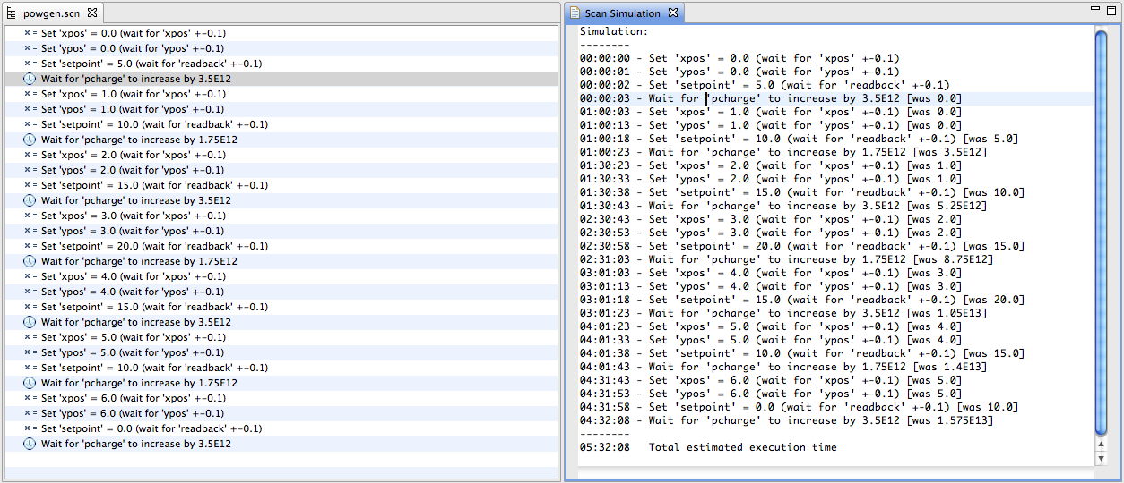
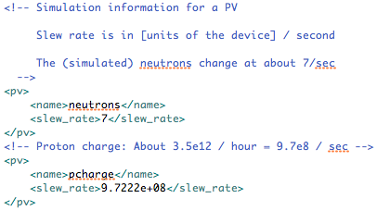
Simulation Mode
Simulated PV changes
Estimates times

Slide 19
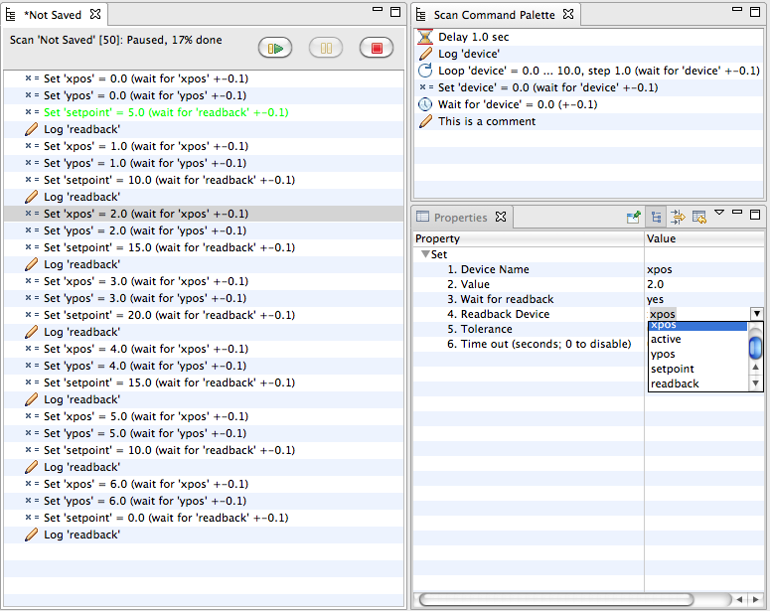
Monitor, Adjust Live Scan
Scan Info
Active Command
Adjust properties
of live scan

Slide 20
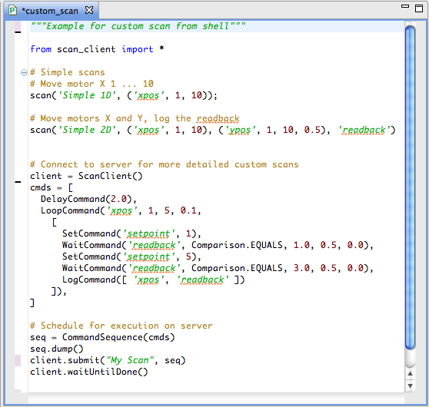
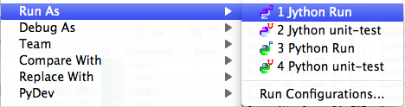
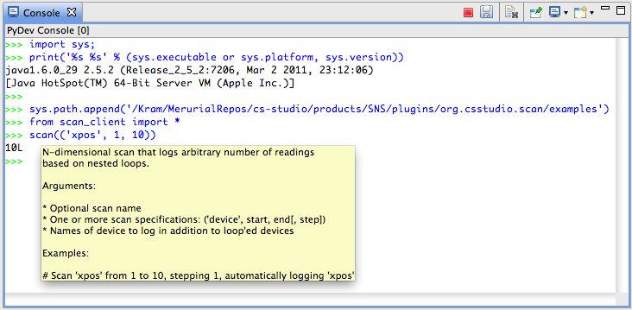
Scripted Scan
Jython editor, debugger
Jython console
… or use ‘vi’, shell:
from scan_client import * help(scan) scan('Demo', ('xpos', 1, 10))

Slide 21
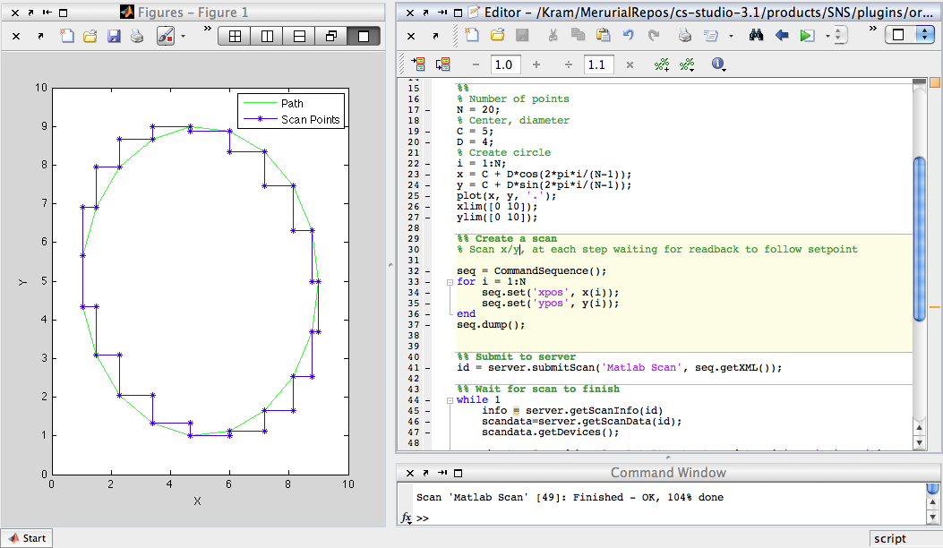
Matlab
Create Scan
Monitor
Analyze
(maybe submit follow-up scan)

Slide 22
Performance
Command Execution
80000 commands/second: Delay 0 sec, Set w/o read-back
4500 commands/second: Set w/ read-back, Loop
Download scan into Editor
10000 commands: 1 second
50000 commands: 15 seconds
Stability
Continuously running for two months so far.

Slide 23
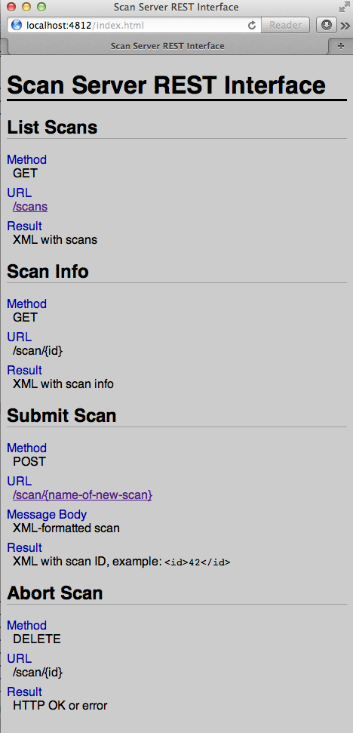
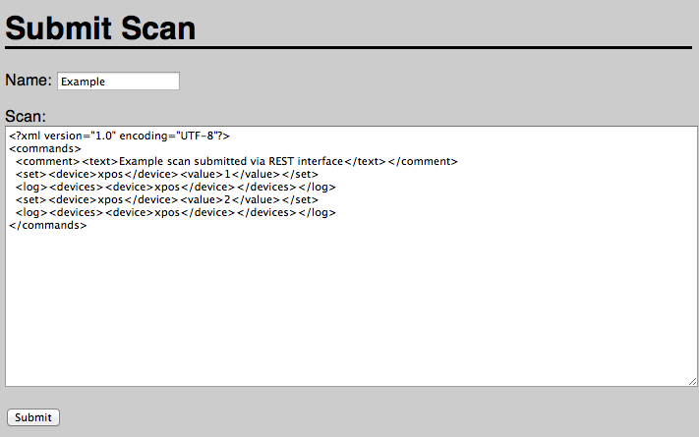
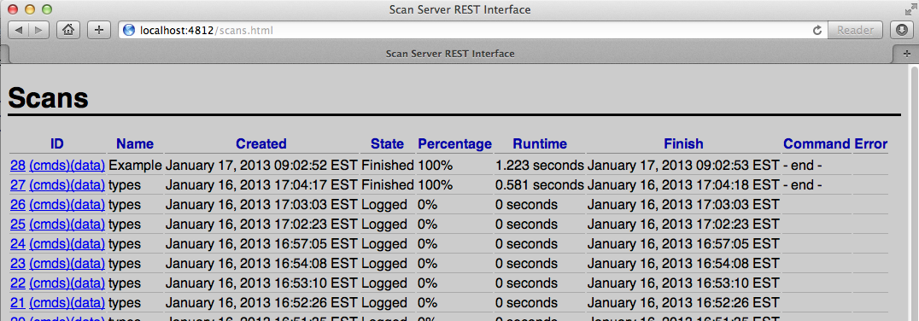
Web Interface Development

Slide 24
Beamline Setup
Network
Version Control, Issue Tracking, Wiki
Directory Layout
IOC Control

Slide 25
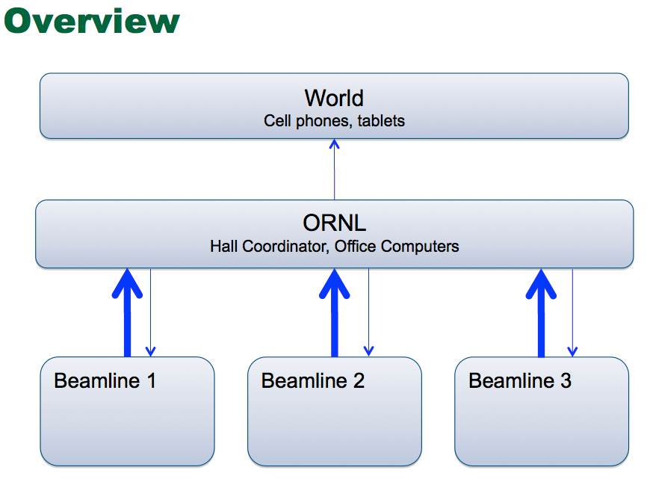
Network
Beam lines are as autonomous as possible
Beam line X cannot read/write beam line Y
Instrument hall coordinator, SNS/HFIR personnel, visitors on ORNL network can read most beam line information
For any beam line
World may be able to read some beam line information
Limited, controlled write access from ORNL network
ssh access for config, maintainance
Selected actions may be allowed via web server

Slide 26
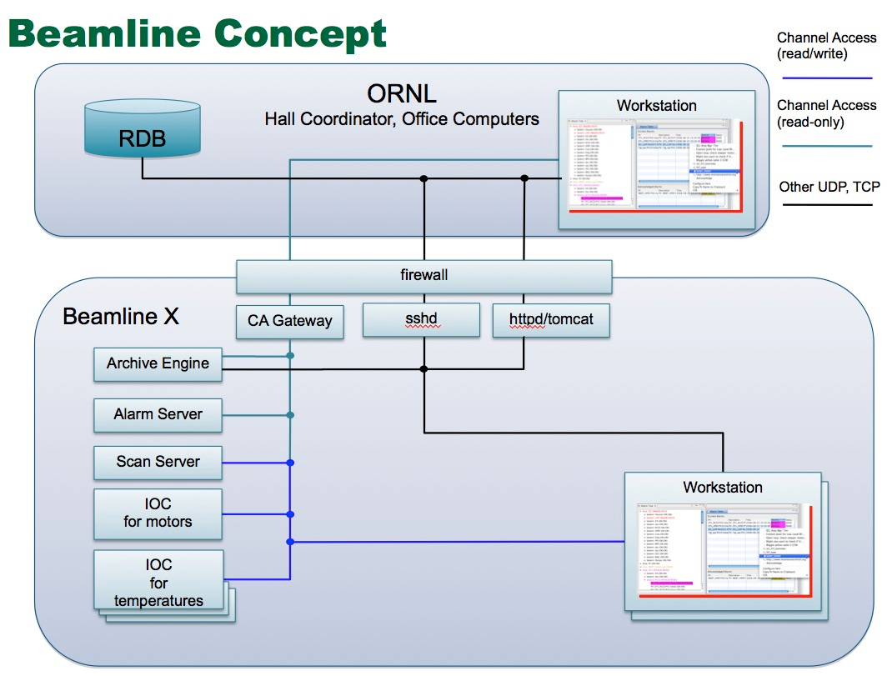
Server

Slide 27

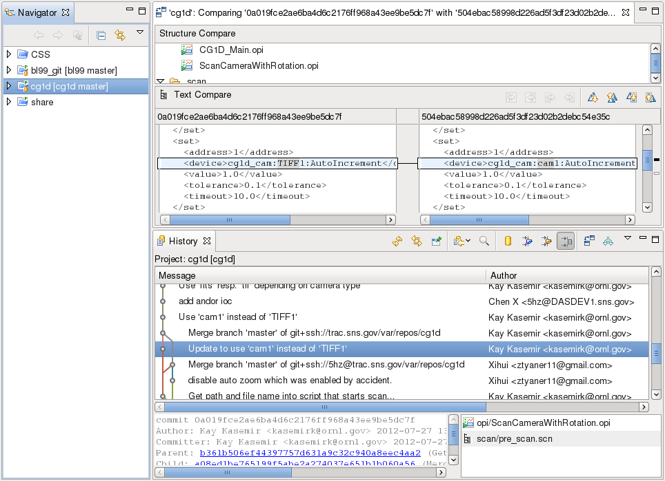
Version Control - Git
http://git-scm.com/
Distributed Version Control System
Lighting Fast
Easy and powerful in branching and merging
Nice CSS Integration
Commit
Pull/Push
Compare

Slide 28
Git Repositories
Shared repositories
epics
Including base, support modules, extensions
css
Including CSS, ScanServer, Archive Engine, Alarm Server, settings.ini
share
Including shared OPI files , scan files, images ...
Beamline specific repositories
bl1
bl1 related IOC applications, configuration files, OPI files, scan files…
bl2
bl3
…

Slide 29

wiki and issue tracking
Trac
http://trac.edgewall.org/
Integrated wiki, issue tracking system for software development
Integrate with git to browse source, tracking changes…
Open source project

Slide 30
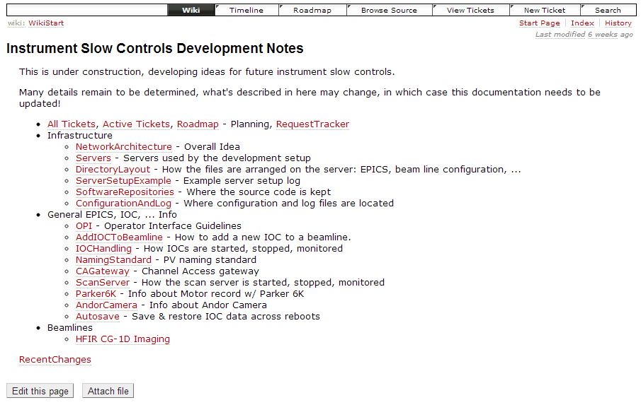
wiki
Allow all members to edit/browse document online

Slide 31
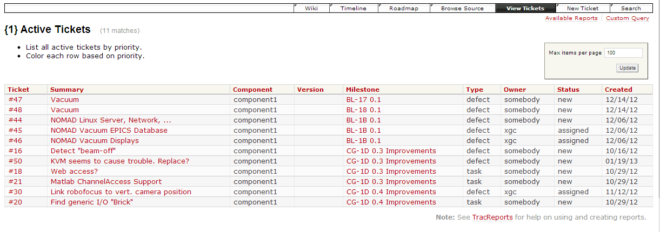
Issue Tracking
Each issue is a ticket
Owner
Type
Status

Slide 32
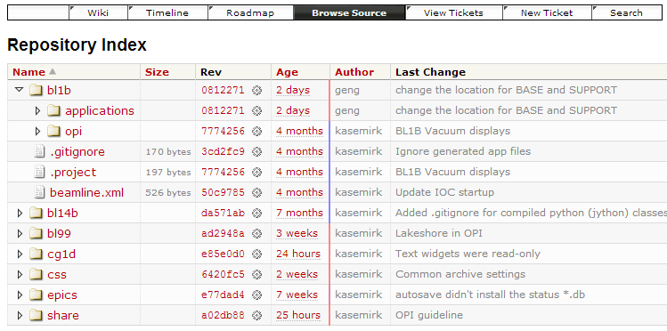
Browse Source
Browse source in repositories

Slide 33
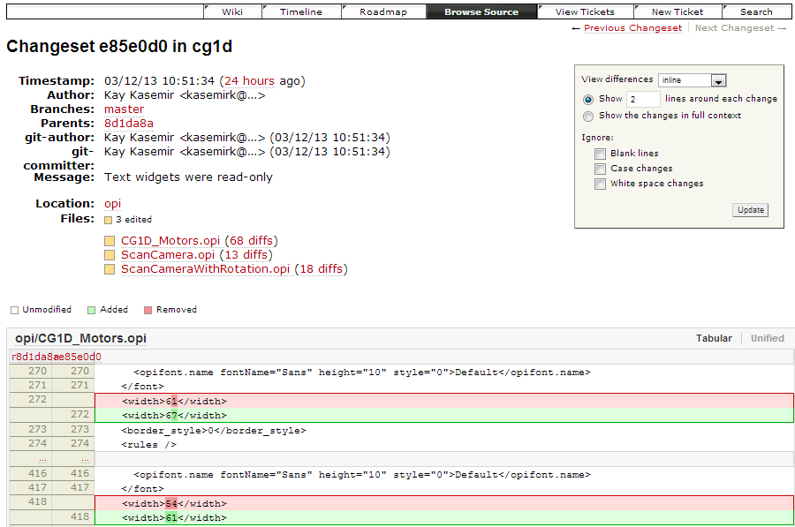
Tracking Source Changes

Slide 34
Directory Layout
A unified directory layout on every beamline
/home/controls/
Root of all (slow) controls files
/home/controls/{beamline}/
Beam-line-specific EPICS, CSS and OPI files
/home/controls/share/
Shared operator interface files
/home/controls/css/
CSS binaries, shared CSS configuration files
/home/controls/epics/
EPICS base, device support, extensions
/home/controls/var/
Variable area for EPICS IOCs (autosave files, ...)

Slide 35
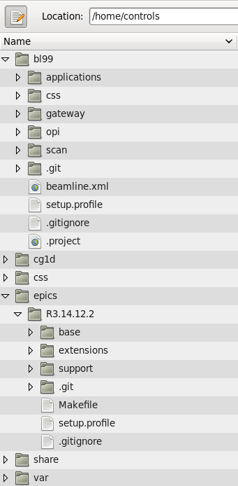
Directory Layout
IOC applications
Beamline specific CSS, scan server settings,
startup scripts…
Beamline specific configuration file
Beamline specific environment setup file
Extensions, such as ca gateway, ImageJ…
Support modules, such as areaDetector, motor records
General epics environment setup file

Slide 36
Environment setup
Common setup - epics/R3.14.12.2/setup.profile
Beamline specific setup – bl99/setup.profile
export EPICS_BASE=${EPICS}/base
…
export EPICS_HOST_ARCH=`"${EPICS_BASE}"/startup/EpicsHostArch.pl`
…
export JAVA_HOME=/usr/lib/jvm/java-1.7.0-sun.x86_64
export PATH="${JAVA_HOME}/bin:$PATH"
…
umask 0002
…
#source common setup
source /home/controls/epics/R3.14.12.2/setup.profile
#specific IP address for each beamline
export EPICS_CA_ADDR_LIST="192.168.1.255“
export EPICS_CAS_INTF_ADDR_LIST="192.168.1.101“
…

Slide 37
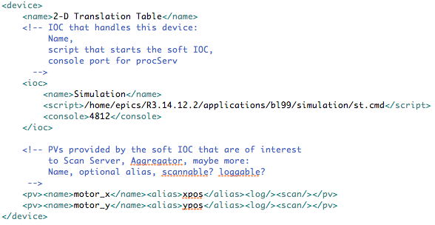
Beamline Configuration file – bl1/beamline.xml
Required (soft) IOCs
Used by separate tools to start/stop as required
Scan System Aliases
Available within scans
Simulation Info
Slew rates
DAQ info
Which channels to log with neutron data?

Slide 38
Soft IOC control –iocs.py
Multiple soft IOCs on server, we need to
Start, Stop IOCs
Check IOCs Status
Connect to IOC console
$ iocs.py -h
Usage: iocs.py [options] status | update | start | stop | console | log {IOC name}
Options:
-h, --help show this help message and exit
-c CONFIG_FILE Configuration file (default: beamline.xml)
Command:
status - Display status for all IOCs
update - Assert that all 'active' IOCs are started, others stopped
start - Start all IOCs that are not running
stop - Stop all IOCs that are found running
console - Open telnet connection to IOC's console (requires specific IOC name)
log - Dump the IOC console log
Command is applied to all IOCs unless specific IOCs are listed

Slide 39
Thank you!
Example setup can be downloaded from
http://ics-web.sns.ornl.gov/share/xihui/ihepTraining/

