Slide 1
TECHNICAL NUGGET
3. Complexity Control: Lasso and Cross-Validation
Asher Strell
R. Tibshirani (1996). Regression Shrinkage and Selection via the Lasso. J. Royal Statistical Society, Series B, 58(1), 267–288.
J. Friedman, T. Hastie & R. Tibshirani (2010). Regularization Paths for Generalized Linear Models via Coordinate Descent. J. Statistical Software, 33(1), 1–22.
Notes:
Jana fit 24 slopes and an intercept by OLS. My section asks whether that is more parameters than the data supports, and answers it with a penalty chosen on held-out data.

Slide 2
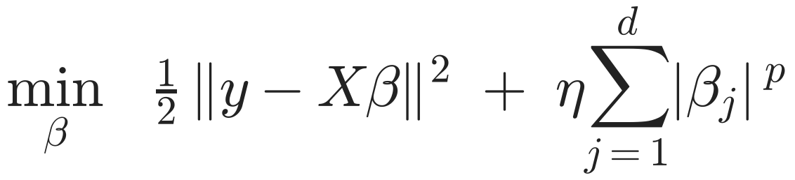
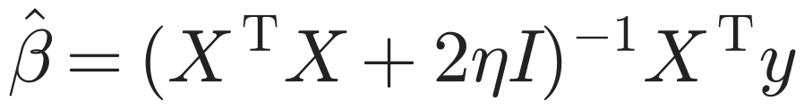
Is the Model Too Complex? Add a Penalty
p = 2 · ridge
p = 1 · lasso (what we present)
|β_{j}| has no derivative at 0, so there is no closed form. Needs an algorithm.
Sets coefficients exactly to zero: it selects features.
Closed form: the normal equation with one extra term. Shrinks every coefficient, never to zero.
Start
End
Tool
The OLS sum of squares and its normal equation (Jana, section 2)
An update for one coefficient, repeated until nothing moves
Minimize over one coordinate at a time: a 1-D problem we can solve by hand
Notes:
eta is the penalty weight: the price the model pays for each unit of coefficient size. eta = 0 is OLS. Note for the team: section 4 uses eta for the linear predictor x'beta and lambda for its penalty; here eta is the penalty, as Professor Wiggins wrote it.

Slide 3
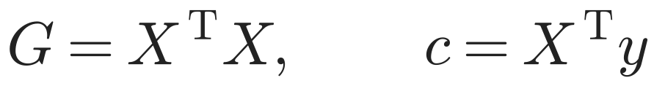
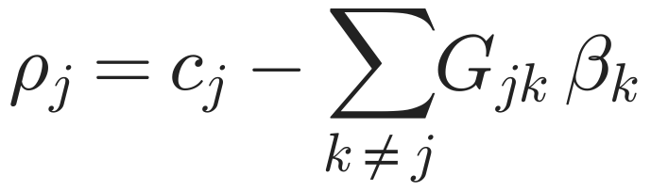
Derivation (1/2): One Coefficient at a Time
1. Standardize X, center y
The intercept drops out, and one η means the same for every feature.
2. Expand the sum of squares
3. Freeze every coefficient except βⱼ
where
ρⱼ: how strongly column j lines up with what the other columns leave unexplained.
Notes:
G and c are the same two quantities as in Jana's normal equation. Holding the other coefficients fixed leaves a quadratic in beta_j plus the absolute-value term.

Slide 4
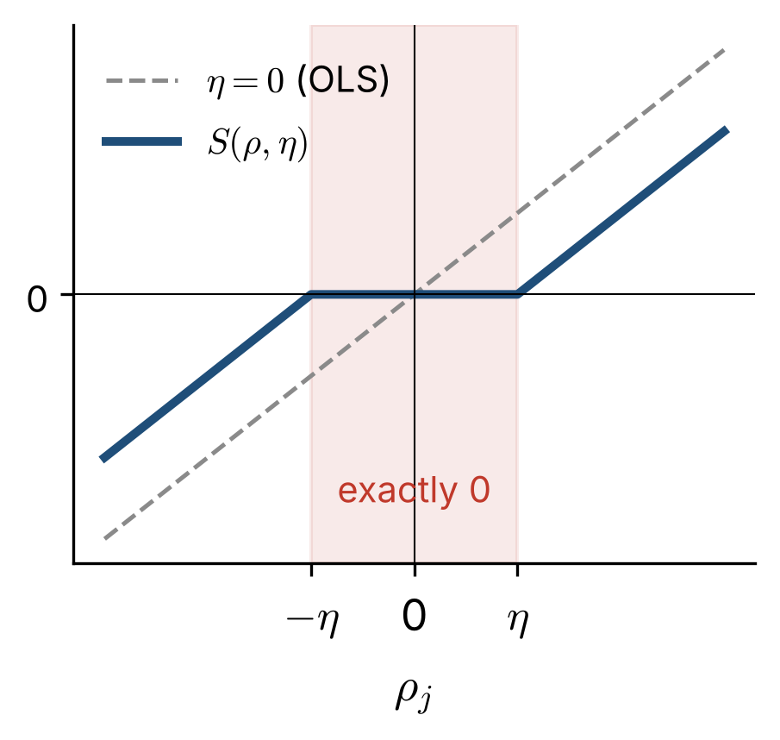
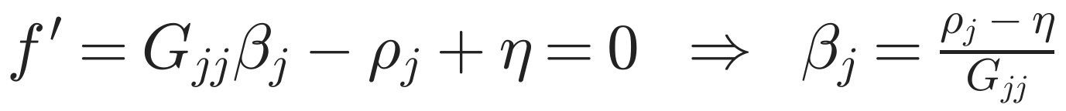
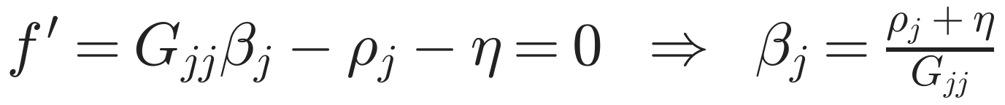
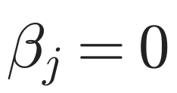
Derivation (2/2): The Soft-Threshold
4. Minimize f: convex, with a kink at 0
βⱼ > 0
valid only if ρⱼ > η
βⱼ < 0
valid only if ρⱼ < −η
|ρⱼ| ≤ η
neither case holds: the minimum sits on the kink
η = 0: βⱼ ← ρⱼ / Gⱼⱼ, which is Gauss–Seidel on the normal equation Gβ = c. No penalty returns OLS.
Notes:
The kink is what produces exact zeros. Each update can only lower a convex objective, so cycling over j converges to the lasso solution.

Slide 5
Pseudocode 1: Lasso by Coordinate Descent
LASSO(X, y, η) | columns of X standardized, y centered
G ← X^{T}X; c ← X^{T}y | same two quantities as the normal equation
β ← 0 | start with every feature switched off
repeat
for j = 1, …, d | d = 24 slopes
ρ_{j} ← c_{j} − Σ_{k≠j} G_{jk} β_{k} | what column j still explains
β_{j} ← S(ρ_{j}, η) / G_{jj} | the 1-D minimizer from the derivation
until max change in β < 10⁻¹⁰ | 107 sweeps at η = 0.05 η_{max}
return β
S(ρ, η) = sign(ρ) · max(|ρ| − η, 0) | soft-threshold: zero when |ρ| ≤ η
Checked in the notebook: η = 0 reproduces OLS, and η > 0 agrees with scikit-learn's lasso to 8 decimal places.

Slide 6
Pseudocode 2: Choosing η on Held-Out Data
CHOOSE-ETA(X, y, grid, K) | K = 5; grid: 40 values from η_{max} down, plus 0
assign every artist to one of K folds | an artist's lots stay together
for k = 1, …, K
standardize using the other K − 1 folds | held-out fold never touches the fit
for η in grid, largest first | η_{max} = max_{j} |c_{j}|: every β_{j} = 0
β ← LASSO(other folds, η) | Pseudocode 1, warm-started from the last β
err[η, k] ← mean squared error on fold k
cv(η) ← mean over k of err[η, k]
η* ← argmin cv(η) | best predictive power
return η*, LASSO(all data, η*) | then compare β(η*) with β(0)
Folds are by artist, not by lot: lots by one artist share fame and exposure, so splitting them would leak.

Slide 7
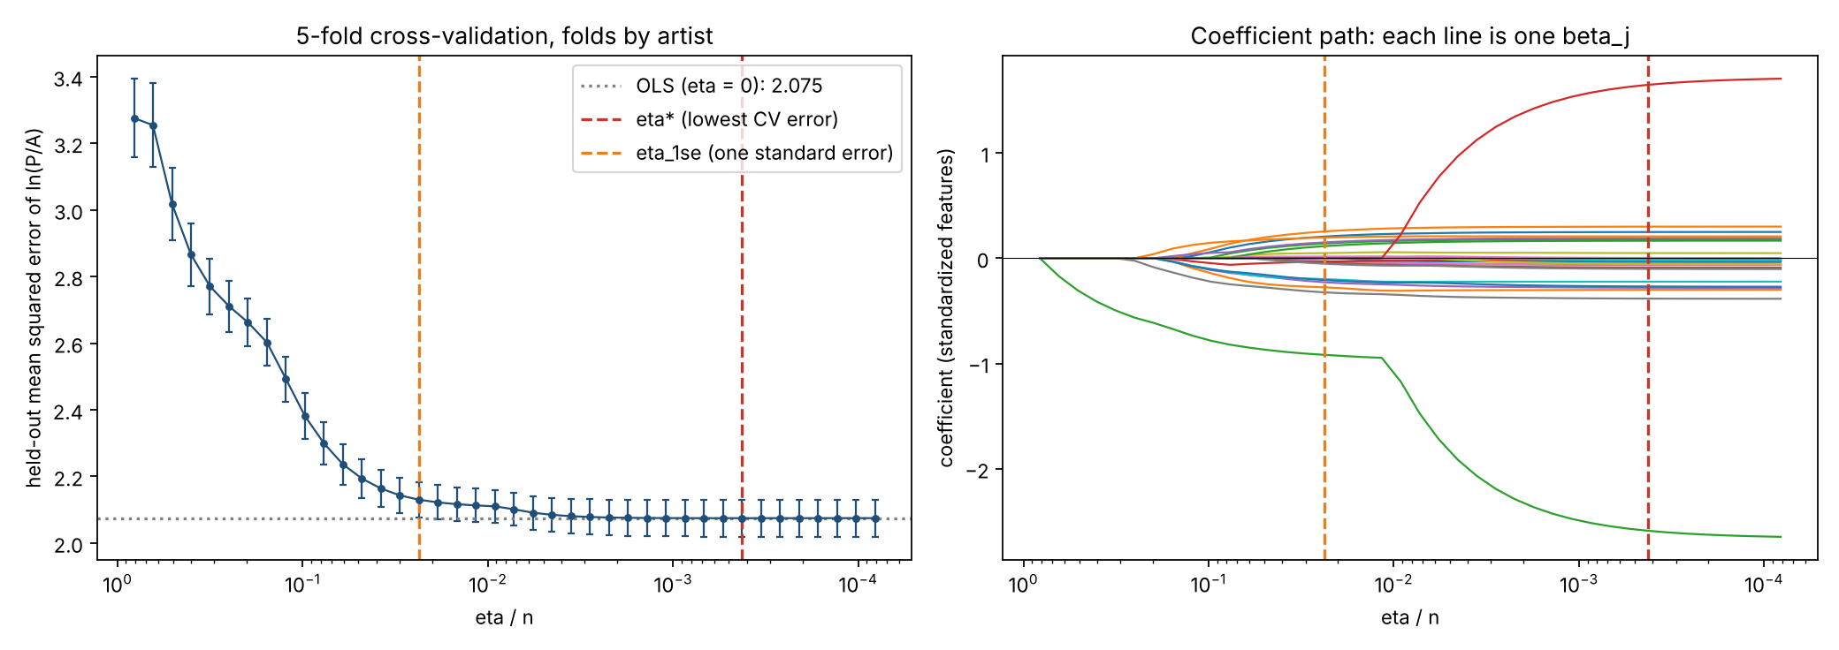
Demo: Sweeping η
Left: held-out error falls as the penalty is relaxed, then goes flat. The minimum is at η*/n = 0.0004.
Right: each line is one βⱼ. Features switch on one at a time as η shrinks.
Notes:
Run lasso_complexity_control.ipynb here: about 11 seconds top to bottom. eta_1se (orange) is the largest eta whose held-out error is within one standard error of the best.

Slide 8
Result: β(η*) Against β(0)
Coefficient | OLS, η = 0 | Lasso, η* | Lasso, η1se | OLS p
Exposure: established | 0.837 | 0.835 | 0.708 | <0.001
Medium: drawing | −0.727 | −0.722 | −0.590 | <0.001
Fame | 0.133 | 0.133 | 0.126 | <0.001
ln A | −2.078 | −2.022 | −0.717 | <0.001
(ln A)² | 0.085 | 0.081 | 0 | <0.001
Support: panel | −0.111 | −0.110 | 0 | 0.036
Created 2000+ | −0.148 | −0.138 | 0 | 0.050
Created pre-1800 | −0.138 | −0.123 | 0 | 0.251
Kept (of 24) | 24 | 24 | 20
R² on 2026 sales | 0.380 | 0.381 | 0.372
0.0001
gain in held-out error at η*, against a standard error of 0.056
−0.008
R² on 2026 sales from dropping 4 coefficients at η1se
Held-out data picks a penalty so small that β(η*) is essentially OLS.
Notes:
eta_1se is the largest penalty whose held-out error is within one standard error of the best. The 2026 sales were never used to fit or to choose eta.

Slide 9
What Complexity Control Tells Us
The model is not overfit
Limitation: collinear size terms
Limitation: shrunken coefficients
With about 900 sales per coefficient, held-out error is flat from η* down to η = 0. The hedonic model's 24 slopes are supported by the data.
ln A and (ln A)² move together, so lasso keeps one and drops the other. That is about the pair, not evidence that the size curve is a straight line.
Lasso coefficients are biased toward zero. Read them for which features survive; quote Jana's OLS table for effect sizes.
Next: if the linear model is not too complex, is it too simple? Section 5 tests that with a random forest.

