Slide 1

PREDICTING THE RISK OF WITHDRAWAL IN THE FIRST YEAR
Using a Machine Learning Approach to Forecasting Early Student Success

Slide 2
PREDICTING THE RISK OF WITHDRAWAL IN THE FIRST YEAR
Problem: How do we predict the risk of withdrawal in the first year?
Solution: By running a series of “trained” machine learning models on the latest available student and socioeconomic data.
Our student risk model uses these data to predict the probability that a student will not persist into the next academic year.
The training is done using historical data from prior year cohorts and the derived weights combine to yield the risk of withdrawal for students in the current year cohort.
For this presentation, the population of interest is full-time freshmen for Pullman in the 2022 academic year. But this is expanded to domestic full-time freshmen and transfers for all campuses in our production models.

Slide 3

What are we going to talk about?
Machine learning
Our data
Our variables
Our modeling strategy
Baseline performance
Interpretation of results
Proof of concept dashboard
Limitations, details, and your questions
Please interrupt me!
OVERVIEW

Slide 4
Terminology alert!*
ML 101
What is machine learning anyway?
Based on prior data, an algorithm attempts to generalize what will happen if given new data, and suggests an outcome.
An algorithm, huh?
It’s a process in which a set of rules or steps are followed in calculations or other problem-solving operations.
Training, testing, bias, variance, oh my!
After fit to prior data, the ideal algorithm has low bias, that is, it accurately models the true relationship when encountering new data, and it has low variance, that is, it produces consistent predictions across different sets of new data.
*Shout out to StatQuest with Josh Starmer: https://www.youtube.com/channel/UCtYLUTtgS3k1Fg4y5tAhLbw
MACHINE LEARNING

Slide 5
Moving-Window Analysis with Longitudinal Data
Train
Predict
Year 1
Train
Predict
Year 2
Train
Predict
Year 3
Past
Time
Future
DATA

Slide 6
Similar idea here.
Pre-census
Admissions and socioeconomic data. Variables include high school GPA, poverty rate, education rate, median income, racial/ethnic makeup, etc.
Census
College, program/plan, and coursework data. Variables include direct transfer agreement (DTA) degrees, AP test credits, Running Start, etc.
Mid-term
Student performance data. Variables include mid-term GPA, number of withdrawn credit hours, etc.
Past
Time
Future
VARIABLES

Slide 7
Ensemble Model
Logistic Regression
Classifier
Stochastic Gradient Descent
Multi-layer Perceptron Classifier
Currently used
Currently used
In the future
Interpretable
Accurate
MODELING

Slide 8
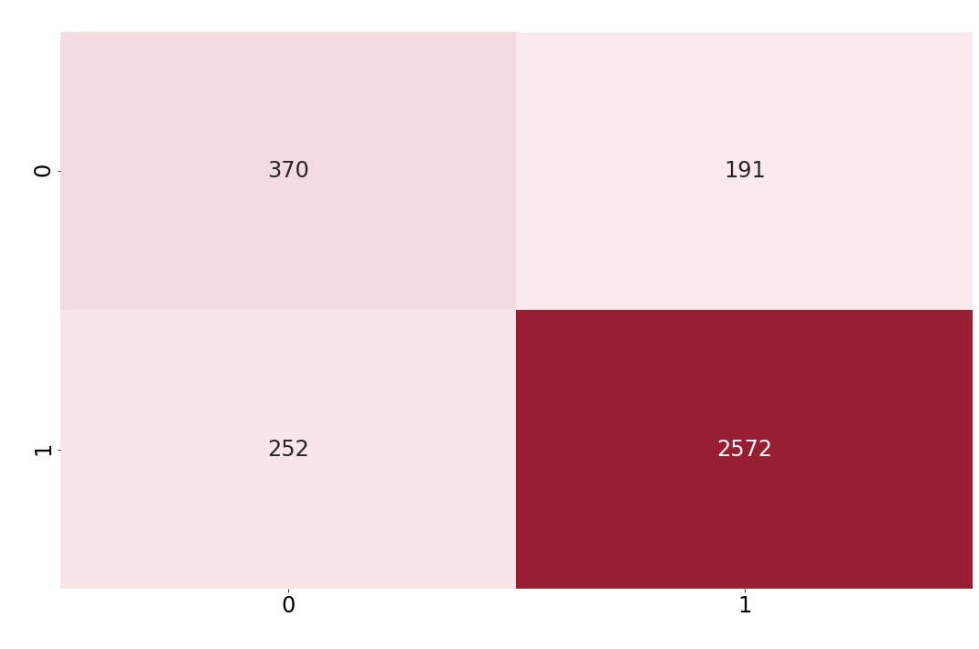
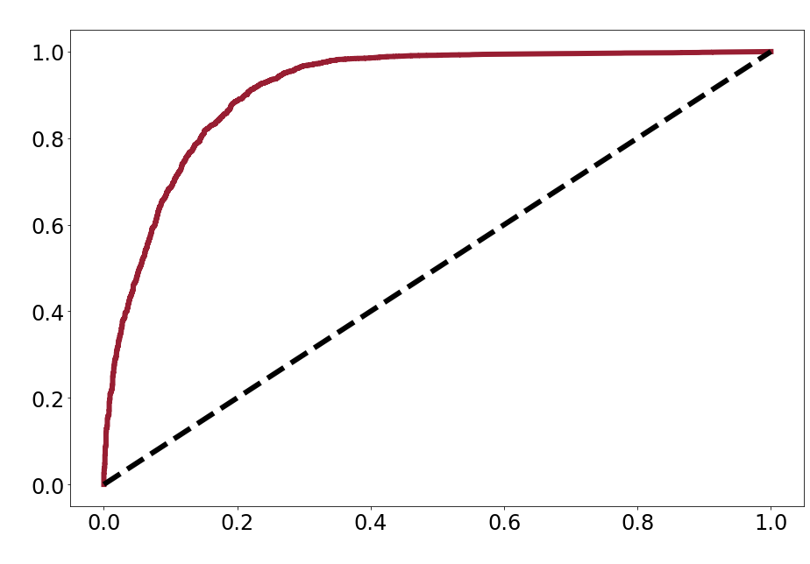
So, how is baseline performance?
Ensemble Confusion Matrix
Ensemble ROC Curve
True Class
True-Positive Rate (Sensitivity)
Predicted Class
.9140 AUC
Ehhh … excellent (Gorunescu et al. 2011).
False-Positive Rate (1 – Specificity)
PERFORMANCE

Slide 9
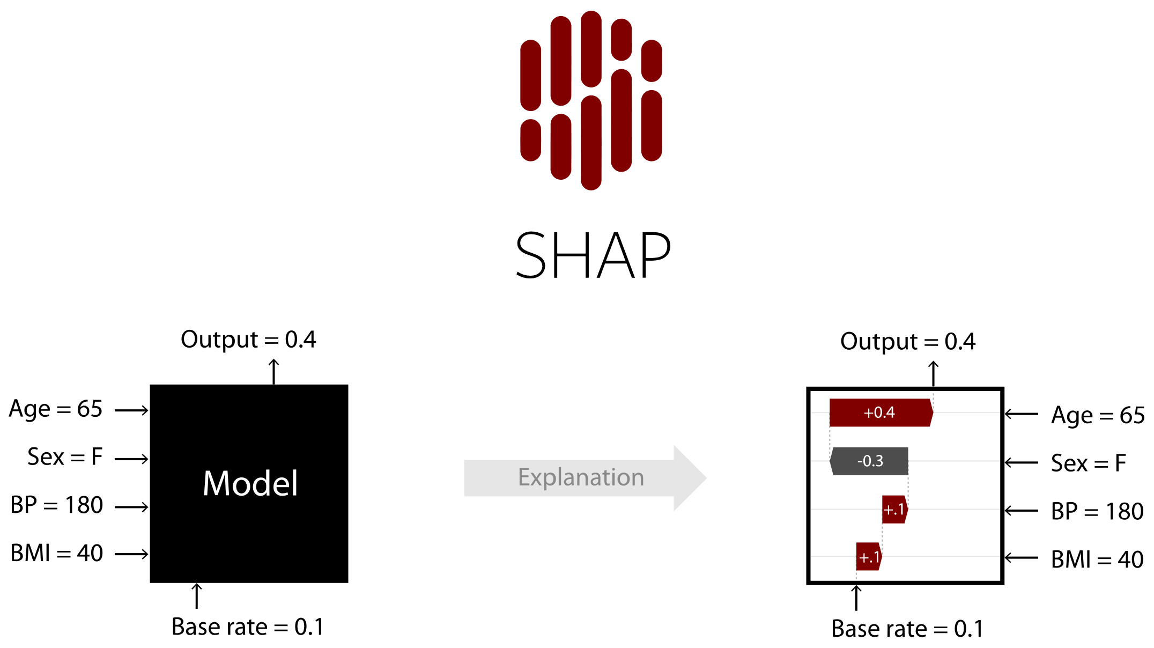
But what do the results mean?
Lundberg, Scott M., and Su-In Lee. (2017). A Unified Approach to Interpreting Model Predictions. In I. Guyon, U. V. Luxburg, S. Bengio, H. Wallach, R. Fergus, S. Vishwanathan, & R. Garnett (Eds.), Advances in Neural Information Processing Systems 30 (pp. 4765–4774). http://papers.nips.cc/paper/7062-a-unified-approach-to-interpreting-model-predictions.pdf
INTERPRETATION

Slide 10
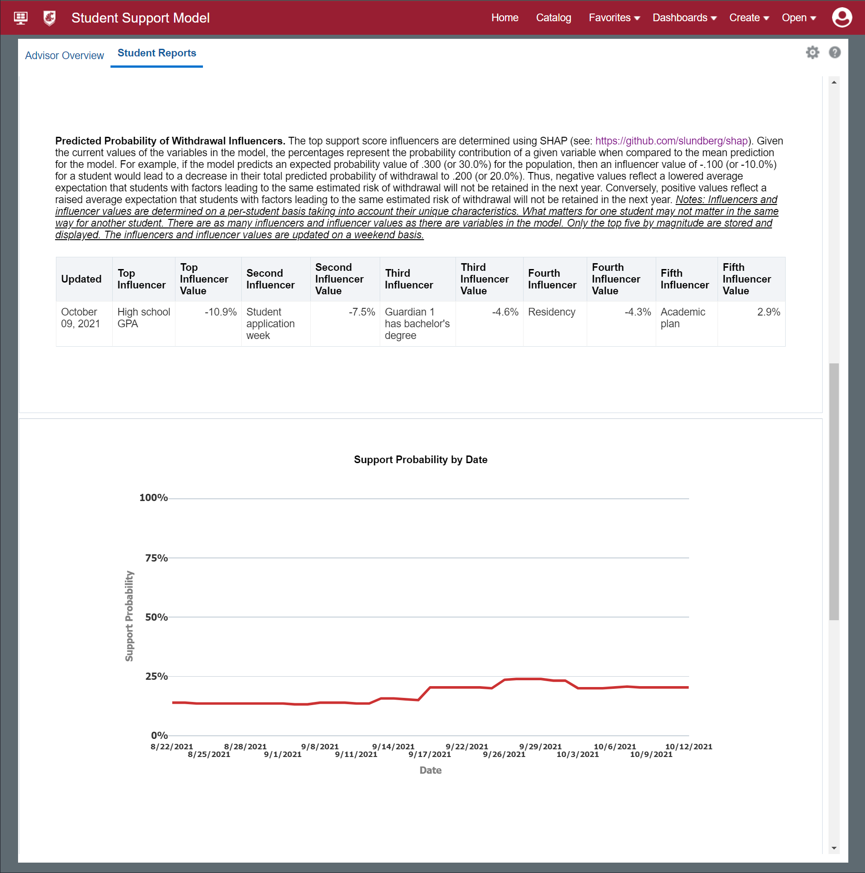
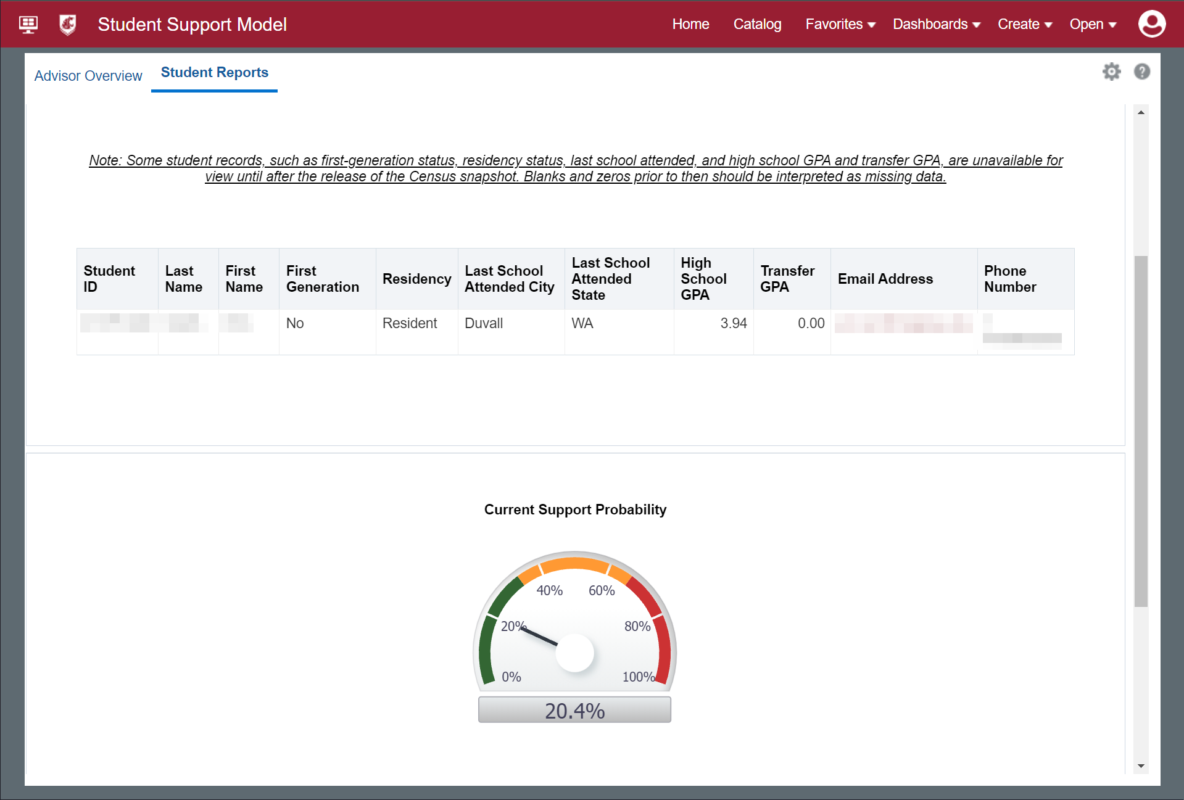
Communication is key.
What’s communication?
DASHBOARD

Slide 11
There are many benefits.
In-house ML solution
Built using existing products
Flexible enough for a variety of outcomes
Strong baseline performance
But there are tasks ahead.
MLP, new variables, new outcomes, and the data unknowns
In summary.
WRAP-UP

Slide 12

Thanks for listening!
https://wsuaacprodoac-wsucloud.analytics.ocp.oraclecloud.com

