Slide 1

PREDICTING THE RISK OF WITHDRAWAL IN THE FIRST YEAR
Using a Machine Learning Approach to Forecasting Early Student Success

Slide 2
PREDICTING THE RISK OF WITHDRAWAL IN THE FIRST YEAR
Problem: How do we predict the risk of withdrawal in the first year?
Solution: By running a series of “trained” machine learning models on the latest available student and socioeconomic data.
Our student risk model uses these data to predict the probability that a student will not persist into the next academic year.
The training is done using historical data from prior year cohorts and the derived weights combine to yield the risk of withdrawal for students in the current year cohort.
For our proof of concept, the population of interest is full-time Pullman freshmen in the 2021 academic year.

Slide 3

What are we going to talk about?
The data
The variables
Our modeling strategy
Model performance
Proof of concept dashboard
Limitations, details, and your questions
Please interrupt me!
OVERVIEW

Slide 4
Walk-forward Analysis with Longitudinal Data
Train
Predict
Year 1
Train
Predict
Year 2
Train
Predict
Year 3
Past
Time
Future
DATA

Slide 5
Similar idea here.
Pre-census
Admissions and socioeconomic data. Variables include high school GPA, poverty rate, education rate, median income, racial/ethnic makeup, etc.
Census
College, program/plan, and coursework data. Variables include direct transfer agreement (DTA) degrees, AP test credits, Running Start, etc.
Mid-term
Student performance data. Variables include mid-term GPA, number of withdrawn credit hours, etc.
Past
Time
Future
VARIABLES

Slide 6
Ensemble Model
Logistic Regression
Classifier
Stochastic Gradient Descent
Multi-layer Perceptron Classifier
Currently used
Currently used
In the future
Interpretable
Accurate
MODELING

Slide 7
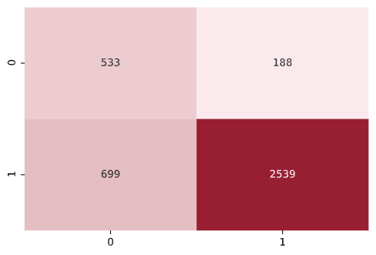
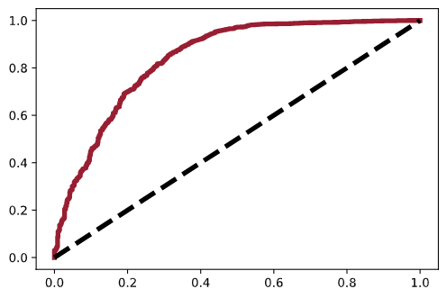
So, how is model performance?
Ensemble Confusion Matrix
Ensemble ROC Curve
True Class
True-Positive Rate (Sensitivity)
Predicted Class
.8403 AUC
Ehhh … good (Gorunescu et al. 2011).
False-Positive Rate (1 – Specificity)
PERFORMANCE

Slide 8
There are many benefits.
In-house ML solution
Built using existing products
Flexible enough for a variety of outcomes
Strong baseline performance
But there are tasks ahead.
MLP, SHAP, new variables, and the unknowns
In summary.
WRAP-UP

Slide 9

Thanks for listening!
https://wsuaacprodoac-wsucloud.analytics.ocp.oraclecloud.com/

