Slide 1
Bagging-SVM2
Reporter: Gengzangcuomao
Members: Ziqi Zhou
Mingjie Li
Xing Xia
Cairangdangzhi
Qian Wu
Wanmecuo

Slide 2
What’s SVM?
Gather and prepare the data
Start by collecting data that includes class labels
Split the data into training and testing sets
Choose a kernel function
kernels include linear, polynomial, and Gaussian RBF
Set model parameters(C)
Train and test the model on data
Tune the parameters
Predict the outcome

Slide 3
What’s SVM?
Algorithm 1 SVM
Require: Gather and prepare the data; start by collecting data X, class labels y; Split the data into training and testing sets X_training, X_testing; Input:
Input feature X, class labels y;
Output:
Predict the various indicators;
step1: Choose a kernel function, kernels include linear, polynomial, Gaussian
RBF and sigmoid;
step2: fit(X_training, y_training) Satisfy the constraints: s.t return various indicators
step3: end fit

Slide 4
What’s Bagging-SVM2?
ALgorithm 2 Bagging-SVM
Require: Gather and prepare the data; start by collecting data X, class labels y; Smot upsampling; Split the data into training and testing sets X_training, X_testing; Input:
Input feature X, class labels y;
Output:
Predict the various indicators;
step1: Trains n base learners in parallel
step2: Each learner is trained on data by randomly sampling Assume m training examples, then randomly sampling m examples
Around 1/2 examples will be sampled
step3: Make decisions by majority voting(classification)

Slide 5
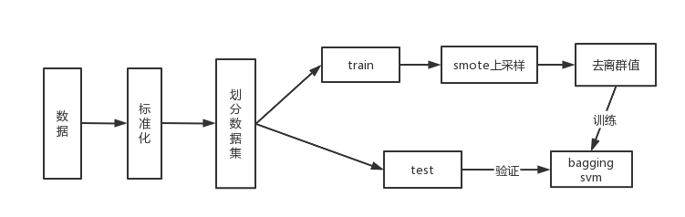
What’s Bagging-SVM2?

Slide 6
What’s Bagging-SVM2?
Algorithm 3 Bagging-SVM2
Require: Gather and prepare the data; Standardize the features of data X; Perform smote upsampling on the training set; Remove outliers features in features of X_training; Input:
Input feature X; class labels y;
Output:
Predict the various indicators;
step1: Trains n base learners in parallel
step2: Each learner is trained on data by randomly sampling Assume m training examples, then randomly sampling m examples
Around 1/2 examples will be sampled
step3: Make decisions by majority voting(classification)

Slide 7
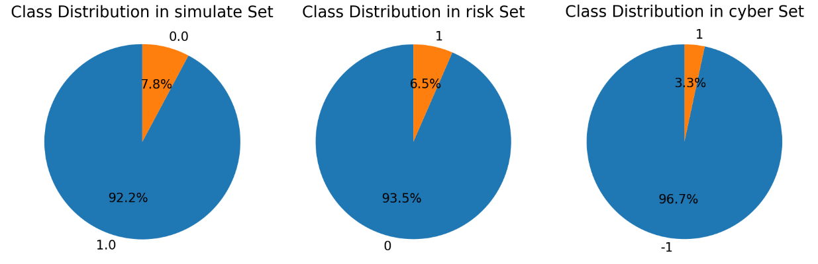
Data visualization
Figure1 Results of class distribution in different datasets

Slide 8
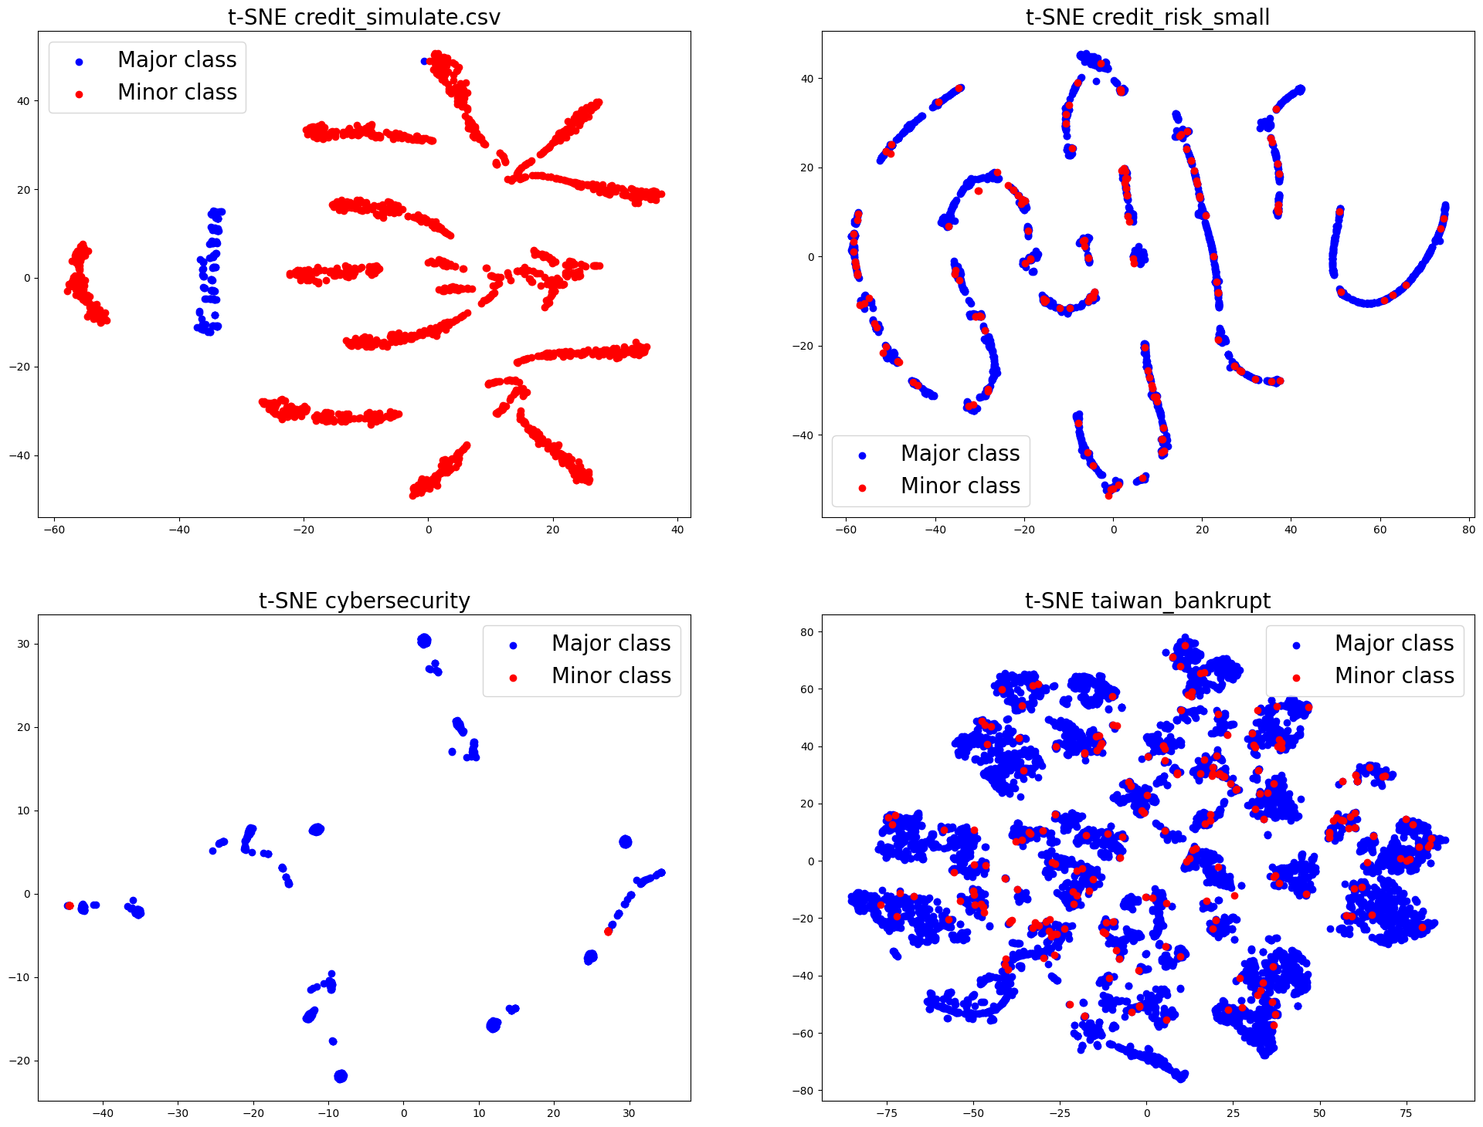
Data visualization（without MinMaxScaler）
Figure2.1 Visualization of t-SNE in different dataset(without MinMaxScaler)

Slide 9
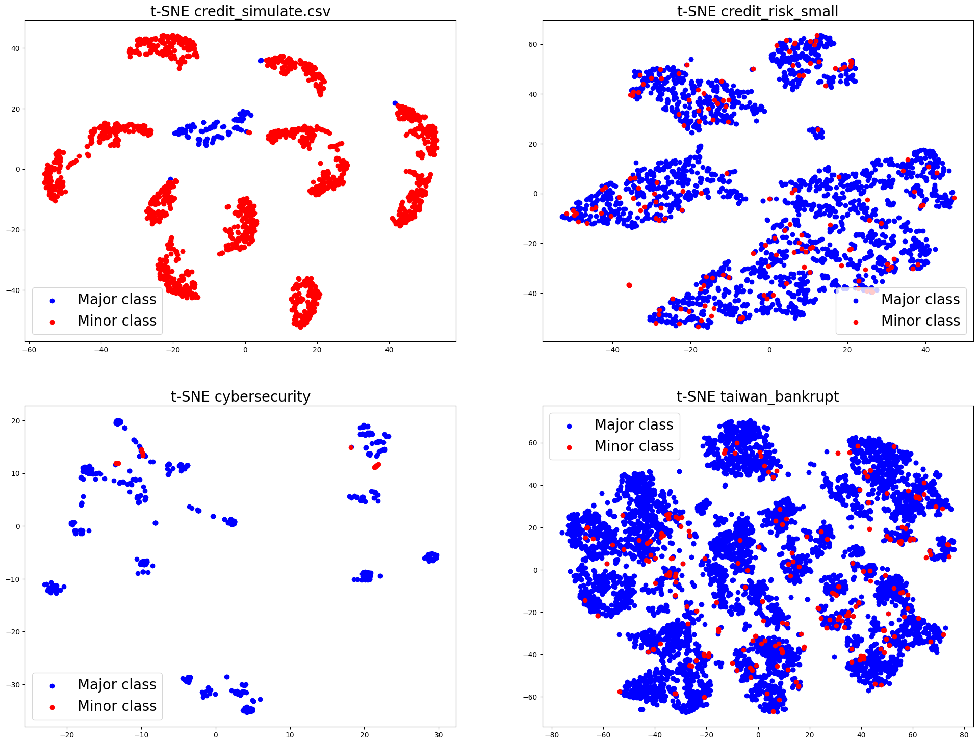
Data visualization（ MinMaxScaler）
Figure2 Visualization of t-SNE in different dataset

Slide 10
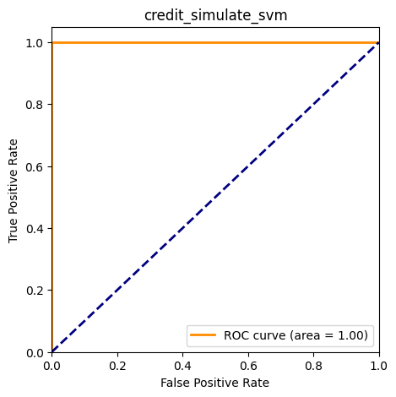
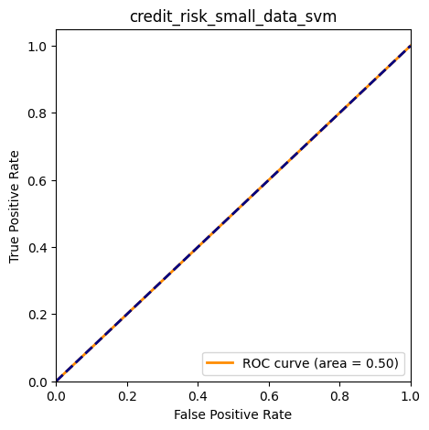
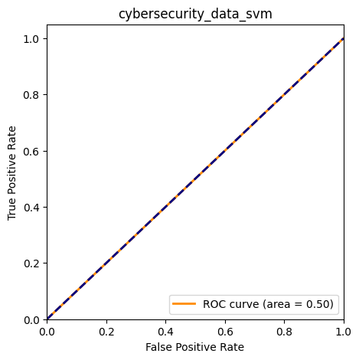
Resolving dataset imbalances_SVM
Figure3 Results of SVM in different dataset

Slide 11
Resolving dataset imbalances_SVM
Table 1 Credit_data_simulate_svm
Credit_data_simulate | precision | recall | f1-score | support
0 | 1.00 | 1.00 | 1.00 | 27
1 | 1.00 | 1.00 | 1.00 | 307
accuracy | -- | -- | 1.00 | 334
macro avg | 1.00 | 1.00 | 1.00 | 334
weight avg | 1.00 | 1.00 | 1.00 | 334

Slide 12
Resolving dataset imbalances_SVM
Table 2 credit_risk_small_data_svm
credit_risk_small_data | precision | recall | f1-score | support
0 | 0.92 | 1.00 | 0.96 | 444
1 | 0.00 | 0.00 | 0.00 | 37
accuracy | -- | -- | 0.92 | 481
macro avg | 0.46 | 0.50 | 0.48 | 481
weight avg | 0.85 | 0.92 | 0.89 | 481

Slide 13
Resolving dataset imbalances_SVM
Table 3 cybersecurity_data_svm
cybersecurity_data | precision | recall | f1-score | support
-1 | 0.96 | 1.00 | 0.98 | 98
1 | 0.00 | 0.00 | 0.00 | 4
accuracy | -- | -- | 0.96 | 102
macro avg | 0.48 | 0.50 | 0.49 | 102
weight avg | 0.92 | 0.96 | 0.94 | 102

Slide 14

Resolving dataset imbalances_SVM
Dataset : taiwan_bankrupt_data
Table 4 cybersecurity_data_svm
taiwan_bankrupt_data | precision | recall | f1-score | support
0 | 0.96 | 1.00 | 0.98 | 1313
1 | 0.00 | 0.00 | 0.00 | 51
accuracy | -- | -- | 0.96 | 1364
macro avg | 0.48 | 0.50 | 0.49 | 1364
weight avg | 0.93 | 0.96 | 0.94 | 1364
Figure4 Results of SVM in Taiwan_brankrupt_data dataset

Slide 15
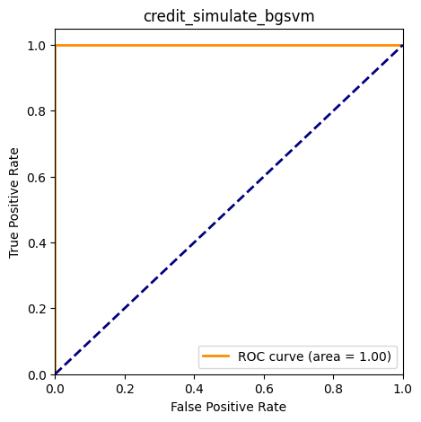
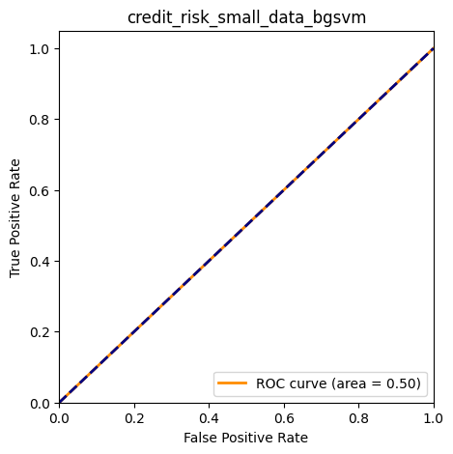
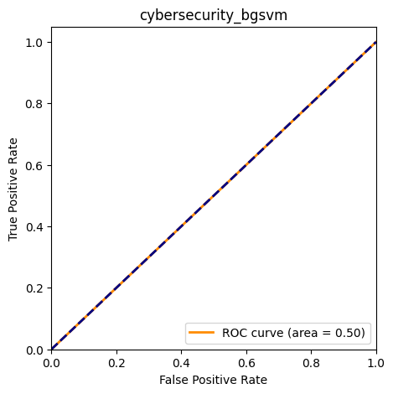
Resolving dataset imbalances_bagging_SVM
Figure5 Results of Bagging_SVM in different dataset

Slide 16
Resolving dataset imbalances_bagging_SVM
Table 5 Credit_data_simulate_bagging_svm
Credit_data_simulate | precision | recall | f1-score | support
0 | 1.00 | 1.00 | 1.00 | 27
1 | 1.00 | 1.00 | 1.00 | 307
accuracy | -- | -- | 1.00 | 334
macro avg | 1.00 | 1.00 | 1.00 | 334
weight avg | 1.00 | 1.00 | 1.00 | 334

Slide 17
Resolving dataset imbalances_bagging_SVM
Table 6 credit_risk_small_data_bagging_svm
credit_risk_small_data | precision | recall | f1-score | support
0 | 0.92 | 1.00 | 0.96 | 444
1 | 0.00 | 0.00 | 0.00 | 37
accuracy | -- | -- | 0.92 | 481
macro avg | 0.46 | 0.50 | 0.48 | 481
weight avg | 0.85 | 0.92 | 0.89 | 481

Slide 18
Resolving dataset imbalances_baggingSVM
Table 7 cybersecurity_data_baggingsvm
cybersecurity_data | precision | recall | f1-score | support
-1 | 0.96 | 1.00 | 0.98 | 98
1 | 1.00 | 1.00 | 0.00 | 4
accuracy | -- | -- | 0.96 | 102
macro avg | 0.48 | 0.50 | 0.49 | 102
weight avg | 0.92 | 0.96 | 0.94 | 102

Slide 19
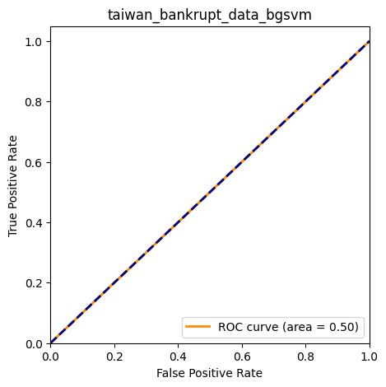
Resolving dataset imbalances_baggingSVM
Table 8 taiwan_bankrupt_data_baggingsvm
taiwan_bankrupt_data | precision | recall | f1-score | support
0 | 0.96 | 1.00 | 0.98 | 1313
1 | 0.00 | 0.00 | 0.00 | 51
accuracy | -- | -- | 0.96 | 1364
macro avg | 0.48 | 0.50 | 0.49 | 1364
weight avg | 0.93 | 0.96 | 0.94 | 1364
Figure6 Results of Bagging_SVM in Taiwan_bankrupt_ dataset

Slide 20

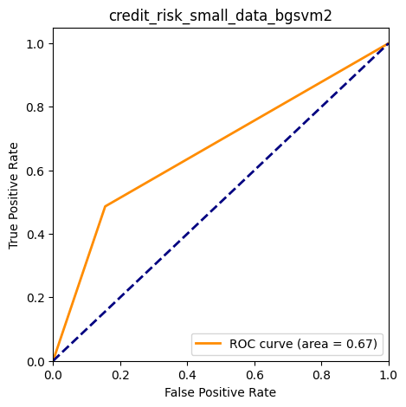
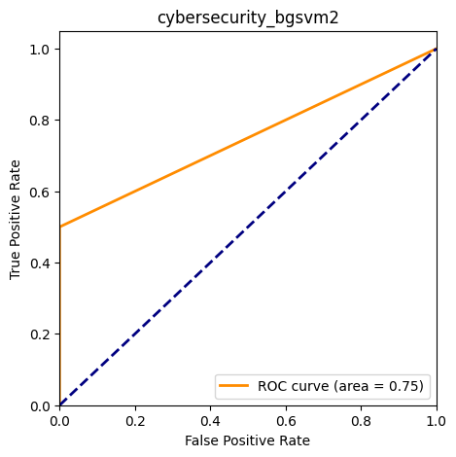
Resolving dataset imbalances_baggingSVM2
Figure7 Results of Bagging_SVM2 in different dataset

Slide 21
Resolving dataset imbalances_baggingSVM2
Table 9 credit_data_simulate_baggingsvm2
credit_data_simulate | precision | recall | f1-score | support
0 | 1.00 | 1.00 | 1.00 | 27
1 | 1.00 | 1.00 | 1.00 | 307
accuracy | -- | -- | 1.00 | 334
macro avg | 1.00 | 1.00 | 1.00 | 334
weight avg | 1.00 | 1.00 | 1.00 | 334

Slide 22
Resolving dataset imbalances_baggingSVM2
Table10 credit_risk_small_data_baggingsvm2
credit_risk_small_data | precision | recall | f1-score | support
0 | 0.95 | 0.83 | 0.89 | 444
1 | 0.19 | 0.49 | 0.28 | 37
accuracy | -- | -- | 0.80 | 481
macro avg | 0.57 | 0.66 | 0.58 | 481
weight avg | 0.89 | 0.80 | 0.84 | 481

Slide 23
Resolving dataset imbalances_baggingSVM2
Table11 cybersecurity_data_baggingsvm2
cybersecurity_data | precision | recall | f1-score | support
-1 | 0.98 | 1.00 | 0.99 | 98
1 | 1.00 | 0.50 | 0.67 | 4
accuracy | -- | -- | 0.98 | 102
macro avg | 0.99 | 0.75 | 0.83 | 102
weight avg | 0.98 | 0.98 | 0.98 | 102

Slide 24
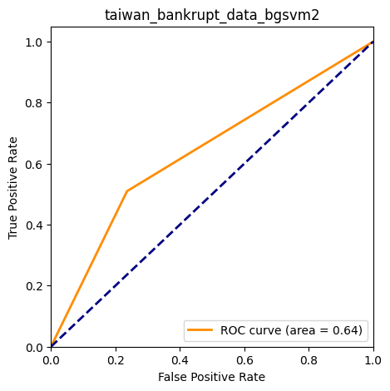
Resolving dataset imbalances_baggingSVM2
Table12 taiwan_bankrupt_data_baggingsvm2
taiwan_bankrupt_data | precision | recall | f1-score | support
0 | 0.98 | 0.76 | 0.86 | 1313
1 | 0.08 | 0.53 | 0.14 | 51
accuracy | -- | -- | 0.76 | 1364
macro avg | 0.53 | 0.65 | 0.50 | 1364
weight avg | 0.94 | 0.76 | 0.83 | 1364
Figure8 Results of Bagging_SVM2 in Taiwan_bankrupt_ dataset

Slide 25
Performances of Bagging SVM and Bagging SVM2 in different dataset
credit_data_simulate
 | class | precision | recall | f1-score | support | accuracy | f1-macro | f1-weighted | support
SVM | 0 | 1.00 | 1.00 | 1.00 | 27 | 1.00 | 1.00 | 1.00 | 334
 | 1 | 1.00 | 1.00 | 1.00 | 307
bagging svm | 0 | 1.00 | 1.00 | 1.00 | 27 | 1.00 | 1.00 | 1.00 | 334
 | 1 | 1.00 | 1.00 | 1.00 | 307
bagging svm2 | 0 | 1.00 | 1.00 | 1.00 | 27 | 1.00 | 1.00 | 1.00 | 334
 | 1 | 1.00 | 1.00 | 1.00 | 307

Slide 26
Performances of Bagging SVM and Bagging SVM2 in different dataset
credit_risk_small_data
 | class | precision | recall | f1-score | support | accuracy | f1-macro | f1-weighted | support
SVM | 0 | 0.92 | 1.00 | 0.96 | 444 | 0.92 | 0.48 | 0.89 | 481
 | 1 | 0.00 | 0.00 | 0.00 | 37
bagging svm | 0 | 0.92 | 1.00 | 0.96 | 444 | 0.92 | 0.48 | 0.89 | 481
 | 1 | 0.00 | 0.00 | 0.00 | 37
bagging svm2 | 0 | 0.95 | 0.83 | 0.89 | 444 | 0.80 | 0.58 | 0.84 | 481
 | 1 | 0.19 | 0.49 | 0.28 | 37

Slide 27
Performances of Bagging SVM and Bagging SVM2 in different dataset
cybersecurity_data
 | class | precision | recall | f1-score | support | accuracy | f1-macro | f1-weighted | support
SVM | -1 | 0.96 | 1.00 | 0.98 | 98 | 0.96 | 0.49 | 0.94 | 102
 | 1 | 0.00 | 0.00 | 0.00 | 4
bagging svm | -1 | 0.96 | 1.00 | 0.98 | 98 | 0.96 | 0.49 | 0.94 | 102
 | 1 | 0.00 | 0.00 | 0.00 | 4
bagging svm2 | -1 | 0.98 | 1.00 | 0.99 | 98 | 0.98 | 0.83 | 0.98 | 102
 | 1 | 1.00 | 0.50 | 0.67 | 4

Slide 28
Performances of Bagging SVM and Bagging SVM2 in different dataset
taiwan_bankrupt_data
 | class | precision | recall | f1-score | support | accuracy | f1-macro | f1-weighted | support
SVM | 0 | 0.96 | 1.00 | 0.98 | 1313 | 0.96 | 0.49 | 0.94 | 1364
 | 1 | 0.00 | 0.00 | 0.00 | 51
bagging svm | 0 | 0.96 | 1.00 | 0.98 | 1313 | 0.96 | 0.49 | 0.94 | 1364
 | 1 | 0.00 | 0.00 | 0.00 | 51
bagging svm2 | 0 | 0.98 | 0.76 | 0.86 | 1313 | 0.76 | 0.50 | 0.83 | 1364
 | 1 | 0.08 | 0.53 | 0.14 | 51

Slide 29
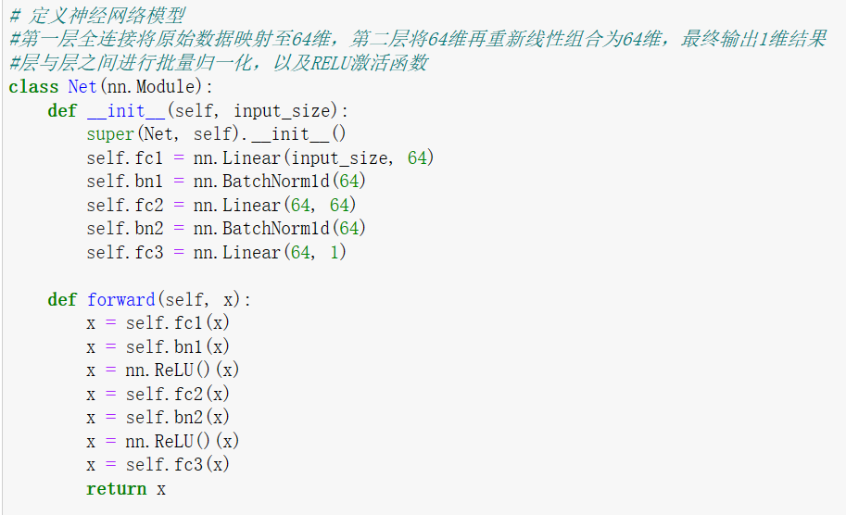
Three deep learning model——DNN

Slide 30
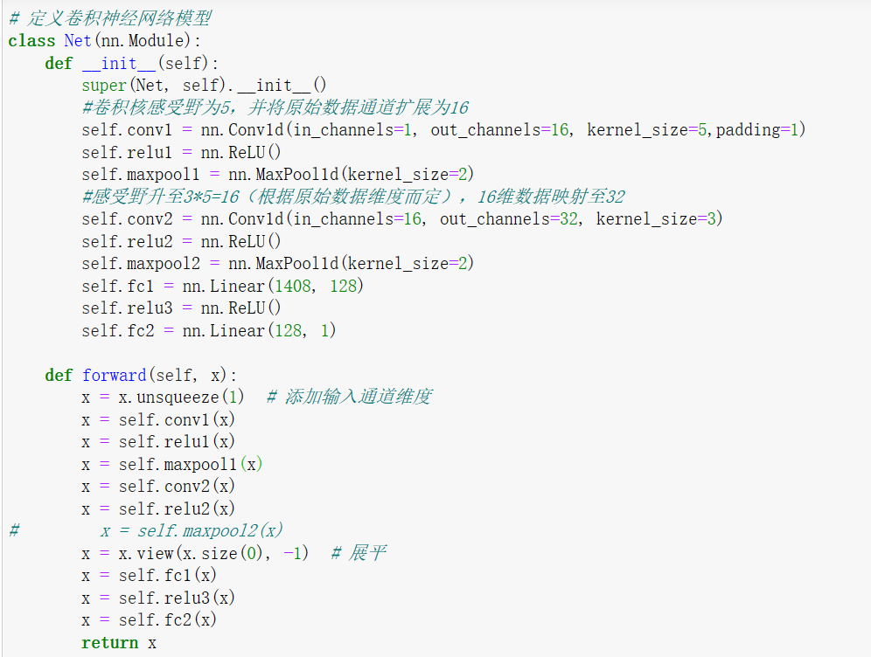
Three deep learning model——CNN

Slide 31
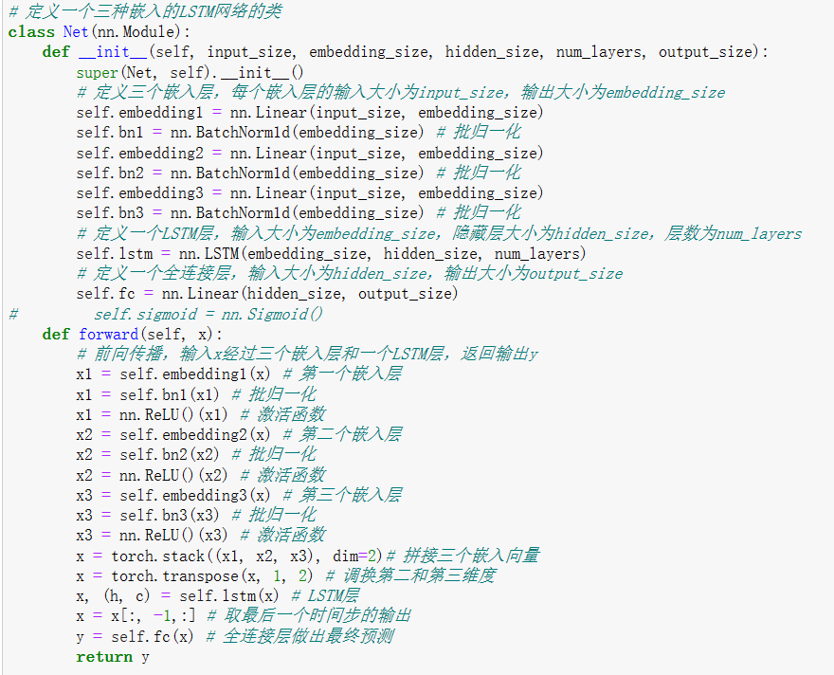
Three deep learning model——LSTM

Slide 32
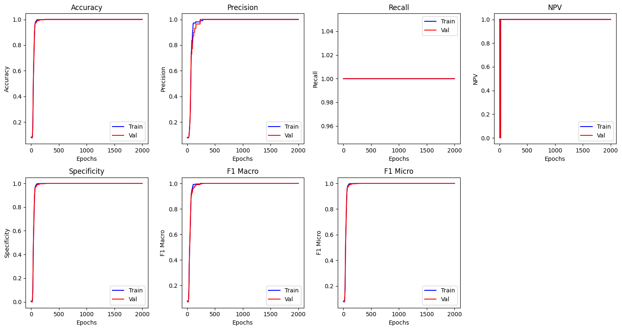
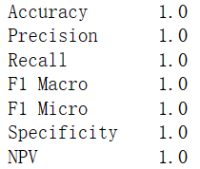
Three deep learning model——DNN
Credit simulate

Slide 33
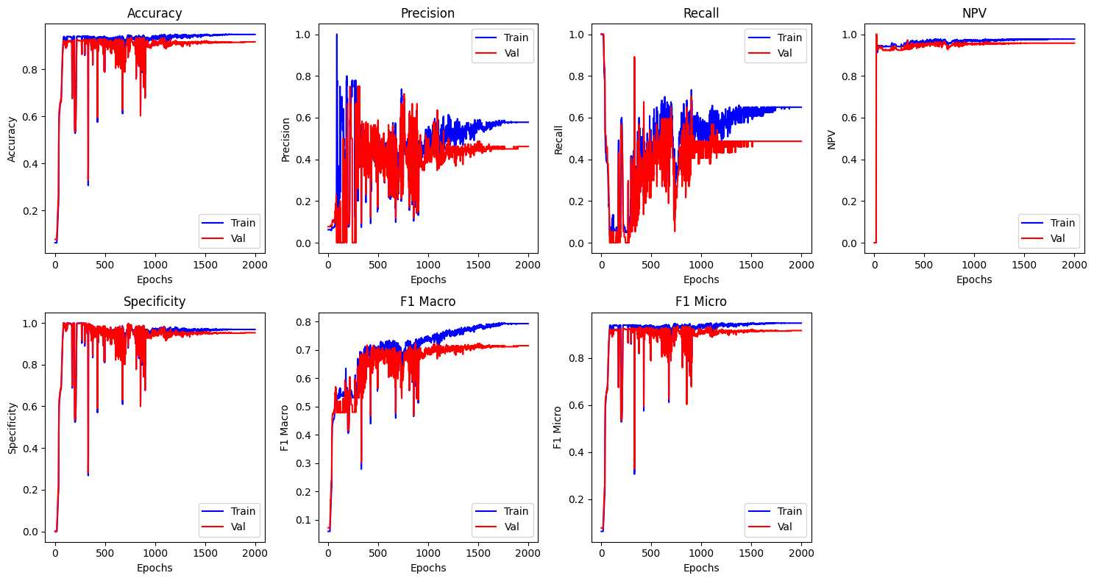
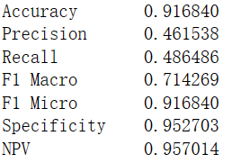
Three deep learning model——DNN
Credit risk

Slide 34
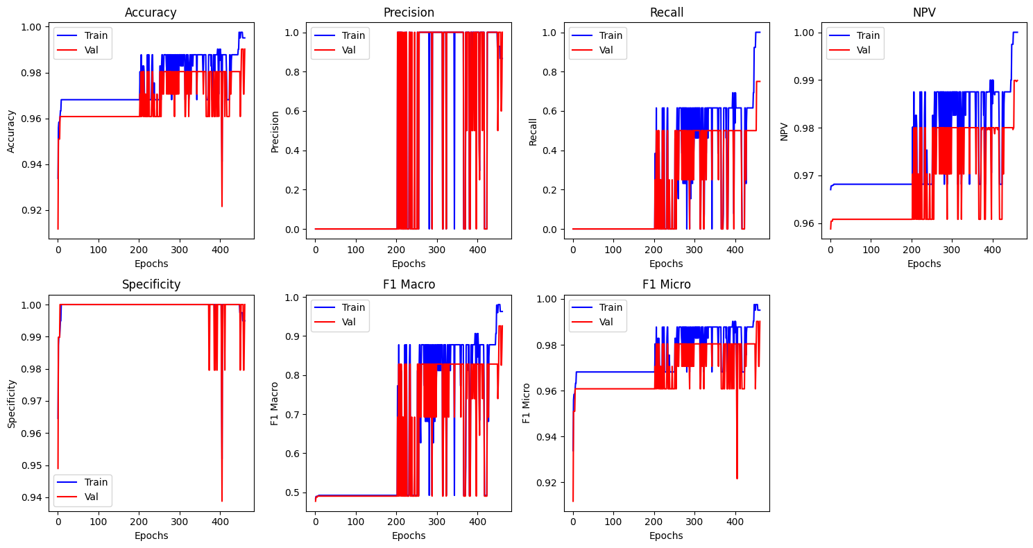
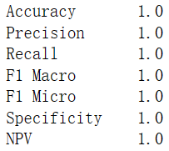
Three deep learning model——DNN
Cybersecurity

Slide 35
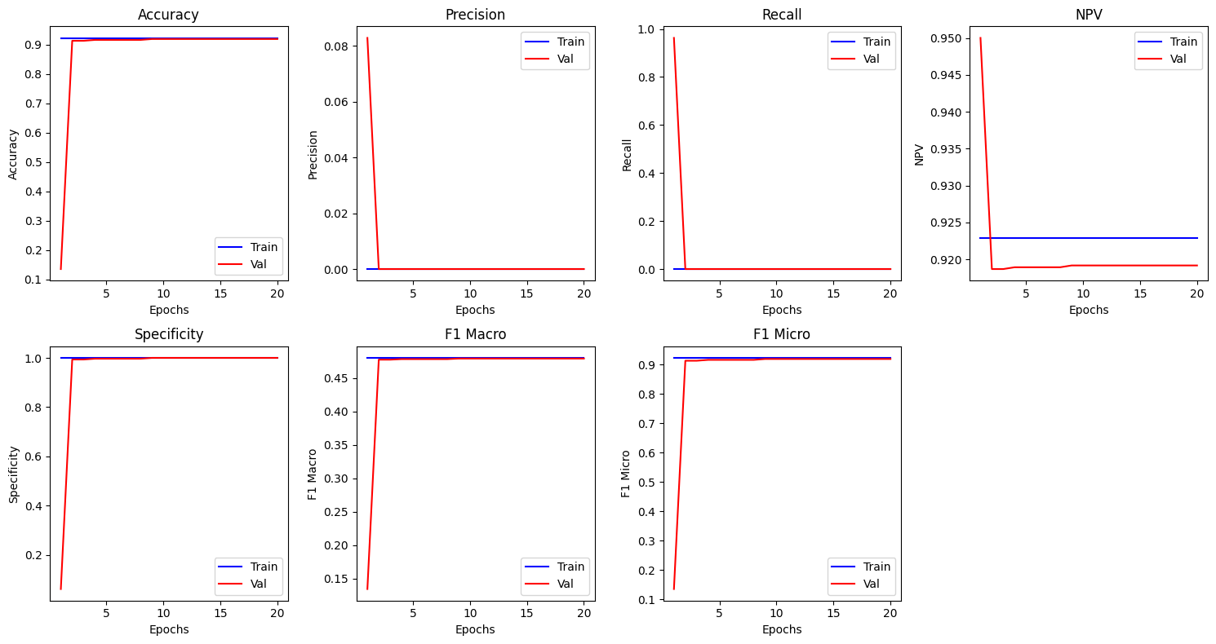
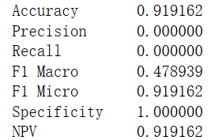
LSTM
Credit simulate/Credit risk/Cybersecurity/Taiwan bankrupt

Slide 36
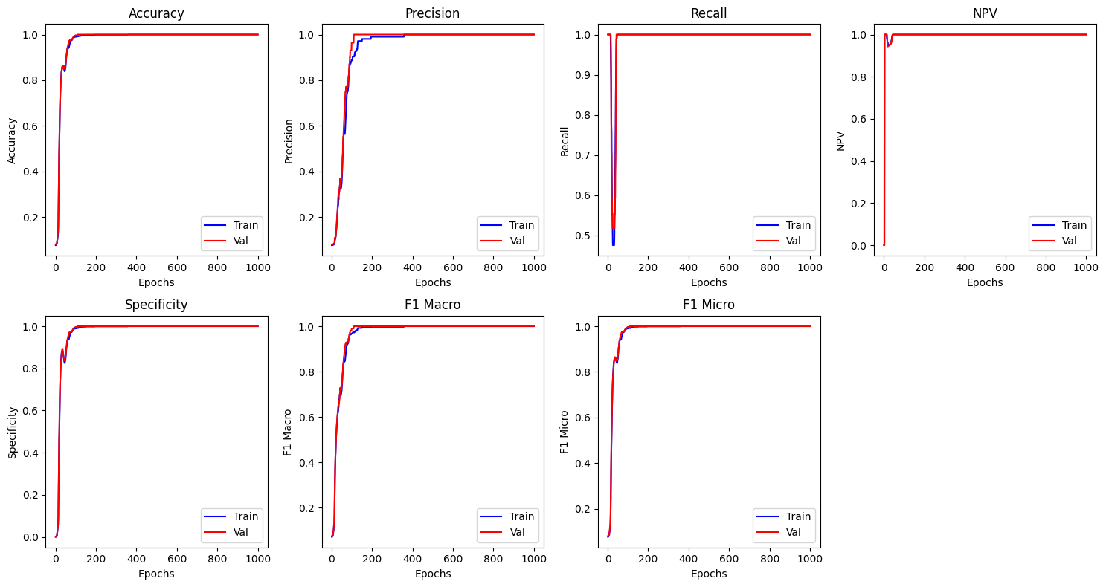
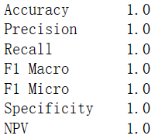
CNN
Credit simulate

Slide 37
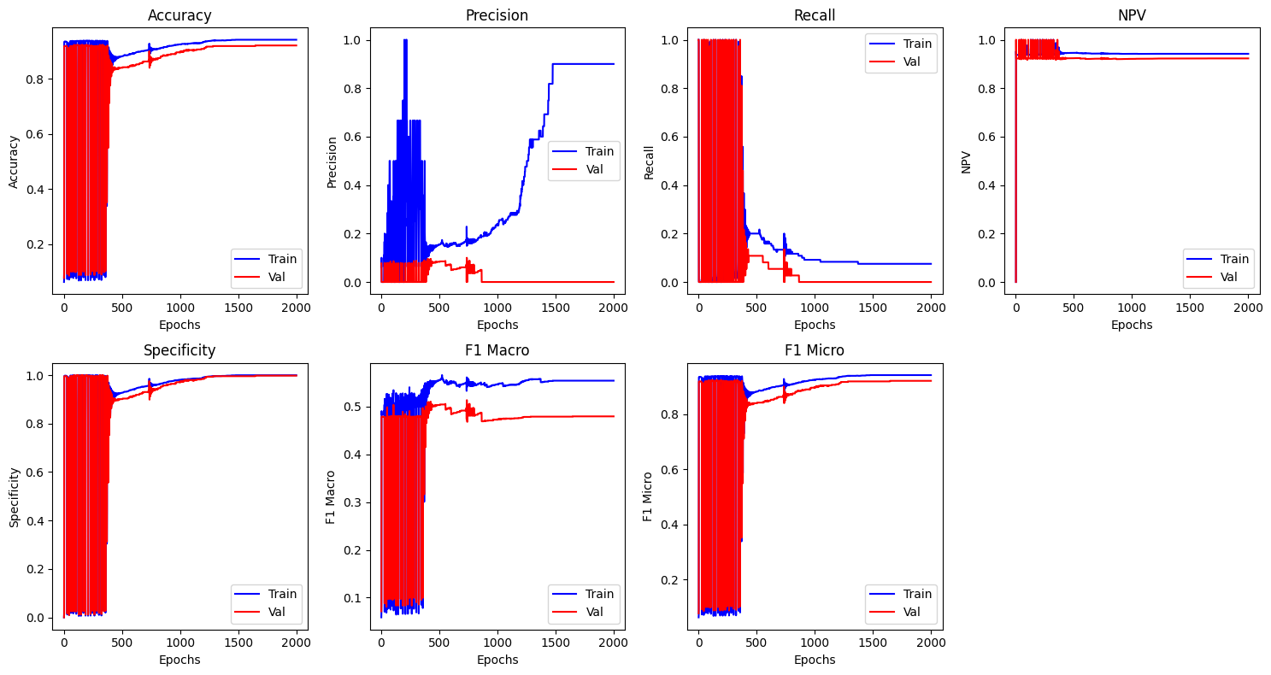
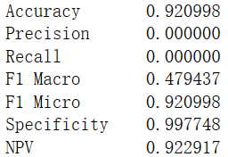
CNN
Credit risk

Slide 38
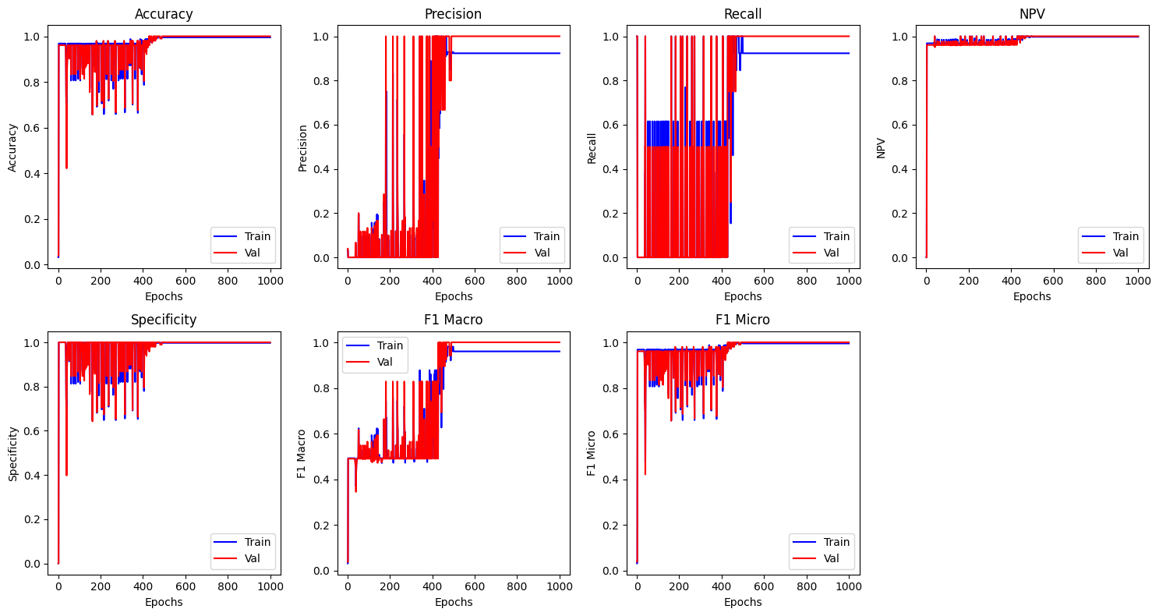
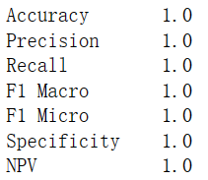
CNN
Cybersecurity

Slide 39
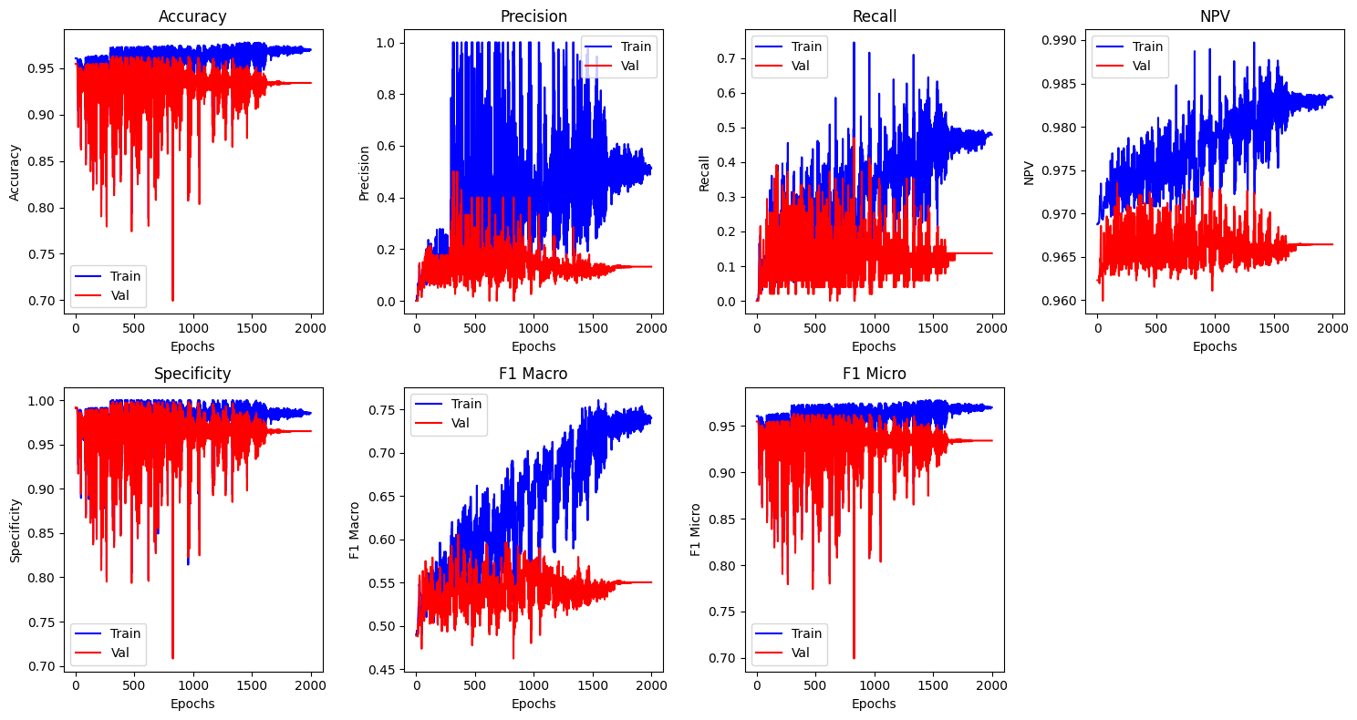
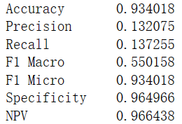
CNN
Taiwan bankrupt

Slide 40
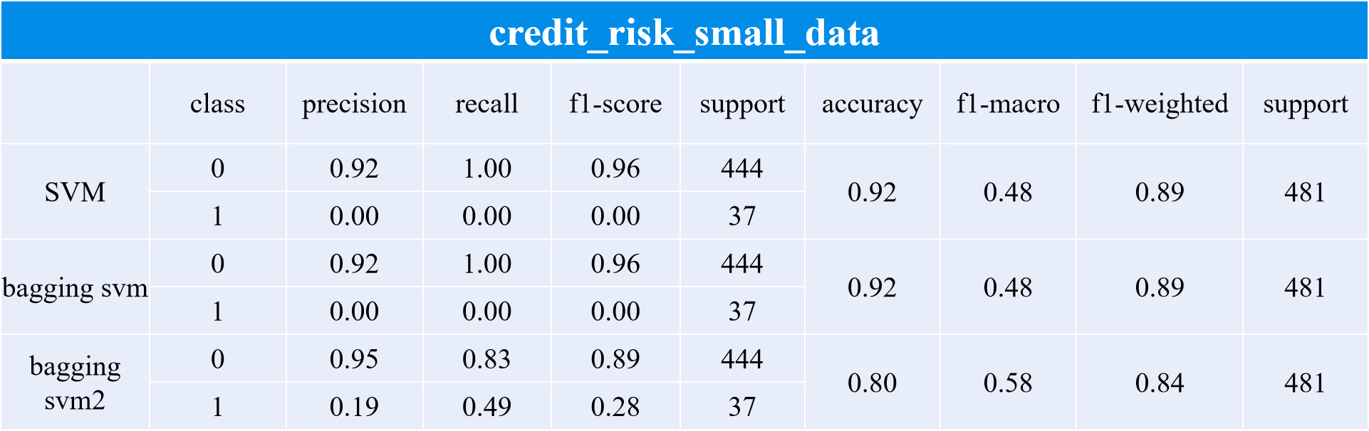
Result
 | Acc | Precision | Recall | Specificity | NPV | F1 Macro | F1 Micro
DNN | 0.92 | 0.46 | 0.49 | 0.95 | 0.96 | 0.71 | 0.92
CNN | 0.92 | 0 | 0 | 1 | 0.92 | 0.48 | 0.92
LSTM | 0.92 | 0 | 0 | 1 | 0.92 | 0.48 | 0.92

Slide 41
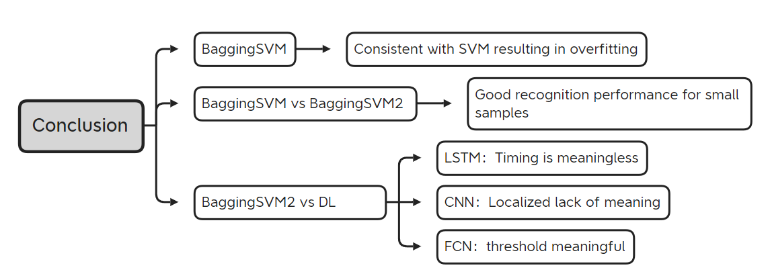
Conclusion

