Slide 1
Concur: A Test Framework for Multithreaded Applications
Rochelle Palting
Graduate Software Implementation Project
Seattle University, Spring 2012

Slide 2
Overview
Project Description 3 mins
Design & Implementation 8 mins
Demo 7 mins
Testing 3 mins
Analysis of Results 2 mins
Summary 2 mins
Q&A 5 mins

Slide 3
Project Description – 1 of 4
Time Period: Winter-Spring 2012
Faculty Advisor: Dr. Eric Larson
Problem addressed:
Students have insufficient resources to adequately determine if their multithreaded program is free from deadlock and/or race conditions. Testing alone is insufficient because many conditions require specific schedules that are not exercised. This leads to the need of a tool that assists students in finding and removing synchronization bugs.
Solution → Build a testing a debugging tool for multithreaded programs involving synchronization.

Slide 4
Project Description – 2 of 4
Goals:
1. Allow a student to test his or her multithreaded program for correctness (i.e. detect bugs)
2. Help a student debug the program when an error is present
Concur: a test framework for multithreaded applications provides an environment in which the user:
has more control over thread selection (scheduling, acquire lock, use semaphore)
can view the current state of each thread, lock and semaphore
can detect synchronization errors such as deadlocks
can reproduce test results

Slide 5
Project Description – 3 of 4
Functional Requirements
ID | Title | Description
F01 | Random mode for thread selection | Concur shall support a random mode for thread selection in which threads are automatically and randomly selected.
F02 | Interactive mode for thread selection | Concur shall support an interactive mode for thread selection in which the user will choose which thread is selected.
F03 | Log trail | Concur shall provide information regarding program execution.
F04 | Thread, lock, and semaphore status | Concur shall provide current state of each thread, lock, and semaphore when in interactive mode.

Slide 6
Project Description – 4 of 4
Non-Functional Requirements
ID | Title | Description
NF01 | Usability | Concur shall be usable for the intended users.
NF02 | Maintainability | Concur shall be maintainable.
NF03 | Extensibility | Concur shall be extensible.

Slide 7
Design & Implementation
Use Cases
Functional Decomposition
Data Flow Diagram
Project Files
Usage:
Steps to detect synchronization bugs
Steps to remove synchronization bugs

Slide 8
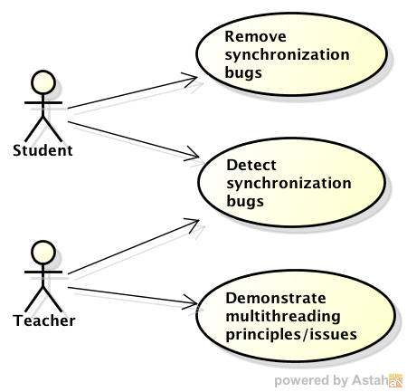
Use Cases

Slide 9
Functional Decomposition
Concur
Test Framework
Wrapper
Concur Application
Scheduler
Logging
Instrumentation Tool
Main Driver
Sections

Slide 10
Data Flow Diagram
TODO: Insert diagram

Slide 11
Project Files
Main.c
- numThreads - numRounds - schedMode - logMode - seed
- int main (int argc, char* argv[]) - void *threadStart (void *param)
Sections.c
- <global variables, locks, mutexes, etc.>
+ initGlobals () + void entrySection (int id) + void criticalSection (int id) + void exitSection (int id) + void remainderSection (int id)
Scheduler.cpp
+ mutexLock (int id, pthread_mutex_t lock) + mutexUnlock (int id, pthread_mutex_t lock) + semWait (int id, sem_t sem) + semPost (int id, sem_t sem) + invokeScheduler (int id, int lineNum) + pauseThread (int id)
Wrapper.py
- numRuns - numThreads - numRounds
- runConcur (…)
Makefile
SUDS
output.txt

Slide 12
Steps to Detect Synchronization Bugs
1. Make project
2. Run program multiple times with Wrapper
3. Notice status of each test run.
TODO: Insert screen shot illustrating these steps

Slide 13
Steps to Remove Synchronization Bug
1. Run Concur with same parameters as failed test run, but with logging turned on
Use random mode for quick results
Use interactive mode to step step through execution and examine status in real time
2. After run fails, examine log trail for specific error
3. Correct the error
Repeat steps 1-3 until bug is removed and test run passes.

Slide 14
Demo
1. Run Wrapper that shows a failed test run.
2. Run Concur with same inputs from failed test run, but with Logging turned on.
3. After reproducing the failed test run, open the Log Trail to examine the error.
Additional steps for the user:
4. Open sections.c to see where error occurred.
5. Correct error and rerun Concur with same inputs.
Additional things to demo:
- Interactive mode

Slide 15
Testing Strategy
Created test plan, test specification and executed test cases that verifies system meets functional requirements.
Tested with three sections.c files for Unisex Bathroom problem.
TODO: ADD MORE

Slide 16
Analysis of Results
Errors encountered and approach to address
Outstanding Errors
Pros/cons of design/implementation
Questions to answer:
Verification: Does the system satisfy the functional requirements?
Validation: Does the system meet the customer’s needs?
Does the system help the user find concurrency errors?
Does the system allow the user to reproduce test run results?
Does the system help the user debug the application?

Slide 17
Summary
Summary of project
Technologies used:
C, C++, Python
pthreads library, signals
Lessons Learned

Slide 18
Questions & Answers

