Slide 1
Concur: A Test Framework for Multithreaded Applications
Rochelle Palting
Faculty Advisor: Dr. Eric Larson
Graduate Software Implementation Project
Seattle University, Winter – Spring 2012

Slide 2
Overview
Problem & Proposed Solution 3 mins
Design & Implementation 8 mins
Demo 7 mins
Test & Analysis 3 mins
Future Work 2 mins
Summary 2 mins
Q&A 5 mins

Slide 3
Scenario – James’ Homework Assignment
sections.c
Ready to test!
Unisex Bathroom Problem:
An office contains a single restroom that has many toilets. The restroom can be used by both men and women but not at the same time.
Develop a solution using locks and/or semaphores that allows any number of men or any number of women, but not both, in the restroom at the same time. The solution must implement the required mutual exclusion and avoid deadlock. However, the solution does not need to be fair.
#include <pthread.h>
#include <semaphore.h>
// global variables
pthread_mutex_t myLock;
sem_t mySem;
personEnterRestroom() {
pthread_mutex_lock (&myLock);
sem_wait (&mySem);
…
}
personLeaveRestroom() {
…
sem_post (&mySem);
pthread_mutex_unlock (&myLock);
}
personUseRestroom() {…}
personDrink() {…}
Entry section
Exit section
Critical section
Remainder section

Slide 4
Scenario – James’ Test & Debug Process
Detect Mutual Exclusion Violation
Test Run States
run test
(dependent on schedule)
Output
Number of people: 4
Drink: 0 (female)
Drink: 1 (male)
Drink: 2 (female)
Drink: 3 (male)
Enter: 0 (female)
Using: 0 (female)
Enter: 2 (female)
Using: 2 (female)
Enter: 1 (male)
Enter: 3 (male)
Using: 1 (male)
Leave: 2 (female)
Drink: 2 (female)
Leave: 0 (female)
Drink: 0 (female)
Using: 3 (male)
…
All done!
update code
Ready to Test
A checker goes through the output and checks for mutual exclusion violations
Mutual Exclusion Violation
No Error Observed
Deadlock
Challenges:
identifying deadlocks
reproducing test runs
running on multiple schedules
Detect Deadlock
james@cs1 > ./hw1 4 2
james@cs1 > _
If the program hangs, it may be due to a deadlock
Notes:
emphasize:
run on multiple schedules
typically the OS scheduler doesn’t vary much in where context switches take place in the program

Slide 5
Problem & Proposed Solution
Problem:
Students have insufficient resources to adequately determine if their multithreaded program is free from deadlock and/or race conditions.
Testing alone is insufficient because many conditions require specific schedules that are not exercised.
This leads to the need of a tool that assists students in finding and removing synchronization bugs.
Solution:
Build a testing and debugging tool for multithreaded programs involving synchronization

Slide 6
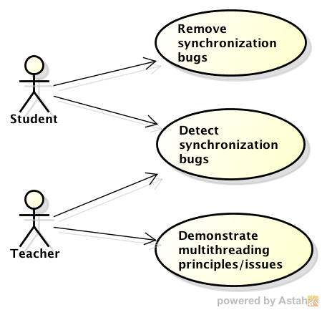
Proposed Solution: Concur
Concur: A testing and debugging tool for multithreaded programs involving synchronization
Goals:
1. Allow a student to test his or her
multithreaded program for
correctness (i.e. detect bugs)
2. Help a student debug the program
when an error is present
* Key Features:
* Deadlock detection
* Controlled thread management
Increased varied schedule coverage
Status of threads, locks, and semaphores

Slide 7
Functional Decomposition
Concur
Test Framework
Multithreaded Application
Instrumentation Tool
SUDS
Scheduler
sched.cpp
Logging
logger.cpp
Wrapper
run-concur.py
Solution
sections.c
Thread, Lock, & Semaphore Management
Log Trail
output.txt
Driver
main.c
Deadlock
Detection
Existing Component
New Component
Notes:
- SUDS – adds invokeScheduler call after each statement increases craziness of the schedules
sections.c – student’s solution implementation
main.c – driver program
SUDS – a C source code instrumentation tool that allows the programmer to direct how and where instrumentation is added to the program
Scheduler – along with the lock/semaphore routines, server as a library to control and debug multithreaded applications
Wrapper – allows the user to the the program several times to enable several randomly produced schedules

Slide 8
Data and Control Flow
Instructor
Student
Provide
Implement
SUDS
Scheduler
Deadlock Detection
deadlock detected
add calls to scheduler
update
main.c
sections.c
sections.synch.c
Lock Status
Sem. Status
Thread Status
Run Result
Run
Logger
log=ON
output.txt
mode=INTERACTIVE
Wrapper
test run result
console
Notes:
add backup slide showing partitions (e.g. library)
sections.c – student’s solution implementation
main.c – driver program
Scheduler
sched.cpp
Error Detection
Deadlock detection
Logging
Wrapper

Slide 9
Scheduler – Key Features
Only permits one thread to run at a time. All other threads are forced to wait for a signal before proceeding.
Scheduler Modes:
Random: exercise different schedules
Interactive: more controlled debugging experience & instructor demo
API (equivalent to POSIX lock and semaphore functions)
mutexLock()
If lock is available, set thread to holding, else add thread to waiting list
mutexUnlock()
Releases lock; reassigns to a waiting thread
semWait()
If semaphore is available, use it, else add thread to waiting list
semPost()
Releases semaphore; reassigns to a waiting thread
Notes:
- random (exercise different schedules) and interactive mode (more controlled debugging experience & instructor demo)
less focus on functions
mention pthread functions
remove invoke scheduler & initialize threads

Slide 10
Scheduler – Data Structures
Data structures
Array of threads
State: Ready | Running | Waiting | Completed
Waiting name: <lock name> | <semaphore name>
Array of locks
Name
isLocked: True | False
Holding thread
List of waiting threads
Array of semaphores
Name
Value
List of waiting threads

Slide 11
Steps to Test & Debug
1. Make project
2. Use Wrapper to execute multiple test runs
Runs multiple random schedules
3. Observe status at end of each test run
(proceed to next step if run failed)
4. Run Concur with same parameters as failed test run, but with logging turned on
Use random mode for faster results
Use interactive mode to step through execution and examine status in real time
5. After run fails, examine log trail for specific error
6. Update solution with fix to error
Repeat steps 4-6 until bug is removed and test run passes.

Slide 12
Demo
1. Run Wrapper that shows a failed test run.
2. Run Concur with same inputs from failed test run, but with Logging turned on.
3. After reproducing the failed test run, open the Log Trail to examine the error.
4. Open sections.c to see where error occurred.
Next steps for the user:
5. Correct error and rerun Concur with same inputs.

Slide 13
Testing & Analysis
Used Wrapper to test four student submissions from Fall 2011 for the Unisex Bathroom problem
Test File | Wrapper Parameters |  |  | Result
 | # Runs | # Threads | # Runs
sections1.c | 10 | 5 | 2 | Deadlock detected at 1st run.
sections2.c | 10 | 5 | 2 | Programming error detected (infinite loop) due to improperly formed spinlock.
sections3.c | 100 | 5 | 2 | No deadlock detected.
sections4.c | 10 | 5 | 2 | Deadlock detected at 1st run.
Concur was successful at detecting deadlocks in test cases and Wrapper supported many test runs.

Slide 14
Concur – Benefits
+ Deadlock detection: If all active threads are blocked waiting for either a lock or semaphore, then a deadlock has occurred.
+ Controlled environment:
Only a single thread can run at once.
Next ready thread to run, next waiting thread to acquire lock or use semaphore is deterministic.
+ Increased schedule coverage:
Wrapper allows automated execution of randomly produced schedules
Interactive mode allows user to choose schedule
+ The framework, with minimal work of the instructor, can be used for a variety of synchronization exercises.
+ The library can be used for other multithreaded programs.

Slide 15
Future Work
Improve performance
E.g. Wrapper with 100 runs, 5 threads, 2 rounds took ≈ 45 mins
Additional analysis to determine if more random schedule test runs is equivalent to higher confidence in error free program.
Incorporate Checker for mutual exclusion violations

Slide 16
Summary
Concur helps students test & debug multithreaded programs by providing an environment with:
More deterministic thread management
Deadlock detection
Increased multiple schedule coverage
Thread, lock, and semaphore status

Slide 17
Questions & Answers

Slide 18
Backup Slides Beyond this Point

Slide 19
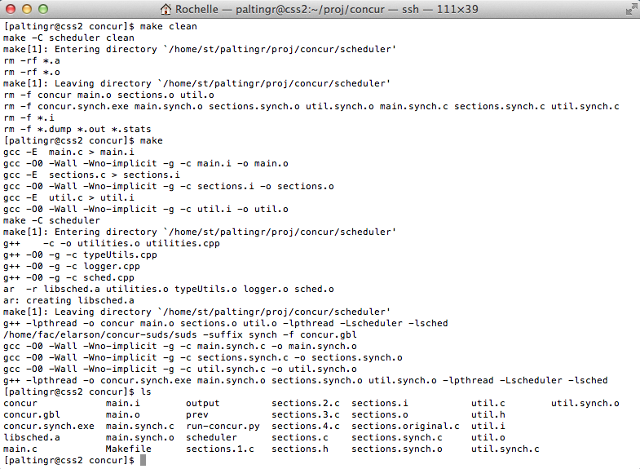
1. Make Project
make clean
make
invoke SUDS
project files

Slide 20
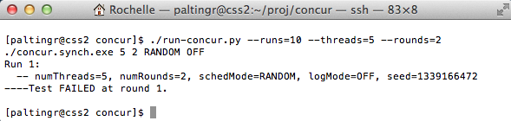
2. Run Wrapper
run python script
invoke concur
failure encountered

Slide 21
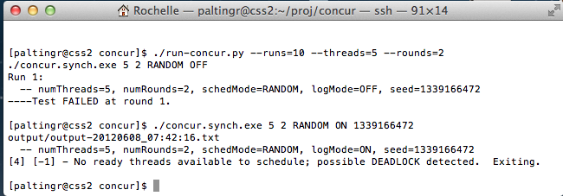
3. Run Concur
invoke concur
failure reproduce

Slide 22
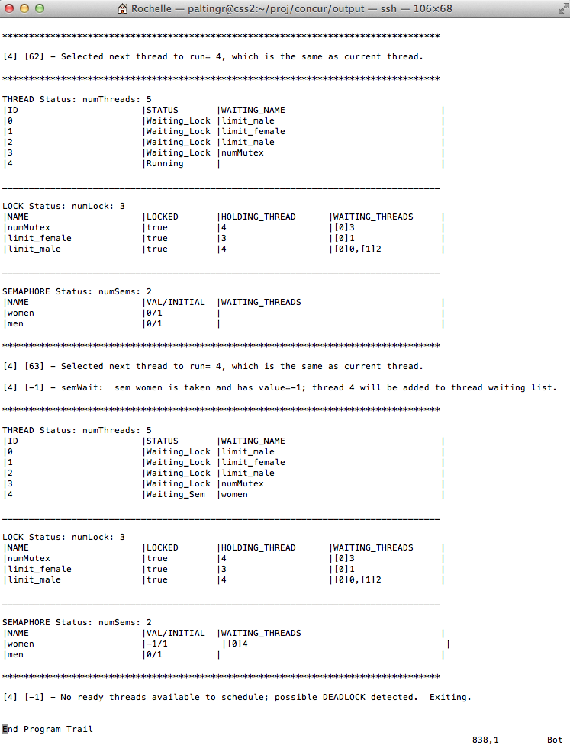
4. Examine Log Trail
last statement executed is line 63 of sections.c made by thread 4
status shows all threads blocked
failure due to deadlock

Slide 23
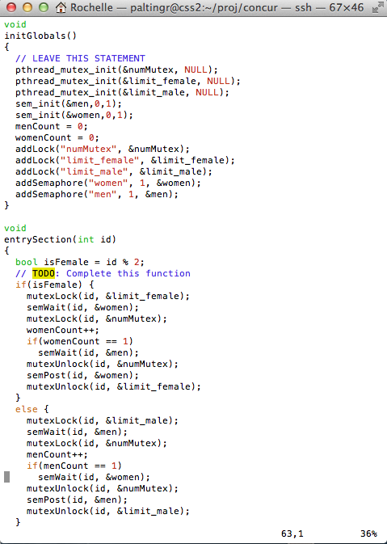
5. Examine sections.c file
deadlock encountered at line 63

Slide 24
Requirements – 1 of 2
Functional Requirements
ID | Title | Description
F01 | Random mode for thread selection | Concur shall support a random mode for thread selection in which threads are automatically and randomly selected.
F02 | Interactive mode for thread selection | Concur shall support an interactive mode for thread selection in which the user will choose which thread is selected.
F03 | Log trail | Concur shall provide information regarding program execution.
F04 | Thread, lock, and semaphore status | Concur shall provide current state of each thread, lock, and semaphore when in interactive mode.

Slide 25
Requirements – 2 of 2
Non-Functional Requirements
ID | Title | Description
NF01 | Usability | Concur shall be usable for the intended users.
NF02 | Maintainability | Concur shall be maintainable.
NF03 | Extensibility | Concur shall be extensible.

Slide 26
Project Files
Main.c
- numThreads - numRounds - schedMode - logMode - seed
- int main (int argc, char* argv[]) - void *threadStart (void *param)
Sections.c
- <global variables, locks, mutexes, etc.>
+ initGlobals () + void entrySection (int id) + void criticalSection (int id) + void exitSection (int id) + void remainderSection (int id)
Scheduler.cpp
+ mutexLock (int id, pthread_mutex_t lock) + mutexUnlock (int id, pthread_mutex_t lock) + semWait (int id, sem_t sem) + semPost (int id, sem_t sem) + invokeScheduler (int id, int lineNum) + pauseThread (int id)
Wrapper.py
- numRuns - numThreads - numRounds
- runConcur (…)
Makefile
SUDS
output.txt

Slide 27
Future Work
Errors encountered and approach to address
Outstanding Errors
Pros/cons of design/implementation
Questions to answer:
Verification: Does the system satisfy the functional requirements?
Validation: Does the system meet the customer’s needs?
Does the system help the user find concurrency errors?
Does the system allow the user to reproduce test run results?
Does the system help the user debug the application?

