Slide 1
Rat: Combining the best parts of the best language3s
Alex Alvarez
Chris Beaudoin
Carter Esparza
Riley kehoe
Sam Prosser

Slide 2
The Team
Different backgrounds and education levels
Different Coding Proficiencies
We’re mostly transfer students with a love for cs, looking to design

Slide 3

The inspiration
We all have an affinity for python and its easy to read format, but we had some issues that thought needed to be addressed
We don’t like whitespace and the lack of clarity with variable types, plus the lack of clarity with what’s contained within functions

Slide 4
Anaconda…
…was our first iteration, an adaptation on Python with some more specificity and cleanliness with the way python is structured.
However, that opened us up to a few new ideas with how we wanted to build and where we could take the language.
Plus every other python change had something to do with snakes, and that had been beaten to death

Slide 5

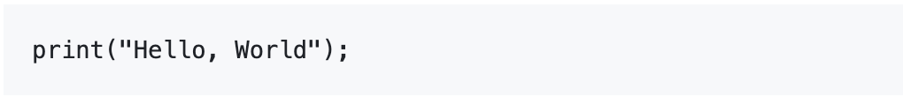
To RAT!
Smaller grammar, clearer and cleaner, with very explicit variable types.
Intended to be a smaller and more simplistic version of python with better functionality

Slide 6
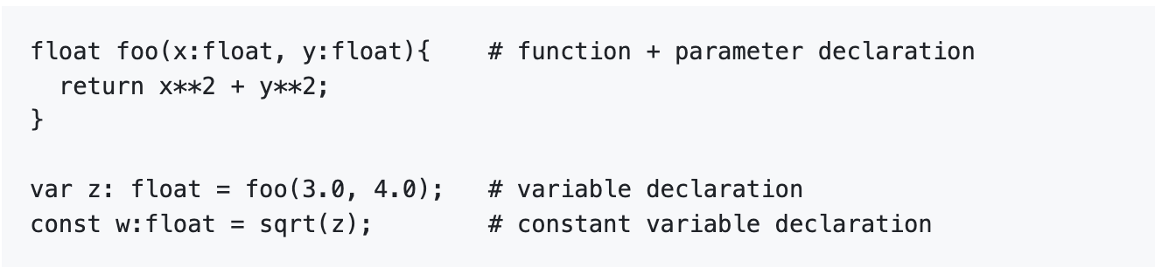
Static Declarations
Our language uses static declarations within Function and Variable Declarations

Slide 7
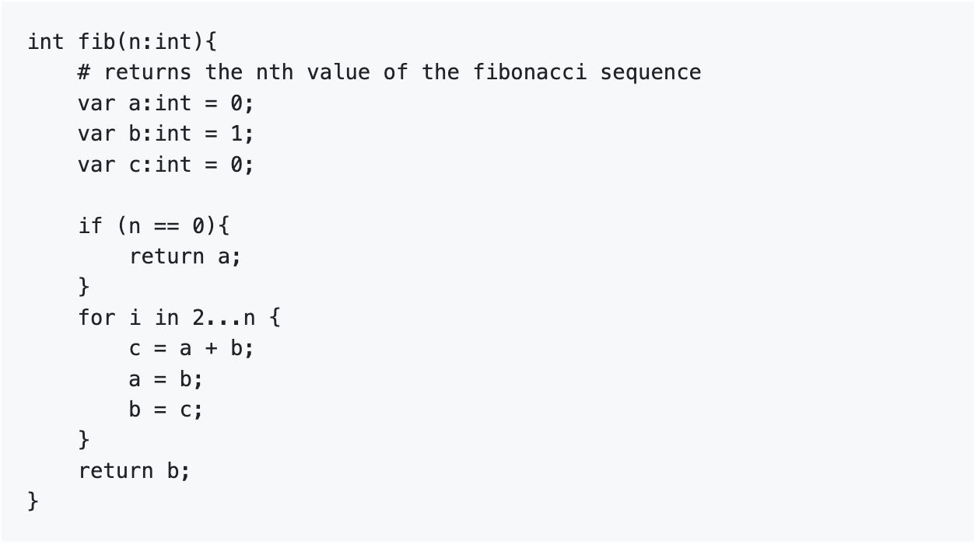
White Space and Bracketing
We manipulate whitespace and Brackets to create clean, concise, and legible code!

Slide 8
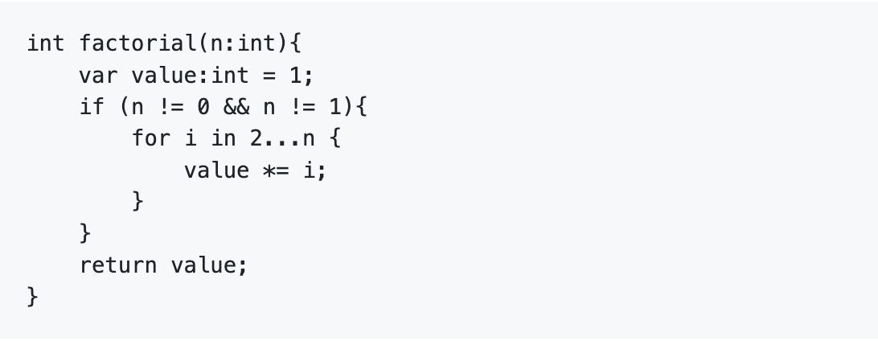
Example Programs
Factorials, because what great coding language can’t process factorials?

Slide 9
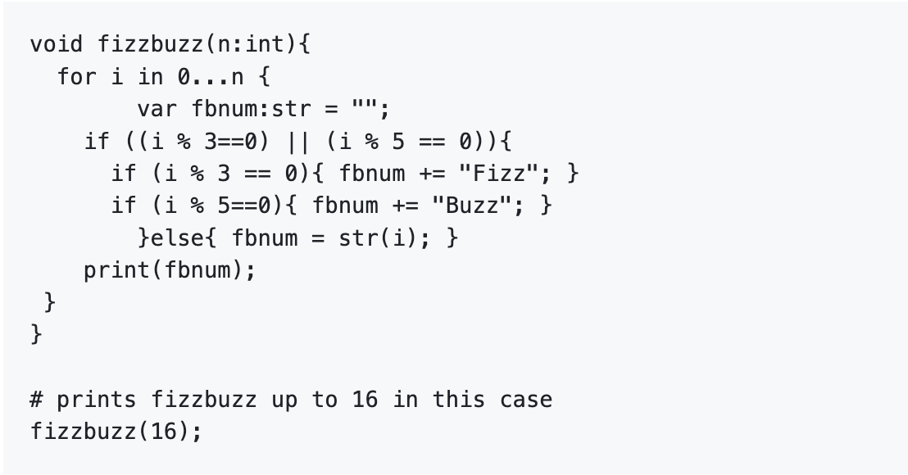
Another Example!
The Classic Fizzbuzz Function!

